Slide 1
Sustainable healthy diets

Slide 2
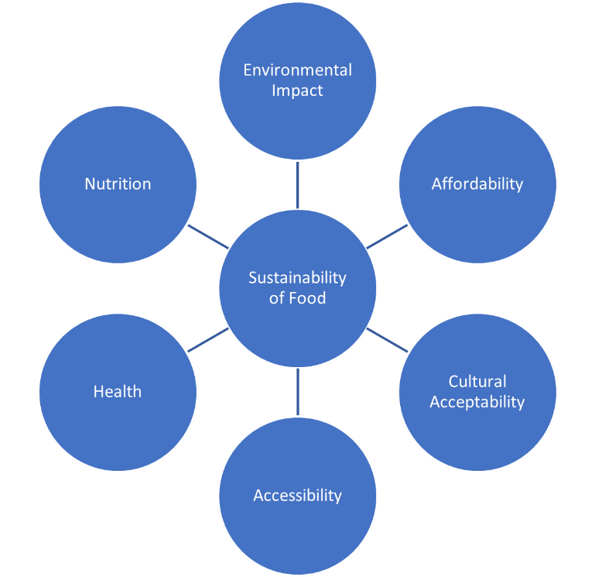
Introduction: Sustainable healthy diets
This presentation is an introduction to a sustainable, healthy diet.
The diagram on the right shows the factors that make up a sustainable diet. In this presentation, nutrition and health are grouped together, as are affordability, acceptability and accessibility.
(including safety)
Adapted from FAO, 2012

Slide 3
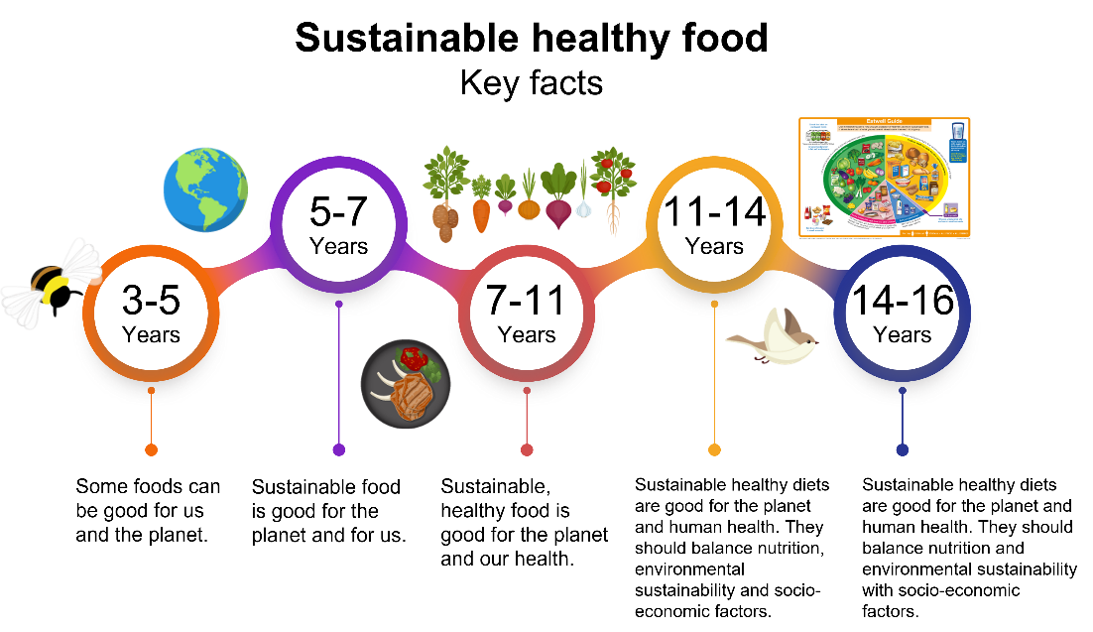
Sustainable, healthy diets Key facts
Each section is based on one of the Food – a fact of life Key facts, which progress through the age phases.
The Key facts cover the core competences for children and young people aged 5-16 years and indicate what a pupil should know at each stage of their learning journey.
See our Curriculum roadmaps to find out more about the Key facts

Slide 4
Sustainable healthy diets Summarised Key Fact:
Sustainable healthy diets are good for the planet and human health. They should balance nutrition and environmental sustainability with socio-economic factors, e.g. affordability, accessibility and cultural acceptability.
Sustainability is a complex topic and must consider both the planet and people.
Balance is important to consider. For example, a food might be affordable, but not nutritious or produced with care for the environment.
Another food might be produced with care for the environment and nutritious, but not be affordable or accessible.

Slide 5
Contents
Environmental impact
The greenhouse effect
Climate change and food production
Biodiversity
Sustainable farming in the UK
Nutrition and health
Affordability, acceptability and accessibility
The presentation can be used in its entirety, or you can use the hyperlinks above to choose the slides most relevant to the particular focus of your teaching and learning around sustainable healthy food. There are a few short questions at the end of each section, with answers on the next slide.

Slide 6
Environmental impact

Slide 7
Sustainable healthy diets Key fact
Sustainable food is produced and processed with low or zero environmental pressure. Environmental factors to be considered include carbon emissions, land and water usage, and impact on biodiversity.
Reducing food loss or waste is an economic, social and environmental priority for individuals and supply chain businesses at local and global levels.
When we think about the environment, we are considering more than just greenhouse gases. For example, we should also consider water and land used to produce the foods that we eat, the impact on biodiversity (positive or negative), and any food lost and/or wasted before it is eaten.

Slide 8

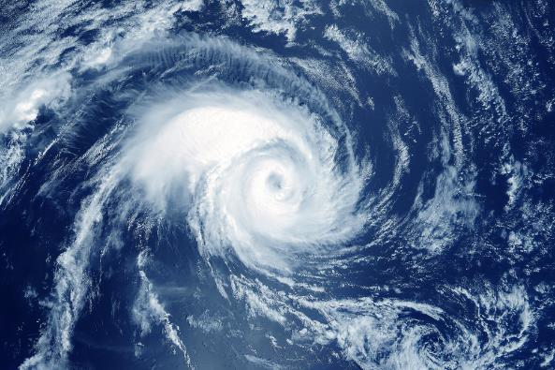

Impact of the changing environment
An increase in global temperatures.
An increase in extreme weather events, such as hurricanes and flooding.
A change in the climate of an area.

Slide 9
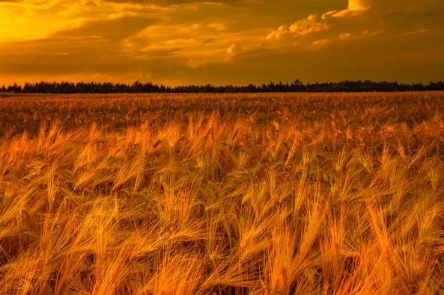
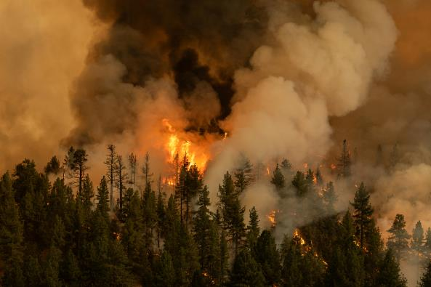

Impact of the changing environment
Climate change can cause extreme or unusual weather, which can affect food production and impact on national and global food security. This can result in:
Conditions changing so it can be harder to grow food.
An increase in fires.
Changes to the water cycle (e.g. polar ice caps melting).

Slide 10
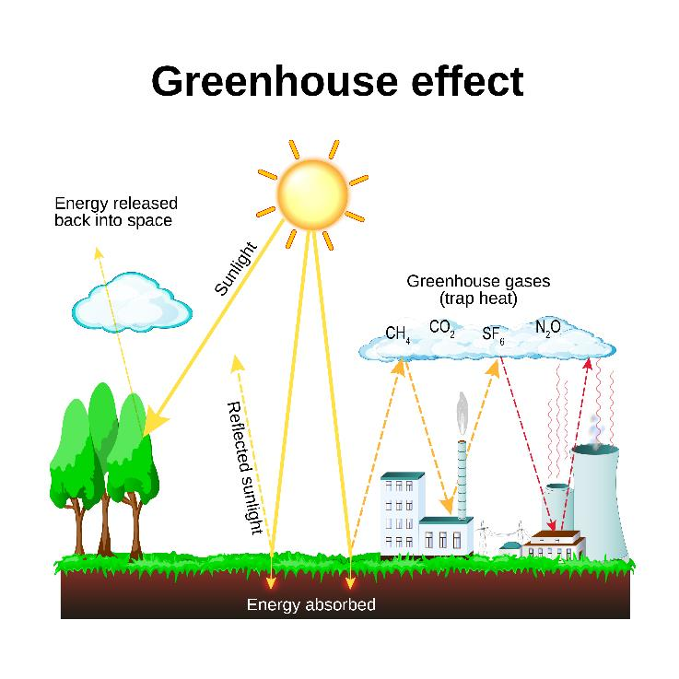
The greenhouse effect
Humans can affect climate change through the release of greenhouse gases (e.g. through burning fossil fuels), which are found in the Earth's atmosphere and trap the Sun's heat.
This makes the Earth much warmer.
To reduce this effect, we need to reduce our emissions, e.g. by using renewable energy such as wind and solar or by capturing carbon.

Slide 11
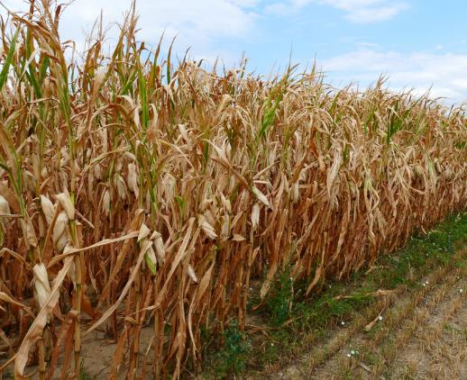
Climate change and food production
Climate change can affect food production:
Longer dry periods can cause water to dry up and crops to yield less, or even die.
Longer or extreme wet periods can flood fields and cause crops to be damaged, or even die.
Increased wind and rain can cause crops to collapse, and animals may have to be kept inside more often.
Warm conditions can cause heat stress for farm animals and damage the pastures they feed from.
Longer warm and wet periods can make crops more likely to grow mould.
Excessive weather conditions can develop different diseases in crops and animals.

Slide 12
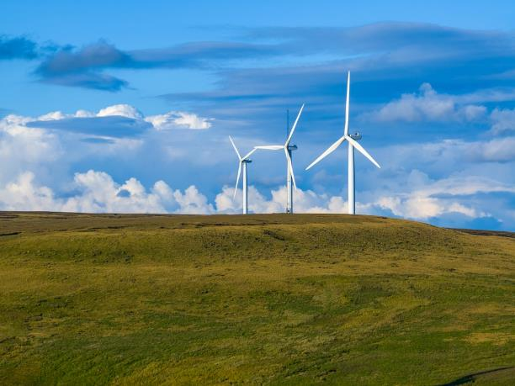
Combatting climate change
Combatting climate change requires two main goals:
Reducing the amount of greenhouse gases emitted.
Storing (sequestering*) as much carbon as possible.
Replacing fossil fuel burning with renewable energy, e.g. solar or wind, is the main way to reduce emissions.
In the UK, greenhouse gas emissions from agriculture account for around 11% of emissions. This has decreased over the last 20 years, meaning almost 90% comes from other sectors e.g. residential, business, energy supply and transport.
*Sequestration means to remove carbon from the atmosphere and store it elsewhere, e.g. trees, pasture, soil
Source: 2021 UK Greenhouse Gas Emissions

Slide 13
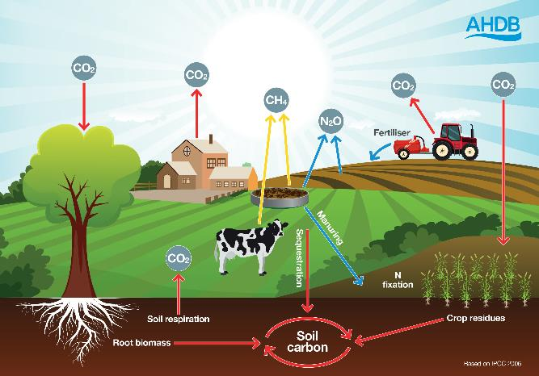
Carbon sequestration
Farms can sequester some carbon, in the soil and plants. This can help to remove some carbon from the atmosphere.
How farmers use and care for the land can impact how much carbon that can be absorbed. To store more carbon, farmers can reduce ploughing, improve soil health and plant additional trees and hedgerows.
However, the total amount of carbon that can be stored by farmland is often debated.
Carbon dioxide (CO₂), methane (CH₄) and nitrous oxide (N₂0) may be released from energy usage, livestock and fertilising. However, sequestration of carbon dioxide and nitrogen dioxide (through crops, trees and other plants and the soil) can help to mitigate this effect.
*Sequestration means to remove carbon from the atmosphere and store it elsewhere, e.g. soil, trees, pasture.

Slide 14
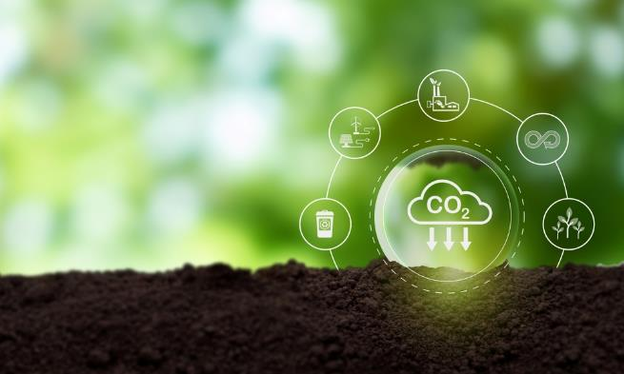
Combatting climate change in food production
The way our food is produced can have an impact on the climate. Many farms are investing in:
natural carbon storage in trees, hedgerows, and underground in the soil, e.g. fields and pastures;
renewable energy from wind, solar and bio-waste;
new techniques, such as feeding animals on foods that make them produce less methane (a greenhouse gas) and reducing synthetic fertiliser usage;
genetics and enhanced animal health and welfare to improve the efficiency of livestock farming.

Slide 15
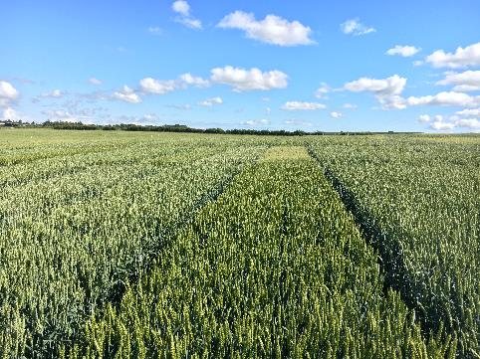
Food production adapting to climate change
Adapting food production methods helps to cope with extreme weather caused by climate change. This includes:
Breeding crop varieties that are more resilient to extreme weathers such as flooding, drought, wind and rain.
Improving water management on farms to be more resilient in periods of drought and flooding.
Rotating between animals and crops, to improve soil health and reduce use of synthetic fertilisers.
Housing cows (bringing them indoors) during high temperatures.
Planting trees where livestock graze to provide more shade.
This image shows a trial site for new wheat crop varieties in the UK

Slide 16
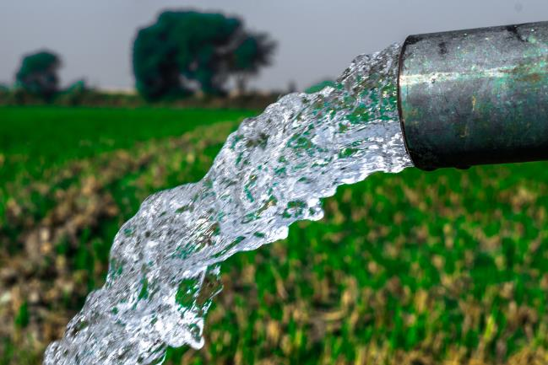
Water usage
Water is a finite resource. Although Earth is about 70% water, access to usable water is limited in many places.
Water is needed to keep crops and animals healthy, and care should be taken, by everyone, to use only what is needed and not to waste water.
Climate change means that some places have even less water than usual, which can pose a risk to crops and animals in these areas.
Heavy rains may also wash soil and nutrients into rivers and streams, which can harm wildlife.

Slide 17
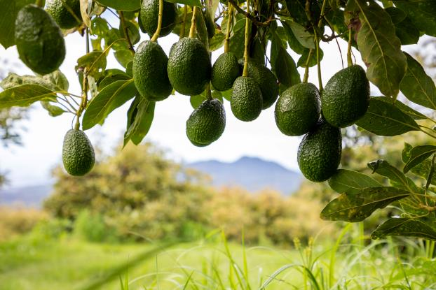
Water usage
Most water used for food production in the UK is rainwater, not mains water, but some countries may need to pump large amounts of water to grow crops or for animals to drink.
Some crops may also require more water to grow than others. For example, avocados, almonds and green beans require large amounts of water.
Avocados growing on a tree. Avocados are native to The Americas.

Slide 18
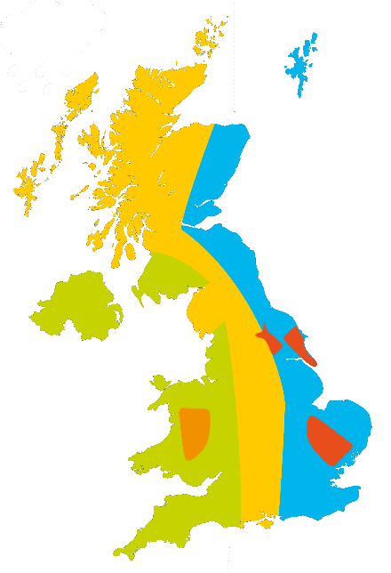
Land usage
Not all land is suitable for the same purpose.
Flatter, more fertile land is generally more suitable for crops. Fertilising nutrient-poor soils can also help to increase the land area available for crops.
Some land may be very stony, or the terrain may be difficult. This land may be useful for grazing animals and/or growing trees.
If soils are mismanaged, they may become 'degraded' and the land must be restored for crops or other plants to grow well.
Globally, increased demand for food production has led to deforestation and biodiversity loss.
Sheep
Dairy
Mixed
Arable
Pigs
More information about land use in the UK can be found in the Where food comes from Knowledge organiser.

Slide 19
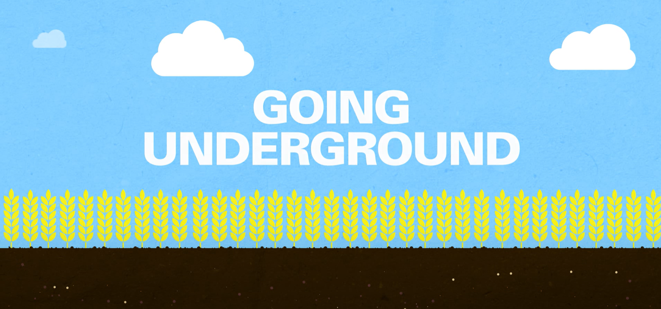
What does soil do and why is it important for food production?
Soil can:
exchange gases with the air and store carbon dioxide;
regulate the flow of water;
provide nutrients for plant growth;
increase biodiversity;
break down organic materials (through microorganisms that live there).
Watch the video above for more information on soil health (source: AHDB)

Slide 20
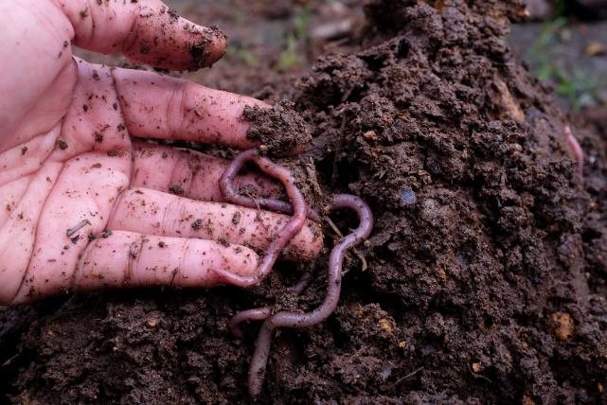
Soil health
Soil health is vitally important for the foods we eat to grow properly.
Soil contains organisms such as worms that can aerate the soil, and microorganisms such as tiny fungi (mycorrhizae) that can help plants to grow better.
Soil also contains important minerals such as nitrates, phosphates, potassium and magnesium.
If the soil lacks any of these, food crops and grassland may not grow well. However, these less fertile soils can be improved with addition of livestock, organic manures or fertilisers. Healthy soils are good at cycling carbon.

Slide 21
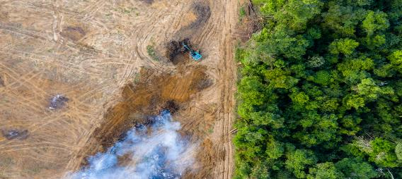
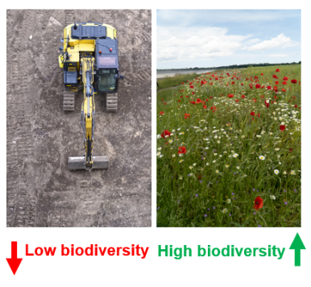
Biodiversity
Low biodiversity
High biodiversity
Biodiversity is a measure of how many different species live in an ecosystem.*
If biodiversity is lowered, e.g. one or more species goes extinct, this can have knock-on effects on other plants and animals in the area.
Biodiversity is important in food production to promote a healthy and balanced ecosystem (e.g. encouraging insects and birds to live on or near fields can help to keep pests under control and help to pollinate some crops).
The process of protecting and reintroducing species to increase or maintain biodiversity is known as conservation.
This image above shows an area of ‘deforestation’ in Borneo, where trees have been cut down (left). This area has low biodiversity as there are no plants and no habitats for animals. The remaining forest (right) has higher biodiversity because the plants form a habitat for other animals to live in.
*Biodiversity and the effect of human interaction on ecosystems – AQA, BBC Bitesize, 2023

Slide 22
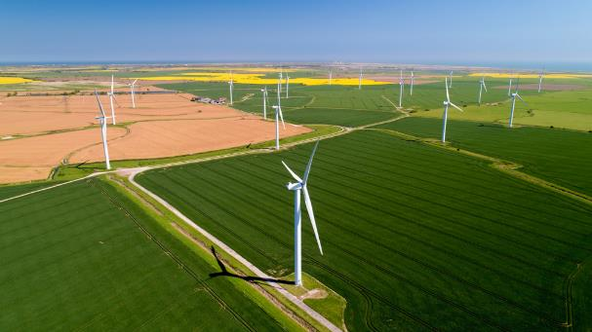
Sustainable farming in the UK
In the UK, greenhouse gas emissions from agriculture have fallen over the last 20 years.
UK emissions from agriculture are well below the global average. However, more work still needs to be done to reduce emissions in the sector.
UK agriculture has committed to a ‘net zero’* carbon emissions target by 2050.
Innovative measures are being introduced, such as altering animal feed to reduce methane production and increasing renewable energy methods (wind and solar) on farms.
*Net zero means that the amount of emissions created are equal to the amount removed.

Slide 23
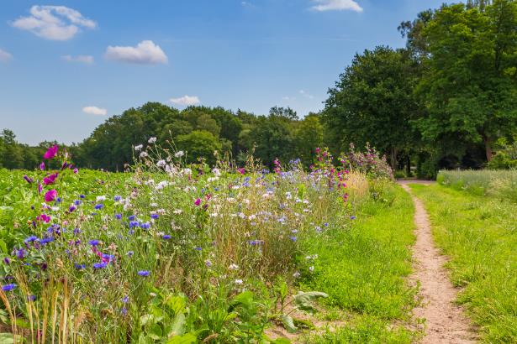
What are farmers and food producers doing?
Switching to more sustainable methods of farming can help to reduce its impact on the environment.
Sustainable methods can include:
enhancing soil health - protecting and improving soil health through practices such as using organic fertiliser like manure and integrating livestock into arable rotations to reduce synthetic fertiliser usage;
promoting biodiversity - creating field margins and planting trees and hedgerows to enhance biodiversity and capture carbon;

Slide 24
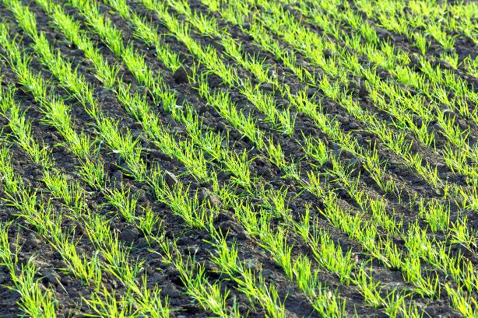
What are farmers and food producers doing?
Other sustainable methods can include:
implementing crop rotation - rotating different crops and practising rotational grazing to maintain soil fertility and improve ecosystem health;
improving efficiency - ensuring farms are run efficiently, as greater efficiency correlates with sustainability, minimising resource use and waste;
utilising genetics - using genetic advancements to improve the environmental efficiency of livestock, reducing their overall impact.

Slide 25
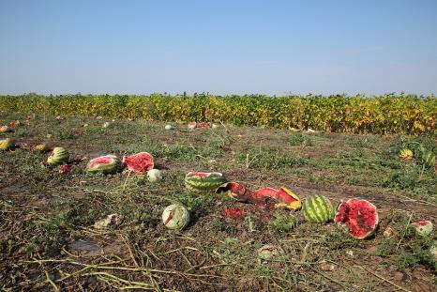
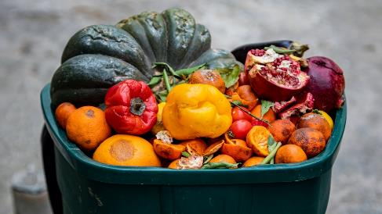
Food loss and food waste
About one third of all food is lost or wasted.
This waste also contributes to greenhouse gas emissions (approximately 10% globally).
WRAP UK estimates that:
70% of food is wasted at home;
30% is lost in the supply chain.
Finding ways to reduce food waste at home doesn’t only have environmental benefits but could also save money, because less food would need to be bought.
Farmers and retailers are trying to find ways to reduce food that is lost and wasted, e.g. selling ‘wonky veg’ that would otherwise be thrown away and taking by-products from the milling and malting industry that are inedible to humans and using this as animal feed.
Food loss is food that is lost before it makes it to stores. Food waste is food we waste at home or in stores.
Source: Food Waste – 2024 Facts & Statistics

Slide 26
Questions – Environmental impact
Describe how farmers and food producers in the UK can reduce the environmental impact of their farming.
Define ‘The Greenhouse Effect’.
Explain how carbon sequestration can remove some carbon from the atmosphere.
Name three benefits of healthy soil.
True or false? All land can be used to grow crops.

Slide 27
Answers – Environmental impact
Describe how farmers and food producers in the UK can reduce the environmental impact of their farming.
Reduce carbon emissions by farming more efficiently
Switch to renewable energy sources
Reduce fertiliser usage or use different ones
Soil management
Capture carbon
Rotate animals and crops
Promoting biodiversity
Water conservation
Define ‘The Greenhouse Effect’. The Greenhouse Effect is caused by greenhouse gases which trap the sun’s heat. Human actions have increased the amount of greenhouse gases released, resulting in more warming.

Slide 28
Answers – Environmental impact
Explain how carbon sequestration can remove some carbon from the atmosphere.
Carbon sequestration is the process involved in capturing and storing of carbon dioxide.
Carbon can be stored in the soil and by plants.
Name three benefits of healthy soil.
Any of:
Can store carbon
Regulates the flow of water
Breaks down organic materials
Provides nutrients and minerals for plant growth
Contains mycorrhizae (fungi) that can help plants to grow better
Increases biodiversity
True or false? All land can be used to grow crops. False

Slide 29
Sustainable healthy food Key fact
Sustainable, healthy diets are dietary patterns that promote all dimensions of a person’s health and wellbeing.
The human impacts of sustainable, healthy diets are important to consider. Ideally, sustainably produced foods should also provide benefits to our health.

Slide 30
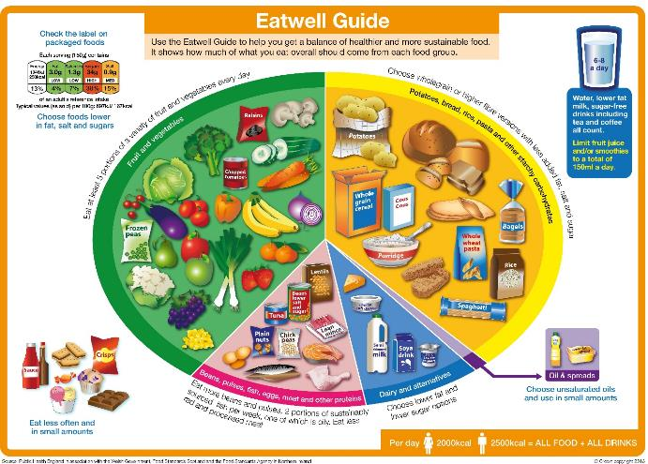
The Eatwell Guide
The Eatwell Guide shows the proportions in which different groups of foods are needed in order to have a well-balanced and healthy diet.
The proportions shown are representative of food eaten over a day or more, not necessarily at each mealtime.
People should choose a variety of different foods from each food group to help get the wide range of nutrients the body needs to stay healthy.
If everyone in the UK followed the Eatwell Guide, our diets would have a much lower environmental impact than they currently do.*
*Source: The Carbon Trust

Slide 31
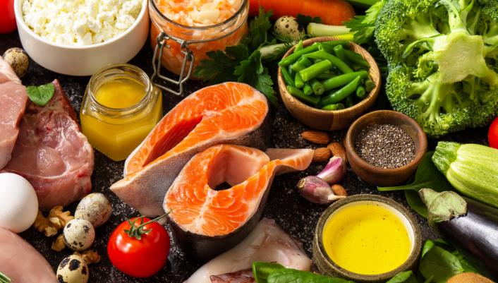
Nutrients
There are a wide variety of nutrients that we need to consume to stay healthy.
Having a varied and balanced diet that follows the principles of the Eatwell Guide helps to ensure that a diverse range of nutrients are also consumed.
A lack of access to, or an increased cost of some foods found in the Eatwell Guide, may result in lower intake of key nutrients and have a negative impact on health.

Slide 32

Energy
Energy is essential for life, and is required to fuel many different body processes, growth and activities.
To maintain weight, it is necessary to balance energy intake (from food and drink) with energy expenditure (from activity).
Activities such as cycling or walking not only count as physical activity. They can also reduce emissions when they replace journeys that would otherwise be taken by car.

Slide 33
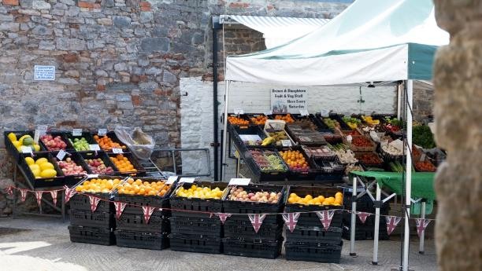
5 A DAY
We should eat at least 5 portions of vegetables and fruit per day.
Variety is important, because different vegetables and fruits contain different nutrients and in different amounts.
As a nation, we are eating far less than 5 portions per day¹.
Buying local produce, where available, can reduce the distance it has to travel (the ‘food miles’) and therefore be more sustainable. Fresh produce can be cheaper when it is in season (e.g. strawberries in June/July), because more of it is available.
1. National Diet and Nutrition Survey, 2020

Slide 34
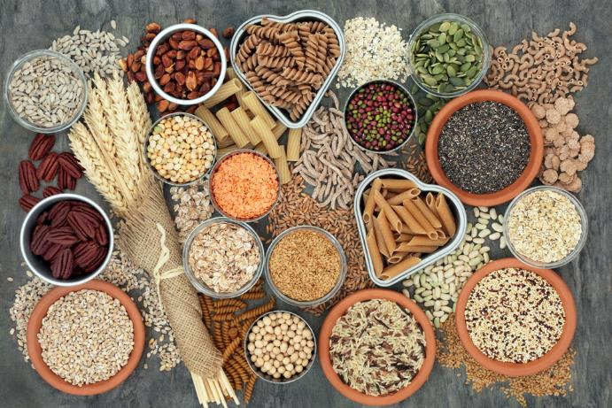
Fibre
Dietary fibre is important for our digestive health and can help to reduce constipation.
It may also reduce the risk of cardiovascular disease, colorectal cancer and type 2 diabetes.
High-fibre foods provide a low amount of energy (calories) per gram. They may be able to keep people feeling fuller for longer, reducing overall energy (calorie) intake.

Slide 35
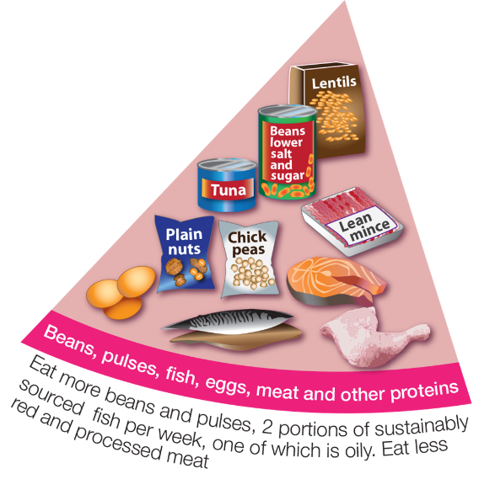
Beans, pulses, fish, eggs, meat and other proteins
These foods are sources of protein, vitamins and minerals.
Aim for at least two portions (2 x 140g) of sustainably sourced fish a week, including a portion of oily fish.
If you eat more than 90g of red and processed meat per day, try to cut down to no more than 70g per day. This may reduce the risk of certain diseases, such as colorectal cancer, and reduce environmental impact.
It is recommended that you do not eat too much red meat, processed meat or meat that is high in saturated fats as this can lead to health problems. However, some nutrients, such as B12 are mostly found in animal products.
Net zero carbon UK livestock report October 2020, CIEL, 2020 , British Nutrition Foundation, 2023, Marine Stewardship Council, 2024

Slide 36
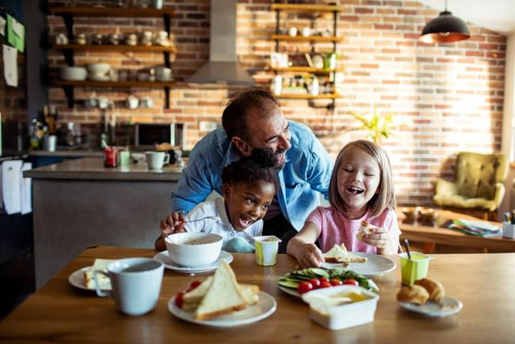
Plant-rich diets
Generally, plant-rich diets (those that contain mostly plant foods) are more sustainable than those that contain high amounts of meat and dairy.
Beans, peas and lentils are plant-based protein sources. They’re naturally low in fat, and they’re high in fibre, protein, vitamins and minerals.
Plant protein sources are often more sustainable options. However, UK meat and dairy production is more sustainable than many other countries.*
*Net zero carbon UK livestock report October 2020, CIEL, 2020 & British Nutrition Foundation, 2023

Slide 37
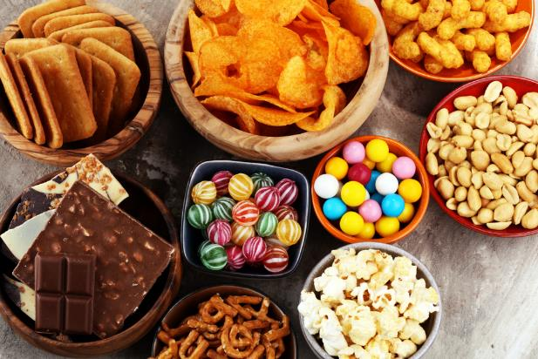
Foods high in fat, salt and sugar
Foods that are high in fat, salt and sugar (HFSS) are generally less sustainable options than those that are not.
This is because of the higher amount of energy required to process these foods and produce and transport the individual ingredients.
These foods are less healthy options and sit outside the Eatwell Guide. They should be eaten infrequently and in small amounts.
A healthy, sustainable diet. British Nutrition Foundation, 2023

Slide 38

Hydration
Our body is nearly two-thirds water, so drinking enough fluid to stay hydrated is important.
Water is essential for life, and it is important to get the right amount of fluid to be healthy.
The body loses water all the time, when we go to the toilet, from sweat and also evaporation from skin. If we do not consume enough water, we become dehydrated.
To be more sustainable, we should try to limit the amount of water we waste, e.g. turning taps off when they are not in use or using a bowl when washing the dishes.
Choosing tap water (where safe) is more sustainable than bottled water. Soft drinks will usually have an even bigger environmental impact, due to additional energy used to transport ingredients and make the final product.

Slide 39
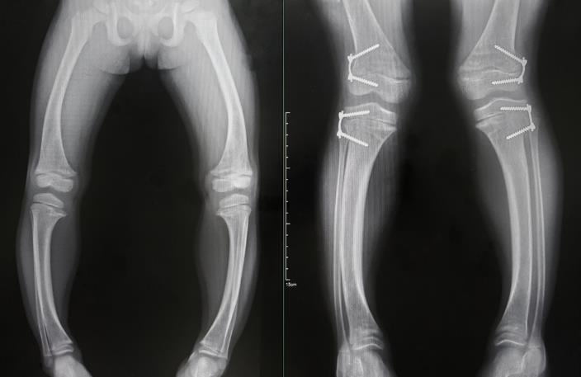
Health conditions
Access to a healthy, balanced diet is important to reduce the risk of certain health conditions.
In the UK, increased food costs (and other factors) have resulted in increased levels of malnutrition over the last decade or so.
Rare deficiency-related conditions, such as rickets and scurvy, although still uncommon, have also seen an increase in recent years.
Having access to affordable, healthy food is a key consideration when we talk about sustainable healthy diets.
Rickets is a condition that results from a prolonged vitamin D deficiency. This prevents calcium from being properly absorbed and leads to a softening of bones.
Source: NHS digital

Slide 40
Questions – Nutrition and health
Explain why the Eatwell Guide recommends no more than 70g of red and processed meat per day.
Describe the link between dietary fibre and health.
True or false? Animal products are the main source of vitamin B₁₂ in the diet.
Explain why buying local produce that is in season may be more sustainable.
Explain why foods that are high in fat, salt and sugar (HFSS) are generally less sustainable options than those that are not.

Slide 41
Answers – Nutrition and health
Explain why the Eatwell Guide recommends no more than 70g of red and processed meat per day. This may reduce the risk of certain diseases, such as colorectal cancer, and reduce environmental impact.
Describe the link between dietary fibre and health. Dietary fibre is important for our digestive health and can help to reduce constipation. It may also reduce the risk of cardiovascular disease, colorectal cancer and type 2 diabetes.
True or false? Animal products are the main source of vitamin B12 in the diet. True
Explain why buying local produce that is in season may be more sustainable.
Food that is in season is more abundant
Foods that are not in season are less abundant and may be grown further away, increasing prices
Explain why foods that are high in fat, salt and sugar (HFSS) are generally less sustainable options than those that are not. Because of the higher amount of energy required to process these foods and produce and transport the individual ingredients.

Slide 42
Sustainable healthy food Key fact
Sustainable healthy diets are accessible, affordable, culturally acceptable and safe.
If a food is produced with care for the environment and is nutritious, but is not accessible, affordable or safe, then many individuals cannot obtain the benefits.
Therefore, ensuring that everybody has access to these foods is a key component of sustainability.

Slide 43
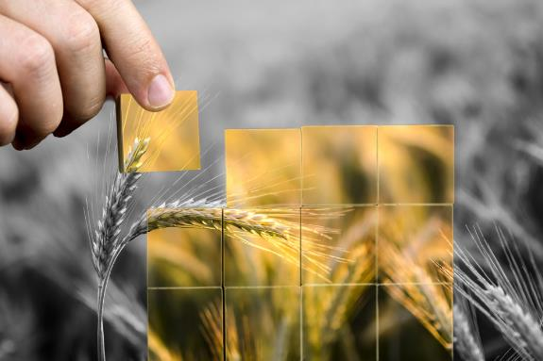
Food security
Food security means having access to enough safe and nutritious food.
The food should also meet the need for an active and healthy life.
Food security may be affected by:
economic factors, e.g. the price of food rising;
physical factors, e.g. droughts and flooding destroying crops;
social factors, e.g. wars and conflict.
Food security is an increasing concern in the UK. The percentage of people in food insecure houses went from 7% in 2022, to 11% one year later.
Sources: UN Committee on World Food Security House of Commons, Who is experiencing food insecurity in the UK? (2024)

Slide 44
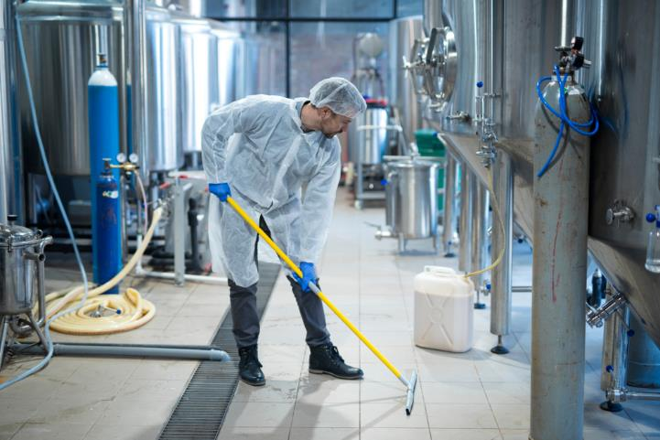
Food hygiene and safety
Sustainably produced foods should also be safe to eat.
Good food hygiene, production and storage practices can ensure that food poses little risk to health.
Many countries with low food security may also have reduced access to safe and hygienically produced foods.

Slide 45
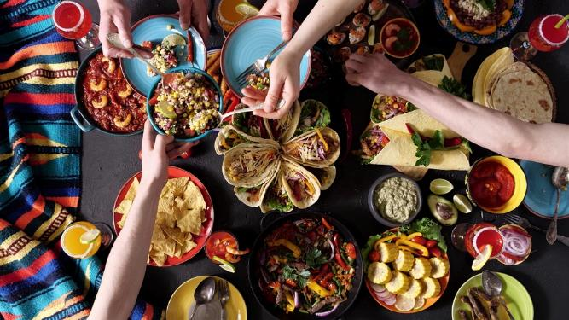
Cultural considerations
Food security also takes into account the food preferences of people.
Some foods may not be culturally or religiously acceptable to all groups.
For example, foods in Islamic cultures must be ‘halal’, whilst those in Jewish cultures should be ‘kosher’ and meet certain requirements.
Some people may also be vegetarian or vegan, have allergies or another reason why they don’t eat certain foods. These people still need access to a healthy diet that fulfils their needs.
Food traditions are recognised as an important part of culture by organisations like the Food and Agriculture Organization of the United Nations.

Slide 46
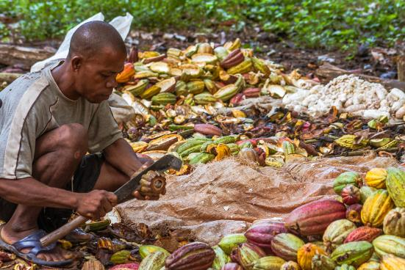
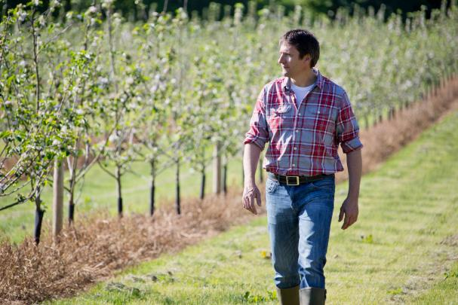
Social considerations
Social considerations in food production include:
ensuring that farmers and growers are paid fairly;
ensuring safe labour practices;
ensuring animal welfare;
ensuring that people living near areas where food is produced are not negatively affected;
ensuring that countries or areas that grow food are not exploited.

Slide 47
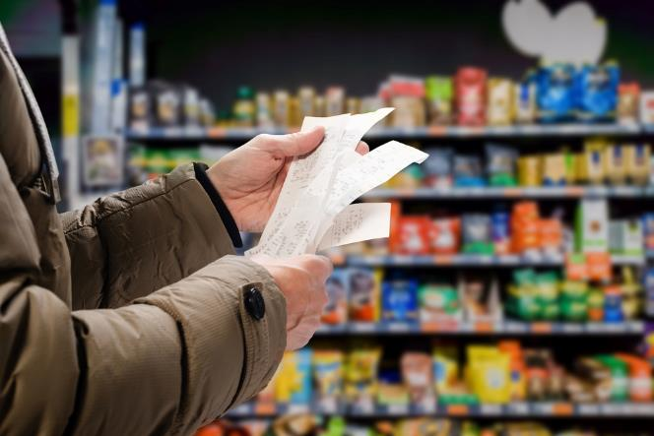
Economic considerations
A truly sustainable food should also be affordable.
Many more niche or novel products can be healthy and be produced sustainably but might cost more money than less sustainable alternatives.
For most consumers, price and taste are the first considerations when buying food, so if more sustainable foods are more expensive, then they may be bought less often.
Some foods that are produced with more care for the environment are more expensive to grow, which can increase costs for producers. This may also make these foods more expensive for producers and consumers.

Slide 48
Questions – Affordability, acceptability and accessibility
Describe a cultural consideration when discussing food security.
Name two of the three factors that affect food security.
Discuss what you think can be done to ensure that food producers are treated fairly.

Slide 49
Answers – Affordability, acceptability and accessibility
Describe a cultural consideration when discussing food security.
Any of:
Vegan or vegetarian
Religiously acceptable
Culturally acceptable (traditional foods)
Allergy requirements
Name two of the three factors that affect food security.
Any of:
economic factors, e.g. the price of food rising;
physical factors, e.g. droughts and flooding destroying crops;
social factors, e.g. wars and conflict.

Slide 50
Answers – Affordability, acceptability and accessibility
Discuss what you think can be done to ensure that food producers are treated fairly.
Discussion around:
ensuring that farmers and growers are paid fairly;
ensuring safe labour practices;
ensuring animal welfare;
ensuring that people living near areas where food is produced are not negatively affected;
ensuring that countries or areas that grow food are not exploited.

Slide 51
Conclusion
Balance is the key consideration when deciding whether food is sustainable. It is important that the following are balanced:
environmental factors
nutritional and health factors
socioeconomic factors
The origins of the foods we eat can be complicated and not all foods may balance all of these factors perfectly.
However, as a society, we should aim to grow, sell, promote, and purchase foods that meet as many of these criteria as possible. We should also try to minimise the loss and waste of food as much as we can.

Slide 52
Sustainable healthy diets
For further information, go to:
www.foodafactoflife.org.uk
This resource meets the Guidelines for producers and users of school education resources about food.

