Slide 1
Food

Slide 2
Food
Can you name these foods?

Slide 3
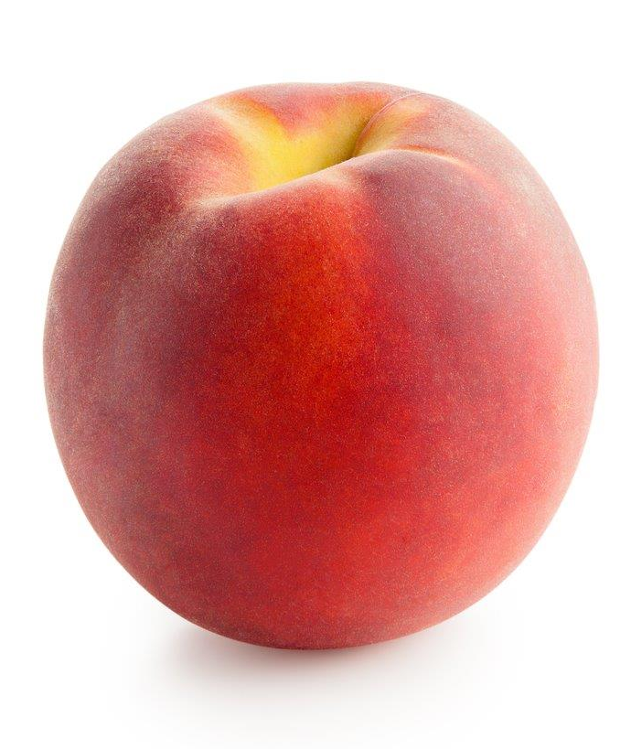
Peach

Slide 4
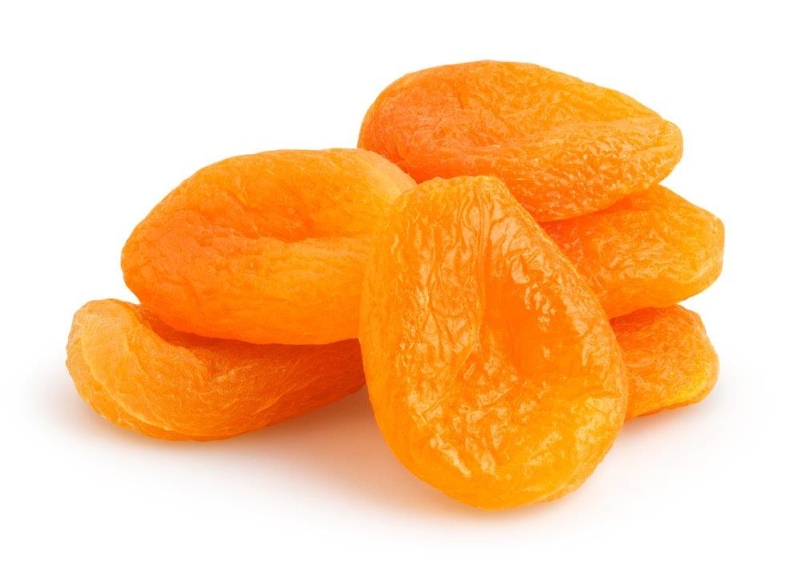
Dried apricots

Slide 5
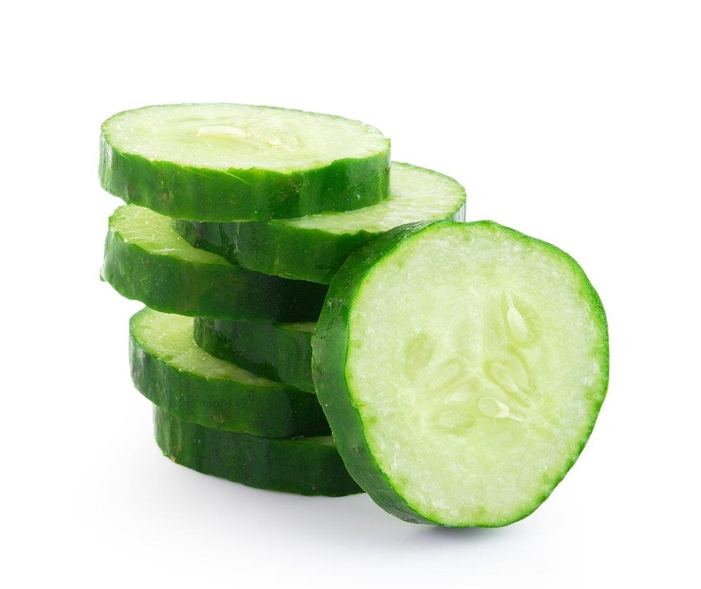
Cucumber

Slide 6
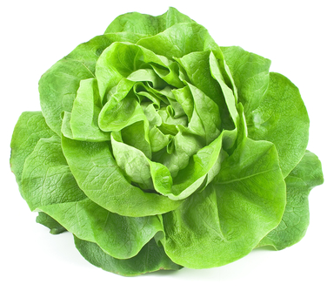
Lettuce

Slide 7
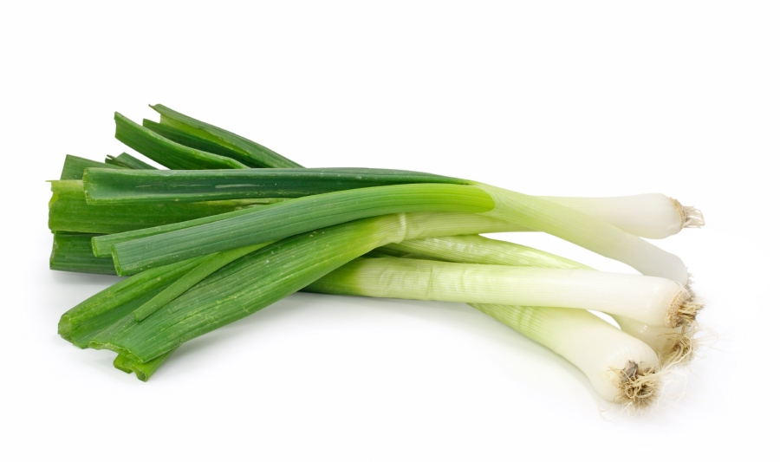
Spring onions

Slide 8
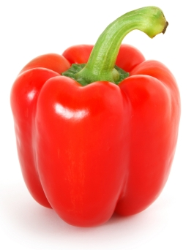
Pepper

Slide 9
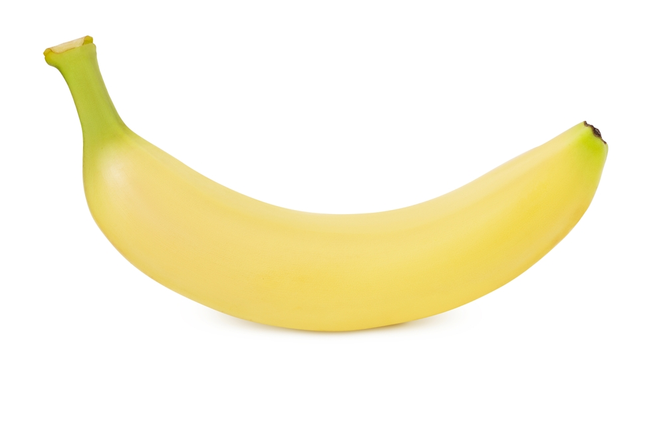
Banana

Slide 10
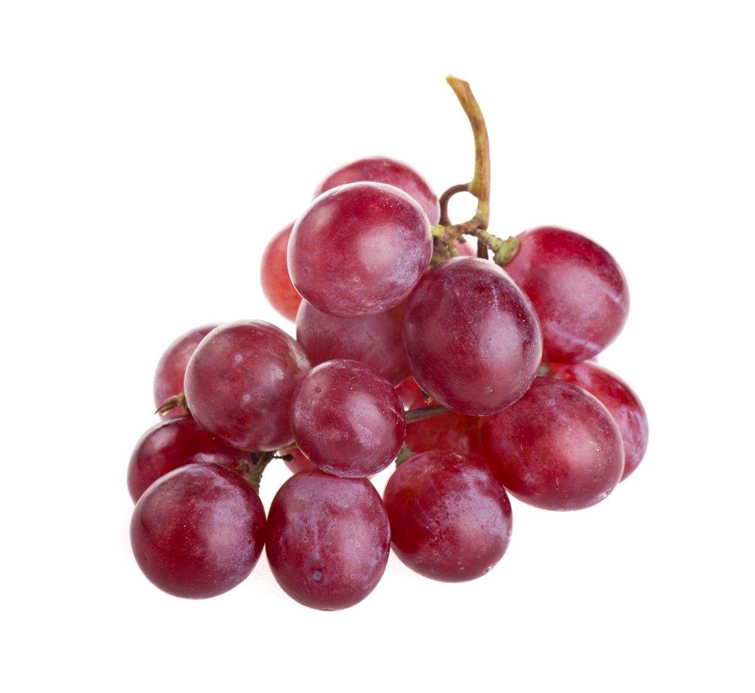
Grapes

Slide 11
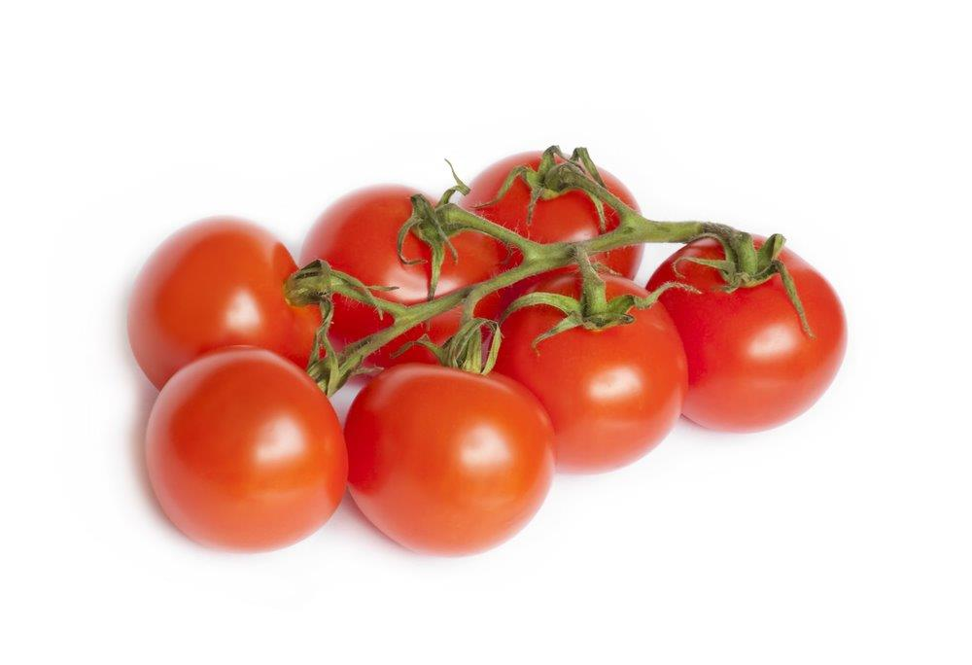
Cherry tomatoes

Slide 12
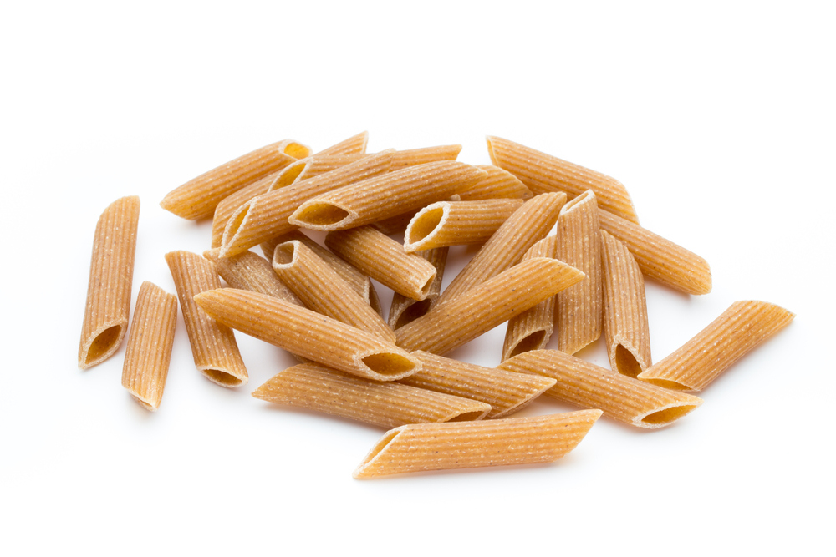
Pasta

Slide 13
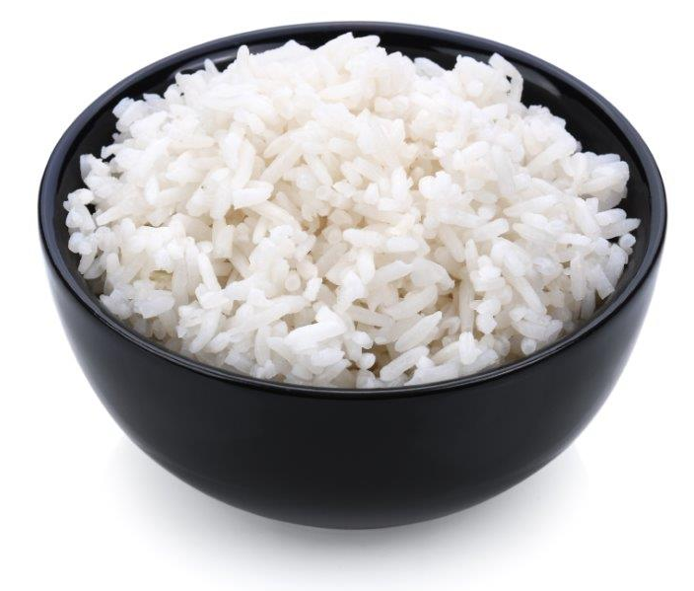
Rice

Slide 14
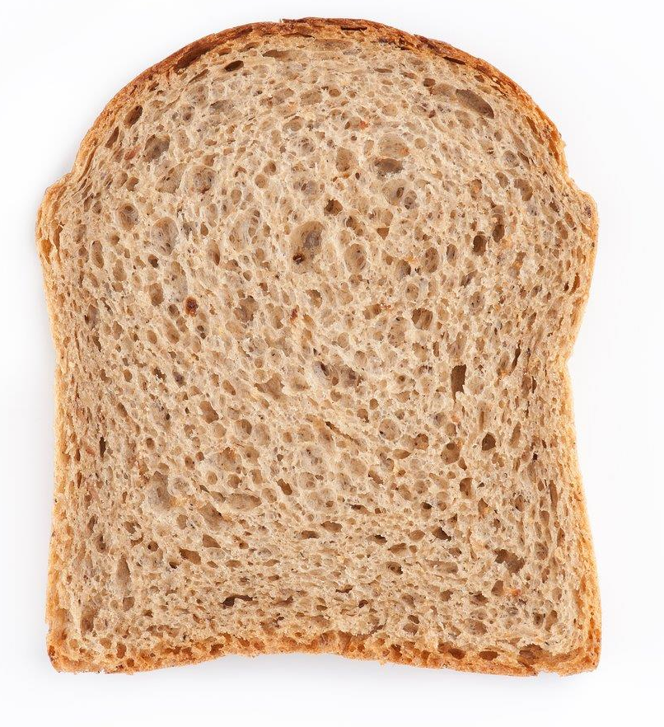
Wholegrain bread

Slide 15
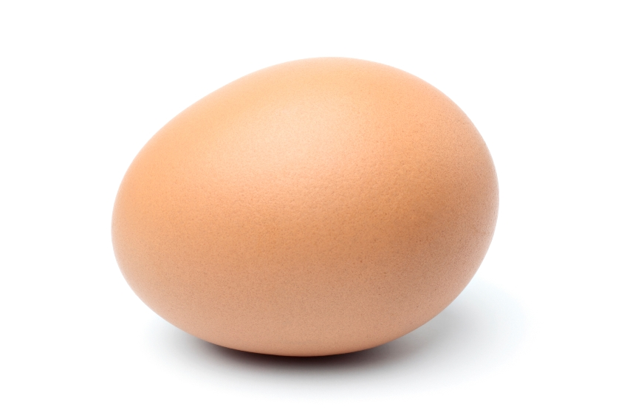
Egg

Slide 16
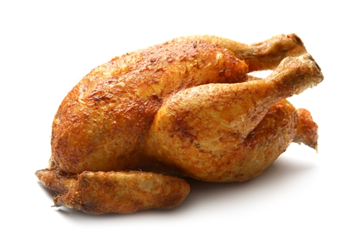
Chicken

Slide 17
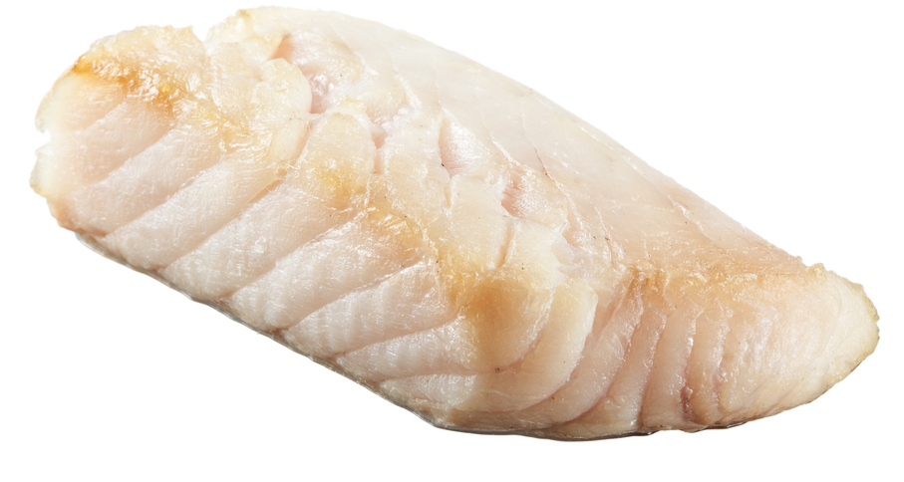
Cod

Slide 18
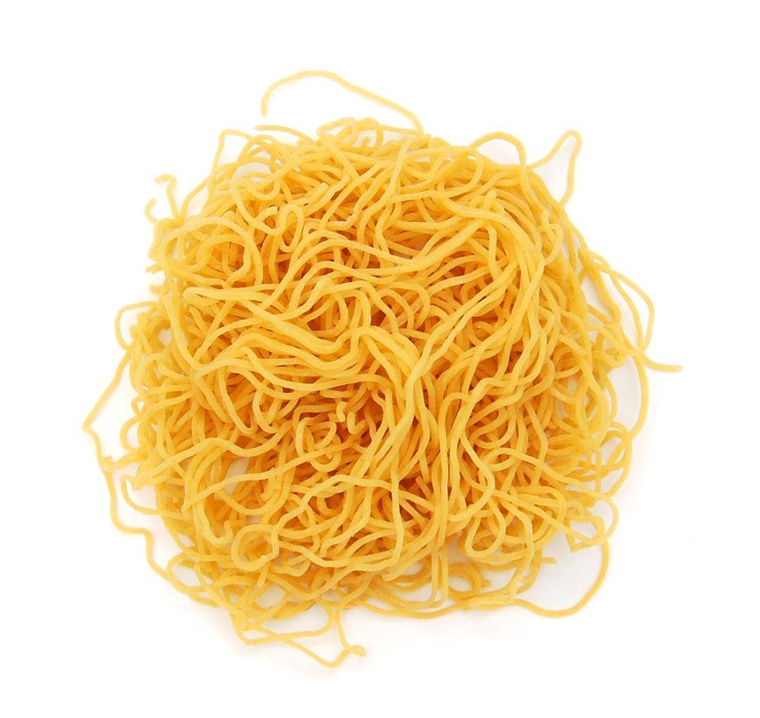
Noodles

Slide 19

Oil

Slide 20
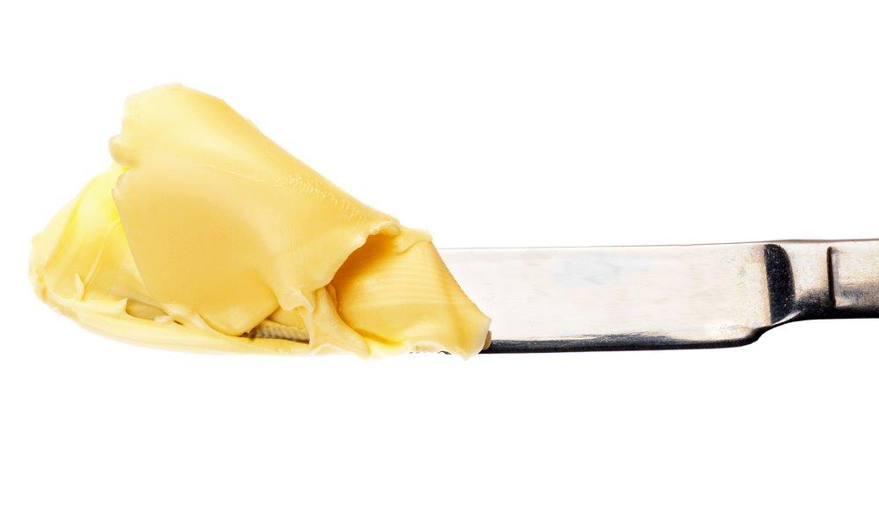
Spread

Slide 21
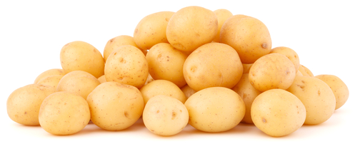
Potatoes

Slide 22
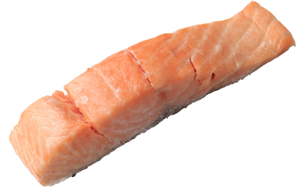
Salmon

Slide 23

Yogurt

Slide 24
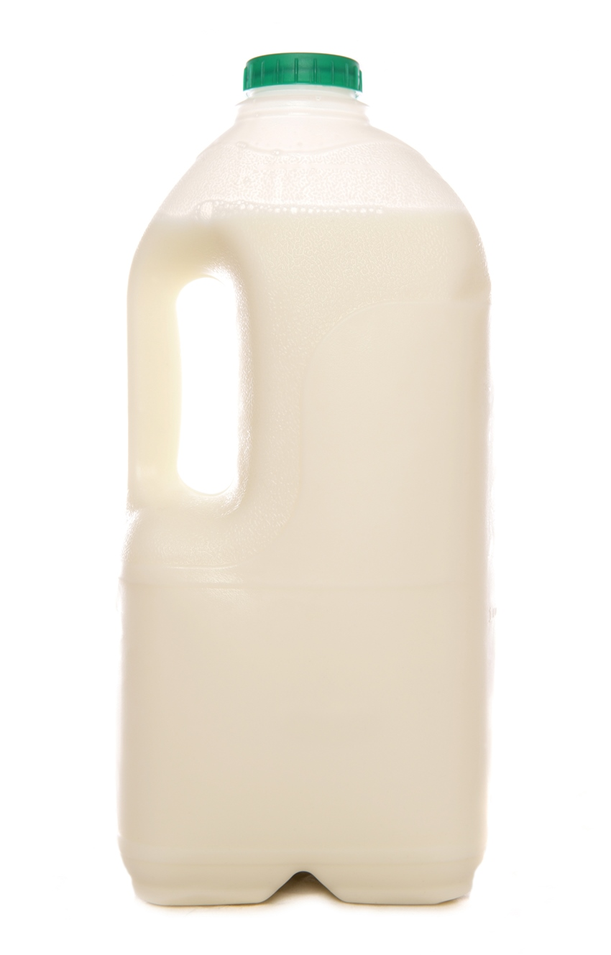
Milk

Slide 25
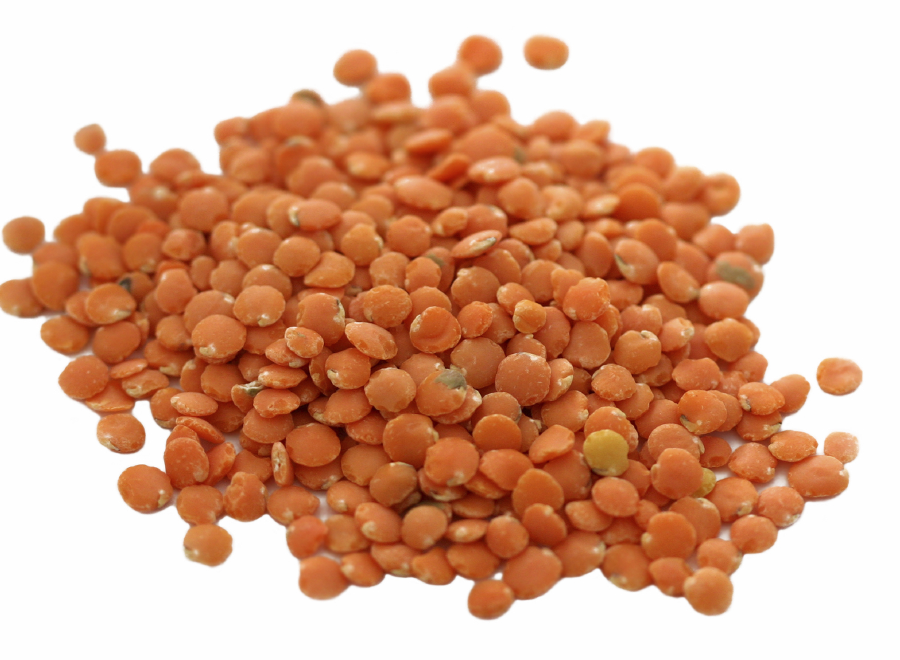
Lentils

Slide 26
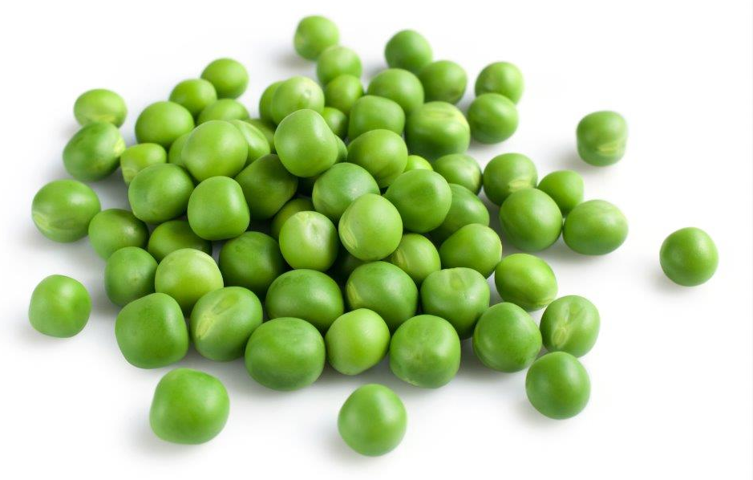
Peas

Slide 27
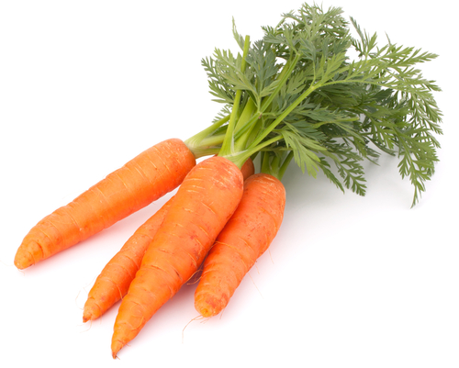
Carrots

Slide 28
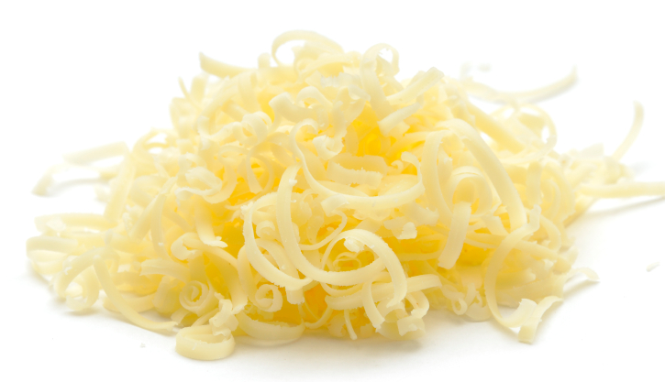
Cheese

Slide 29
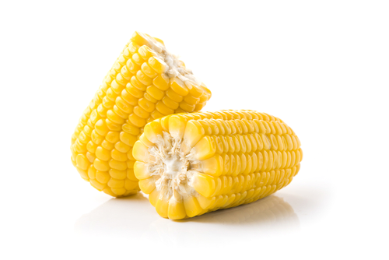
Sweetcorn

Slide 30
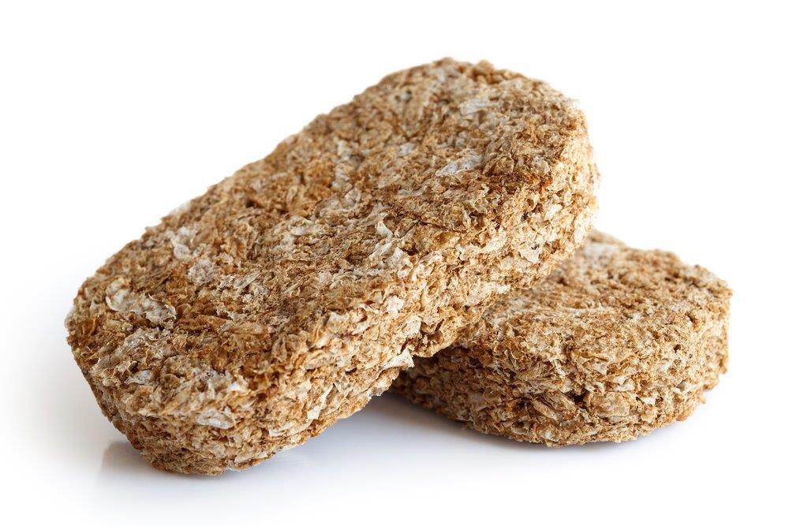
Wheat biscuits

Slide 31
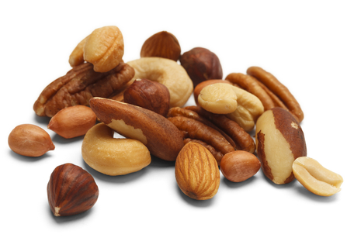
Mixed nuts

Slide 32
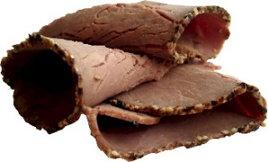
Beef

Slide 33

Soft cheese

Slide 34
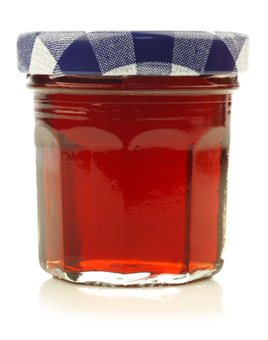
Jam

Slide 35
Food
For further information, go to:
www.foodafactoflife.org.uk
This resource meets the Guidelines for producers and users of school education resources about food.

