Slide 1
Diet and cancer

Slide 2
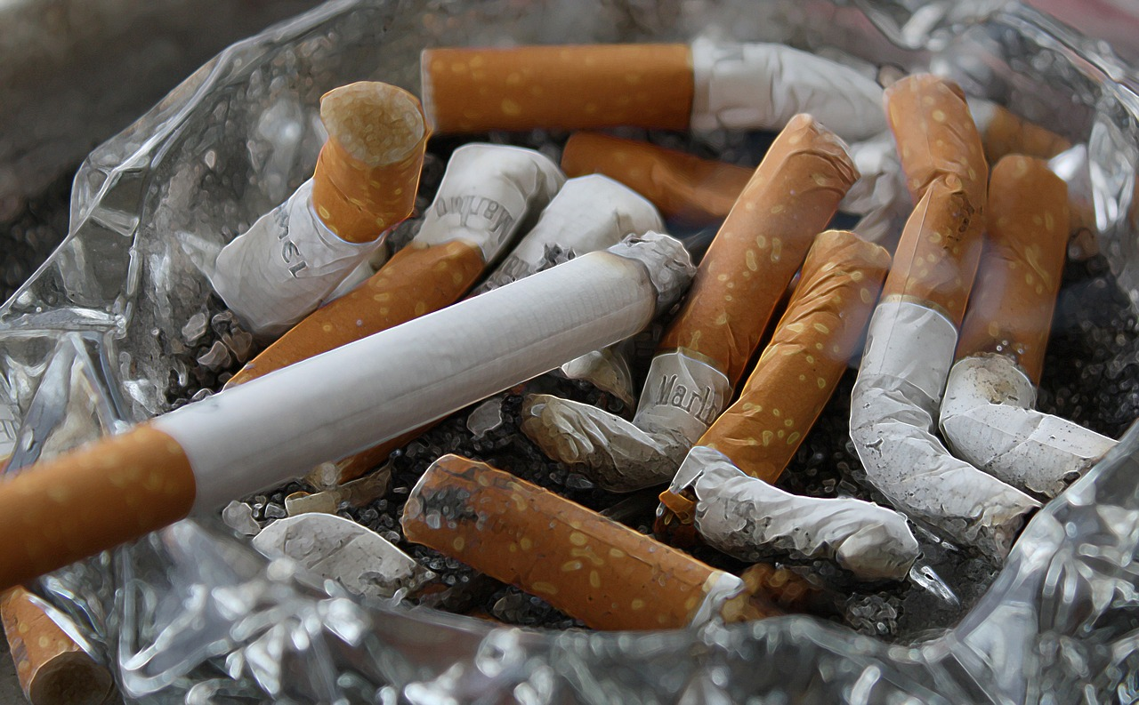
What is cancer?
Cancer occurs when abnormal cells in the body develop and increase rapidly.
The abnormal cells can also spread to other parts of the body and multiply.
Cancer can occur in different parts of the body.

Slide 3
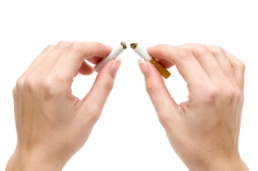
Cancer in the UK
It is estimated that healthier diets could help prevent 1 in 10 cancers in the UK. The strongest dietary links are with cancers of the digestive tract – mouth, food pipe (gullet or oesophagus), stomach and bowel (colon).
Each year in the UK, more than 331,000 people are diagnosed with cancer. The four most common cancers are breast, prostate, lung and bowel (colorectal) which make up over half of all these cases. It is estimated that 1 in 2 people will develop cancer at some point in their lives.
Cancer risk - British Nutrition Foundation

Slide 4
Risk factors for cancer
Age: Cells are more likely to become damaged as the body ages.
Genetics: People with a family history of a particular cancer are more likely to develop it themselves.
Environment: Tobacco smoke, diet, alcohol, radiation are some lifestyle factors which may influence the risk of developing some cancers.
Hormones: The risk of some cancers is linked to levels of certain hormones in the body.
Infection: Certain cancers are linked to viral infection.

Slide 5
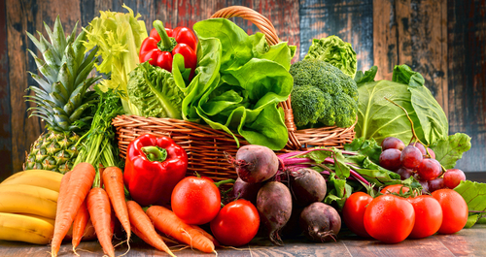
Diet and cancer
Dietary factors may protect against or increase the risk of cancer.
High intakes of fruit and vegetables have shown to reduce the risk of some cancers, e.g. lung cancer and stomach cancer.
Extra energy from the diet, if not used through activity, increases the risk of different cancers, such as in the oesophagus, pancreas, colon and breast.
Alcohol may also increase the risk of certain types of cancer, e.g. breast cancer and cancers in the mouth and oesophagus.

Slide 6
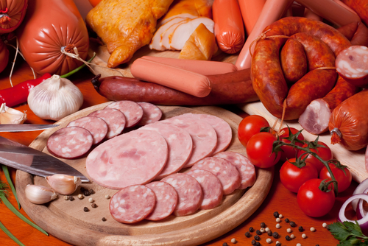
Red and processed meat
Meat is a good source of protein, and vitamins and minerals, such as iron and zinc and can be enjoyed as part of a healthy, balanced diet. However, evidence suggests that a high consumption of red and/or processed meat is linked with an increased risk of bowel cancer – the evidence is stronger for processed meat.
'Red meat' refers to beef, pork and lamb. 'Processed meat' refers to meat preserved by smoking, curing or salting, or addition of chemical preservatives, and includes bacon, sausages, salami and ham.

Slide 7
Red and processed meat
To put it into perspective, the overall risks of developing bowel cancer because of your consumption of red and/or processed meat are small compared to other factors linked to cancer such as smoking.
The Department of Health recommends people who eat more than 90g (cooked weight) of red and processed meat a day to cut down to 70g (100g raw weight), the equivalent of 500g a week (700g raw weight).

Slide 8
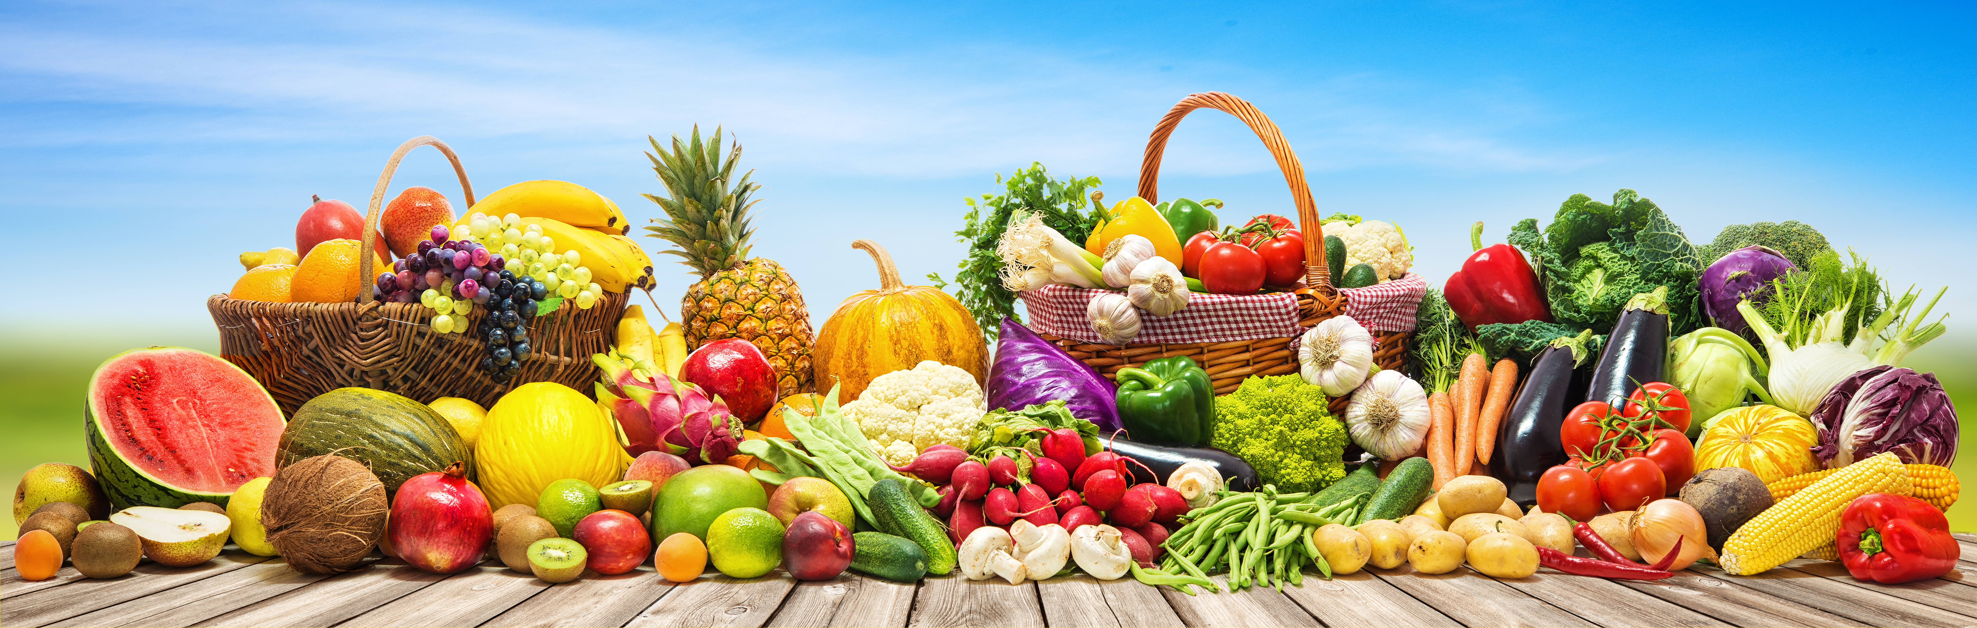
Fruit and vegetables
Fruit and vegetables provide large amounts of antioxidants, which can protect cells from damage and becoming abnormal.
Examples of antioxidants include carotene in carrots, vitamin E in nuts, seeds and vegetable oil and vitamin C in oranges.
Fruit and vegetables are also rich sources of fibre, which may reduce the risk of colorectal (bowel) cancer.

Slide 9
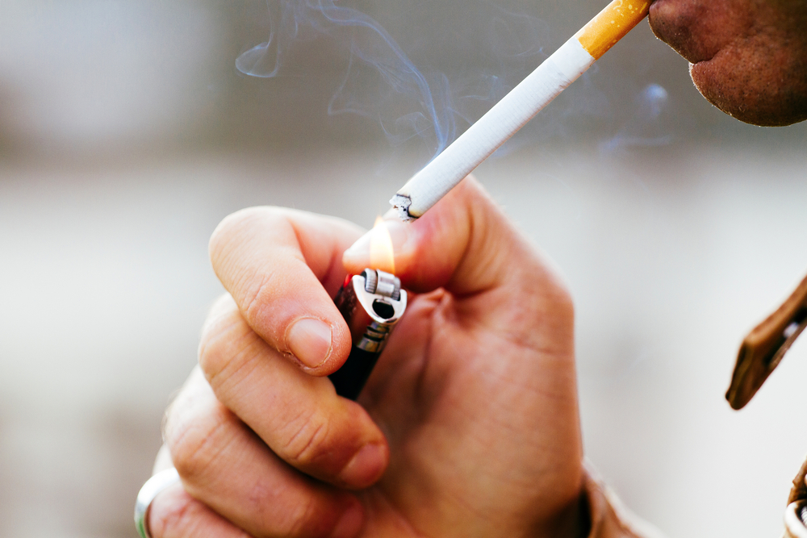
Carcinogens
Carcinogens are substances which can start the process of cancer.
Tobacco smoke contains carcinogens which cause lung cancer.
Carcinogens can also be present in food, but usually in smaller amounts, so the risk is relatively low.
Carcinogens found in foods may be substances that are formed naturally, due to contamination (e.g. aflatoxins in mouldy peanuts).

Slide 10
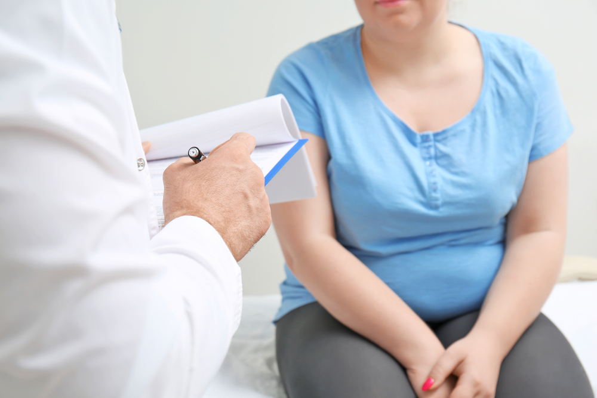
Energy balance
Physical inactivity, overweight and obesity have been strongly linked to an increased risk of some cancers, such as those in the colon, pancreas, kidney and breast.
It is important to balance the energy from food with the energy used through activity.

Slide 11
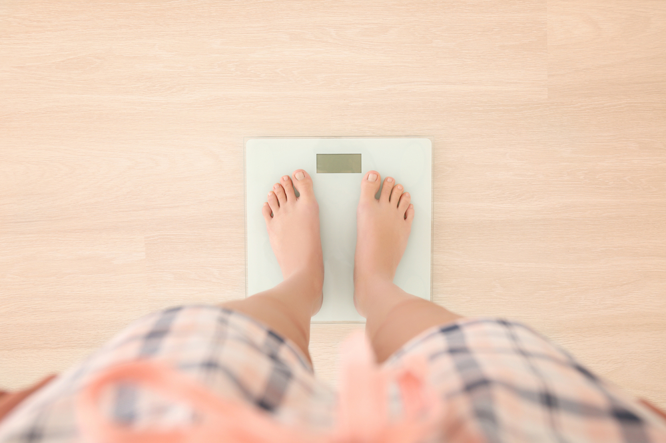
Healthy weight
Being overweight and obese increases the risk of some cancers, as well as other diseases, such as hypertension, heart disease, stroke and diabetes.
It is important to keep a healthy weight to maintain health.

Slide 12
Body Mass Index
The Body Mass Index (BMI) is a good indicator for adults to see if they are underweight, overweight or a healthy weight. To calculate BMI (kg/m2), divide weight (kg) by height (m) x height (m).
BMI = weight (kg)
(height in m) ²
Recommended BMI range
Underweight | Less than 18.5
Normal | 18.5 – less than 25
Overweight | 25 – less than 30
Obese | 30-40
Very obese | Over 40

Slide 13
Cancer prevention
The World Cancer Research Fund has released nine cancer prevention recommendations.
Be a healthy weight.
Move more.
Avoid high-calorie foods and drinks.
Enjoy more grains, veg, fruit and barley.
Limit intake of red meat and avoid processed meat.
Don’t drink alcohol.
Eat less salt.
Don’t rely on supplements.
Breastfeed your baby.

Slide 14
Quiz- Kahoot
Open the link below on the main screen and get students to log onto kahoot.it on their tablets or smartphones. They can then enter the code (that will come up on the main screen when you start the game) and their own nickname. They can then play along with the quiz choosing the multiple choice answers that correspond with the questions on the main screen. There will then be a leaderboard of the scores after each question and at the end.
https://play.kahoot.it/#/?quizId=0e69d208-8a9d-4230-8431-a17c3b4fef83

Slide 15
Diet and cancer
For further information, go to:
www.foodafactoflife.org.uk
This resource meets the Guidelines for producers and users of school education resources about food.

