Slide 1
Nutritional analysis – why and how?

Slide 2
Why is nutrient information important?
“A knowledge of the chemical composition of foods is the first essential in the dietary treatment of disease or in any quantitative study of human nutrition”
McCance & Widdowson, 1940

Slide 3
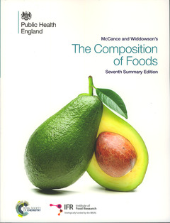
McCance and Widdowson: The Composition of Food
The Chemical Composition of Foods was first published in 1940 and even in its seventh edition it is very much the “bible” for nutritionists, food scientists, dietitians and many others.
Data on the composition UK foods.
First published in 1940.
7th edition published in 2015.
1180 foods and nearly 50 nutrients.
Standard equations used.
Integrated Dataset with more detailed information is available online.
All information on Explore food has been taken from McCance and Widdowson: The Composition of Food.

Slide 4
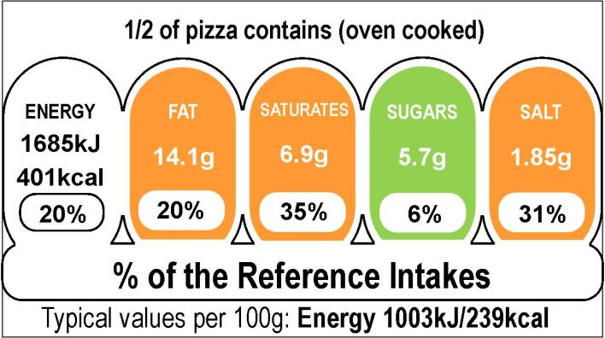
Why is nutritional analysis important?
It lets consumers know what nutrients are provided by food.
It allows consumers to know if they are meeting the Dietary Reference Values (DRVs):
In the UK, we have a set of Dietary reference values (DRVs) so people know how much of each nutrient they should be consuming.
Analysing a recipe, or the diet over a day, allows comparisons to the DRVs so people can see whether they are meeting the recommendations.
Knowing whether or not DRVs are being met enables you to determine whether the diet should be modified.

Slide 5
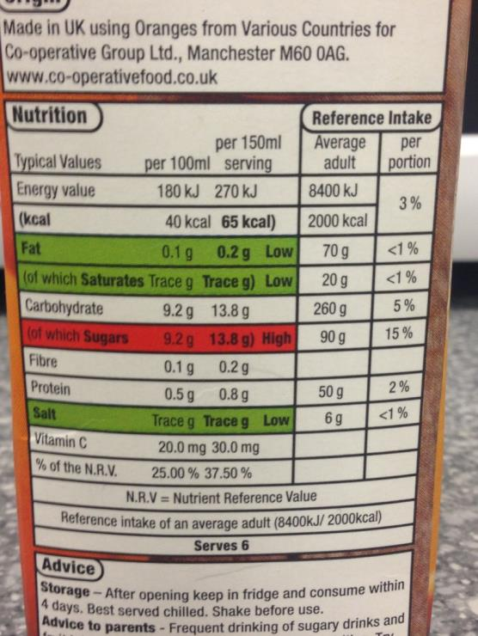
Nutrient information
Nutrient information on packaging provides consumers with clear information.
The Food Information Regulation is an EU regulation that states the information that must be on the back of pack.
Some companies also include the nutrition information for the product made to the suggested recipe.
Nutrient information on the label allows food to be compared and helps consumers make informed choices.

Slide 6
Important nutritional analysis tips
The recipe
Key watch outs
Portion size
Preparation
Cooking
Volume and weight are different

Slide 7
The recipe
The most important thing is to ensure the recipe is clear and contains all the information needed.
Chilli Con Carne Recipe
2 tins chopped tomatoes
Onions
2 Carrots
1 pack minced beef
1 bay leaf
400g kidney beans
Tsp chilli powder
Salt and pepper to taste
Tip: Serve with rice and top with yogurt.
How many does it serve?
How many?
What size?
What quantity?
What pack? Standard, lean or extra lean?
Will be removed
How much?
Drained weight?
Should a tip be included? White or brown rice? Type of yogurt?

Slide 8
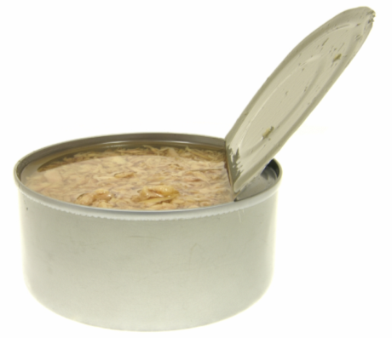
Key watch outs
Are the weights of ingredients given?
How much is a pinch or dollop?
Are the ingredients described in detail?
Are they lean, or reduced fat, salt or sugar?
Are all the ingredients used?
They might be used only for flavour.
Are any ingredients removed or added?
How many does it serve?
Consider drained weights.

Slide 9
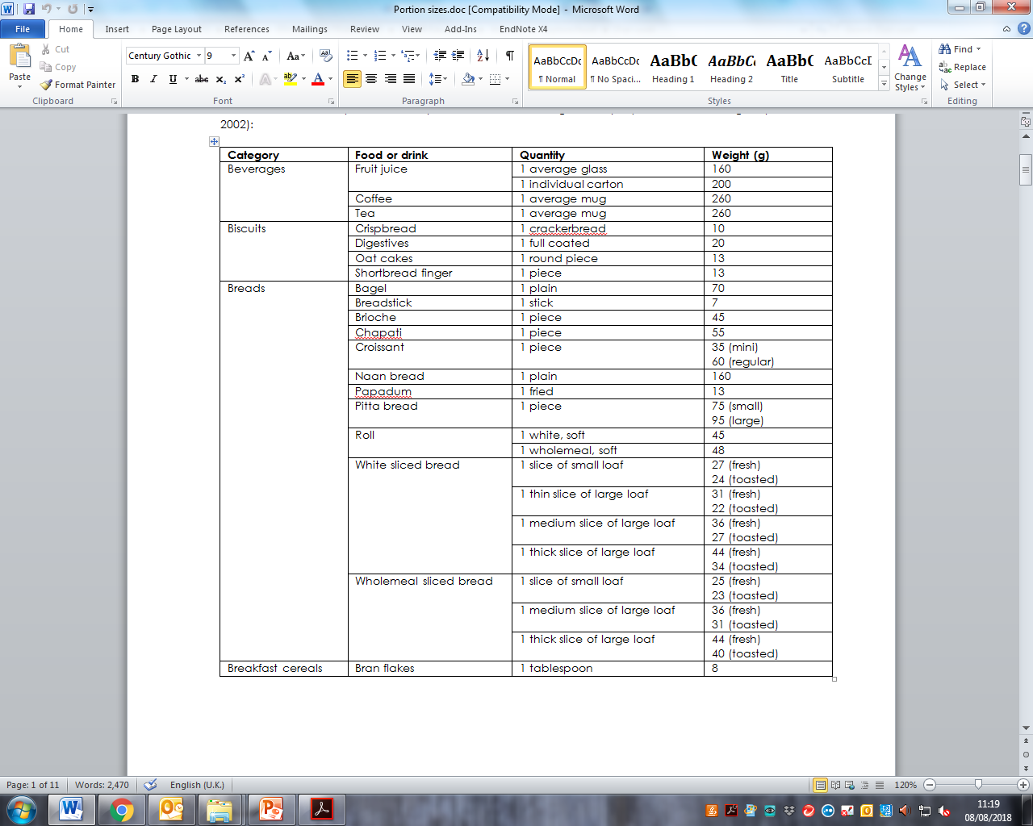
Portion size
Often recipes simply state ‘four chicken breasts’ or ‘one large tomato’, but what does this mean?
If portion sizes are not specified in the recipe, then you can use the portion size worksheet to help.
It provides information on typical weights and portion sizes of foods eaten and provides average, small, regular and large portion sizes.
Note: there are no official portion size measures but a guide can be found on Explore food.
http://explorefood.foodafactoflife.org.uk/

Slide 10

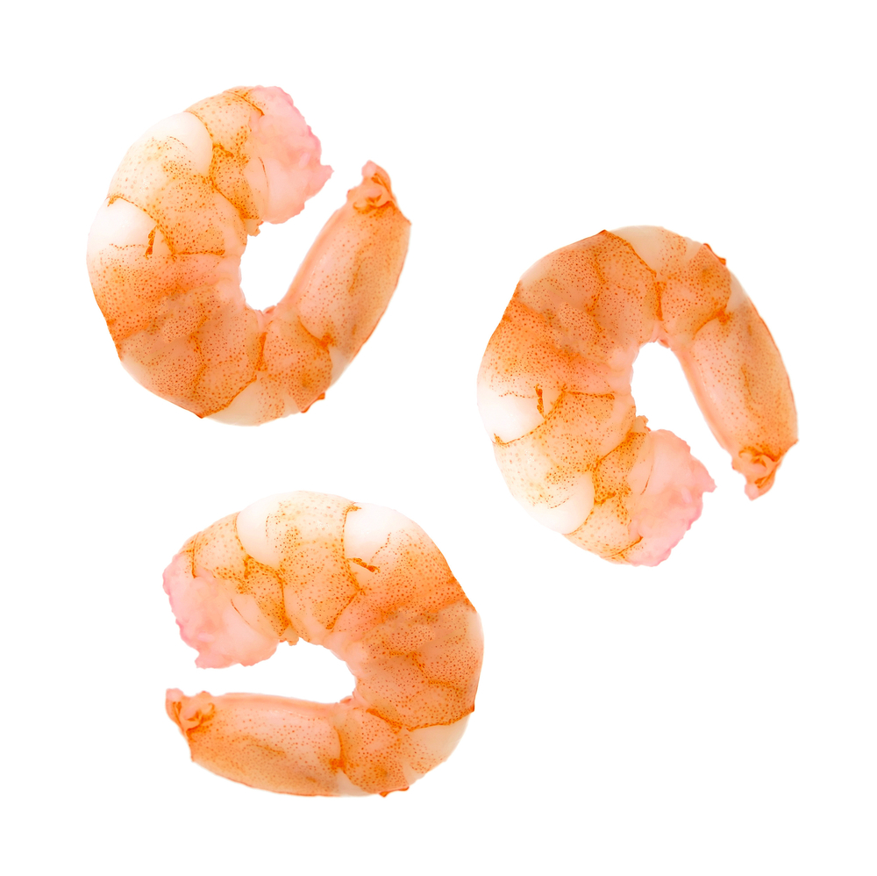
Preparation
It is important to remember that some foods change weight when they are prepared and cooked. For example:
vegetables are peeled and trimmed;
egg shells are removed;
fish is filleted;
meat is taken off the bone;
seafood and nuts are de-shelled.

Slide 11
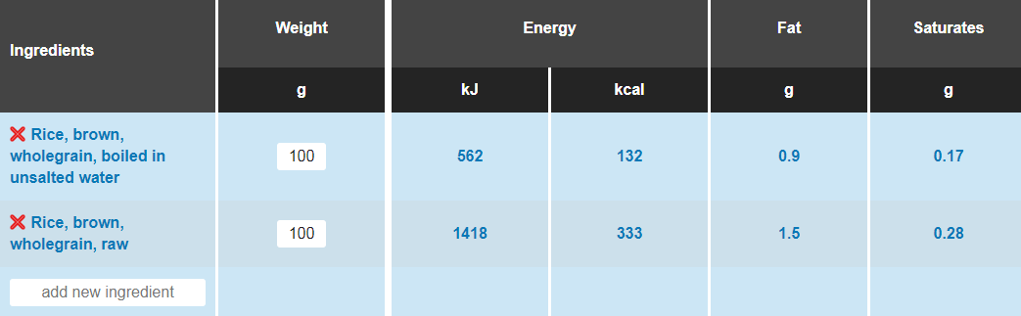
Cooking
Foods also change weight when they are cooked, so accounting for this is vital when providing information per 100g.
Foods can either lose weight (e.g. baked foods) or gain weight (e.g. fried or boiled foods) when cooked.
When using a nutritional analysis programme, it is important that the correct weight for the type of ingredient is chosen otherwise this will affect the results (e.g. with boiled or raw rice).

Slide 12
Volume and weight are different
100ml is not the same as 100g.
Weights vary depending on density.
In industry the weight of liquids is calculated using set formulas based on their ‘specific gravity’.
 | Volume | Weight
Water | 100ml | 100g
Milk | 100ml | 103g
Vegetable Oil | 100ml | 91g

Slide 13

Ice cream
Ice cream is an example of how weight and volume are different.
A tub of ice cream may contain 900ml of ice cream, but only weighs around 500g.
100ml = 119kcal
100g = 210kcal

Slide 14
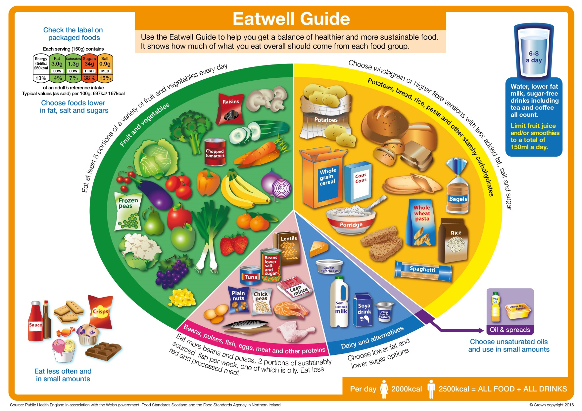
Modifying Recipes

Slide 15
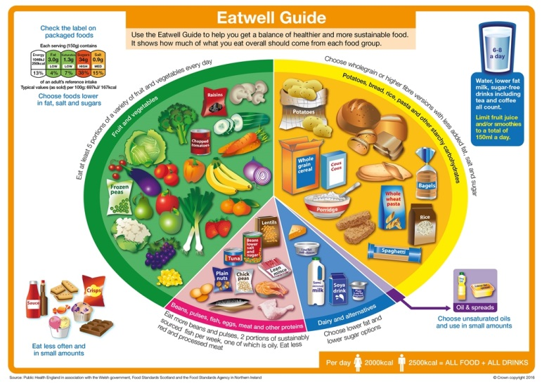
Modifying recipes
These recommendations should be followed when developing and modifying recipes.
Ingredient choice – following government recommendations
Eat lots of fruit and vegetables
Base meals on starchy carbohydrates
Cut down on saturated fat and sugar
Eat less salt
Eat more fish – including a portion of oily fish

Slide 16
Easy recipe modifications
Top tips
Make sure meals are balanced.
Increase fruit and vegetables.
Choose fish, beans and vegetables canned in water with no added salt or sugar.
Choose fruit canned in juice.
Swap double cream for whipping cream or a cream alternative.
Use reduced fat varieties.
Season with herbs, chilli, lemon and pepper instead of salt.
Increase the number of servings (decrease portion size).

Slide 17
Nutritional analysis – why and how?
For further information, go to:
www.foodafactoflife.org.uk
This resource meets the Guidelines for producers and users of school education resources about food.

