Slide 1
Recipe modification and cooking for health

Slide 2
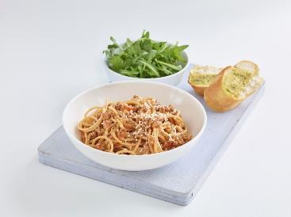
Why adapt or modify recipes?
Recipes have been tried and tested so that you know the ingredients, proportions and methods that are suggested will work. You are assured of a reliable result if you follow the instructions carefully, so why would you want to adapt or modify a recipe?
To meet the needs of different groups of people e.g. vegetarian.
To reduce the cost of a recipe.
To avoid certain foods because of intolerance or allergy.
Reducing the energy content.
Improving the nutritional value/balance (nutritional content or profile) e.g. reducing salt content.
Ingredients are unavailable.
To cater for like and dislikes.

Slide 3
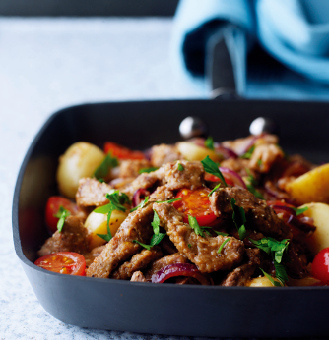
How can this be done successfully?
When modifying recipes, changes can occur when ingredients are substituted or altered meaning that the colour, flavour, texture and nutritional value is altered.
It is important to be aware of the needs of the consumer and have knowledge of the function of the ingredients, proportions and ratios.
It is advisable not to make too many adaptations in one recipe and the new recipe should always be cooked to make sure that it smells, looks and tastes good!

Slide 4
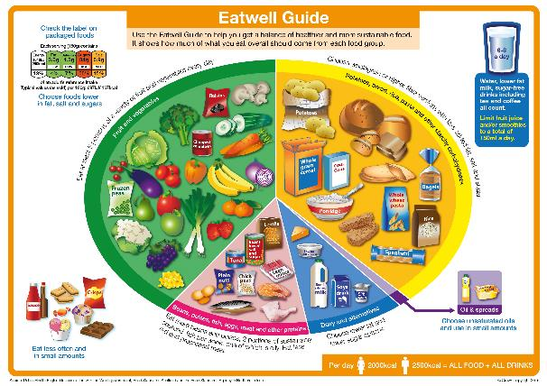
Ingredient choice
Within each Eatwell Guide food group there are many choices that students can select when planning dishes and menus, some of which are healthier than others.
When selecting food items for dishes, the healthier options from within each food group should be chosen.

Slide 5
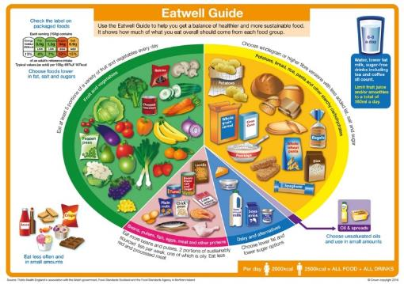
Ingredient choice – following government recommendations
These recommendations should be followed when developing and modifying recipes.
Eat lots of fruit and vegetables
Base meals on starchy carbohydrates
Cut down on saturated fat and sugar
Eat more fish – including a portion of oily fish
Eat less salt

Slide 6
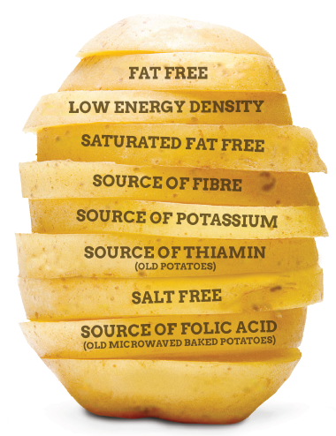
Starchy food
Starchy food should make up just over a third of the food we eat.
Choose higher-fibre, wholegrain varieties by purchasing whole wheat pasta, brown rice, or simply leaving the skins on potatoes.

Slide 7
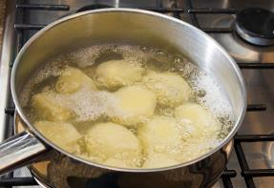
Tips for cooking with potatoes:
use semi skimmed, 1% or skimmed milk when making mashed potato;
use unsaturated oil like rapeseed instead of butter;
add minimal salt;
brush roast potatoes with oil to reduce amount of oil in the tray;
blanch chips to reduce fry time;
drain off fat and dry all fried potatoes;
cut chips thicker as they have a smaller surface area so absorb less oil;
leave potato skins on while cooking, and eat the skins;
just cover with water when boiling.

Slide 8
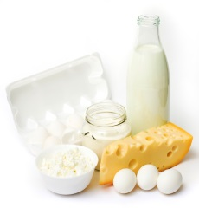
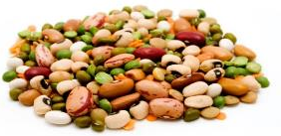
Healthier swaps
When choosing ingredients, an easy way to meet government recommendations is to consider ‘swapping’.
Swapping suggestions include:
use reduced fat or lighter versions of milk, cheese, cream and other dairy products;
use lean minced beef and lamb (ideally less than 5% fat);
use meats that are naturally lower in fat than red meats e.g. pork, turkey and fish;
use alternative protein sources such as tofu, mycoprotein, beans, lentils and pulses.

Slide 9
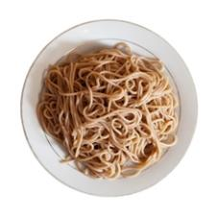
Fibre
The fibre content of dishes can also be increased through swapping ingredients.
For example, did you know that wholemeal spaghetti has considerably more fibre than white spaghetti?
White spaghetti boiled (per 220g portion) – 3.7g fibre
Wholemeal spaghetti boiled (per 220g portion) – 9.2g fibre
White long grain rice boiled (per 180g portion) – 2.0g fibre
Brown rice boiled (per 180g portion) – 2.7g fibre

Slide 10
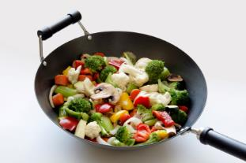
Reducing the fat content
Making changes to the way food is prepared and cooked can also improve the nutritional content or profile of the dish.
Reducing the fat content:
trim visible fat;
use a spray oil;
steam, boil, poach, grill, bake or stir fry with a small amount of oil.

Slide 11
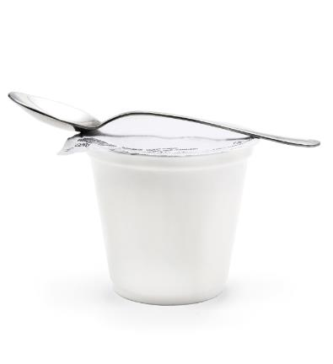
Reducing the sugar content
Reducing the sugar content:
reduce the amount of sugar added to recipes or replace with fruit or a sweetener;
serve yogurt or half fat crème fraiche rather than cream or custard.
Remember that savoury dishes can also contain added sugars.

Slide 12
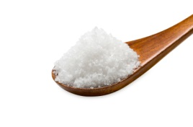
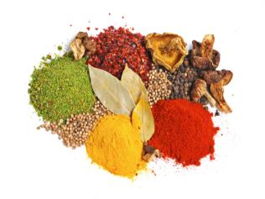
Reducing the salt content
Reducing the salt content:
use measuring spoons to help control salt dosage;
replace salt in recipes with herbs and spices;
reduce the use of ingredients high in salt e.g. soy sauce;
don’t salt water for boiling and add salt after reducing sauces.

Slide 13


Increasing the fruit and vegetable content
Increasing the fruit and vegetable content:
add vegetables into rice or couscous;
experiment with colourful and interesting salads;
incorporate vegetables into sauces or with other items, e.g. mashed with potatoes;
add vegetables into sweet foods such as carrot, parsnip and beetroot;
incorporate fruit into savoury dishes, e.g. tagines, casseroles and salads;
add more fruits and vegetables to dishes.

Slide 14















Cooking for health – follow the key messages of the Eatwell Guide
Eat at least 5 portions of a variety of fruit and vegetables every day.
Base meals on potatoes, bread, rice, pasta or other starchy carbohydrates; choosing wholegrain versions where possible.
Eat some beans, pulses, fish, eggs, meat and other proteins (including 2 portions of fish every week, one of which should be oily).
Have some dairy or dairy alternatives (such as soya drinks); choosing lower fat and lower sugar options.
Choose unsaturated oils and spreads and eat in small amounts.
Drink 6-8 cups/glasses of fluid a day.
If consuming foods and drinks high in fat, salt or sugar have these less often and in small amounts.

Slide 15
Recipe modification and cooking for health
For further information, go to:
www.foodafactoflife.org.uk
This resource meets the Guidelines for producers and users of school education resources about food.

