Slide 1
Functional properties overview

Slide 2
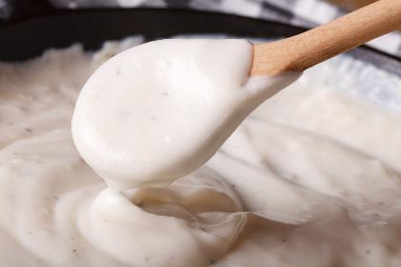
Introduction
Ingredients have a range of different properties. These properties can lead them to have different functions when they are included in foods.
Carbohydrates, proteins and fats all have a range of different properties that make them useful in a variety of food products.

Slide 3
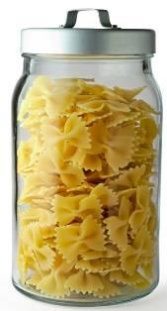
Carbohydrates in food
Many foods contain some carbohydrates but the amounts of sugars, starch and fibre differ. Sugars are naturally present in foods such as milk, fruits, vegetables and honey. In the UK, sugar beet and sugar cane are the most common sources of sugar. Honey, treacle and golden syrup are also popular. Starch is present in foods such as potatoes, bread, rice and pasta.

Slide 4
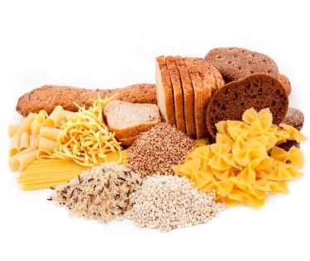
Fibre
Fibre is present in whole grains, fruits and vegetables, especially the outer covering of seeds.
It is a mixture of substances (mainly complex carbohydrates) which cannot be digested in the small intestine.
There are two types of fibre:
Soluble fibre - found in fruit, vegetables, pulses and oats.
Insoluble fibre - found in cereals such as bread and pasta.

Slide 5
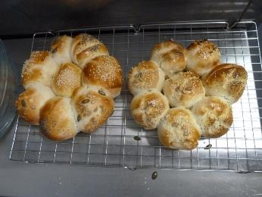
Carbohydrates and their functional properties in food products
Carbohydrates perform different functions in food products.
They can:
help to cause the colour change of bread, toast and bakery products;
contribute to the chewiness, colour and sweet flavour of caramel;
thicken products such as sauces and custards.

Slide 6
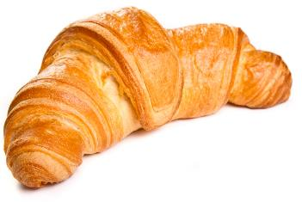
The Maillard reaction
Foods which are baked, grilled or roasted undergo colour, odour and flavour changes. This is primarily due to a group of reactions involving amino acids (from protein) and reducing sugars. These compounds contribute to the colour and flavour of many foods such as toast, bread and croissants. This reaction is known as the Maillard reaction, after the Frenchman who discovered it. This reaction can also take place in foods with high protein content, such as meats.

Slide 7
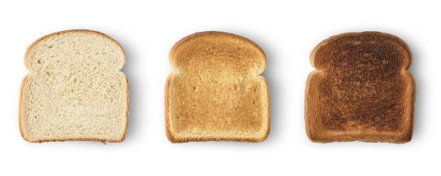
Dextrinisation
When foods containing starch are heated (without the presence of water) they can also produce brown compounds due to dextrinisation. Dextrinisation occurs when the heat breaks the large starch polysaccharides into smaller molecules known as dextrins. Many of these dextrins can also produce a brown colour. Toast is a good example to illustrate dextrinisation.

Slide 8
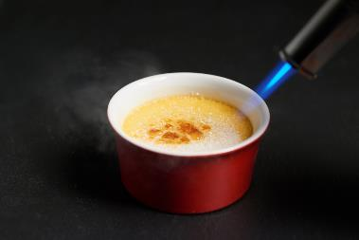
Caramelisation
When sucrose (table sugar) is heated above its melting point it undergoes physical and chemical changes to produce caramel. This happens more readily without water. However, syrups will caramelise with rapid heating. This process is used extensively in the production of confectionery. Overheating will cause the substance to become bitter and dark. Maillard, dextrinisation and caramelisation reactions are all examples of non-enzymic browning reactions.

Slide 9
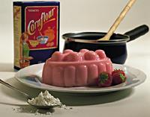
Gelatinisation
When starch is mixed with water and heated, the starch granules swell and eventually rupture, absorbing liquid, which thickens the mixture. On cooling, if enough starch is used, a gel forms. This process is used in the production of blancmange. Traditionally, English blancmange utilises cornflour as a source of starch, whilst French blancmange uses gelatine, which is a protein and gels by a different process.

Slide 10
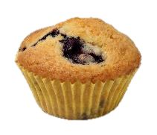
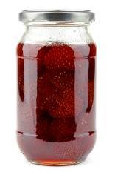
Other characteristics of carbohydrates
Flavouring:
Sugar, e.g. sucrose, may be used to flavour many products such as drinks, cakes, tomato sauce and confectionery. It supplies sweetness and mouthfeel.
Preservation:
High concentrations of sugar prevents the growth of microorganisms.
It is used extensively in the production of jam, marmalade and some canned fruit. Sugar is an important ingredient in determining the shelf-life of a product.
Gelling:
Some fruits, such as apples and blackcurrants, are rich sources of pectin. Pectin is used as a gelling agent in the production of jam.

Slide 11
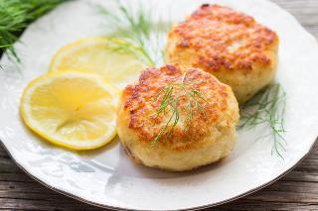
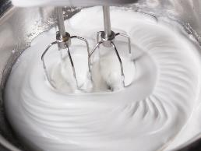
Proteins
Proteins perform different functions in food products.
They:
aerate foods, e.g. whisking egg whites;
thicken sauces, e.g. egg custard;
bind ingredients together, e.g. fishcakes;
form structures, e.g. gluten development in bread;
gel, e.g. lime jelly.

Slide 12
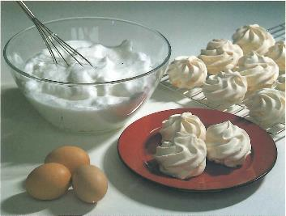
Denaturation
Denaturation is the change in structure of protein molecules. The process results in the unfolding of the protein’s structure. Factors which contribute to denaturation are heat, salts, pH and mechanical action. Denaturation is a partially reversible change. For example, when an egg white is whisked it incorporates air to form a foam. If the foam is left to stand, it will collapse back to form liquid egg white. However, as the change is only partially reversed, trying to make a new foam from the previously collapsed one will not work well.

Slide 13
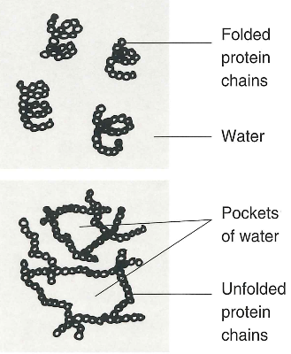
Coagulation
Coagulation follows denaturation. For example, when egg white is cooked it changes colour and becomes firmer (sets). The heat causes egg proteins to unfold from their coiled state and form a solid, stable network. This change is irreversible.

Slide 14
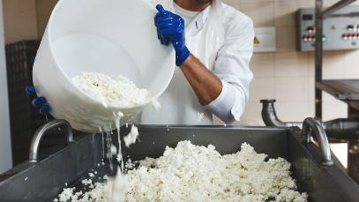
Coagulation
Another form of coagulation occurs in the production of cheese. Rennet (which contains the enzyme rennin) is added to milk, causing the protein casein to clot, producing curds (solid) and whey (liquid). Rennet is traditionally sourced from the stomachs of calves, but vegetarian options are now also available. Other applications of coagulation are:
cheese and yogurt production;
thickening of sauces with beaten egg;
binding ingredients together, e.g. fishcakes;
reformed meats;
providing a coating for products, e.g. scotch eggs.

Slide 15
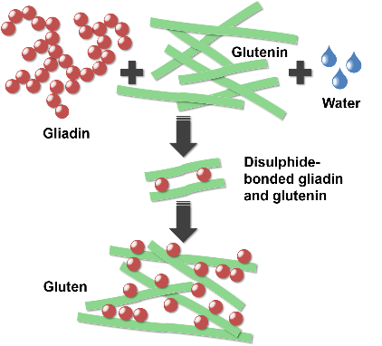
Gluten formation
Two proteins, gliadin and glutenin, found in wheat flour, form gluten when mixed with water. Gluten is strong, elastic and forms a 3D network in dough. In the production of bread, kneading helps untangle the gluten strands and align them. Gluten helps give structure to the bread and keeps in the gases that expand during cooking. The amount and type of protein present depends on the flour type and quality. Strong flour contains a maximum of 17% protein, plain flour 10%. Some other flours also contain gluten, including rye and barley flours.

Slide 16
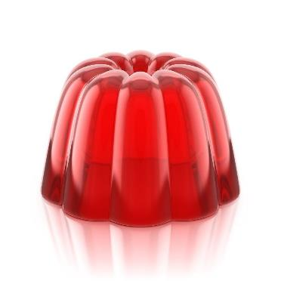
Gelation
Gelatine is a protein which is extracted from collagen, present in animal connective tissue.
When it is mixed with warm water, the gelatine protein molecules start to unwind.
On cooling, a stable, solid network is formed, trapping the liquid.
Gelation is reversible.

Slide 17
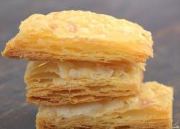
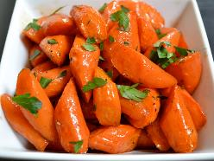
Fats
Fats performs different functions in food products.
They help to:
add ‘shortness’ or ‘flakiness’ to foods, e.g. shortbread, pastry;
provide a range of textures and cooking mediums;
glaze foods, e.g. butter on carrots;
aerate mixtures, e.g. a creamed cake mix;
add a range of flavours.

Slide 18
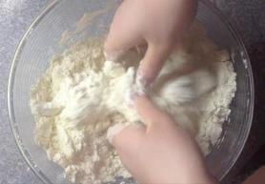
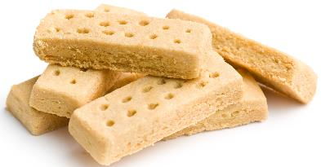
Shortening
Shortcrust pastry, biscuits and shortbread rely on fat to give them their characteristic crumbly texture. The fats coats the flour particles and prevents them from absorbing water. This reduces the gluten development, which would cause the dough to become elastic. Fats such as pure vegetable fats or lard are suitable for shortening because of their low water content. There are distinctive colours associated with the type of fat used. Butter produces a golden colour and lard produces a pale yellow. A compromise is sometimes reached by using a combination of the two.

Slide 19
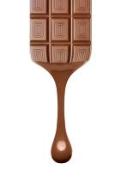
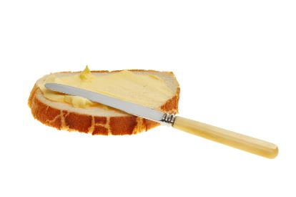
Plasticity
Fats do not melt at fixed temperatures, but over a range. This property is called plasticity. It gives all fats unique characteristics. This plasticity is due to the mixture of triglycerides, each with their own melting point. Some products are formulated using fats containing triglycerides with lower melting points so they can spread from the fridge (e.g. soft spread) or melt on the tongue (e.g. chocolate). Other fats have higher melting points and are used for cooking.

Slide 20
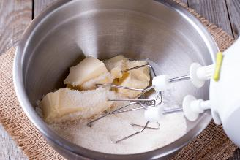
Aeration
Products such as creamed cakes need air incorporated into the mixture in order to give a well-risen texture. This is achieved by creaming a fat, such as butter or baking spread, with caster sugar.
Small bubbles of air are incorporated and form a stable foam.

Slide 21
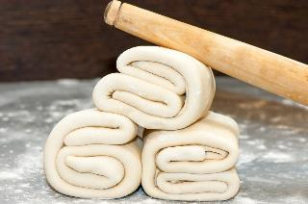
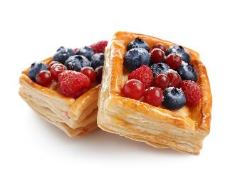
Flakiness
Flaky and puff pastry use fat to help separate layers of gluten and starch formed in the dough. The fat melts during cooking, leaving thin layers.
The water present in the pastry produces steam, which evaporates and causes the layers to rise.
The fat prevents the layers from sticking together.

Slide 22
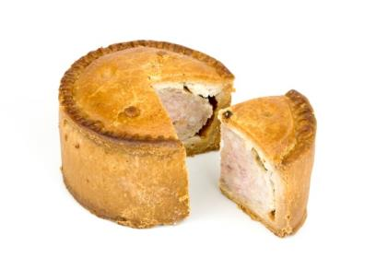
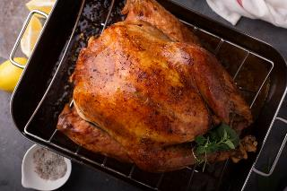
Retention of moisture
Some fats can help retain a bakery product’s moisture and increase its shelf-life.
They may also be used to baste food that is being cooked by dry heat.

Slide 23
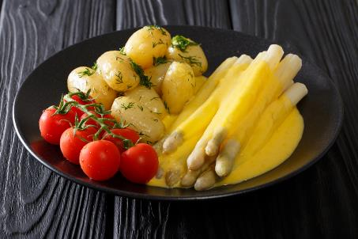
Glazing
Placed on hot vegetables, some fats, e.g. butter, give a glossy appearance.
Fats also add shine to sauces.

Slide 24
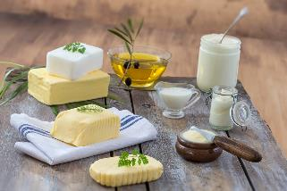
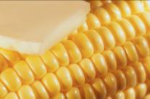
Sensory attributes
All fats and oils have unique flavours and odours.
Some are more suited for particular purposes than others, e.g. olive oil for salad dressing (for flavour) and lard for pastry (due to its blandness).
They can also contribute to the texture of the food, for example by increasing succulence.

Slide 25
Functional properties overview
For further information, go to:
www.foodafactoflife.org.uk
This resource meets the Guidelines for producers and users of school education resources about food.

