Slide 1
Chicken fajitas
Complexity: medium - high

Slide 2
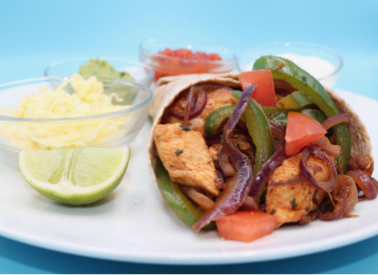
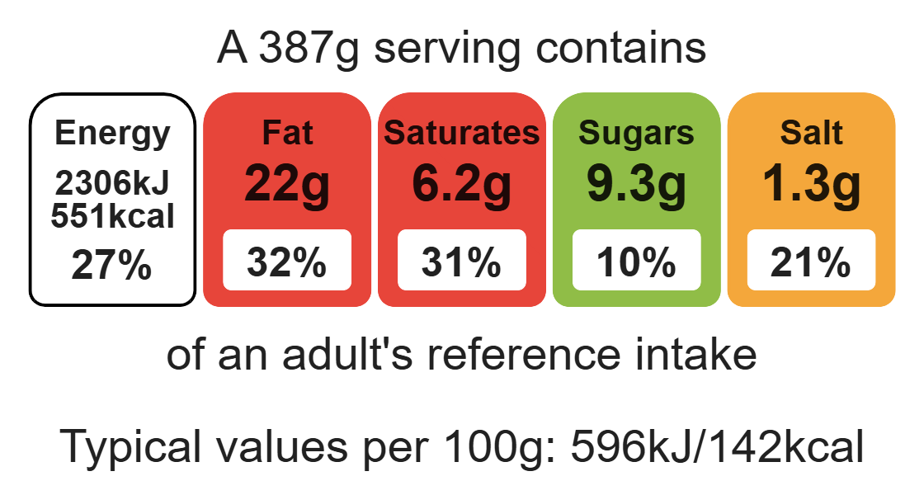
Nutritional analysis
Serves 1

Slide 3
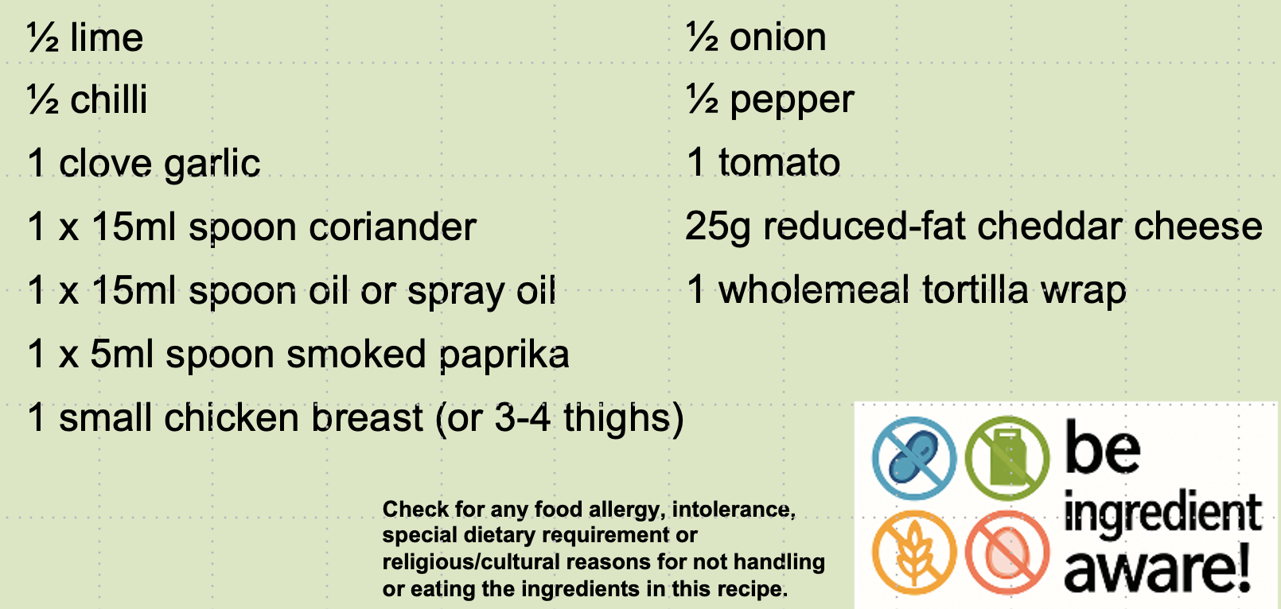
Starter activity
These are the ingredients we are going to use to make chicken fajitas.
Can you identify the following in the recipe?
A protein being used.
A citrus fruit.
Something that provides calcium, protein and fat.
Something that provides fibre.
Bonus question
What does the term “be ingredient aware” mean?

Slide 4
Example responses
A protein being used. Chicken
A citrus fruit. Lime
Something that provides calcium,
protein and fat. Cheese
4) Something that provides fibre. Pepper, wholemeal wrap
Bonus question
What does the term “be ingredient aware” mean?
Ingredients must be checked for any food allergy, intolerance, special dietary requirement or religious/cultural reasons for not handling or eating the ingredients in the recipe.

Slide 5
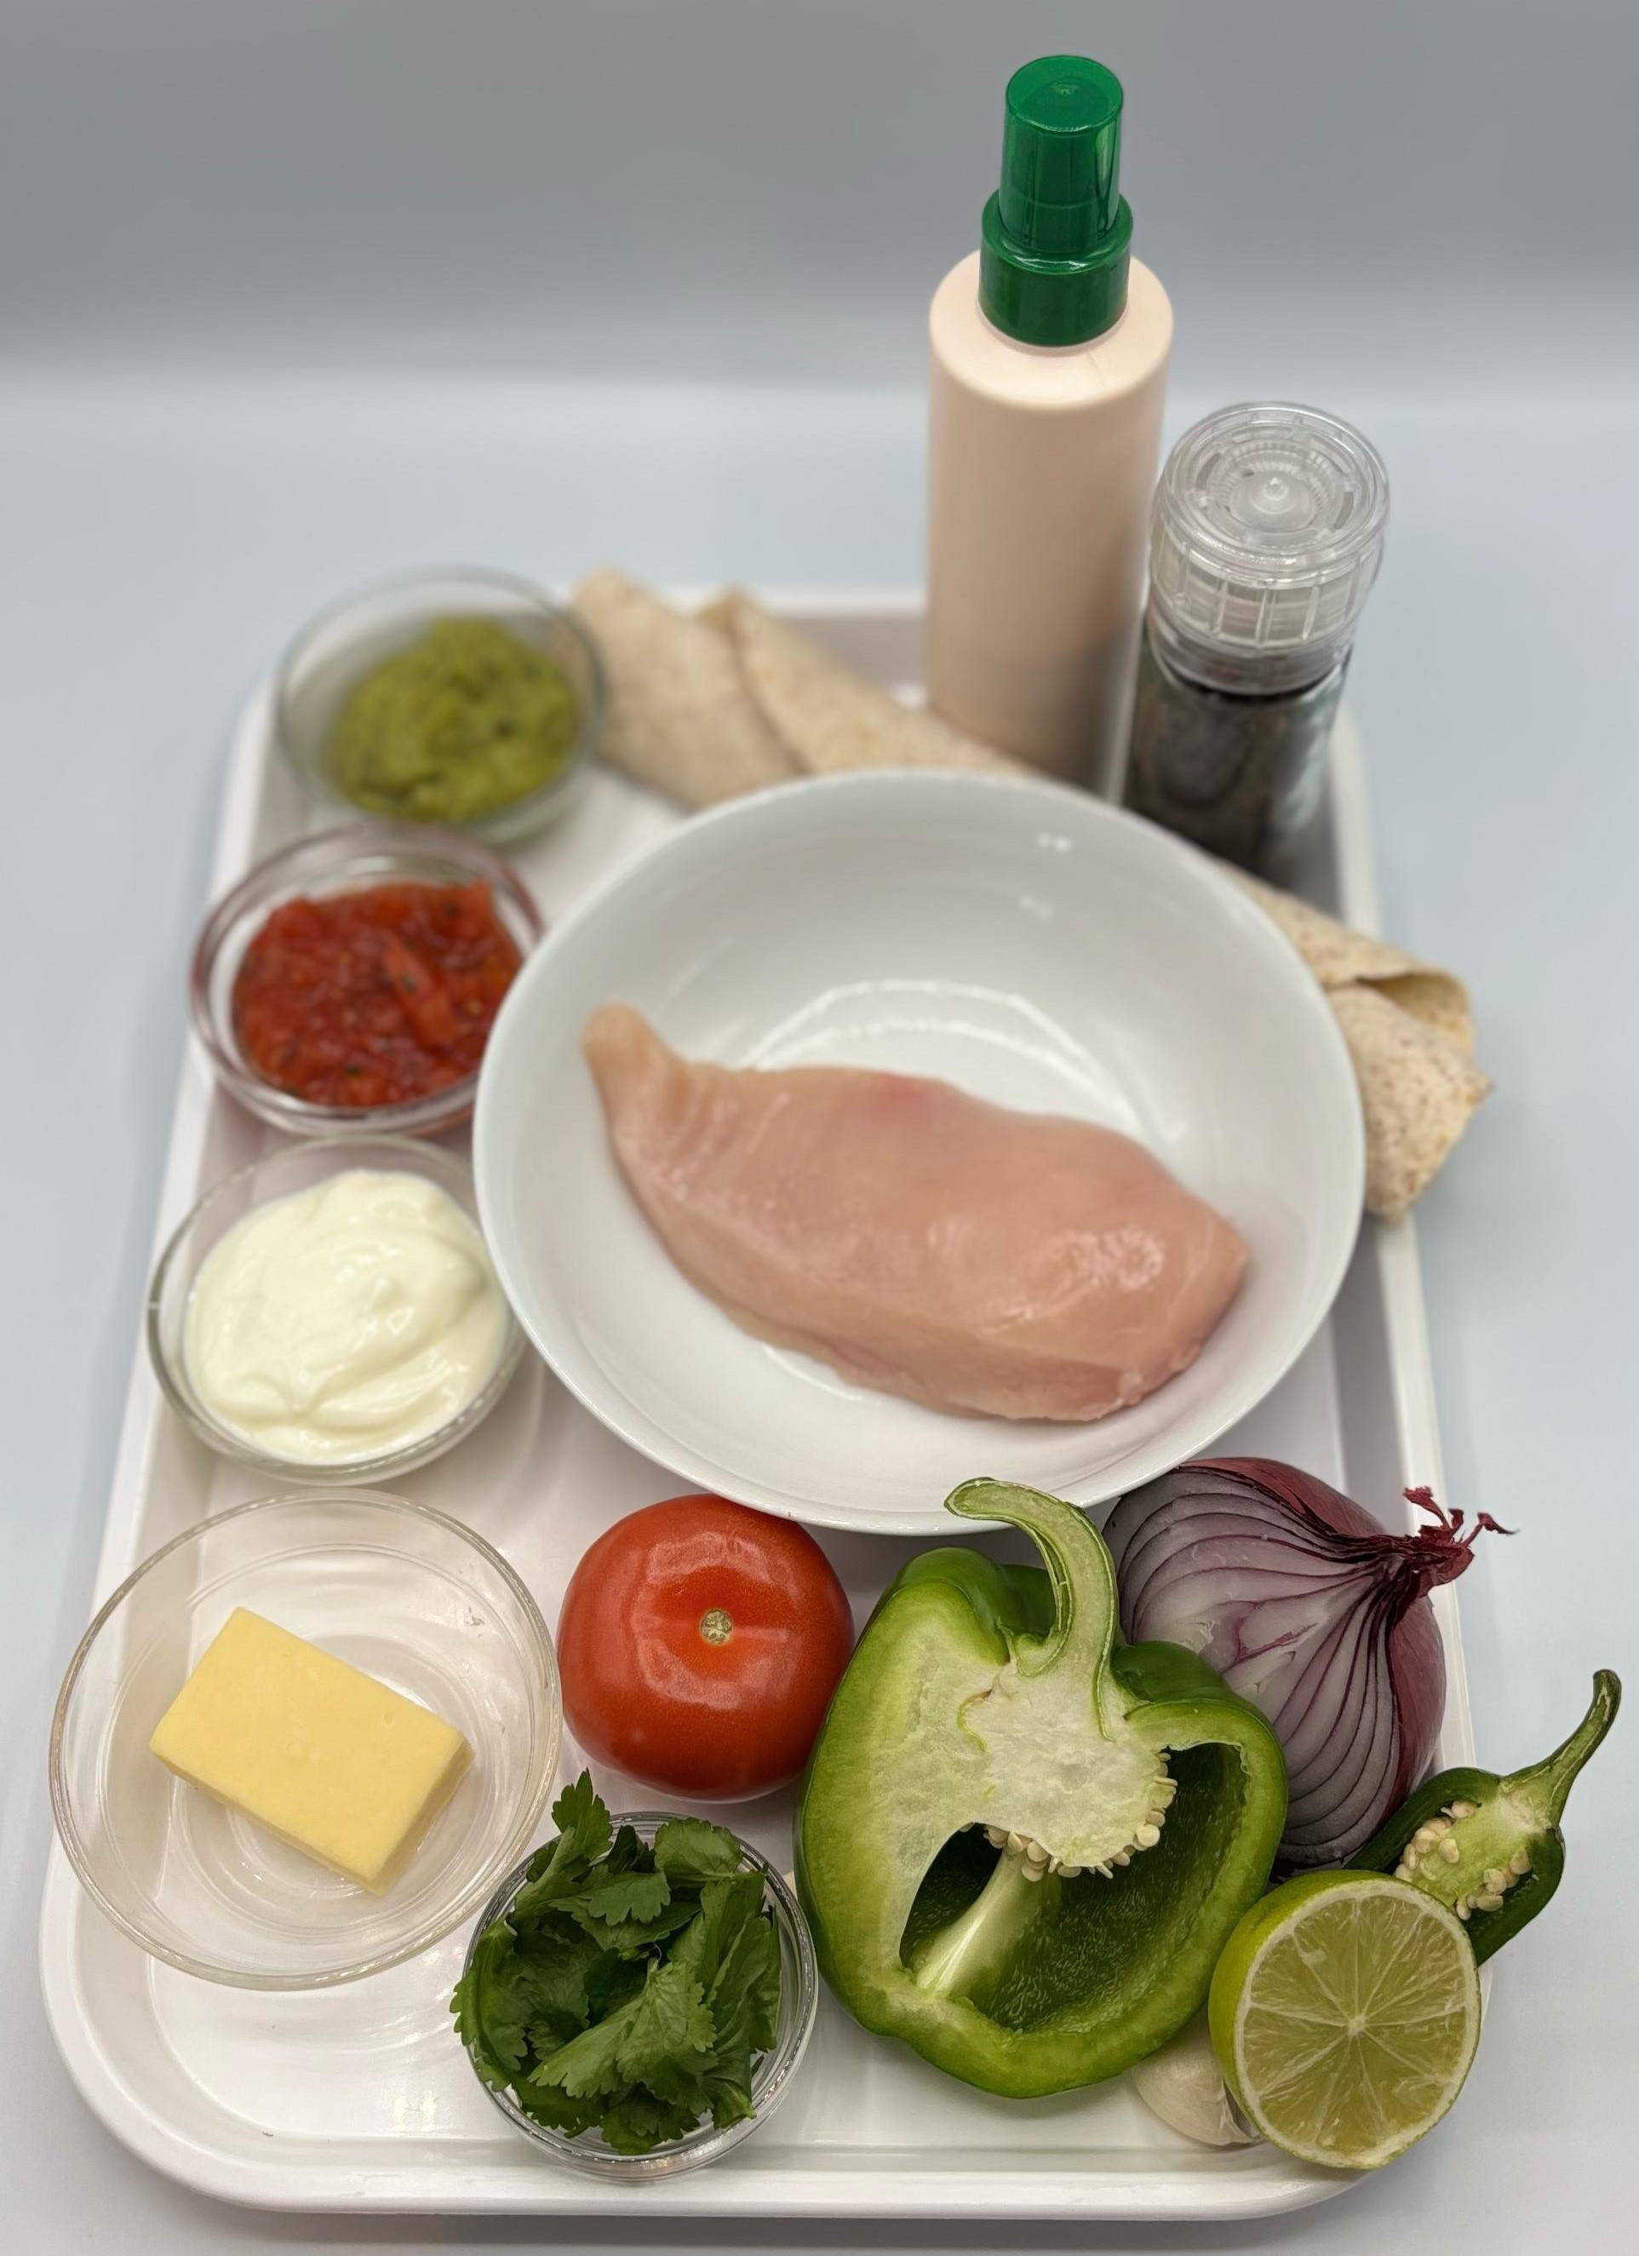

Ingredients (serves 1)
½ lime
½ chilli
1 clove garlic
1 x 15ml spoon coriander
1 x 15ml spoon oil or spray oil
1 x 5ml spoon smoked paprika
1 small chicken breast (or 3-4 thighs)
½ onion
½ pepper
1 tomato
25g reduced-fat cheddar cheese
1 wholemeal tortilla wrap
Check for any food allergy, intolerance, special dietary requirement or religious/cultural reasons for not handling or eating the ingredients in this recipe.

Slide 6
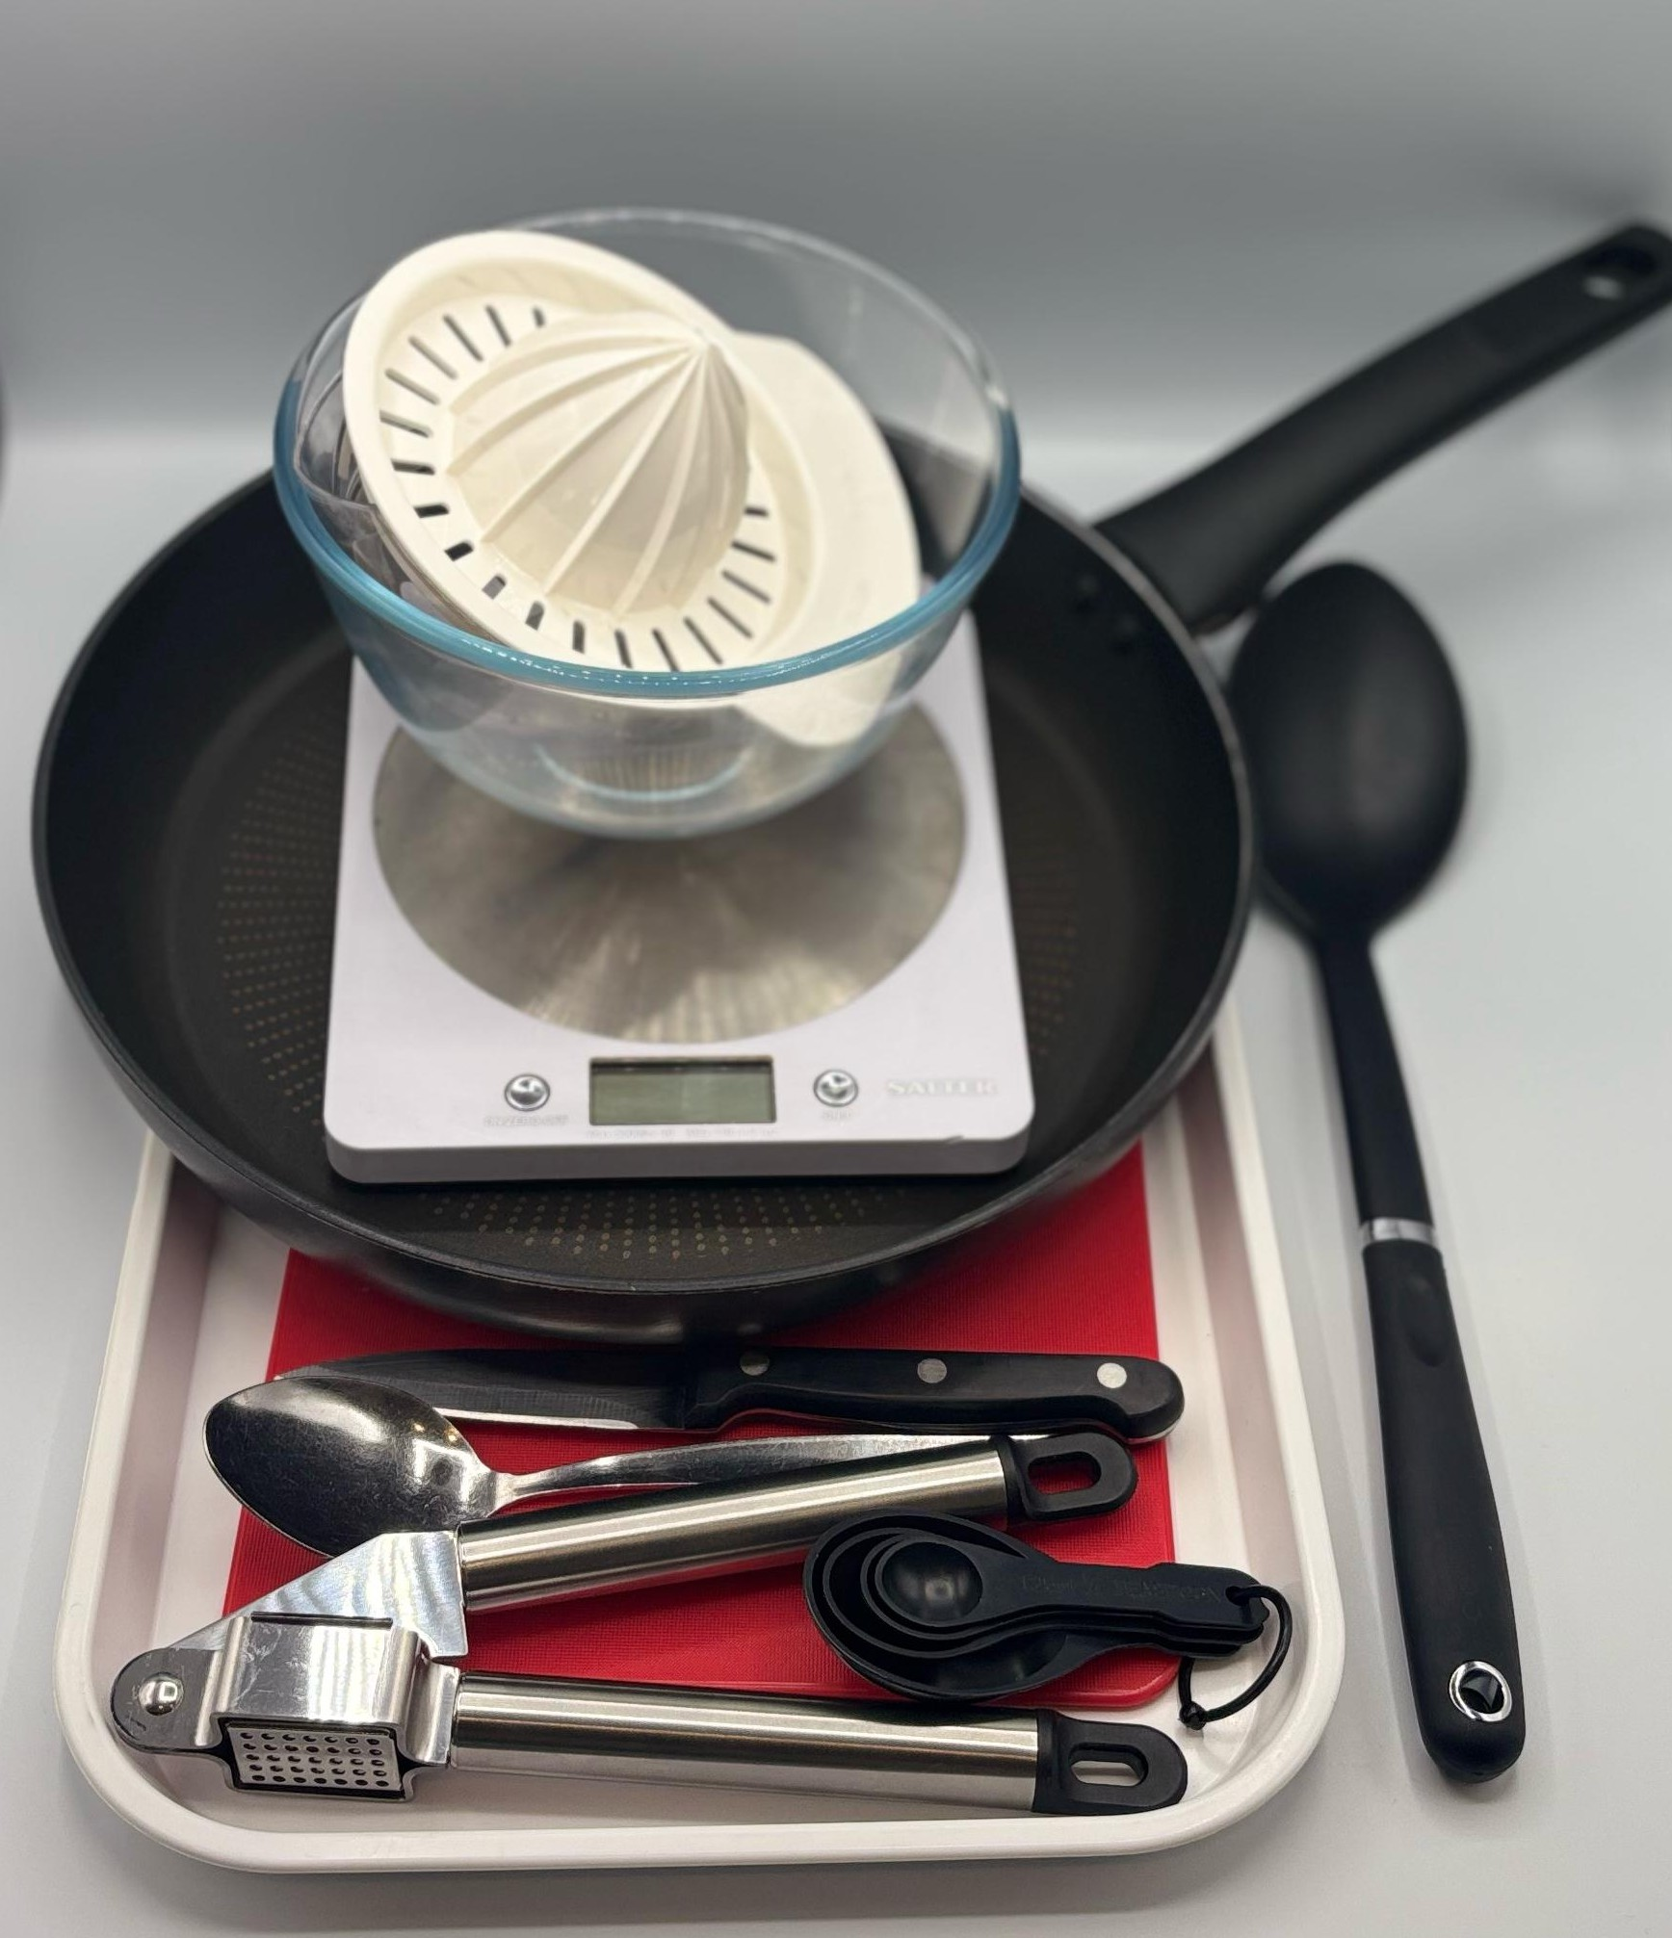
Equipment
Weighing scales
Chopping boards
Sharp knives
Juicer
Garlic press
Mixing bowl
Grater
Wok or frying pan
Heat resistant spoon
Measuring spoons
2 metal spoons

Slide 7
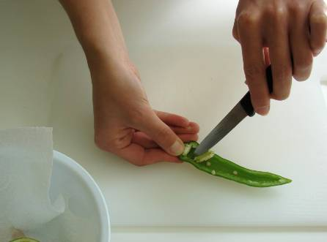
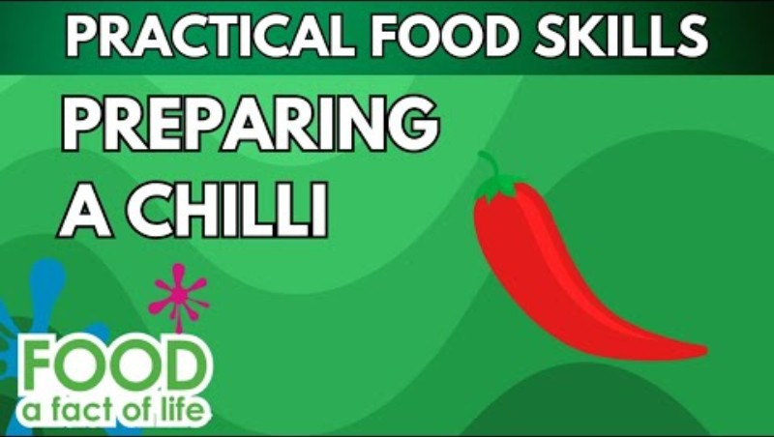
Food skills
Stir and combine
Grate
Portion/divide
Stir-fry
Weigh
Measure
Juice
Cut
Chop
Slice
Dice and trim
Crush
Mix
Click below to see how to de-seed a chilli

Slide 8
Method
Prepare the marinade ingredients and place in a bowl:
  juice the lime;
  peel and crush the garlic;
  de-seed and slice the chilli;
  chop the coriander.
2. Add the paprika and oil. Stir everything together.
3. On a red chopping board, remove any gristle from the chicken and cut into strips. Thoroughly wash and dry hands after touching the raw meat. Mix with the marinade, cover and place in the fridge until needed.

Slide 9
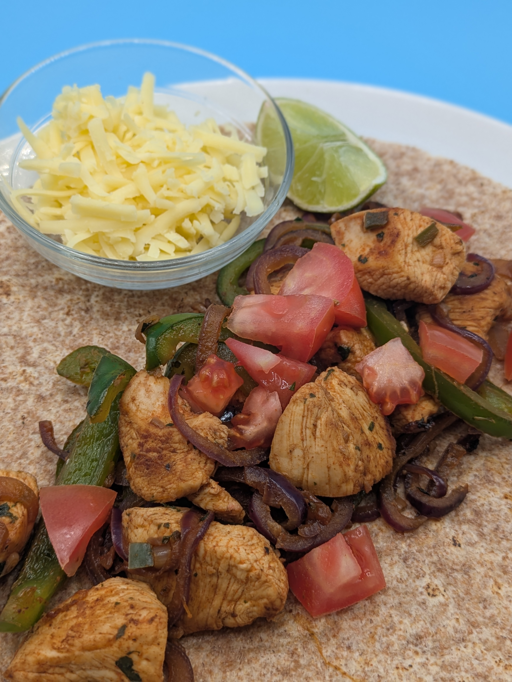
Method
4. Prepare the remaining ingredients with a clean knife on a clean chopping board:
  peel and slice the onion;
  de-seed and slice pepper;
  chop the tomato;
  grate the cheese.
Add the marinated chicken to a hot wok or frying pan and stir-fry for about 4 minutes. Check that the chicken is cooked throughout, and no pink remains.
Add the onion and pepper and continue to cook for a further 2 minutes until softened.
Spread a little of the fajita mix in the centre of the tortilla, add some tomato, cheese and any optional ingredients such as guacamole, salsa or natural yogurt and then roll up.

Slide 10
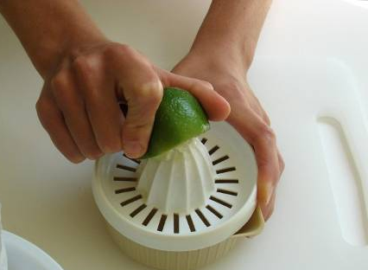
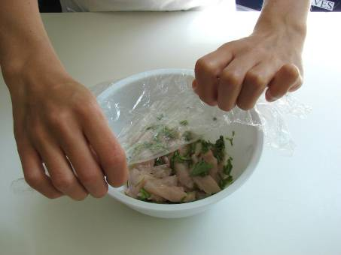
Food science
Marinade
Fajitas use a marinade of lime, oil, garlic, chilli, paprika and coriander.
The lime in the marinade denatures (breaks down) the protein in the chicken to make it more tender.
The rest of the ingredients are used for flavour and colour.

Slide 11
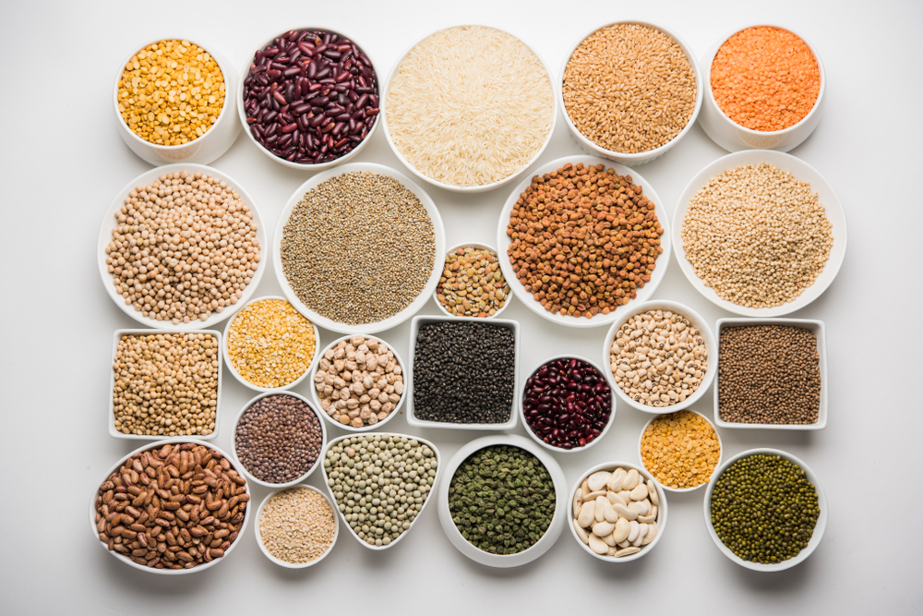
Top tips
Vary your protein: Try thin slices of beef, pork, lamb, fish or minced meat.
Serving suggestion: Add optional toppings of guacamole, salsa and natural yoghurt.
For a vegetarian alternative: Omit the meat and add extra vegetables, beans, pulses or halloumi.
Warm the tortillas in the oven or in the frying pan for 20 seconds to make them easier to fold.

Slide 12
Plenary: quick fire questions
Explain why it is important to thoroughly wash and dry hands before and after touching raw meat.
State one good food hygiene or safety practice you followed when making your fajitas.
State the minimum temperature a digital probe should reach when checking if hot food is cooked.
Describe the process of using a digital probe to check the temperature of food. Explain each action.
Explain how you could check if meat is cooked if you don’t have a digital probe.
Suggest two ways you could develop this dish for a vegetarian.

Slide 13
Example responses
Explain why it is important to thoroughly wash and dry hands before and after touching raw meat. To prevent cross-contamination
State one good food hygiene or safety practice you followed when making your fajitas. Using a red chopping board to prepare raw meat.
State the minimum temperature a digital probe should reach when checking if hot food is cooked. 75 °C
Describe the process of using a digital probe to check the temperature of food. Explain each action. Place the clean probe into the centre of the chicken as this is the thickest part of the chicken, allow it to measure the temperature. Clean the probe after use, to prevent any cross-contamination.
Explain how you could check if meat is cooked if you don’t have a digital probe. Check that the chicken is cooked throughout, and no pink remains.
Suggest two ways you could develop this dish for a vegetarian. Replace chicken with beans, halloumi or paneer.

Slide 14
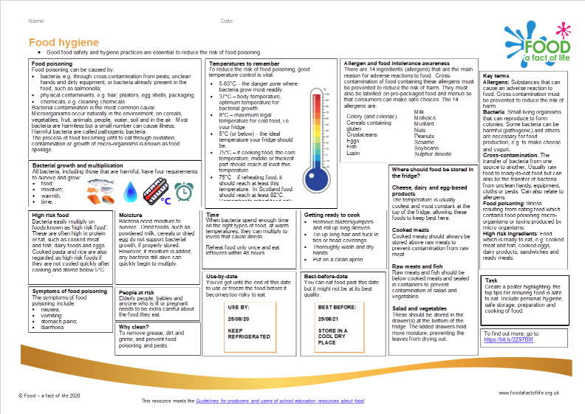
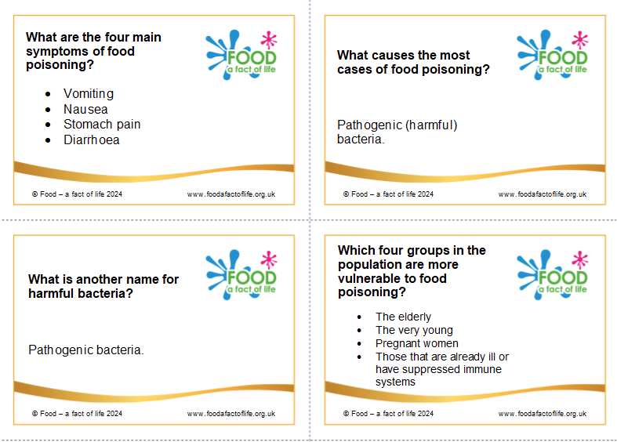
Looking for more…
Reinforce the importance of good food hygiene when cooking with raw meat with your pupils.
Use our knowledge organiser to teach your pupils and cut out our questions to create revision flashcards or a quiz!
For more support, use this fajitas lesson plan from the Food – a fact of life Schemes of Work.

Slide 15
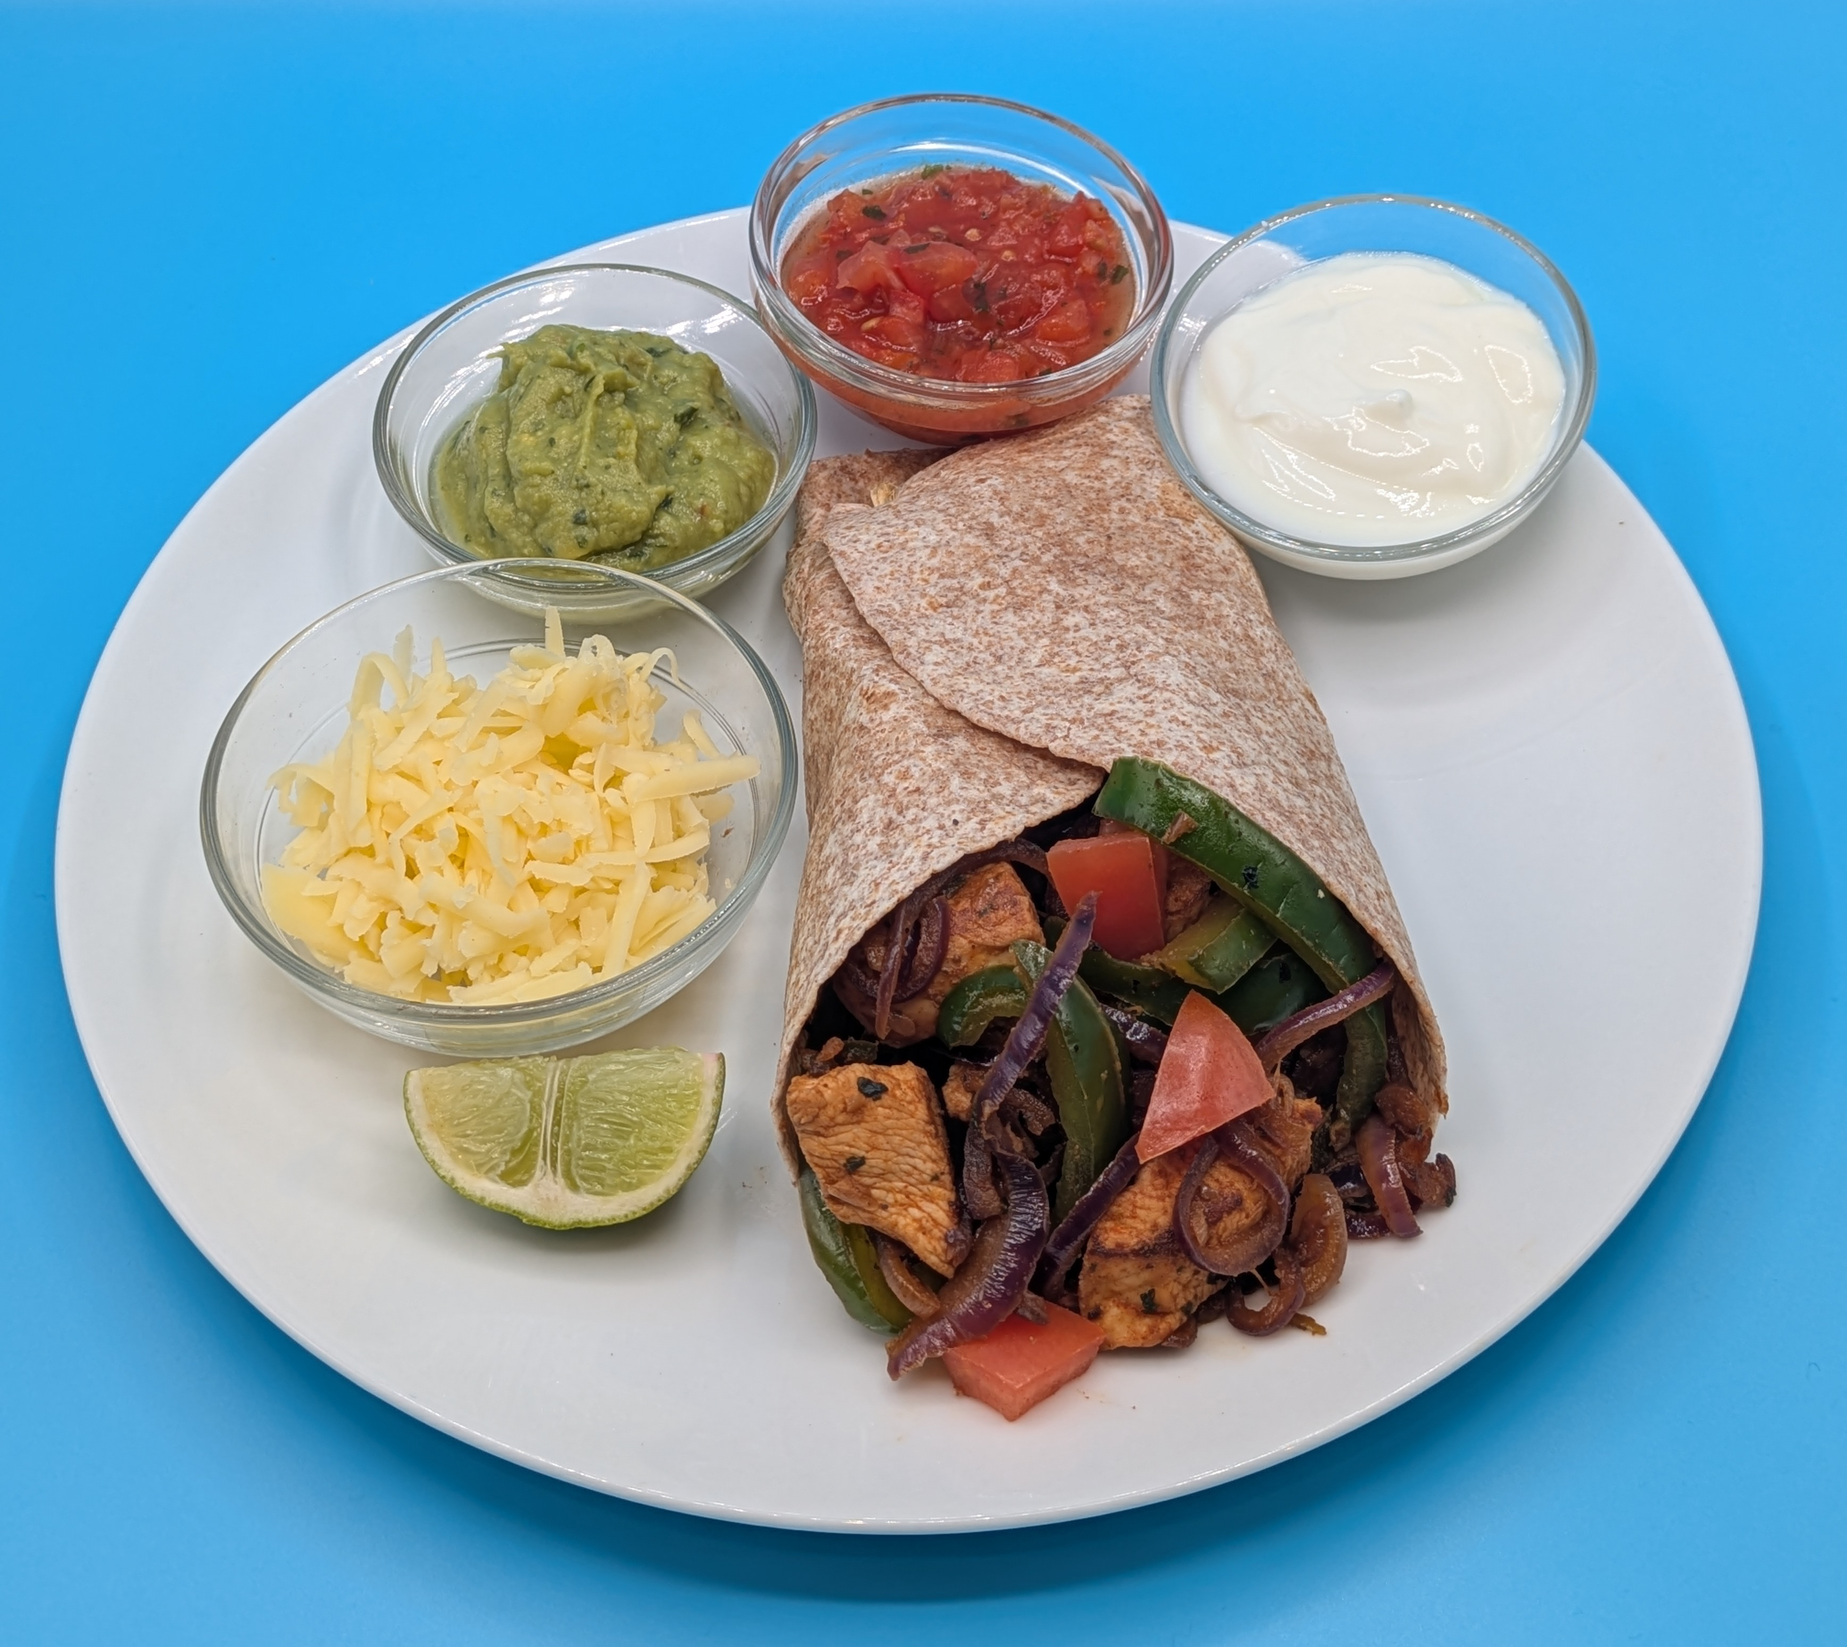
Chicken fajitas
For further information, go to:
www.foodafactoflife.org.uk
This resource meets the Guidelines for producers and users of school education resources about food.

