Slide 1
Healthier cooking

Slide 2
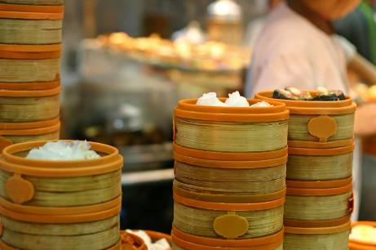
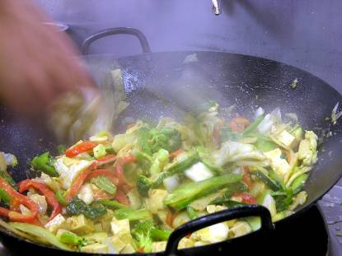
Healthier cooking
Food can be prepared and cooked in several ways to promote health.

Slide 3
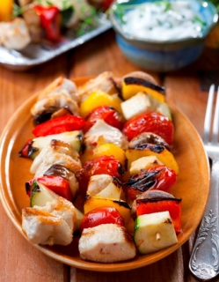
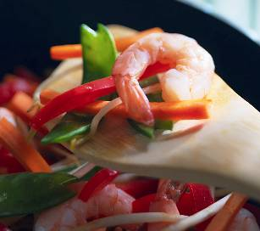
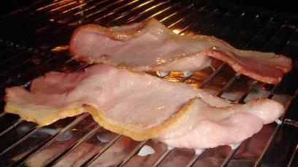
Cooking method
Grill – grill bacon or chicken
Poach – poach eggs
Stir-fry – stir-fry vegetables and noodles

Slide 4
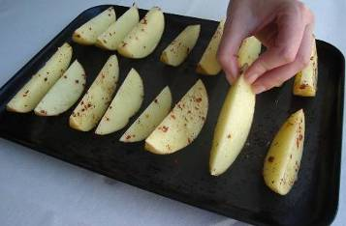
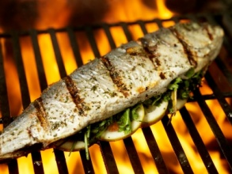
Cooking method
Bake – bake potato wedges
Boil – boil rice
Steam – steam vegetables
Barbecue – barbecue fish

Slide 5
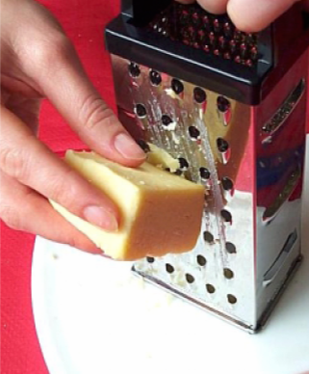
Preparing food
Cut bread into thick slices.
Choose lower fat dairy foods.
Grate cheese – you use less.

Slide 6
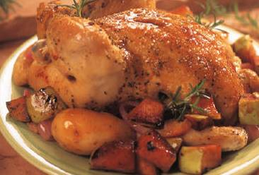
Preparing food
Choose lean meat (or remove visible fat or skin from chicken).
Use tuna in water, rather than oil/brine.

Slide 7
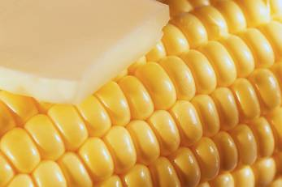
Serving food
Do not glaze vegetables with butter.
Use fruit juice instead on a syrup on fruit salad.
If you have a sticky filling in a sandwich, do not butter the bread.

Slide 8
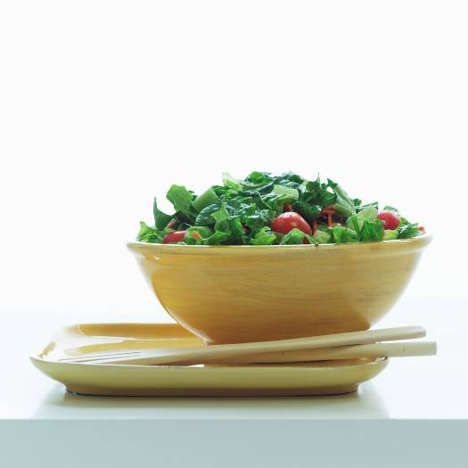
Serving food
Have a salad or portion of vegetables with your main meal.
Bulk up meals with fruit and vegetables and bread, pasta, rice and potatoes.

Slide 9
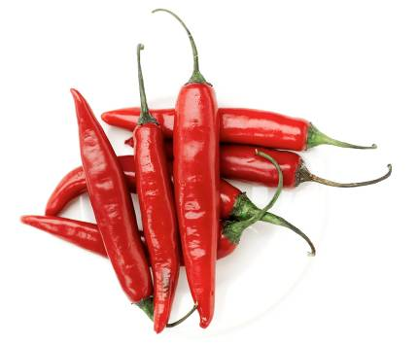
Not adding salt
Use different ingredients for flavour:
chilli / garlic;
lemon / lime;
herbs / spices;
black pepper.

Slide 10
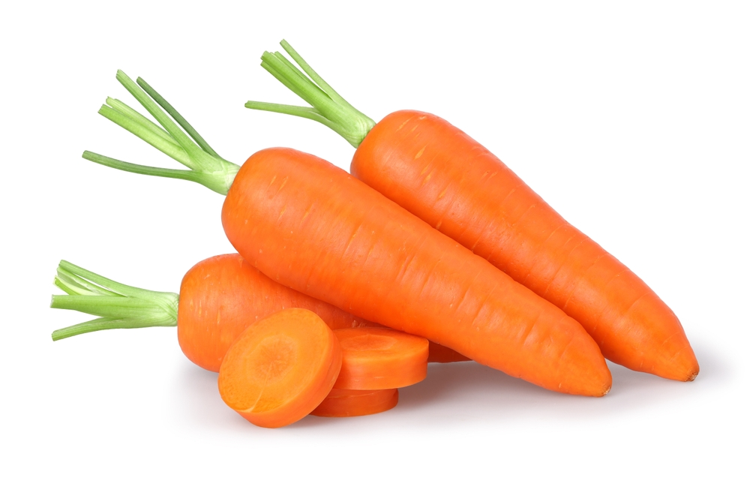
Adding fruit or vegetables
Add extra:
carrots in a soup or stew;
vegetables in a curry or pasta sauce;
beans in a chilli or a salad;
fruit in a dessert, like jelly or crumble.

Slide 11
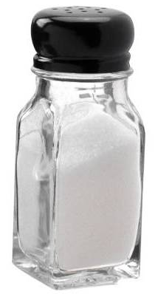
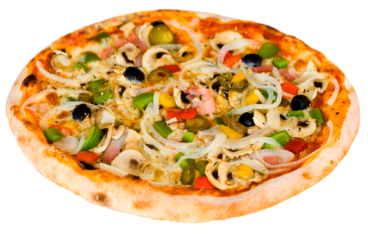
Remove, add or change an ingredient
Remove salt from a recipe.
Add extra vegetables to a pizza.
Change pepperoni for ham.

Slide 12
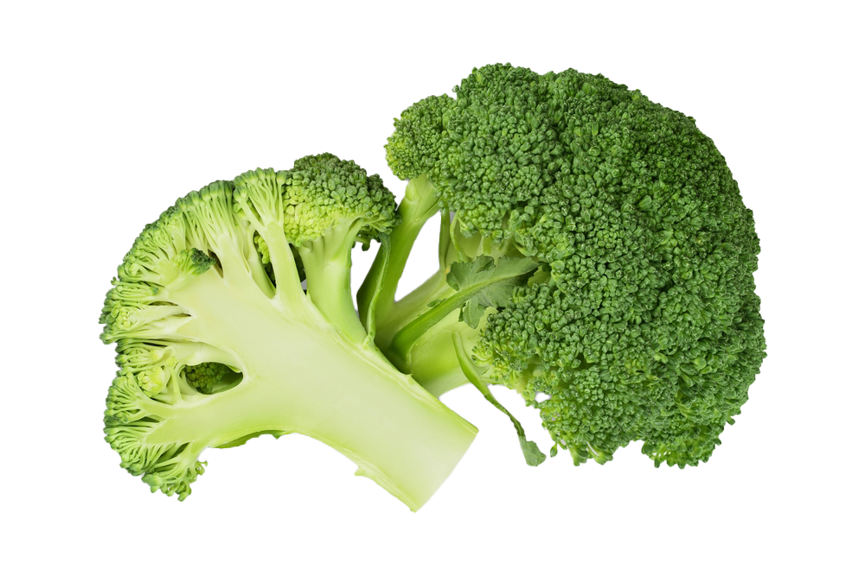
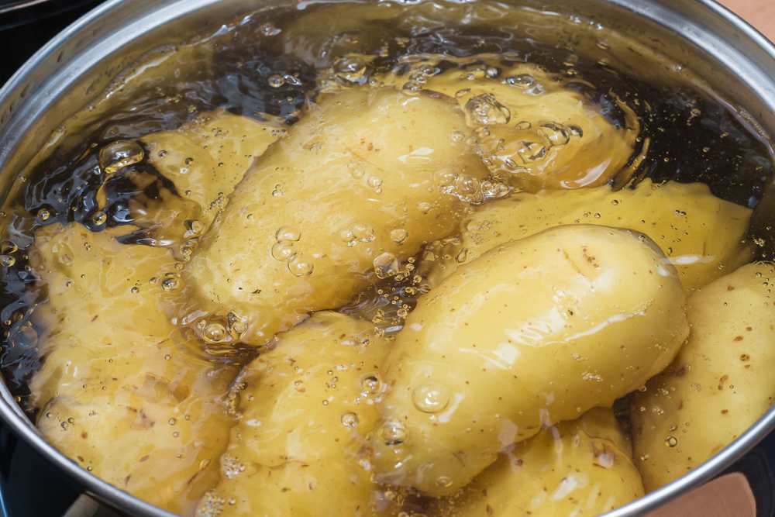
Changing the portion size
Eat more fruit and vegetables.
Have more bread, pasta, rice and potatoes.
Have smaller amounts of rich food.

Slide 13
Healthier cooking
For further information, go to:
www.foodafactoflife.org.uk
This resource meets the Guidelines for producers and users of school education resources about food.

