Slide 1
Scones
Complexity: low - medium

Slide 2
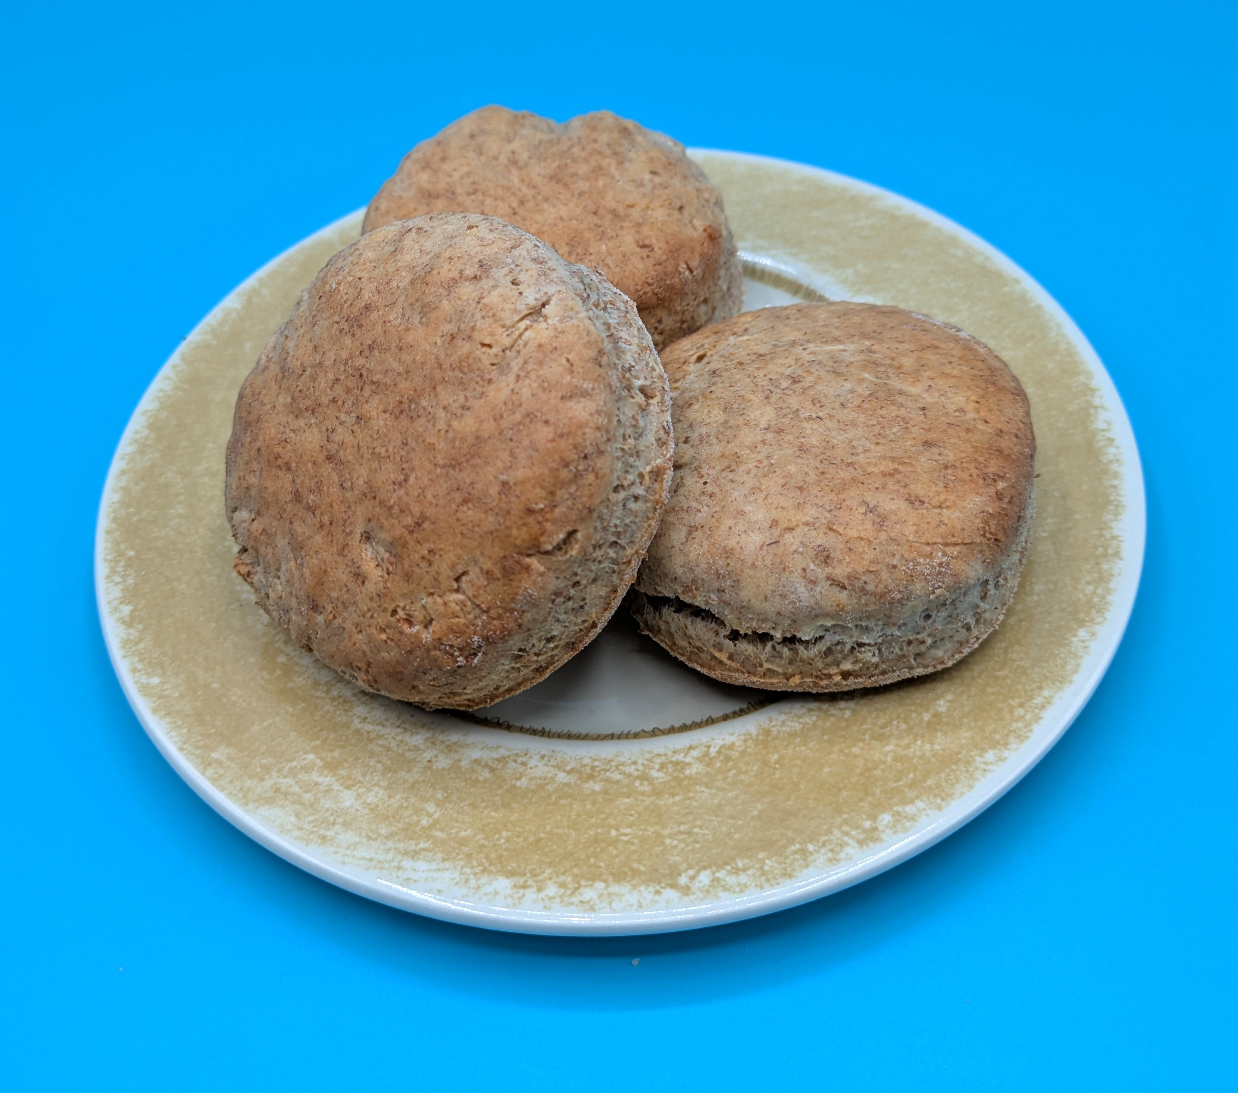
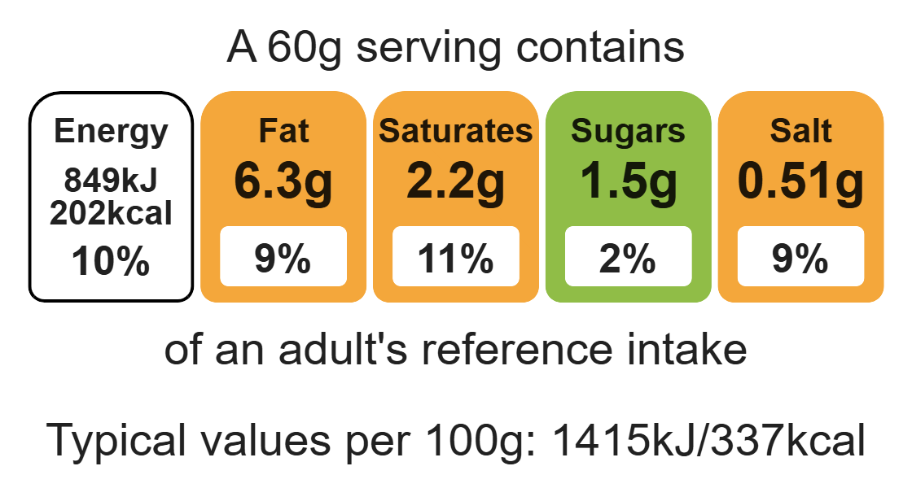
Nutritional analysis

Slide 3
Starter activity
Which food skill or technique?
Which food skill could be used to prepare cheese?
Which technique could be used to dice onions?
Which food skill could be used to create the scone dough?

Slide 4
Example responses
Which food skill or technique?
Which food skill could be used to prepare cheese? Grating, slicing.
Which technique could be used to dice onions? Bridge hold, claw grip.
Which food skill could be used to create the scone dough?
Rubbing-in, kneading, forming.

Slide 5
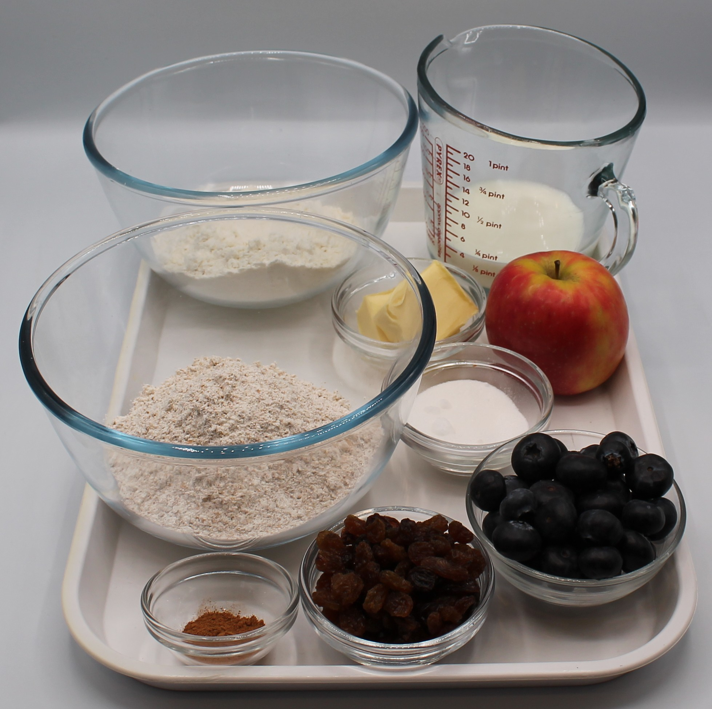

Ingredients (makes 8 sweet scones)
125g self-raising white flour
125g self-raising wholemeal flour
40g baking fat/block
25g caster sugar
150ml semi-skimmed milk
Check for any food allergy, intolerance, special dietary requirement or religious/cultural reasons for not handling or eating the ingredients in this recipe.
Additional flavourings
50g blueberries 50g raisins 1 pear 1 apple | ½ x 5ml spoon cinnamon or ginger.

Slide 6
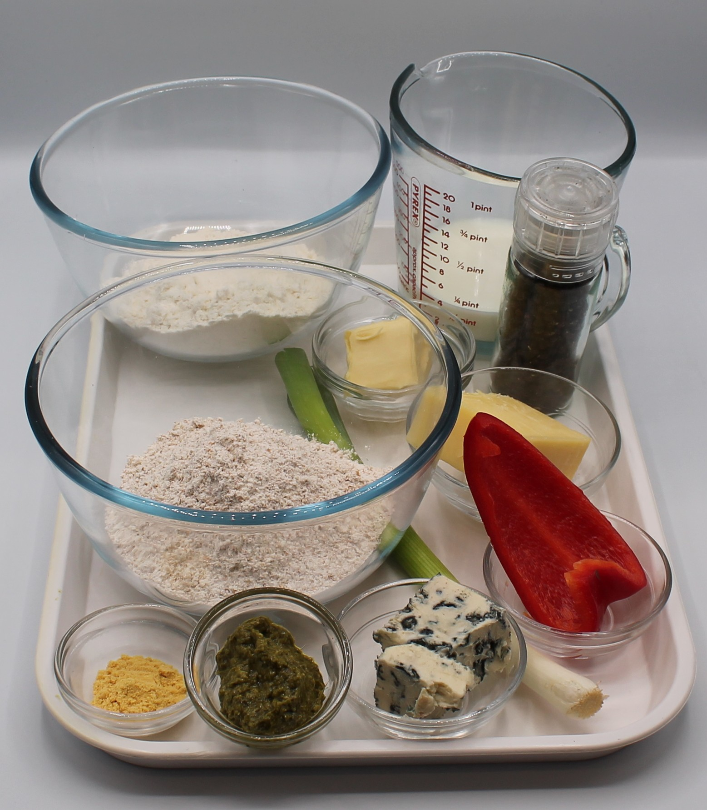
Ingredients (makes 8 savoury)
125g self-raising white flour
125g self-raising wholemeal flour
40g baking fat/block
150ml semi-skimmed milk
Additional flavourings
75g reduced-fat cheese 75g Sundried tomatoes 1x spring onion 1x 5ml spoon pesto 1 x 15ml passata | ½ x 5ml spoon mustard powder, chives, black pepper
Check for any food allergy, intolerance, special dietary requirement or religious/cultural reasons for not handling or eating the ingredients in this recipe.

Slide 7
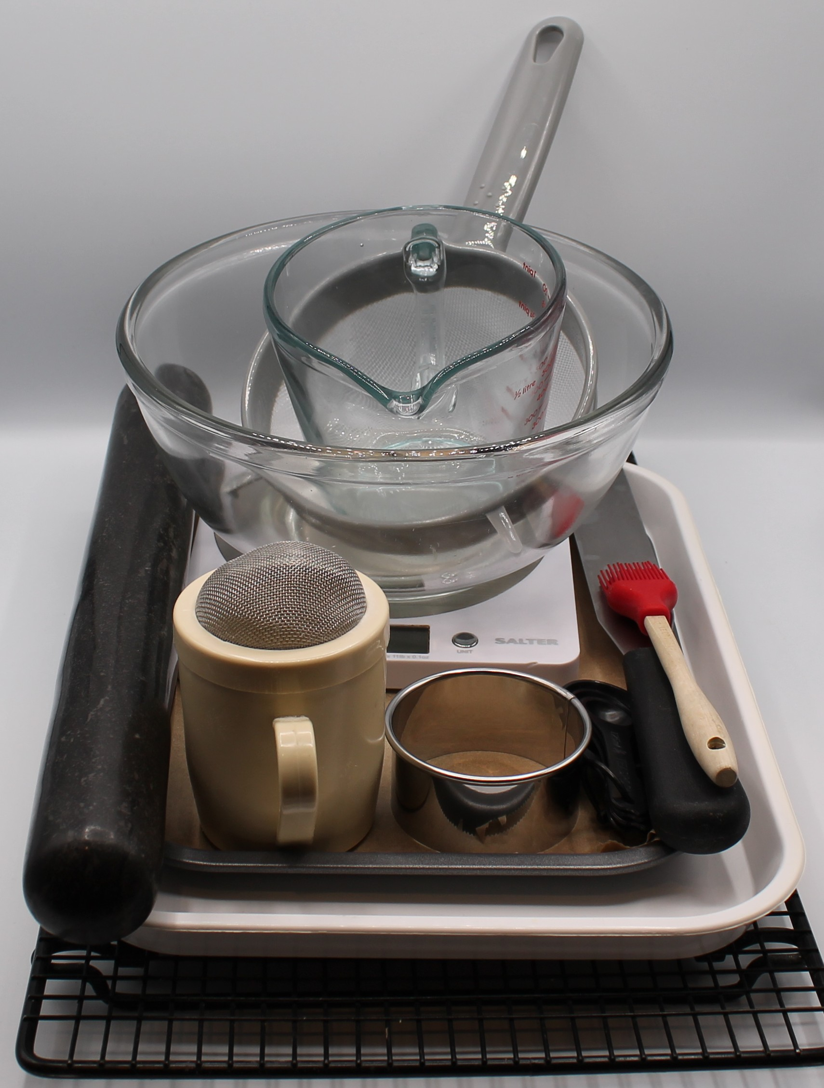
Equipment
Rolling pin
Scone cutter
Pastry brush
Cooling rack
Baking tray
Weighing scales
Sieve
Mixing bowl
Measuring jug
Palette knife
Flour dredger

Slide 8
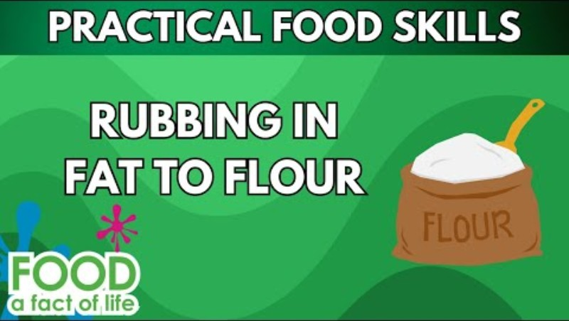
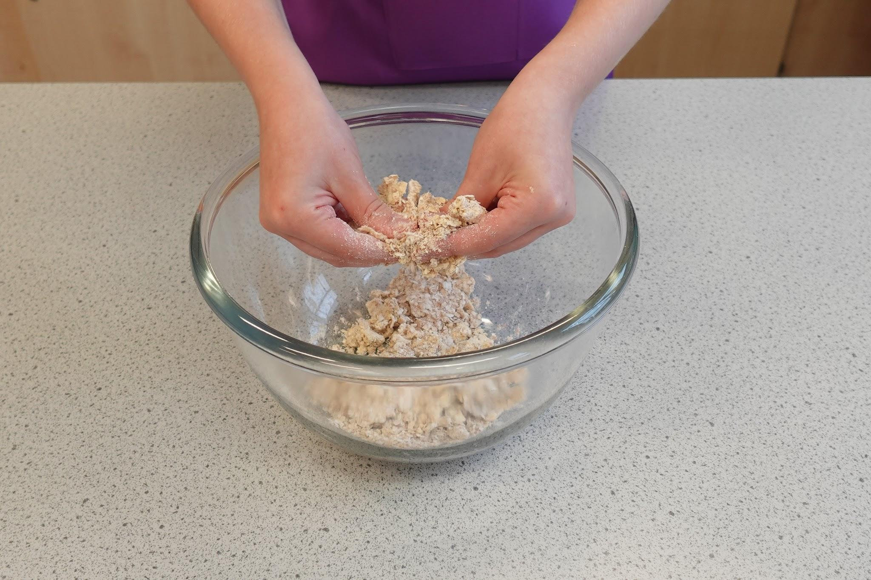
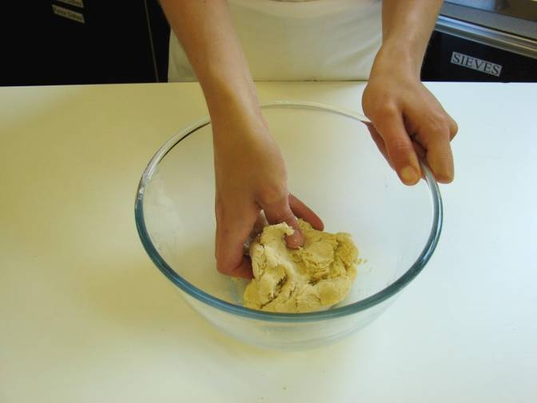
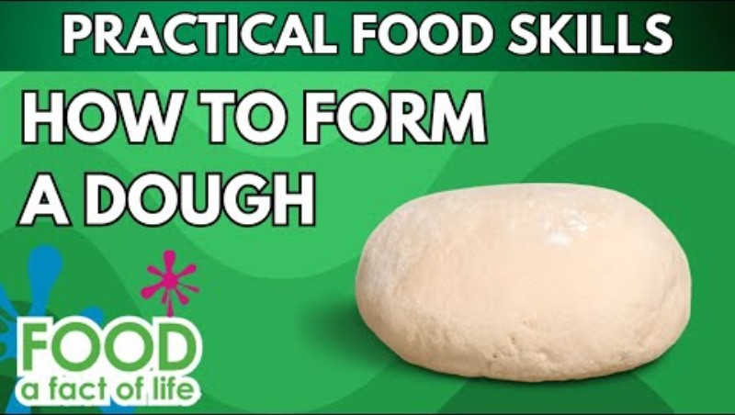
Food skills
Weigh
Measure
Sift
Rub-in
Mix
Stir
Combine
Knead
Roll out
Cut out
Glaze and coat
Bake
Click below to watch how to rub-in
Click below to watch how to form a dough

Slide 9
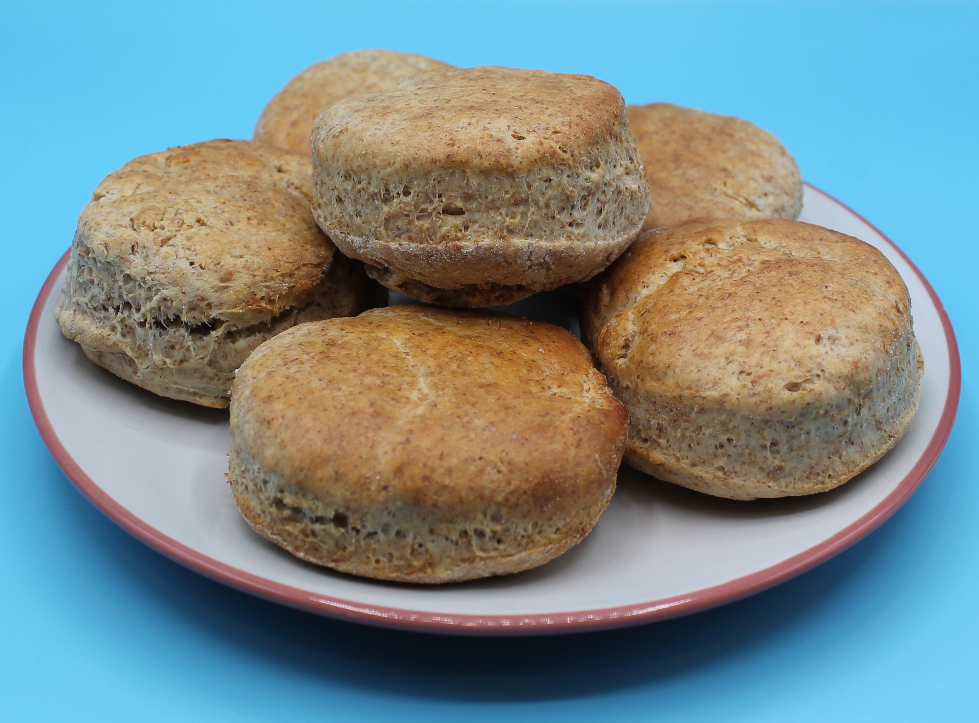
Method
Preheat the oven to 220ºC or gas mark 7.
Line the baking tray.
Sift the flour into the mixing bowl.
Rub-in the fat into the flour using your fingertips, until it resembles breadcrumbs. Add any additional flavourings.
Make a well in the middle of the flour and carefully pour in the milk gradually. Save just a little of the milk.
Mix with the palette knife to form a ball of soft dough. If the mixture is too dry add a little extra milk.
Place the dough on a lightly floured work surface and knead lightly.
Flour the rolling pin. Roll out the dough to about 1.5cm deep.
Cut-out the scones using a cutter.
Place the scones onto the baking tray and glaze each scone with a little milk.
Bake for 12-15 minutes, until golden brown.
Allow to cool on a cooling rack.

Slide 10
Top tips
Focus on fibre: to increase the fibre content of your scones try it with 250g self-raising wholemeal flour. Don’t forget you may need some extra liquid.
When rubbing the spread into the flour, lift your hands to help get air into the mixture and shake the bowl to encourage large lumps to the surface.
Remember to add any additional ingredients or flavourings before you add the milk!

Slide 11
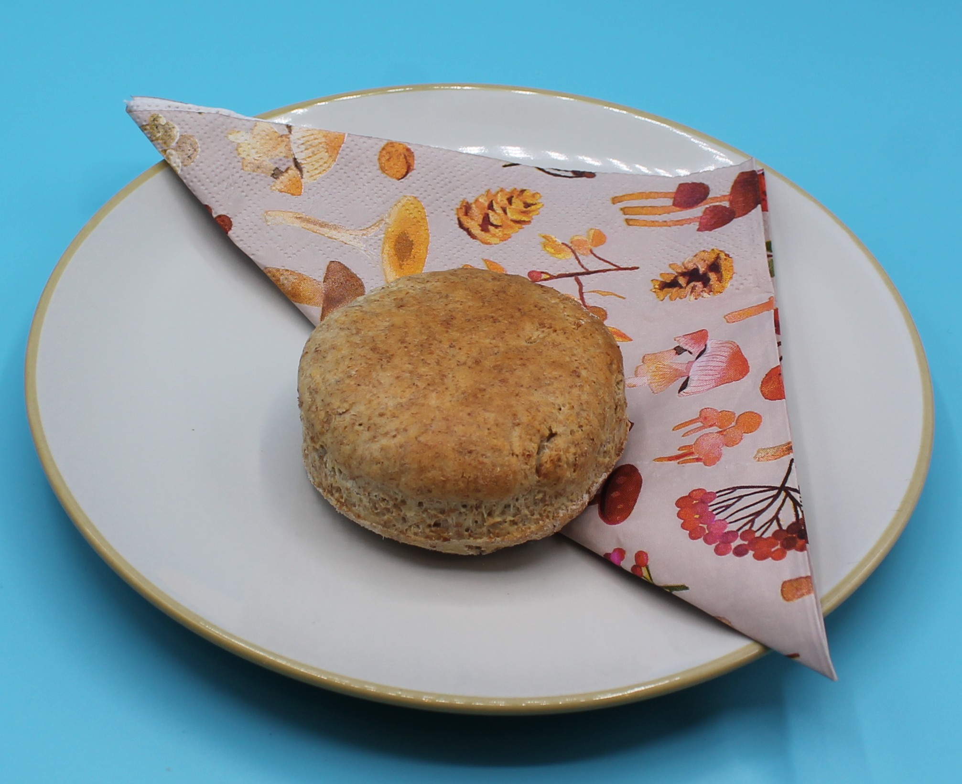
Food science
​Shortening
Scones use fat to give them their characteristic crumbly texture. When rubbing-in, the fat coats the flour particles and prevents them from absorbing water. This reduces the gluten development, which would cause the dough to become elastic.
Dextrinisation
The starch in the flour turns to dextrin, causing it to go golden brown under the application of dry heat.

Slide 12
Plenary
Rate at least four food skills for proficiency, noting improvements for the future.
Food skills and techniques | Proficiency
 | Beginner | Intermediate | Advanced | Expert
Rubbing-in
Forming dough
Rolling-out
Cutting-out
Beginner - starting to learn the skill Intermediate - can perform tasks with some guidance Advanced - strong grasp of the skill and works independently Expert - demonstrates full mastery and can guide others
Provide a comment on each of your ratings.

Slide 13

Example responses
Food skills and techniques | Proficiency
 | beginner | intermediate | advanced | expert
Rubbing-in
Forming dough
I used my rubbing-in skills practised when making apple crumble to help with my accuracy. I added too much liquid to my dough and it was sticky. I added more flour with a spoon.

Slide 14
Example responses
Food skills and techniques | Proficiency
 | beginner | intermediate | advanced | expert
Rolling-out
Cutting-out
My rolling out was OK, it was a little uneven in parts. I cut out my scones perfectly using the scone cutter, I made sure that I had very little waste by cutting them out very close to each other.

Slide 15
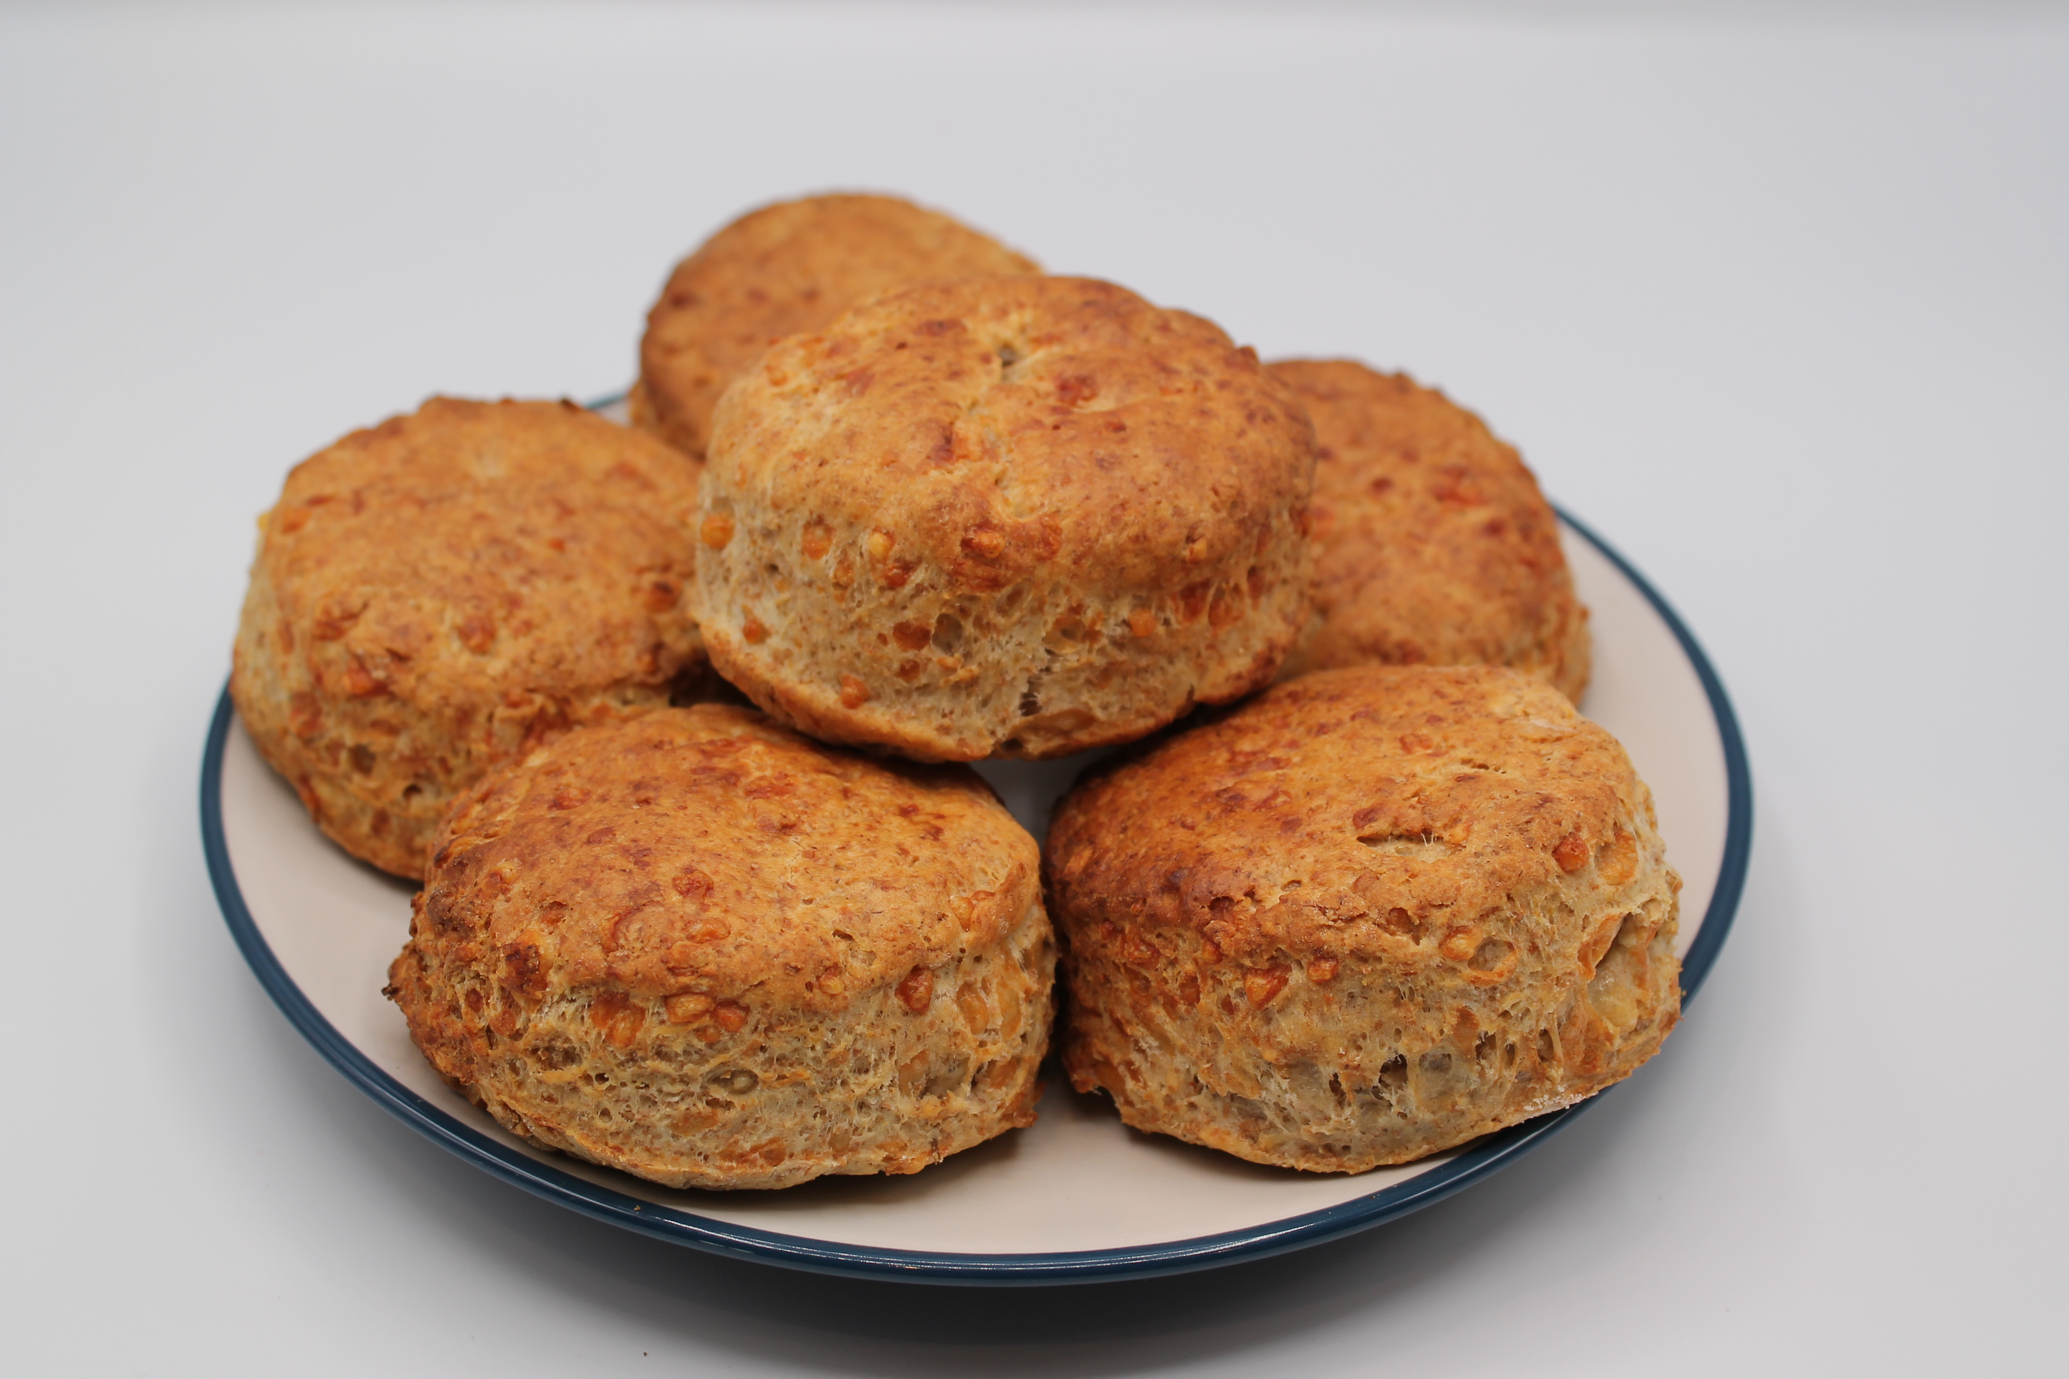
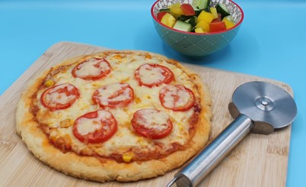
Looking for more…
Why not task your students to experiment with flavour combinations when choosing the ingredients for their scones?
Use our scones challenge worksheet to chose their ingredients and make edits to their equipment and method as a result.
If you would like to challenge your pupils to make a more complex recipe using the rubbing-in method, why not use this recipe to make scone-based pizza?

Slide 16
Scones
For further information, go to:
www.foodafactoflife.org.uk
This resource meets the Guidelines for producers and users of school education resources about food.

