Slide 1
Grab and go

Slide 2
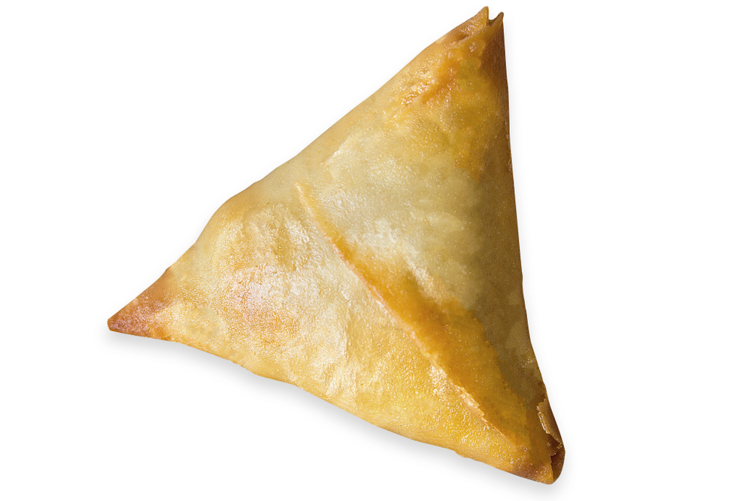
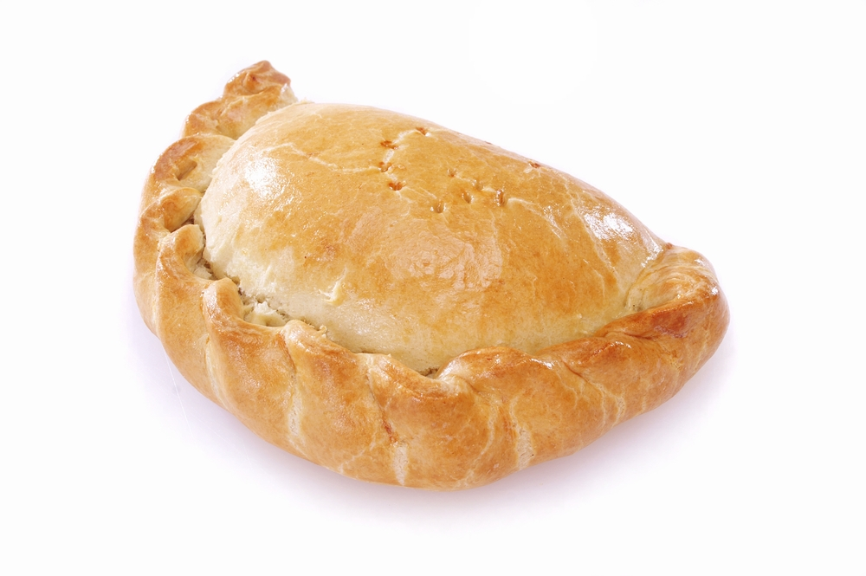
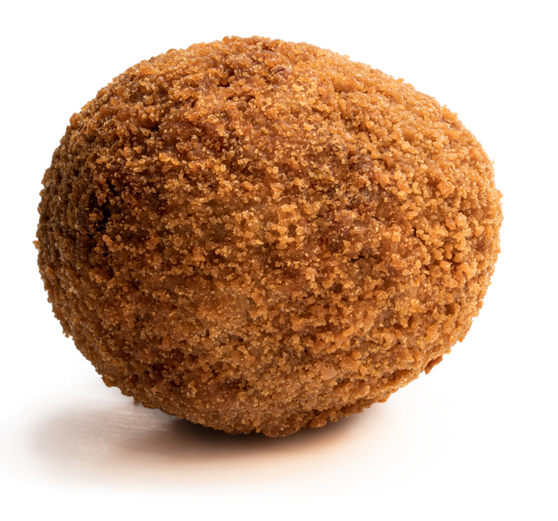

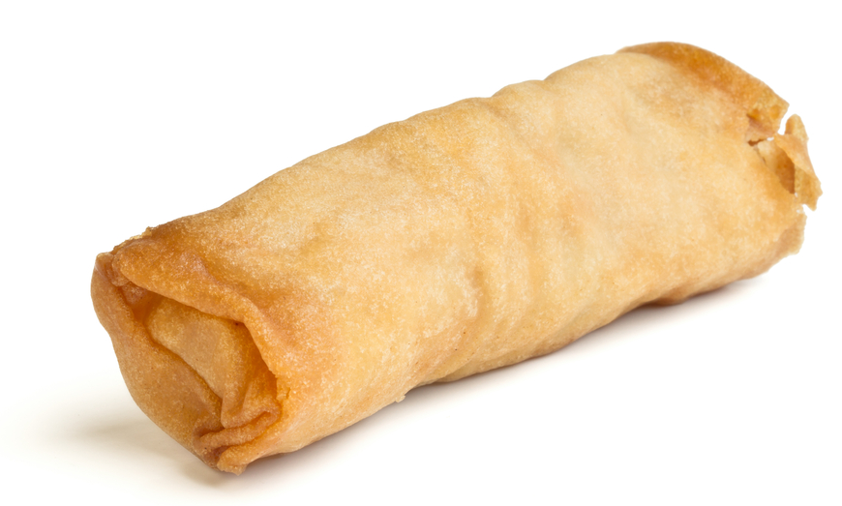
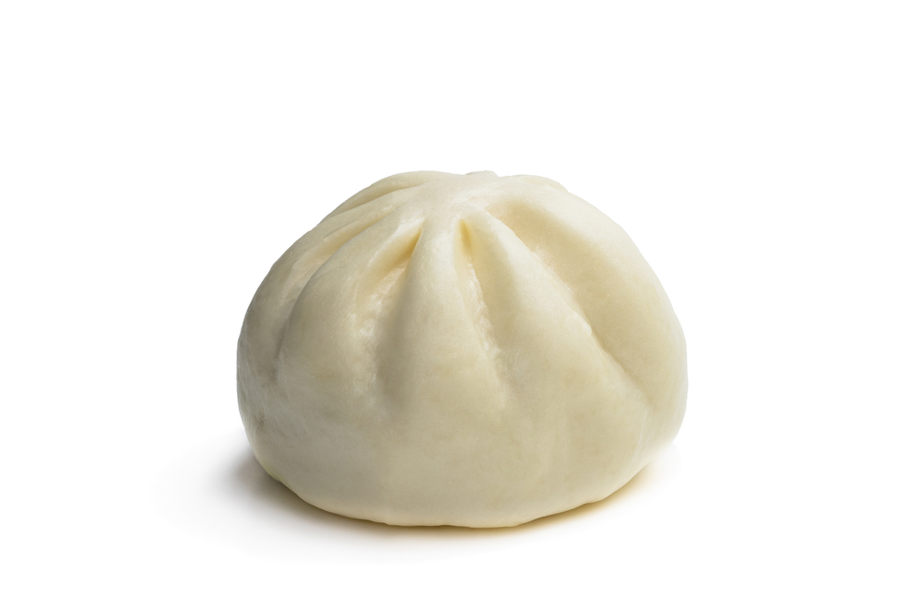
Name each on the go product!
Vegetable samosa
Cornish pasty
Scotch egg
Spring roll
Jamaican beef patty
Duck bao bun

Slide 3
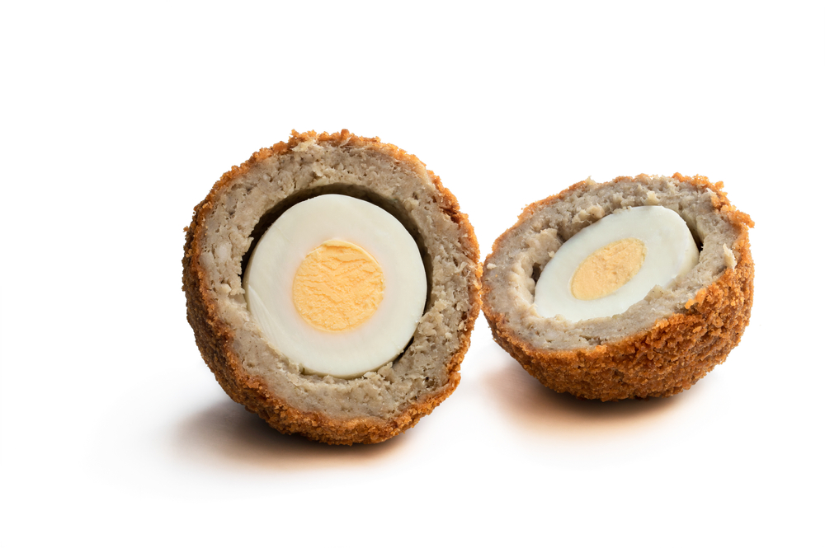
Scotch egg
What ingredients do you think have been used to make this scotch egg?
Sausage meat
Egg
Breadcrumbs

Slide 4
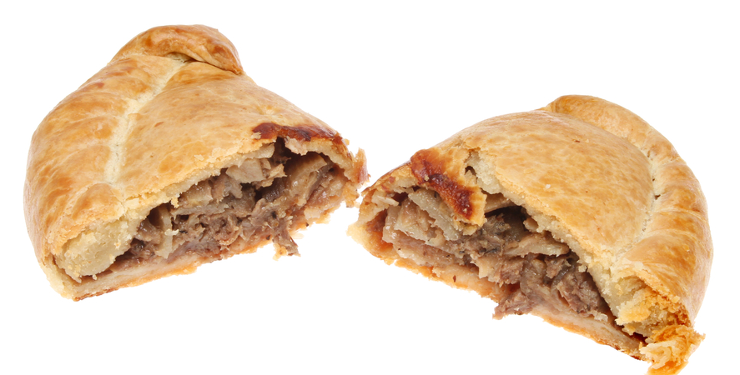
Cornish pasty
What ingredients do you think have been used to make this Cornish pasty?
Pastry
Beef
Potato
Onion
Swede

Slide 5
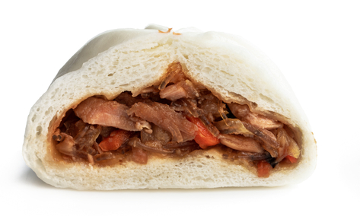
Duck bao bun
What ingredients do you think have been used to make this duck bao bun?
Dough
Duck
Cabbage
Carrot
Spring onion

Slide 6
What do you notice about all these on the go products?
What other products can you think of that are like these?

Slide 7
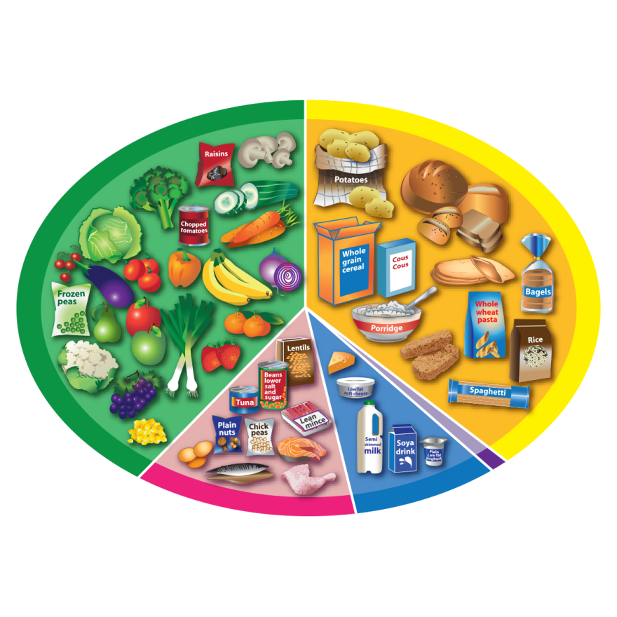
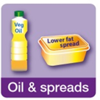

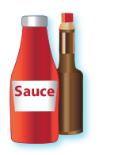





Eatwell Guide
Fruit and vegetables
Potatoes, bread, rice, pasta and other starchy carbohydrates
Can you remember the names of the Eatwell Guide food groups?
Why are these types of foods not in the Eatwell Guide?
Beans, pulses, fish, eggs, meat and other proteins
Dairy and alternatives
Oils and spreads
Foods high in fat, salt and sugar

Slide 8
Eatwell Guide
Where do these ingredients belong?
Breadcrumbs
Breadcrumbs
Cabbage
Duck
Pastry
Carrot
Spring onion
Egg
Dough
Carrot
Dough
Cabbage
Spring onion
Pastry
Egg
Duck

Slide 9
Eatwell Guide
Eat at least five portions every day.
Fruit and vegetables
Eat a food from this group at every meal time.
Try wholegrain varieties.
Can you remember the Eatwell Guide health messages?
Potatoes, bread, rice, pasta and other starchy carbohydrates
Eat in small amounts.
Oils and spreads
Foods high in fat, salt and sugar
We do not need these types of foods to be healthy. If we have them, it should be less often and in small amounts.
Eat some foods from this group every day.
Dairy and alternatives
Beans, pulses, fish, eggs, meat and other proteins
Have some of these foods every day.

Slide 10
Nutrients

Slide 11
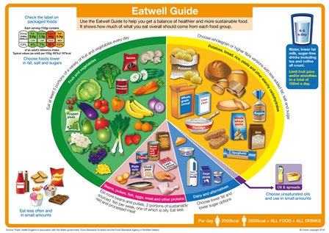
Nutrients
We need different nutrients to keep us healthy. Different types of food provides nutrients in different amounts.
To help us get all the nutrients we need, we should eat a variety of food from the Eatwell Guide food groups.
Let’s take a closer look at the nutrients we need.

Slide 12
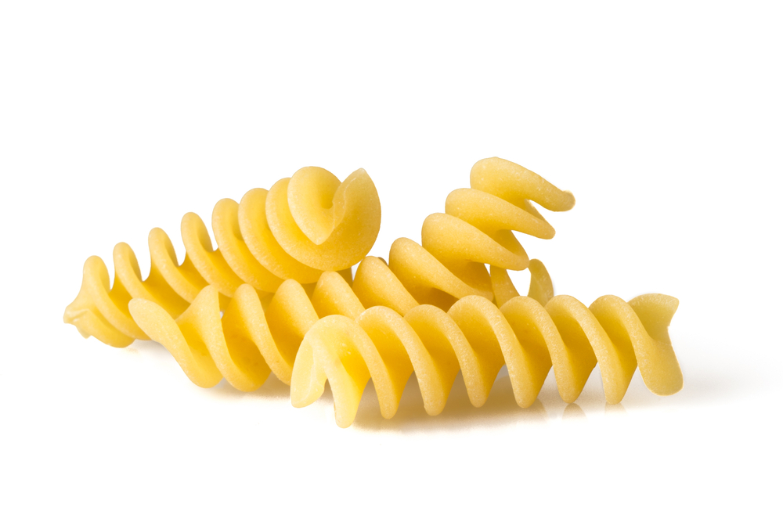
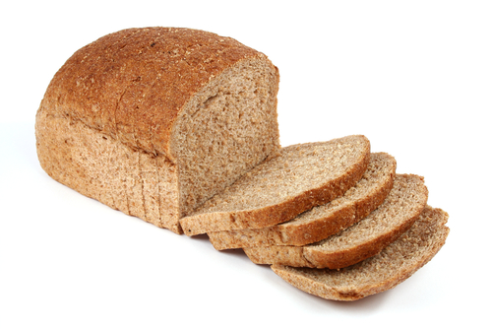
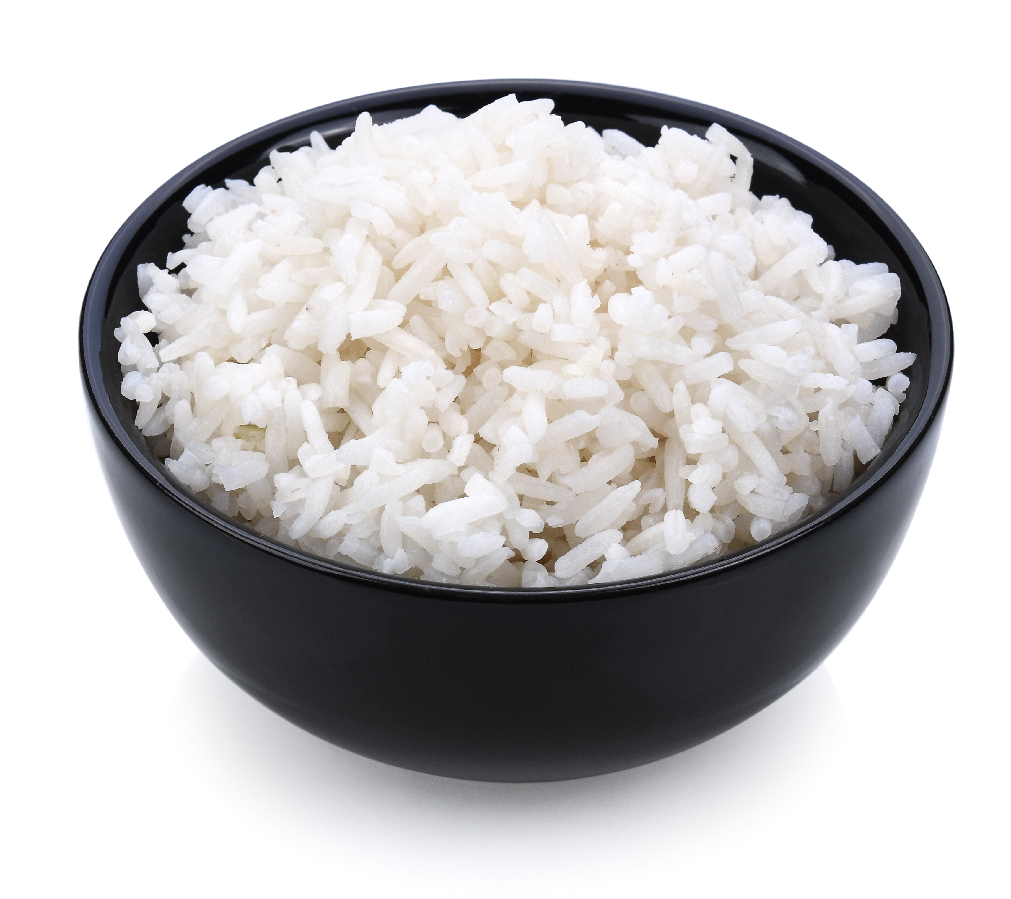
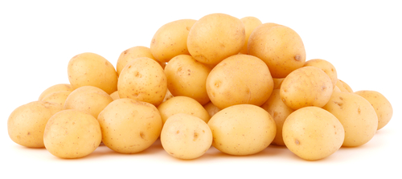
Nutrients
Carbohydrate
Carbohydrate is an important source of energy for the body.
Carbohydrate is provided by foods like potatoes, bread, rice and pasta.

Slide 13
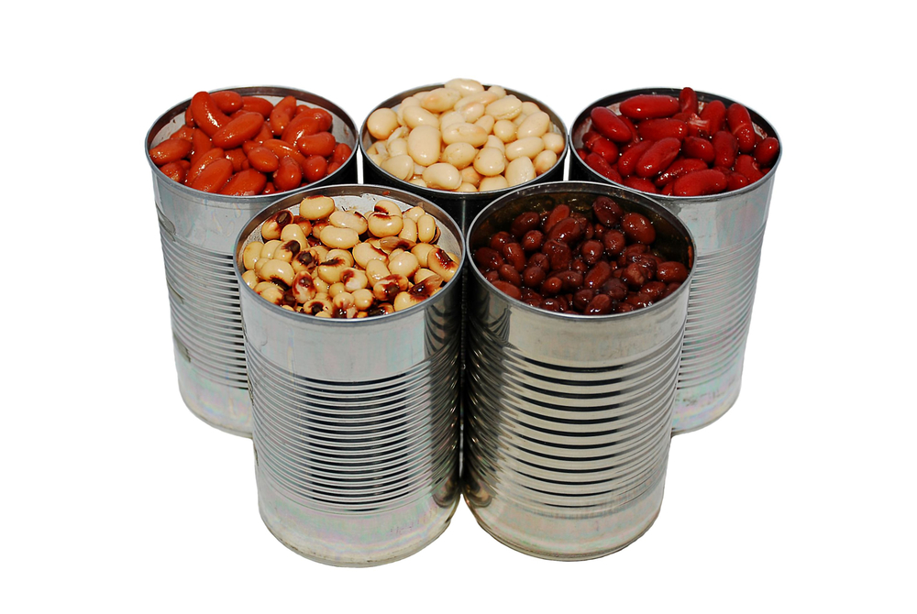
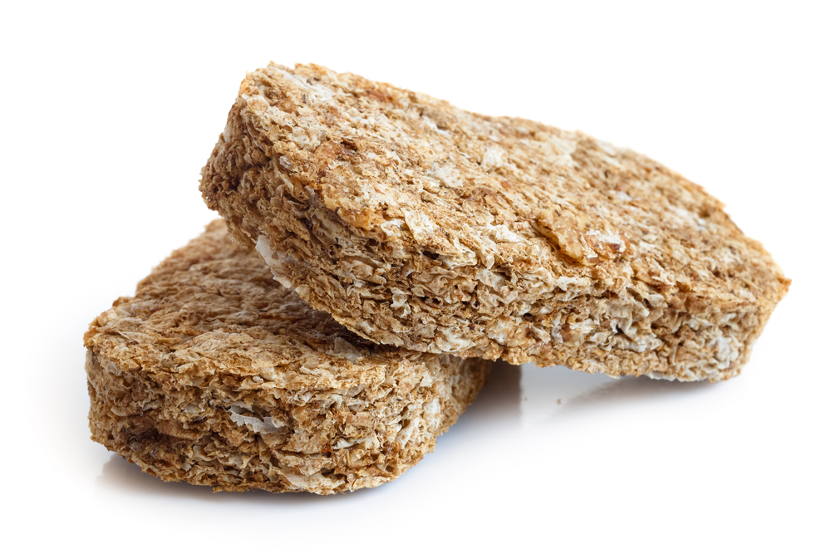
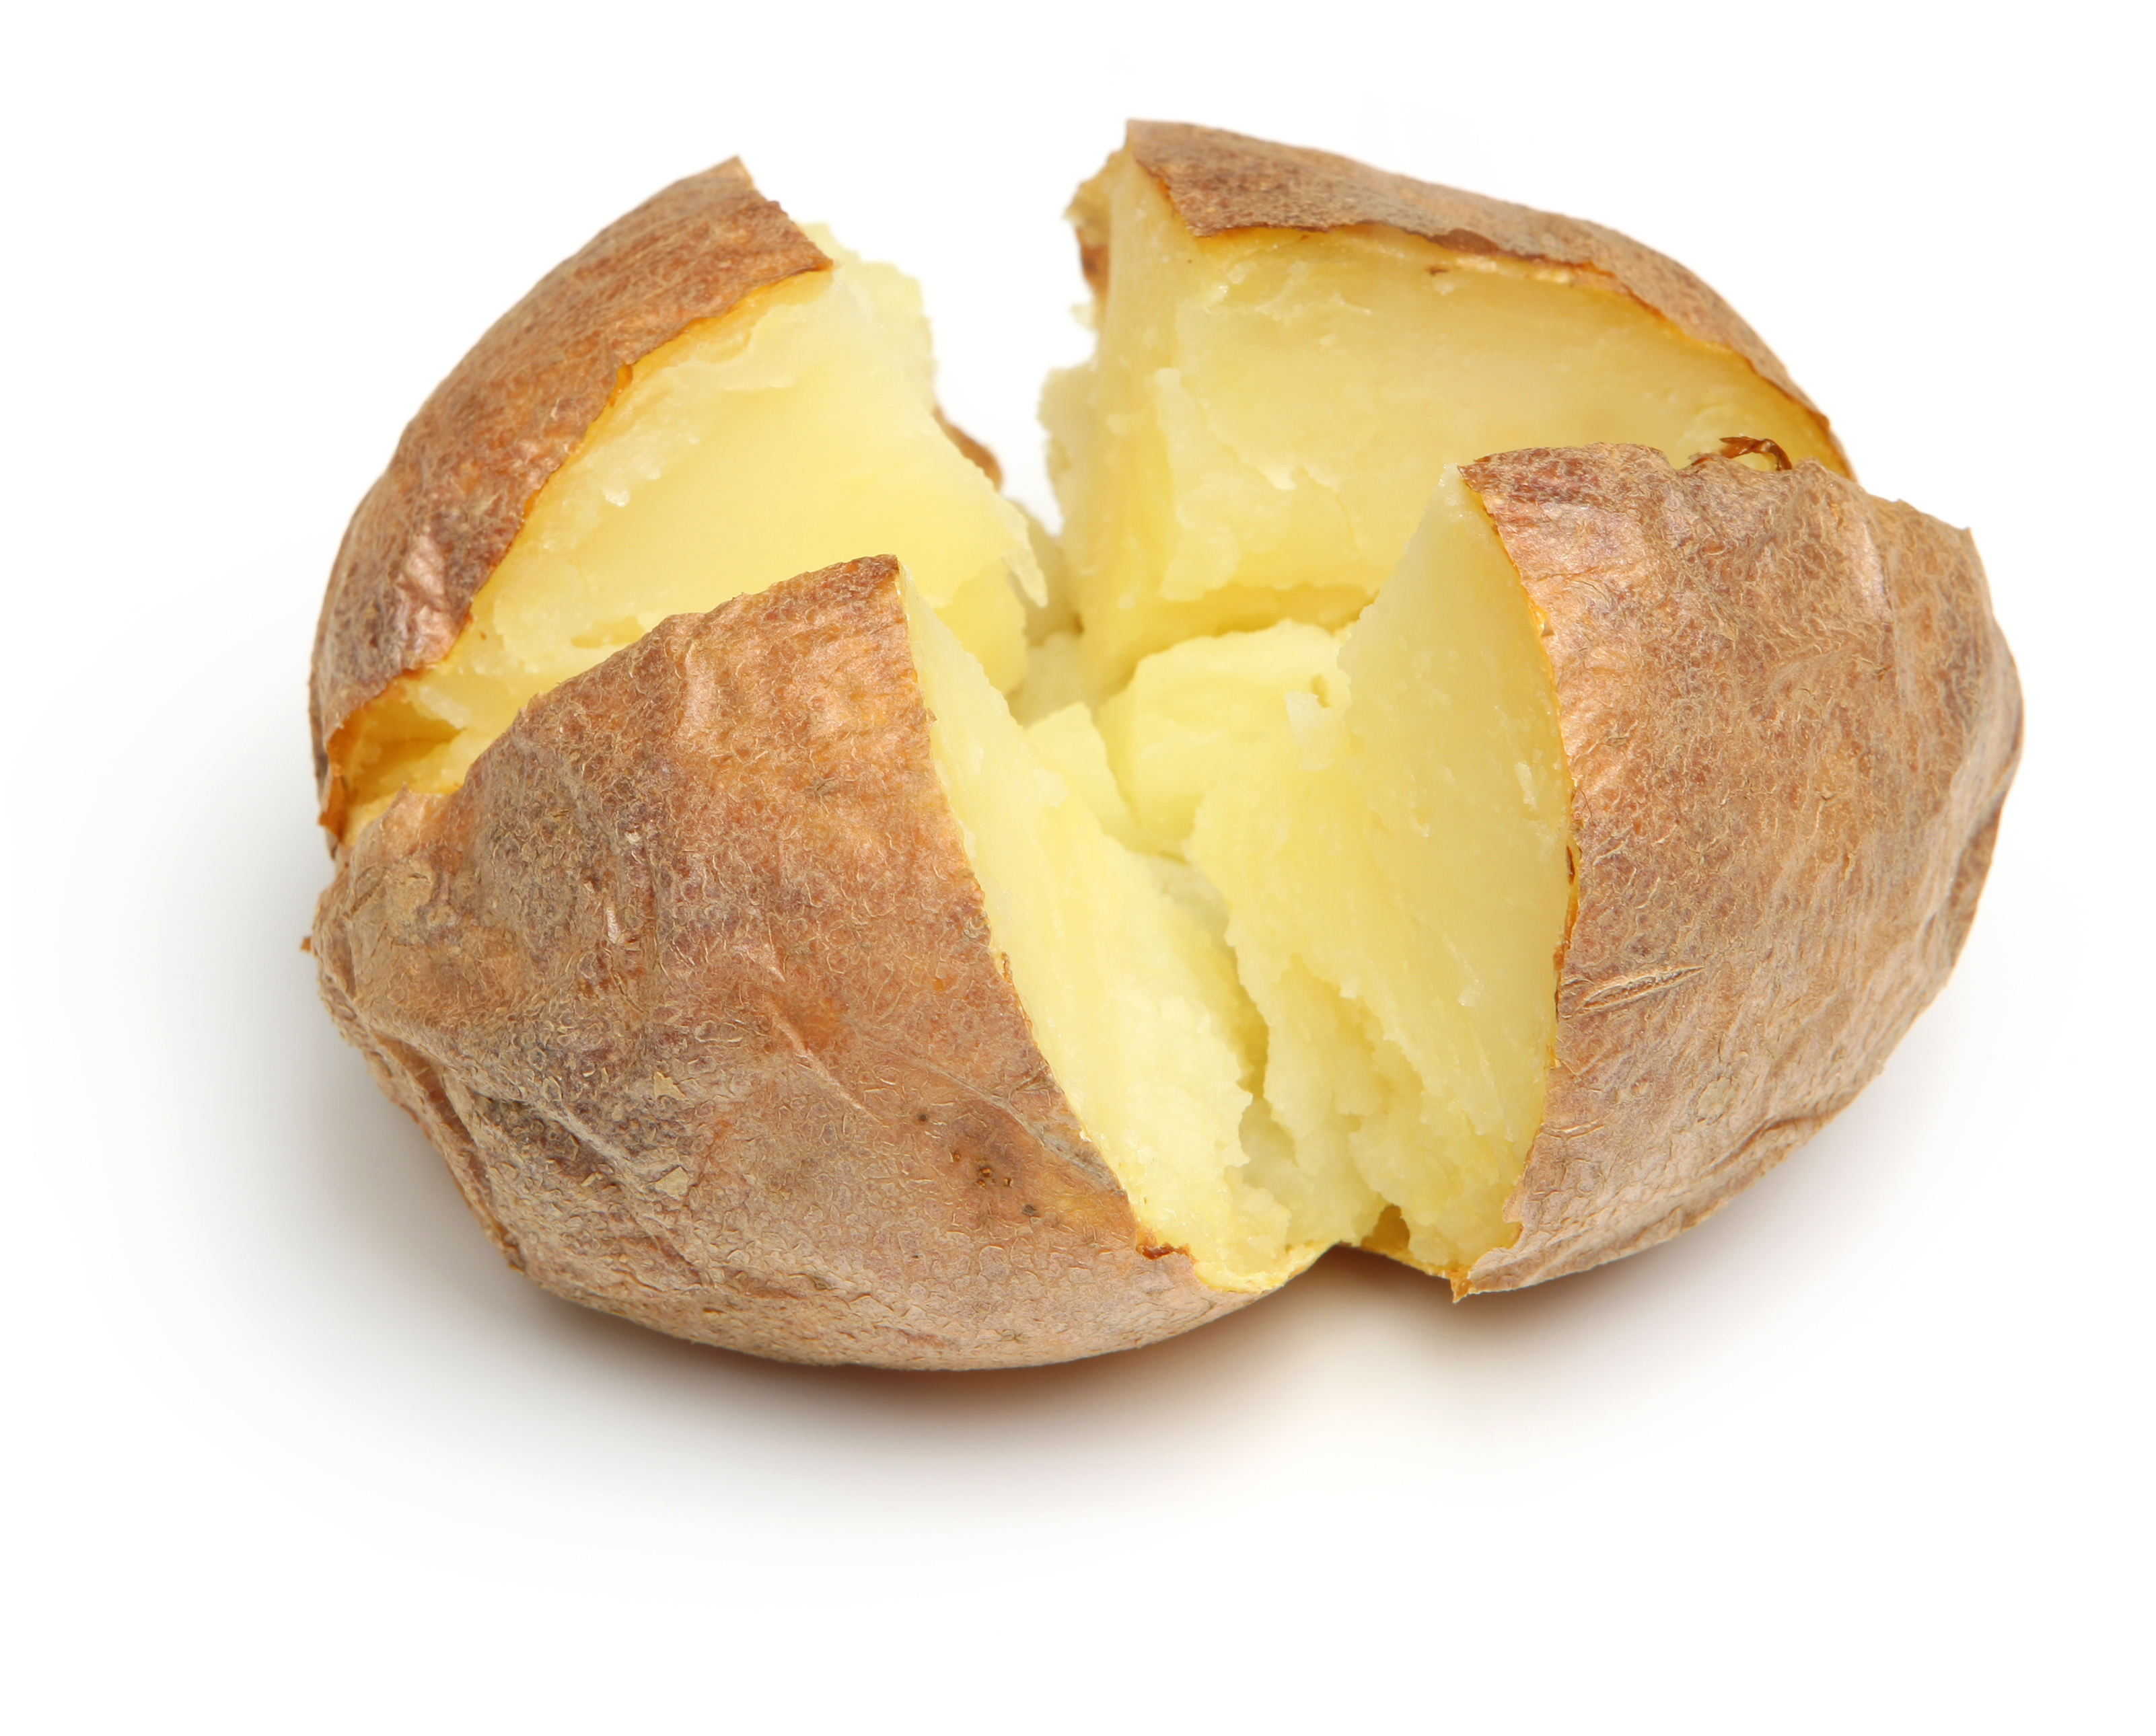
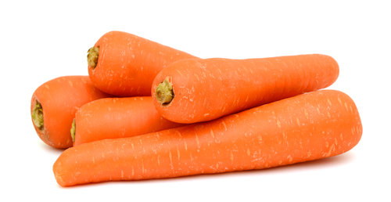
Nutrients
Fibre
Fibre helps keep the digestive system healthy.
Fibre is provided by wholegrain foods (e.g. wholemeal bread, wholegrain cereal) potatoes with skins on, fruit and vegetables, pulses, beans, lentils and nuts.

Slide 14
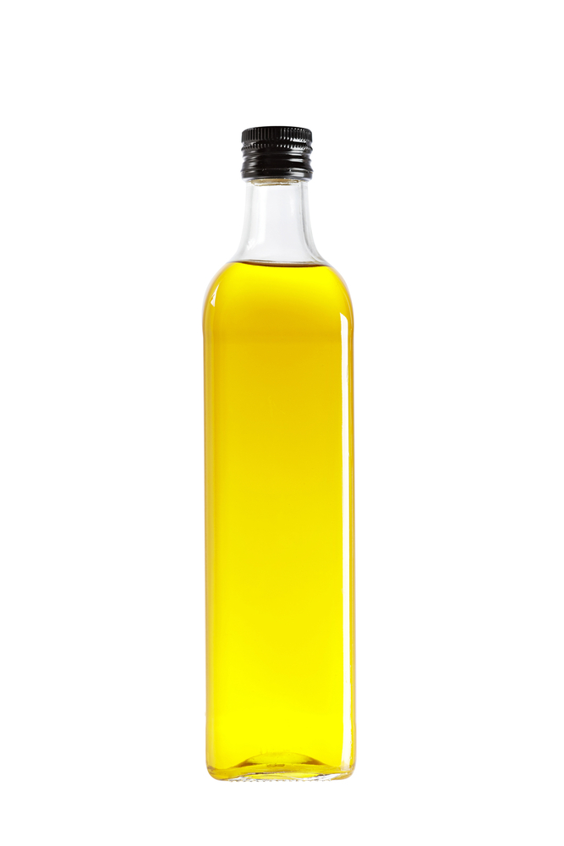
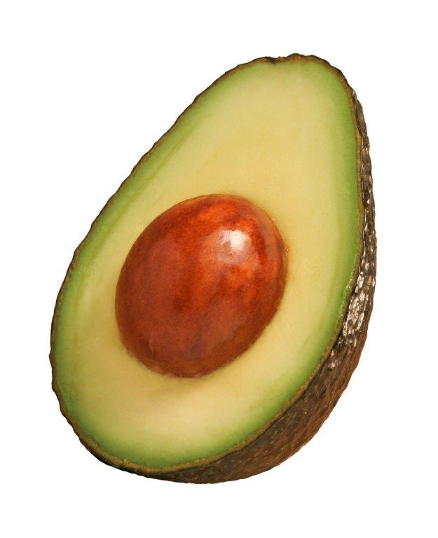
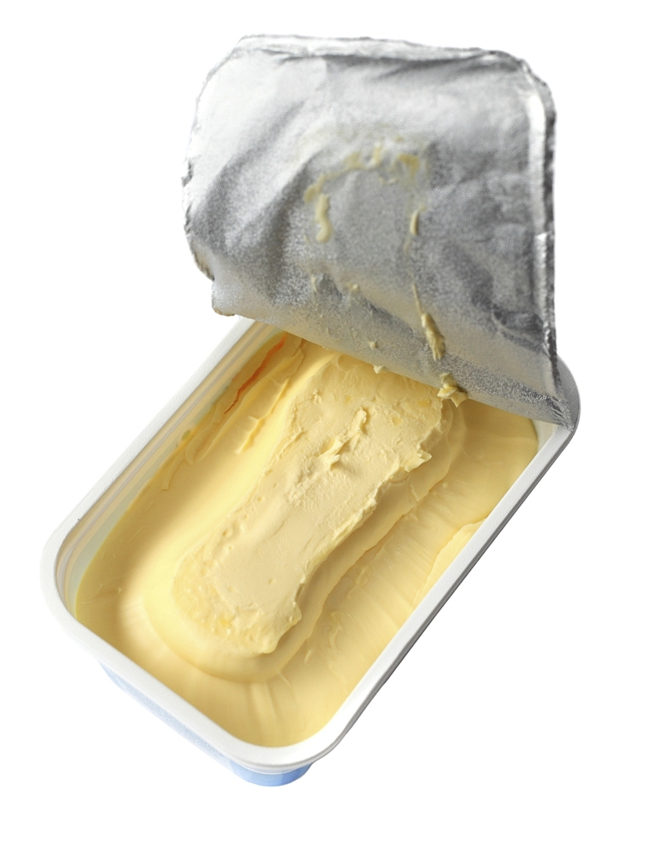
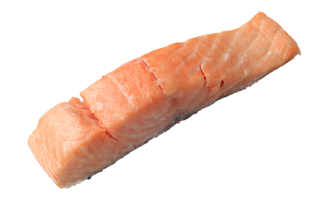
Nutrients
Fat
We need a small amount of fat for general good health and to help us absorb some vitamins (A, D, E and K).
We should choose unsaturated fat, which is provided by foods like spreads, oils, oily fish and avocados.
We need to limit saturated fat. Saturated fat is found in foods like butter, pastry, cakes and biscuits.

Slide 15
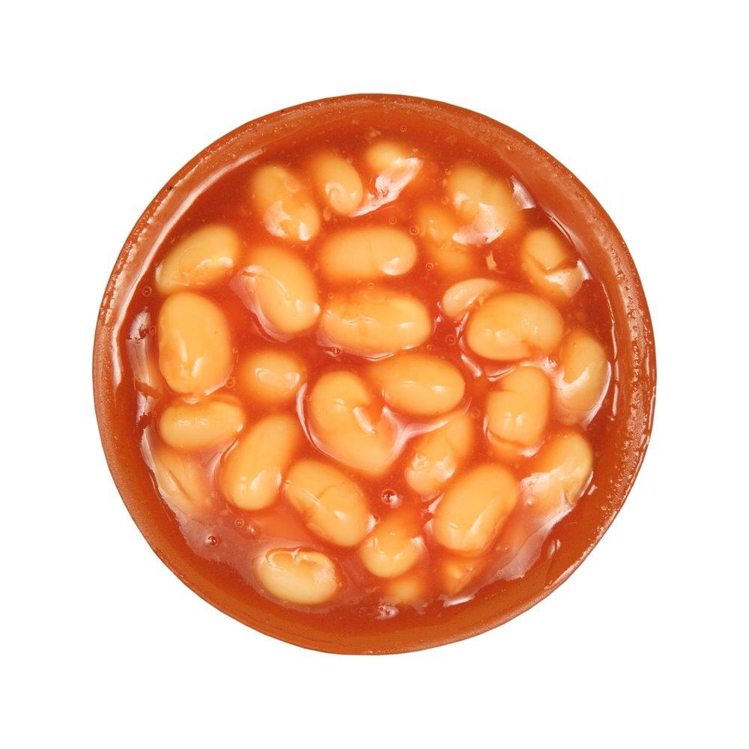
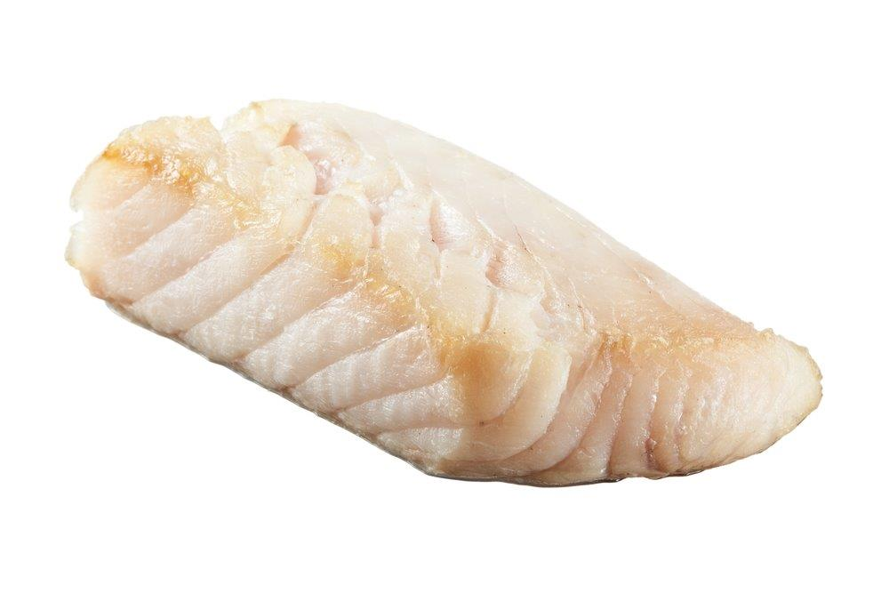
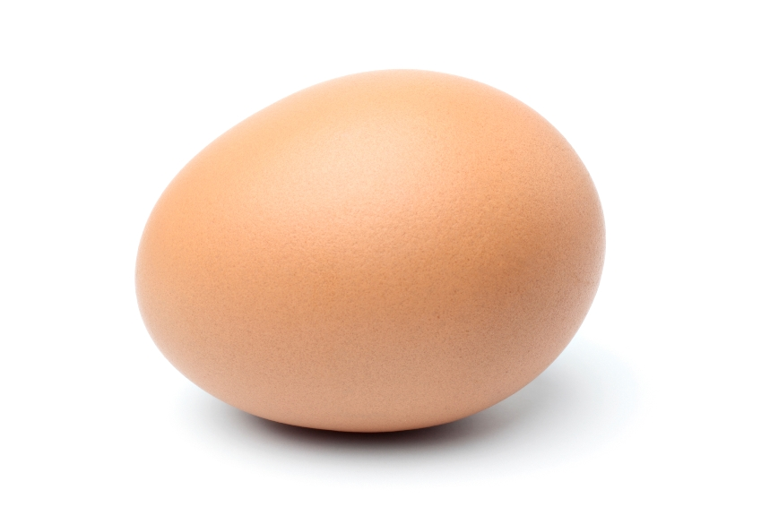
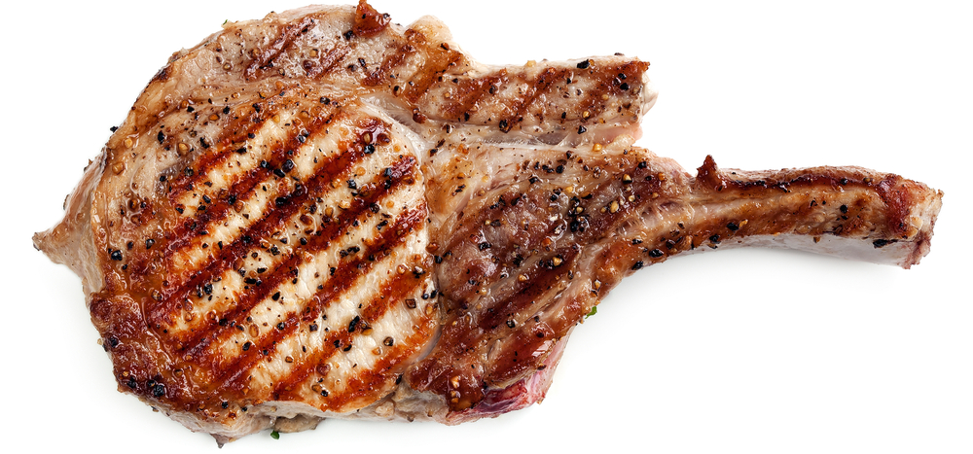
Nutrients
Protein
Protein is needed for growth and repair of muscles.
Protein is provided by foods like beans, pulses, fish, eggs and meat.

Slide 16
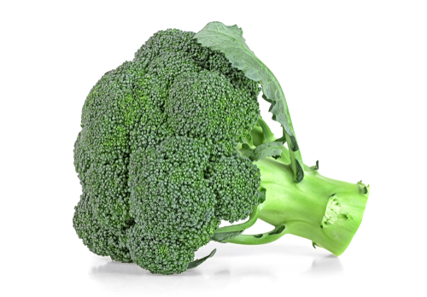
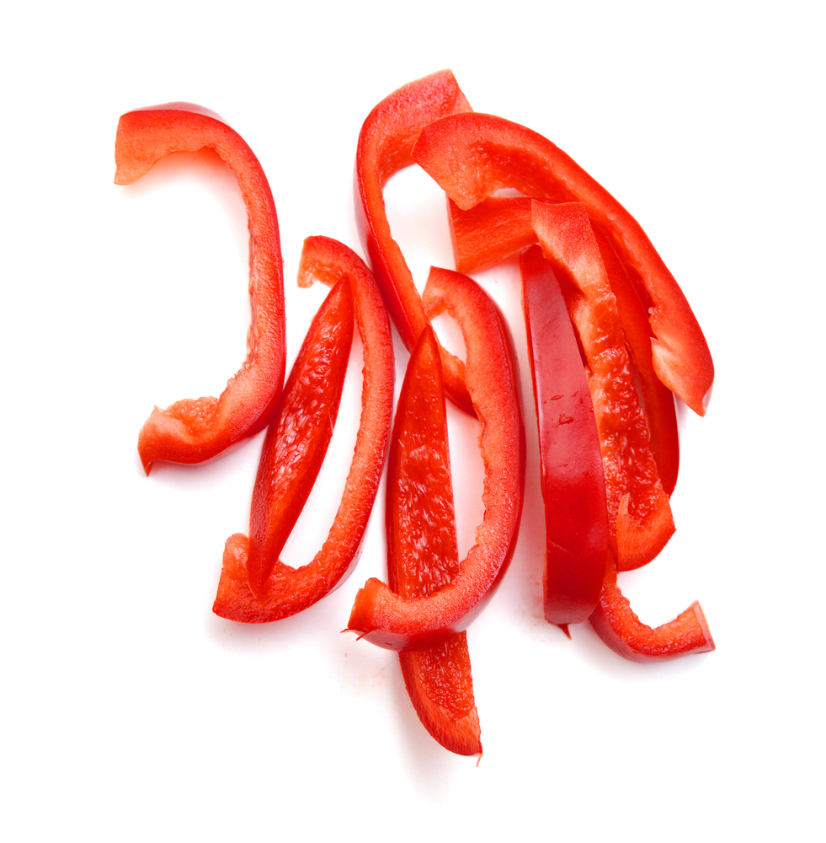

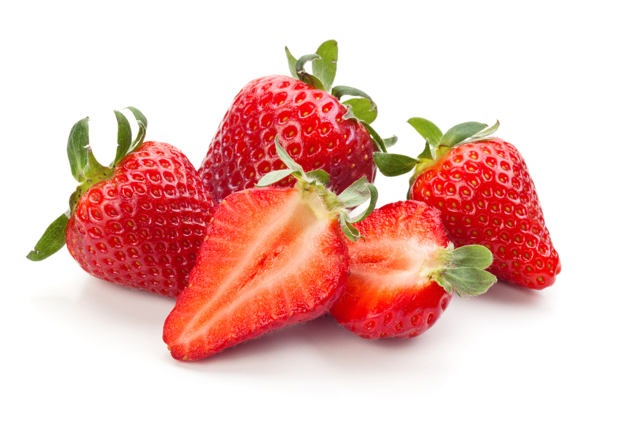
Nutrients
Vitamins
There are lots of different vitamins.
Vitamin C is one example.
Vitamin C is needed for healthy body tissues (e.g. skin and gums) and helping us heal.
Broccoli, red pepper, oranges and strawberries are examples of foods that provide vitamin C.

Slide 17
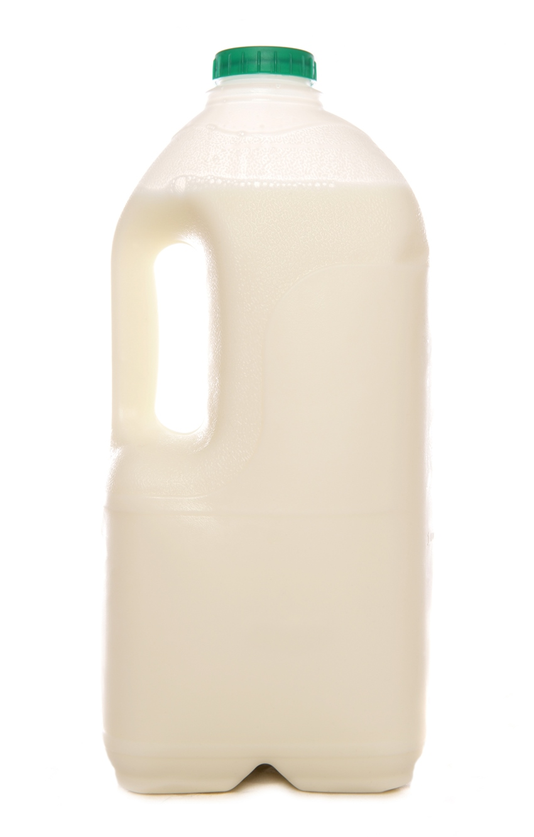
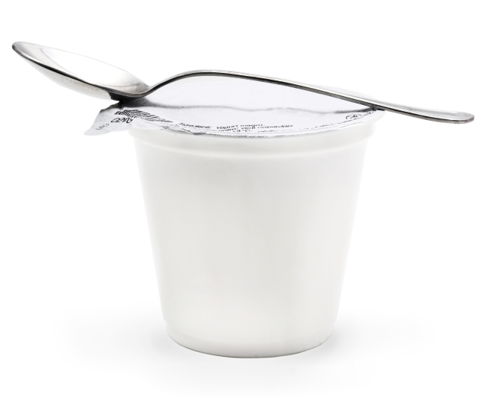
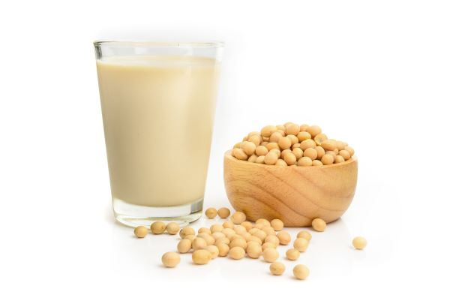
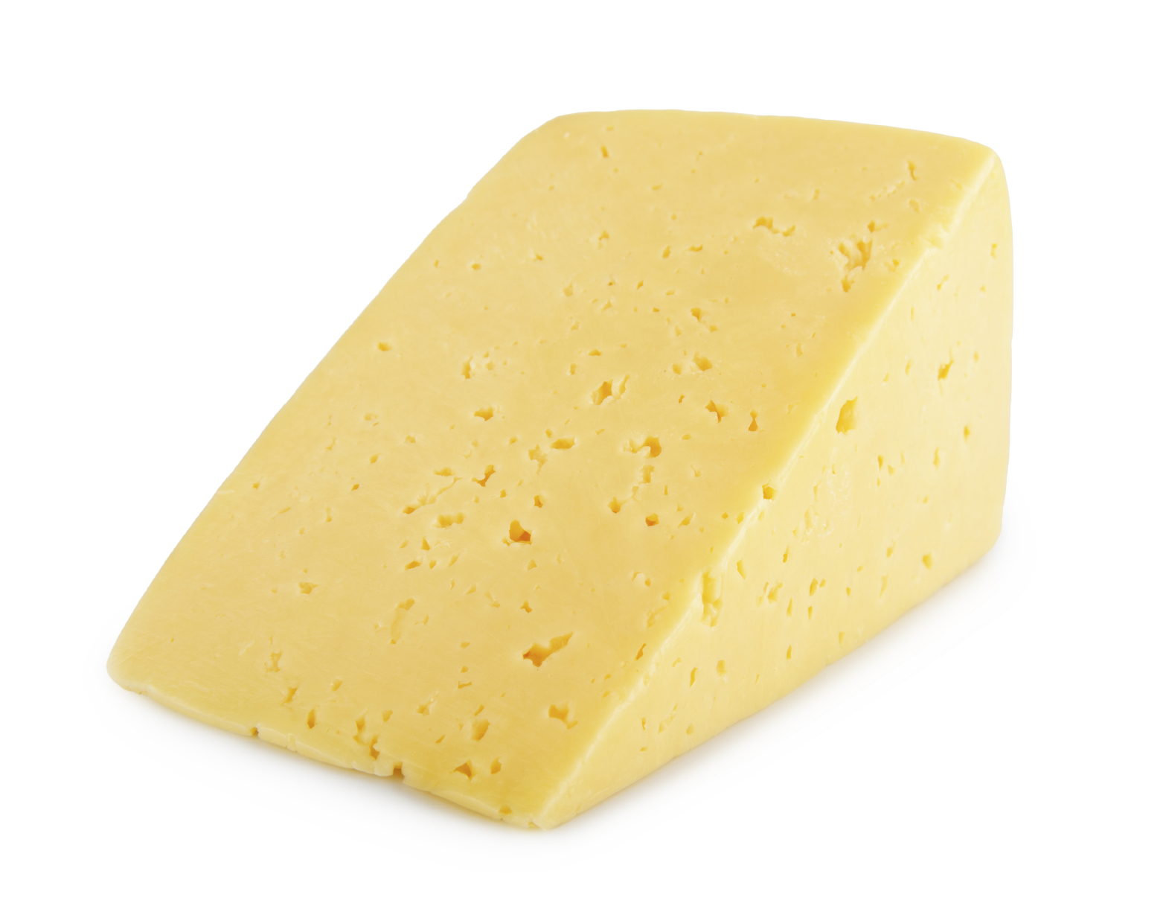
Nutrients
Minerals
There are lots of different minerals. Calcium is one example.
Calcium is needed for healthy bones and teeth.
Calcium is provided by foods like milk, cheese and yogurt (or dairy alternatives that are fortified with calcium, e.g. soya milk).

Slide 18
The Eatwell Guide and nutrients
We need different nutrients to keep us healthy.
Can you remember what the nutrients are called?
To help us get all the nutrients we need, we should eat a variety of food from the Eatwell Guide food groups.
Carbohydrate
Fibre
Fat
Protein
Vitamins
Minerals

Slide 19
Food labels and healthier on the go products

Slide 20
Making a healthier product
Sort the ingredients from the Cornish pasty into the Eatwell Guide food groups.
Cornish pasty
Main ingredients:
Pastry
Beef
Potato
Swede
Onion
Potato
Onion
Swede
Pastry
Beef
Foods high in fat, salt and sugars

Slide 21
Making a healthier product
The case of a Cornish pasty is made from pastry. A main ingredient in pastry is fat,
so pastry belongs with Foods high in fat, salt and sugars.
Pastry
Foods high in fat, salt and sugars
What do you know about Foods high in fat, salt and sugars?
These foods are not needed in the diet so, if they are included, they should be eaten less often and in small amounts.

Slide 22
Making a healthier product
Quite often, on the go products can be high in fat.
This could be because they are made with pastry or fried (cooked in fat), or both. Can you think of some examples?
Made with pastry
Fried

Slide 23
Food labels
We can check food labels to help us make healthier choices.
Typical Values | Per 100g
Energy | 1,045 kJ
 | 251 kcal
Fat | 15.5g
of which saturates | 7g
Carbohydrate | 21.1g
of which sugars | 1.7g
Fibre | 1.6g
Protein | 5.9g
Salt | 1.1g
Here is a nutrition information label for a Cornish pasty.
Let’s take a closer look!

Slide 24
Cornish pasty
Nutrition labels show information for 100g of a food, so different foods can be compared more easily.
Typical Values | Per 100g
Energy | 1,045 kJ
 | 251 kcal
Fat | 15.5g
of which saturates | 7g
Carbohydrate | 21.1g
of which sugars | 1.7g
Fibre | 1.6g
Protein | 5.9g
Salt | 1.1g
The label shows the amount of energy provided by the food in kilojoules (kJ) and kilocalories (kcal).
We can see the total amount of fat in this food, and below it we can see how much of the fat is
saturated fat (of which saturates).
For carbohydrate, we can see the total amount of carbohydrate, and below it we can see how much of the carbohydrate is from sugars (of which sugars).

Slide 25
Cornish pasty
Typical Values | Per 100g
Energy | 1,045 kJ
 | 251 kcal
Fat | 15.5g
of which saturates | 7g
Carbohydrate | 21.1g
of which sugars | 1.7g
Fibre | 1.6g
Protein | 5.9g
Salt | 1.1g
Read the nutrition label to find out…
How much fibre per 100g?
How much salt per 100g?
How much saturated fat per 100g?
We don’t always eat 100g of a food. Sometimes we eat more, and sometimes we eat less.
What will happen to the nutrients we get if we eat more or less than 100g?

Slide 26
Cornish pasty
Take a look at these guidelines.
Cornish pasty
Nutrient | High (per 100g) | Low (per 100g)
Total fat | More than 17.5g | 3g or less
Saturated fat | More than 5g | 1.5g or less
Sugars | More than 22.5g | 5g or less
Salt | More than 1.5g | 0.3g or less
Typical Values | Per 100g
Energy | 1,045 kJ
 | 251 kcal
Fat | 15.5g
of which saturates | 7g
Carbohydrate | 21.1g
of which sugars | 1.7g
Fibre | 1.6g
Protein | 5.9g
Salt | 1.1g
Is the Cornish pasty high, low, or somewhere in between, for:
total fat?
saturated fat?
sugars?
salt?

Slide 27
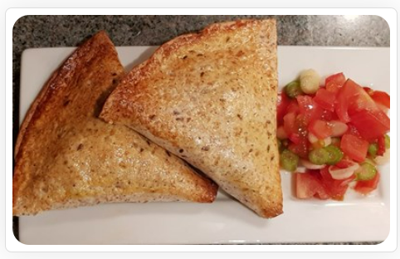
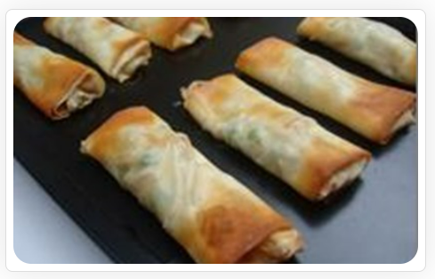
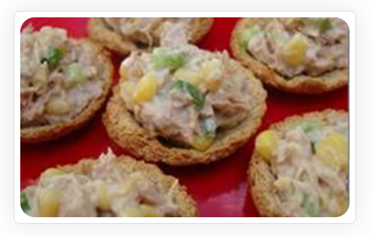
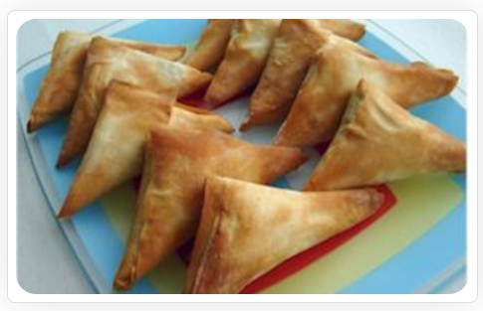
Making a healthier product
How could we make on the go products that have less fat?
Use an alternative to pastry, e.g. bread.
Bake instead of frying.
Mexican pockets
Simple spring rolls
Terrific tuna tarts
Vegetable samosas
Click on the links to take a look at some of these recipes!

Slide 28
Spring roll comparison

Slide 29
Spring roll comparison
Spring roll (Supermarket)
Typical Values | Per 100g
Energy | 1,019 kJ
 | 244 kcal
Fat | 13.3g
of which saturates | 1.1g
Carbohydrate | 25.3g
of which sugars | 3.4g
Fibre | 2.9g
Protein | 4.3g
Salt | 0.61g
Simple spring roll (FFL recipe)
Typical Values | Per 100g
Energy | 738 kJ
 | 175 kcal
Fat | 4g
of which saturates | 0.4g
Carbohydrate | 31g
of which sugars | 3g
Fibre | 3g
Protein | 5g
Salt | Not available on Explore food tool
What do you notice?

Slide 30
Spring roll comparison
What could be the reason that the supermarket spring roll has a lot more total fat and saturated fat than the Food – a fact of life Simple spring rolls recipe?
Spring rolls (Supermarket)
Typical Values | Per 100g
Fat | 13.3g
of which saturates | 1.1g
Simple spring rolls (FFL recipe)
Typical Values | Per 100g
Fat | 4g
of which saturates | 0.4g

Slide 31
Making a healthier product
On the go products, such as Cornish pasties and spring rolls, can be high in fat.
This can be because they are made with pastry or fried, or both.
Baked spring rolls that have a thin pastry case.
Most people need to eat less fat.
We can make healthier on the go products that contain less fat by:
baking them instead of frying;
using less pastry;
swapping the pastry casing for an alternative, such as bread.
Mexican pockets that use a bread casing.
Most people need to have more fruit and vegetables and more fibre.
How could the vegetables and fibre be increased in an on the go product?

Slide 32
Designing a healthier on the go product

Slide 33
Making a healthier product
On the go products, such as Cornish pasties and spring rolls, can be high in fat.
This can be because they are made with pastry or fried, or both.
Baked spring rolls that have a thin pastry case.
Most people need to eat less fat.
We can make healthier on the go products that contain less fat by:
baking them instead of frying;
using less pastry;
swapping the pastry casing for an alternative, such as bread.
Mexican pockets that use a bread casing.
Most people need to have more fruit and vegetables and more fibre.
How could the fruit or vegetables and fibre be increased in an on the go product?

Slide 34
Planning a healthier product
carrots
peas
thin pastry, e.g. filo
More fruit and vegetables
bake
pineapple
Less fat
tomatoes
sweetcorn
mushrooms
bread case
reduced fat cheese
beans, e.g. canned kidney beans
lentils, e.g. canned green lentils
Wholegrains,
e.g. wholemeal bread, wholemeal pastry
More fibre
peas, e.g. canned chickpeas

Slide 35
Ingredient ideas
Top tip:
Choose reduced fat varieties.
Fruit and vegetables:
Peas
Carrots
Mushrooms
Sweetcorn
Pineapple
Peaches
Cooked meat:
Ham
Beef
Chicken
Cheese:
Cottage cheese
Mozzarella
Cheddar cheese
Soft cheese
Fish:
Tuna
Salmon
Top tip:
Try canned varieties of fruit, vegetables, beans, pulses and fish for convenience. Choose varieties canned in water or fruit juice.
Flavours:
Herbs, e.g. basil, coriander
Spices, e.g. curry powder, chilli powder
Spring onions
Lemon or lime juice or zest
Beans and pulses:
Kidney beans
Chickpeas
Lentils

Slide 36
Grab and go
For further information, go to:
www.foodafactoflife.org.uk

