Slide 1
Vegetable couscous salad
Complexity: low - medium

Slide 2
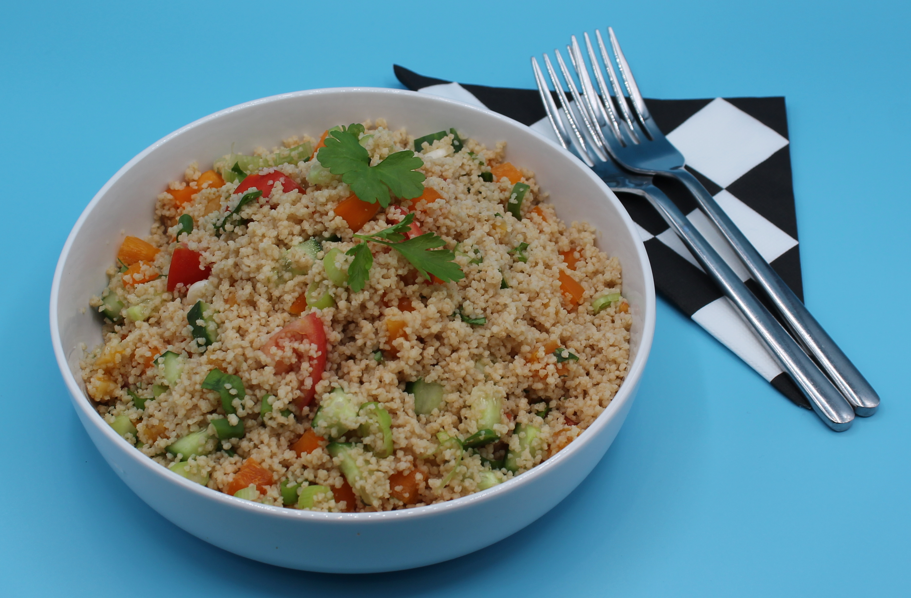
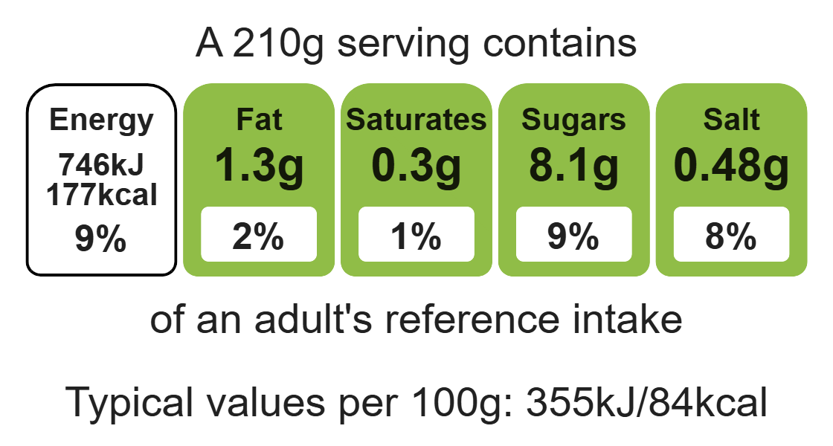
Nutritional analysis
Serves 1

Slide 3
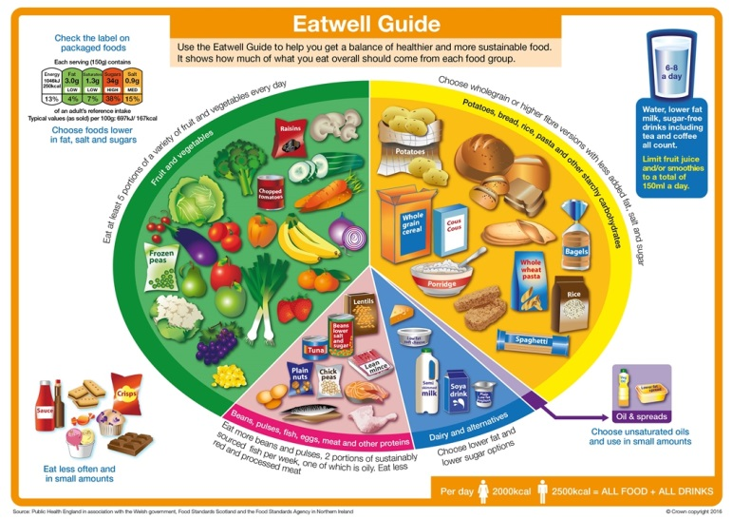
Starter activity
Which two sections of the Eatwell Guice should we base most of our meals on?
How many portions of fish should we eat per week?
Which section would we find beans?
Which section provides us with calcium?
How may drinks should we have per day?

Slide 4
Example responses
Which two sections of the Eatwell Guide should we base most of our meals on?
Fruit and Veg, Potatoes, bread, rice, pasta and other starchy veg.
2. How many portions of fish should we eat per week? Two, of one which should be oily.
3. Which section would we find beans?
Beans, pulses, fish, eggs, meat and other proteins.
4. Which section provides us with calcium? Dairy and alternatives
5. How may drinks should we have per day? 6-8 per day

Slide 5
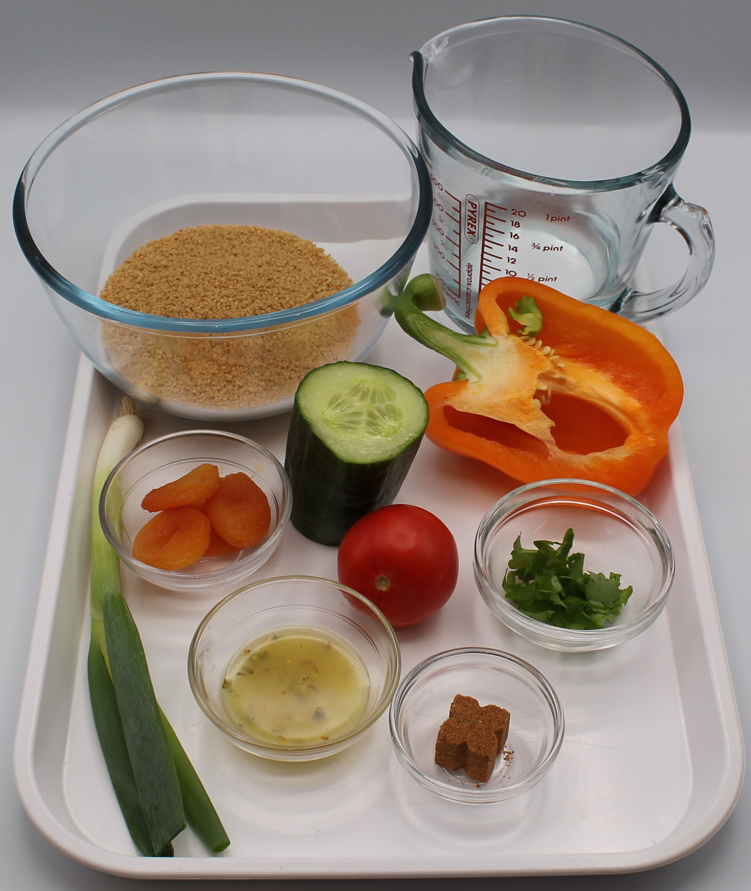

Ingredients (serves 1)
75ml boiling water
½ reduced-salt vegetable stock cube
70g wholemeal couscous
1 tomato
1 spring onion
¼ cucumber
¼ pepper
2 dried apricots
1 x 15ml spoon parsley
1 x 15ml spoon low fat dressing
Check for any food allergy, intolerance, special dietary requirement or religious/cultural reasons for not handling or eating the ingredients in this recipe.

Slide 6
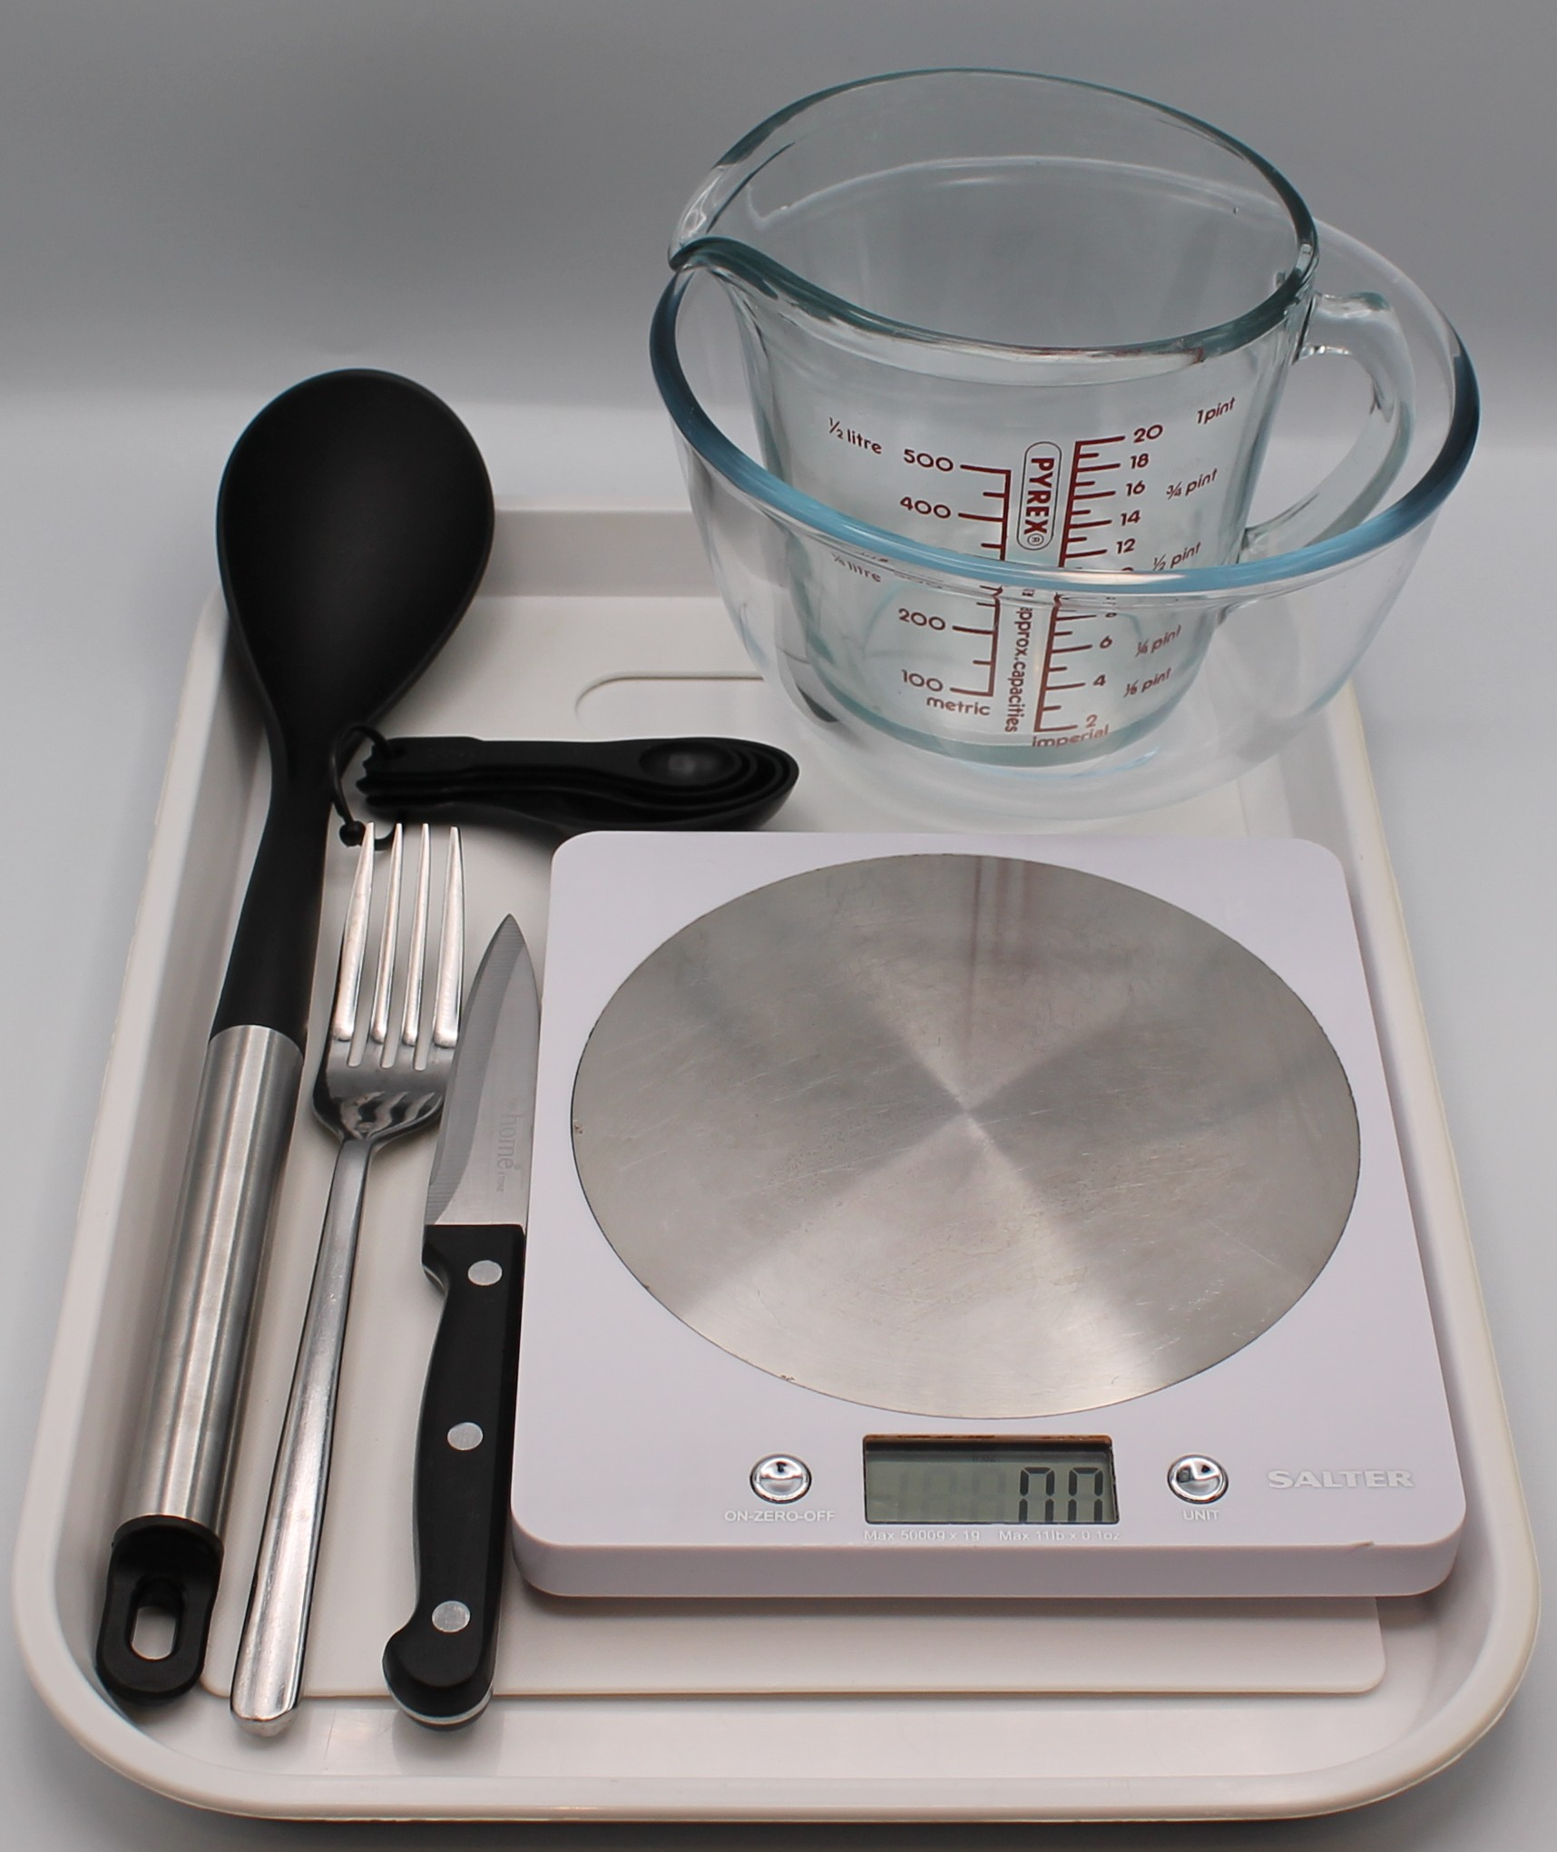
Equipment
Weighing scales
Kettle
Measuring jug
Fork
Large bowl
Chopping board
Sharp knife
Mixing spoon
Measuring spoons

Slide 7
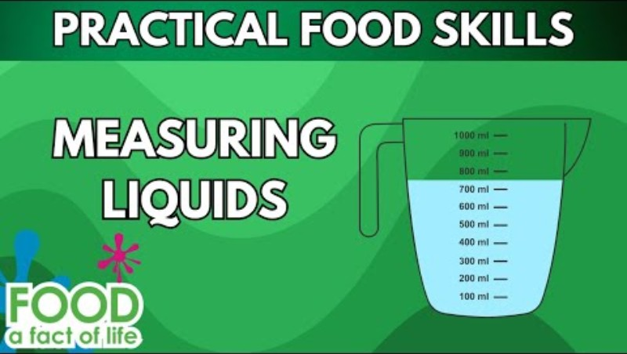
Food skills
Click below to watch how to measure liquids
Weigh
Measure
Cut
Chop
Slice
Dice and trim
Mix
Stir

Slide 8
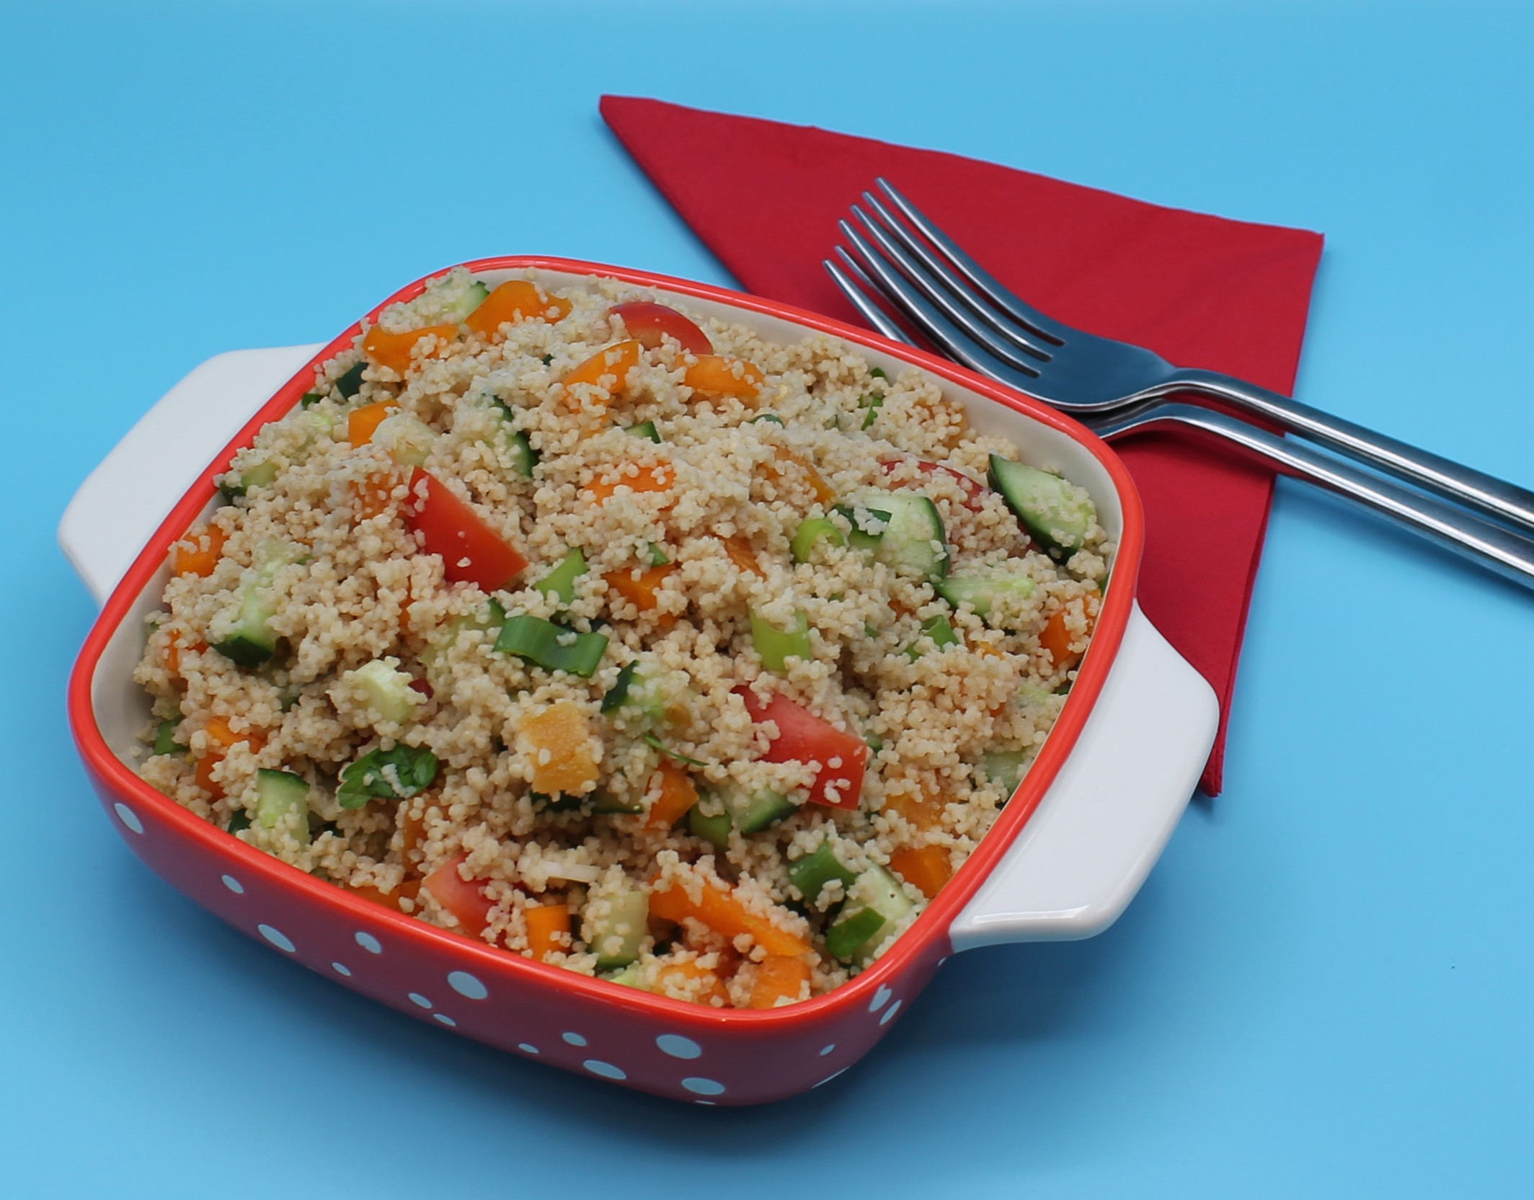
Method
Make up the stock by dissolving the stock cube in the boiling water in the jug.
Place the couscous in a large bowl and pour over the stock. Cover and leave for 2-3 minutes.
Fluff with a fork and leave to stand for a further 5 minutes.
Prepare the salad ingredients:
chop the tomato;
deseed and dice the pepper;
dice the cucumber;
slice the apricots;
slice the spring onion into rings;
chop the parsley.
Add all the vegetables to the couscous and stir.
Stir in the dressing.

Slide 9
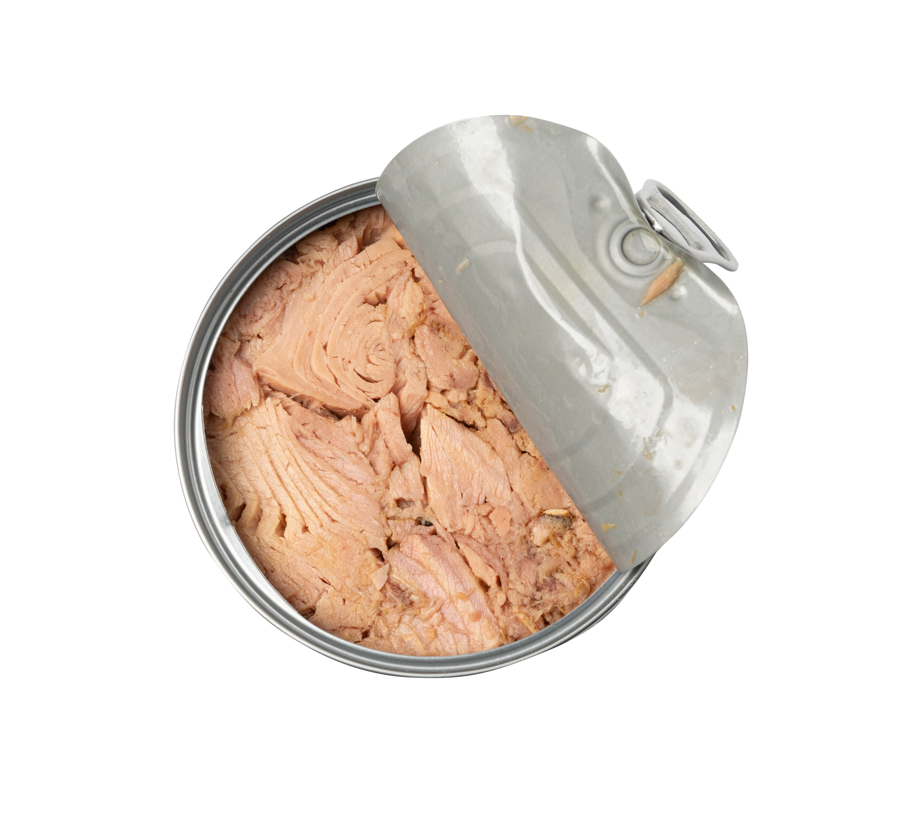
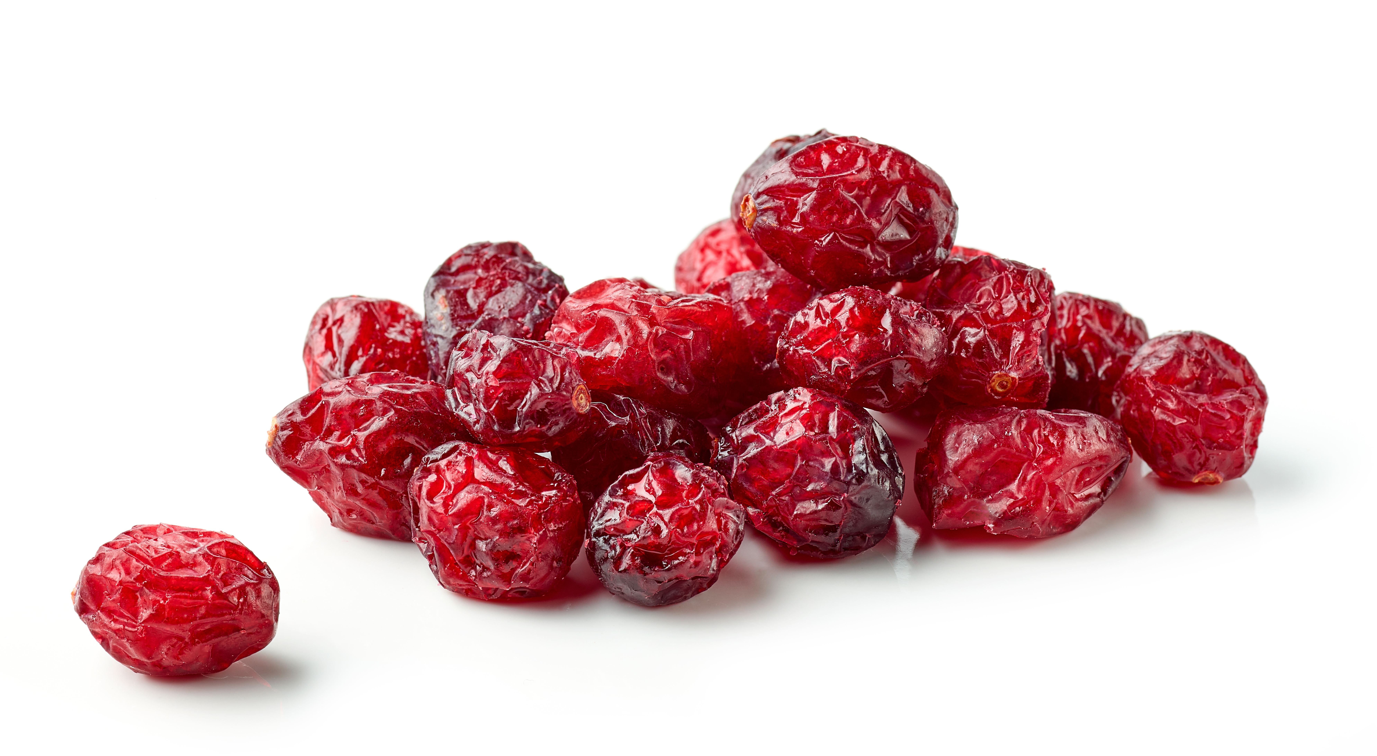
Top tips
Vary your protein: Try adding chickpeas, chopped cooked chicken, or tuna
Reduce food waste: Use leftover sweetcorn, peas, olives, mushrooms
Turn up the flavour: Why not try dried cranberries or raisins?

Slide 10
Food science
Rehydration
Couscous is like tiny pasta made from semolina wheat. At the factory, it's steamed (cooked with hot steam) and then dried, so it cooks quickly at home.
When you add hot water, the couscous soaks up the water and becomes soft and fluffy - this is called rehydration.
The heat also causes the starch inside to swell up a little, which makes it tender.
Covering the bowl keeps in the steam, which helps the couscous cook evenly.

Slide 11
Plenary
Based on the following success criteria, evaluate how you performed.
Success criteria | My performance
Safe use of kettle
Fluffing of couscous
Chopping of tomatoes
Deseeding and dicing pepper
Dicing cucumber
Slicing apricots and spring onion
Presenting

Slide 12
Example responses
Based on the following success criteria, evaluate how you performed.
Success criteria | My performance
Safe use of kettle | Safely measured liquid without help.
Fluffing of cous cous | Used my fork to break up the lumps of couscous, this worked well.
Chopping of tomatoes | Tomatoes were roughly same size and shape. Need more practise.
Deseeding and dicing pepper | Removed all the seeds and diced evenly.
Dicing cucumber | Diced cucumber quite well, I was pleased.
Slicing apricots and spring onion | Used my claw grip to slice evenly. It might have been easier to use kitchen scissors to snip the spring onion.
Presenting | Need to spend more time mixing to make sure all ingredients are spread throughout.

Slide 13
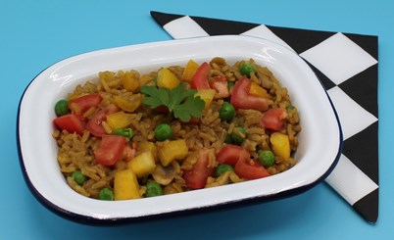
Looking for more…
Why not continue the learning and explore the topic of vegetables with your pupils?
Check out our presentation to get you started!
If you would like to challenge your pupils to make a similar recipe but using rice and demonstrating safe use of the hob and temperature control, why not task them to make a savoury rice? There is a lesson plan to support in the Food – a fact of life Schemes of Work.

Slide 14
Vegetable cous cous salad
For further information, go to:
www.foodafactoflife.org.uk
This resource meets the Guidelines for producers and users of school education resources about food.

