Slide 1
The journey of your main meal
A Where food comes from Challenge for 14-16 year olds

Slide 2
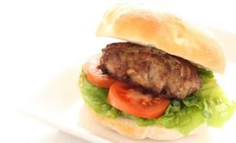

The Challenge
Have you ever wondered what happens to your food before you cook and eat it? Choose one of these four dishes:
Homemade burgers
Fish pie
Mushroom and chickpea curry
Tomato and basil tart
Highlight the steps taken from ‘field to fork’ to get the dish to your table by creating one of the following:
an engaging infographic;
a video or presentation.
.

Slide 3
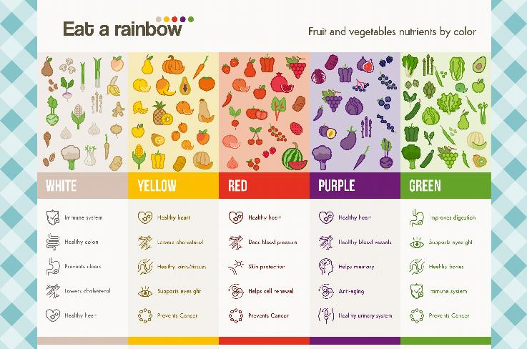
Let’s get started – the Challenge is on!
What are ‘infographics’?
“A picture or diagram or a group of pictures or diagrams showing or explaining information.”
Infographics can be used to communicate complex information in a visually engaging way.
They can be used in a variety of ways, e.g. social media platforms, websites, printed posters and displays. This would be a factor when deciding what information to include and how to display it for the intended audience.
Cambridge Dictionary

Slide 4
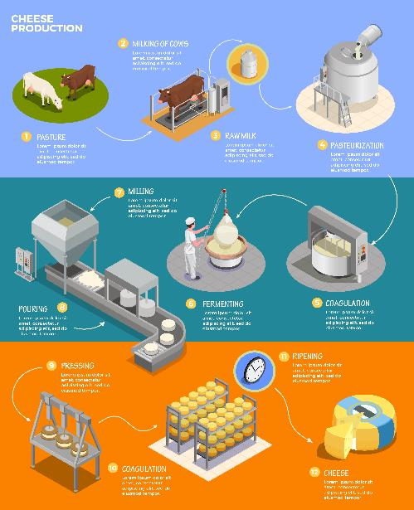
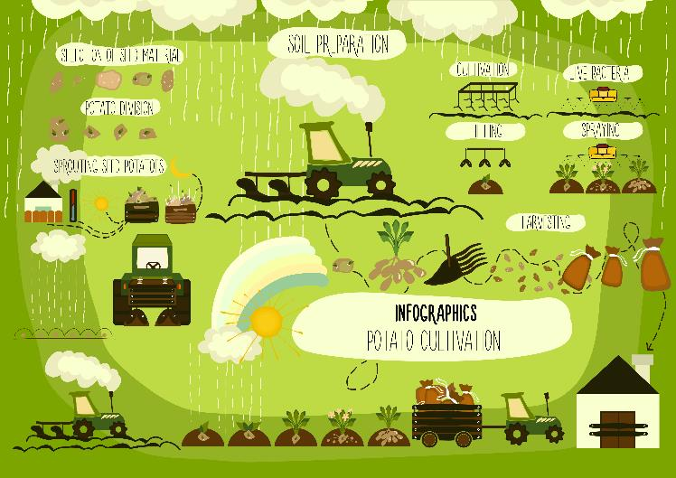
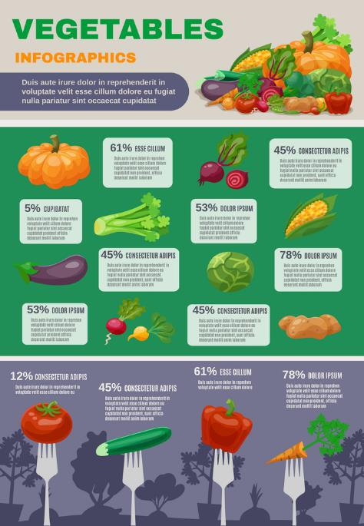
Infographics – some examples

Slide 5
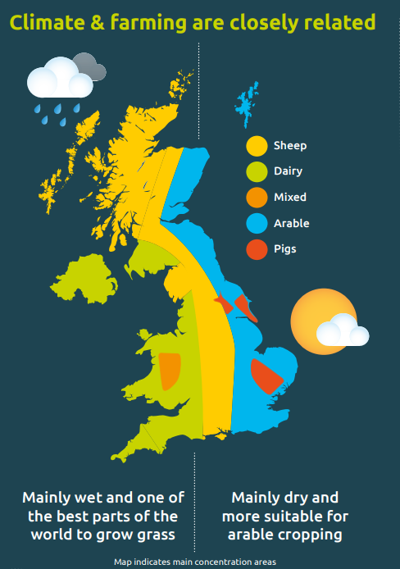
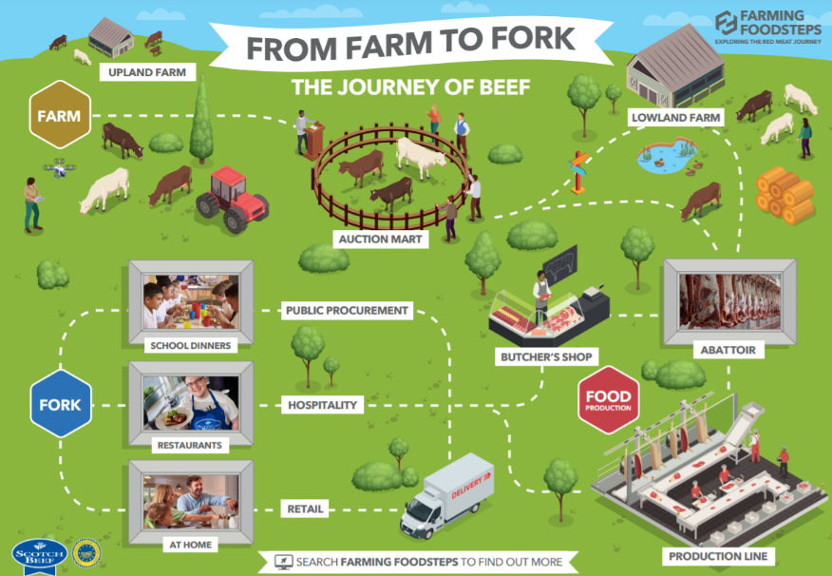
Infographics – some more examples
Quality Meat Scotland

Slide 6
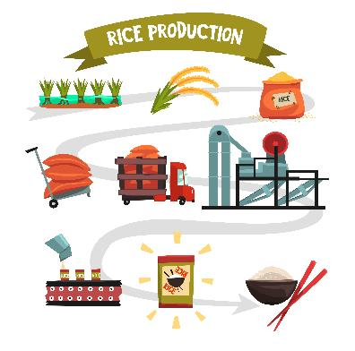
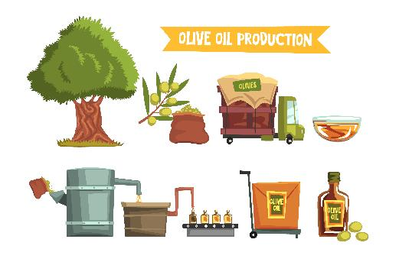
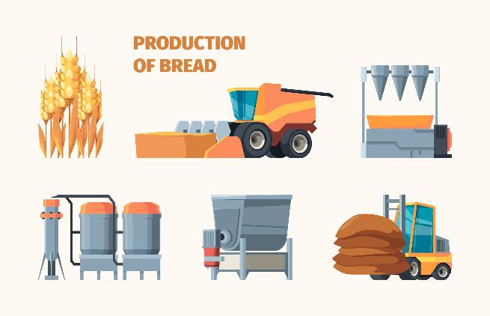
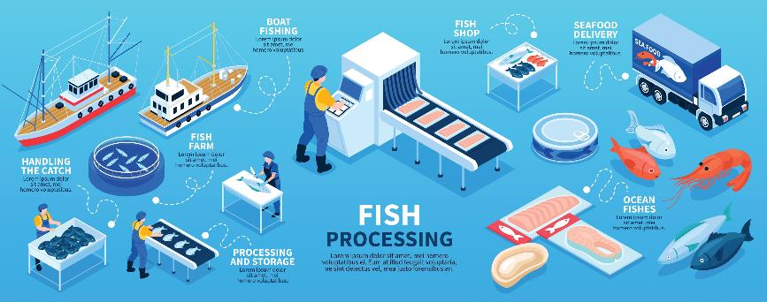
Infographics – some more examples

Slide 7
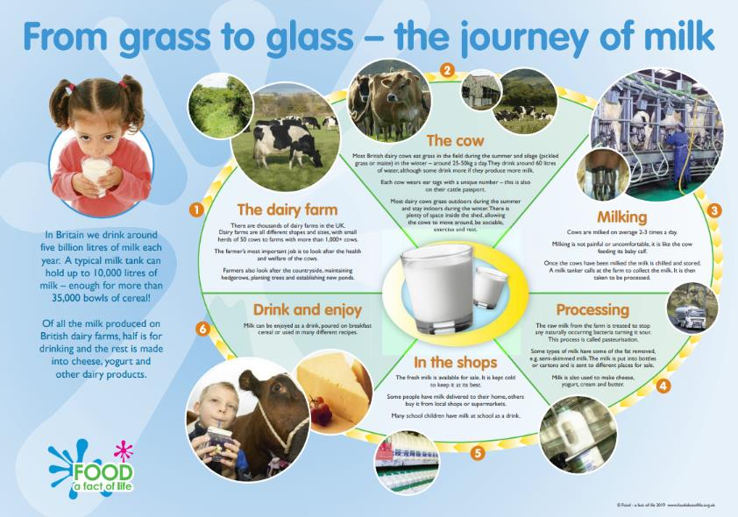
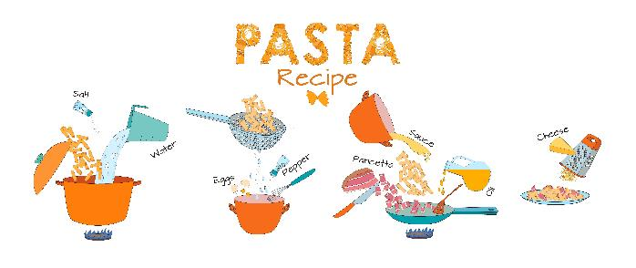
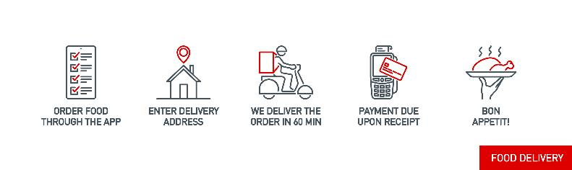
Infographics – some more examples

Slide 8


Other media?
You could consider using other types of media to explain the step-by-step ‘farm to fork’ process.
You could record a short video or create a PPT presentation as an alternative to an infographic.
What ideas do you have?
Draw up a plan!

Slide 9
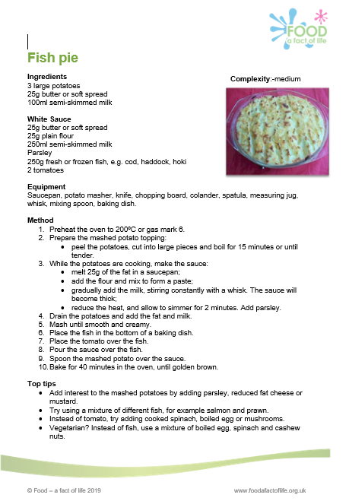
Where to start?
1. Identify the ingredients – read the ingredients list.
2. List the main ingredients that you will trace from ‘farm to fork’.
3. Research:
where the ingredients come from (grown, reared, or caught);
the main steps in the ‘field to fork’ journey for each ingredient;
how the ingredients are processed before use in cooking.

Slide 10
The Challenge
Have you ever wondered what happens to your food before you cook and eat it? Choose one of these four dishes:
Homemade burgers
Fish pie
Mushroom and chickpea curry
Tomato and basil tart
Highlight the steps taken to get the dish to your table by creating one of the following:
an engaging infographic;
a video or presentation.
.
Good luck!

Slide 11
Teacher’s guide

Slide 12
The Food – a fact of life Challenges
The Food – a fact of life Challenge activities have been written to support teachers not following the national curriculum for their specific country or those following a challenge or theme-based approach. However, they could be used in any school across the UK.
The Challenges cover healthy eating, cooking and where food comes from and provide a wide range of activities that teachers can select depending on their pupils’ needs, age and abilities, and the time available.
There are 12 Challenges developed to be used with nursery, primary or secondary pupils.
Each Challenge comprises the Challenge, opportunities for learning and a variety of pupil activities that can be completed individually or in groups. Each Challenge culminates in a final outcome, which could be paper based, such as a report, poster, newspaper article or PPT presentation, a video or interactive activity, or a recipe, menu or dish/range of dishes, depending on the theme of the Challenge.
Optional pupil certificates are available to download and personalise once the Challenge has been achieved.

Slide 13


The 14-16 Where food comes from challenge
Have you ever wondered what happens to your food before you cook and eat it? Choose one of these four dishes:
Homemade burgers
Fish pie
Mushroom and chickpea curry
Tomato and basil tart
Highlight the steps taken to get the dish to your table by creating one of the following:
an engaging infographic;
a video or presentation.
.

Slide 14
Alternative Challenge
You may wish to consider the alternative Challenge on the following slide for students who need a less guided approach.
This give the students the opportunity to select a dish of entirely their own choice or you could be more specific about the type of main meal dish – it is flexible.
The suggested resources and activities can be used to complete the alternative Challenge.

Slide 15
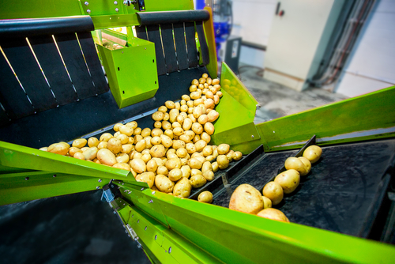
The 14-16 Where food comes from challenge
Have you ever wondered what happens to your food before you cook and eat it?
Create an engaging infographic to highlight the steps taken from ‘field to fork’ to get your main meal to your table.

Slide 16
Opportunities for learning
By undertaking this challenge, the opportunities for learning include:
researching where food comes from and how it can be used to create a healthy and more sustainable diet;
finding out about growing, farming and processing food commodities in the UK;
applying their knowledge of food science;
using a nutritional analysis programme;
investigating how to create an infographic (or other media) to demonstrate their knowledge and understanding of where ingredients are from and how they are processed.

Slide 17
How can pupils complete the Challenge?
A range of activity suggestions have been provided – you choose the ones that are most suitable for your pupils and the time that you have available to complete the challenge.
Activities include:
Finding out – activities around where food comes from, farming and growing food, food processing and quality assurance.
Making and evaluating – demonstrating a range of practical food skills and cooking methods, demonstrating the principles of food hygiene and safety.
Bringing it all together – planning and producing an infographic or alternative of their chosen dish to show where the main ingredients are from, how and when they are processed.

Slide 18
Finding out - activities
Pupils, individually or in groups, could:
Choose a food commodity and research how it is produced, state if it is grown, reared or caught. Complete the Food is grown, reared or caught fact file.
View the presentations about Farming food, Growing food and seasonality.

Slide 19
Finding out - activities
Watch the Where food comes from videos as a starting point for further investigation.
Read through the presentations and watch the videos which show the farm to fork journey of different fruit and vegetables.
View the Eat the seasons presentation to learn about when different fruit and vegetables are in season.
Learn more about seasonality using the What’s in season worksheet.
Look at the Meal cards and identify the ingredients in each meal or dish. Choose one ingredient and find out where it is traditionally grown or produced.
Take a look at the Farming for you posters. Make a list of 12 key facts you have learnt about where food comes from, two from each of the six posters.

Slide 20
Finding out - activities
Watch the farm to fork videos and answer the questions on the screen as you go along.
Click and drag the images in these food chains to show where food comes from.
Find out more about food assurance by viewing the Food assurance schemes presentation and completing the worksheets.
Use the Matching activity and match the food assurance logos with the name of the food assurance schemes.

Slide 21
Finding out
Wheat, flour and bread
Investigate wheat farming and processing in the UK using the Lesson plan and the presentation and worksheet.
Use the Sensory and nutrition worksheet to investigate the effect of processing on the sensory and nutritional properties of flour. The lesson guide provides an overview and activity ideas for the teacher.
Use the Grain science lesson plan to explore the characteristics of flour and how they are applied when preparing and cooking.
Find out more about the history, production and uses of wheat flour in breadmaking.

Slide 22
Finding out
Wheat, flour and bread
Investigate the science of breadmaking using the Teacher’s guide, presentation and yeast experiment.
Investigate the effects of different ingredients in bread making experiment.
Investigate gluten using the gluten formation worksheet.
Investigate the use of flour in pastry worksheet.

Slide 23
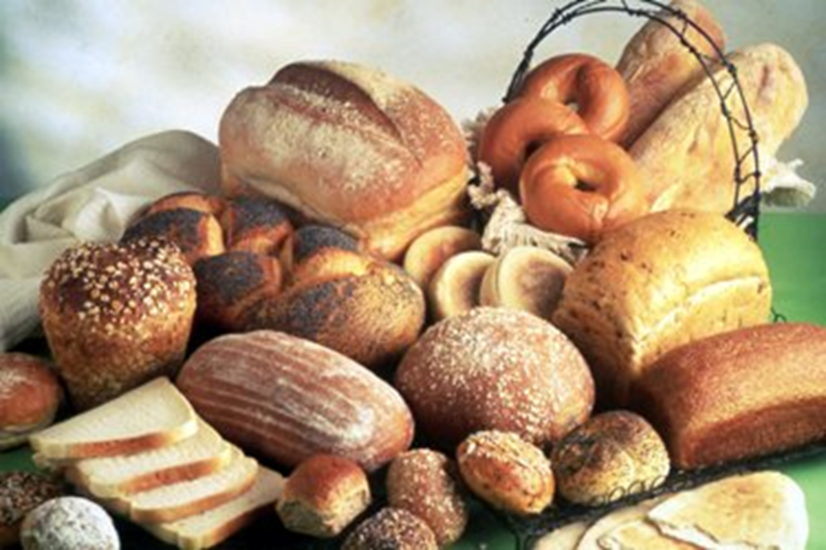
Finding out
Wheat, flour and bread
Do you know what makes a good loaf of bread?
Investigate:
the ingredients – what do you need?
the science – what makes bread rise?
the stages of making and baking.
Carry out a sensory evaluation of different types of bread.
Compare and contrast commercial and homemade bread. What are the differences ?

Slide 24
Finding out
Milk and dairy foods
Investigate the production and processing of milk and dairy food. Start by viewing the Introduction to dairy farming presentation.
View the Milk processing presentation and complete the Milk processing worksheet (answer sheet).
View the Cheese production presentation and complete the Cheese production worksheet (answer sheet).
Use the Year on a dairy farm poster and From grass to glass poster to create a simple infographic about milk production.

Slide 25
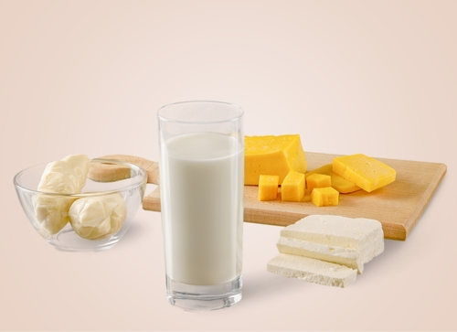
Finding out
Milk and dairy foods
Milk and dairy products are commonly used in domestic and commercial food preparation.
Investigate the production and processing of milk and/or cheese.
Plan a milk or cheese tasting session. How can you record your results?
Does processing affect the sensory qualities of the ingredient?

Slide 26
Bringing it all together
Pupils should:
Select one of the four recipes, or chose their own, to highlight the steps taken to get the dish to the table by creating one of the following:
an engaging infographic;
a video or presentation.

Slide 27
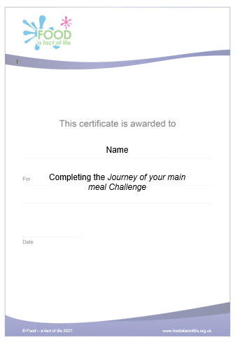
Celebrating success
Optional pupil certificates are available to download and personalise once the Challenge has been achieved.
Why not present the certificates at a celebration assembly or award ceremony?
Downloadable certificate

Slide 28
The journey of your main meal
For further information, go to:
www.foodafactoflife.org.uk
This resource meets the Guidelines for producers and users of school education resources about food.

