Slide 1
Food fiesta
A Cooking Challenge for 14 -16 year olds

Slide 2
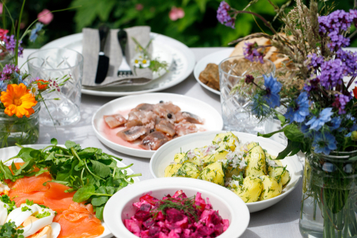
The Challenge
Plan a menu for a summer fiesta, and then prepare and cook a dish, or range of dishes, to serve.

Slide 3
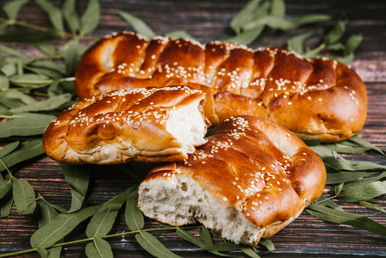
Let’s get started – the Challenge is on!
Fiestas
Discuss in pairs the term fiesta. What does it mean to you?
Fiesta is a Spanish word meaning feast, used to mean a religious festival or any kind of celebration, especially a saint's day celebrated in Spanish-speaking countries.
It can also be a celebration, party, holiday or carnival - often outdoors!
Traditional Mexican bread called "Pan de fiesta"

Slide 4
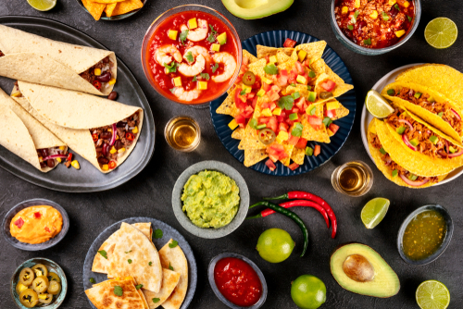
Let’s get started – the Challenge is on!
Fiesta food
In pairs, list five foods that are often served as part of a celebration.
Explain what makes these food special.
Name a recipe or dish that is a party/fiesta favourite for you, your family or friends. Describe the recipe or dish to the person next to you.

Slide 5
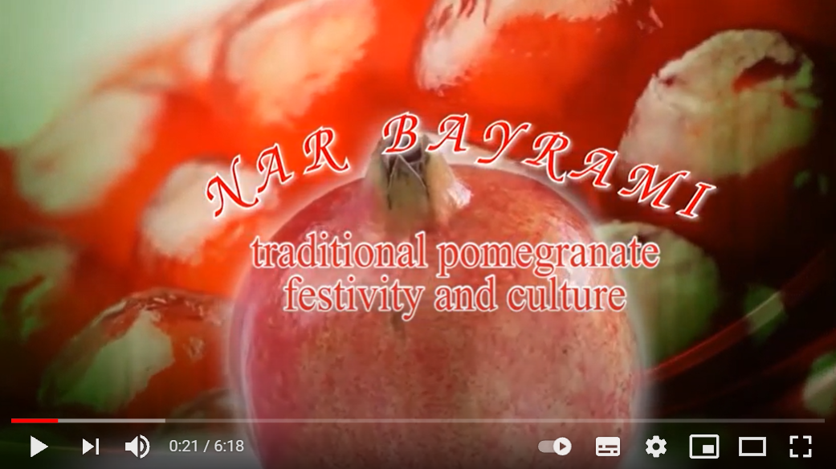
Did you know?
Some fiestas and festivals celebrating food are currently recognised by UNESCO and its Representative List of the Intangible Cultural Heritage of Humanity, including:
Nar Bayrami an annual festival in October/November in Azerbaijan’s Goychay region that celebrates the pomegranate and its traditional uses and symbolic meaning.
The Cherry Festival in Sefrou, Morocco, celebrates the natural and cultural beauty of the region, symbolised by the cherry fruit.
Oshituthi shomagongo, Marula fruit festival brings together the eight Aawambo communities in northern Namibia.
Click on the image to watch a video about the Nar Bayrami festival

Slide 6
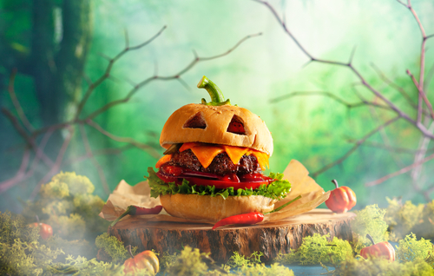
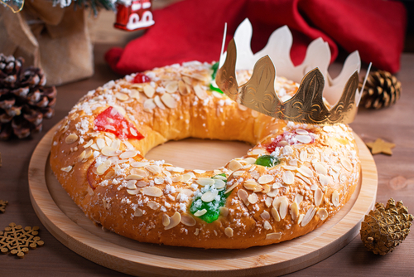
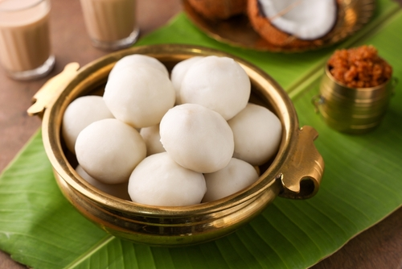
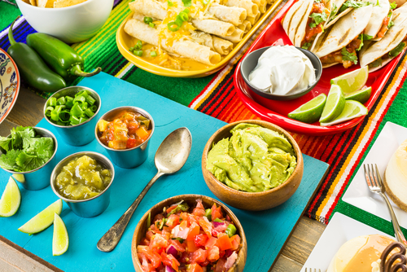
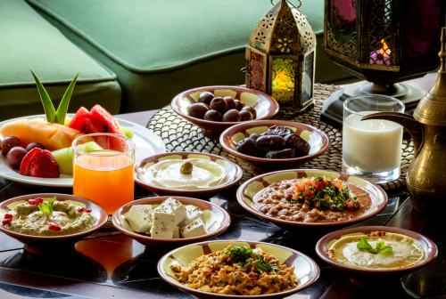
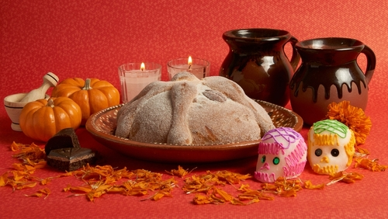
Fiestas and parties around the world!
Halloween party USA
Three Kings’ Day (Dia de los Reyes) Spain
Kozhukatta Pidi on Palm Sunday, India
https://www.shutterstock.com/image-photo/iftar-suhoor-served-ramadan-1333792940
Fiesta party buffet table - Mexico
Iftar or Suhoor served in Ramadan
Bread of the dead to celebrate the Day of the Dead in Mexico
Notes:
Images links:

Slide 7
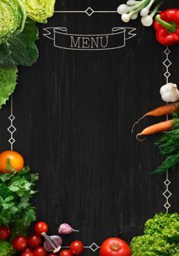
Planning
When planning your fiesta or summer party menu there are things to consider that will help you make decisions about the dishes to include. Here are some points to start:
What cooking facilities do you need?
What is the celebration?
When would it be eaten?
How and where will it be served?
What is the style of food?
Who would be attending?
How can you make use of seasonal/local food?
Are there any special dietary considerations?
What are the key food safety points ?
How can you use a balance of ingredients, flavours and textures?
How can you achieve a good balance of energy and nutrients?

Slide 8
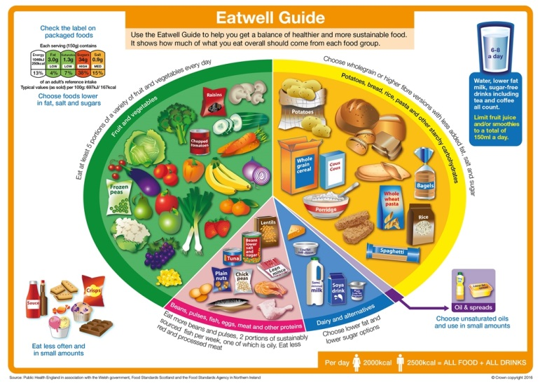
A balanced approach
The Eatwell Guide shows the proportions in which different groups of foods are needed in order to have a well-balanced and healthy diet.
Following the Eatwell Guide can also lower your environmental footprint.
Consider the ways in which you can choose a variety of different foods from each food group to help get the wide range of nutrients the body needs to stay healthy.
Reflect on how the food groups can be incorporated into your ‘fiesta menu’.

Slide 9
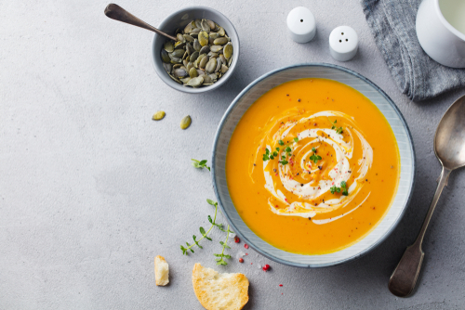
Texture of food
What is the texture of a food? Why is it important? How can a variety be included in your menu?
Food texture is defined as those properties of a food that are sensed by touch in the mouth and with the hands.
We use many words to describe food texture, for example foods can be smooth, lumpy, sticky, crispy, crumbly, crunchy, hard, tough, fibrous and chewy.
Choose a food and list five words that describe the food.

Slide 10
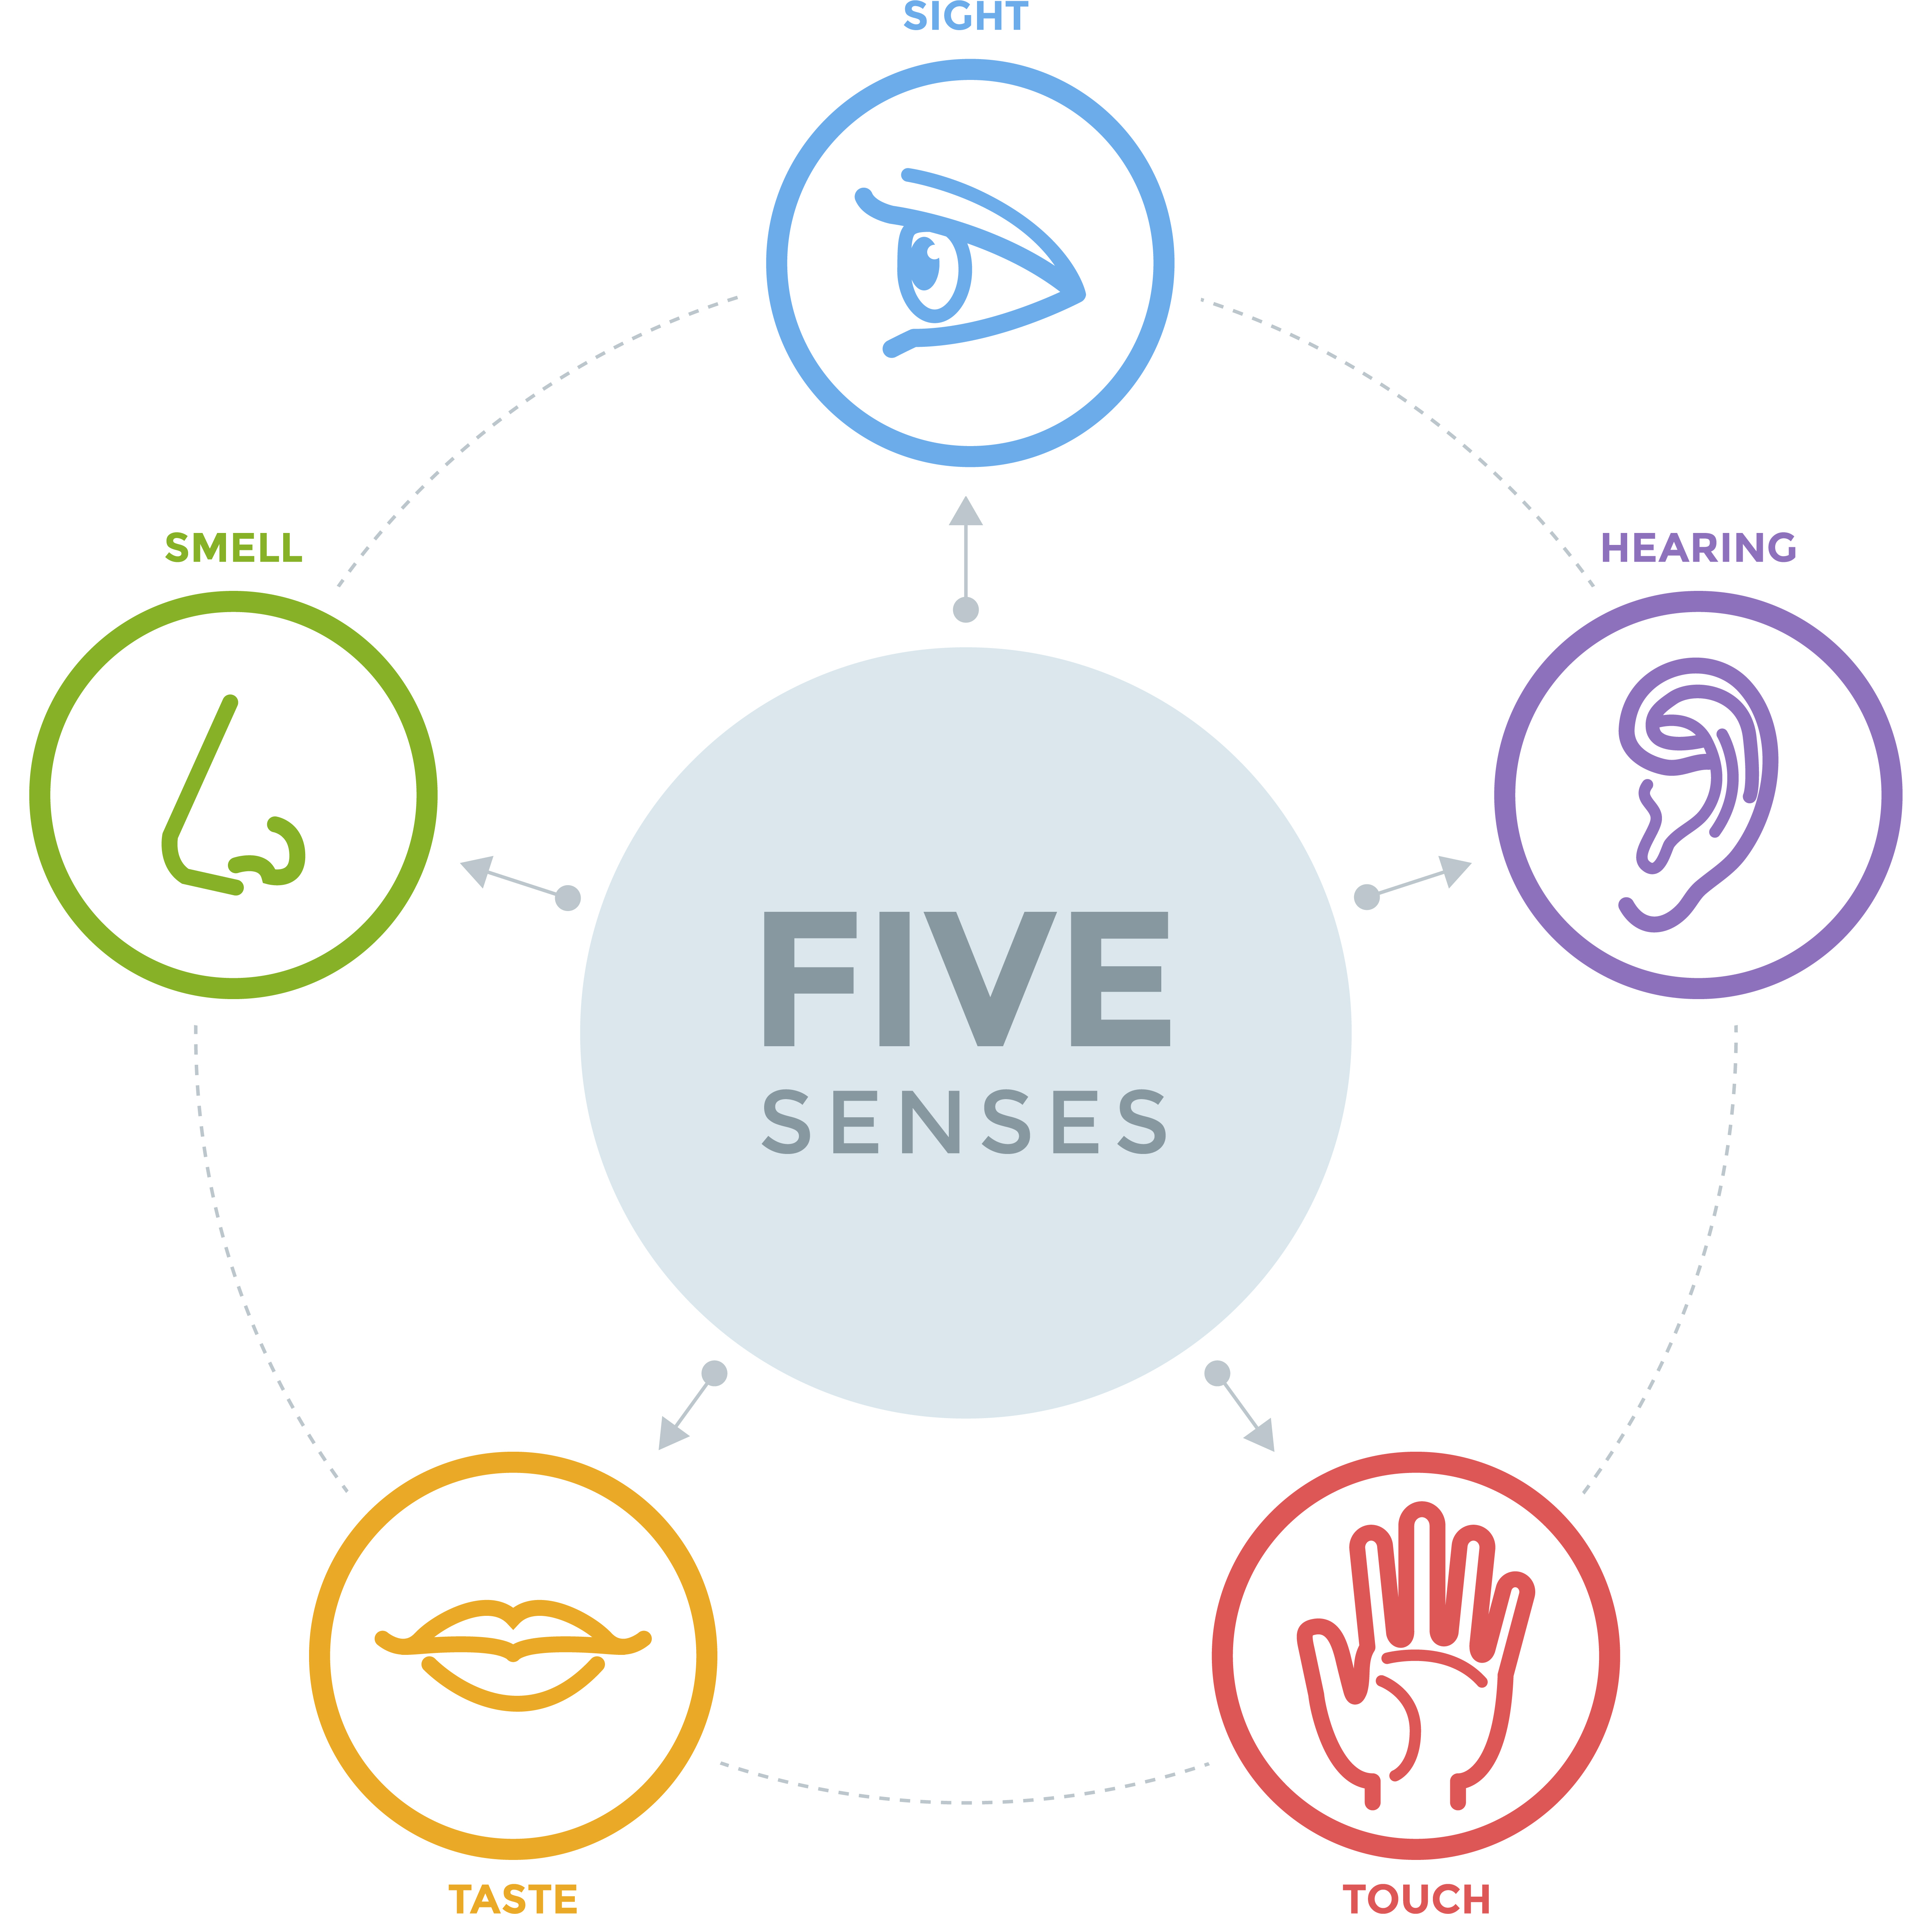
Flavours – did you know?
Flavour is the sensory impression of a food or other substance and is determined mainly by the chemical senses of taste and smell.
Flavour is a complicated mix of sensory data. Taste is just one of the senses that contributes to flavour.
Each of your five senses can send messages to the brain about what you’re eating or drinking.
Taste and flavour together influence how people experience food.

Slide 11
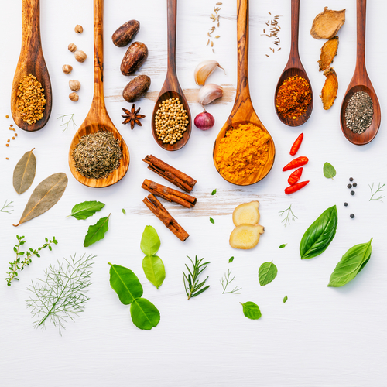
Adding flavour to food
Flavour is based mainly on how a food or drink is sensed by cells in the mouth, these are a collection of 50 -100 taste receptors or taste buds.
When certain chemicals in food trigger a response in these receptors, the brain detects one or more of five types of tastes - sweet, sour, salty, bitter or umami.
When preparing and cooking food we can alter or enhance the flavour by adding ingredients such as herbs and spices.
How can you use these ingredients to enhance the flavours in your chosen menu?

Slide 12
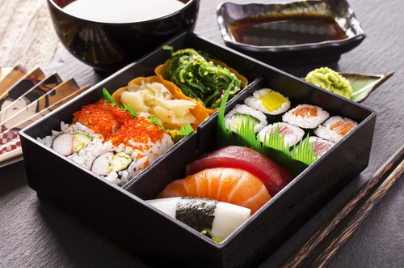
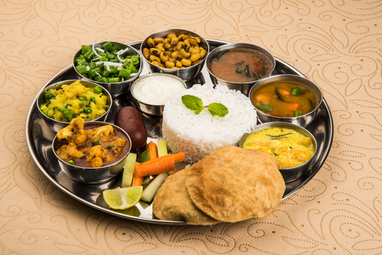
How does it look?
Food presentation is the art of modifying, processing, arranging, or decorating food to enhance its aesthetic appeal.
What makes food look attractive?
Points to consider when planning:
garnishes and decorations should be edible and add interest to the dish;
a variety of textures and colours always looks great;
less is more, don’t overdo the styling and presentation.

Slide 13
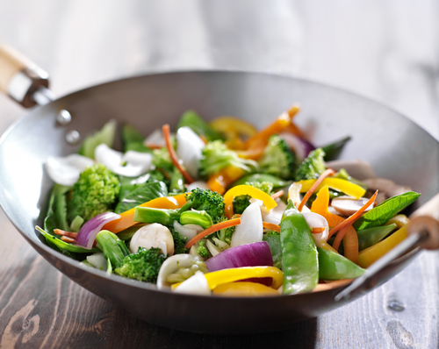
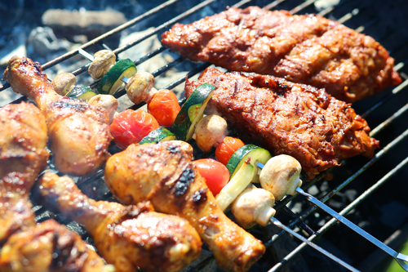
Cooking up your menu
Consider different ways that the dishes on your summer fiesta menu could be cooked.
Outdoor cooking on a grill or barbeque is popular in the summer months.
The method of cooking will depend on the type of menu that you plan.
Remember that the method of cooking chosen may have an effect on the nutritional value of the dish.

Slide 14
The Challenge
Plan a menu for a summer fiesta, and then prepare and cook a dish, or range of dishes, to serve.
Good luck!

Slide 15
Teachers Guide

Slide 16
The Food – a fact of life Challenges
The Food – a fact of life Challenge activities have been written to support teachers not following the national curriculum for their specific country or those following a challenge or theme-based approach. However, they could be used in any school across the UK.
The Challenges cover healthy eating, cooking and where food comes from and provide a wide range of activities that teachers can select depending on their pupils’ needs, age and abilities, and the time available.
There are 12 Challenges developed to be used with nursery, primary or secondary pupils.
Each Challenge comprises the Challenge, opportunities for learning and a variety of pupil activities that can be completed individually or in groups. Each Challenge culminates in a final outcome, which could be paper based, such as a report, poster, newspaper article or PPT presentation, a video or interactive activity, or a recipe, menu or dish/range of dishes, depending on the theme of the Challenge.
Optional pupil certificates are available to download and personalise once the Challenge has been achieved.

Slide 17
The 14-16 Cooking Challenge
Plan a menu for a summer fiesta, and then prepare and cook a dish, or range of dishes, to serve.

Slide 18
Opportunities for learning
By doing this challenge, the opportunities for learning include:
researching food fiestas around the world, such as recipes, ingredients and cooking methods;
applying knowledge of healthy eating and sustainable diets to create a suitable menu;
investigating the importance of flavour, texture and appearance when planning, cooking and serving food;
researching different methods of cooking and their effect on the nutritional value;
demonstrating food preparation and cooking techniques through making a range of dishes;
demonstrating the principles of food hygiene and safety.

Slide 19
How can pupils complete the Challenge?
A range of activity suggestions have been provided – you choose the ones that are most suitable for your pupils and the time that you have available to complete the challenge.
Activities include:
Finding out – activities around researching food around the world that is served at fiestas/celebrations, planning menus, the use of ingredients to add texture/flavour, methods of cooking and presentation.
Making and evaluating – activities around applying knowledge of healthy eating and sustainable diets, demonstrating a range of practical food skills and cooking methods, demonstrating the principles of food hygiene and safety.
Bringing it all together – planning a menu and making a selection of dishes if time allows.

Slide 20
Finding out - activities
Pupils, individually or in groups, could:
Investigate the different celebratory events (such as fiestas) that are held around the world and the food that is associated with the event. Create a bank of words and/or images and present an ‘ideas board’ or short presentation to showcase ideas.
View a range of ingredients or images of foods from different countries. Ask the pupils to match the name against the ingredient. Discuss why the foods are found in different countries and the effect of weather and climate. Use the Food production, weather and climate presentation to support this task.
Find out more about British and international cuisines by viewing this presentation and completing this worksheet.

Slide 21
Finding out - activities
Investigate how herbs and spices can be used to enhance the flavour of dishes. Use sensory evaluation tests to explain their choices.
Create a presentation to demonstrate the principles of serving and presenting food. Use The Art of food presentation and styling poster and presentation to support.
Use the internet, food blogs, magazines or recipe books to research suitable food styling and presentation for the following types of dishes or meals. Explain why they would be appropriate.
  Street food such as tapas, burgers or kebabs.
  Summer picnic food to celebrate the end of school or university with friends.
  Canapés at a 60th birthday party.

Slide 22
Finding out activities
Find a traditional and modern recipe for the same dish and list the reasons why the recipe has changed. An example could be Lamb tagine and Minced lamb tagine. This could include: consideration of dietary advice, healthier eating; wider variety of alternative ingredients available; use of ready-made components; change in lifestyle e.g. less time for cooking traditional meals; loss of personal food preparation and cooking skills; increased cost of ingredients and personal preference.
List three of your favourite party or celebration recipes and research where they are from. Name the country where it originates from and identify three other recipes that also originate from that country.
Create an infographic showing the different types of bread that are made and eaten around the world. The Bread traditions around the world presentation can be used to support. Consider if any of these breads could be used in your summer fiesta menu.

Slide 23
Finding out - activities
Recap on cooking methods and heat exchange, show the Heat exchange presentation. Task pupils to complete the Heat exchange worksheet.
Identify healthier ways to cook food - show the Healthier cooking methods presentation. Ask pupils to list the healthier cooking methods and for each method, suggest at least two different recipes.
Investigate the effects of cooking on food, show the Effect of cooking presentation and complete the worksheet. Use the Effect of cooking on food quiz and answers to test knowledge.
Review the principles of the Eatwell Guide using the presentation and worksheet or watch the Eatwell Guide video.
Use the nutritional analysis programme Explore Food to investigate the effect of reducing fat and sugar in recipes and/or the use of healthier cooking methods.

Slide 24
Making and evaluating - activities
Make a range of dishes suitable for a fiesta or party to acquire, develop and secure practical food skills, and use a range of ingredients and cooking techniques. There is a wide variety of recipes on Food – a fact of life.
Investigate ‘global cuisine’. (This means a local, regional or national cuisine that has spread around the world, its food is served worldwide. Examples of this are Chinese, Indian and Japanese food which can be found in many parts of the world). Make a ‘global cuisine’ dish. Search the recipes on Food - a fact of life for inspiration.
Use Gourmet Burger Builder and presentations such as Party time! , The BBQ, Posh nosh! and Eat with mates! for inspiration, create an exciting burger for your menu. Follow the recipe produced and make your burger.

Slide 25
Making and evaluating - activities
Modify the cooking method for a particular food or recipe and evaluate the results e.g. cooking sausages or burgers in a frying pan, under the grill or in the oven.
Get creative with ingredients through the burger, kofta and sausage challenges.

Slide 26
Bringing it all together
Pupils should:
1. Plan a menu suitable for a summer fiesta taking into account the suitability of dishes, applied knowledge of healthy eating, suitable methods of cooking, the use of flavours and textures and presentation.
2. Prepare, cook and serve one of the dishes, or a range of dishes.

Slide 27
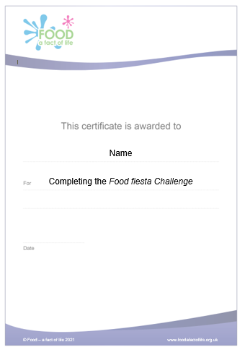
Celebrating success
Optional pupil certificates are available to download and personalise once the Challenge has been achieved.
Why not present the certificates at a celebration assembly or award ceremony?
Downloadable certificate

Slide 28
Food fiesta
For further information, go to:
www.foodafactoflife.org.uk
This resource meets the Guidelines for producers and users of school education resources about food.

