Slide 1
Variety is the spice of life
A Healthy eating Challenge for 14-16 year olds

Slide 2

The Challenge
Create a three-day menu for someone with a specific dietary need, which provides variety and balance, but also something a little different too!
For an extra challenge, choose one of the dishes to cook and prepare.

Slide 3
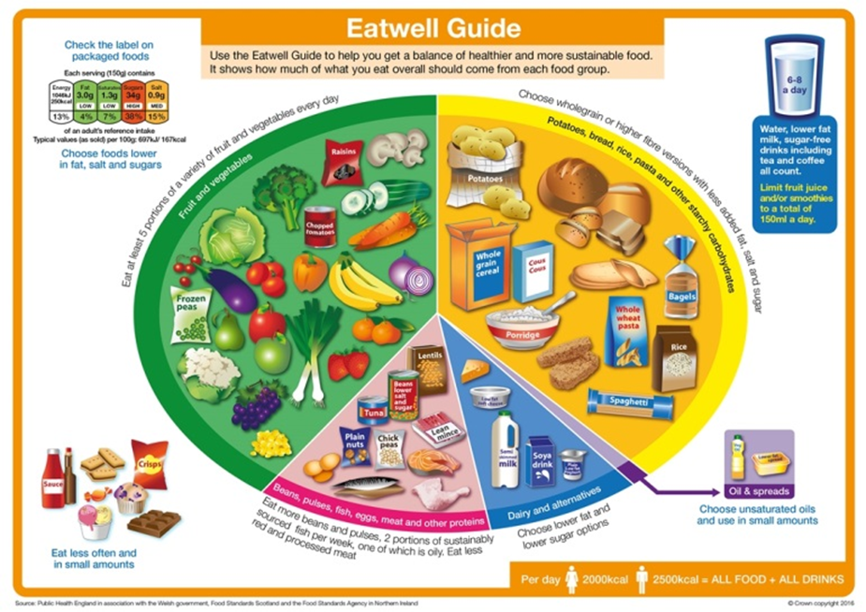
Let’s get started – the Challenge is on!
Work with a partner to answer these questions:
What is the Eatwell Guide?
Who is the Eatwell Guide for?
Should every meal be in proportion to The Eatwell Guide? Explain your answer.

Slide 4
Nutrients
There are two different types of nutrients:
macronutrients;
micronutrients.
What are the three macronutrients that are essential for health?
Carbohydrate, protein and fat. (These provide energy.)
What are two types of micronutrients?
Vitamins and minerals.
Per gram, fat provides more than twice the energy of carbohydrate.

Slide 5
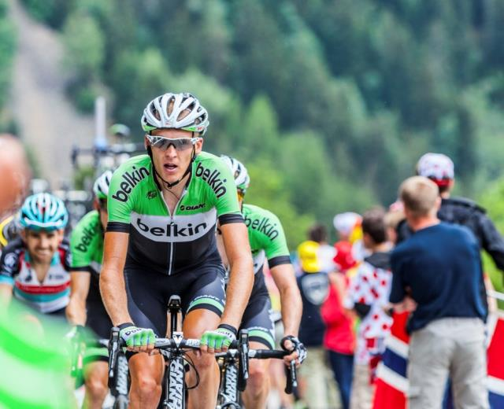
Energy needs
Energy is essential for life, and is required to fuel many different body processes, growth and activities.
These include:
keeping the heart beating and the organs functioning;
maintaining body temperature;
muscle contraction.

Slide 6

Energy needs
Different people need different amounts of dietary energy depending on their:
age;
gender;
body size;
level of activity;
genes.

Slide 7
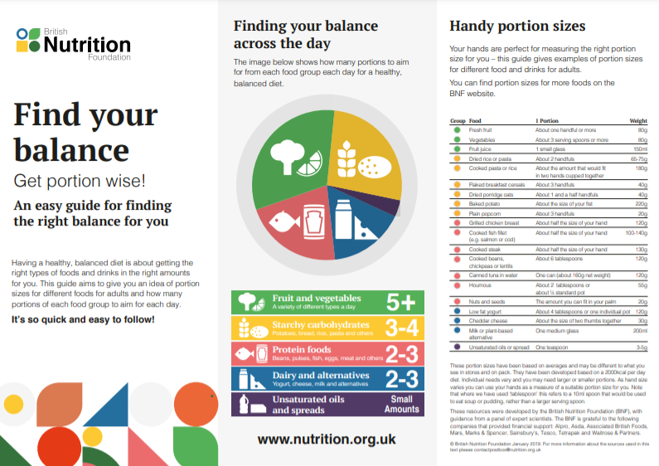
Portion size
Healthy adults need a range of different foods. The amount of food needed varies from person to person.
What factors do you need to consider when thinking about portion size?
Not sure about portion size for different foods? Find out more here.
Find your balance

Slide 8
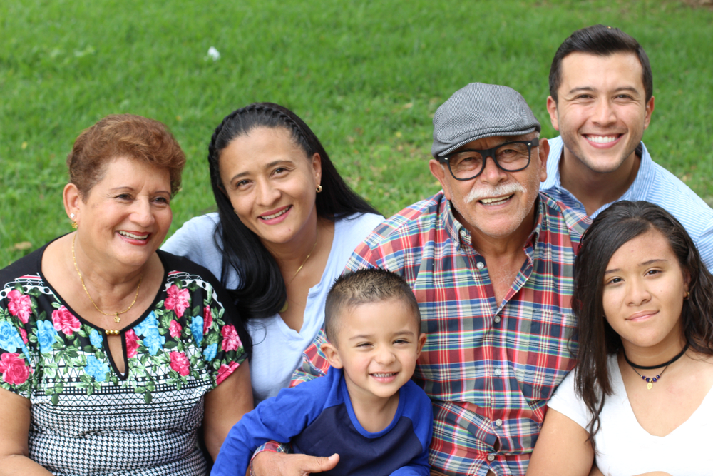
Nutritional needs through life
Energy and nutrient requirements change through life and depend on many factors, such as age, gender, body size, level of activity and genes.
Make a list of the key stages in life that may affect nutritional needs. Why do they change?
Did you include the following?
Pregnancy & breast feeding Toddlers
Childhood Adolescence
Adulthood Older adults

Slide 9

Diet and health
A balanced diet is based on the Eatwell Guide.
Following a healthy, balanced diet helps ensure that our bodies get all the nutrients needed to function well from day to day.
A balanced diet can also reduce the risk of diseases like heart disease, stroke, type 2 diabetes and some types of cancer in the longer term.
Nutrition.org.uk

Slide 10
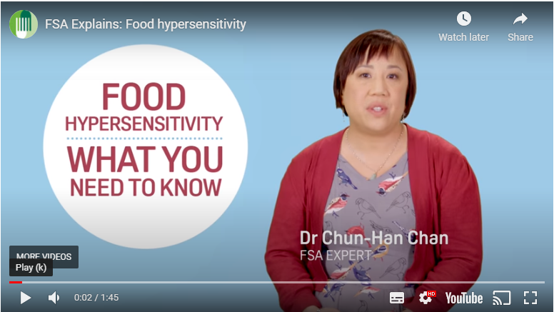
Allergies and intolerances
Food intolerance is the general term used to describe a range of adverse responses to food, including:
allergic reactions;
adverse reactions resulting from enzyme deficiencies;
pharmacological reactions;
other non-defined responses.
What information would you make available with your menu plan?
Watch the Food Standards Agency video for more information.

Slide 11
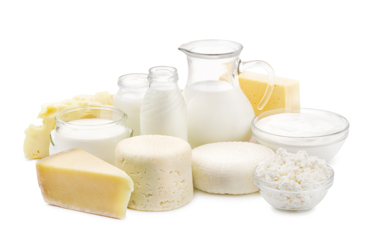
Did you know?
According to the Food Standards Agency Food and You report (April 2019), the most common foods that people reported having an adverse reaction to were:
cows’ milk and cows’ milk products (23%);
fruit (16%);
cereals containing gluten (13%).
Food and You Survey Wave 5

Slide 12
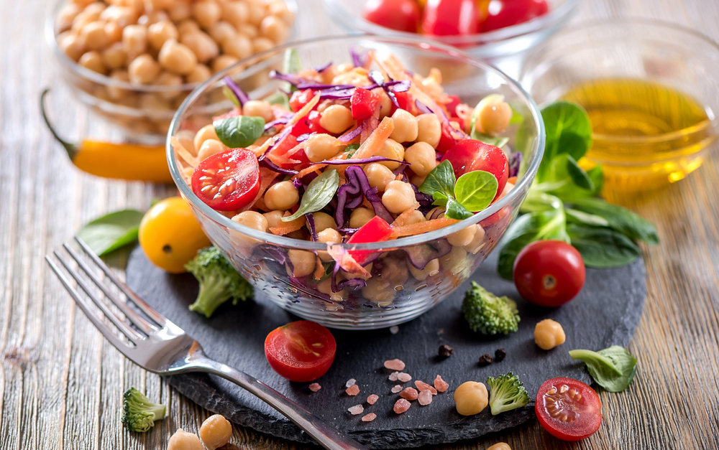
Vegetarian and vegan diets
Well planned vegetarian and vegan diets can be nutritious and healthy.
The UK government suggests a vegetarian diet should be based on the Eatwell Guide.
How can vegetarians and vegans ensure they have a balanced diet that provides all the essential nutrients?

Slide 13
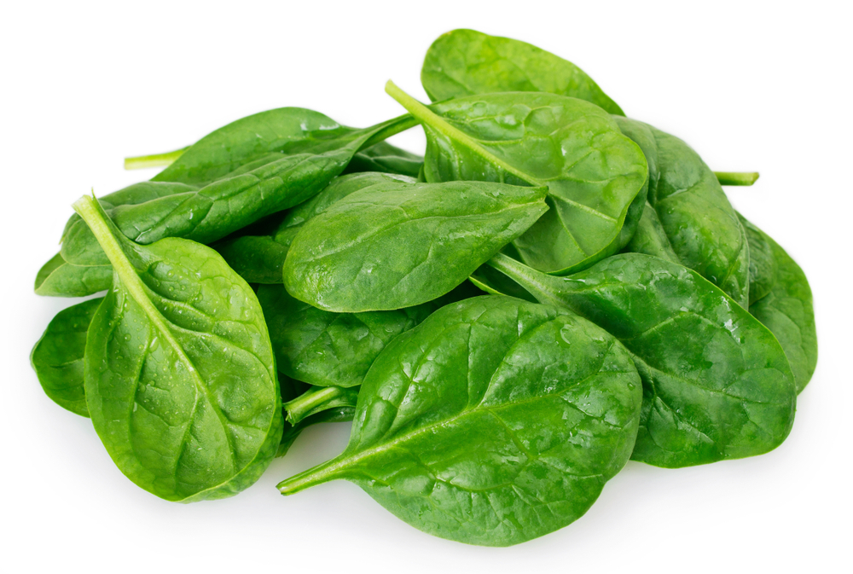
Did you know?
The iron found in plant foods (called non-haem iron) is less readily absorbed in the body than the iron from animal sources (known as haem iron).
Vegetarians may have lower iron stores so it is important to include good sources of iron in the diet. Vitamin C helps the body to absorb iron.
Foods that provide iron for vegetarians include:
wholegrain cereals and bread;
dark green leafy vegetables (such as watercress and spinach);
beans and lentils;
some fortified breakfast cereals (with added iron);
dried apricots and figs.
nutrition.org.uk

Slide 14
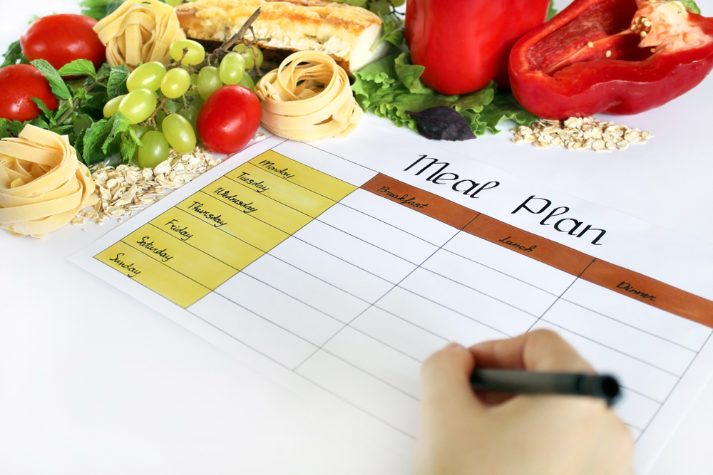
Meal planning
Decide what specific dietary need(s) you are going to focus on.
Discuss and record what you will need to take into consideration when planning your menu for the Challenge.
You may consider using a nutritional analysis programme to help you make decisions.

Slide 15
The Challenge
Create a three-day menu for someone with a specific dietary need, which provides variety and balance, but also something a little different too!
For an extra challenge, choose one of the dishes to cook and prepare.
Good luck!

Slide 16
Teacher’s guide

Slide 17
The Food – a fact of life Challenges
The Food – a fact of life Challenge activities have been written to support teachers not following the national curriculum for their specific country or those following a challenge or theme-based approach. However, they could be used in any school across the UK.
The Challenges cover healthy eating, cooking and where food comes from and provide a wide range of activities that teachers can select depending on their pupils’ needs, age and abilities, and the time available.
There are 12 Challenges developed to be used with nursery, primary or secondary pupils.
Each Challenge comprises the Challenge, opportunities for learning and a variety of pupil activities that can be completed individually or in groups. Each Challenge culminates in a final outcome, which could be paper based, such as a report, poster, newspaper article or PPT presentation, a video or interactive activity, or a recipe, menu or dish/range of dishes, depending on the theme of the Challenge.
Optional pupil certificates are available to download and personalise once the Challenge has been achieved.

Slide 18
The 14-16 Healthy Eating Challenge
Create a three-day menu for someone with a specific dietary need, which provides variety and balance, but also something a little different too!
For an extra challenge, choose one of the dishes to cook and prepare.

Slide 19
Opportunities for learning
By doing this challenge, the opportunities for learning include:
applying knowledge of the current healthy eating guidelines;
investigating how peoples’ nutritional needs change and how to plan a balanced diet for different life stages;
researching health issues that are associated with dietary excess or deficiency, allergy and intolerance and lifestyle choices.
investigating portion size when meal planning.

Slide 20
How can pupils complete the Challenge?
A range of activity suggestions have been provided – you choose the ones that are most suitable for your pupils and the time that you have available to complete the challenge.
Activities include:
Finding out – activities around the Eatwell guide and application of knowledge, energy and nutrients, dietary needs, allergies and intolerance and portion size.
Making and evaluating – activities around applying knowledge of healthy eating and sustainable diets, demonstrating a range of practical food skills and cooking methods, demonstrating the principles of food hygiene and safety, and using the senses to evaluate dishes made.
Bringing it all together – creating an innovative 3 day menu plan for a person with a specific dietary need, if appropriate demonstrating practical skills to make a dish.

Slide 21
Finding out - activities
Pupils, individually or in groups, could:
Healthy eating
Review the principles of the Eatwell guide and their application in meal planning. Use the Eatwell guide presentation, worksheet and quiz to review and test knowledge.
Revise the Eatwell guide principles by viewing the short videos about the guide and each of the five food groups.
Energy and nutrients
Investigate further the sources and functions of macro and micronutrients. Use the Nutrients presentations, worksheets and quiz to consolidate learning.

Slide 22
Finding out - activities
View the presentation about Dietary reference values and complete the worksheet to establish an understanding of nutritional requirements. There is also a quiz with answers.
Review the importance of fibre in the diet using the Fibre presentations, worksheets, quiz and activities. Discuss how these principles can be incorporated into their menu planner.
Play the Vitamins and minerals matching games to match each nutrient to one of the foods they are found in.
Use this interactive activity to match the energy used by different activities.
Enter the information from the menu plan into Explore Food. Compare the results to the recommendations for the specified person.

Slide 23
Finding out - activities
Play the interactive Energy in, energy out quiz and test their knowledge of how much energy (calories) is provided by different food and how much is used when active.
Dietary needs
Complete the diet and health food route journal which looks at nutritional needs throughout life, energy balance, eating well and nutrients.
View the Nutritional needs throughout life presentation and complete the worksheet and quiz.
View the Health issues overview presentation and complete the Diet and health quiz.
Investigate the importance of fibre in the diet. Use the Fibre presentation, worksheets and activities to find out how it can be included in their menu.

Slide 24
Finding out - activities
Select the appropriate Medical conditions presentation to support their menu planning (these include – bone health, cancer, CHD, diabetes, diverticular disease, high blood pressure, inflammatory bowel disease, anemia, malnutrition, obesity).
Vegetarian/Vegan
Explore the dietary needs of people who are vegetarian and/or vegan. The Different dietary needs presentation and worksheet provides information. Further information can be found on www.nutrition.org.uk
Investigate sources of protein from the Beans, pulses, fish, eggs, meat and other proteins food group that are suitable for a vegetarian diet. Watch the video looking at the protein section in the Eatwell guide.
Investigate where products such as tofu, myco-protein (Quorn) and other vegetarian alternatives come from and how they can be included in a menu plan using the Meat alternatives presentation and worksheet.

Slide 25
Finding out activities
Portion size
Use the British Nutrition Foundations’ Find your balance resource to list the weights of common ‘handy’ measures.
Investigate portion size - pour their usual amount of breakfast cereal into a bowl, estimate how much they have put in and then weigh it. How does the amount weighed compare to the recommended portion size on the pack (usually 30g-45g)? Pour the recommended portion size into another bowl and compare the two. Discuss the difference and how this might impact nutrient intake. This activity can be done with other types of food, for example dried pasta or rice. There is a class activity to support this.

Slide 26
Allergies and intolerance
Use the Adverse reactions to food presentation and Adverse reactions to food worksheet to explain the importance of understanding allergies to food and food intolerances. There is also a quiz.
Complete the Allergen labelling activity to recognise and highlight the allergens present in three recipes.
Create their own Chef’s recipe card to identify the allergens that may be present in dishes they plan.

Slide 27
Making and evaluating - activities
Discuss with the pupils who they think sports/energy drinks products are aimed at. Compare the list of ingredients for a variety of drinks and identify what is different. Provide a container of sugar cubes and ask the pupils to weigh out the amount of sugars provided in the drinks using the information on the nutrition labels.
Investigate, plan and cook a range of dishes that demonstrate the sources of identified nutrients. Use Explore Food at analyse the recipe.
Create a time plan for the recipe(s) that they have chosen. There are worksheets to support.
Create a visual step-by-step recipe and information card/video to support people trying out the new recipes and ideas.
Use the ‘Find your fibre fortune’ instructions and worksheet to create a fibre-filled meal based on three randomly selected ingredients. Fill out the questions on the worksheet.

Slide 28
Bringing it all together
Pupils should:
Create an innovative menu for a person with a specific dietary need. It should showcase their knowledge and understanding of the Eatwell guide, energy and nutrients and nutritional needs through life, lifestyle choices and/or those living with health issues.
If appropriate pupils can prepare, cook and serve a dish or dishes from the menu.
Supporting information and evidence could be made available such as a nutritional analysis or presentation and guidance resources.

Slide 29
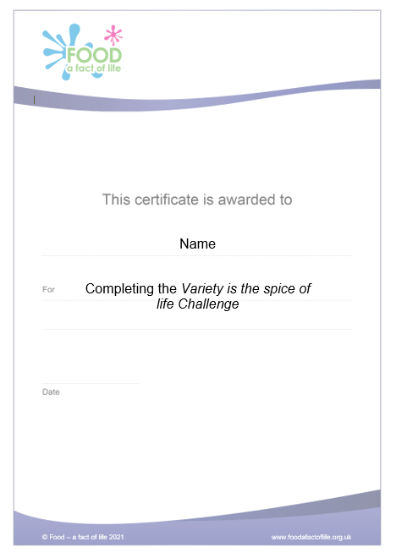
Celebrating success
Optional pupil certificates are available to download and personalise once the Challenge has been achieved.
Why not present the certificates at a celebration assembly or award ceremony?
Downloadable certificate

Slide 30
Variety is the spice of life
For further information, go to:
www.foodafactoflife.org.uk
This resource meets the Guidelines for producers and users of school education resources about food.

