Slide 1
Eat your way around the UK
A Where food comes from Challenge for 11-14 year olds

Slide 2
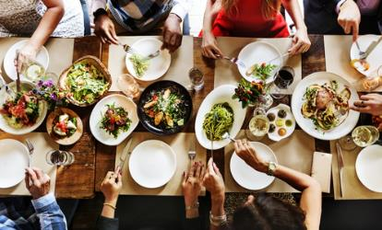
The Challenge
Your school wants to open a community café whose unique selling point will be to predominantly use ingredients grown, reared or caught in the UK.
Create a menu, write a recipe or make a dish for the new café managers to consider.

Slide 3
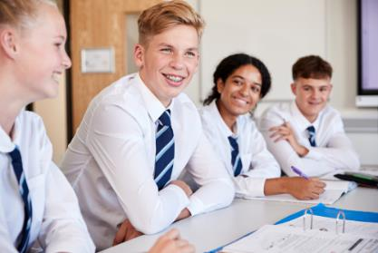
Let’s get started – the Challenge is on!
Discuss what the term ‘Community café’ means to you and your school. Make a list of key words.
Draw up a list of the things that will need to be considered when planning your menu or recipe.
How will you present your ideas to the new café managers for consideration?

Slide 4
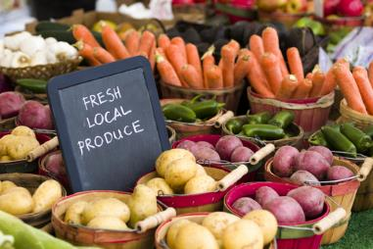
Where does food come from?
Our food has to be grown, reared or caught.
The food is then processed in different ways.
The food is sold to the public through a range of different methods, such as:
farm shops/markets;
supermarkets;
butchers/delicatessens;
online retailers;
restaurants and cafes.

Slide 5
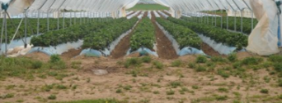
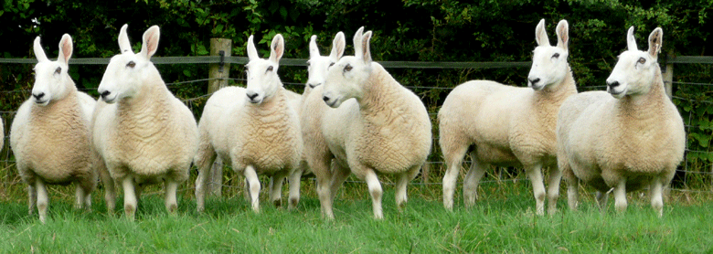
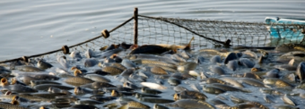
Food in the UK
There are a wide variety of foods that are grown, reared or caught in the UK.
Here are some examples. Name five others.
Grown
Cereals (e.g. wheat, barley, oats)
Fruit
Vegetables and salad
Reared
Cattle Poultry
Game Sheep
Goat Pigs
Caught
Fish
Shellfish

Slide 6
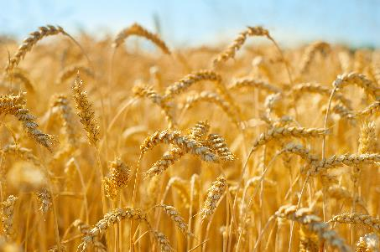
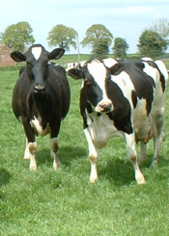
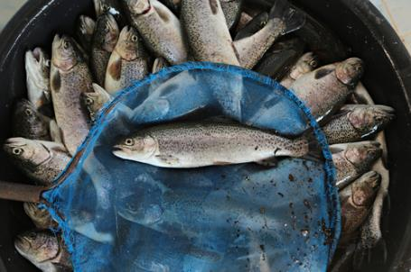
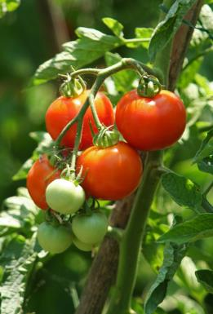
Plant or animal?
All food comes from either a plant or an animal.
Name four foods that originate from each of these examples:

Slide 7
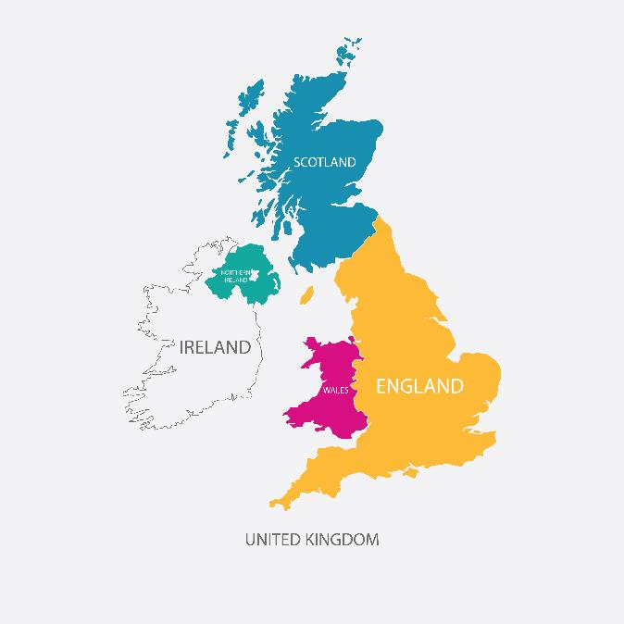
Did you know?
Some parts of the United Kingdom have excellent soil for crops, while others are used for cattle, sheep, pigs and poultry.
In the north-west of England, Wales and Scotland, farmers keep cattle and sheep. Sheep can survive the cold winters on the hills and moors.
In the east of England (East Anglia), wheat, barley and vegetables grow in large fields.
Cattle, sheep, pigs and dairy are the largest commodity sectors in Northern Ireland.
In the south-east of England and the lowlands of Scotland, grain, potatoes and sugar beet are grown. Most UK cauliflowers are grown in the south-east.
In the south-west of England, the rich grass is ideal for feeding dairy cows.

Slide 8
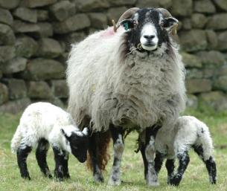
Did you know?
Every year the UK produces over 20 million tonnes of grain.
British dairy farmers produce 15 billion litres of milk each year.
There are 5.1 million pigs and 34 million sheep and lambs in the UK.
Beef, pork, lamb and dairy are produced in the UK to world-class food and farming standards.
Farmers help to support 1 million hectares of woodland and forests. This helps look after the habitats of wildlife such as birds, insects and pollinators. They also look after or plant hedges, trees and wild flowers.
Agriculture in the United Kingdom 2019 - GOV.UK (www.gov.uk)

Slide 9
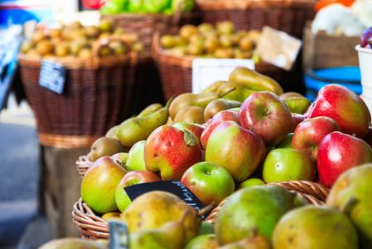
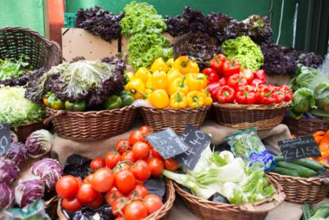
What’s available in the UK?
Your challenge is to predominantly use ingredients grown, reared or caught in the UK.
Make a list of ingredients that are grown, reared or caught in the UK that you could use.
Do you have any ingredients that are a local specialty?
Identify five ingredients that are not grown, reared or caught in the UK that you could use.

Slide 10
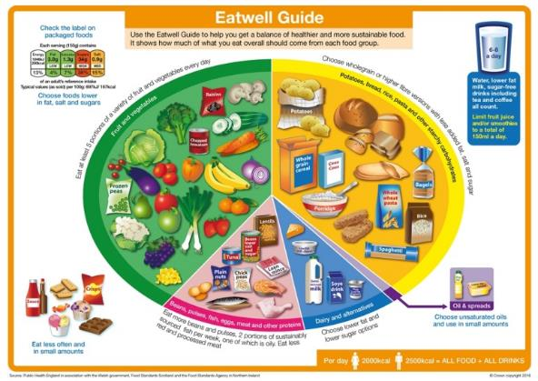
The Eatwell Guide
We should all be following the healthy eating model. In the UK, this is known as the Eatwell Guide.
The Eatwell Guide shows the proportions in which different groups of foods are needed in order to have a well-balanced and healthy diet.
The proportions shown are representative of food eaten over a day or more, not necessarily at each mealtime.

Slide 11
Healthy eating and sustainable diets – applying your knowledge
We should all be choosing a variety of different foods from each food group to help get the wide range of nutrients the body needs to stay healthy.
Following the Eatwell Guide can also be good for the environment/planet, as well as your own health.

Slide 12

Planning
Some questions to consider:
What ingredients have you decided to use for your menu or recipe?
How does it showcase the use of ingredients predominantly from the UK?
Do the dishes make use of seasonal ingredients?
How will your chosen menus, recipe or dish be served?
How are you meeting the needs of your local community?

Slide 13

The Challenge
Your school wants to open a community café whose unique selling point will be to predominantly use ingredients grown, reared or caught in the UK.
Create a menu, write a recipe or make a dish for the new café managers to consider.
Good luck!

Slide 14
Teacher’s guide

Slide 15
The Food – a fact of life Challenges
The Food – a fact of life Challenge activities have been written to support teachers not following the national curriculum for their specific country or those following a challenge or theme-based approach. However, they could be used in any school across the UK.
The Challenges cover healthy eating, cooking and where food comes from and provide a wide range of activities that teachers can select depending on their pupils’ needs, age and abilities, and the time available.
There are 12 Challenges developed to be used with nursery, primary or secondary pupils.
Each Challenge comprises the Challenge, opportunities for learning and a variety of pupil activities that can be completed individually or in groups. Each Challenge culminates in a final outcome, which could be paper based, such as a report, poster, newspaper article or PPT presentation, a video or interactive activity, or a recipe, menu or dish/range of dishes, depending on the theme of the Challenge.
Optional pupil certificates are available to download and personalise once the Challenge has been achieved.

Slide 16

The 11-14 Where food comes from Challenge
Your school wants to open a community café whose unique selling point will be to predominantly* use ingredients grown, reared or caught in the UK.
Create a menu or recipe or make a dish for the new café managers to consider.
*pupils may use ingredients not grown, reared or caught in the UK, e.g. rice, couscous or pasta, but the main focus should be on ingredients produced in the UK.

Slide 17
Opportunities for learning
By undertaking this challenge, the opportunities for learning include:
researching where food comes from and how it can be used to create a healthy and more sustainable diet;
finding out about growing, farming and processing food commodities in the UK;
exploring food certification and assurance schemes and their role for the consumer;
researching seasonality and the benefits of using seasonal and local food;
applying knowledge of healthier and more sustainable diets in a practical context;
using a nutritional analysis programme.

Slide 18
How can pupils complete the Challenge?
A range of activity suggestions have been provided – you choose the ones that are most suitable for your pupils and the time that you have available to complete the challenge.
Activities include:
Finding out – activities around where food comes from, farming and growing food, seasonality, food processing and quality assurance.
Making and evaluating – demonstrating a range of practical food skills and cooking methods, demonstrating the principles of food hygiene and safety.
Bringing it all together – planning and producing a menu, recipe or dish suitable for a community café that uses predominately ingredients from the UK.

Slide 19
Finding out - activities
Pupils, individually or in groups, could:
Where food is grown, reared or caught
View the How food is grown, reared or caught presentation and complete the Fact file worksheet.
Choose a food commodity and research how it is produced. State if it is grown, reared or caught. Complete the Food is grown, reared or caught fact file.
Watch the farm to fork videos and answer the questions on the screen. Choose a food that hasn’t been shown and draw a story board of its journey from farm to fork.
View the Down on the farm presentation and learn about the origins of different animals on the farm. Complete the Down on the farm worksheet to test your knowledge.

Slide 20
Finding out - activities
Look at the Farming for you posters. Make a list of 12 key facts they have learnt about where food comes from, two from each of the six posters.
Play the Plant or animal drag and drop to test their knowledge on where food comes from.
Watch these two interactive videos about ‘slippery salmon’ and ‘excellent eggs’ and answer the questions on the screen.
View the Growing food presentation and identify how the food is processed ready for eating.
View the Farming food presentation and discuss the different methods in a group.

Slide 21
Finding out - activities
Seasonality
View the Eat the seasons presentation to learn about when different fruit and vegetables are in season. Make a poster/infographic showing the different food and when they are in season throughout the year.
Learn more about seasonality using the What’s in season worksheet.
Food processing
View the video clips about food production and processing as an introduction to a lesson or independent learning.
View the Food production and processing presentation and complete the Food processing activity.

Slide 22
Finding out activities
Read through the Development of food technology presentation looking at the history of food production. Test knowledge with the Development of food technology worksheet.
Food assurance
View the Food assurance schemes presentation and complete the worksheet.
Carry out the Matching activity and match the food assurance logos with the name of the food assurance schemes.
Test knowledge using the Food assurance quiz and answers.

Slide 23
Making and evaluating activities
Pupils, individually or in groups, could:
Create a seasonal recipe. Pick one of the four seasons and create a dish that uses food that is in season at that time (use the UK seasons presentation to see what food is in season when).
Make one of the FFL recipes with seasonal ingredients.
Plan and cook a selection of suitable dishes for the community café. Plan and carry out a sensory analysis and analyse the results.
Plan and cook a selection of suitable dishes for the community café. Use a nutritional analysis programme, such as Explore food to calculate the energy and nutrients provided by a recipe.

Slide 24
Bringing it all together
Pupils should:
Create a menu or recipe or make a dish for a community café whose unique selling point will be to predominantly* use ingredients grown, reared or caught in the UK. The dish is to be presented to the new café managers for consideration.
The outcome(s) should showcase their knowledge of:
ingredients that are grown, reared or caught in the UK;
the benefits of using seasonal and/or local ingredients.
*pupils may use ingredients not grown, reared or caught in the UK, e.g. rice, couscous or pasta, but the main focus should be on ingredients produced in the UK.

Slide 25
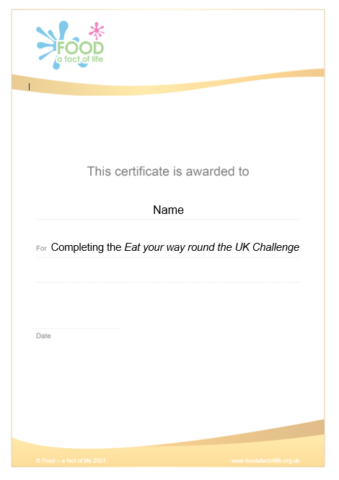
Celebrating success
Optional pupil certificates are available to download and personalise once the Challenge has been achieved.
Why not present the certificates at a celebration assembly or award ceremony?
Downloadable certificate

Slide 26
Eat your way around the UK
For further information, go to:
www.foodafactoflife.org.uk
This resource meets the Guidelines for producers and users of school education resources about food.

