Slide 1
People around the world eat different food

Slide 2
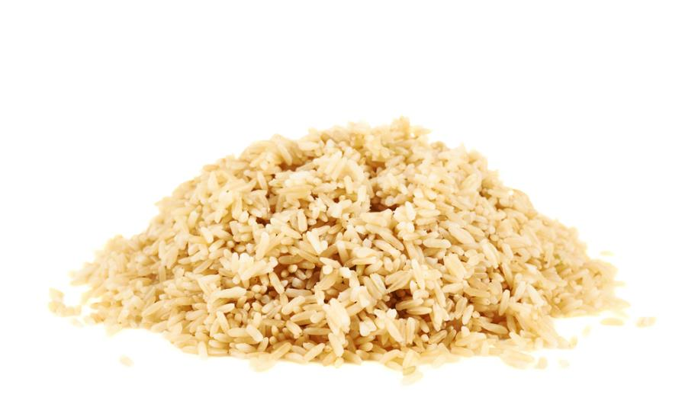
Rice

Slide 3
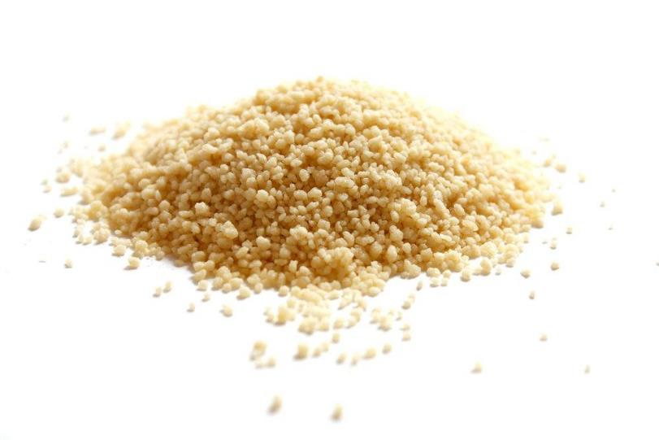
Couscous

Slide 4
Plantain

Slide 5

Yam

Slide 6
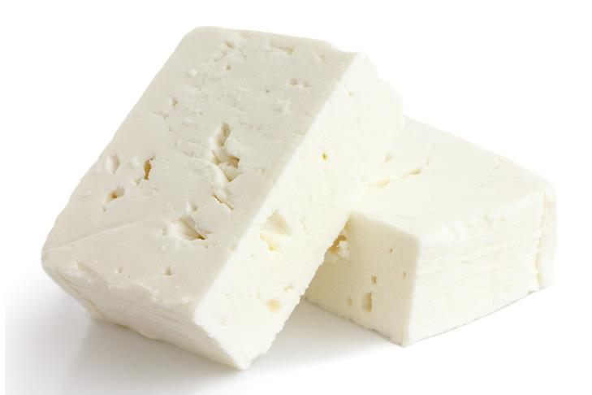
Feta cheese

Slide 7
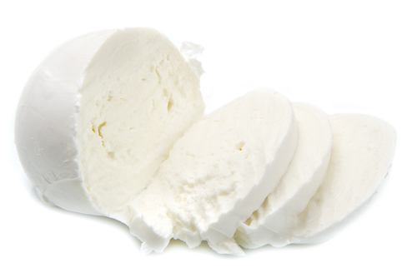
Buffalo mozzarella cheese

Slide 8
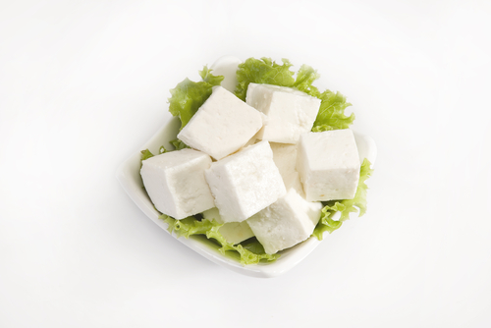
Paneer

Slide 9
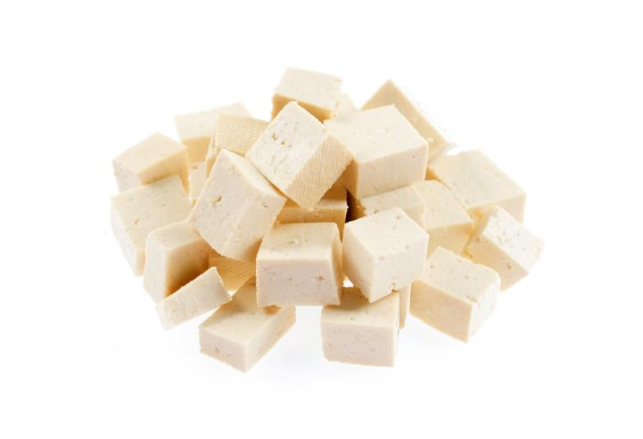
Tofu

Slide 10
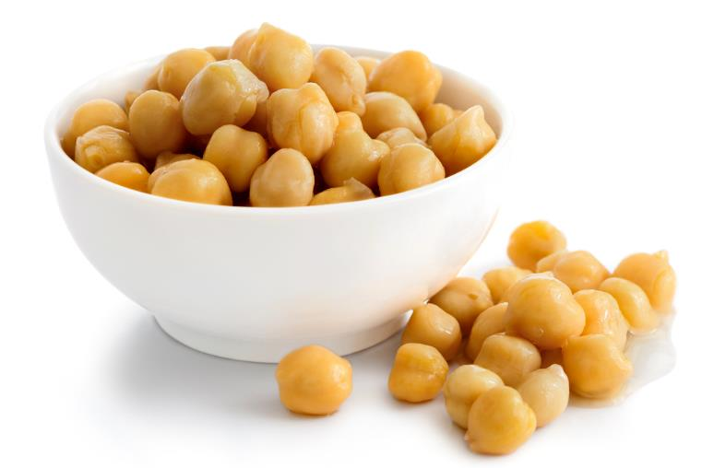
Chick peas

Slide 11
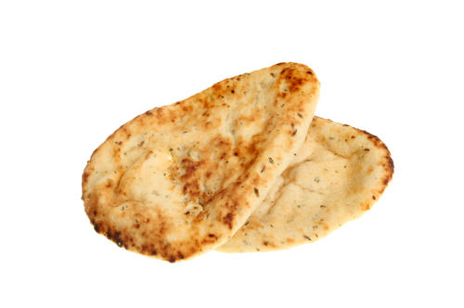
Naan bread

Slide 12
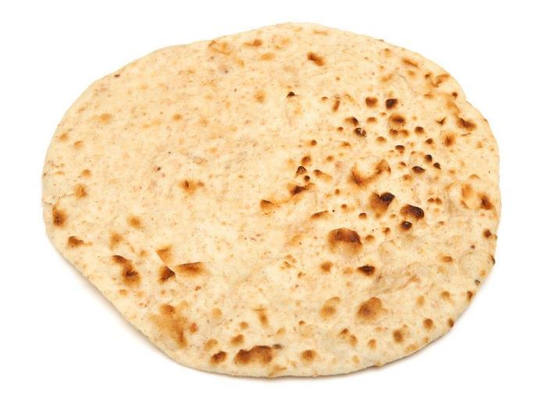
Chapati

Slide 13
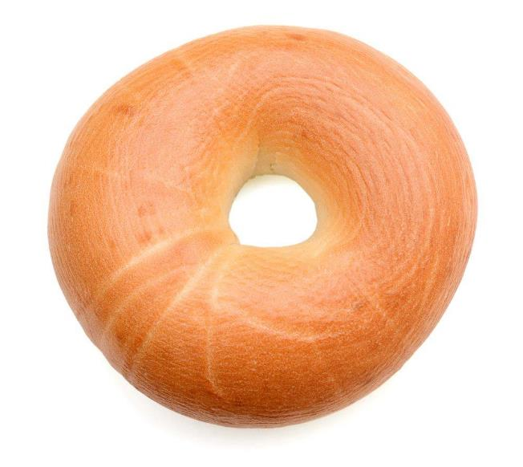
Bagel

Slide 14
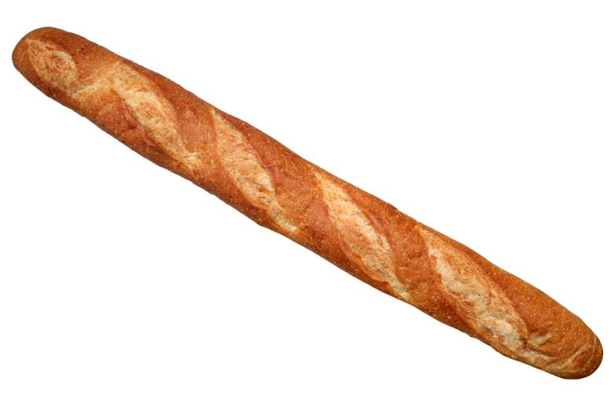
French bread

Slide 15
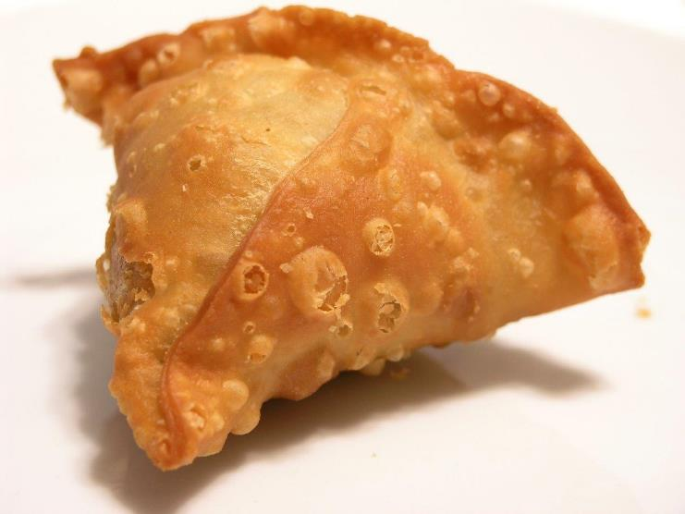
Samosa

Slide 16
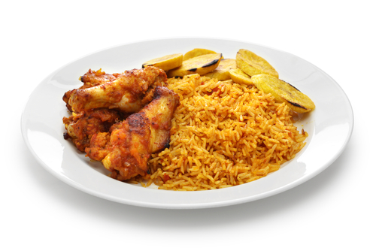
Jollof rice and plantain

Slide 17
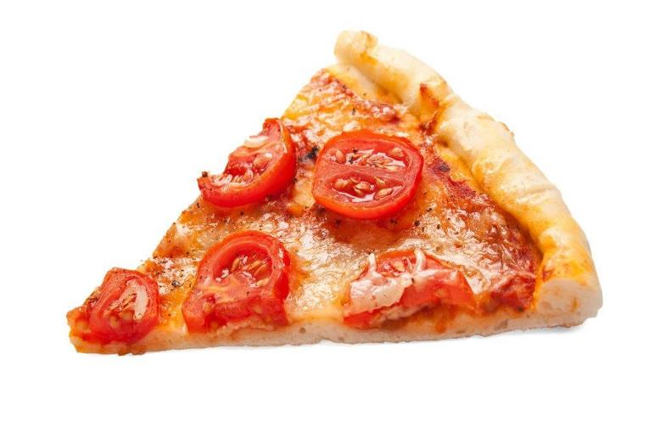
Pizza

Slide 18
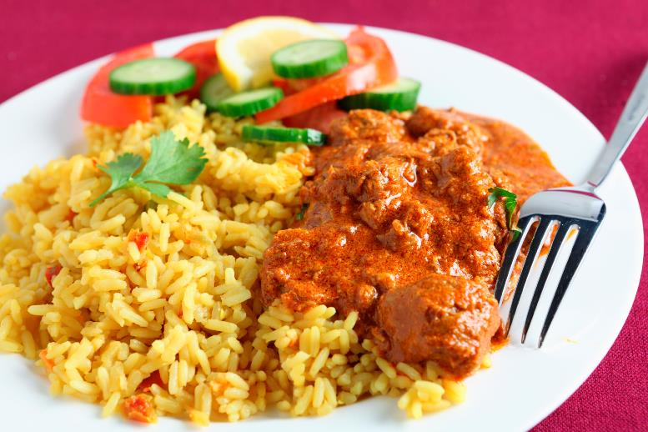
Curry and rice

Slide 19
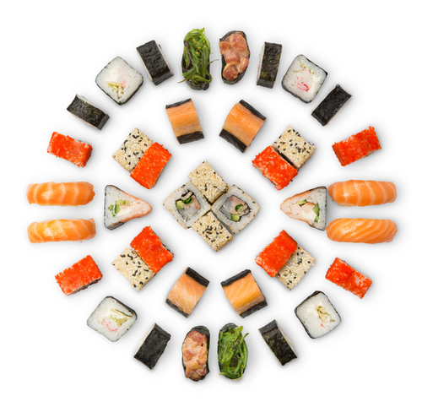
Sushi

Slide 20
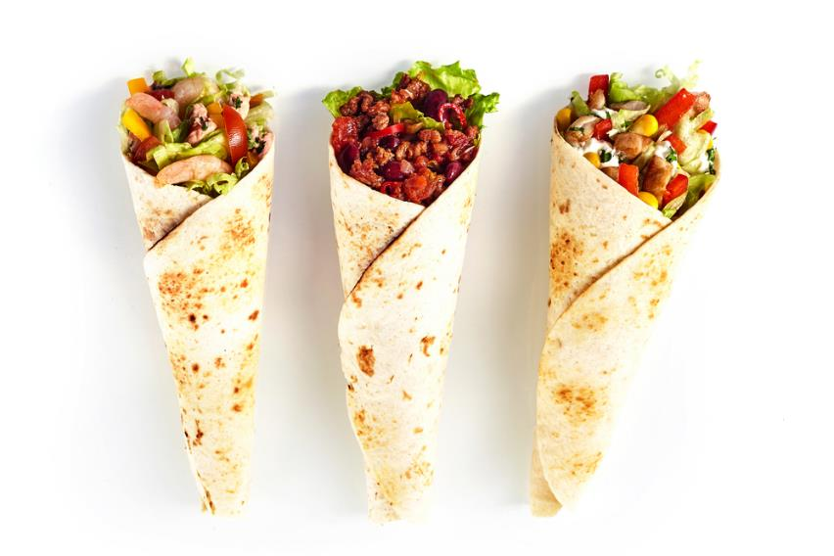
Fajitas

Slide 21
People around the world eat different food
For further information, go to:
www.foodafactoflife.org.uk
This resource meets the Guidelines for producers and users of school education resources about food.

