Slide 1
Meal time images

Slide 2
Meal time images
Name the food or meal.
2. When would the food be eaten?

Slide 3
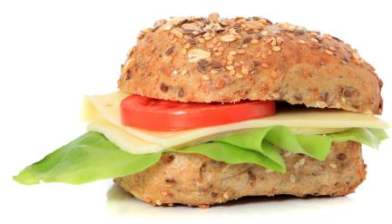
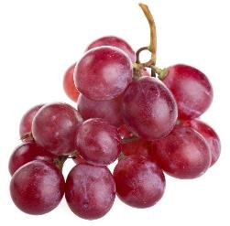
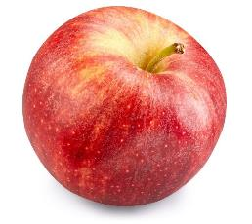
Cheese and salad roll, apple and grapes

Slide 4
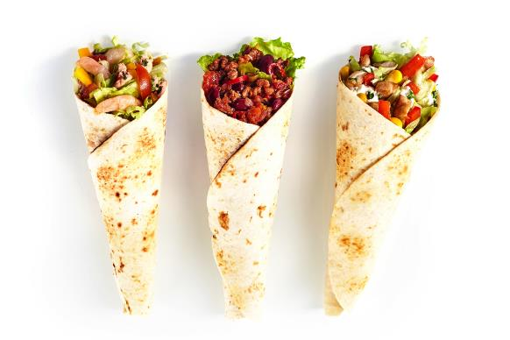
Fajitas

Slide 5
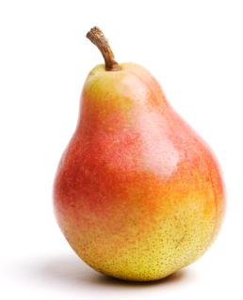
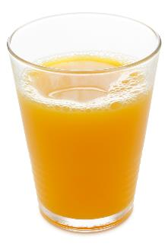
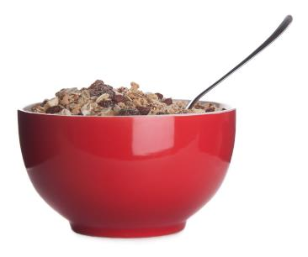
Muesli, pear and orange juice

Slide 6
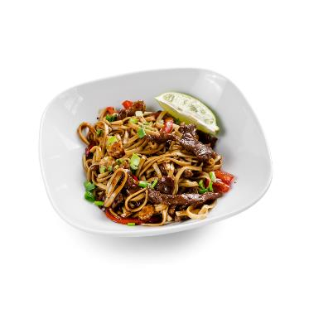
Beef stir fry with wholegrain noodles

Slide 7
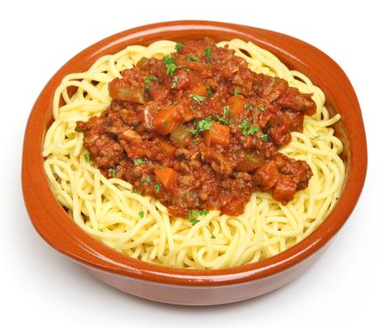
Spaghetti bolognaise

Slide 8
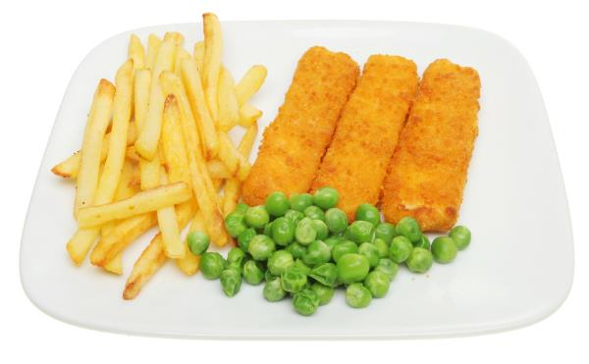
Fish fingers, chips and peas

Slide 9
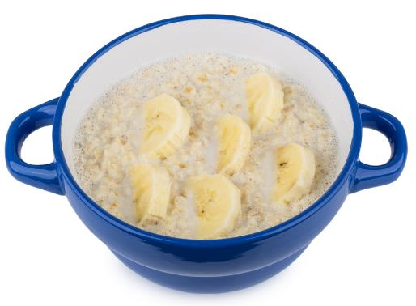
Porridge with banana

Slide 10
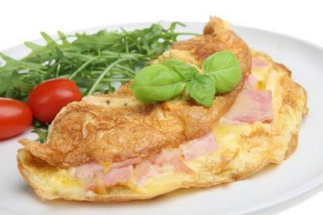
Ham and cheese omelette

Slide 11
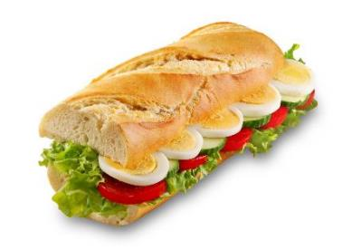
Egg and salad baguette

Slide 12
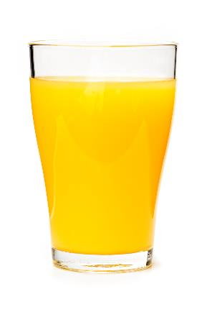
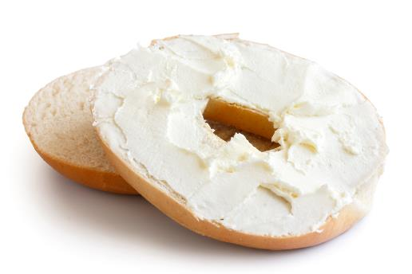
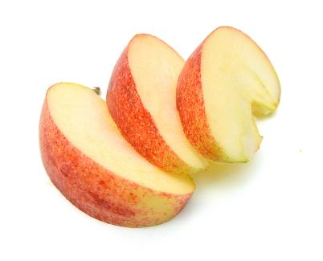
Bagel with soft cheese, sliced apple and orange juice

Slide 13
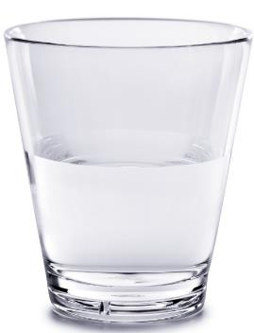
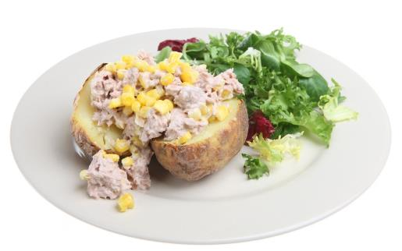
Tuna and sweetcorn in a baked jacket potato and water

Slide 14
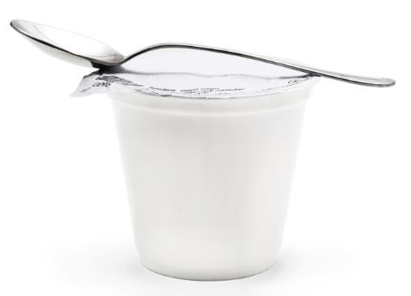
Yogurt

Slide 15
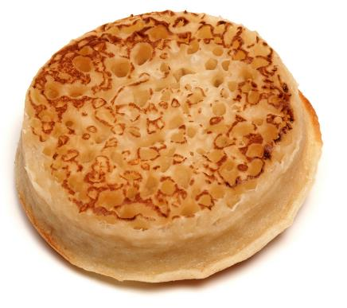
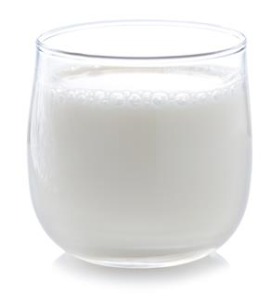
Crumpet and milk

Slide 16
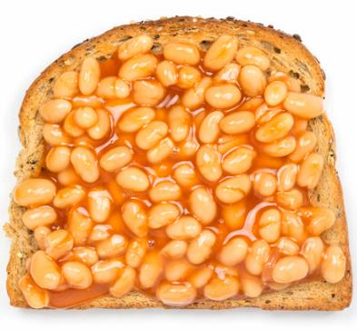
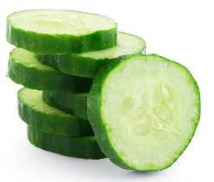
Beans on toast and cucumber

Slide 17
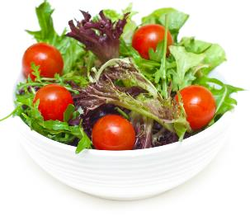

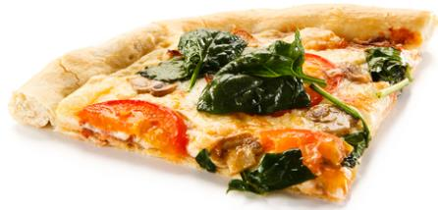
Vegetable pizza, salad and water

Slide 18
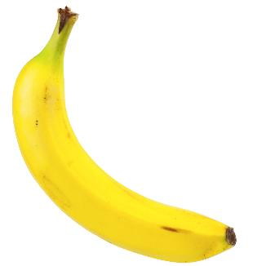
Banana

Slide 19
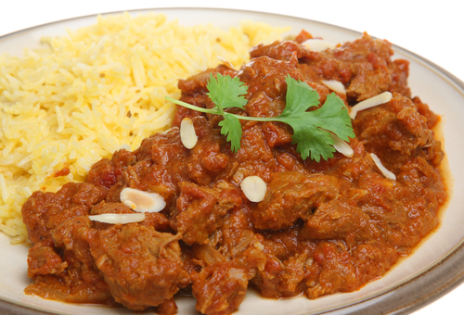
Lamb curry

Slide 20
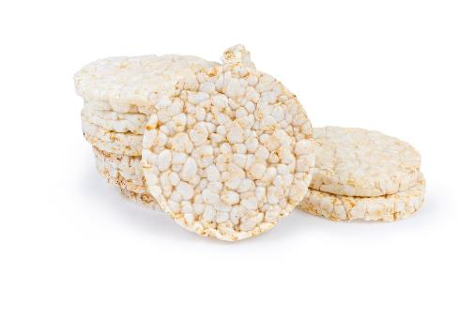
Rice cakes

Slide 21
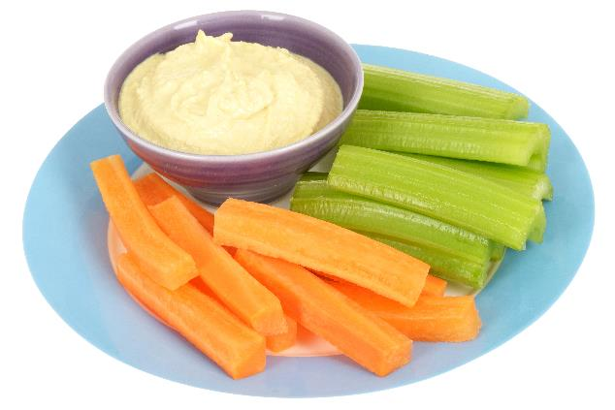
Hummus and vegetable sticks

Slide 22
Meal time images
For further information, go to:
www.foodafactoflife.org.uk
This resource meets the Guidelines for producers and users of school education resources about food.

