Slide 1
Using our senses

Slide 2
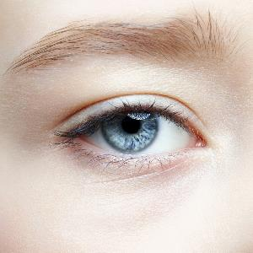
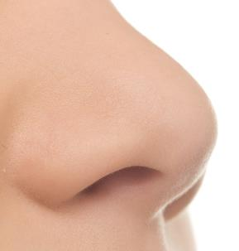
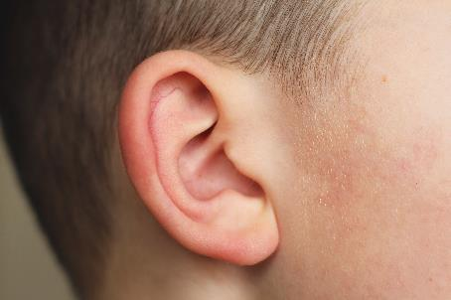
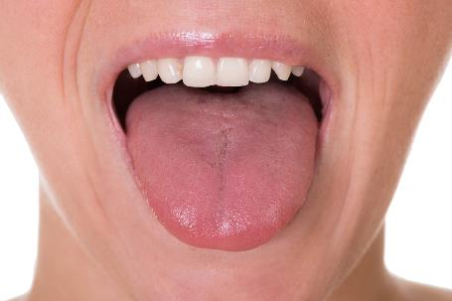
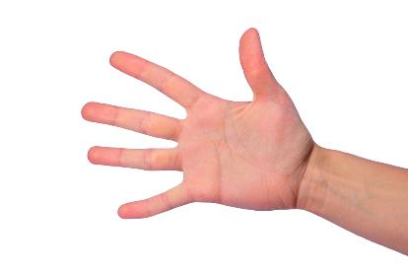
Using your senses
We use our senses to taste food and drink.
Sight
Smell
Hearing
Taste
Touch

Slide 3


Sight
We use our eyes to look at food and drink.

Slide 4


Smell
We use our noses to smell food and drink.

Slide 5
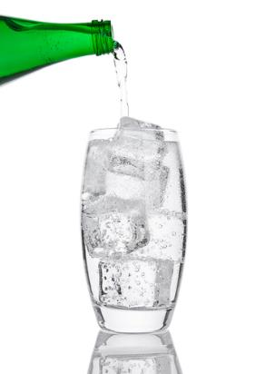
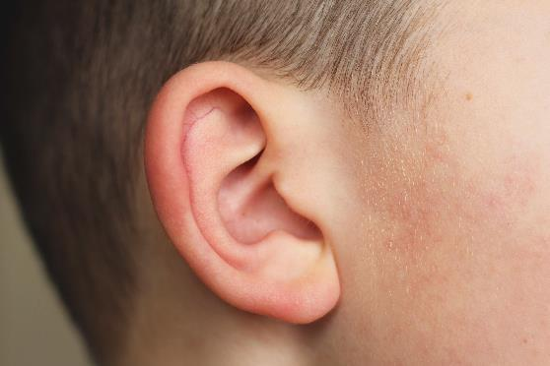
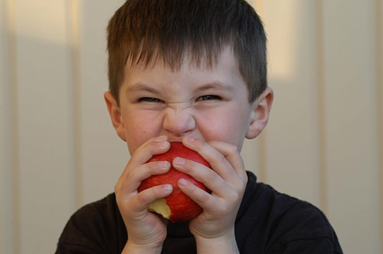
Hearing
We use our ears to hear food and drink.
Crunchy apple
Fizzy water

Slide 6
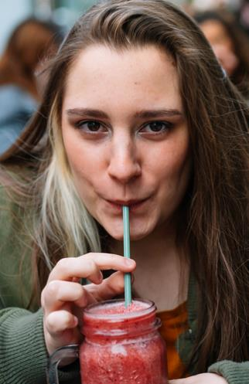

Taste
We use our mouths to taste food and drink.

Slide 7
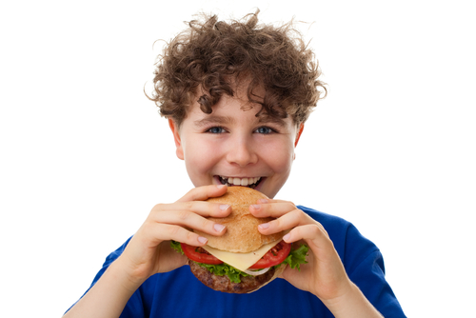
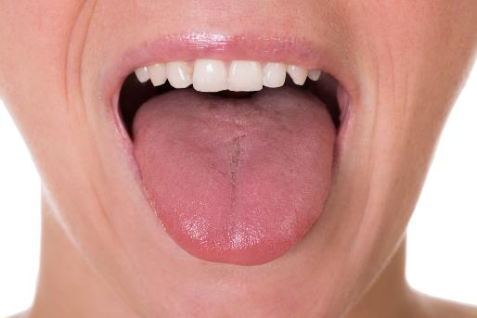

Touch
We use our mouths and hands to feel food and drink.

Slide 8
Using your senses
For further information, go to:
www.foodafactoflife.org.uk
This resource meets the Guidelines for producers and users of school education resources about food.

