Slide 1
Shopping

Slide 2
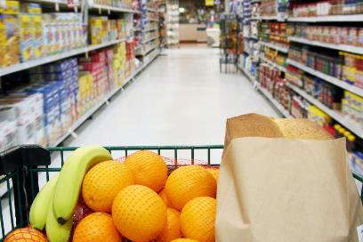
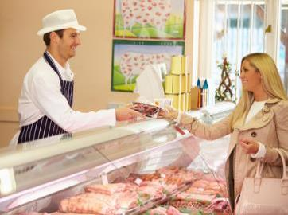
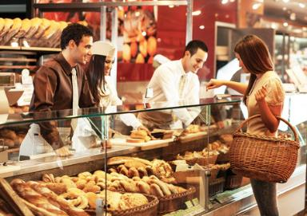
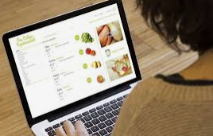
Different places you can buy food
Supermarket
Butcher
Baker
Online

Slide 3
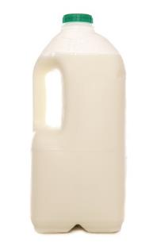
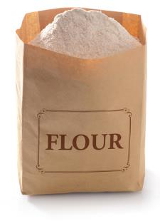


Supermarket
Different foods can be bought from a supermarket.
Milk
Eggs
Flour

Slide 4

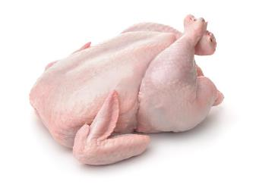
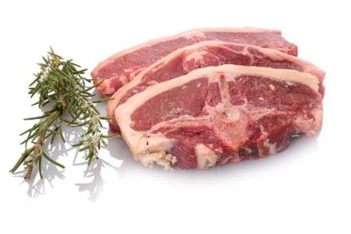
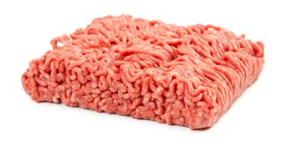
Butcher
Fresh meat can be bought from a butcher.
Minced meat
Chicken
Chops

Slide 5

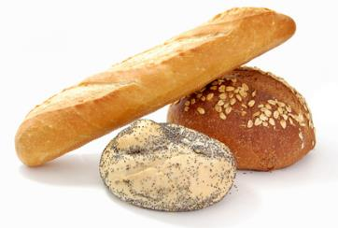
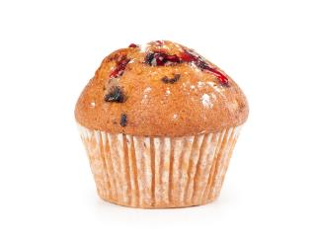
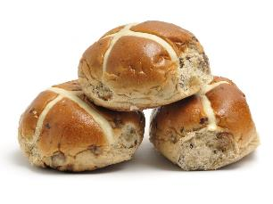
Baker
Breads and cakes can be bought from a baker.
Bread
Cakes
Hot X Buns

Slide 6
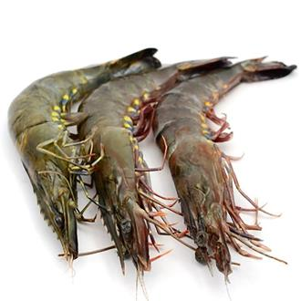
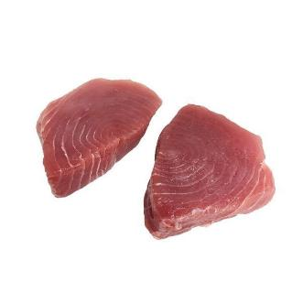
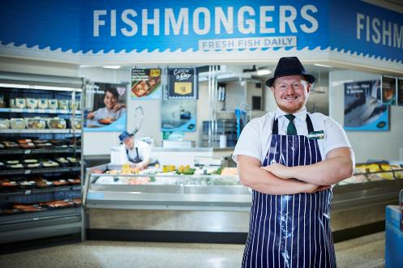

Fishmonger
Fresh fish and shellfish can be bought from a fishmonger.
Cod
King prawns
Tuna steaks

Slide 7
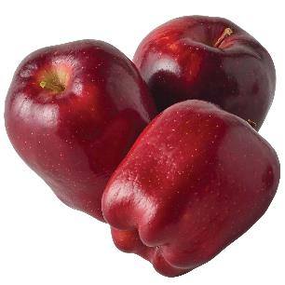
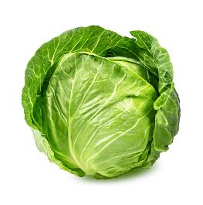
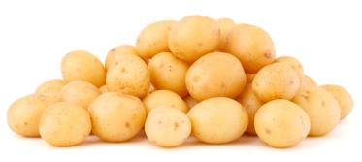
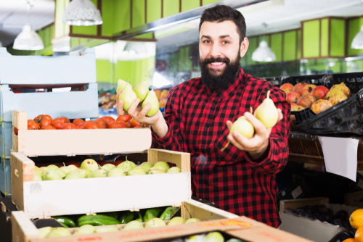
Greengrocer
Fresh fruit and vegetables can be bought from a greengrocer.
Apples
Cabbage
Potatoes

Slide 8
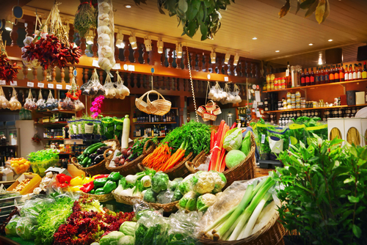


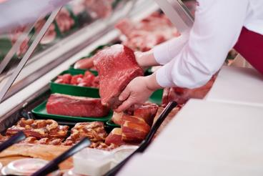
Farm shop
Different foods can be bought from a farm shop, often locally grown.
Cheese
Strawberries
Meat

Slide 9
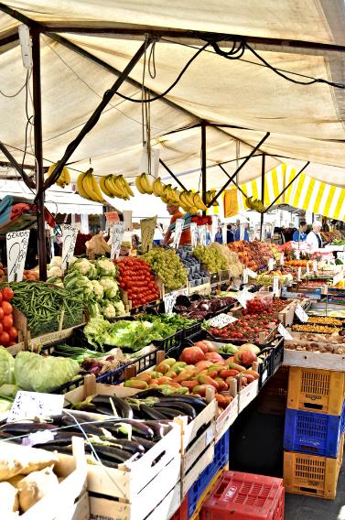
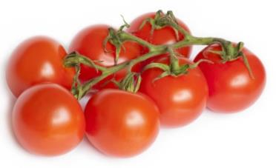
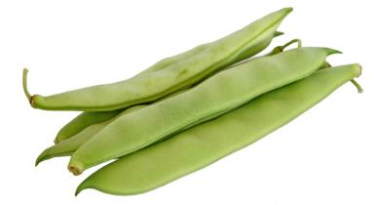
Market
Fresh food can be bought from a market.
Tomatoes
Beans
Potatoes

Slide 10
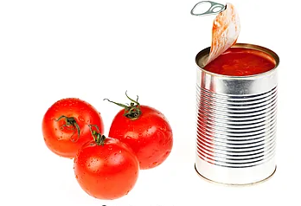
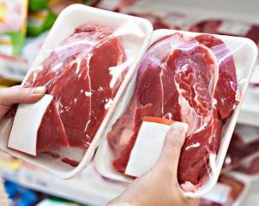
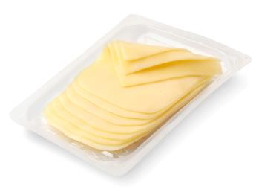
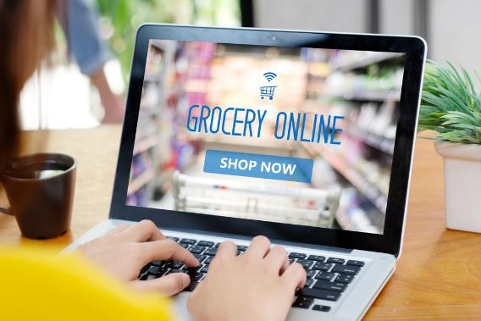
Online
You can buy food online.
Canned tomatoes
Meat
Cheese

Slide 11
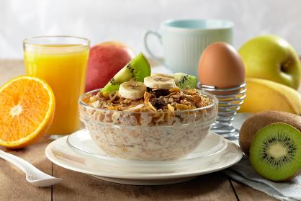
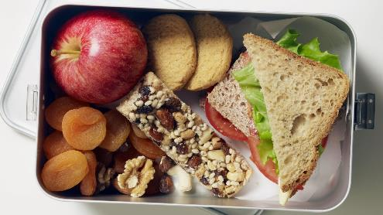
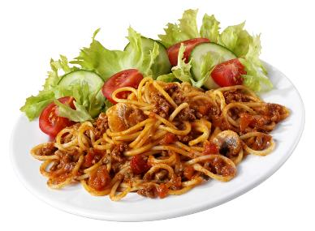
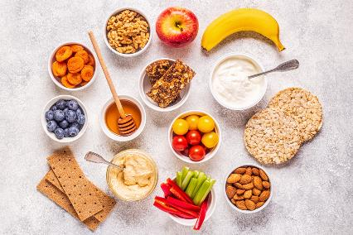
Different food at different times
Breakfast
Lunch
Evening Meal
Snacks

Slide 12


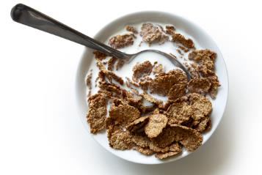

Breakfast
Eaten in the morning.
For example:
Boiled egg
Cereal
Fresh fruit

Slide 13

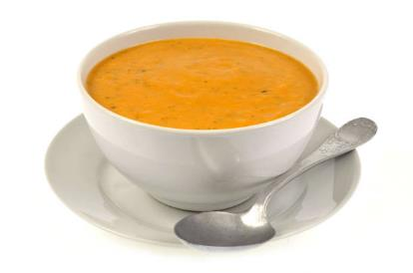
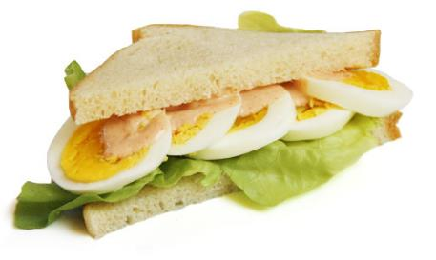
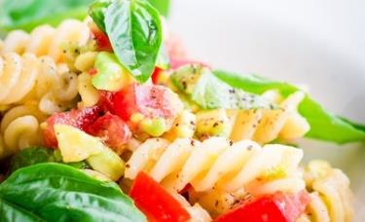
Lunch
Eaten around mid-day.
For example:
Soup
Sandwich
Pasta

Slide 14
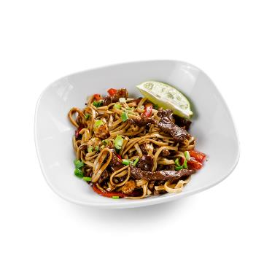

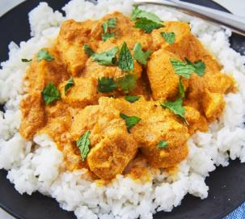
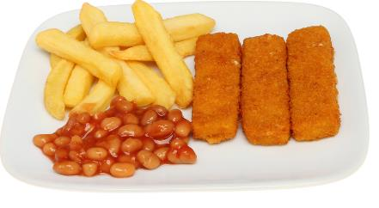
Evening meal
Eaten early evening.
For example:
Chicken curry
Stir fry
Fish fingers

Slide 15
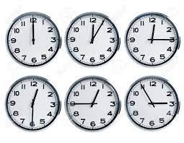
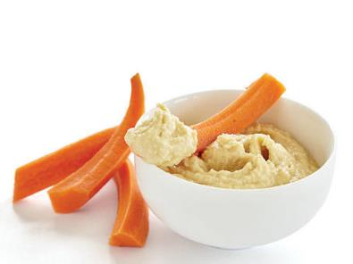
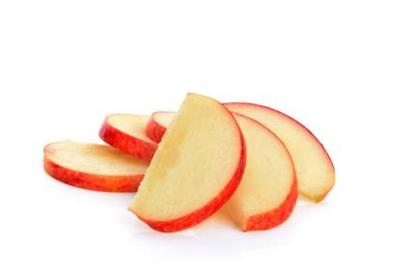
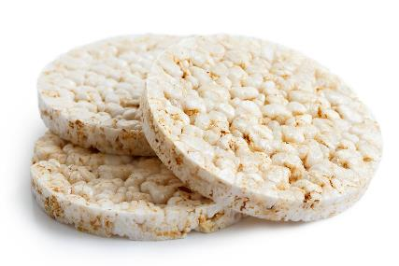
Snacks
Snacks may be eaten during the day.
Carrot sticks
Sliced apple
Rice cakes

Slide 16
Which of these foods would you eat at breakfast?

Slide 17
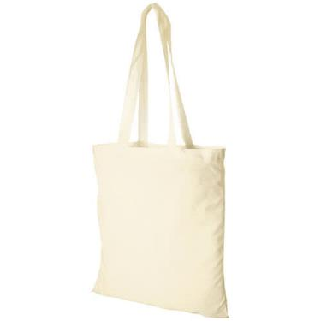
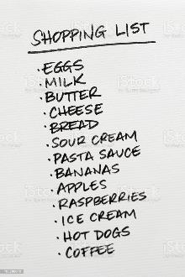
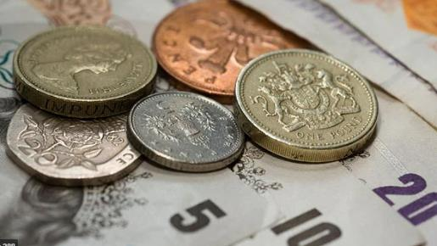
Going shopping
Remember to take with you:
Shopping list
Money
Shopping bag

Slide 18



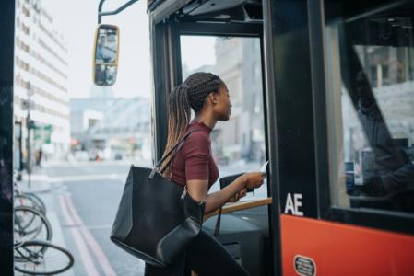
Getting to the shops
Walk
Cycle
Car
Bus

Slide 19
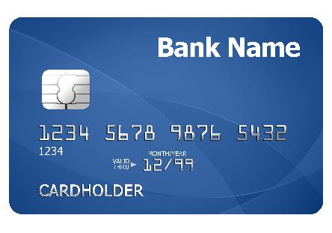

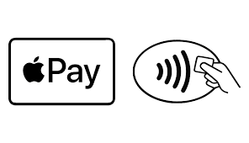
Ways to pay
Cash
Card
Mobile phone

Slide 20

Cash
You can use notes or coins.

Slide 21
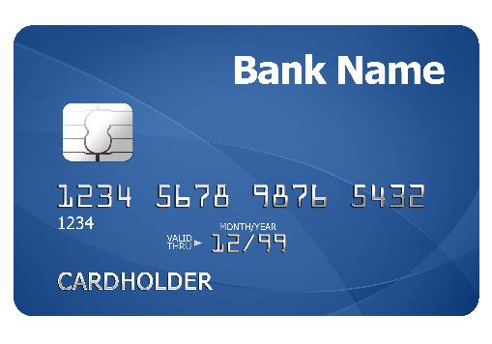
Bank cards
Debit cards – give you access to money in your bank account.
Credit cards – let you spend money and pay it back later.

Slide 22


Mobile phones
Pay for food and drink using a phone.

Slide 23




Reasons for eating out
With friends and family
Special occasions
For fun
On holiday

Slide 24




Places to buy food to eat out
Restaurants
Cafés or coffee shops
Fast food outlets
School canteen

Slide 25




Places to buy food to take away
Fast food outlets
Fish and chip shops
Sandwich shops
Takeaways, such as Indian, Chinese or pizza

Slide 26
Shopping
For further information, go to:
www.foodafactoflife.org.uk
This resource meets the Guidelines for producers and users of school education resources about food.

