Slide 1
Amazing allotments

Slide 2
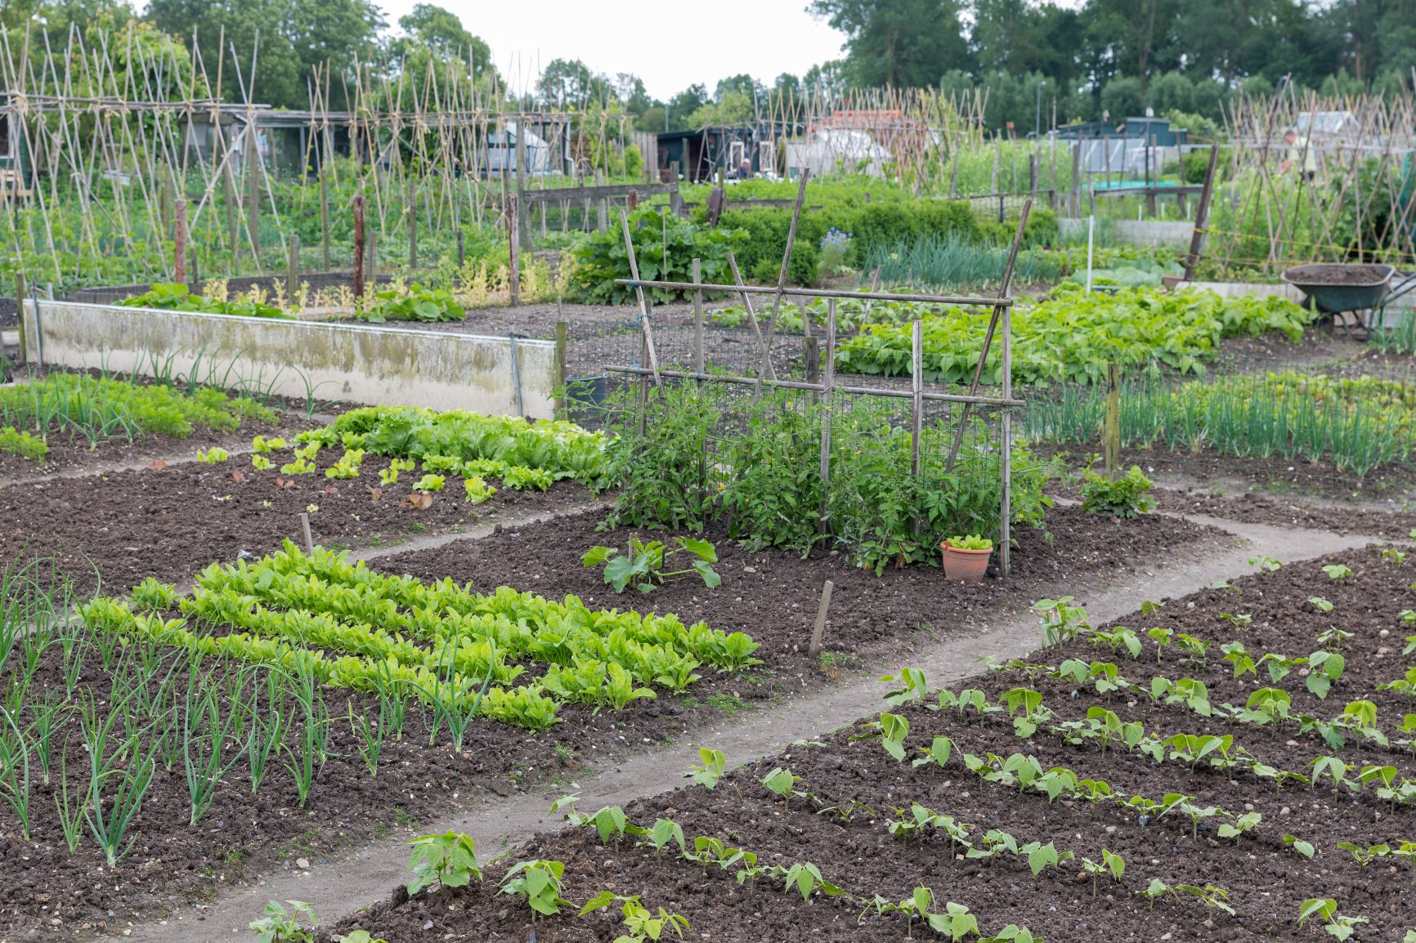
Allotment

Slide 3
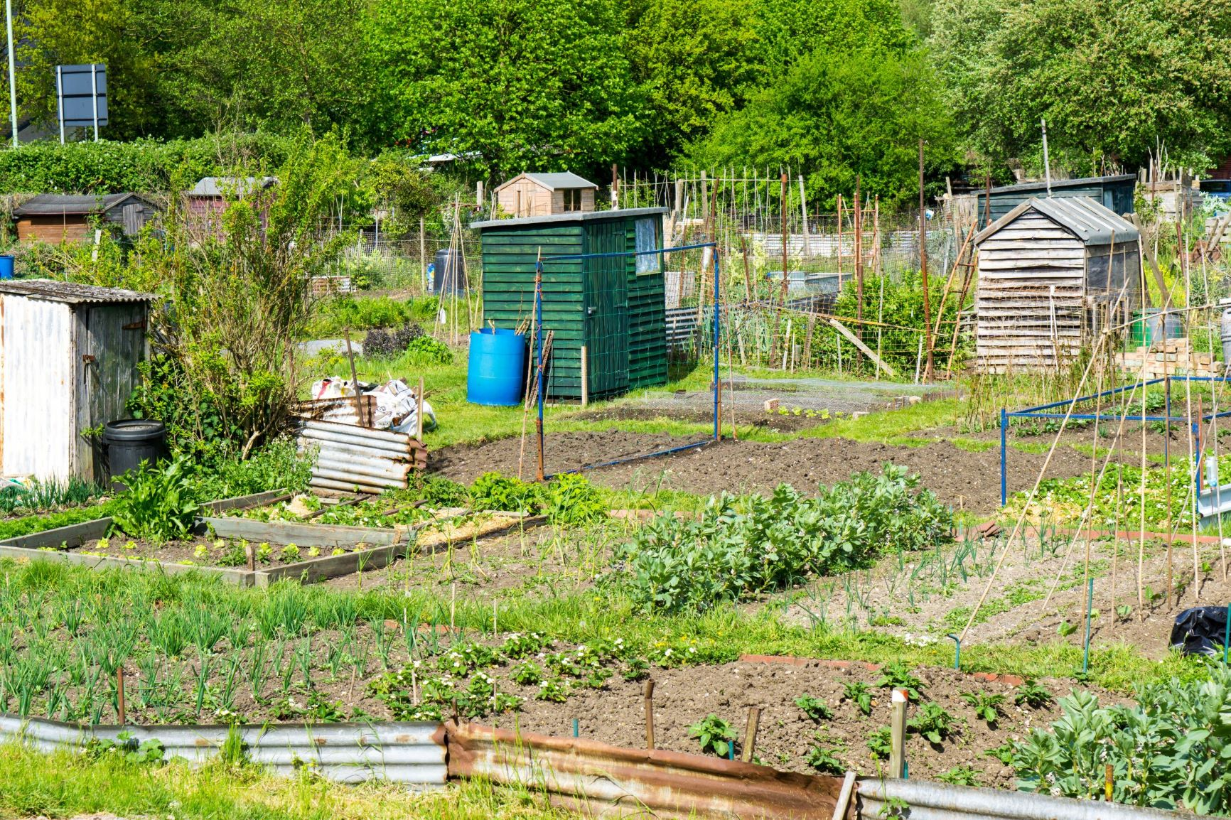
Allotment

Slide 4
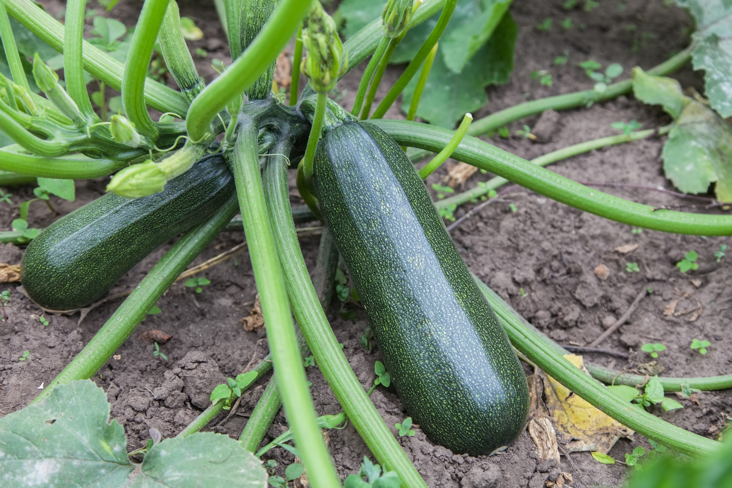
Courgettes

Slide 5
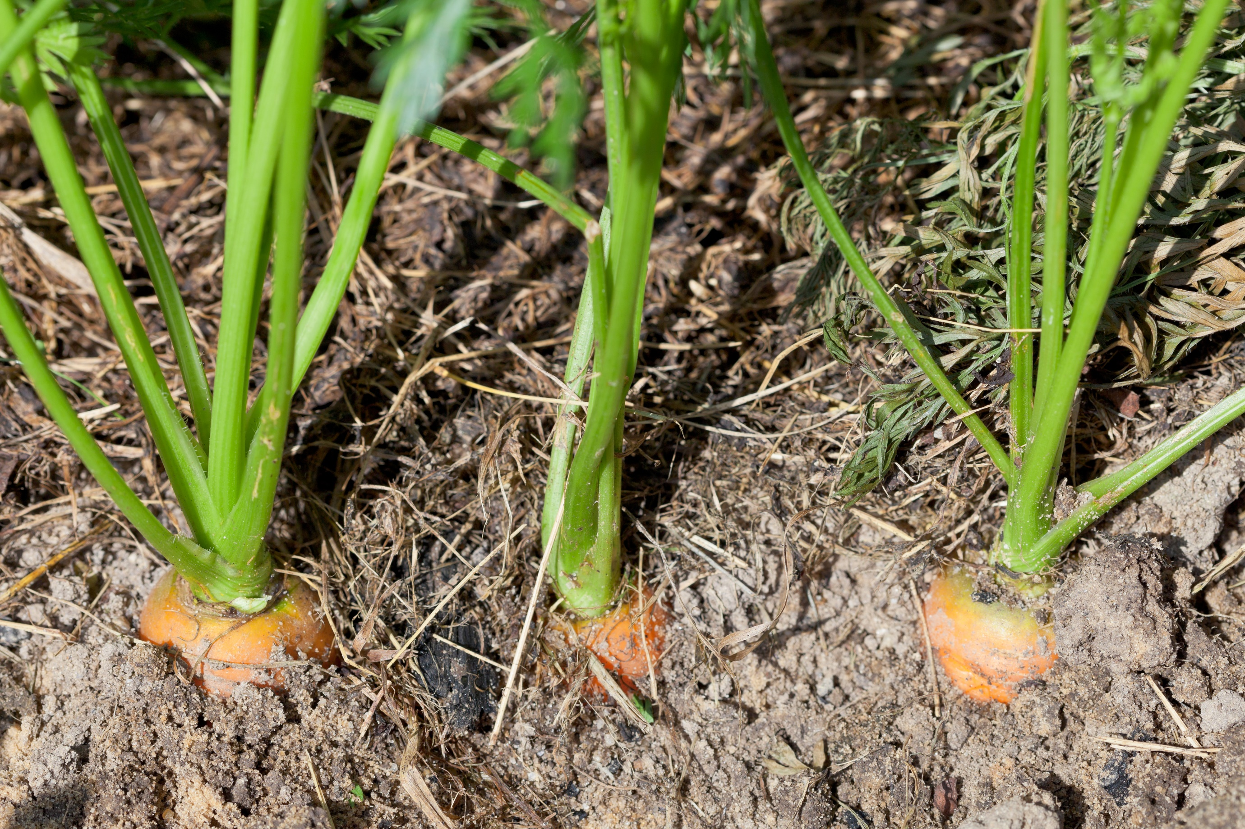
Carrots

Slide 6
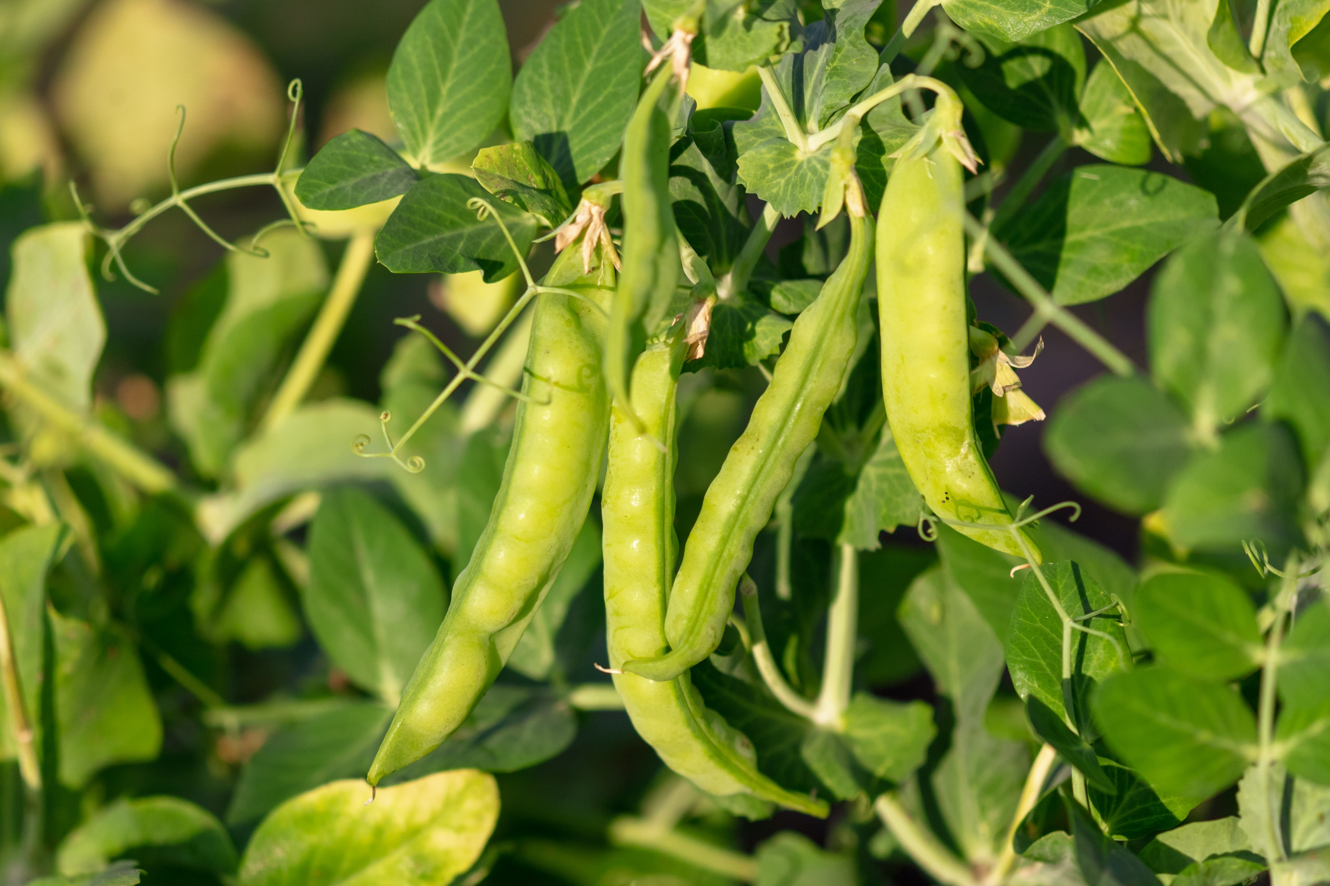
Peas in pods

Slide 7
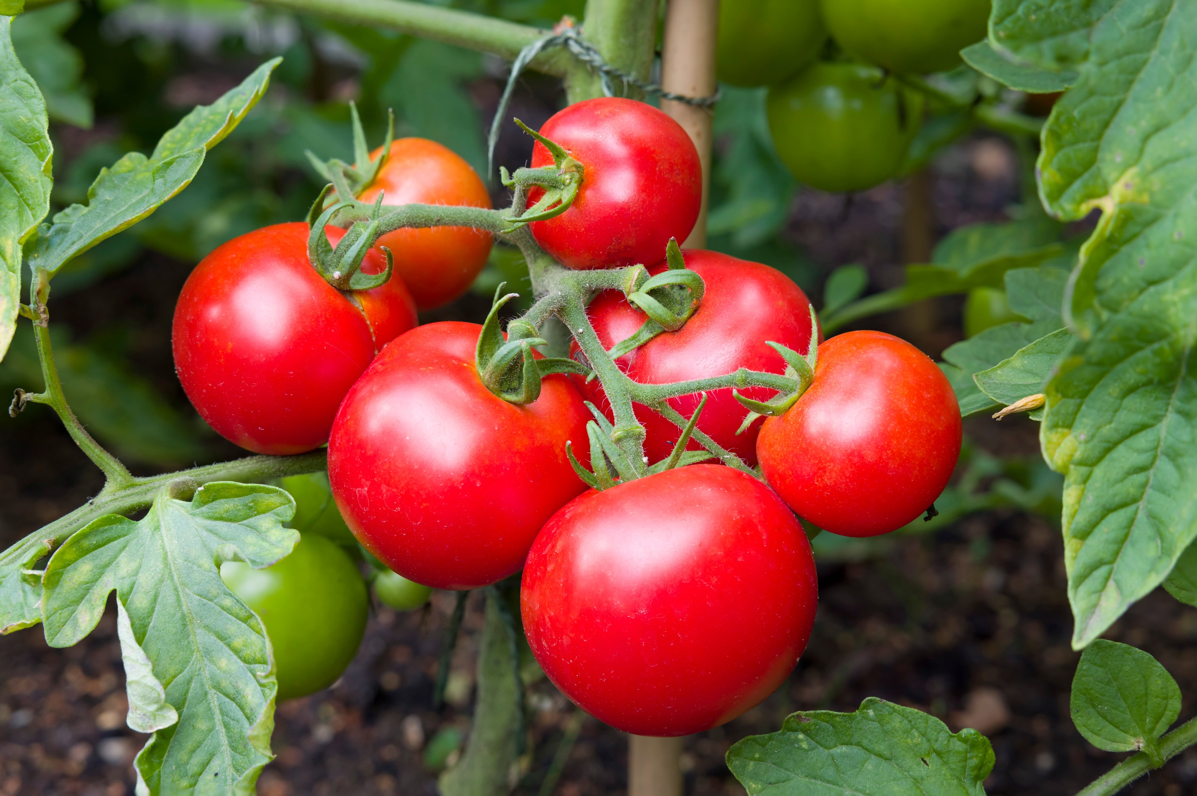
Tomatoes

Slide 8
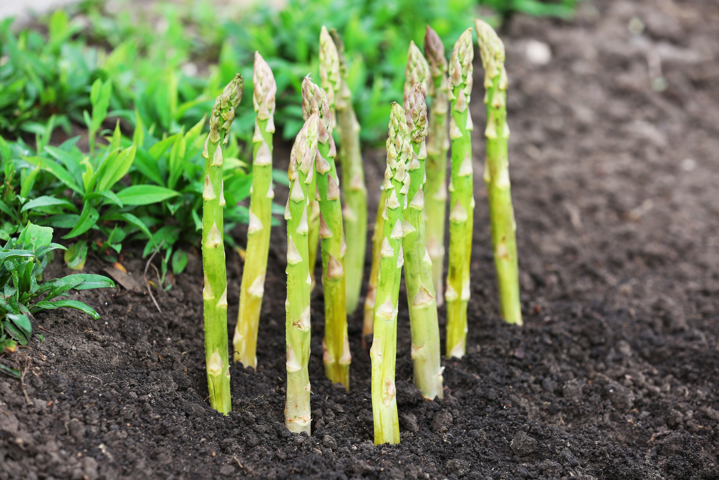
Asparagus

Slide 9
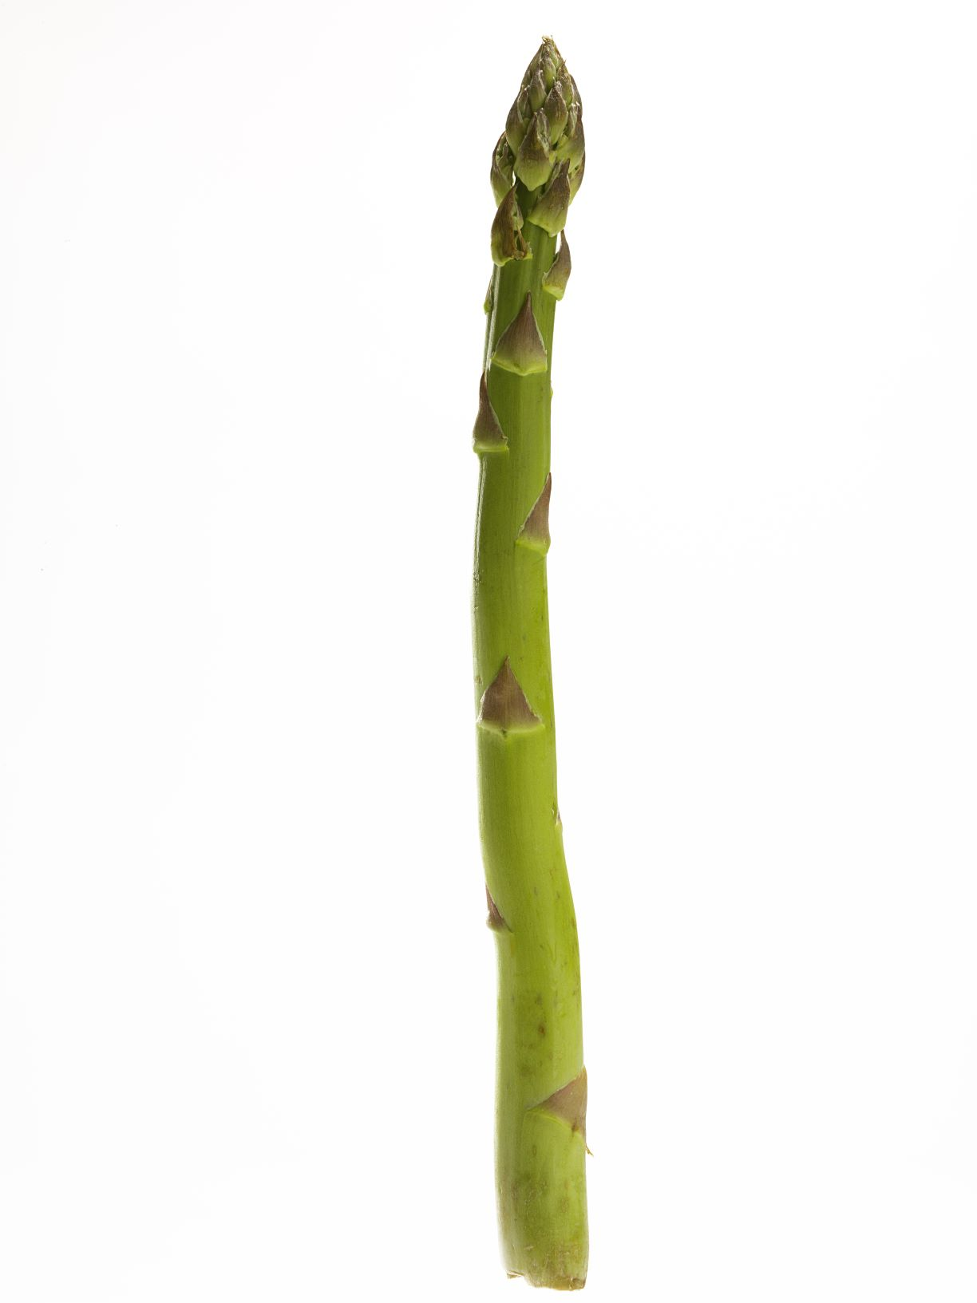
Allotment vegetables

Slide 10
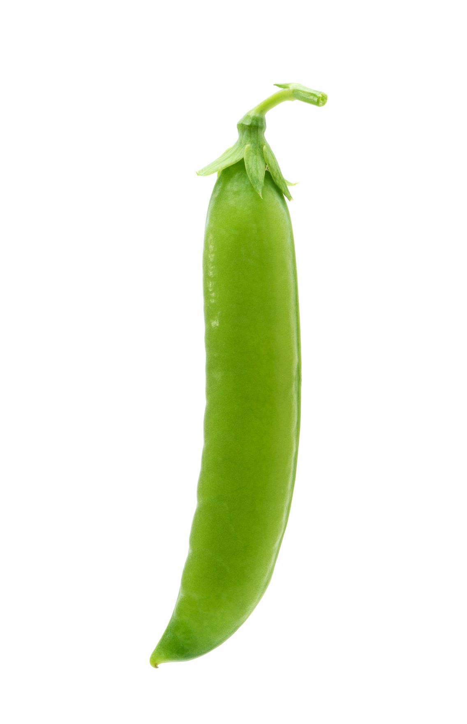

Slide 11
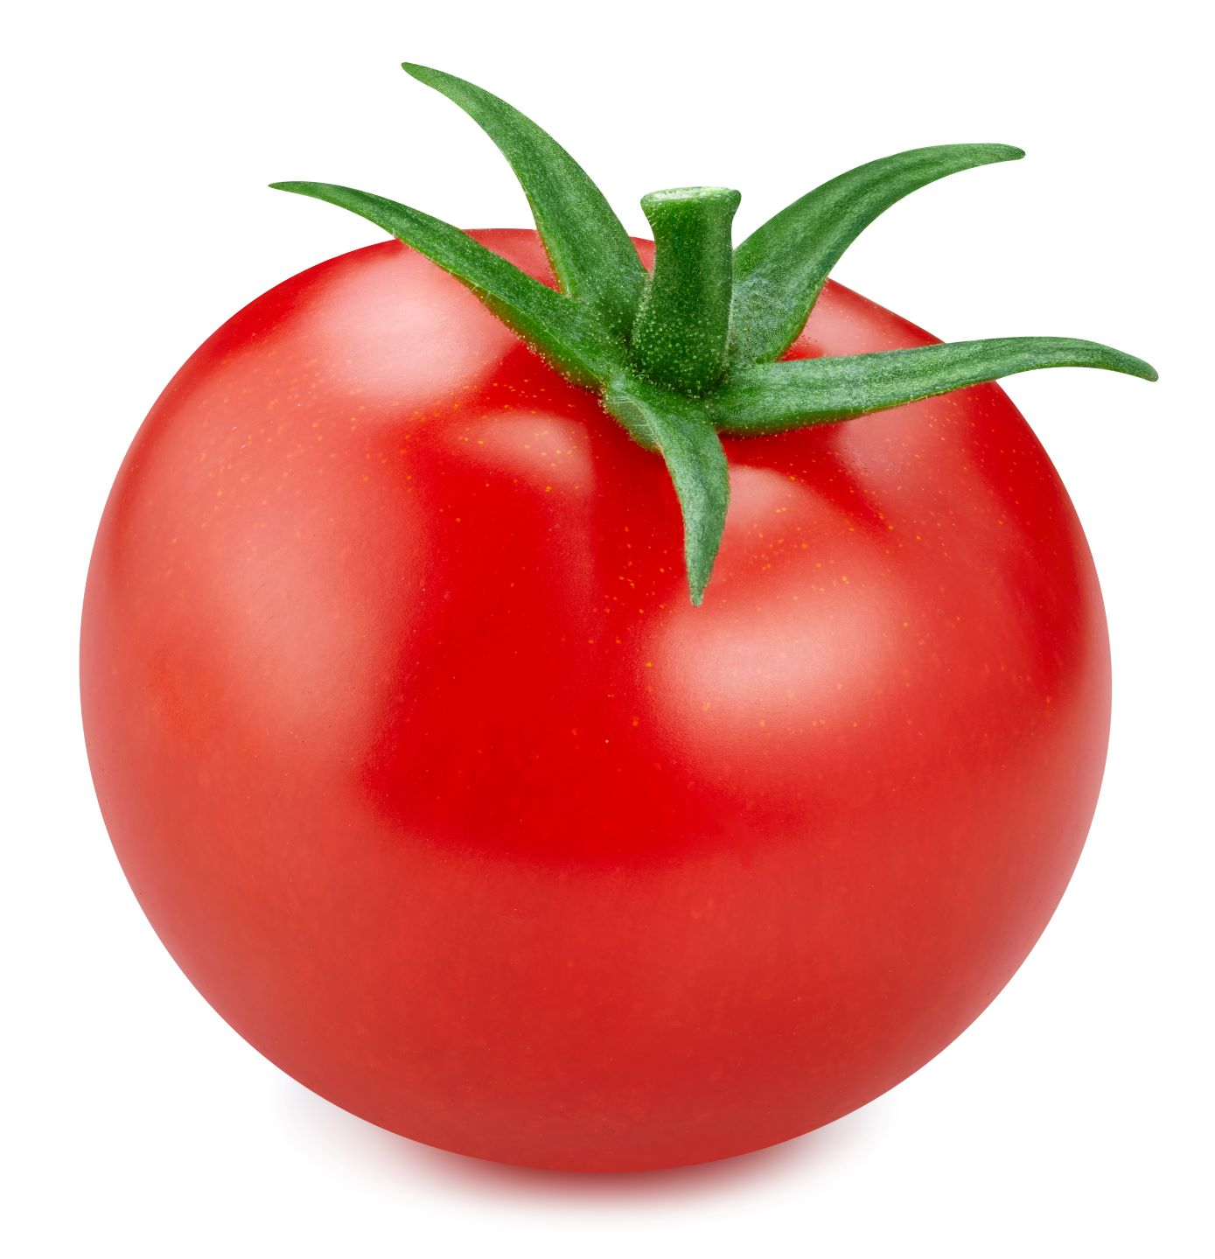

Slide 12
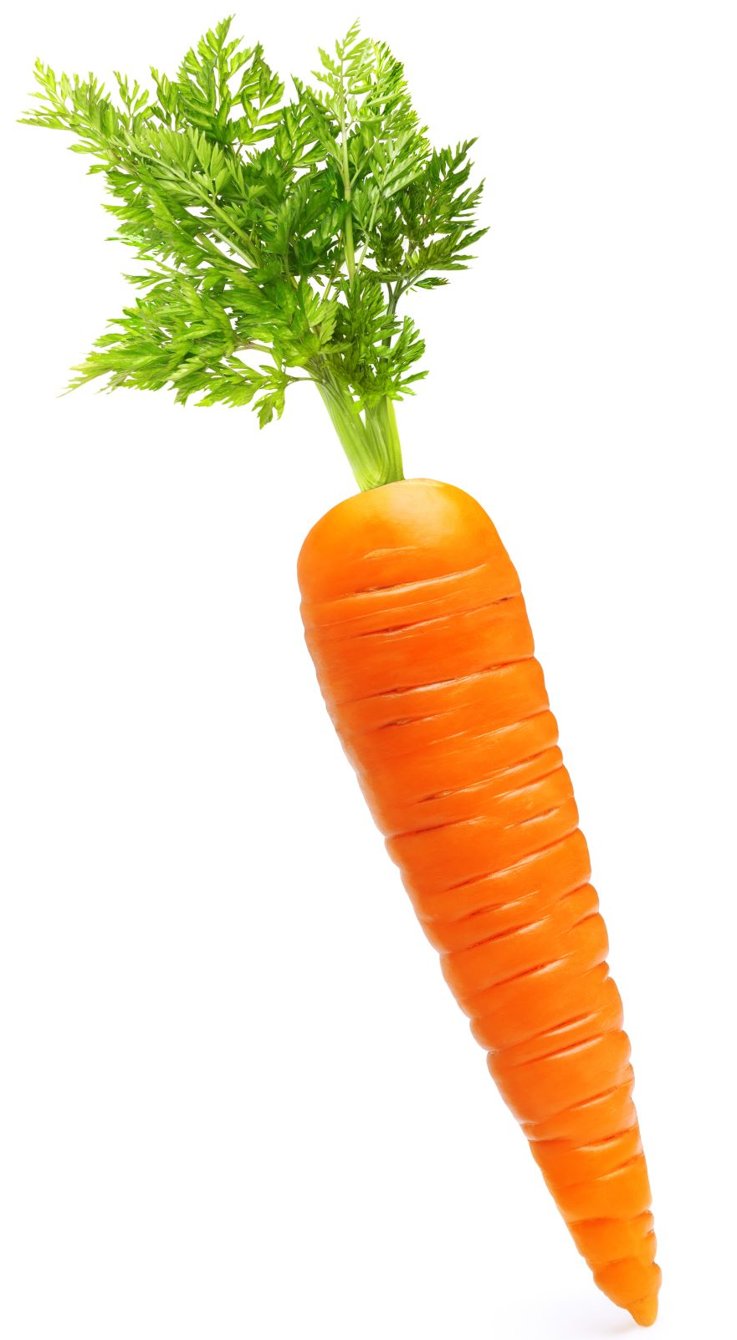

Slide 13
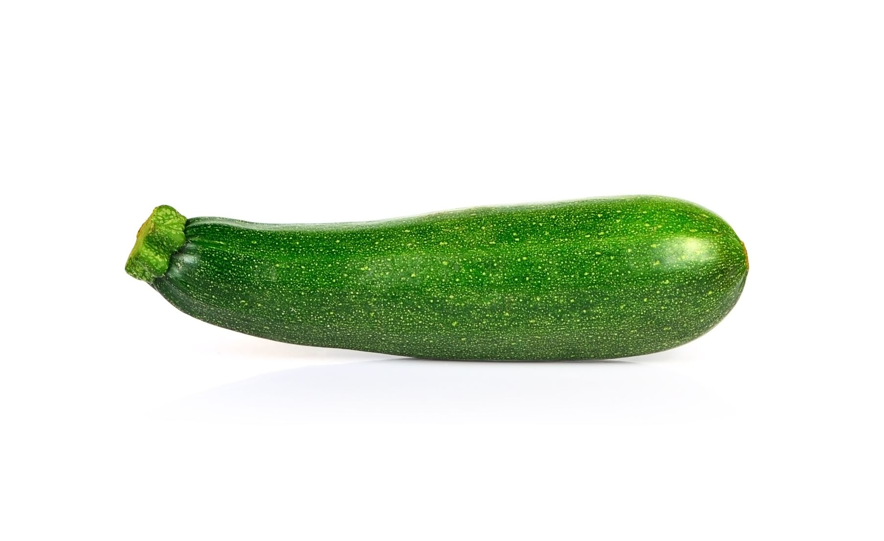

Slide 14
Allotment labels
Peas

Slide 15
Carrots

Slide 16
Courgettes

Slide 17
Asparagus

Slide 18
Tomatoes

Slide 19
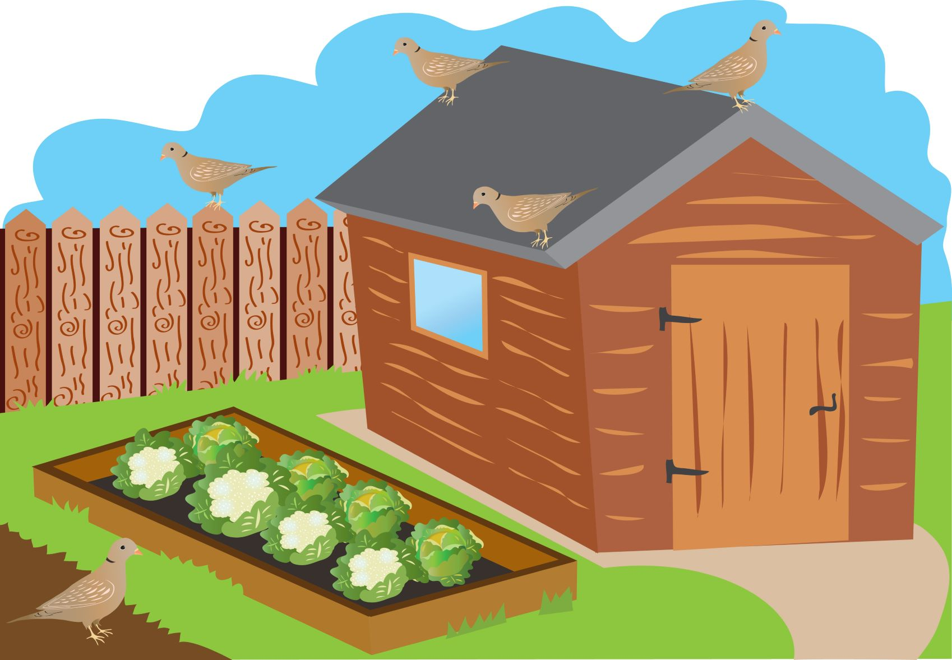

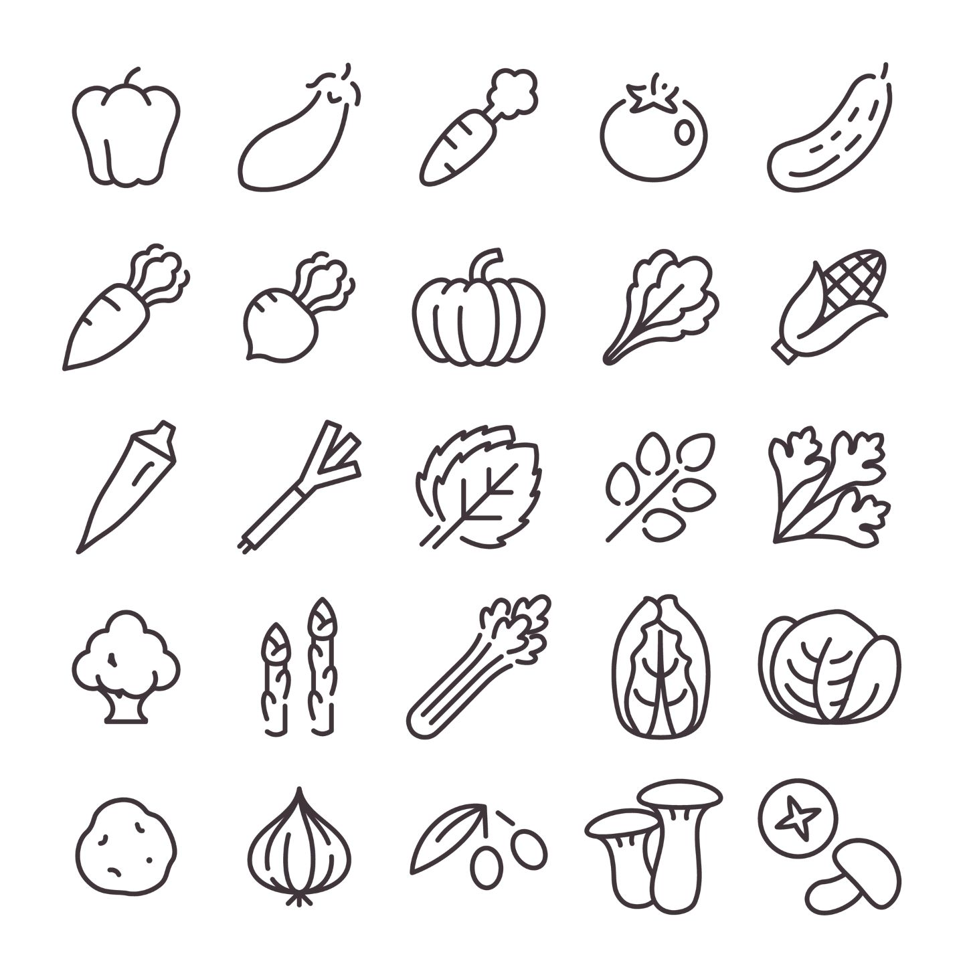
Allotment board
Peas
Tomatoes
Asparagus
Courgettes
Carrots

Slide 20

Vegetable dice
Roll again!

Slide 21
Dice

Slide 22
This certificate is awarded to
______________________
For counting out vegetables to create a lovely allotment in the play area!
From_________________________ Date___________

Slide 23






Veggie count!
Colour and count each type of vegetable. How many of each you can see?
At home
Broccoli
Corn-on-the-cob
Pumpkin
Okra
Pepper

Slide 24
Amazing allotments
For further information, go to:
www.foodafactoflife.org.uk
This resource meets the Guidelines for producers and users of school education resources about food.

