Slide 1
Awesome activity

Slide 2
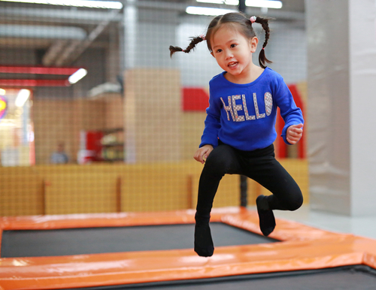
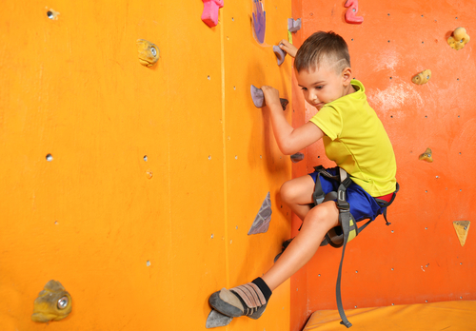
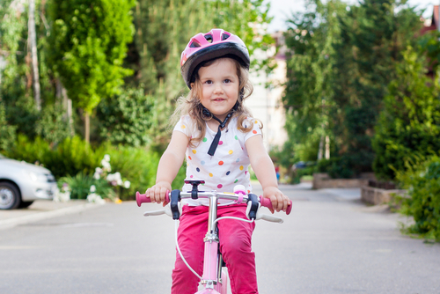
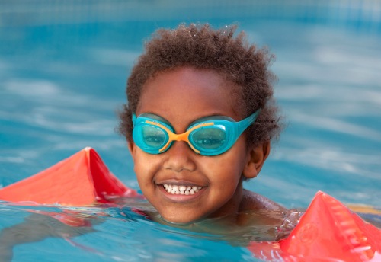
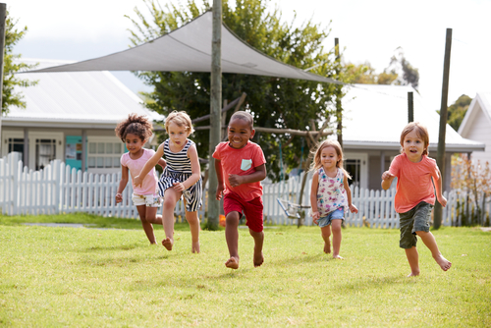
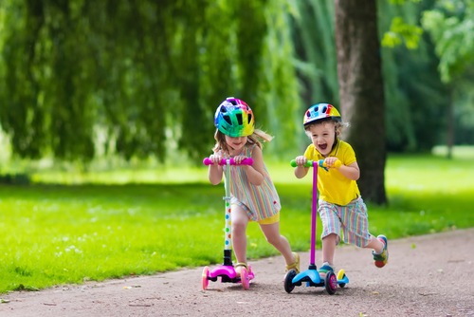
Activities

Slide 3
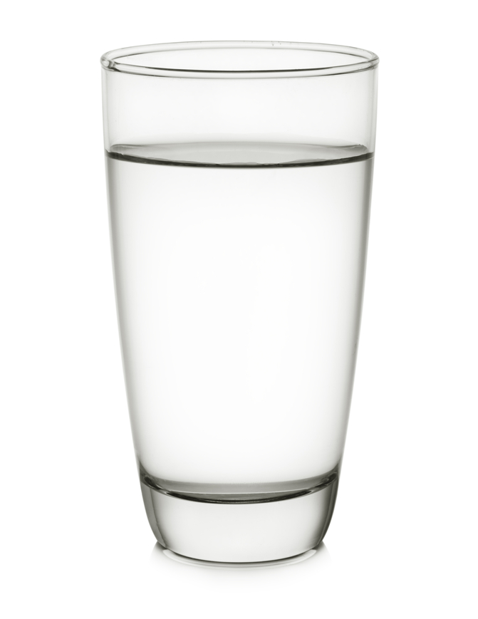
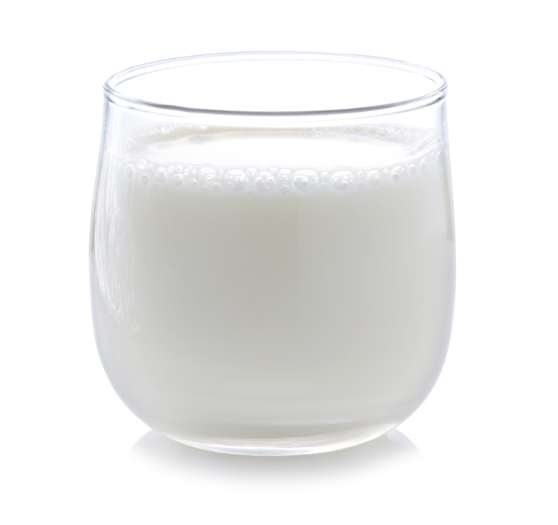
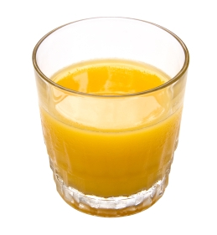
Drinks

Slide 4
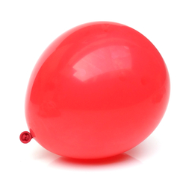
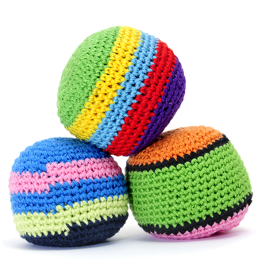
Activity cards
Keep the balloon up for the count of 10. | Walk 10 steps with a bean bag on your head.

Slide 5
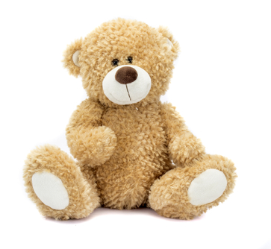
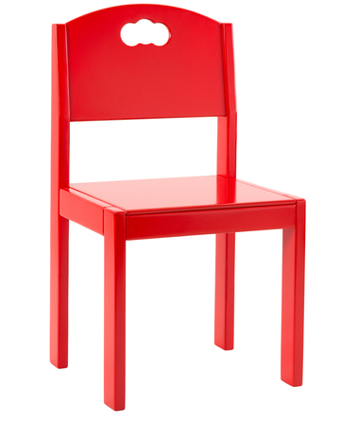
Activity cards
Throw 5 soft toys into a box. | Crawl under a row of 5 chairs.

Slide 6
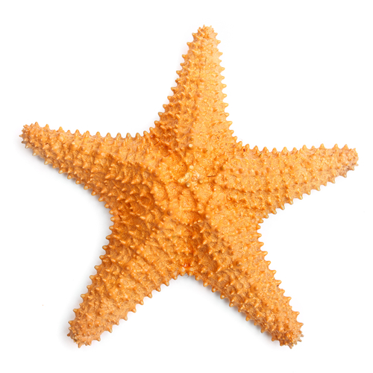
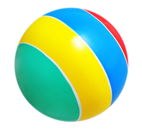
Activity cards
Do 10 star jumps. | Bounce a ball 5 times.

Slide 7
Activity tracker
Name:__________________

Slide 8
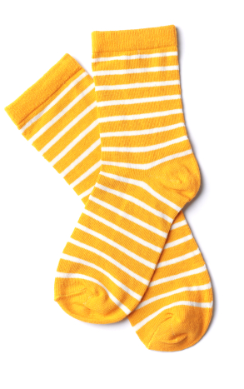
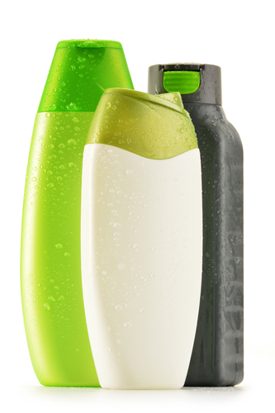
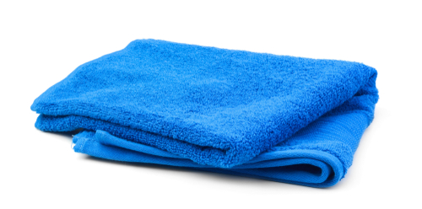
Get active! Set up an obstacle course for all the family to try!
At home
Use safe items from around your home to make your obstacle course.
Draw your obstacle course here:
Balled up socks for throwing into plastic containers.
Empty shampoo or shower gel bottles as targets, or markers to run around!
Towels as stepping stones to jump between!

Slide 9
Awesome activity
For further information, go to:
www.foodafactoflife.org.uk
This resource meets the Guidelines for producers and users of school education resources about food.

