Slide 1
Beautiful bread

Slide 2
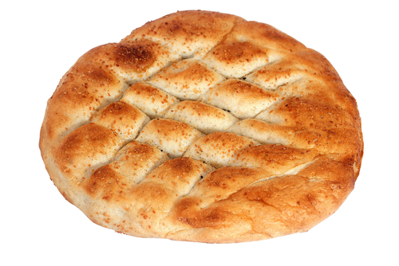

Bread
Turkish flat bread

Slide 3
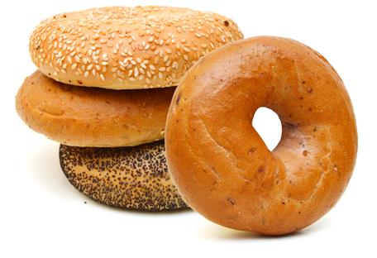

Bread
Polish bagels

Slide 4
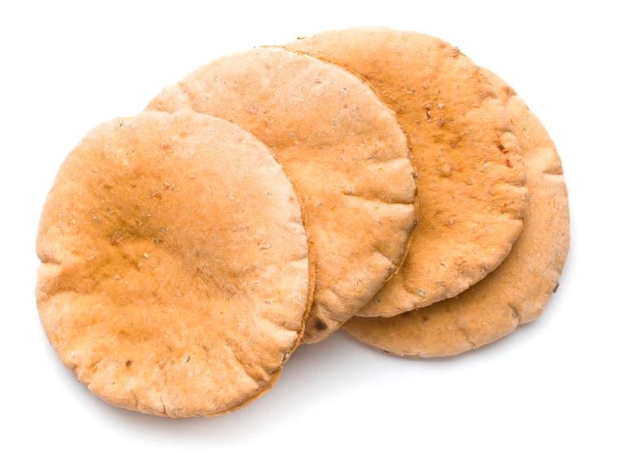

Bread
Greek pita bread

Slide 5
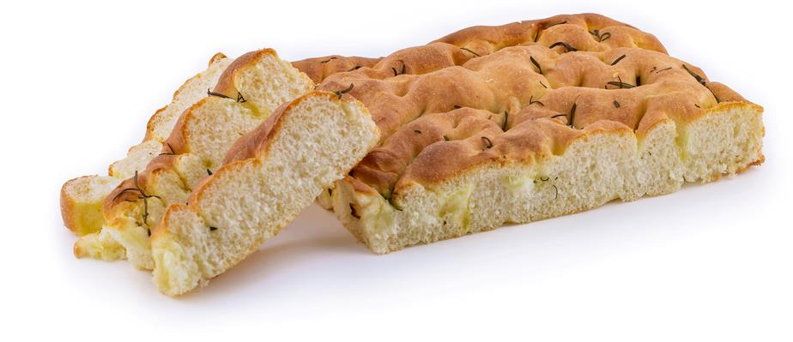

Bread
Italian focaccia

Slide 6
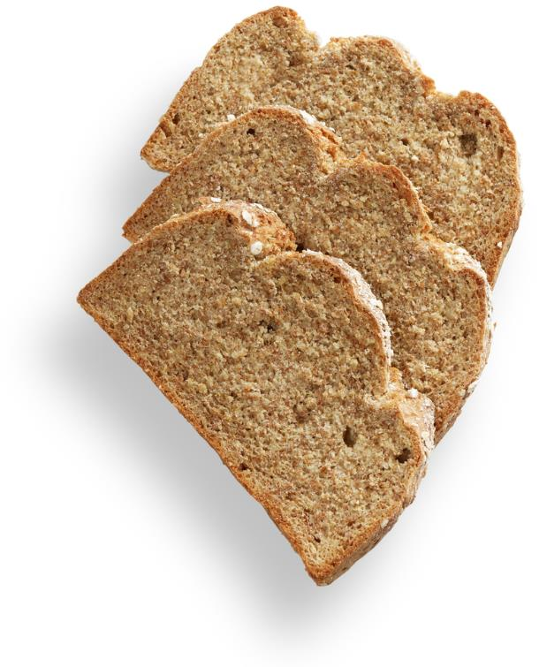

Bread
Irish soda bread

Slide 7
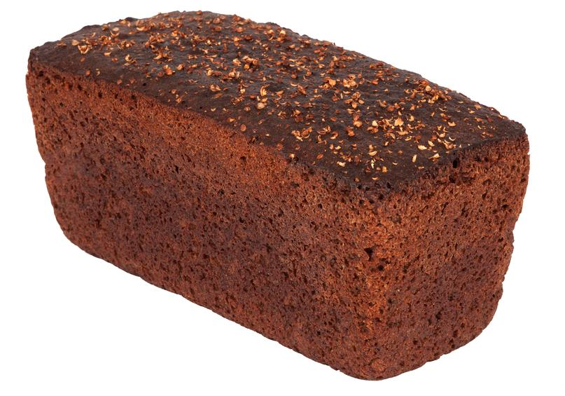

Bread
Russian black bread

Slide 8
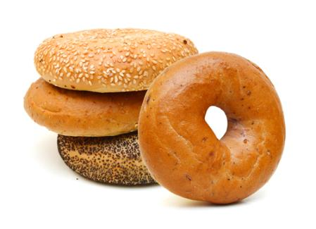
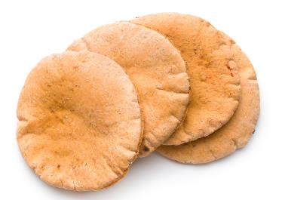
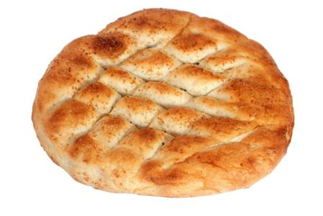


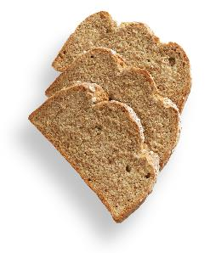
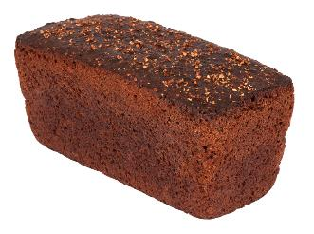
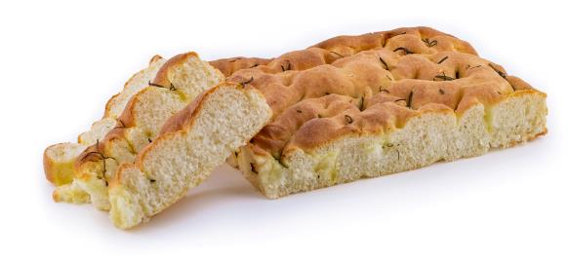


Bread
Turkish flat bread
Polish bagels
Greek pita bread
Italian focaccia
Irish soda bread
Russian black bread

Slide 9
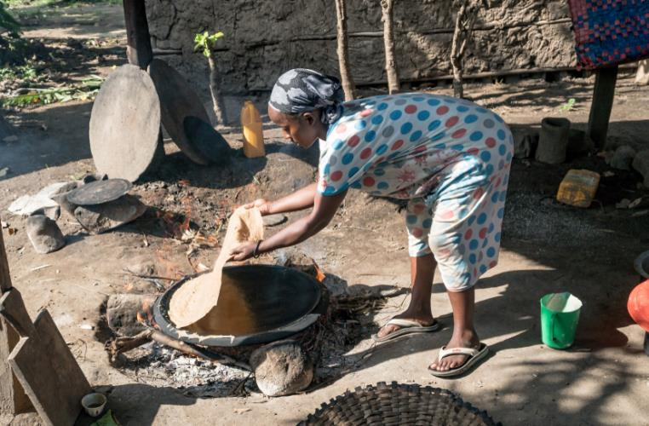
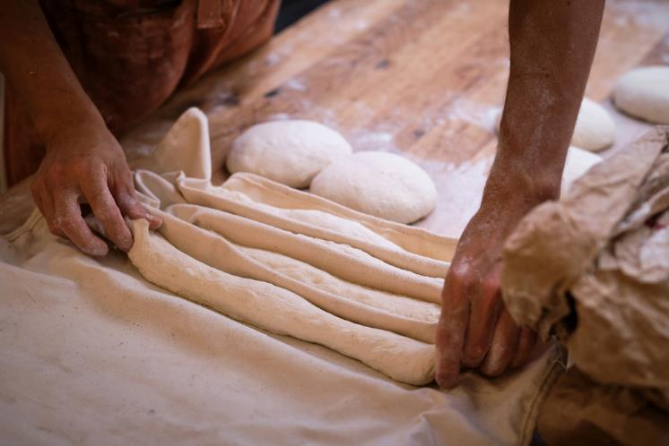


Bread being made
Ethiopia
France

Slide 10
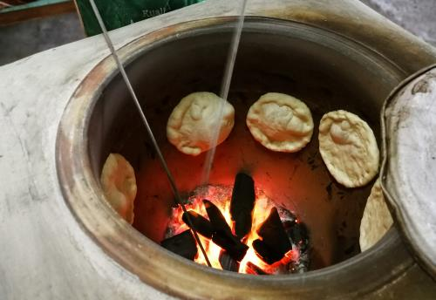
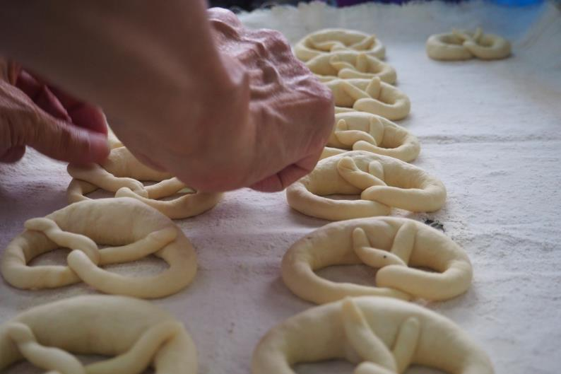


Bread being made
India
Germany

Slide 11
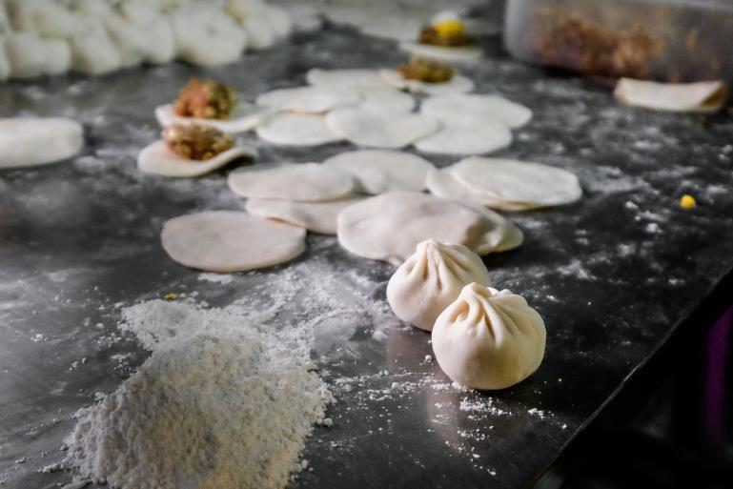
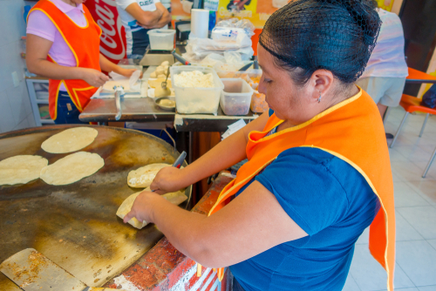


Bread being made
China
Mexico

Slide 12
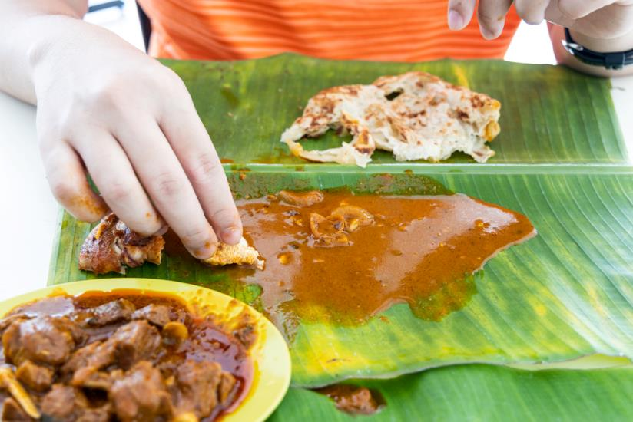
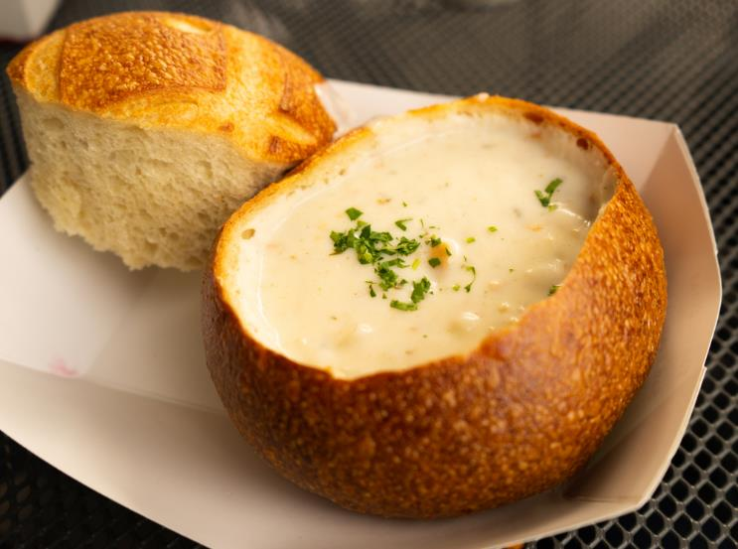


Bread being eaten
Malaysia
United States

Slide 13
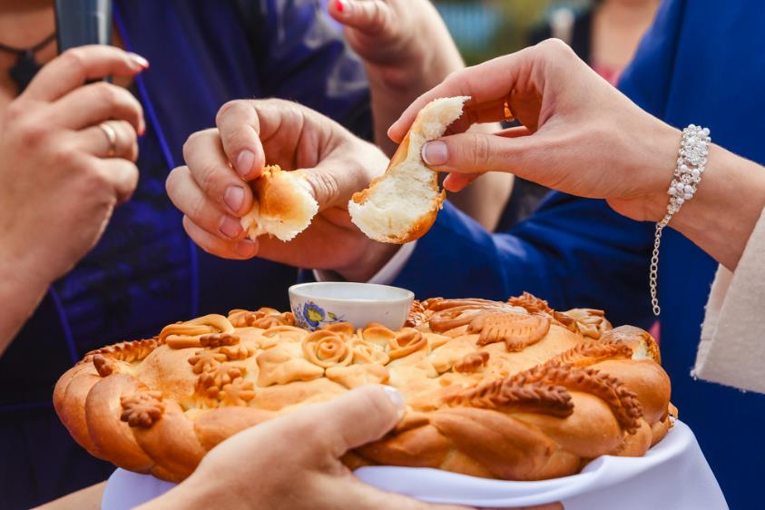

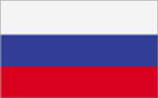

Bread being eaten
Russia
United Kingdom

Slide 14
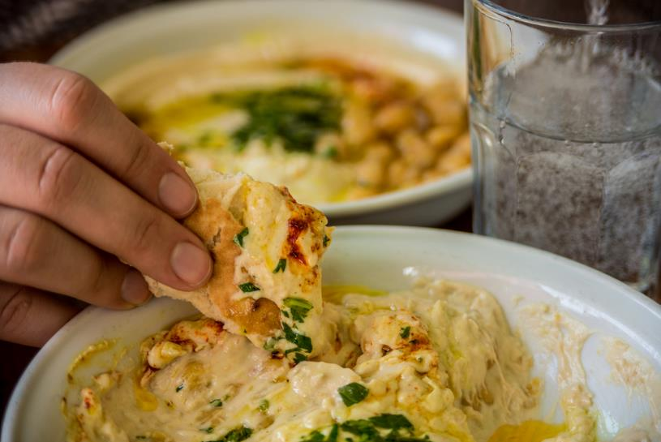
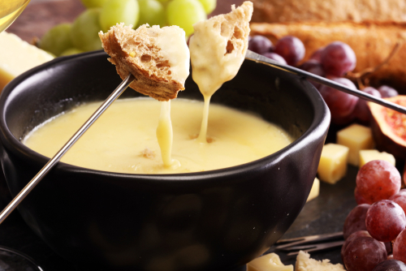


Bread being eaten
Turkey
Switzerland

Slide 15
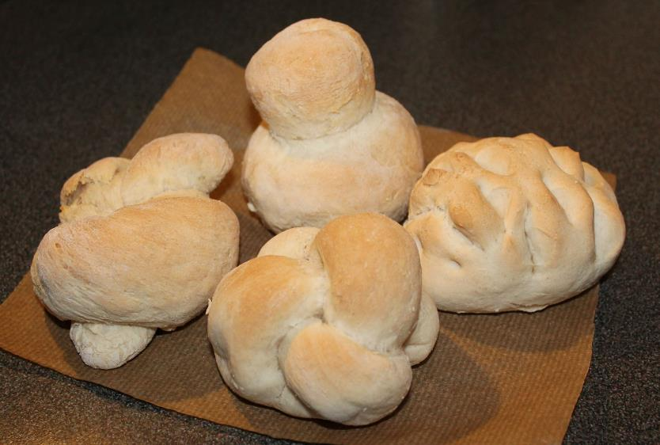
Bread recipe
Ingredients
250g strong flour
1/2 x 5ml spoon salt
7g pack fast action dried yeast
150ml warm water
Equipment
Weighing scales, measuring spoons, measuring jug, baking tray, greaseproof paper, sieve, mixing bowl, mixing spoon, flour dredger, oven gloves, cooling rack.

Slide 16
Method
1.Preheat the oven to 220ºC or gas mark 7.
2.Line the baking tray with greaseproof paper.
3.Sift together the flour and salt into the mixing bowl.
4.Stir in the yeast.
5.Make a well in the middle of the flour mixture and add the warm water. Note: the water must not be hot. Mix to form a soft dough.
6.Sprinkle a little flour onto a clean work surface and place the dough on the surface.
7.Knead the dough for 10 minutes.
8.Divide the dough into 4 pieces and shape into rolls.
9.Place the rolls on the baking tray.
10.Cover the dough and leave to prove for 30 minutes in a warm place, until they double in size.
11.Bake for 10 - 15 minutes until golden brown. Adults to use the oven.

Slide 17
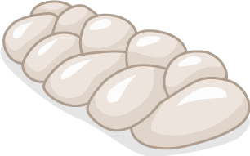



Bread shapes

Slide 18
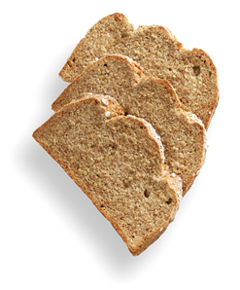
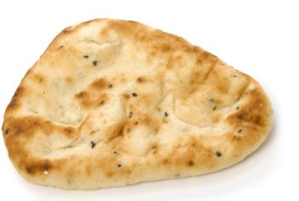
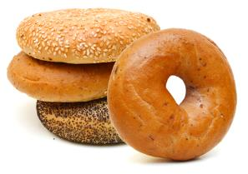
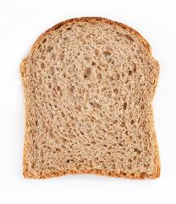
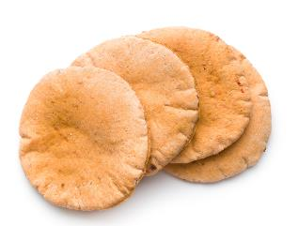
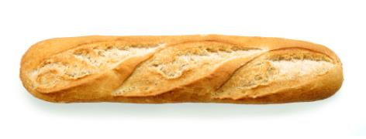
Bread bingo! Try to find these different types of bread next time you go shopping.
At home
Bagels | Soda bread | Naan bread
Sliced brown bread | Pita bread | Baguette

Slide 19
Beautiful bread
For further information, go to:
www.foodafactoflife.org.uk
This resource meets the Guidelines for producers and users of school education resources about food.

