Slide 1
Food origins

Slide 2
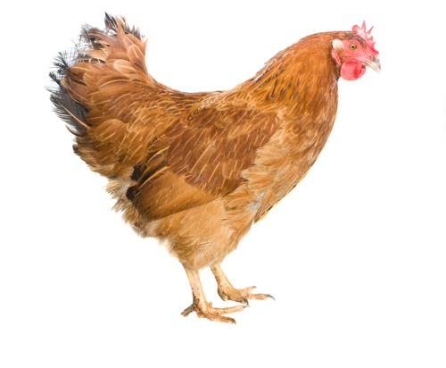
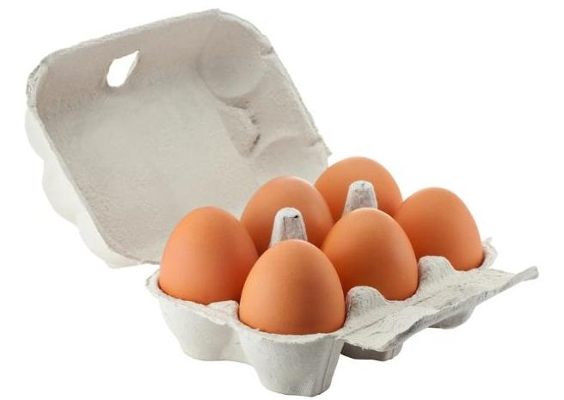
Origins
Eggs
are from a
chicken

Slide 3
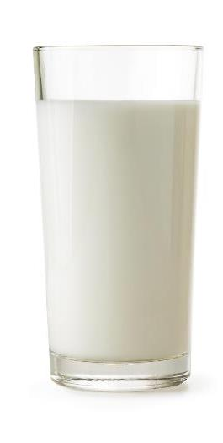
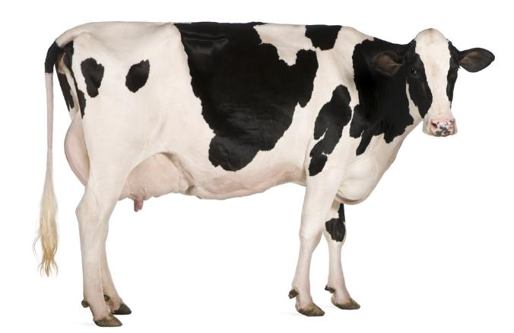
Origins
Milk
is from a
dairy cow

Slide 4
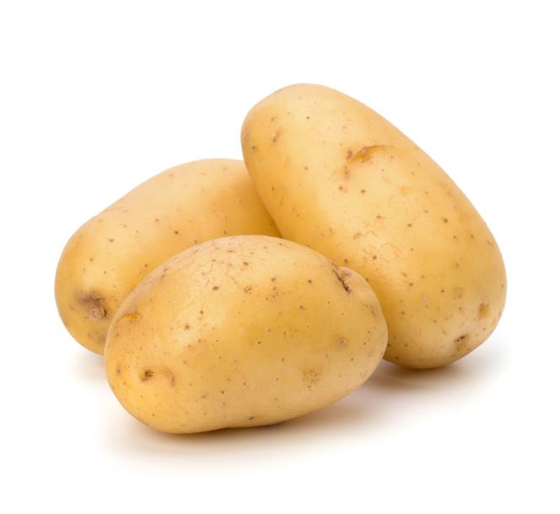
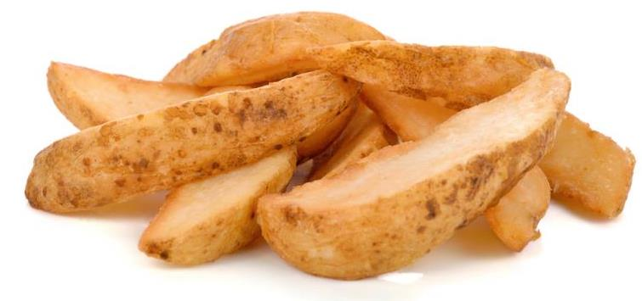
Origins
Wedges
are from
potatoes

Slide 5
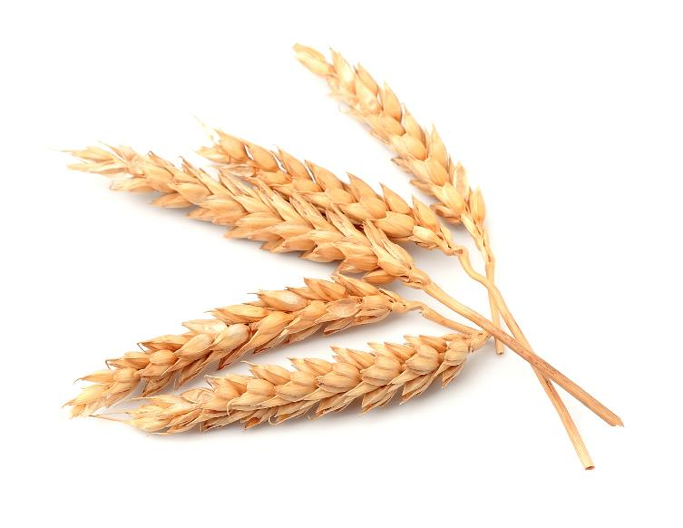
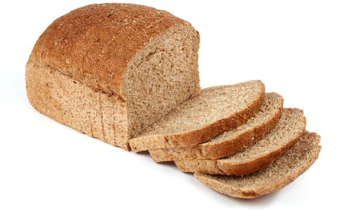
Origins
Bread
is from
Wheat

Slide 6

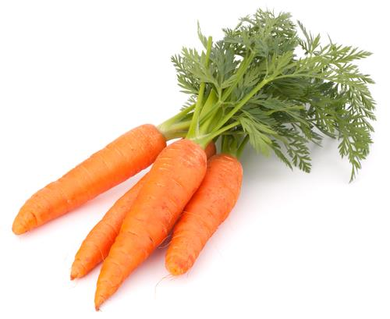
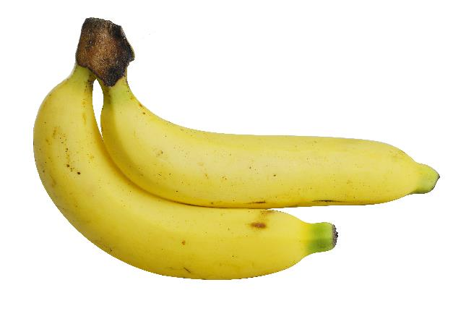
From a plant and animal?
Plant
Plant
Animal
Carrots
Banana
Milk

Slide 7
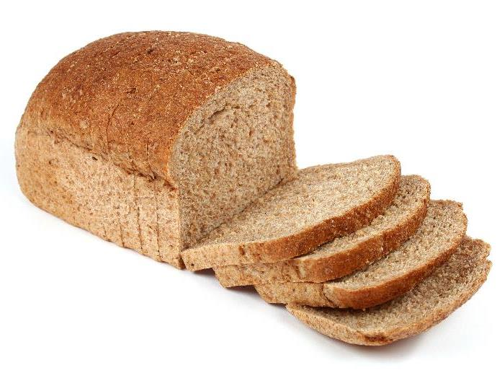
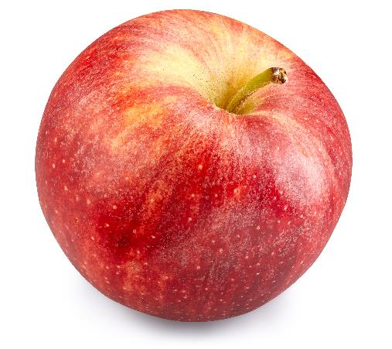
From a plant or animal?
Animal
Plant
Plant
Eggs
Apple
Bread

Slide 8
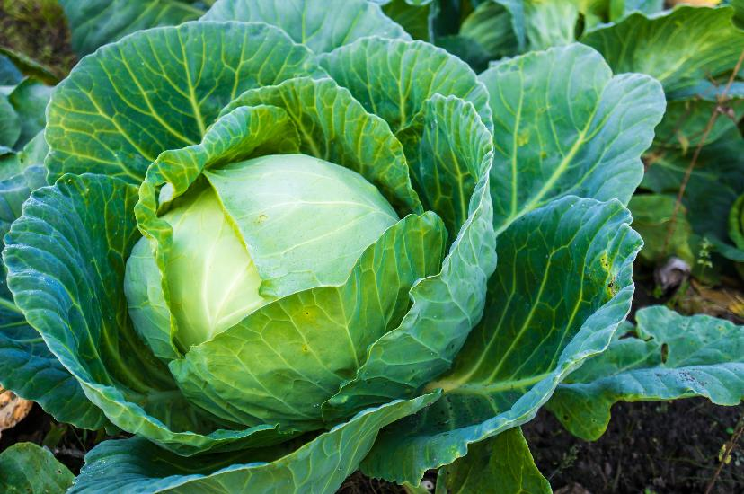
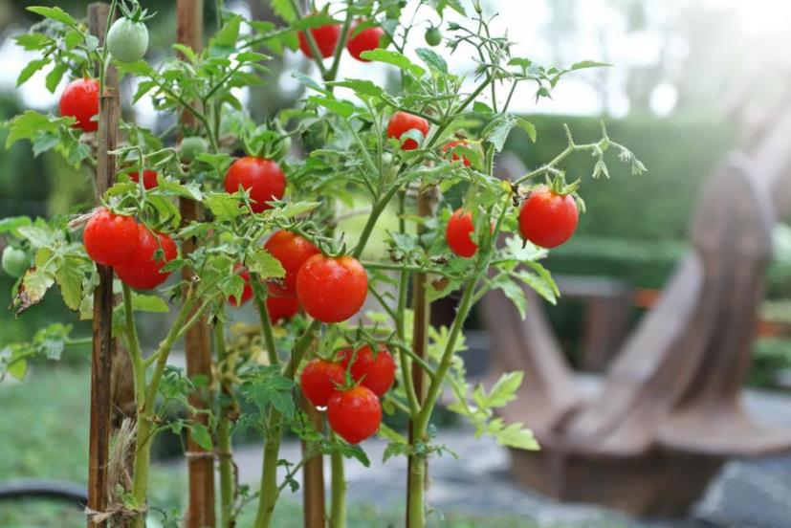
Food is grown
Cabbage. A plant.
Tomatoes. A plant.

Slide 9
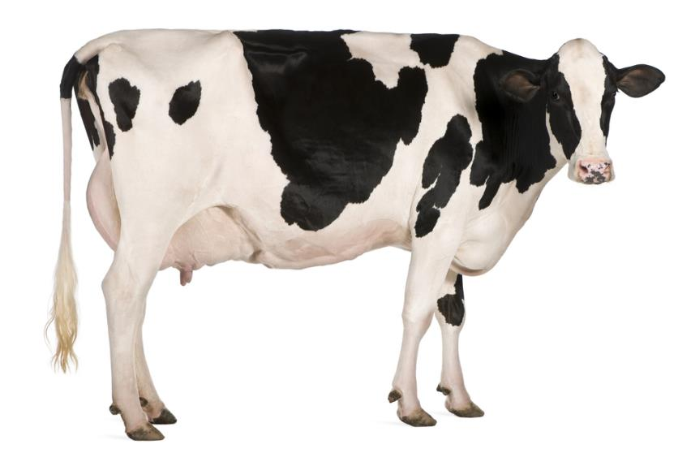
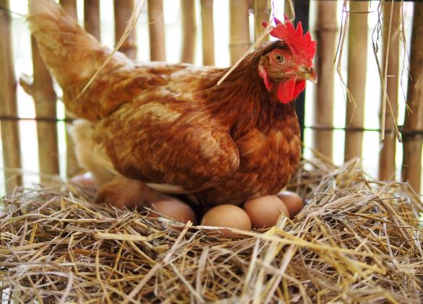
Food is reared
A dairy cow. An animal.
A chicken. An animal.

Slide 10
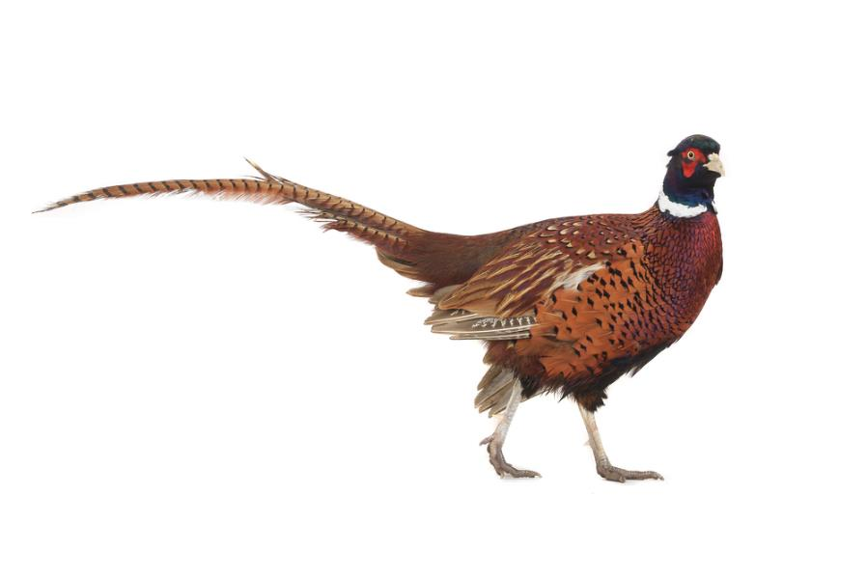
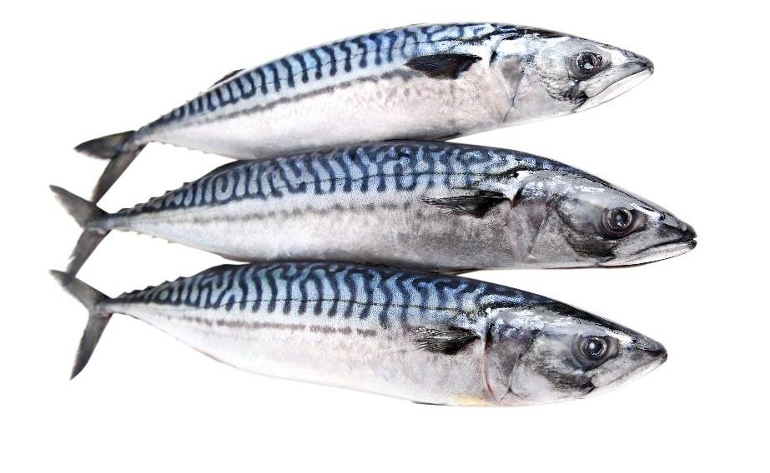
Food is caught
Fish. An animal.
Pheasant. An animal.

Slide 11
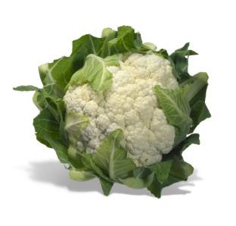
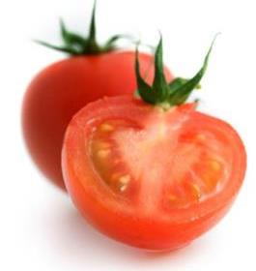
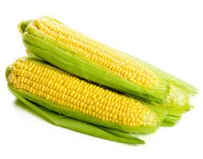
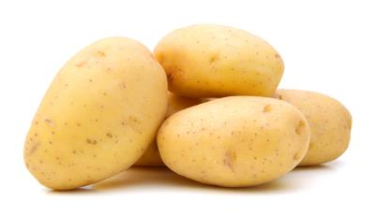
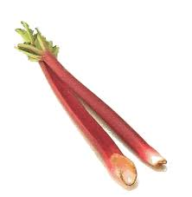
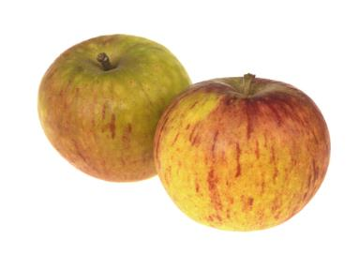
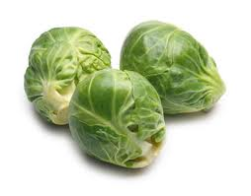
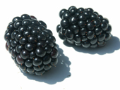
Seasons
Spring
Summer
Autumn
Winter

Slide 12
Which season?
Spring
Summer
Autumn
Winter

Slide 13
Food origins
For further information, go to:
www.foodafactoflife.org.uk
This resource meets the Guidelines for producers and users of school education resources about food.

