Slide 1
Food is produced and processed

Slide 2
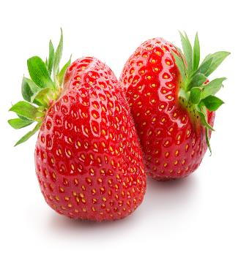
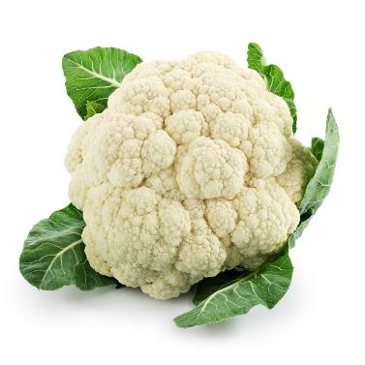
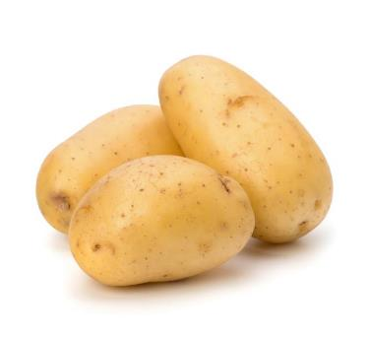
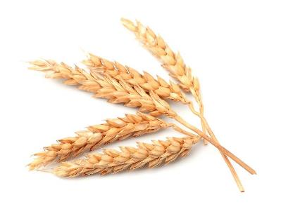
All food is from a plant or animal
Strawberries
Cauliflower
Potatoes
Wheat
Plants

Slide 3
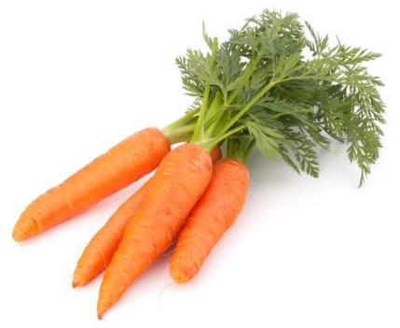
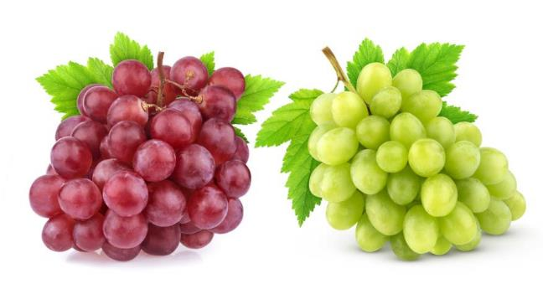
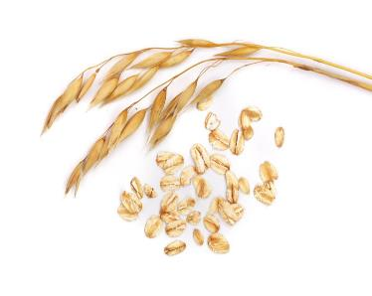
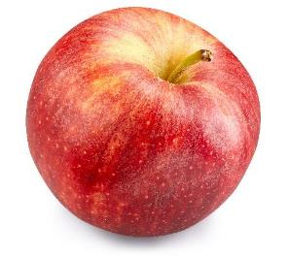
All food is from a plant or animal
Apple
Carrots
Oats
Grapes
Plants

Slide 4
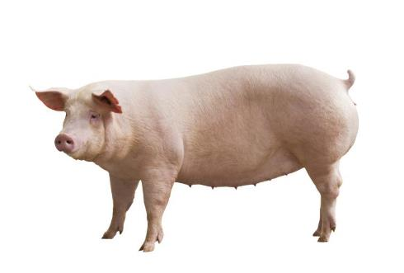
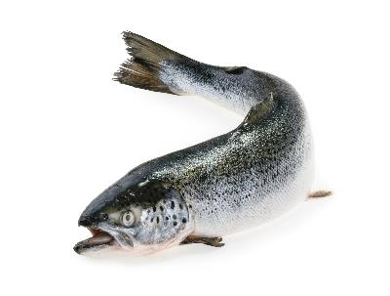
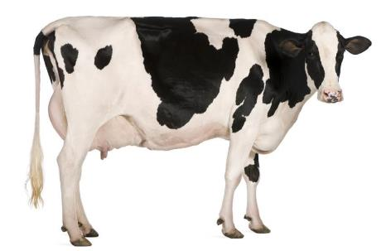
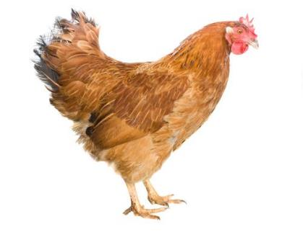
All food is from a plant or animal
Salmon
Dairy cow
Chicken
Pig
Animals

Slide 5
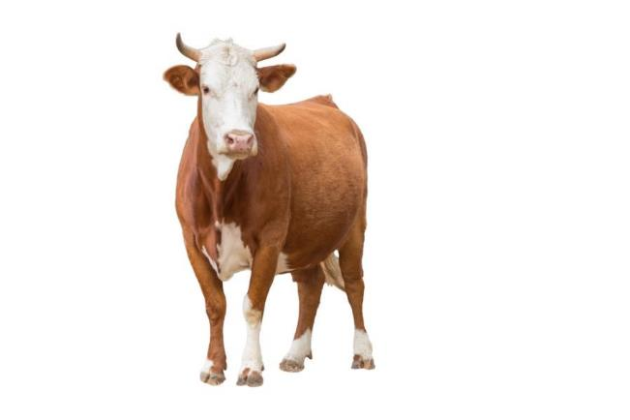
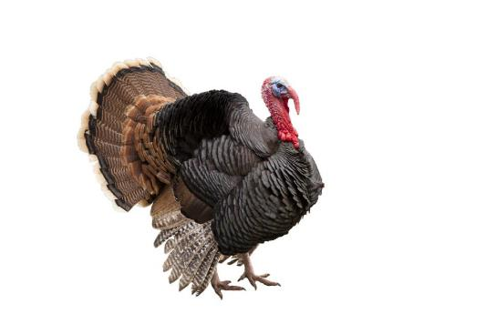
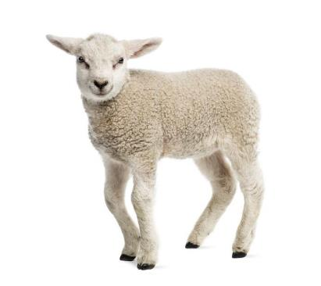
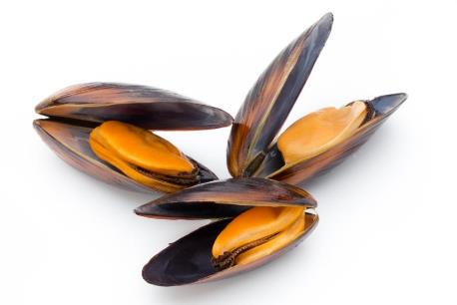
All food is from a plant or animal
Beef cattle
Mussels
Turkey
Lamb
Animals

Slide 6
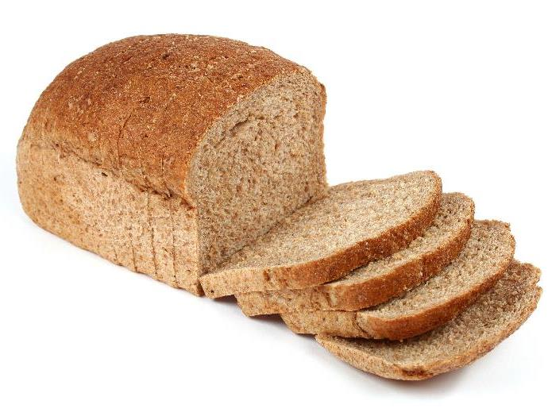
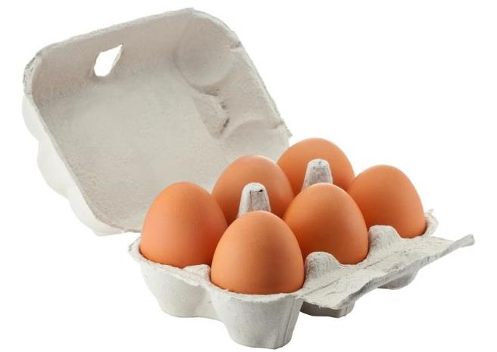

From a plant or animal?
Animal
Plant
Plant
Eggs
Apple
Bread

Slide 7
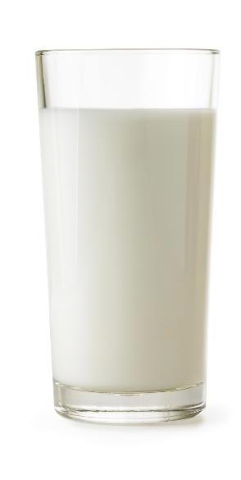

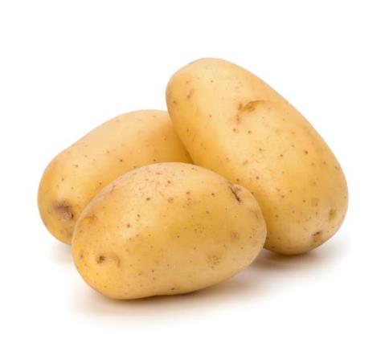
From a plant or animal?
Plant
Plant
Animal
Carrots
Potatoes
Milk

Slide 8
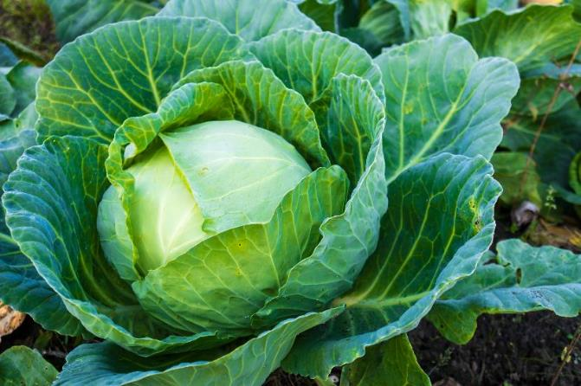
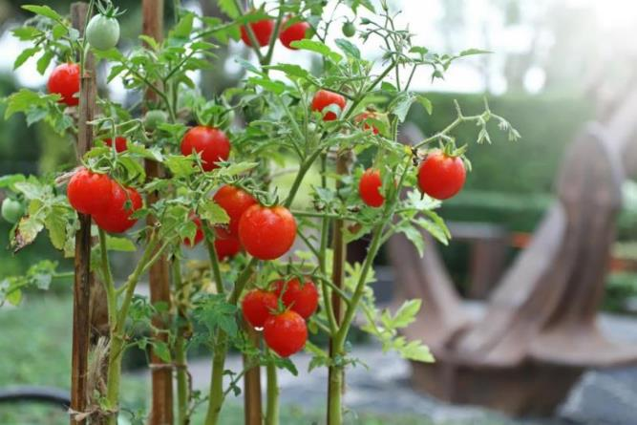
Food is produced
These plants are grown.
Cabbage
Tomatoes

Slide 9
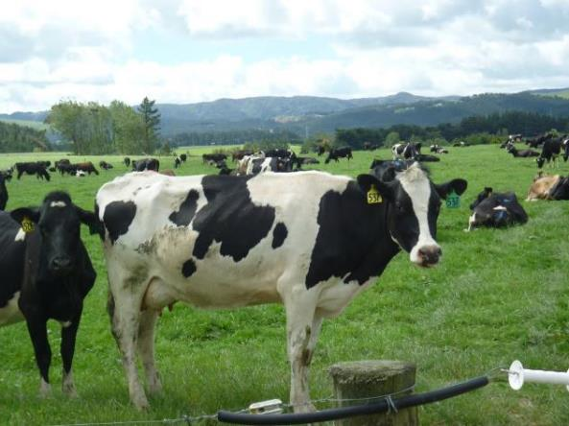
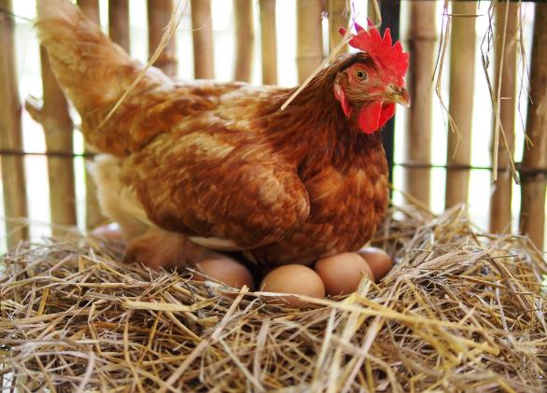
Food is produced
These animals are reared.
Dairy cow
Chicken

Slide 10
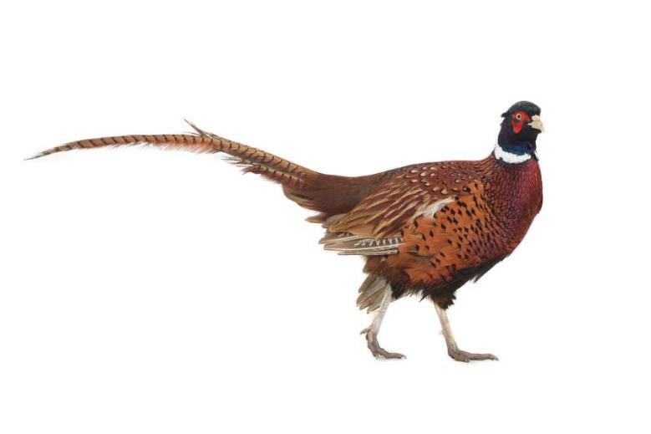
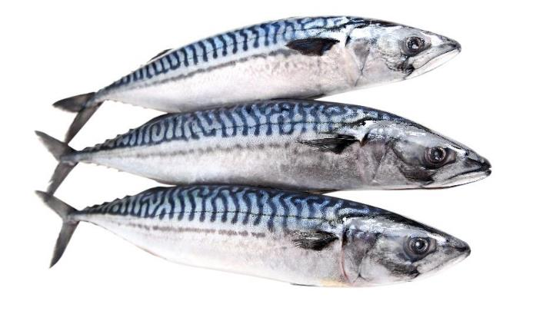
Food is processed
These animals are caught.
Fish
Pheasant

Slide 11
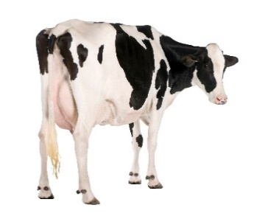
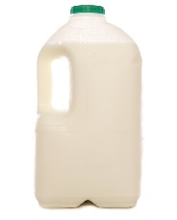
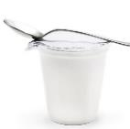
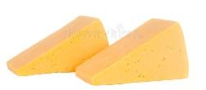
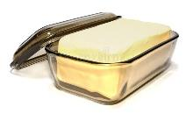
Food origins: Milk
Dairy cow
Milk
Cheese, yogurt and butter

Slide 12
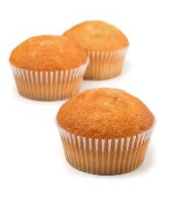
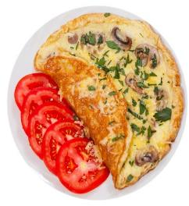
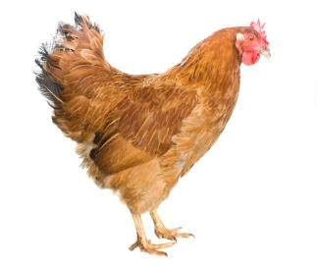

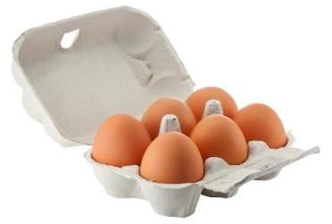
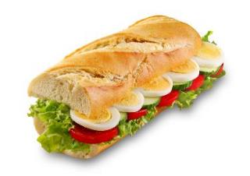
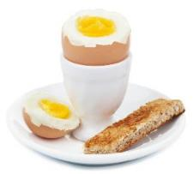
Food origins: Eggs
Hen
Eggs
Egg dishes

Slide 13
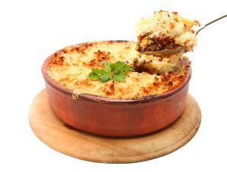
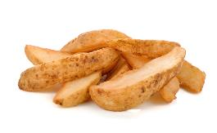
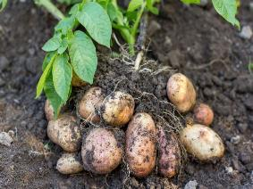
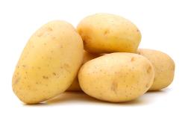
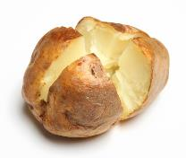
Food origins: Potatoes
Potatoes
Potato dishes

Slide 14
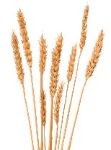
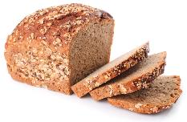

Food origins: Bread
Wheat
Bread

Slide 15
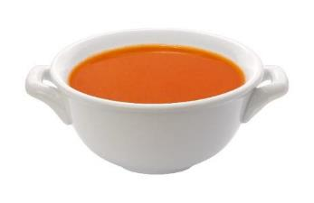

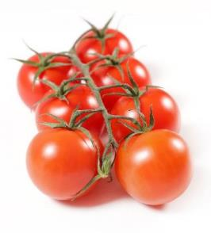
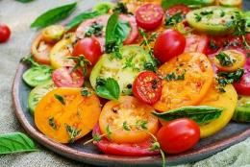
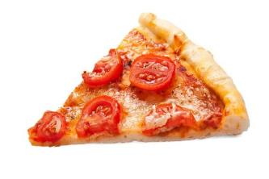
Food origins: Tomatoes
Tomatoes
Tomato dishes

Slide 16
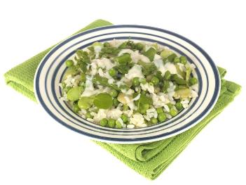
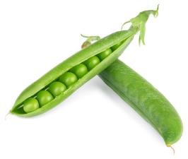



Food origins: Peas
Peas
Pea dishes

Slide 17


Food origins: Strawberries
Strawberries
Strawberry jam

Slide 18


Food origins: Fish
Cod
Fish fingers

Slide 19



Food is processed: Grilled lamb
Rearing
Processing
Grilling

Slide 20





Food is processed: Apple juice
Apple juice
Growing
Picking
Washing
Juicing

Slide 21





Food is processed: Milk
Rearing
Milking
Processing
Milk

Slide 22





Food is processed: Bread
Wheat
Grains
Flour
Bread dough
Bread

Slide 23




Food is processed: Potatoes
Potatoes
Peeling
Boiling
Potato dishes

Slide 24
Food is produced and processed
For further information, go to:
www.foodafactoflife.org.uk
This resource meets the Guidelines for producers and users of school education resources about food.

