Slide 1

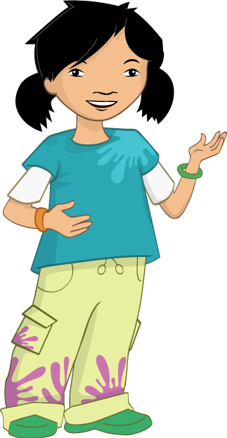
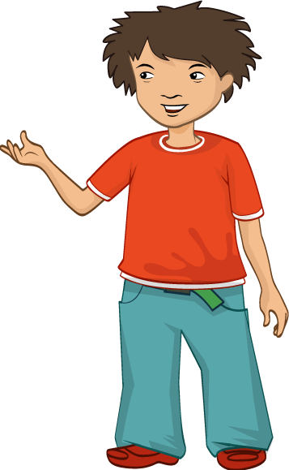
The colourful present

Slide 2

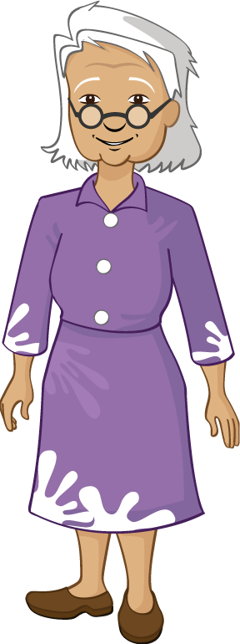
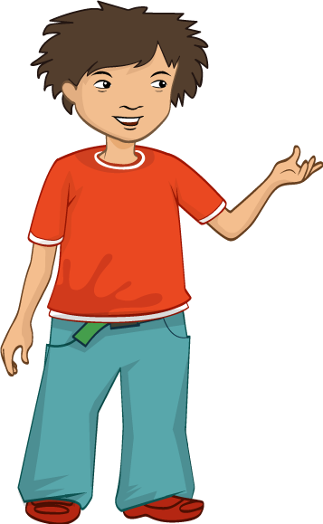


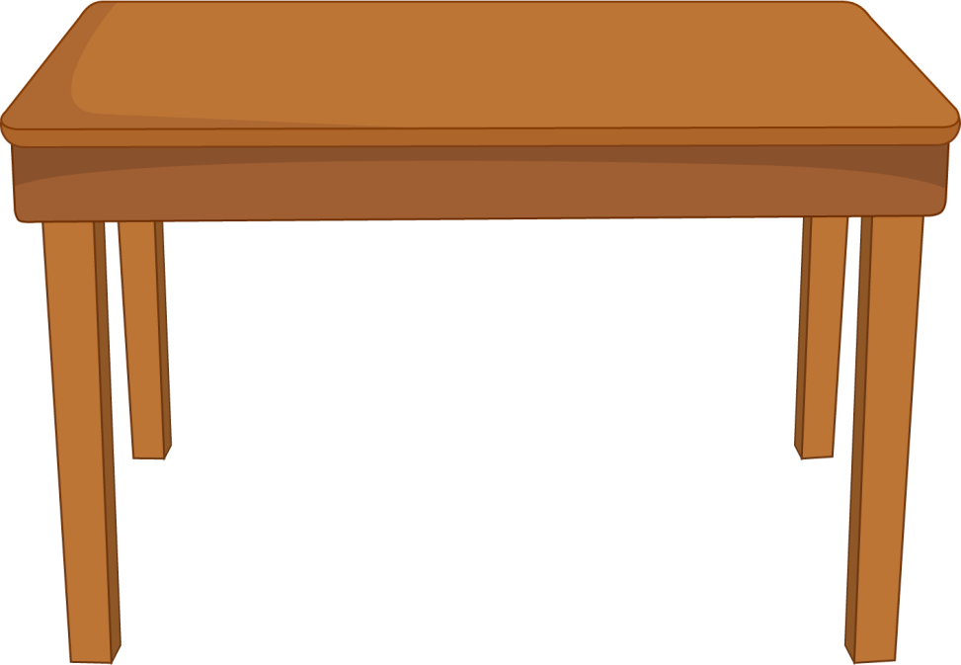



It was Ronnie’s Grandma’s birthday.
Ronnie wanted to give her a special present.

Slide 3

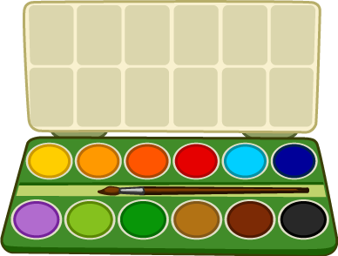

Alisha wanted to help Ronnie.
“You need to get her something colourful,” said Alisha.
Ronnie didn’t understand.
Alisha reminded him about what they had learned at school.

Slide 4
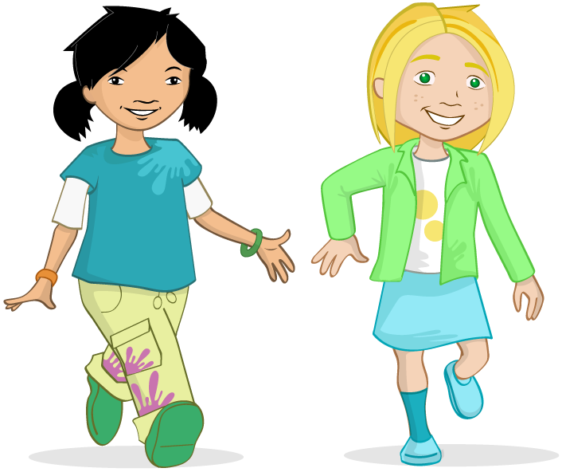





They had been learning you should eat a rainbow of fruit and vegetables.
“We all need to eat at least 5 A DAY,” the teacher had said.

Slide 5
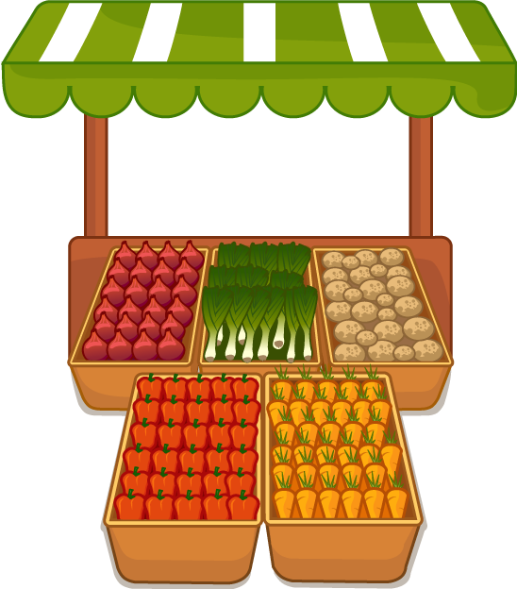
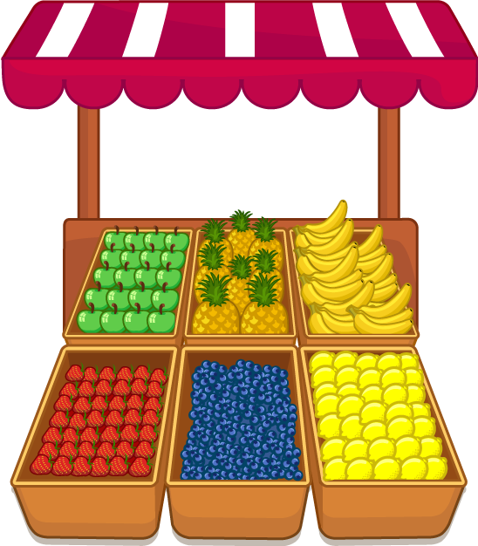
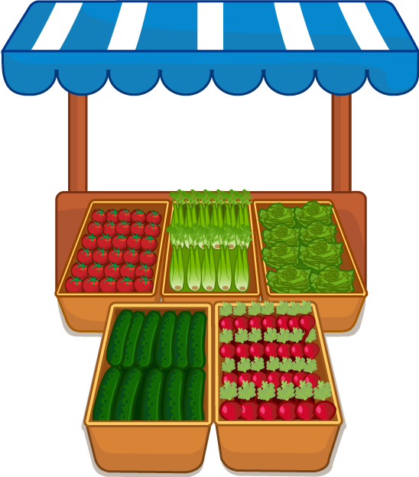
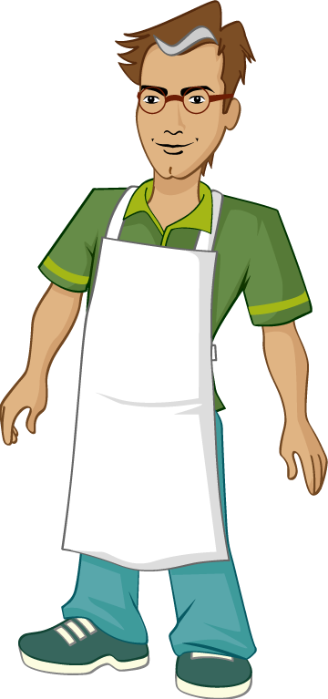
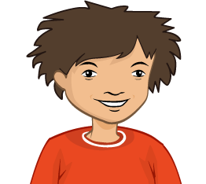

“Let’s go to the fruit and vegetable market,” said Alisha.
Ronnie thought that would be a good way to explore lots of colourful fruit and vegetables.

Slide 6
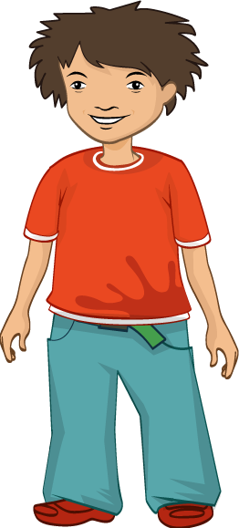
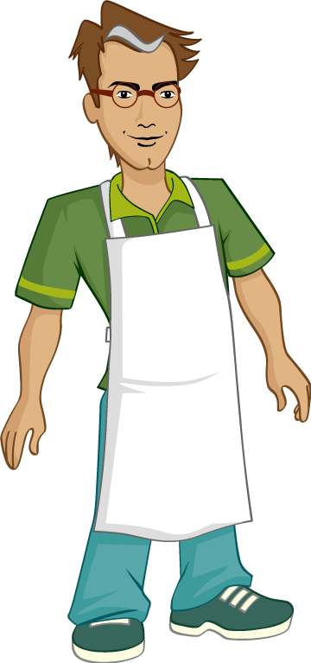
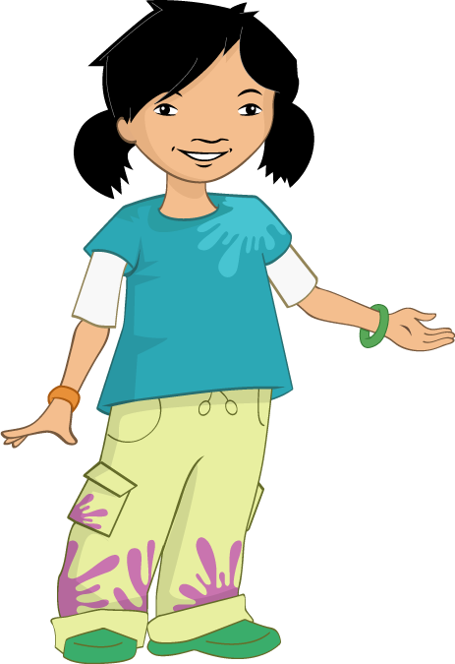
“What is your Grandma’s favourite colour?” asked Alisha.
“Grandma likes yellow,” said Ronnie.
“We could get lemons, bananas or pineapple,” said Alisha.
Ronnie bought some bananas.

Slide 7
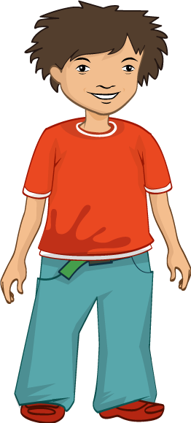

“Grandma likes red as well,” said Ronnie.
“We could get strawberries, peppers or tomatoes,” suggested Alisha.
Ronnie bought some peppers.

Slide 8
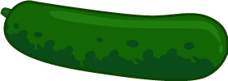
“Does your Grandma like green too?” asked Alisha.
“Yes,” said Ronnie. “We could get cucumber, apples or peas.”
Ronnie bought a cucumber.

Slide 9
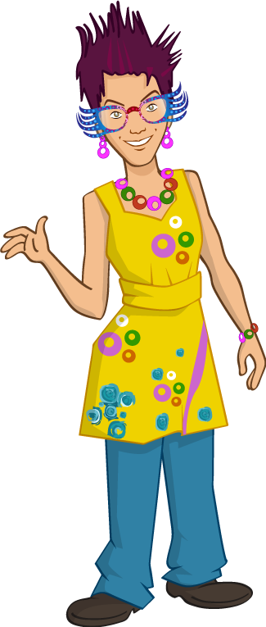

“Grandma likes blue,” said Ronnie.
“We could get…I can’t think of anything blue,” said Alisha.
“ How about blueberries! ” said Ronnie.

Slide 10

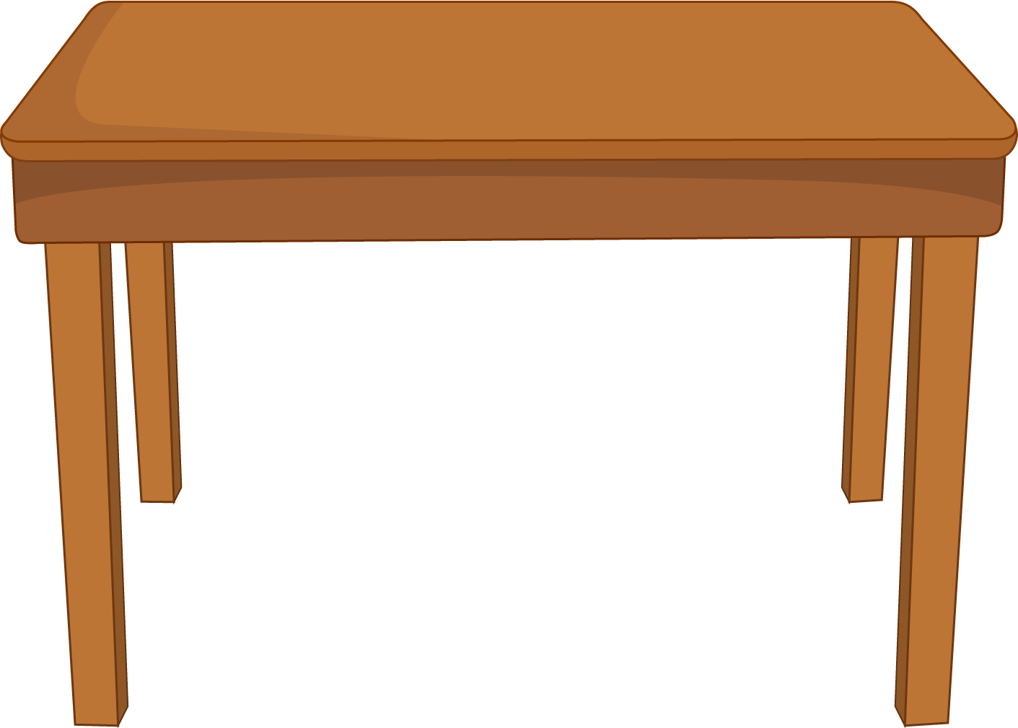

Ronnie and Alisha looked at everything they had bought.
“These will make a great, colourful present,” said Alisha.
“They don’t look like a present,” said Ronnie.

Slide 11
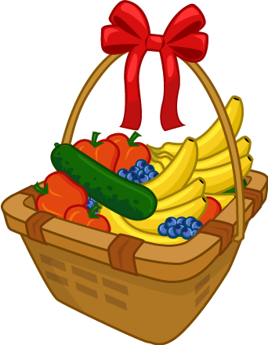
Alisha put all the fruit and vegetables into a basket.
She tied it with a colourful ribbon.
“Perfect,” said Ronnie, with a big grin.

Slide 12

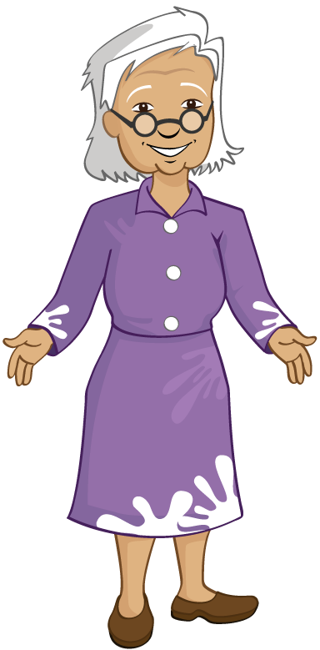












Ronnie took the present to Grandma.
Grandma loved it!
“What a colourful present and it will help me get my 5 A DAY!” she said.

Slide 13
For further information, go to:
www.foodafactoflife.org.uk

