Slide 1
The amazing lunchbox

Slide 2
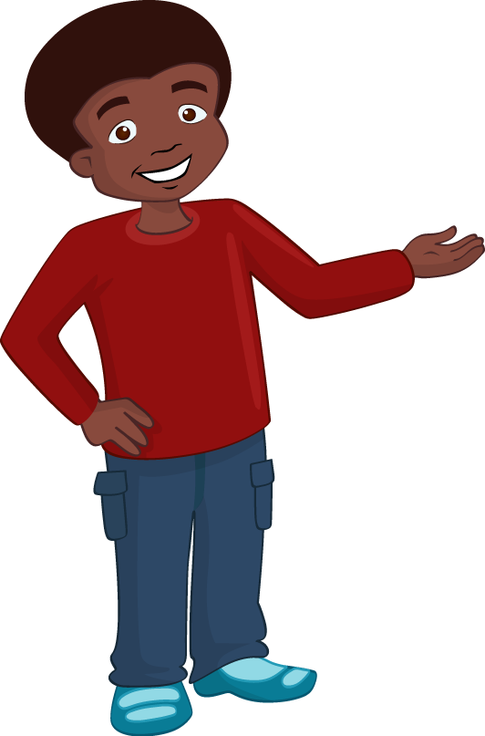
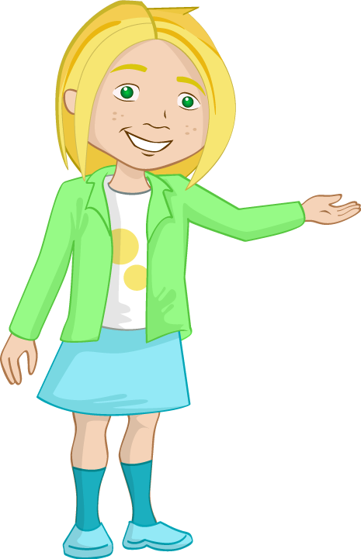
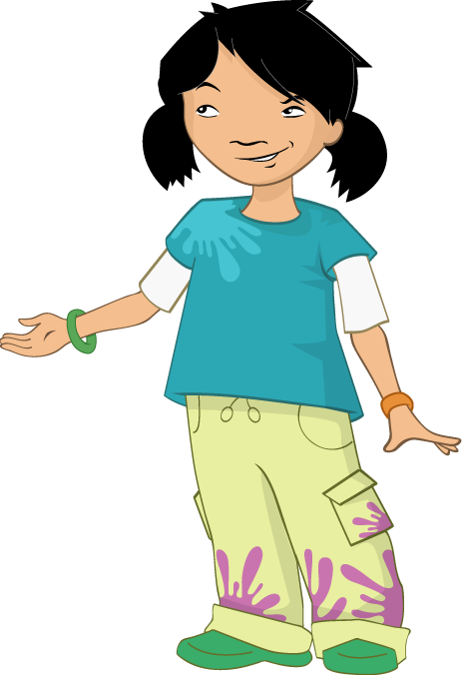
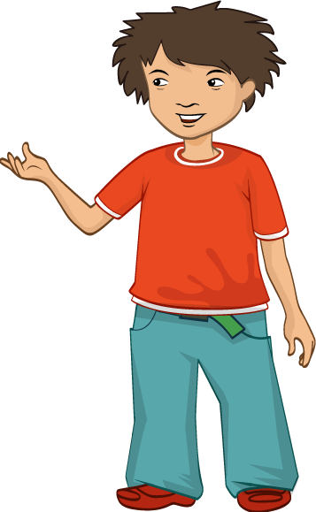




“I’m starving,” said Jordon as he sat next to Nicola on the bench.
“What a surprise!” said Nicola rolling her eyes at Alisha.
It was a sunny day, so Jordan, Nicola, Ronnie and Alisha all sat in the playground eating their packed lunches.
“Guess what’s in my sandwich,” said Jordan.
“Cheese!” replied his three friends straight away.
“Oh,” said Jordan, feeling a bit disappointed that they had guessed so easily.

Slide 3
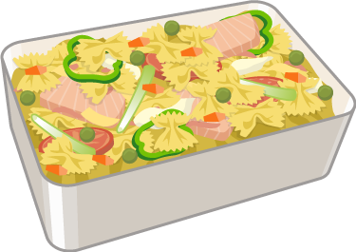
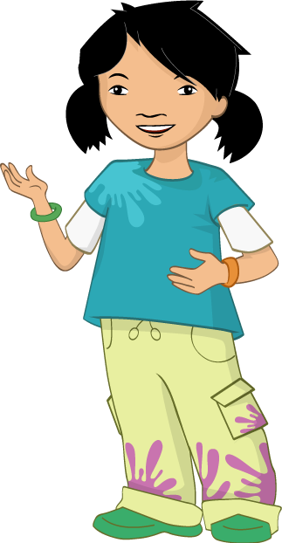

“You do have it quite a lot and we know it’s your favourite, so it wasn’t that hard to guess,” said Alisha.
“And you do ask us that question every time you have cheese!” Nicola pointed out. They all giggled.
“What has everyone else got for lunch?” asked Ronnie.
“I’ve got a wrap with hummus and grated carrot,” said Alisha.
“I’ve got tuna and veggie pasta,” said Nicola.

Slide 4
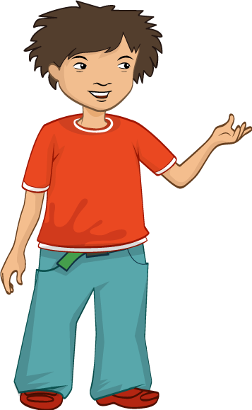

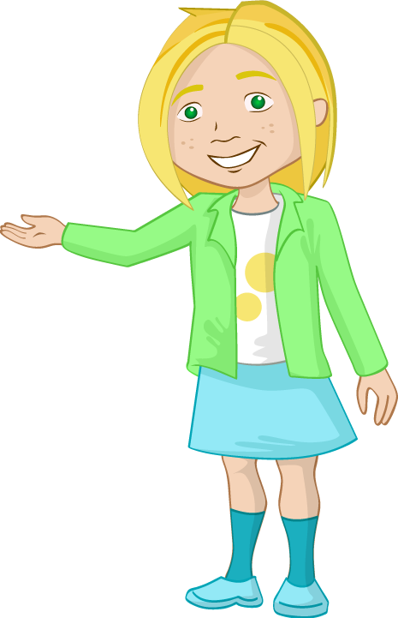

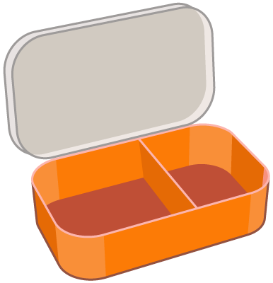
“I’ve got a yogurt and some grapes”, said Ronnie. “We’ve all got something different, I wonder how many different types of lunchbox you could have?”
“Do you think all lunchboxes are healthy?” reflected Jordan.
“I don’t know,” said Nicola. “Why don’t we find out?”
“Yes!” said Jordan. “This is a job for the Food investigators!”

Slide 5
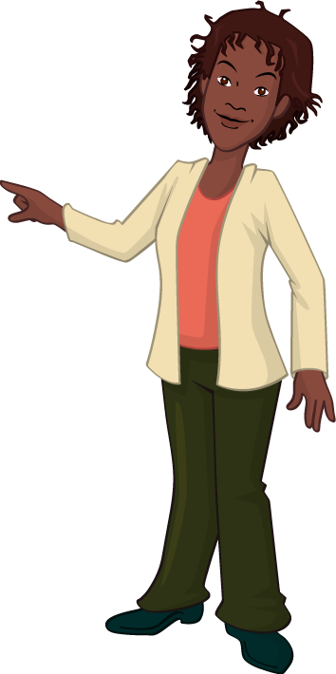


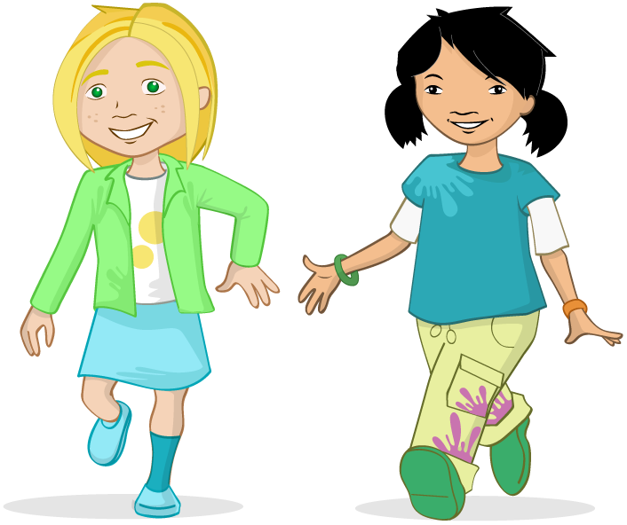
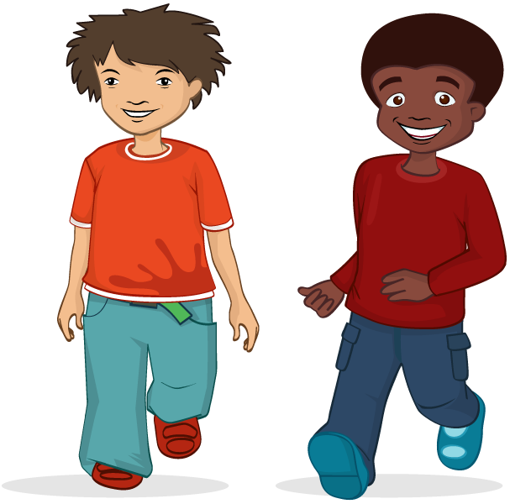


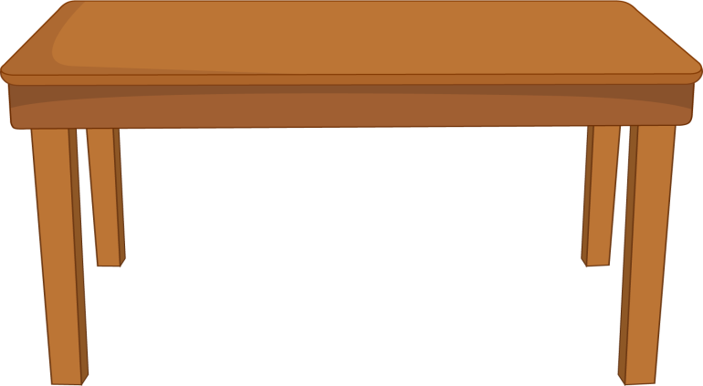

Straight after lunch, the four friends, who called themselves the Food investigators, spoke to Mrs Flynn their class teacher.
“We were talking about our lunchboxes and wondered whether they were healthy,” explained Nicola.
“We want to know more about them,” said Ronnie.
“Yeah, we want to investigate different types,” added Jordan.
“Well,” said Mrs Flynn. “That sounds like a great idea. In fact this is very good timing because we are about to start a healthy eating project!”

Slide 6

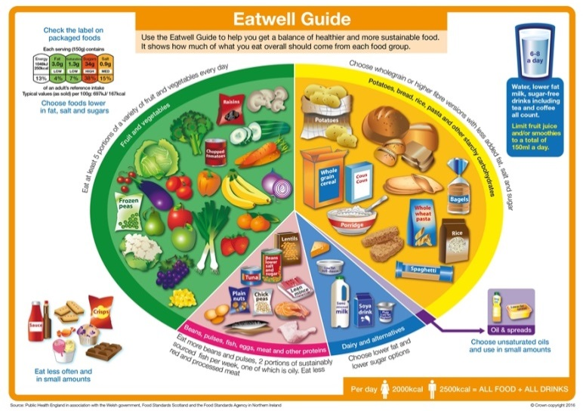
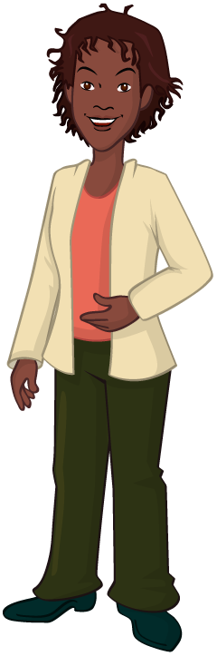
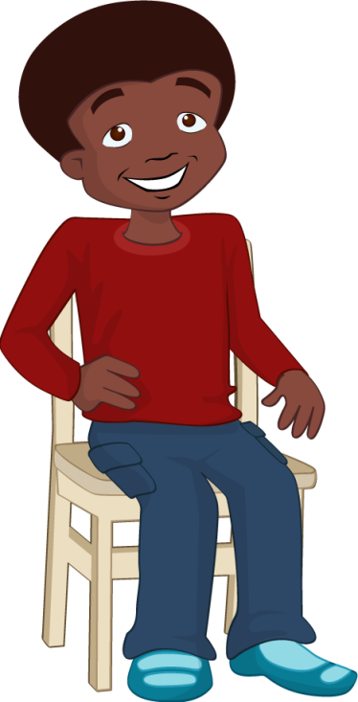
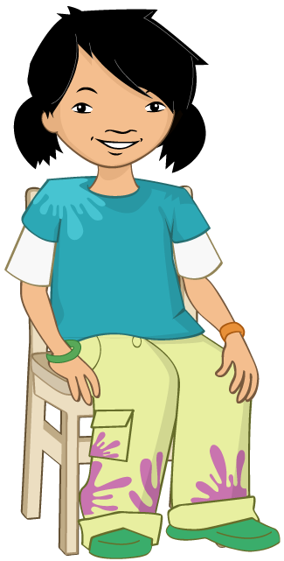
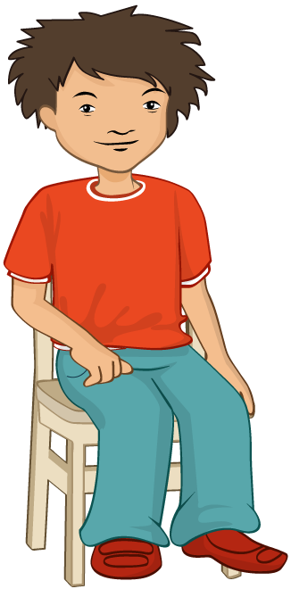
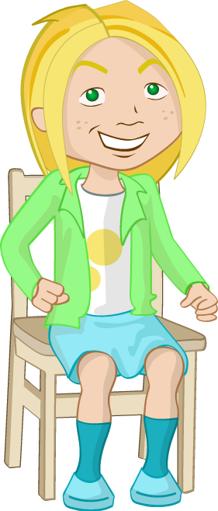
The Food investigators went back to their seats feeling very excited.
“We are starting some new work today on healthy eating,” said Mrs Flynn. “We are going to learn how to eat a healthy, balanced diet.” Mrs Flynn turned to the interactive whiteboard and revealed a colourful looking image. She explained that the image was called The Eatwell Guide. “We can use The Eatwell Guide to help us make healthier choices,” she said. “Can anybody tell me anything about the guide?”

Slide 7
“There is a circle which is split into 5 groups, and the sizes and colours are different,” said Ronnie.
“That’s right,” said Mrs Flynn. “The circle shows us how much of the different food groups we should eat throughout the whole day to be healthy.”
Mrs Flynn pointed to each of the groups in turn and asked the children what foods they could see. “We should eat a variety of different foods from each food group to stay healthy,” she said.

Slide 8
“What else can you tell me about the guide?” Mrs Flynn said.
“Crisps, chocolate, biscuits and ice-cream are not in the circle and there is an image of a food label and a drink” said Nicola.
“Well done Nicola,” said Mrs Flynn. “These foods are outside of the circle because they are not needed in our daily diet as they are high in fat, salt and sugar,” she pointed to the food label. “You can tell what foods are high in fat, salt and sugar because there will be lots of red on the food label.”

Slide 9
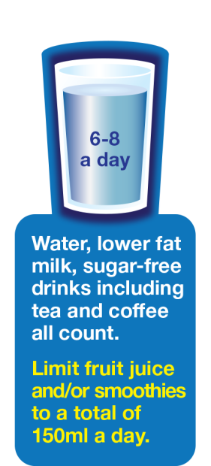
“Why is there a drink on The Eatwell Guide?” Nicole reminded Mrs Flynn.
“The drink is there to remind us to have 6-8 unsweetened drinks a day, such as water or lower fat milk,” Mrs Flynn said. “We can also have a 150ml glass of unsweetened fruit juice or smoothie once a day.”

Slide 10

Lunchbox checklist
□ I have based my lunch on a high fibre or wholegrain starchy food, e.g. wholemeal bread.
□ I have included 2 portions of fruit and vegetables.
□ I have included a portion of beans, pulses, fish, eggs meat or other proteins, e.g. a bean salad.
□ I have included a dairy product which is lower in fat and sugars.
I have included
an unsweetened drink.
“Now,” said Mrs Flynn. “I’m going to set you a task. For your homework, you’re going to create a healthy lunchbox! It has to be healthy lunchbox so I’ve given you a checklist to follow.”
The class were excited, especially the Food Investigators. Their teacher gave out a homework sheet for them to complete.
Outside the school the Food investigators challenged each other to see who would make the best lunchbox. Jordan felt confident, “I’m going to make the most amazing lunchbox.” They all rushed home to get started.

Slide 11
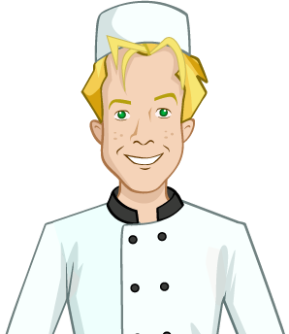


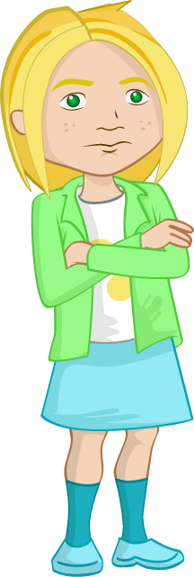





At home, Nicola thought hard about what could be in her amazing lunchbox. She dreamed about all the different foods she could include as she looked through a selection of recipe books in the kitchen. Her list was getting quite long.
“Oh dear!” thought Nicola. “Perhaps I’ve got too many ideas and my lunchbox isn’t that healthy!” Nicola’s Dad could see that she was worried. He sat down and started to talk about all the different types of lunches he knew. Of course they all contained bread - well he was a baker!
After a while they had decided on a traditional ploughman's lunch. “It’s an amazing lunchbox idea, thanks Dad!” said Nicola.

Slide 12

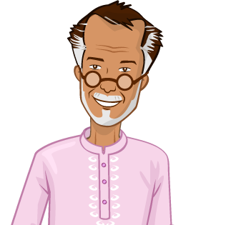
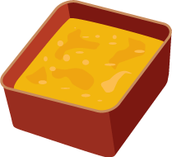

When Ronnie got home he chatted to his family about his lunchbox homework. “What did you have when you were at school, granddad,” he quizzed.
“Well, in my day we had some dhal and chapatti,” answered Ronnie’s granddad. “What, for lunch?” Ronnie exclaimed.
“Why, yes. It was lovely and tasty,” he said. “And I usually had water as my drink.”
Ronnie thought hard about his lunchbox. How could he make it amazing? Could he use his granddad's idea? “It’s a winner!” Ronnie said, much to his granddad’s surprise.

Slide 13

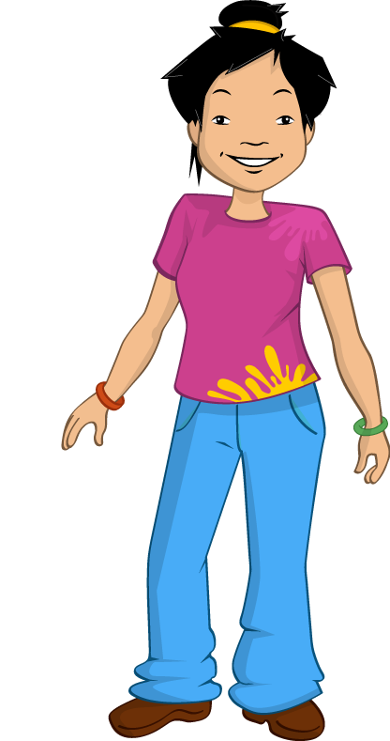
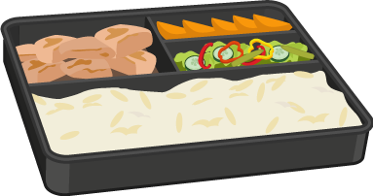
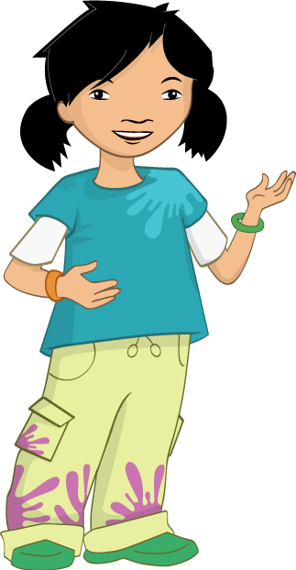
Alisha rushed in her house and leapt onto the computer. After a few clicks, she was looking at lunchboxes from around the world.
“In China I used to have a rice box,” mentioned her Mum. “They were always tasty, with lots of rice, vegetables and chicken.”
“But mum, I want to look at other countries – what about a bento box?” Alisha asked.
“That’s great! My best friend Yoko from Japan loves bento boxes – let me show you online,” said Alisha's Mum, enthusiastically. Alisha smiled, knowing that her lunchbox would be the most amazing.

Slide 14


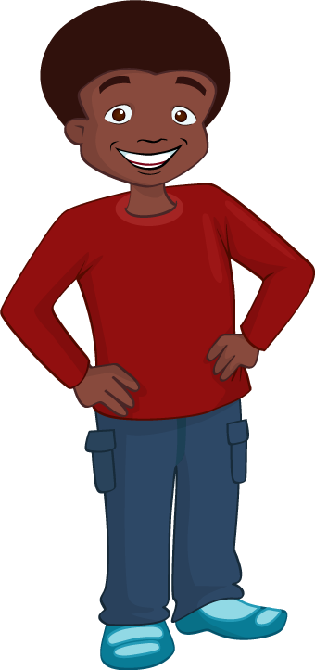


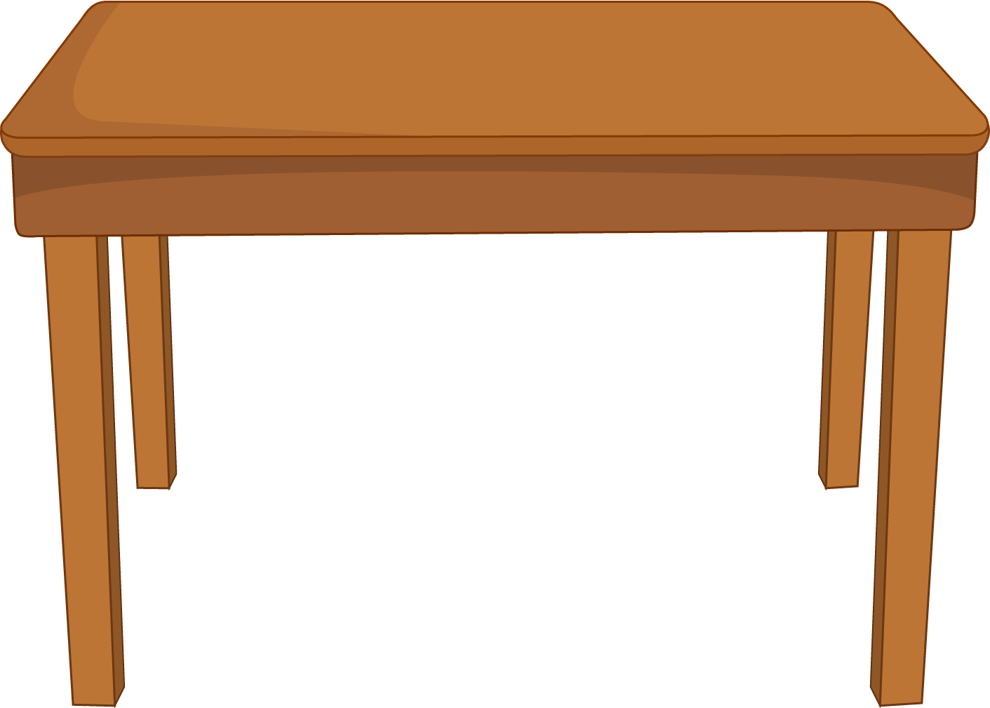
When Jordan got home, he had already decided on his lunchbox. To make it amazing he would base it on his favourite food. Cheese!
He set about drawing his lunchbox, then describing all the foods that it would contain.
“Truly amazing,” he chuckled to himself. He was certain that no one else’s lunchbox would be so amazing.

Slide 15

The next day the four friends met in the playground.
“How did you get on?" Jordan asked his friends.
"Not too bad," said Ronnie. He hoped that his lunchbox would be the best but he didn’t want to say too much just yet.
Alisha and Nicola nodded, saying that they had also managed the task. All four friends looked at each other, all secretly thinking that they had the most amazing lunchbox.

Slide 16


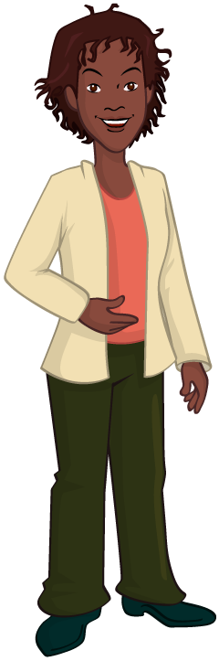
After settling down and taking the register, Mrs Flynn asked all the class for their homework. One by one, different class members handed in their homework sheet.
Next it was Alisha’s turn. But she didn't have her homework sheet - she had a real lunchbox instead! Alisha had made a healthy lunchbox, which was based on the rules from the homework sheet.
"How inventive Alisha, well done!" exclaimed Mrs Flynn.

Slide 17
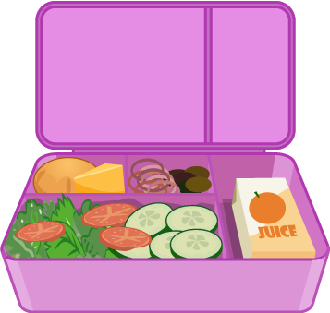
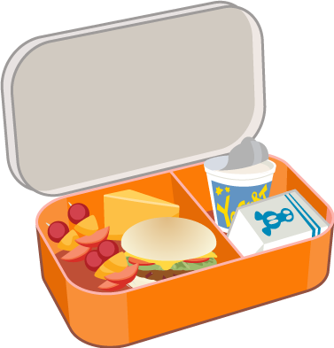

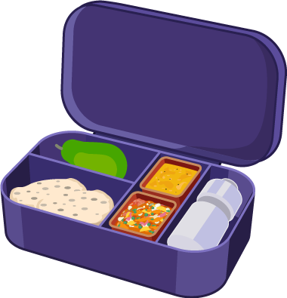
Ronnie, Nicola and Alisha all looked at each other and gasped! "That was my idea!" shouted Jordan, as he lifted up his homework lunchbox. Ronnie and Nicola also lifted up their lunchboxes. All four friends had decided to make their own amazing lunchboxes, instead of just imagining them on the homework sheet. Well, they were the Food investigators after all!
Mrs Flynn smiled and reminded Jordan to put his hand up, rather than shout out. Then she asked Jordan, Nicola and Ronnie to bring their homework and join Alisha at her desk.

Slide 18



The Food investigators opened their lunchboxes to show the class. All the children in the class were amazed by what they saw. One by one, the friends talked about their lunchboxes. Alisha had a bento box from Japan, Nicola had made a traditional ploughman’s lunch and Ronnie had little tubs of exciting dhal and curry, along with chapatti.
Finally, it was Jordan's turn. Wearing a big grin, he revealed his lunchbox. The class couldn't believe their eyes. Everything either contained cheese or was cheese!

Slide 19
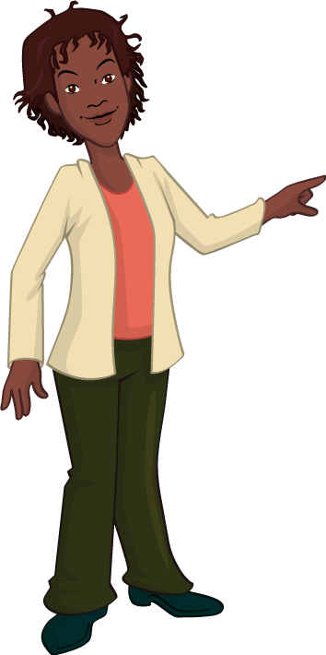

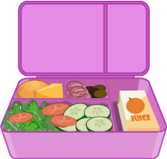


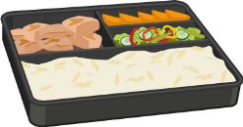



The class gave the Food investigators a round of applause. It had been a great homework task. The Food investigators had brought in enough to share with the class and everyone was excited about trying the food from each lunchbox. "Who's lunchbox is the most amazing, Mrs Flynn?" asked Jordan.
"Well, Jordan," Mrs Flynn replied. “You have all done very well ... but none of you followed your homework sheet fully."

Slide 20
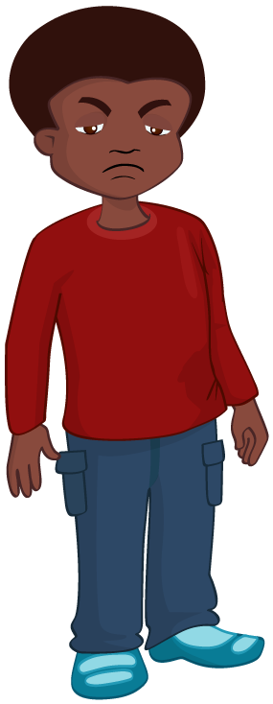
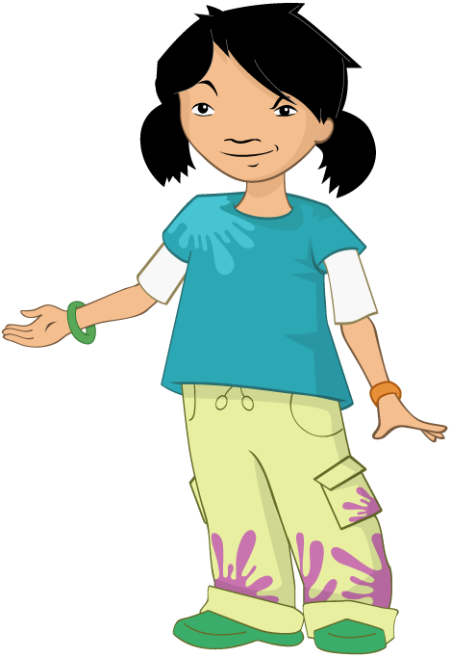
Lunchbox checklist
□ I have based my lunch on a high fibre or wholegrain starchy food, e.g. wholemeal bread.
□ I have included 2 portions of fruit and vegetables.
□ I have included a portion of beans, pulses, fish, eggs meat or other proteins, e.g. a bean salad.
□ I have included a dairy product which is lower in fat and sugars.
I have included
an unsweetened drink.
The Food investigators looked sad. They had all spent a lot of time finding out about different lunches and had also made them. They weren’t sure what they had missed out.
“You forgot to check your lunchbox against the healthy eating checklist,” said Mrs Flynn. “However, there is an amazing lunchbox in this room."
They all looked puzzled. To their surprise Mrs Flynn started taking different foods out of each of their lunchboxes and gathering them together.

Slide 21
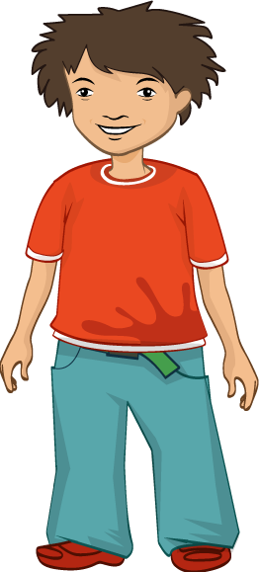
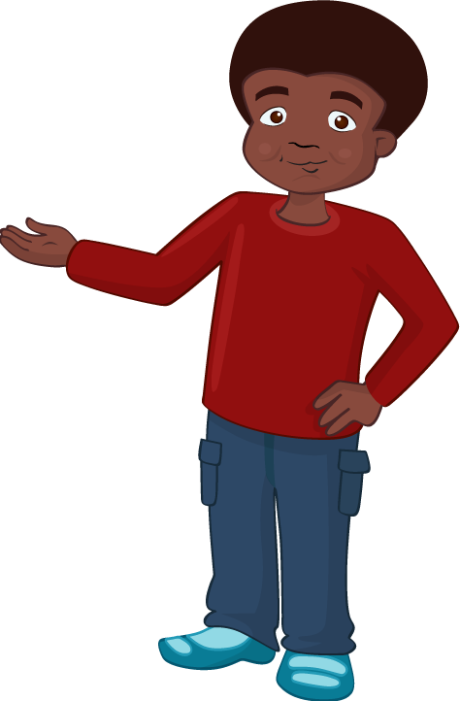
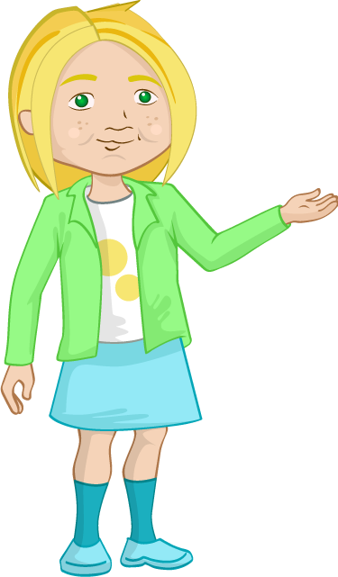
"There!" she said gesturing to the collection of food and drink. "Without knowing it you have all created an amazing lunchbox!”
The children looked at the new lunchbox and then at the healthy lunchbox checklist. Everything on the checklist was included in the new lunchbox. The Food investigators laughed. It truly was an amazing lunchbox and they had all helped to make it!

Slide 22
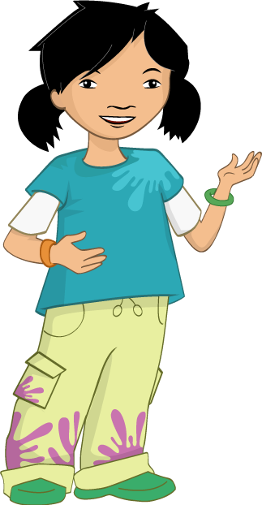

A Healthy Lunchbox
At break time the Food investigators gathered together. They pulled out their notebooks and wrote down everything they had found out about lunchboxes.
“It’s really interesting,” said Ronnie. “I thought lunchboxes had to have sandwiches in them, but there are so many different foods that can be included.”
“I know,” said Alisha. “I’m going to ask my Mum to make me the dhal and chapatti you had in your lunchbox, Ronnie.” “I want to have the bento box you brought in, Alisha,” said Nicola.

Slide 23

“I’d like to have your ploughman’s lunch, Nicola,” said Jordan. “Especially the cheese part!”
“What a surprise!” laughed the other Food investigators.
“I’ve got an idea,” said Ronnie. “We could make those lunches again one day next week and swap with each other!”
“That’s a great idea!” said Alisha.
The Food investigators smiled at one another. They were really pleased with everything they had learnt about lunchboxes and especially pleased that they had all been part of creating an amazing lunchbox.

Slide 24
The end
For further information and support, go to: www.foodafactoflife.org.uk

