Slide 1
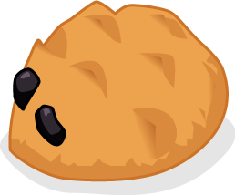
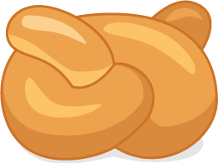

The bread stories

Slide 2


It was the school holidays and Nicola, Ronnie and Alisha were at Jordan’s house waiting for his Gran to arrive. After an exciting visit to a farm last term, the four friend’s had formed a club and called themselves the Food investigators.
They had enjoyed the visit so much they decided to become Food investigators so they could find out more about food.

Slide 3
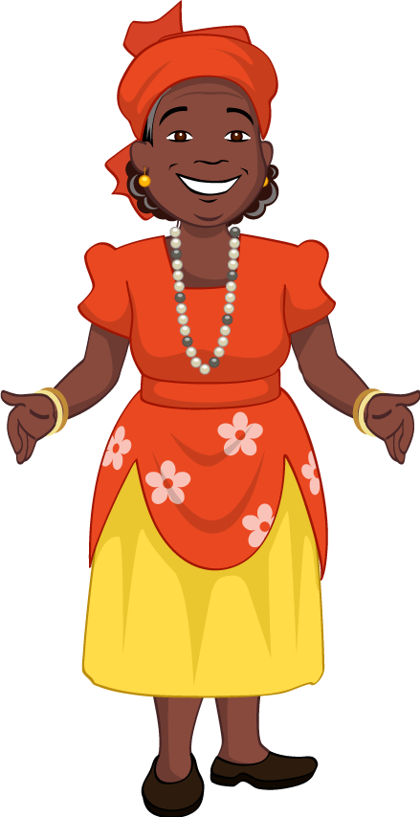

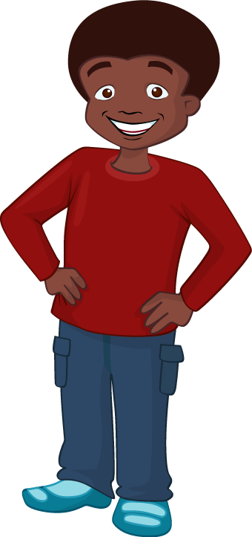
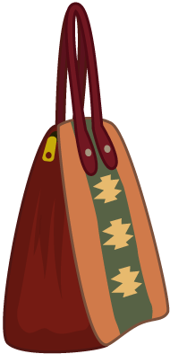
The Food investigators had found out that Jordan’s Gran was visiting from Jamaica. They had asked to meet her so they could learn more about Jamaican food.
“I can see her!” shouted Jordan from the window where he’d been watching.
His friends stood up and looked out. Jordan’s Gran spotted them and a huge smile appeared on her face. Jordan ran to open the door and gave his Gran a big hug.

Slide 4
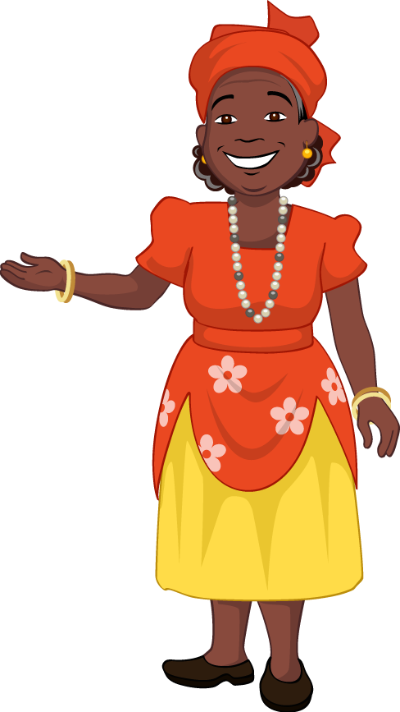
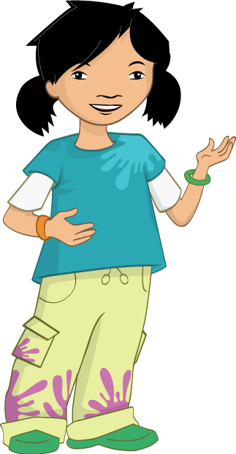
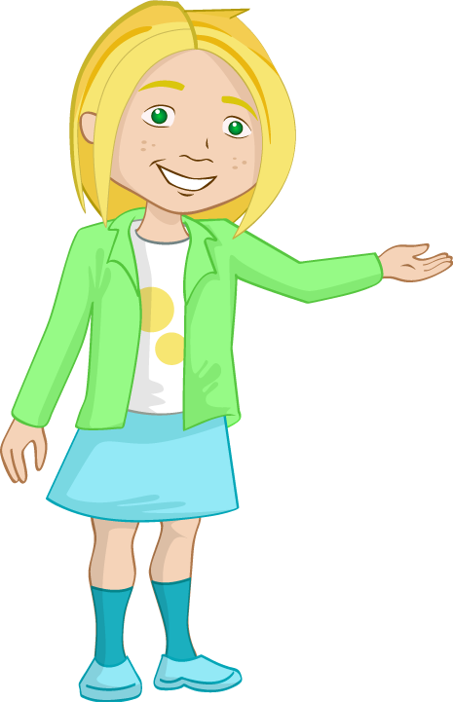
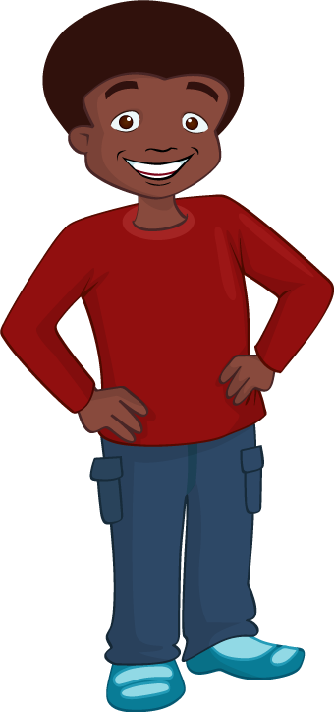
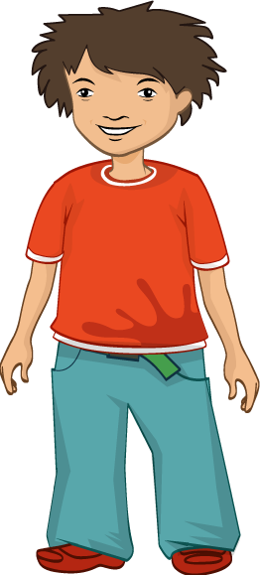
Jordan introduced his friends.
“This is a very special welcome!” said Jordan’s Gran resting her big carpet bag on the floor. “Jordan tells me you are Food investigators and you want to talk to me about food.”
The Food investigators explained all about their club to Jordan’s Gran. After she had settled down with a cup of tea, Jordan’s Gran began to tell them all about Jamaica.

Slide 5
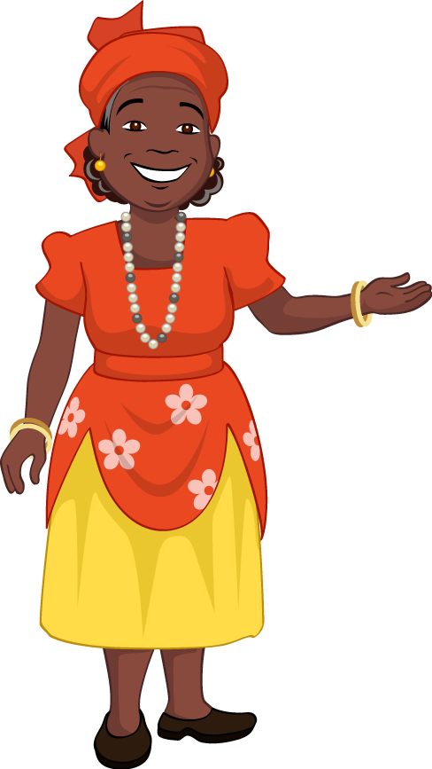





Jordan’s Gran told them that Jamaica was a very beautiful country. She explained that it was hot and perfect for growing delicious fruit like mangoes and papayas.
The Food investigators made lots of notes about what Jordan’s Gran said. She pulled out some old photographs from when she was a child and they could see the fruit growing on trees in the background.

Slide 6
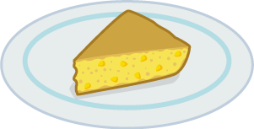
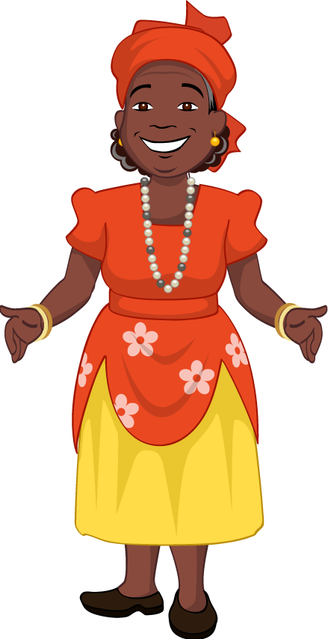
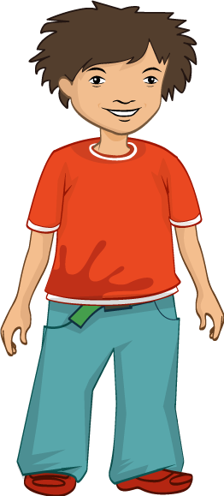
“What sort of foods do you cook in Jamaica? Nicola asked.
“Lots of delicious things, said Jordan’s Gran. “But do you want to know what my favourite food is?” “Yes,” all the children replied.
“Well, it sounds simple, but I just love cornbread. I bake it myself and eat it while it’s still warm from the oven. I usually eat it with some delicious homemade butternut and sweet potato soup.”

Slide 7
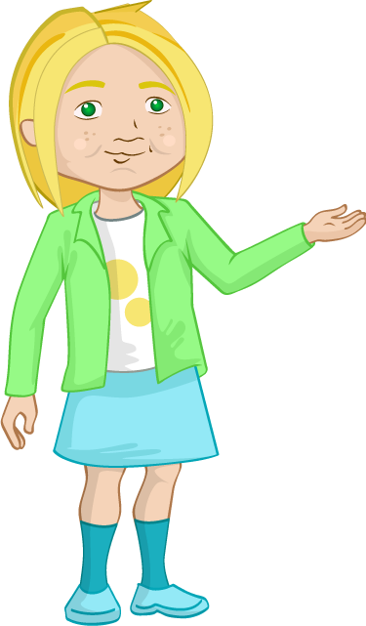
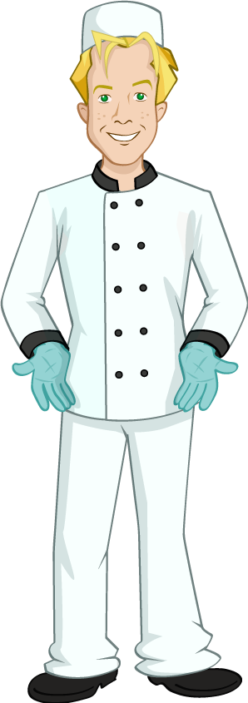
“That sounds amazing,” said Nicola, her mouth watering.
“My Dad is a baker and I know how good warm bread smells, and tastes!”
Jordan’s Gran yawned. She was tired after travelling and needed a rest so the Food investigators went outside to play.
“It was really good to find out about food in Jamaica,” said Nicola.
“What shall we do next? Any ideas?” she asked her friends.

Slide 8
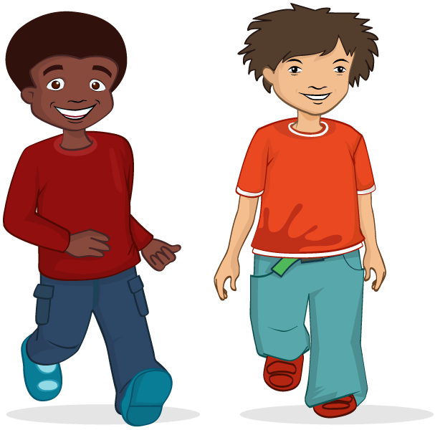
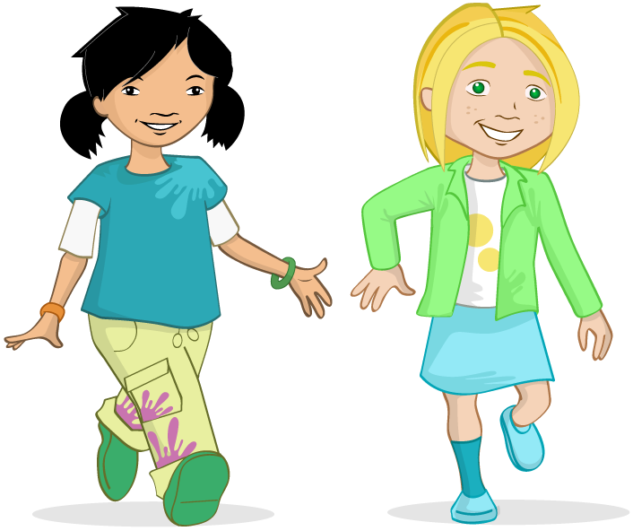
“I’ve got an idea,” said Jordan. “Why don’t you all find out about what your families like to eat?”
“That’s a good idea,” said Nicola. “As your Gran told us about a type of bread and my Dad is a baker, why don’t we try to see what types of breads our families like?”
They all went off to speak to their families.

Slide 9

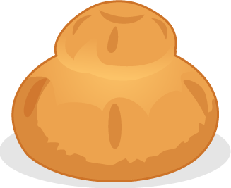
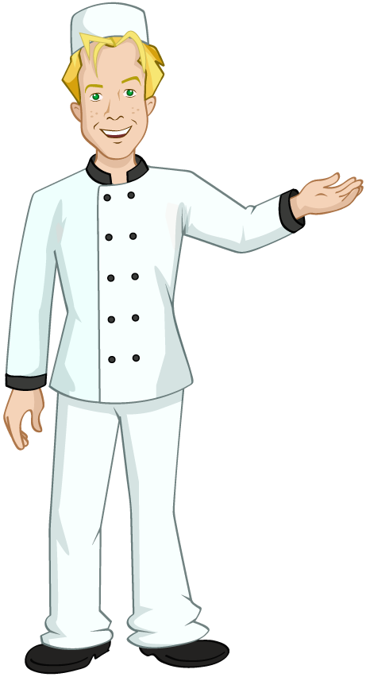
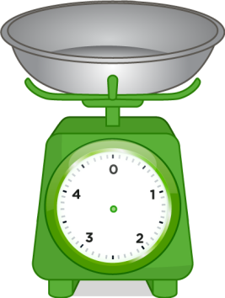


Nicola found her dad at the bakery where he worked. She explained that she was trying to find out about making bread and types of bread her family enjoyed.
Nicola’s Dad told her about a special loaf called a cottage loaf that his dad used to make when he was young. It was made by joining a large ball of dough and a small ball of dough.

Slide 10
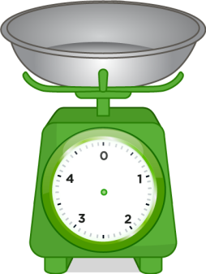

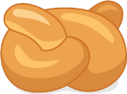
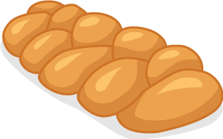

“Wow,” said Nicola. “I’d like to see what that looks like.”
“I’ll tell you what,” said Dad. “Why don’t you invite your friends over tomorrow and we can bake some bread together?” “That would be brilliant, Dad, thank you!” said Nicola.
Nicola was really excited about baking with her Dad. She decided to go and write some notes about what her Dad had said and then phone the other Food investigators.

Slide 11

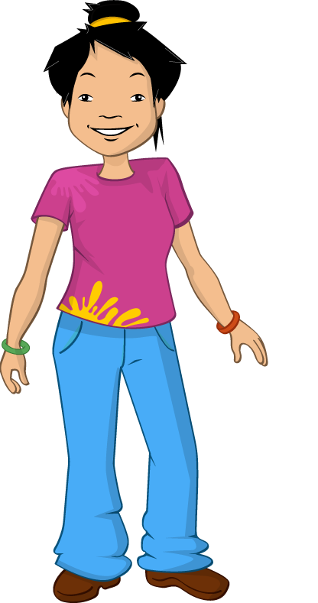



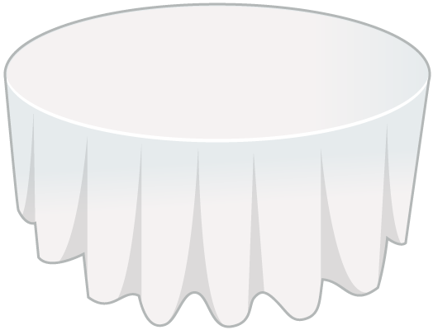
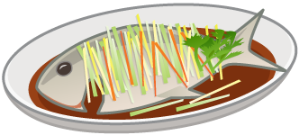

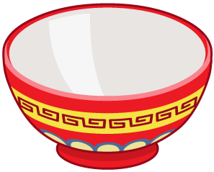
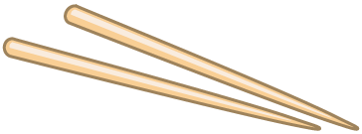
Alisha ran home from Jordan’s house and went to find her mum to ask about bread. When she got home her Mum was busy making the evening meal. Alisha sat down with her notebook.
“I’m trying to find out about different sorts of bread,” Alisha told her Mum.
Alisha’s Mum wiped her hands and then took out an old recipe book.
“This is a special Chinese bread called mantou,” she said.

Slide 12
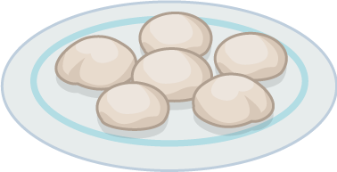
Alisha looked at a photograph showing 6 mantou rolls. They looked a bit like marshmallow, all white and spongy. Alisha’s mum said the mantou rolls were sometimes called Chinese steamed buns and that they were cooked by steaming. She explained that they were mostly eaten in north China where Alisha’s Great Uncle lived.
Alisha was fascinated. She asked her Mum lots more questions and made notes in her book.

Slide 13

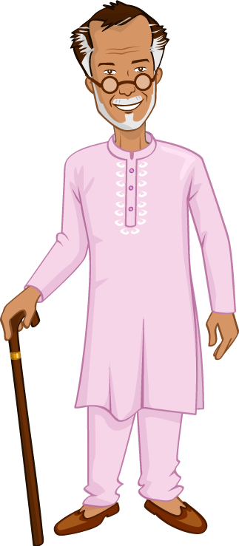
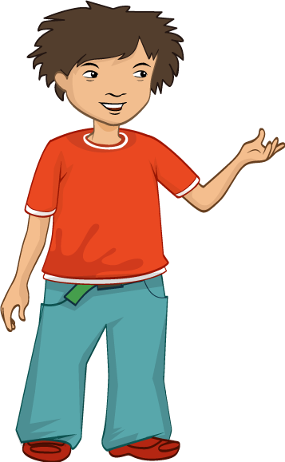

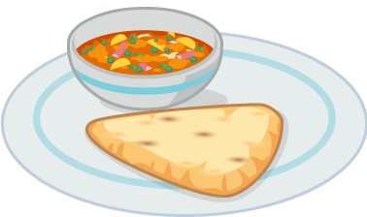

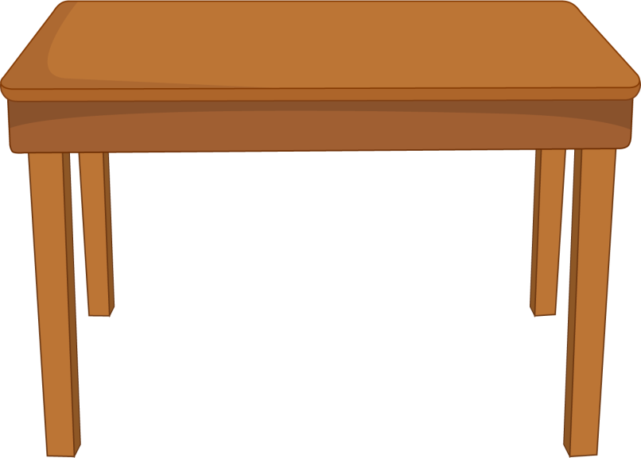
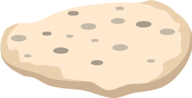
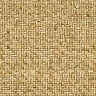
Ronnie knocked on his Grandad’s door.
“Great to see you Ronnie!” said his Grandad cheerfully, as he opened the door. Ronnie followed his Grandad into the kitchen.
“I was just about to have something to eat,” he said “Would you like to join me?”
“Yes please, Grandad,” Ronnie replied enthusiastically. He was feeling rather hungry.

Slide 14
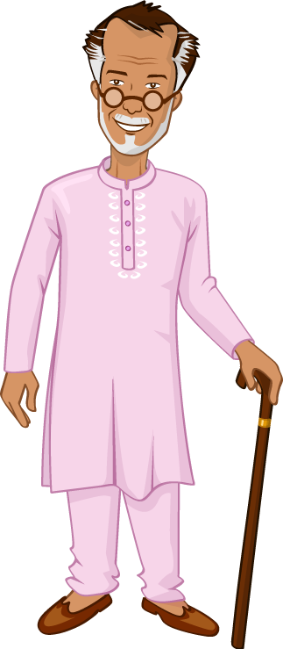
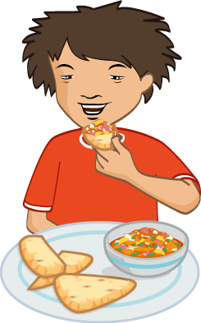


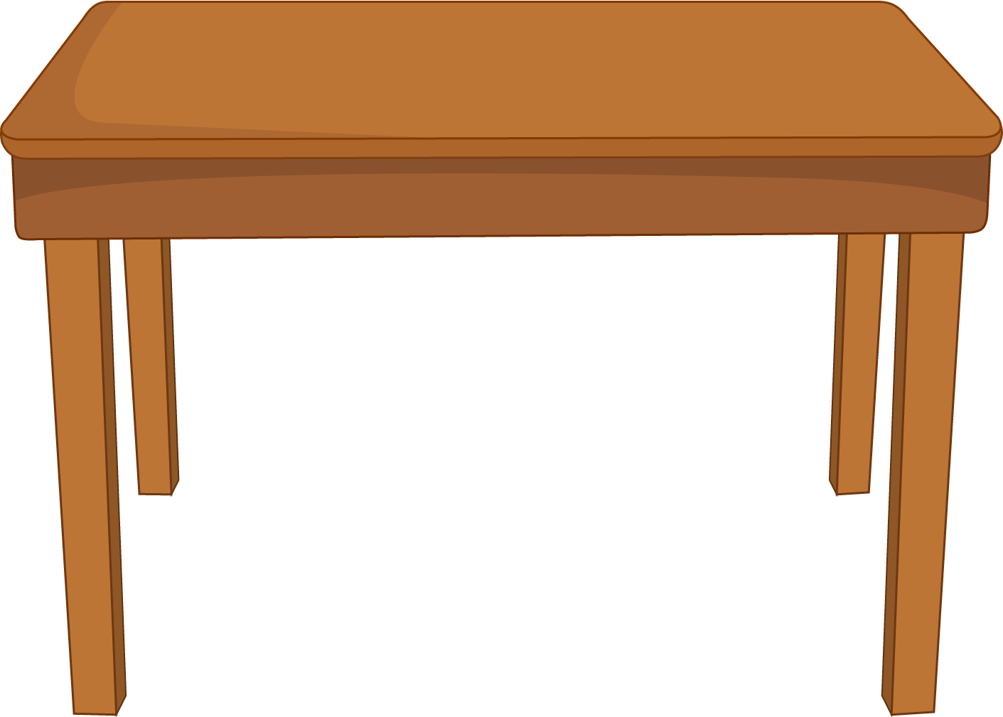
Ronnie sat down to eat Grandad’s famous spinach and chickpea curry with naan bread.
“I’m trying to find out about different sorts of bread,” Ronnie explained. “Can you tell me about naan bread?”
Grandad explained that naan bread was a South Asian bread and eaten in countries such as India, where he had grown up.

Slide 15
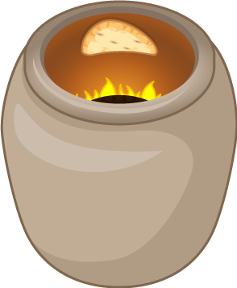
Grandad explained that it was usually cooked in a special oven called a tandoor. Ronnie’s Grandad showed him how to use his naan bread to scoop up the curry, instead of using a fork.
Ronnie had seen his Grandad do this lots of times but he hadn’t tried it himself before. It was a bit tricky but he soon got the hang of it. After they had eaten, Ronnie thanked his Grandad and went home to write down what he had found out.

Slide 16

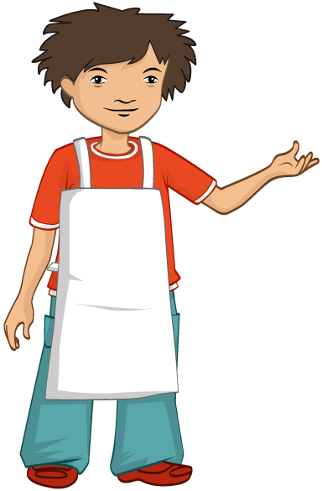
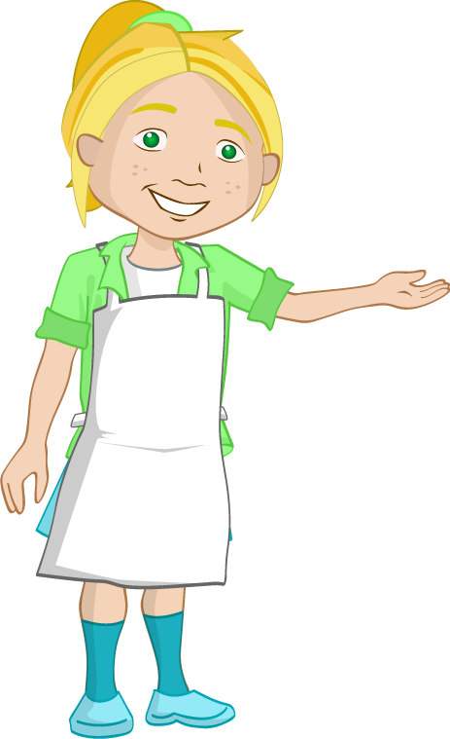
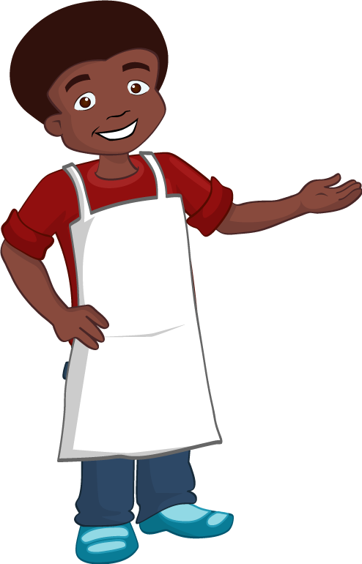
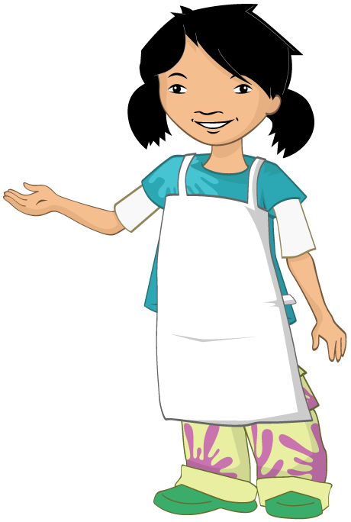
The next day the Food investigators went to Nicola’s house to bake some bread. They were chatting excitedly about everything they had found out.
“Before we start,” said Nicola’s Dad, “we need to get ready so tie back any long hair, roll up your sleeves and wash your hands.”
Everyone followed the instructions and then Nicola’s Dad gave each of them an apron.

Slide 17
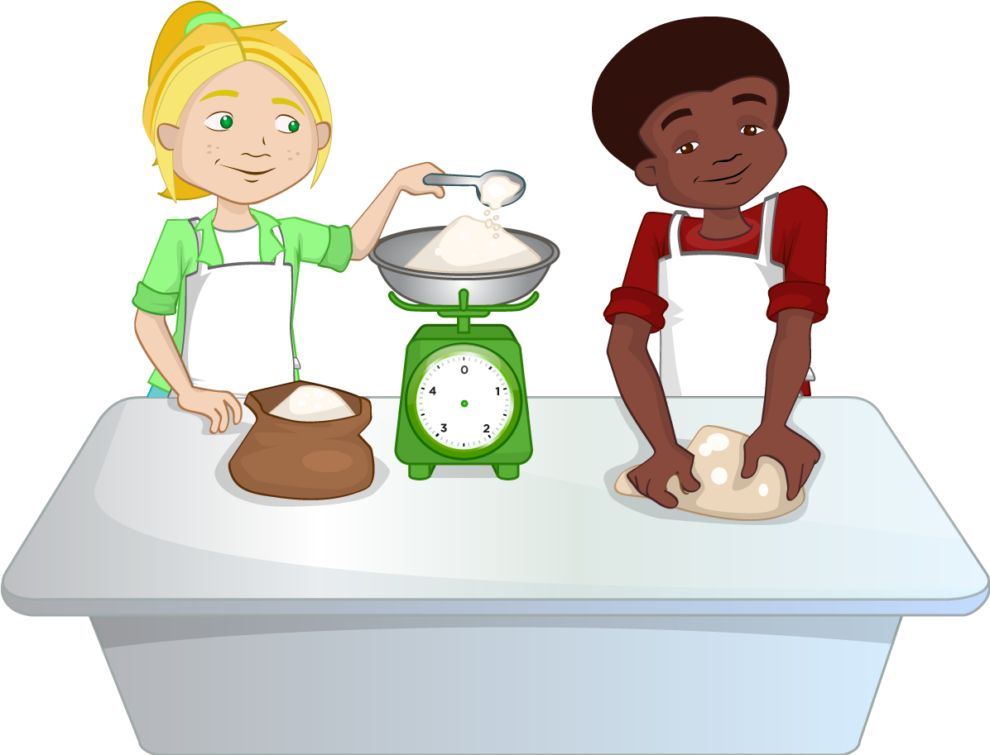
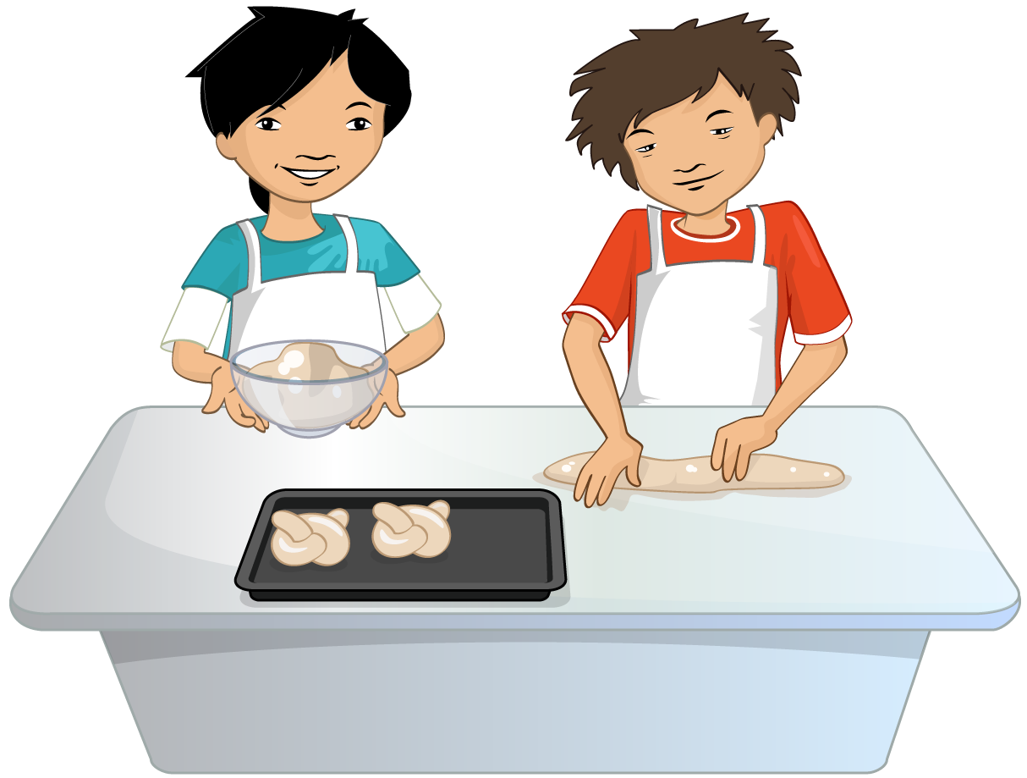
They measured out the ingredients and mixed them together to make a dough. After they had kneaded it, Nicola’s Dad explained that they would have to leave the dough in a warm place to rise.
“Why do we need to do that?” asked Alisha.
“It gives the yeast a chance to work,” explained Nicola’s Dad. “The yeast makes a gas called carbon dioxide which makes the dough rise.”

Slide 18
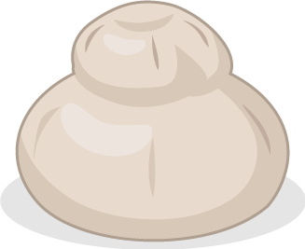
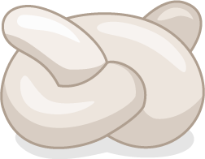
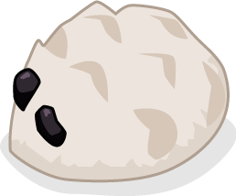
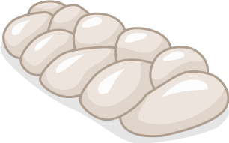
“But why does it need to rise, Dad?” asked Nicola.
Her Dad explained that it helped to make the bread light and soft.
When the dough had risen, Nicola’s Dad gave some to all the Food investigators and showed them how to make different shaped bread rolls.
Nicola made a cottage loaf, Jordan made a hedgehog shaped roll, Ronnie made a knot and Alisha made a plait. They all placed their rolls on the baking sheet ready to go in the oven.

Slide 19


“My Gran would love to see these,” said Jordan.
“Why don’t you invite her over and we can all have lunch together?” said Nicola’s Dad.
Jordan phoned his Gran who was delighted and promised to be there as soon as possible. Jordan’s Gran had arrived just as Nicola’s Dad was taking the bread rolls out of the oven. “Perfect timing,” said Nicola’s Dad.

Slide 20


Jordan’s Gran was very impressed with the beautifully shaped rolls the Food investigators had made.
“They look fantastic!” she exclaimed. “I can’t wait to try them, they smell delicious!”
Jordan’s Gran had been busy too. She had made some cornbread and bought it round to share. “Why don’t we take photos of our bread so that we can keep a record – before we eat it all?” suggested Nicola.

Slide 21






Nicola’s Dad had heard that Jordan’s Gran liked butternut and sweet potato soup so he had made some especially. They all sat down and tasted the bread and the soup.
“This is wonderful!” said Jordan’s Gran. “What beautiful soup! It reminds me of being back home.”
Jordan’s Gran thought the bread rolls were delicious too.

Slide 22

The Food investigators tasted the corn bread. “I hope you like it,” said Jordan’s Gran.
Nicola bit into the corn bread. It was different from the bread rolls. It felt like sponge cake in her mouth but it wasn’t sweet like sponge. “It’s lovely!” she declared.
The other Food investigators nodded their heads enthusiastically in agreement.

Slide 23






After lunch, the Food investigators washed up and tidied the kitchen while Jordan’s Gran and Nicola’s Dad chatted in the lounge.
The Food investigators got out their notebooks and finished making notes on what they had learnt about bread.

Slide 24







“I didn’t know there would be so much to learn about bread!” said Jordan. “Maybe I will be a baker when I grow up.”
“Perhaps you will come and work with me,” said Nicola’s Dad.
“Mmmm,” said Jordon, looking thoughtful. “Maybe!”

Slide 25
For further information, go to:
www.foodafactoflife.org.uk

