Slide 1
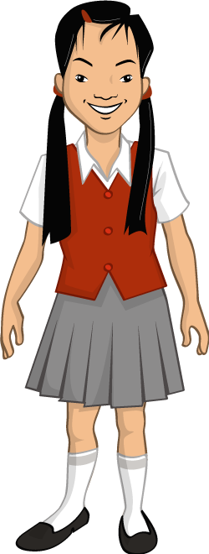
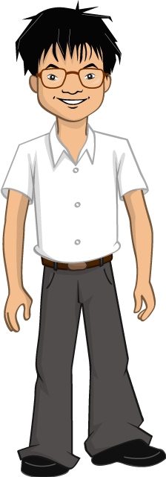
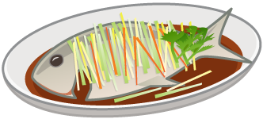
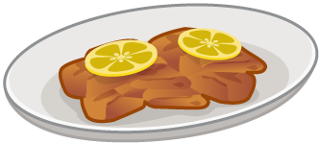
The exciting guests

Slide 2
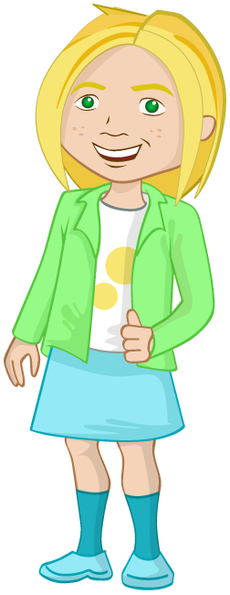
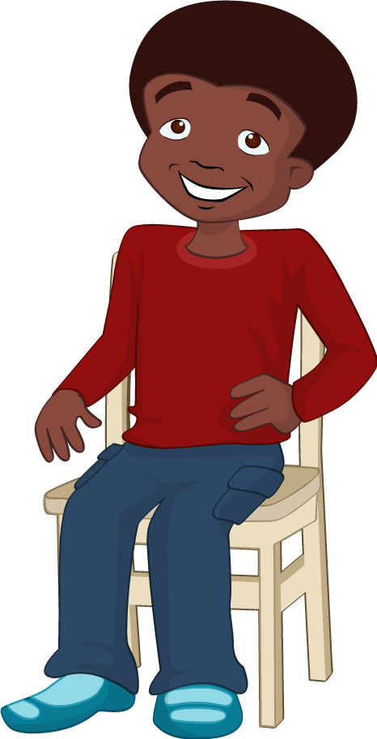
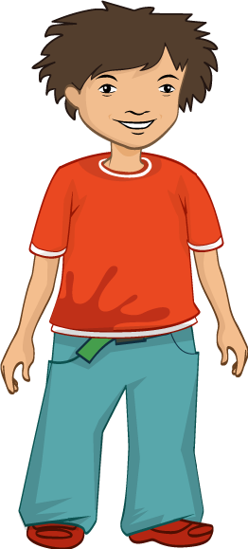
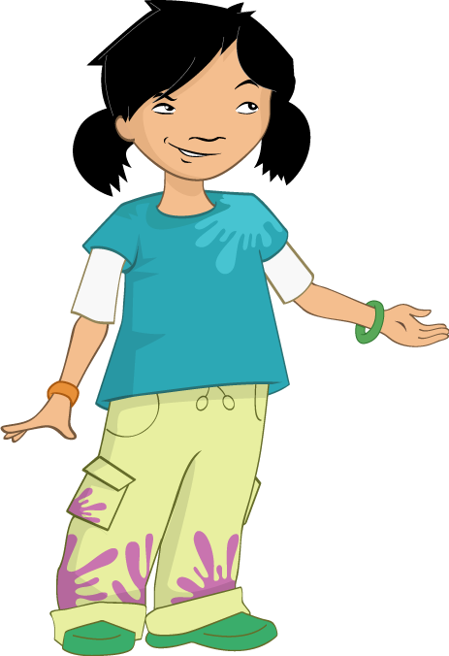
Alisha, Ronnie, Nicola and Jordan were beginning a new school year.
Actually, it wasn’t just any new school year, it was their last year at primary school. They’d been in the same class since they were 5 years old. They hadn’t always got on that well.
Jordan used to shout out in class all the time, and Alisha found that really annoying. Nicola used to be quite grumpy which made everyone else feel grumpy, and Ronnie used to be so quiet that no one really knew what he was like! But over the last few years they had all grown up and become really good friends. In fact, they had even started their own club, they called themselves The food investigators!

Slide 3

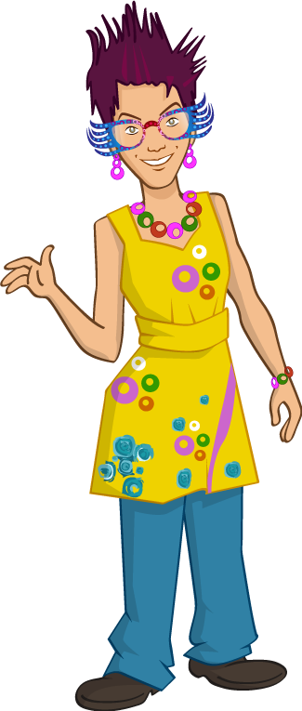


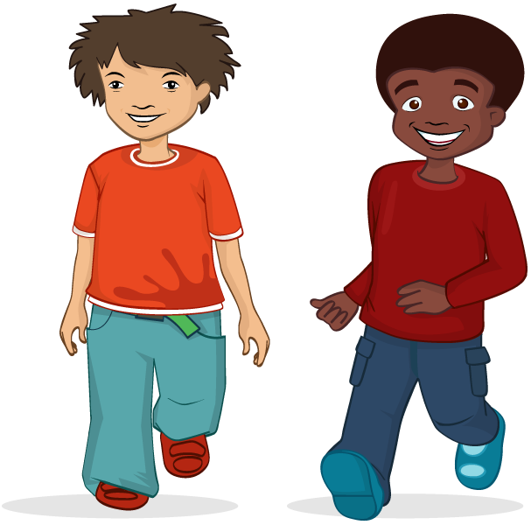
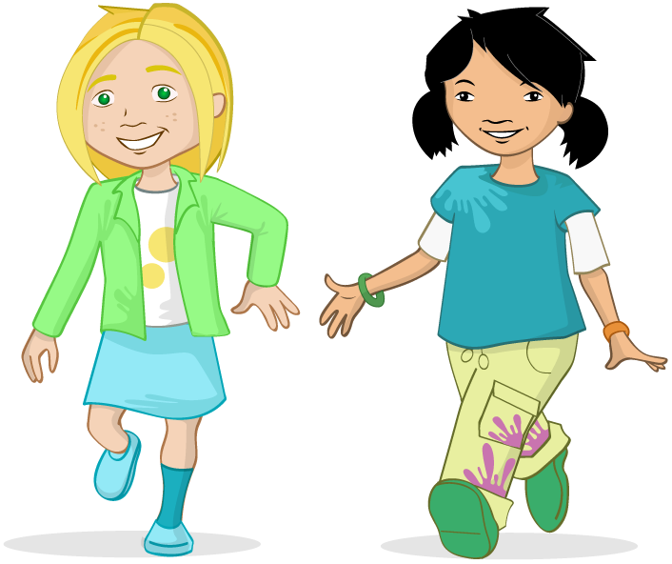



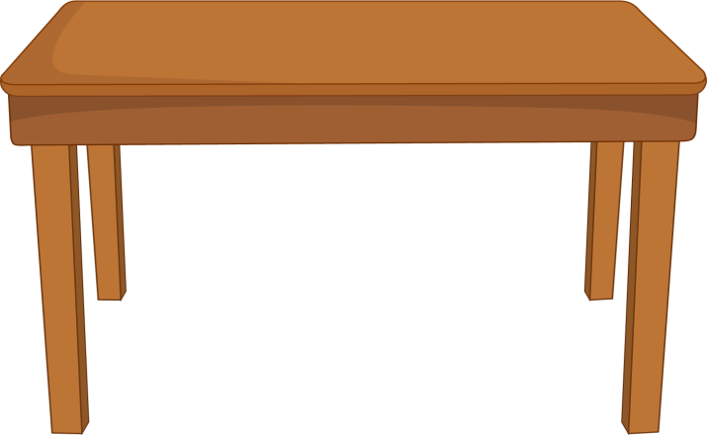

Anyway, back to our story. It was the start of the new school year and the four friends walked into their new classroom chatting about the summer holidays. After a small disagreement about who would sit next to who (even best friends have the occasional disagreement!) they settled down.
“Good morning,” said Miss McKay their class teacher.
The children had been taught by all the teachers in the school, except Miss McKay and they were looking forward to getting to know her. Her pink spiky hair was a little unusual, and no one had ever really seen glasses quite that shape before, but she had always seemed very friendly.

Slide 4
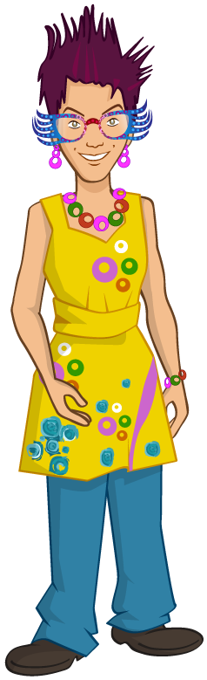
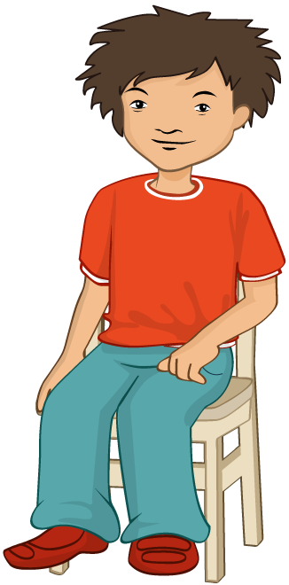
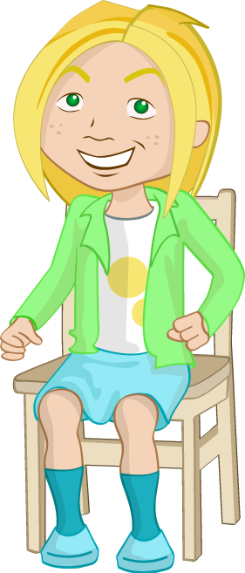
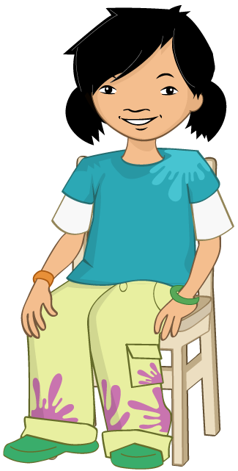
CHINA
“Right,” said Miss McKay. “Let’s get started! I have some rather exciting news!”
Miss McKay explained that the school had started an exchange programme with a primary school in China. Miss McKay’s last class had been writing to the Chinese students and now the schools had decided to visit one another. “Our guests are due later this week!” Miss McKay announced.
The class were very excited and bombarded Miss McKay with lots of questions. They wanted to know where the students would be staying, how long they were staying and how many students were coming.

Slide 5
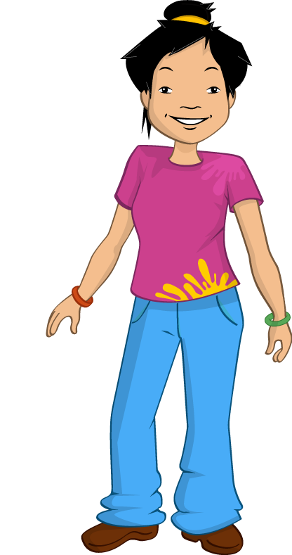
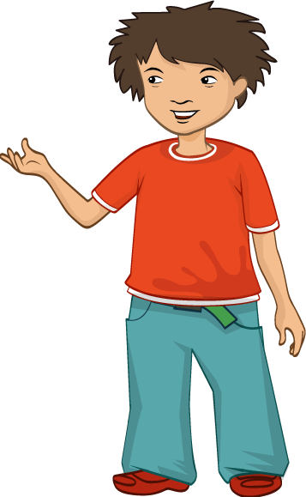

The morning flew by and as quick as a flash it was breaktime. The Food investigators called their first meeting of the new school year.
“I can’t believe we will actually have students from China at our school,” said Alisha.
Some of Alisha’s relations lived in China. Her Mum had been teaching her to speak Chinese and she was really eager to try it out on the visitors.
“I know,” agreed Ronnie. “This is going to be a great chance to find out loads about China and Chinese food.”

Slide 6
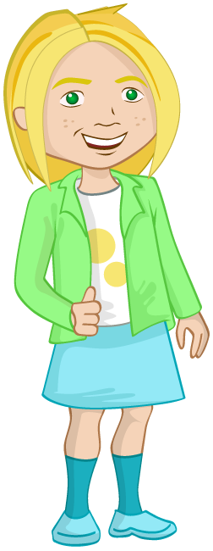
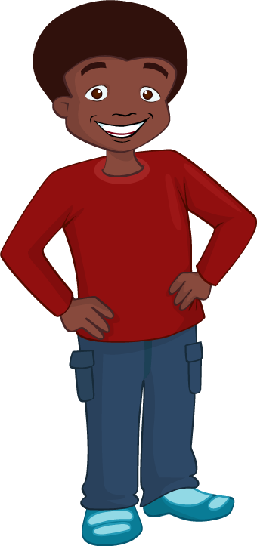
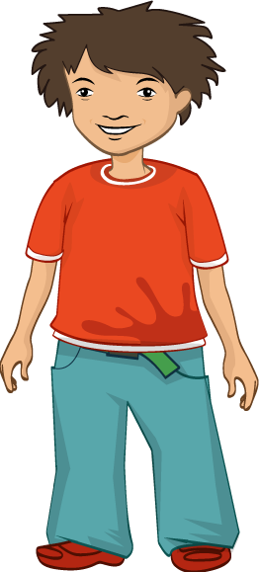
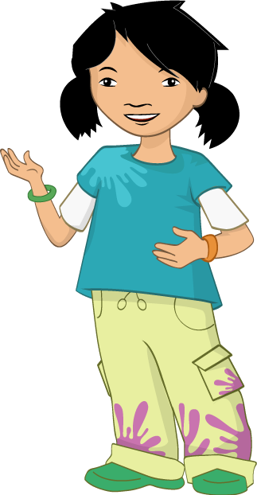




“I think we should get started with our research as soon as possible,” suggested Jordan. “They aren’t arriving until Friday!” said Nicola. “Yes, but we could ask Miss McKay if we can use the computer room at lunchtime to get some background facts,” suggested Alisha. “And I can ask my mum questions, too.”
The friends started to plan their project. They decided to start a scrap book to collect all the information.
After three attempts at starting their scrap book, (due to differences of opinion about the colour pen they should write with, who had the neatest writing and who should do the writing) The food investigators were ready.

Slide 7
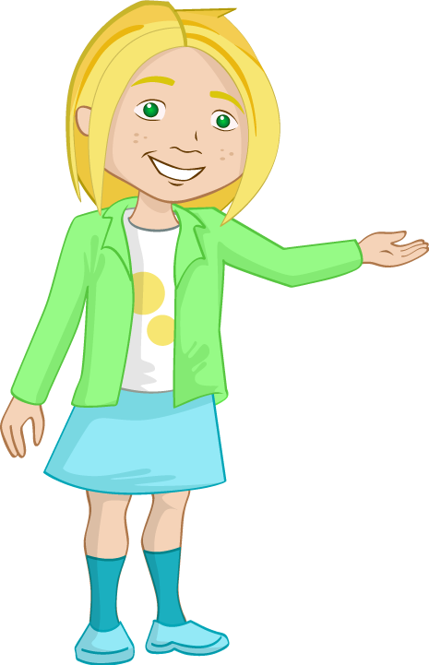
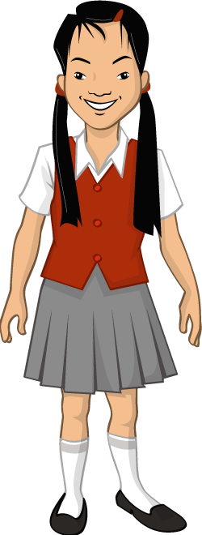
Friday finally arrived. The classroom door opened and there stood the two Chinese students.
“Welcome!” said Miss McKay. “Come in and meet our class.”
The students moved around introducing themselves. They were very polite and friendly. Alisha heard one of the students speaking Chinese. Alisha understood immediately. “I can show you where the toilets are,” she offered.

Slide 8
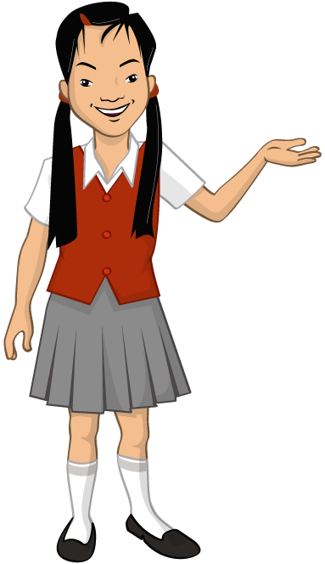
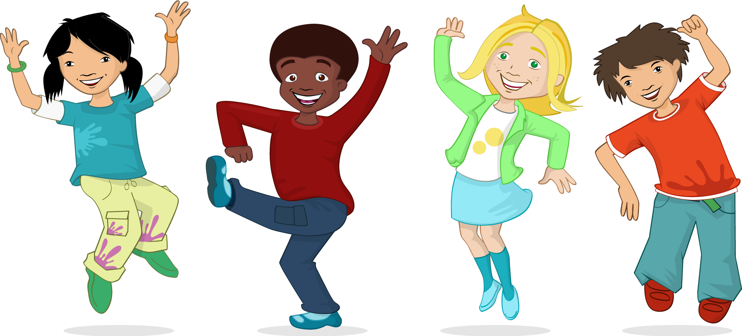


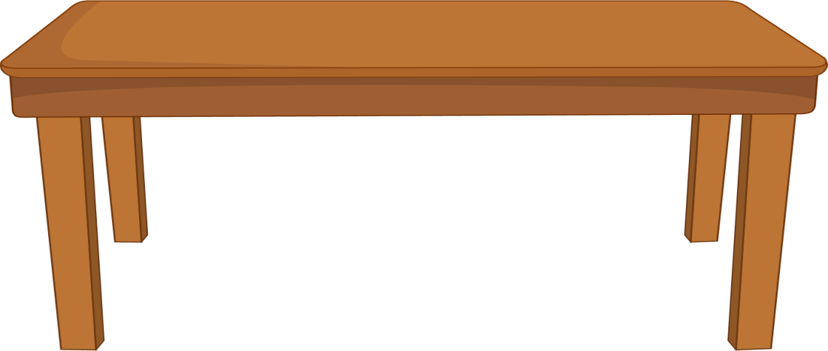
The Moon Festival
Alisha showed the student where the toilets were. It was a great chance for her to practise her Chinese. She found out that the student was called Chik Chi.
“We have got some presents for you,” said Chik Chi as they went back to the classroom.
“How exciting!” said Alisha.
Back in the classroom, Chik Chi explained that they had just celebrated the Moon Festival and that they had brought the children some Mooncakes to try.

Slide 9
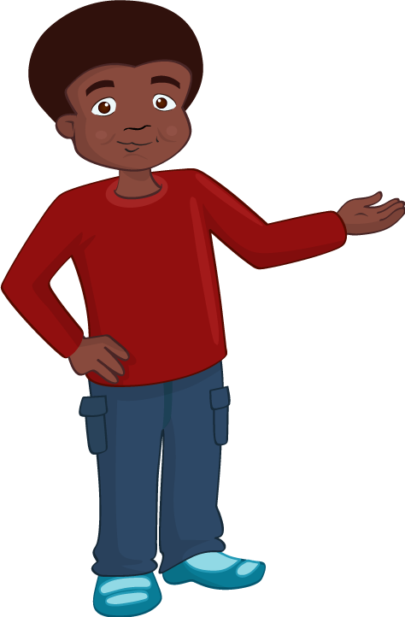




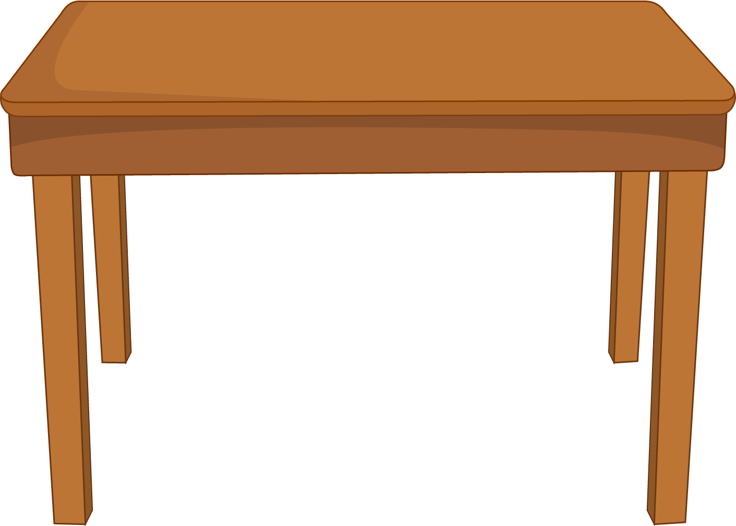
The Mooncakes were delicious. They were pastry on the outside with a soft paste in the middle. Chik Chi cut one open and inside there was a cooked egg yolk. Chik Chi explained that the Mooncakes were designed to look like the moon.
While the children enjoyed the Mooncakes, one of the students, called Yan, showed the class photographs from China. He explained that in their school they had a growing area where they grew a vegetable called bok choi.

Slide 10
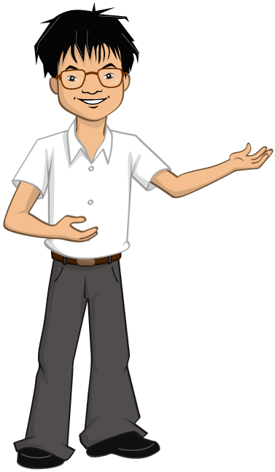

“What’s bok choi like?” asked Ronnie.
“It looks a bit like a small leek or lettuce,“ said Yan. “It tastes like a mixture of cabbage and lettuce.”
Nicola noted that down in the scrap book. She also made a note to find out more about the Moon festival.
“I’ve got an idea,” said Alisha. “A friend of my family owns a Chinese restaurant. I’ll see if we can go and taste some of the foods and dishes.” “That sounds wonderful, Alisha,” encouraged Miss McKay.

Slide 11
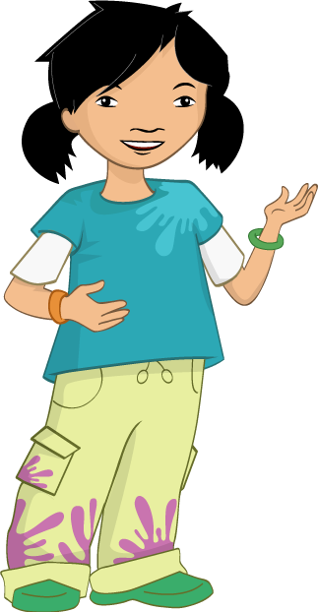

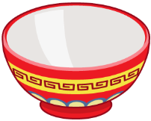


白菜
Alisha asked her parents’ friend about the restaurant visit and they said yes.
The next day the class set out to the restaurant for lunch. Ronnie was really keen to try some bok choi but he couldn’t see it anywhere on the menu. Alisha looked carefully at the menu.
“Here it is,” she said. She pointed at the Chinese writing 白菜 (bok choi). Everyone was very impressed with how Alisha was able to read the writing. “They’re not letters, they are called Chinese characters,” she explained. The class and the guests ordered a feast of lovely food.

Slide 12
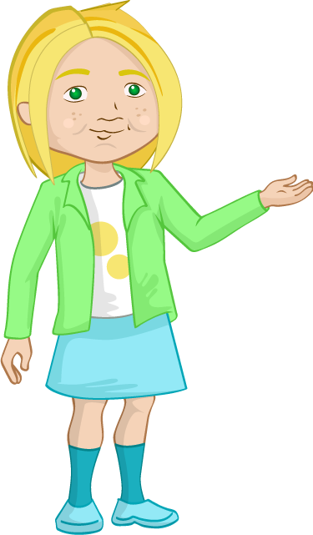
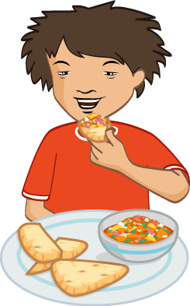
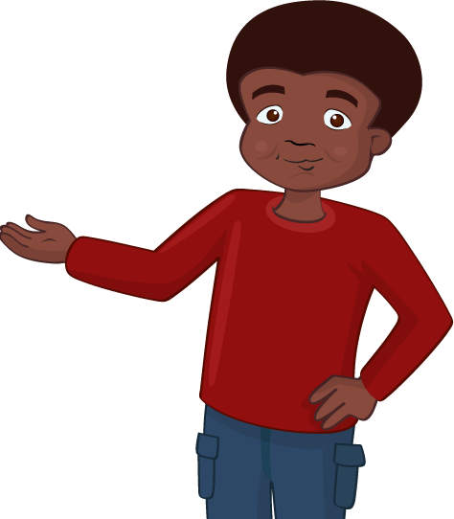

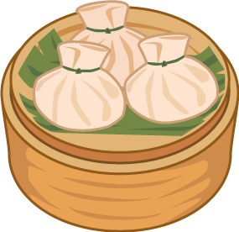
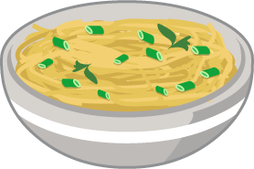
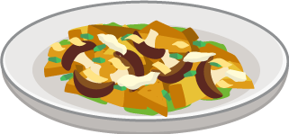

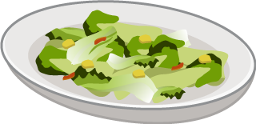
They ate dumplings, steamed fish, braised tofu and Chinese mushrooms, lemon chicken and noodles. They all wanted to taste the bok choi. Jordan took a small bite. He didn’t really think he would like it because Yan said it was a bit like cabbage, he hated cabbage!
He bit into it cautiously. The bok choi had been cooked in garlic and was really fresh and delicious. “That’s lovely,” he said.

Slide 13
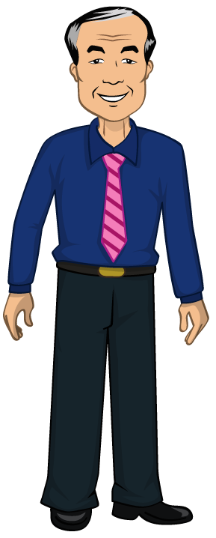

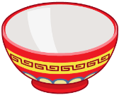
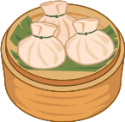


Everyone in the class wanted to hear Alisha speak Chinese. After the meal, Ronnie asked Alisha if she would speak Chinese and ask the restaurant owners if they could have a copy of the menu to stick in the scrap book.
The restaurant owners were very impressed with Alisha and so were the class. Alisha felt really proud of her family connections with China. She was glad her mum had spent time teaching her how to speak Chinese, even though Alisha had complained a bit sometimes!

Slide 14
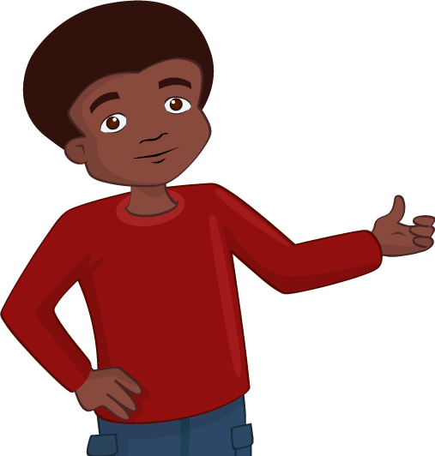
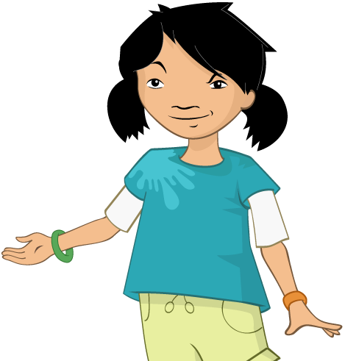
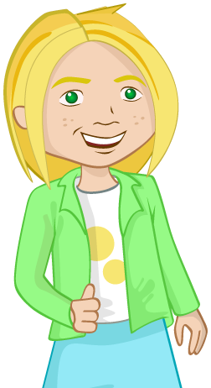

Back at school Ronnie carefully stuck the menu into the scrap book.
“We’ve got lots of information here,” he said. “But it would be nice if we could teach our guests something.” This was a tricky challenge. They all thought hard for a while. Alisha had an idea.
“Remember when we went to that dairy farm in Class V,” she said. “Why don’t we tell the students about that?”
Alisha had remembered her mum saying that foods made from milk were not eaten as much in China. Alisha thought the students would be interested in hearing how milk was produced.

Slide 15
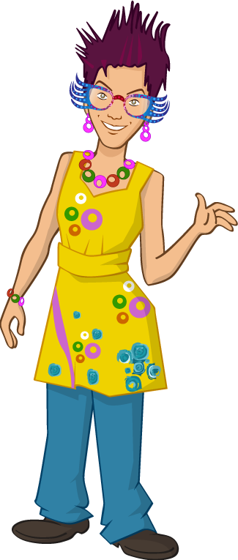
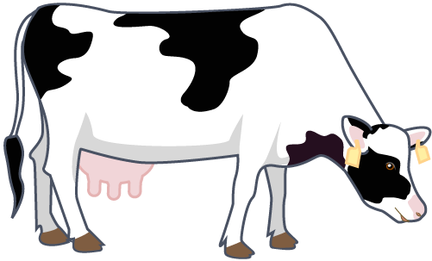
Ronnie, Alisha, Nicola and Jordan set to work preparing a presentation. They used photos of dairy cows in a field and being milked. They drew sketches to show how raw milk is processed ready for drinking. They drew the milk being put into bottles and cartons and taken to shops. They showed their work to Miss McKay.
“That’s super,” she said, pushing her unusual shaped glasses up her nose. “After you have shown them where milk comes from, why don’t we show them what can be made from milk?”

Slide 16
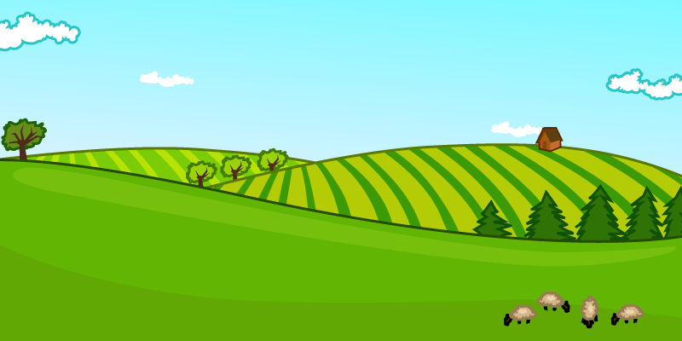
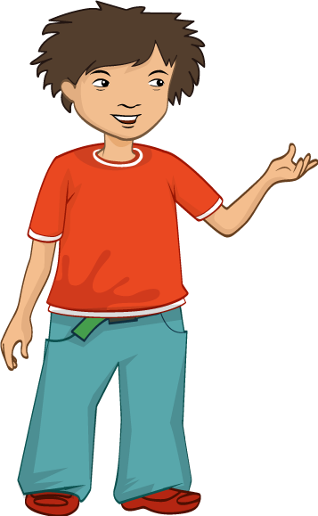
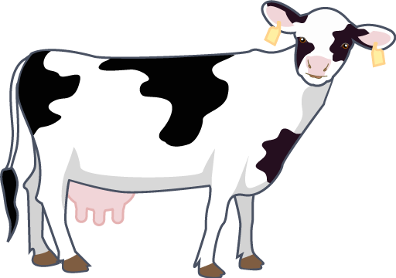


How cheese is made
Miss McKay suggested that they show their guests how cheese was made.
The Food investigators thought that was a great idea and began their research straight away.
“Look at this,” said Nicola, who had been researching on the internet.
She showed the other Food investigators a video clip she had found.
“Great,” said Ronnie. “Let’s add that to our presentation.”

Slide 17


How cheese is made
Rennet
Whey
Curd
The Food investigators saved their presentation until the day the guests were due to leave. All the class settled down to listen. Alisha, Ronnie, Nicola and Jordan stood at the front of the room.
They told the class about how cheese was made. “First, “ said Alisha. “Rennet is added to milk and this causes it to separate.” “It separates into curds and whey,” explained Ronnie. “The whey is watery and the curd is like thick lumps.”

Slide 18




How cheese is made
The guests were fascinated.
“What happens next?” asked Chik Chi.
“Well,” explained Alisha. “The curd is taken from the whey and squeezed to remove all the liquid.”
“Then some salt is mixed in and it is all pressed together and wrapped up tightly,’ added Ronnie.
“And then it is ready to eat?” asked Yan.
“Not straight away,” said Alisha. “It is left to mature so it becomes tasty.”

Slide 19

“Different ingredients can be added to the cheese to give it different flavours,” said Ronnie.
Nicola lifted up a tray which had been resting on the table in front of her. On the tray were small cubes of different types of cheese.
“Here are lots of different types of cheese for you to taste,” she said.
Jordan gave all the children a cup of water so they could refresh their mouths after trying each different type of cheese. “These are delicious,” said Chik Chi. Yan and the other guests nodded in agreement.

Slide 20


“I’m afraid it’s time for our guests to leave now,” said Miss McKay. “We have had a wonderful time!” said Chik Chi. “Thank you for having us.” “And soon some of you will come and visit us in China, we hope,” said Yan.
“Yes,” said Miss McKay. “As Alisha, Ronnie, Nicola and Jordan put together this excellent presentation today, I have decided that they will be the students who will travel to China.”
The Food investigators beamed with delight.

Slide 21

再見!
As the guests got ready to leave, Alisha said goodbye to Chik Chi in Chinese.
Chik Chi promised to write to Alisha with more information for the scrap book.
When the guests had gone, The Food investigators sat down together.
“The scrap book is nearly full with all this information we have collected,” said Ronnie.
“I guess we will need another one for our trip to China,” said Alisha.

Slide 22

“Yes, we can get a nice blue one,” said Jordan.
“I think yellow would be better,” suggested Alisha.
“You chose last time,” said Nicola.
“Stop!” said Ronnie. “Let’s not argue. The Food investigators work as a team remember!”
They all smiled.
“A team!” they said in unison.

Slide 23
The end.
For further information, go to:
www.foodafactoflife.org.uk

