Slide 1
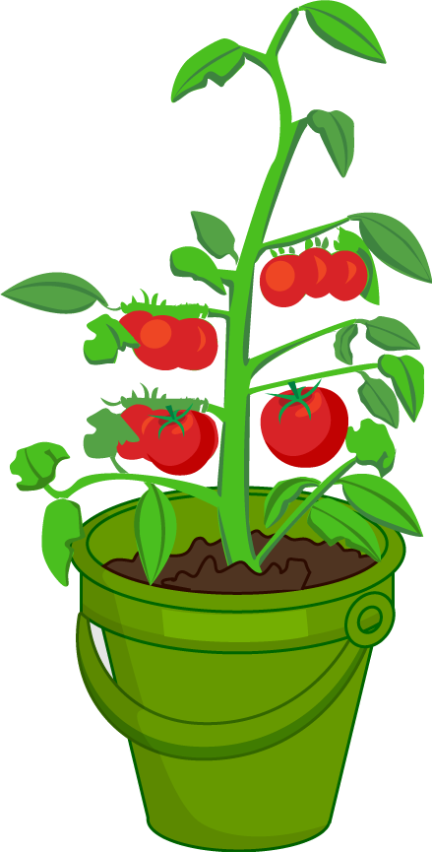
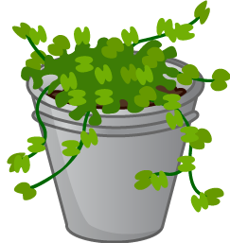
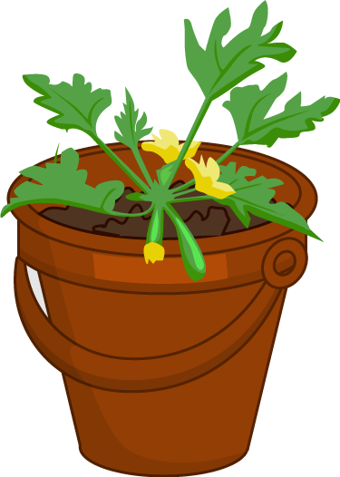
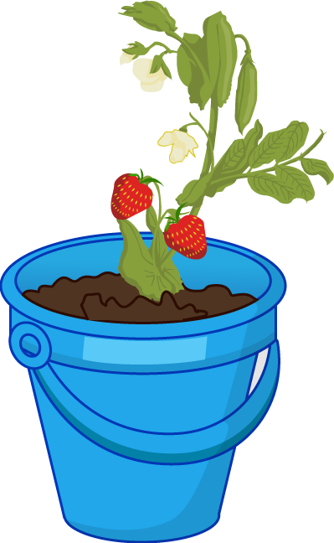
The bucket garden

Slide 2
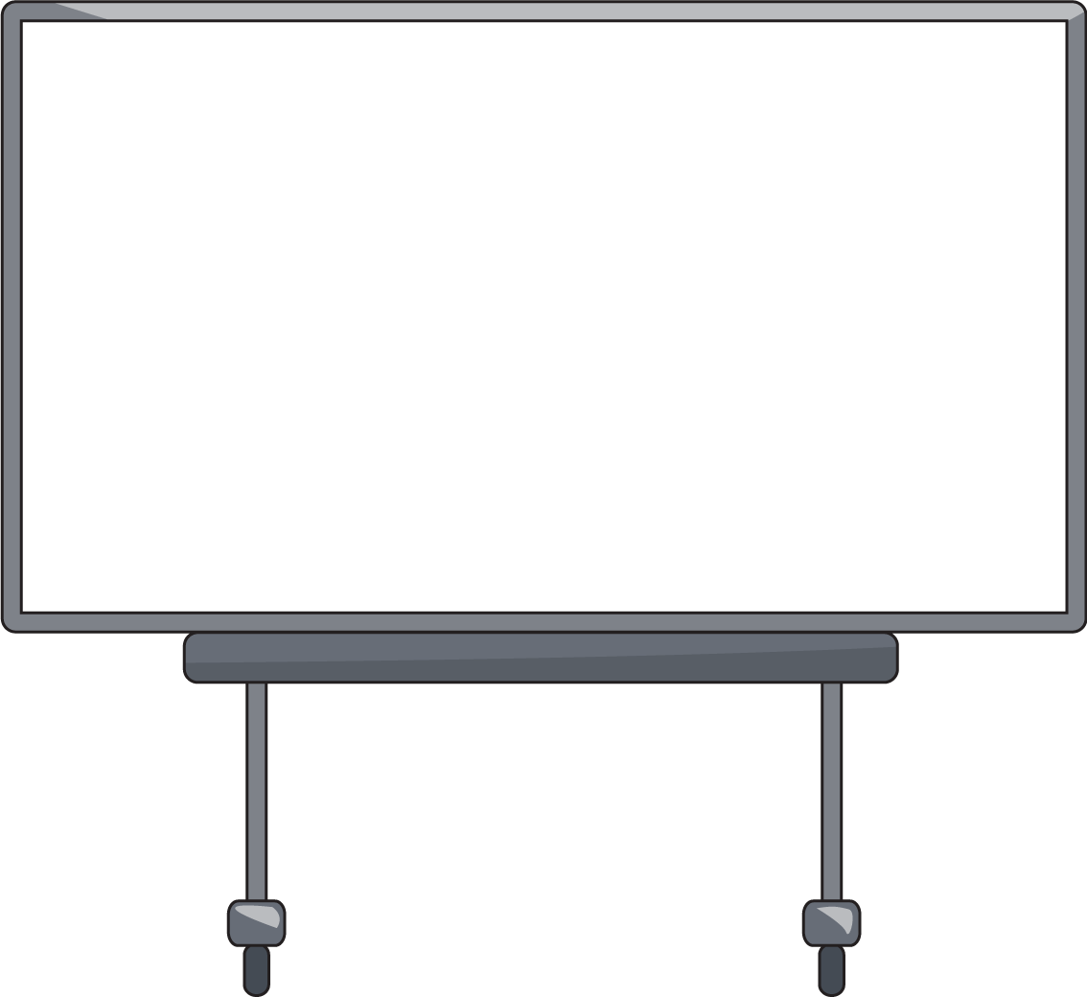
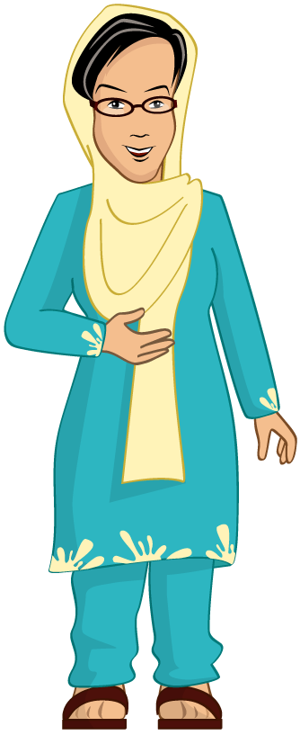
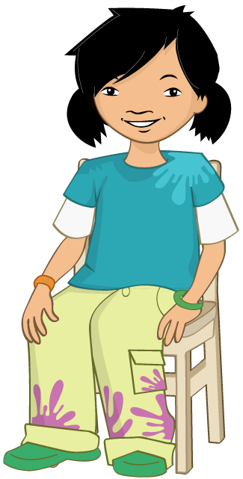

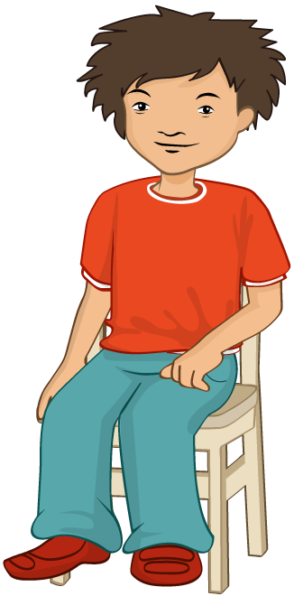
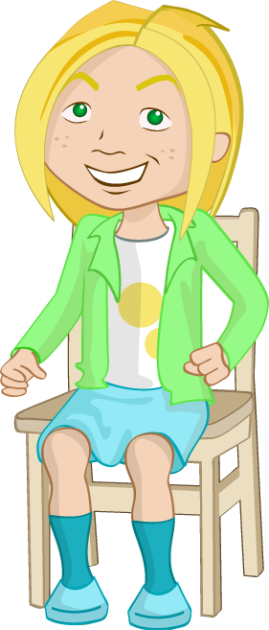
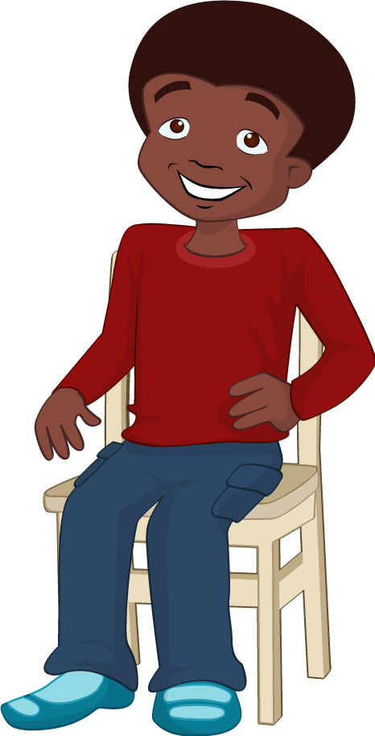
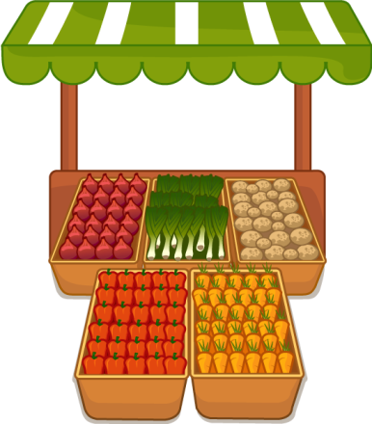
Potatoes
Potatoes
“Where do potatoes come from?” the teacher asked.
“The shops,” shouted Jordan.
“Yes, but where do they come from before they get to the shops?” said the teacher.

Slide 3
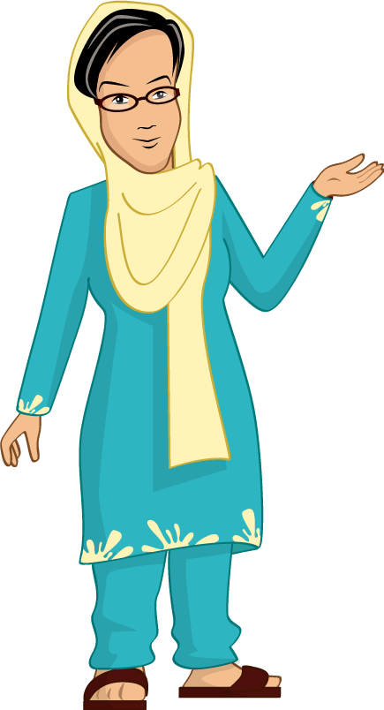
Potatoes
Potatoes
Class B were learning all about potatoes.
Mrs Begum was explaining that potatoes come from plants.
Everyone was a bit confused.

Slide 4

Potatoes
??
Potatoes
Potatoes
“I’ve never seen a potato growing on a plant,” said Jordan.
“Nor have I,” said Nicola.
“I think the best thing to do is to grow our own potatoes and then you’ll be able to see!” said Mrs Begum.

Slide 5
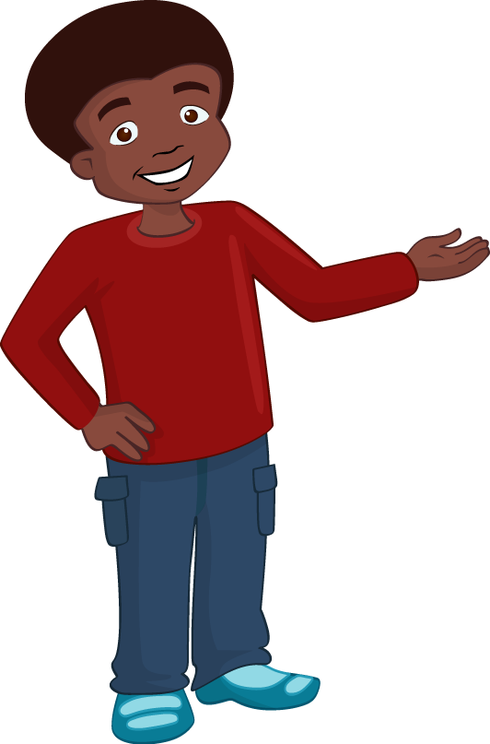
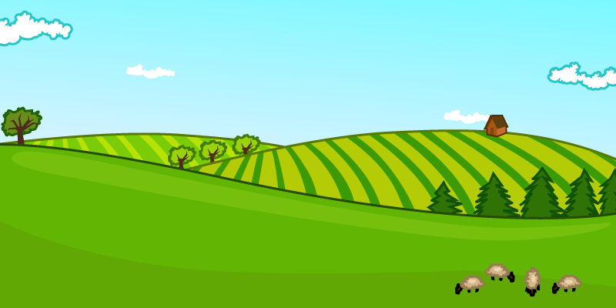
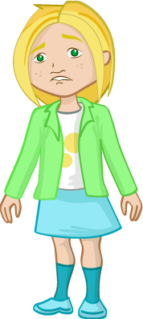
Everyone was excited about the idea of growing potatoes.
“But we don’t have a garden or allotment,” said Jordan.
“I don’t think we will be able to grow any potatoes after all,” said Nicola.

Slide 6
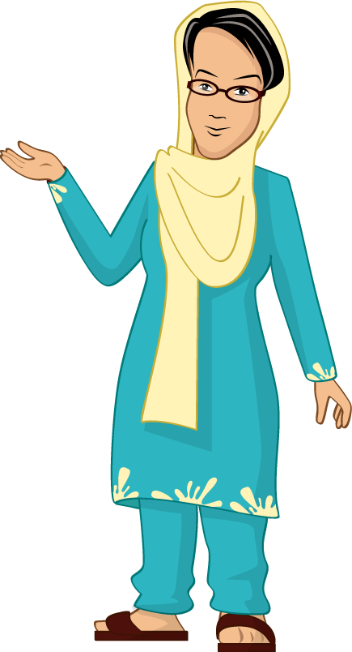

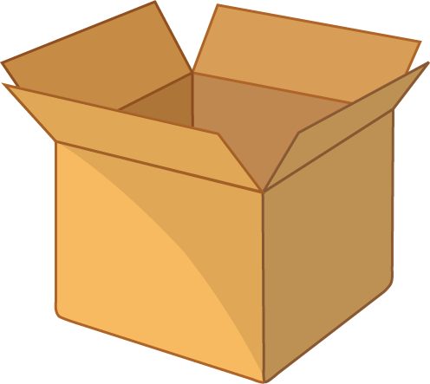
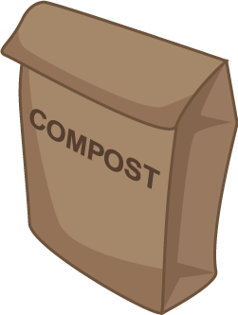
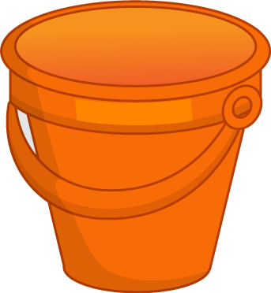
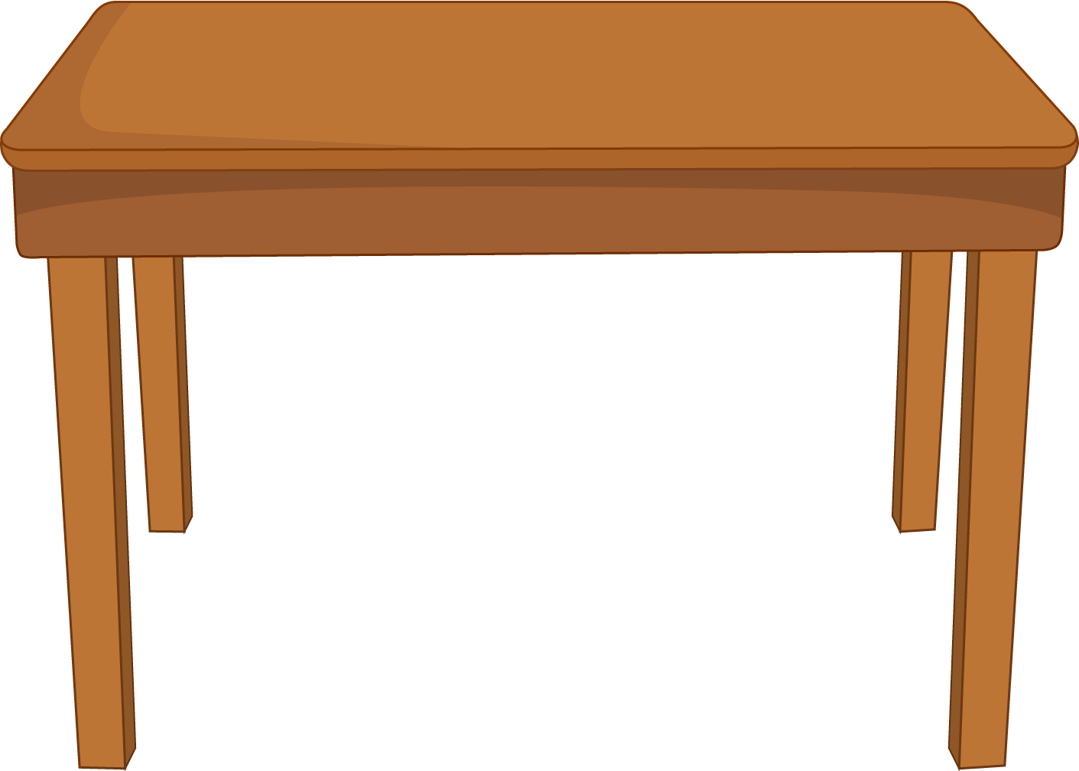
Potatoes
Then something very exciting happened. Mrs Begum lifted a large box onto the table and pulled out a bag of compost, a trowel and a bucket.
She explained that they could grow their own potatoes in the bucket.
Everyone was surprised but very pleased.

Slide 7


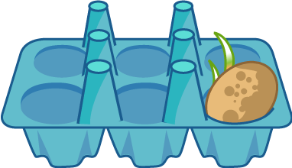
Mrs Begum pulled the last item out of the box.
It was a potato sitting in an egg box.
“This potato has been sitting on my window sill for two weeks. Can you see what’s happened?”
The children looked closely at the potato.

Slide 8
Potatoes
Potatoes
“It’s got bits coming out of it,” said Alisha.
“They look like worms!” said Ronnie.
“The bits are called ‘shoots’,” explained Mrs Begum. “The potato has to be left to ‘chit’ and that means grow shoots.”

Slide 9
Potatoes
“Right, I need two volunteers,” said Mrs Begum.
“Me, me!” the children called out.
“Let me see who’s sitting nicely,” said Mrs Begum.

Slide 10
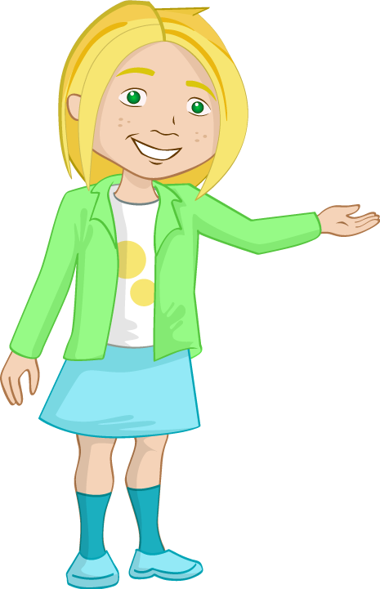

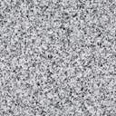
Nicola and Jordan sat up straight with their arms folded.
Mrs Begum chose them and the class went outside. Mrs Begum asked Nicola to fill the bucket up to one-third with compost.

Slide 11
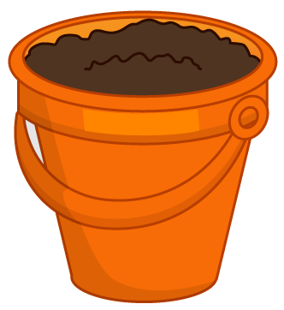
Potatoes
Mrs Begum told Nicola to put the potato in the bucket with the shoots pointing upwards.
Then Nicola used the trowel to fill the bucket up to two-thirds with compost.

Slide 12

Potatoes
Mrs Begum asked Jordan to fill up the watering can. He used it to water the compost.
Mrs Begum explained that they would have to wait a few months for the potato plant to grow.

Slide 13

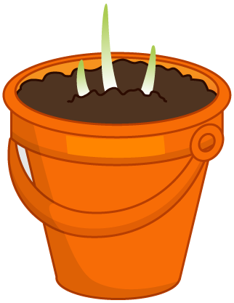
Back in the classroom Jordan and Nicola looked at the bucket through the window.
“We’ve got a garden now,” said Jordon. “It’s a bucket garden!” said Nicola.

Slide 14
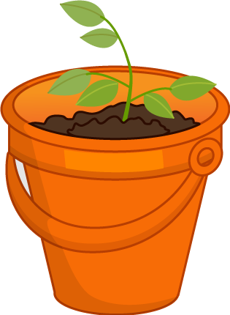
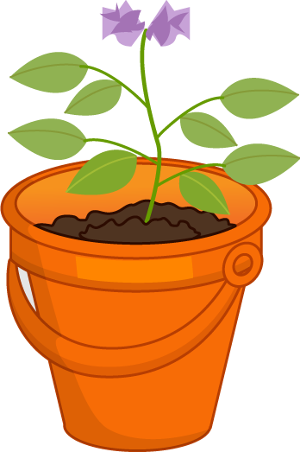
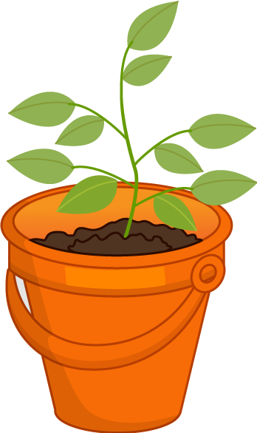
The children checked the plant everyday and took it in turns to do the watering.
Slowly the plant began to grow. It got bigger and bigger. Flowers appeared and then disappeared again.
The children waited for a long time.

Slide 15
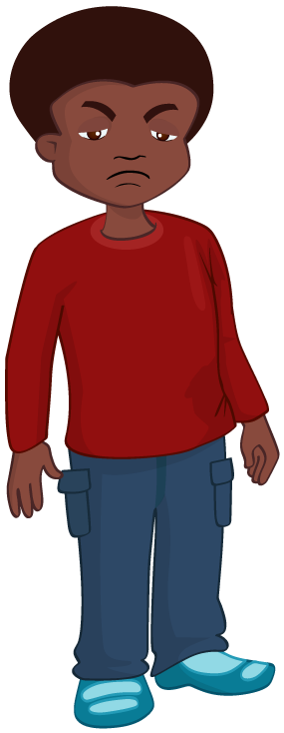
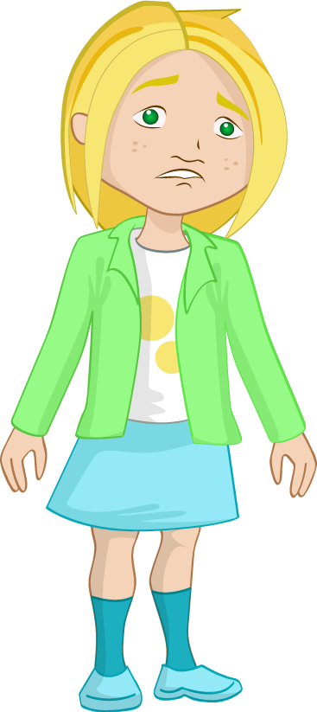
One day Mrs Begum called the children outside.
“Our potatoes are ready!” she said.
Everyone looked at the plant.
“I can’t see any potatoes,” said Jordan.
“Neither can I,” said Nicola. “It hasn’t worked.”

Slide 16
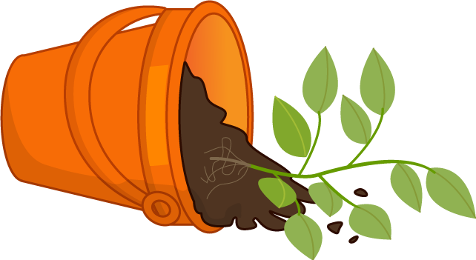
“Let’s see,” said Mrs Begum.
She gently tipped the bucket over and the compost toppled out onto the ground.
The children could see the roots of the plant.

Slide 17
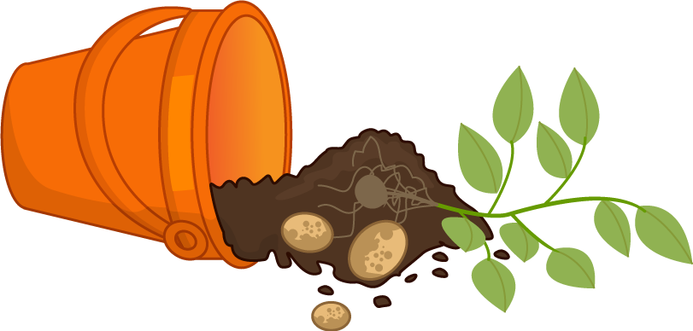
Potatoes
“Look, there, I can see a potato!” shouted Nicola pointing at the bucket.
All the children leaned in for a closer look.
Sure enough, attached to the roots they could see not just one potato, but lots of potatoes!

Slide 18


Everyone cheered and clapped.
Mrs Begum and the children carefully collected up the potatoes and took them back into the classroom.

Slide 19
Potatoes
Tubers
Potatoes
“Are potatoes the roots of a plant then?” asked Alisha.
“They are part of the root, but they are called tubers,” explained Mrs Begum.

Slide 20
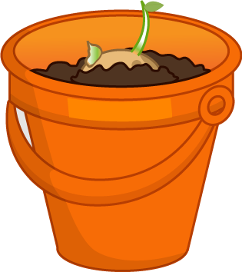

Potatoes
Tubers
Potatoes
“So, if I said where do potatoes some from, what would you say now?” asked Mrs Begum.
“Potato plants,” shouted the class.
“You’re absolutely right!” said Mrs Begum.
“Grown in bucket gardens,” thought Nicola, smiling to herself.

Slide 21
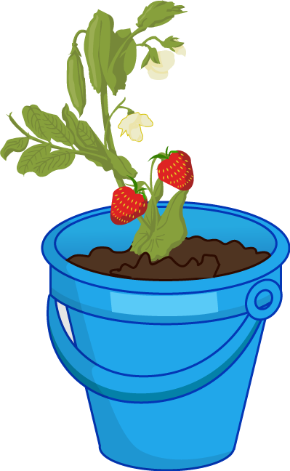
The class were so pleased with the potatoes that they decided to grow other foods.
They planted courgettes, strawberries, tomatoes and herbs.
It wasn’t long before they had their very own school bucket garden!

Slide 22
For further information, go to:
www.foodafactoflife.org.uk

