Slide 1
Practical food skills, cooking and food waste
08/12/2021

Slide 2

Practical food skills, cooking and reducing food waste
Food a fact of life Webinar
Dr Fiona Lavelle

Slide 3
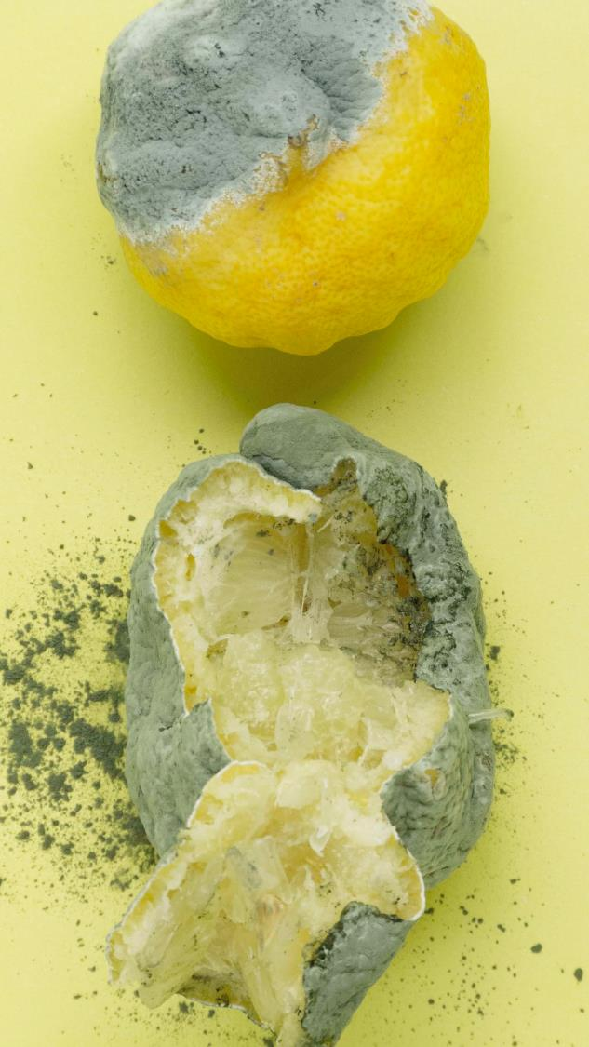
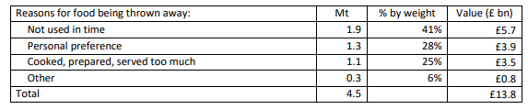
FOOD WASTE
In 2018, 9.5 MILLION TONNES of food waste
  >£19 billion pounds
  36 million tonnes of Green House Gas emissions
Household food waste:
  6.6 million tonnes
  70% - EDIBLE
    4.5 MILLION TONNES
(WRAP, 2021)

Slide 4
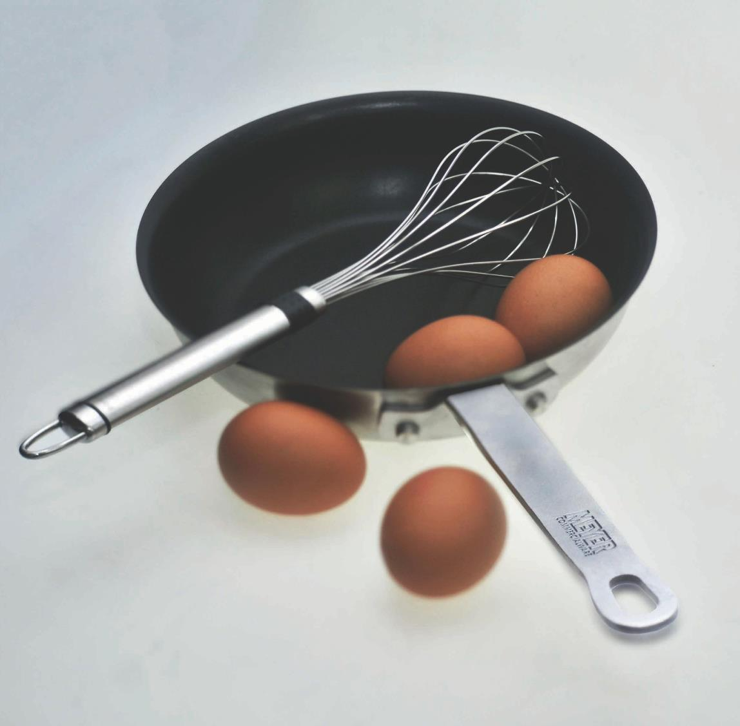
NOT ALL BAD NEWS
Decrease by 18% in FW since 2007
DURING THE PANDEMIC
You took to the pan
Readymade ingredients
Fresh/basic ingredients
Threw away food
Notes:
Talk around the similarities differences with other countries

Slide 5
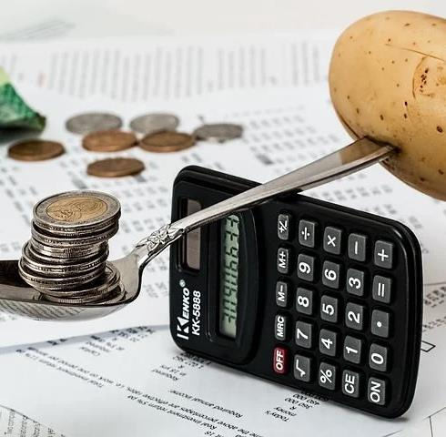
Food Practices
Organisational (planning ahead, shopping with a grocery list, keeping basics in the cupboard) – reduce time in shop &stick to budget
Management (Preparing in advance, batch cooking and freezing) – may become increasingly useful as time reduces again

Slide 6
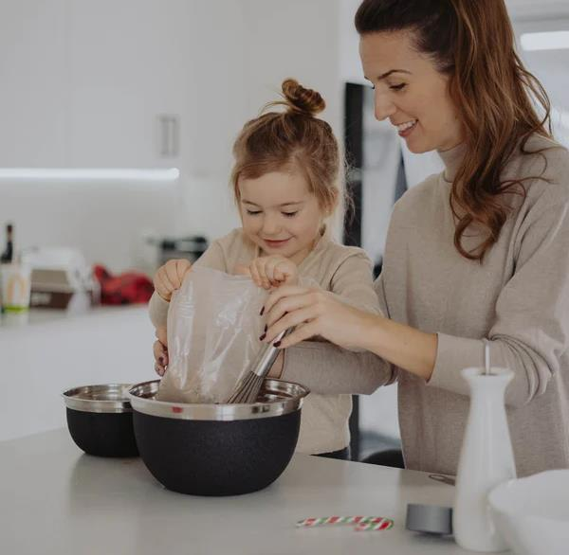
Kids in the Kitchen
Increase in including children in baking activities
And everyday meal prep
Those who included their children more frequently = higher diet quality

Slide 7
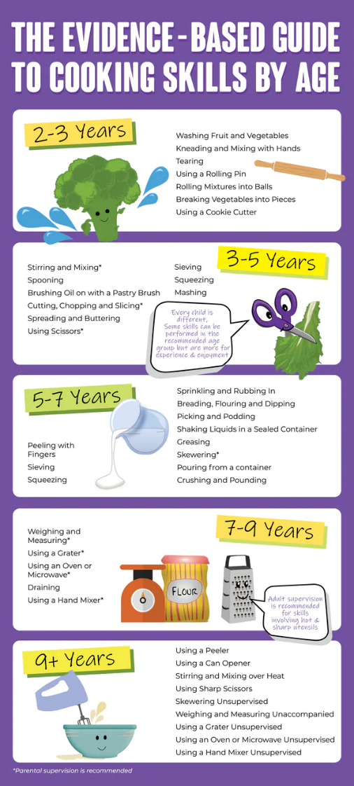
Kids in the Kitchen
Learning CS at younger ages:
  Better dietary patterns as adults
  Less food waste
Age-Appropriate skills to help
Subjects: Maths, literacy, science, geography, history…

Slide 8
Food skills
Resourcefulness
Label Reading/ Consumer Awareness
Meal Planning & Preparation
Shopping
Budgeting
Lavelle et al., 2017

Slide 9

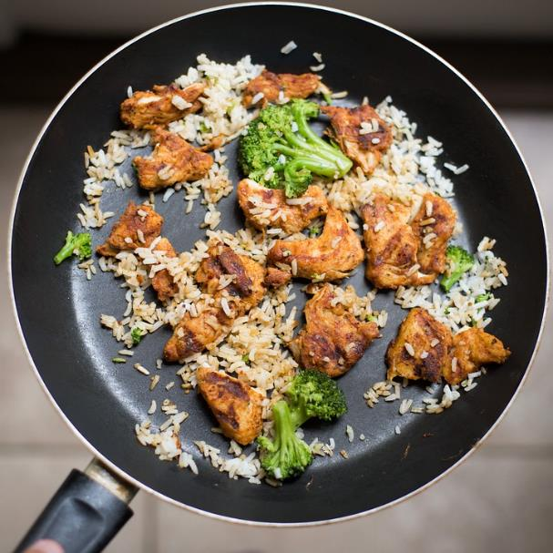
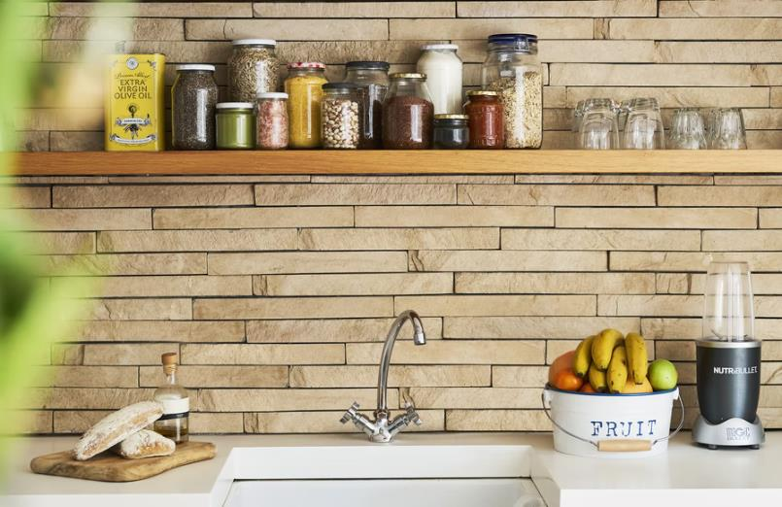
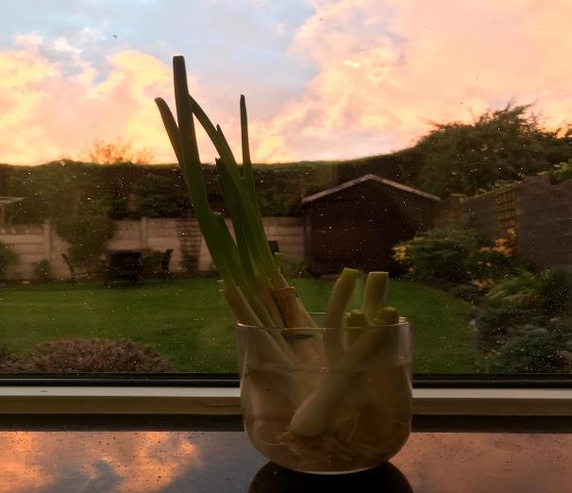
Planning
Storage
Leftovers
Regrow

Slide 10
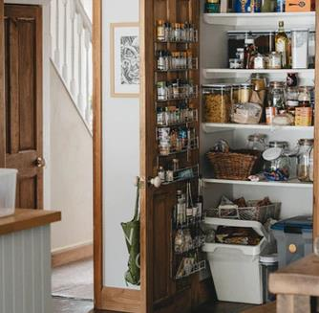
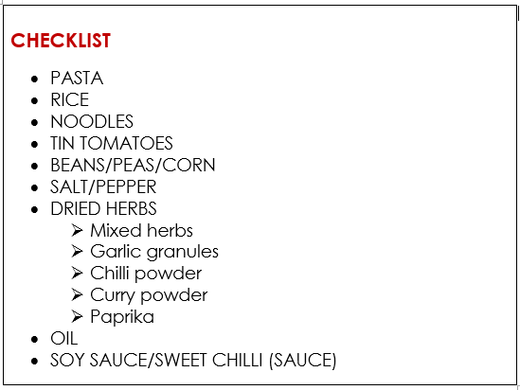
CUPBOARD
Basics
Form the base of quick meals
Help you to cook
*not the cupboard, but always handy to keep a bag of frozen veg in the freezer

Slide 11
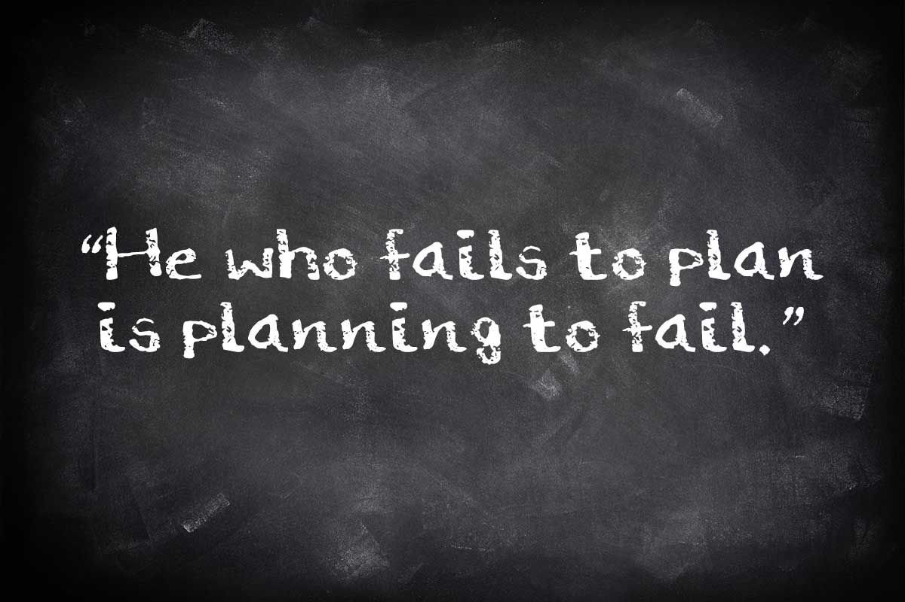
PLANNING

Slide 12
PLANNING
Using leftovers for another meal or to create another meal
Batch cooking + freezing
Keeping basics in the cupboard
RESOURCEFULNESS

Slide 13
PLANNING
Weekly Meal Planning
DAY | MONDAY | TUESDAY | WEDNESDAY | THURSDAY | FRIDAY | SATURDAY | SUNDAY
BREAKFAST | Cornflakes, banana, milk. Orange Juice | Cornflakes, banana, milk. Orange Juice | Cornflakes, banana, milk. Orange Juice | Cornflakes, banana, milk. Orange Juice | Banana pancakes, strawberries, Nutella, Orange Juice
LUNCH | Salad, boiled egg, potato salad, coleslaw | Chicken and vegetable pasta | Baked Potato with bolognaise and cheese | Veggie egg fried rice | Chicken and vegetable pasta
DINNER | Chicken and vegetable pasta | Spaghetti bolognaise | Veggie Egg fried rice | Chicken salad with potato salad and coleslaw | Treat or garlic cheesey chips
SNACKS | Yoghurt, popcorn, orange | Smoothie, popcorn, orange | Smoothie, popcorn, orange | Yoghurt, popcorn, orange | Nuts, popcorn, orange
Batch cooking & freezing

Slide 14
PLANNING
Weekly Meal Planning
DAY | MONDAY | TUESDAY | WEDNESDAY | THURSDAY | FRIDAY | SATURDAY | SUNDAY
BREAKFAST | Cornflakes, banana, milk. Orange Juice | Cornflakes, banana, milk. Orange Juice | Cornflakes, banana, milk. Orange Juice | Cornflakes, banana, milk. Orange Juice | Banana pancakes, strawberries, Nutella, Orange Juice
LUNCH | Salad, boiled egg, potato salad, coleslaw | Chicken and vegetable pasta | Baked Potato with bolognaise and cheese | Veggie egg fried rice | Chicken and vegetable pasta
DINNER | Chicken and vegetable pasta | Spaghetti bolognaise | Veggie Egg fried rice | Chicken salad with potato salad and coleslaw | Treat or garlic cheesey chips
SNACKS | Yoghurt, popcorn, orange | Smoothie, popcorn, orange | Smoothie, popcorn, orange | Yoghurt, popcorn, orange | Nuts, popcorn, orange
Using leftovers in another meal

Slide 15
PLANNING
Weekly Meal Planning
DAY | MONDAY | TUESDAY | WEDNESDAY | THURSDAY | FRIDAY | SATURDAY | SUNDAY
BREAKFAST | Cornflakes, banana, milk. Orange Juice | Cornflakes, banana, milk. Orange Juice | Cornflakes, banana, milk. Orange Juice | Cornflakes, banana, milk. Orange Juice | Banana pancakes, strawberries, Nutella, Orange Juice
LUNCH | Salad, boiled egg, potato salad, coleslaw | Chicken and vegetable pasta | Baked Potato with bolognaise and cheese | Veggie egg fried rice | Chicken and vegetable pasta
DINNER | Chicken and vegetable pasta | Spaghetti bolognaise | Veggie Egg fried rice | Chicken salad with potato salad and coleslaw | Treat or garlic cheesey chips
SNACKS | Yoghurt, popcorn, orange | Smoothie, popcorn, orange | Smoothie, popcorn, orange | Yoghurt, popcorn, orange | Nuts, popcorn, orange
Basics from your cupboard:
Pasta
Rice
Corn
Salt/pepper
Oil
Tin Tomatoes
Dried herbs
Soy Sauce

Slide 16
PLANNING
Weekly Meal Planning
DAY | MONDAY | TUESDAY | WEDNESDAY | THURSDAY | FRIDAY | SATURDAY | SUNDAY
BREAKFAST | Cornflakes, banana, milk. Orange Juice | Cornflakes, banana, milk. Orange Juice | Cornflakes, banana, milk. Orange Juice | Cornflakes, banana, milk. Orange Juice | Banana pancakes, strawberries, Nutella, Orange Juice
LUNCH | Salad, boiled egg, potato salad, coleslaw | Chicken and vegetable pasta | Baked Potato with bolognaise and cheese | Veggie egg fried rice | Chicken and vegetable pasta
DINNER | Chicken and vegetable pasta | Spaghetti bolognaise | Veggie Egg fried rice | Chicken salad with potato salad and coleslaw | Treat or garlic cheesey chips
SNACKS | Yoghurt, popcorn, orange | Smoothie, popcorn, orange | Smoothie, popcorn, orange | Yoghurt, popcorn, orange | Nuts, popcorn, orange
Using the ingredients that you have in different ways – avoid food waste

Slide 17
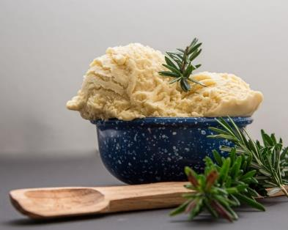
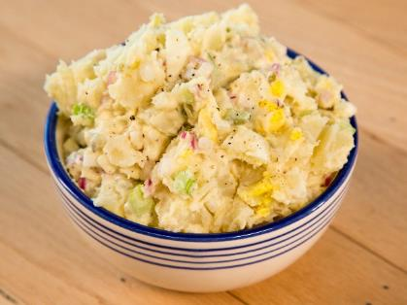
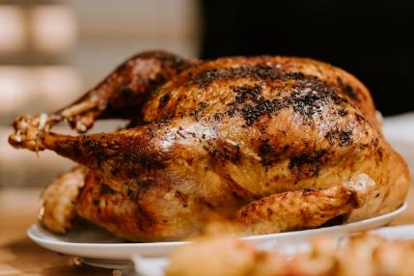
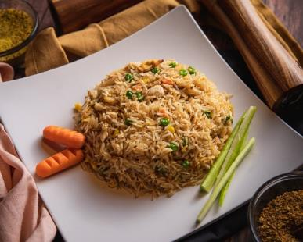
Leftovers & Storage

Slide 18
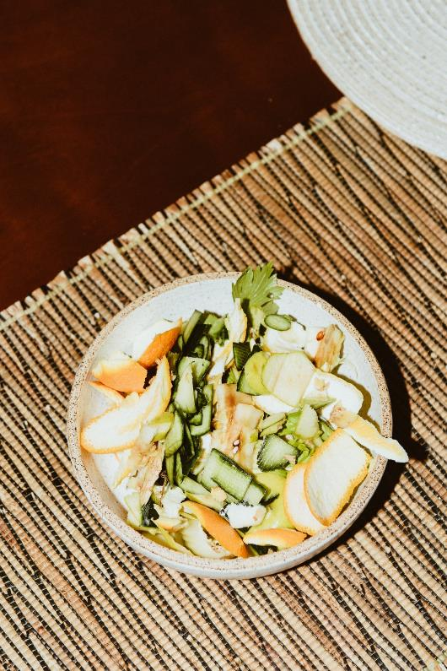
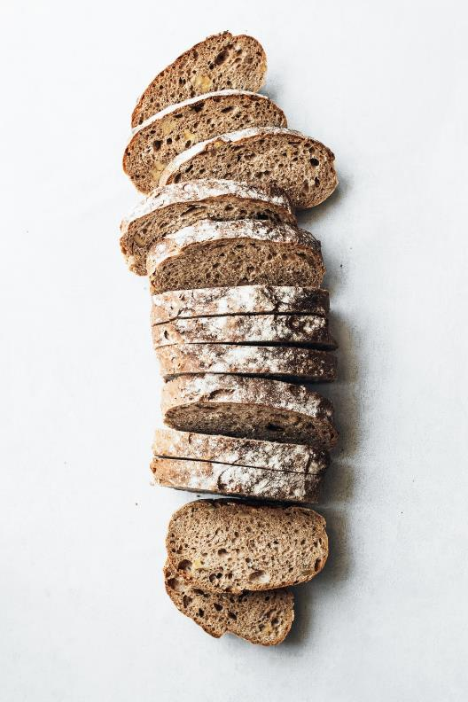
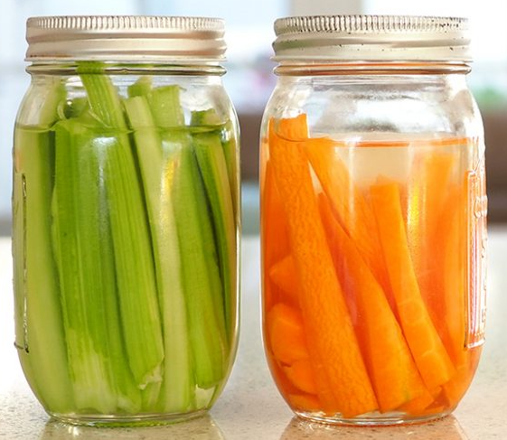
Leftovers & Storage
Keep carrots and celery in water and change water every 4-5 days
Excess vegetables and scraps – try making stock or soup
Stale bread turn into breadcrumbs (for stuffing or pasta bakes), or freeze bread

Slide 19
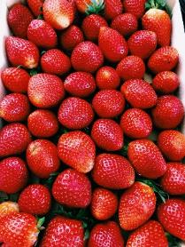
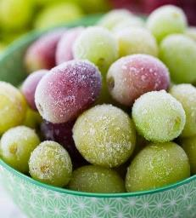
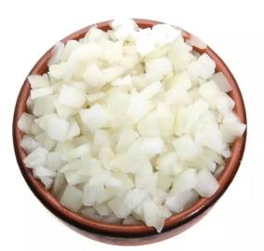
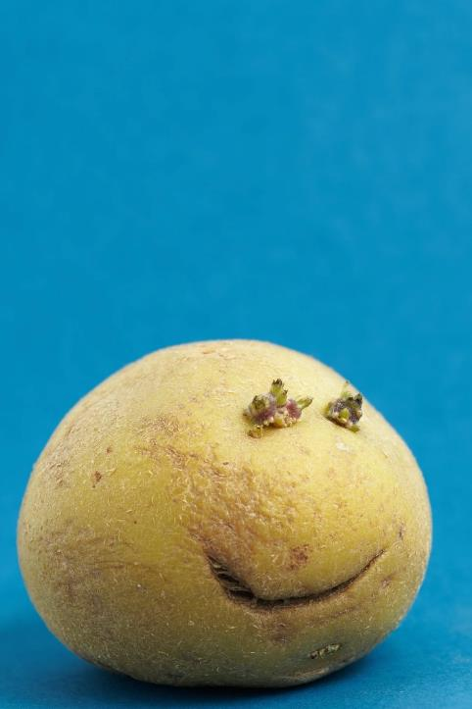
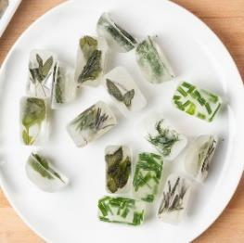
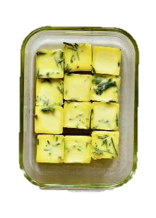
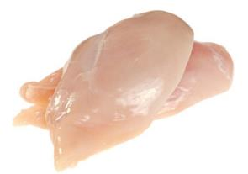
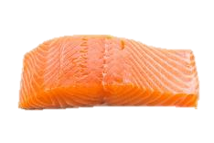
Leftovers & Storage – FREEZE!
Store in a cool and dark place. Cook & freeze if going off (or regrow)
Dice onions and garlic in bulk and freeze
Freeze fruit for tasty snacks or smoothies
Freeze herbs in olive oil or water
Freeze meats and fish

Slide 20
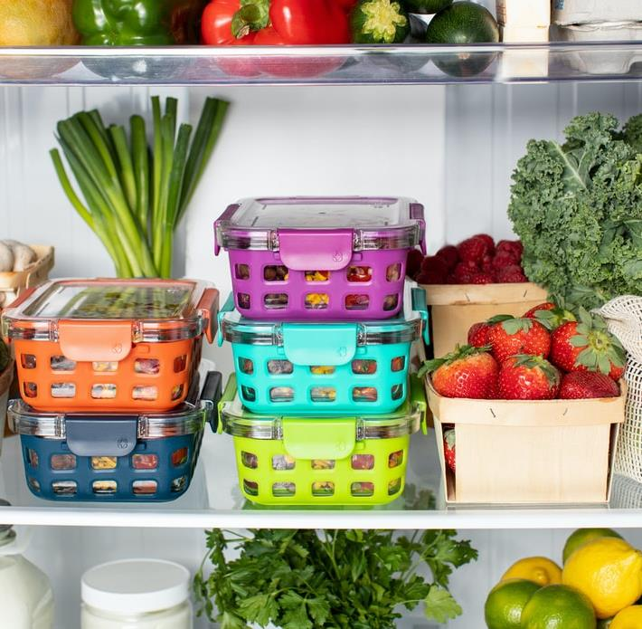
Safety Tips
Always date foods
Use by – Dangerous to eat foods past this date!
Best before – Not dangerous but may impact food quality.
Storage:
Cool down leftovers as quickly as possible (2 hours) – Freeze or store in the fridge and eat within two days.
Defrosting:
When defrosted, the leftover food should only be reheated once because the more you cool and reheat it, the more you increase the risk of food poisoning.
Reheating:
Ensure any leftover food is steaming hot, reaching 70C for 2 minutes.

Slide 21

Reuse - Regrow

Slide 22

School
Activities

Slide 23
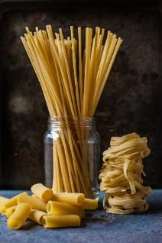
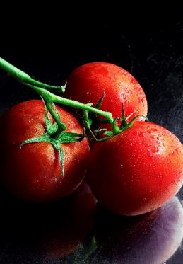
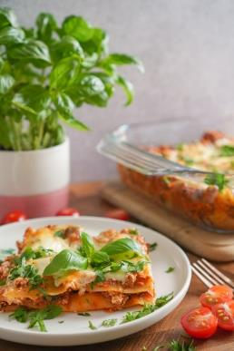
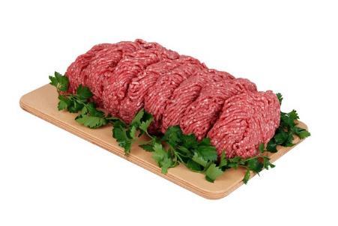
Food web
White Sauce

Slide 24
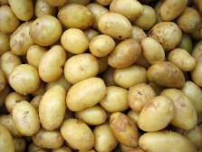
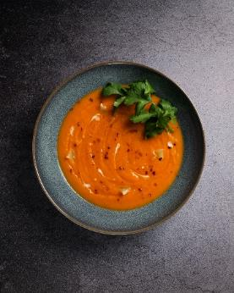



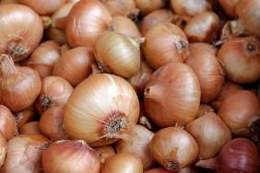

Food web
Stock
White Sauce

Slide 25
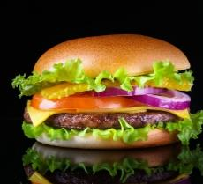
Food web
Stock
White Sauce

Slide 26
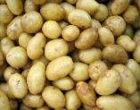
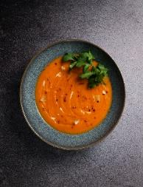
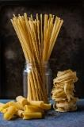

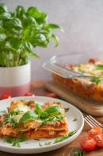



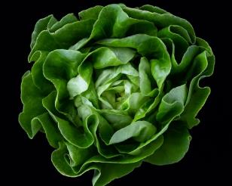
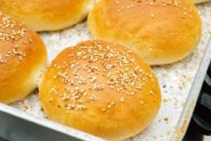
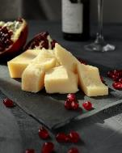
Food web
Stock
White Sauce

Slide 27
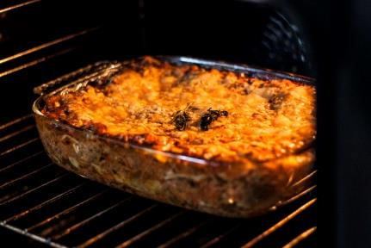
Food web
Stock
White Sauce

Slide 28

Older pupils (secondary)
Budgeting
Value for money
CAUTION – Food insecurity

Slide 29

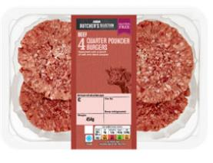
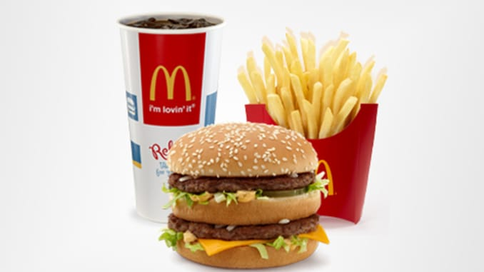

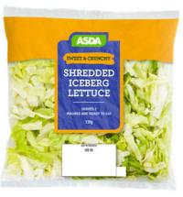


Differences
£5.71
£5.71
TIME
ORGANISATION
EFFORT
QUANTITY – Potential Food Waste*
HEALTHINESS

Slide 30
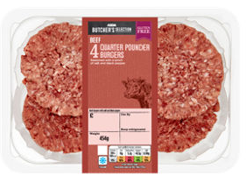
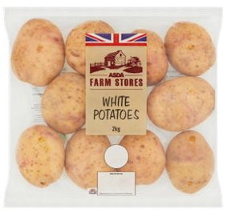
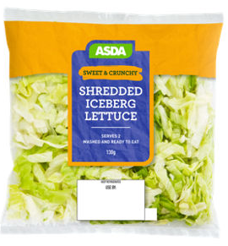


Issue of leftover Ingredients
Potentially leftover ingredients:
  2 X burgers
  Half bag of potatoes
  Lettuce
  Cheese slices
CREATIVITY
With the store cupboard foods, what else could you make?

Slide 31

What else could you make?
Have a look at your £5.71 challenge ingredients
Would you have left over ingredients
With your cupboard ingredients what else could you make

Slide 32


Shopping Rules
Eat before you go!
Know your budget and have planned your meals
Know the offers
USE A LIST

Slide 33

The Shopping List
Know your budget
Look at your weekly meal plan
What ingredients do you need that are not in the cupboard
Double check – hungry housemates
Add a treat

Slide 34




Offers
Shop the offers – stretch the budget
  Substitute ingredients on your list e.g. swap turkey for chicken
Know the day/time your local shop reduces down the food
  Majority of food can be frozen to use at later date
Buy store cupboard essentials when on offer

Slide 35

Resources
Food Life Skills
Shopping
Where food comes from
Growing
Cooking

Slide 36

Some Other Relevant articles
Barriers and Facilitators to cooking from basic ingredients
Cook Like A Boss: An effective co-created multidisciplinary approach to improving children’s cooking competence
Modern transference of domestic cooking skills
The Conversation:
How we cook changed during lockdown – and we can learn from this for life after the pandemic
Children as young as two can learn to cook – here are the kitchen skills they can get to grips with
Cooking with kids at home saw a boom during lockdown – here’s why it needs to continue
Email: f.lavelle@qub.ac.uk

Slide 37



Food – a fact of life resources
Cooking – 5-7 years, 7-11 years, 11-14 years and 14-16 years
Remote learning activities
Interactive activities
Using leftovers – presentation and activity.Learn with stories
Early years activity pack – Amazing allotments
Recipes – over 300 tried and tested recipes with new recipes to come!
Resources for pupils with additional needs
Healthy sustainable diets
Support and resources for pupils aged 5-7 years, 7-11 years, 11-14 years and 14-16 years.

Slide 38


Suggestions for further reading and sources of information
British Nutrition Foundation – new website
European Commission – food waste
Food Standards Agency
  Home food fact checker
  Christmas food hygiene
Healthy sustainable diets (British Nutrition Foundation)
Love Food Hate Waste
RHS Campaign for school gardening
WRAP
Try, swap, change planner

Slide 39
And finally….
Webinars
Food styling and presentation masterclass – 12/01/22
Careers in food and drink – 9/03/22
Virtual practical workshops
Food science and food skills: Practical applications – 15/01/22 (Saturday)
Food science and food skills: Practical applications – 9/02/22 (Twilight)
Online courses available too!

Slide 40
Practical food skills, cooking and food waste
For further information, go to:
www.foodafactoflife.org.uk

