Slide 1
Varieties of wheat flour

Slide 2
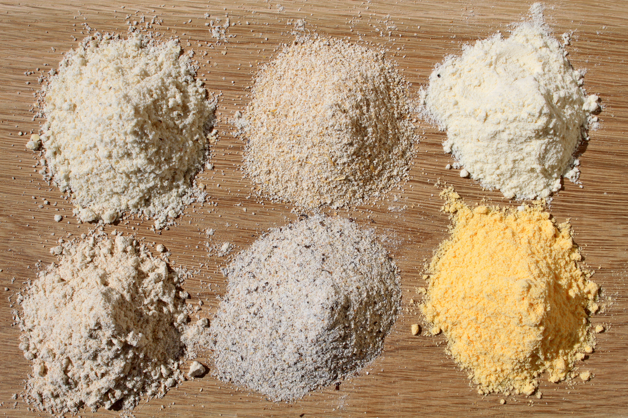
Welcome / Objectives
Text here

Slide 3
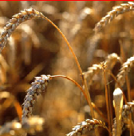
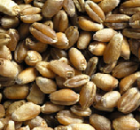
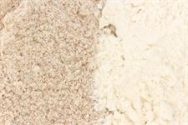
Wheat flour
Farmers grow wheat plants and the grain from those plants is used to make flour.
Flour is used to make a huge range of food products, such as bread, breakfast cereals, biscuits and cakes.
The seed is crushed during the milling process to release the flour from the grain.

Slide 4
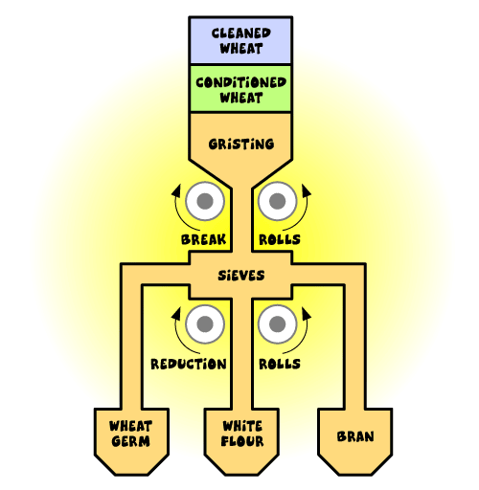
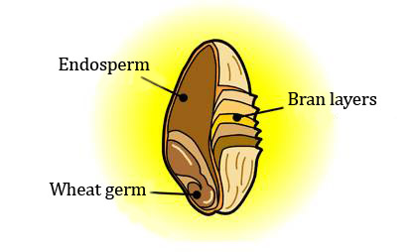
Flour milling
During milling, different parts of the wheat are used or removed at different stages to make different varieties of flour.

Slide 5
Types of flour: white
This usually contains around 75% of the wheat grain.
During milling, most of the bran and wheatgerm are removed.

Slide 6
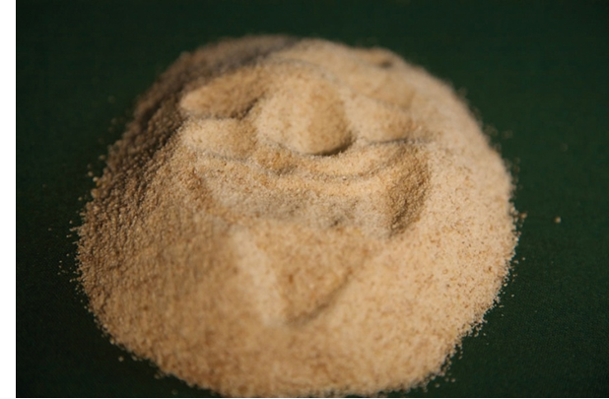
Types of flour: brown
This usually contains about 85% of the original grain.
During milling, some of the bran and wheatgerm are removed.

Slide 7
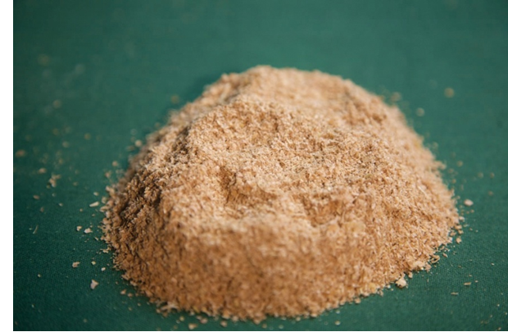
Types of flour: wholemeal
This is made from the whole wheat grain without any additional ingredients, or any parts being removed in the milling process.

Slide 8
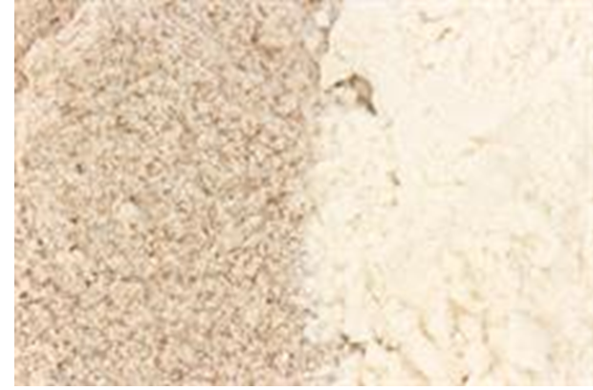
Types of flour: malted wheatgrain
This is brown or wholemeal flour with malted grains added after the milling process.

Slide 9
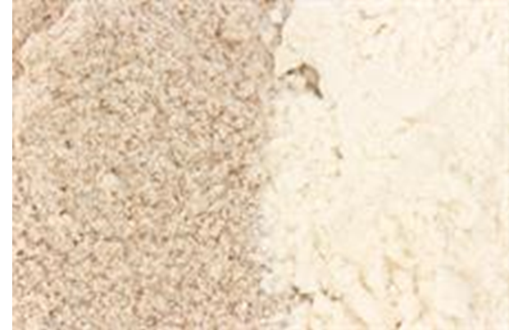
Types of flour: wheatgerm
This can be white or brown flour with at least 10% made up of wheatgerm added during the milling process.

Slide 10
Types of flour: organic
This is made from grain that has been grown to organic standards.
Growers and millers must be registered and are subject to regular inspections.

Slide 11
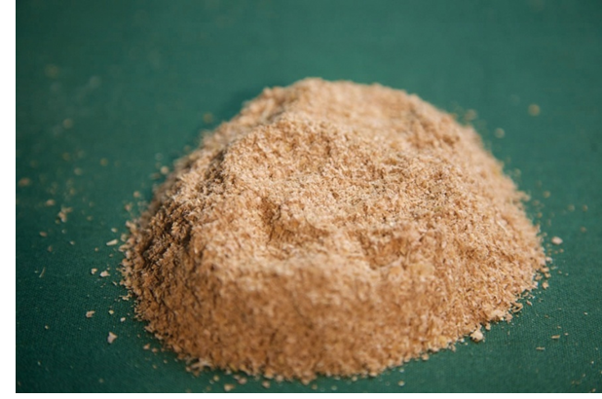
Types of flour: stoneground
This is whole flour grown between two stones using the whole wheat grain with no additional ingredients or any parts being removed.

Slide 12
What about other types of flour?
Around the world there are flours which are not made from wheat.
Some of the more unusual types include flour made from coconut, potato, peas and chickpeas. Other grains such as rye, oats and spelt are also used.

Slide 13
For further information, go to:
www.foodafactoflife.org.uk

