Slide 1
Colour changes with meat

Slide 2
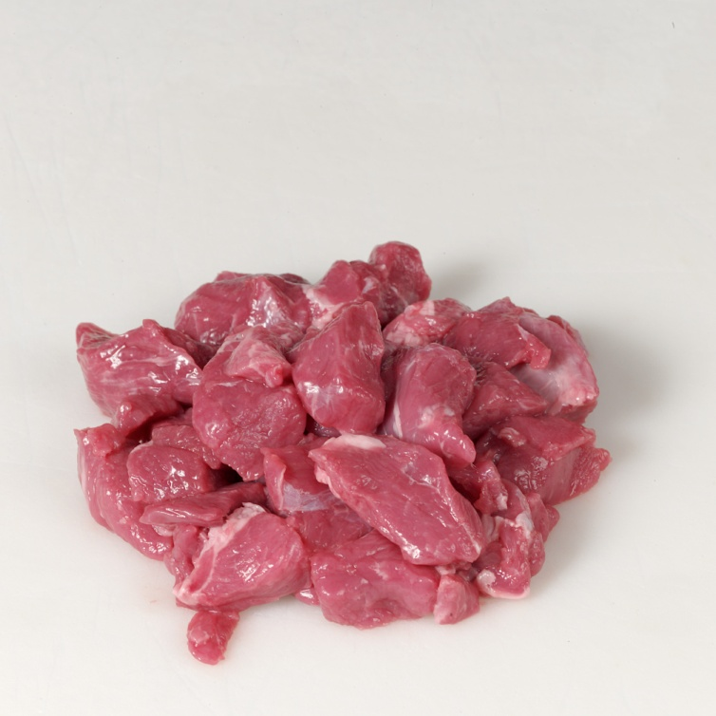
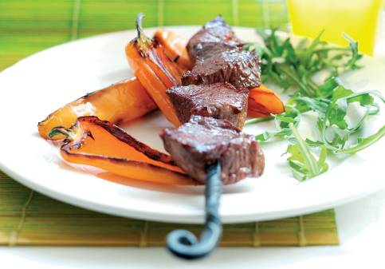
Welcome
Complete the missing words.

Slide 3
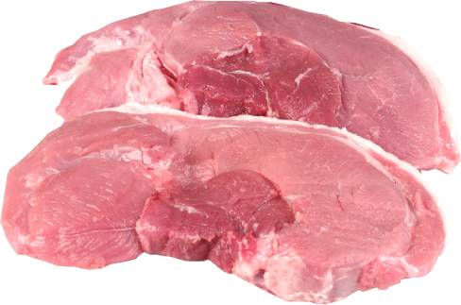
The colour of meat
1
The colour of meat is largely due to the red protein called myoglobin and some haemoglobin (blood) left in the muscle. Some muscles contain more of these red pigments than others.
Colour differences can be due to age and exercise, but are mainly due to the metabolism of the species and the function of the particular muscle.
Meat from muscles which have been used a lot and are from older animals is usually a darker colour.
2
3
Word bank:
Age
Protein
Pigments
Darker
4

Slide 4
The colour of meat
During the time meat is stored the colour changes to a darker brown-red because of the formation of metmyoglobin.
When meat is cut and exposed to oxygen in the air, it takes about twenty minutes for myoglobin to change to oxymyoglobin, which is brighter red in colour.
After some time, the meat becomes a browner colour again as metmyoglobin is formed.
These colour changes do not make any difference to the taste or texture.
1
2
3
4
Word bank:
Browner
Metmyoglobin
Difference
Oxygen

Slide 5
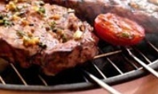
Colour changes during food preparation
1
When meat is cooked the colour changes from red to brown.
Meat muscle contains a protein called myoglobin (similar to haemoglobin) which gives meat its red colour. Immediately after cutting, meat is a purple colour, which turns to bright red after about thirty minutes as myoglobin takes on oxygen to form oxymyoglobin.
After several days of exposure to air the surface of meat turns a brownish colour as the myoglobin oxidises to become metmyoglobin.
During cooking all these pigments are denatured and the meat will take on a brownish colour throughout.
2
3
4
Word bank:
protein brown
oxygen bright red
denatured metmyoglobin
5
6

Slide 6
For further information, go to:
www.foodafactoflife.org.uk

