Slide 1
Introduction to dairy farming

Slide 2
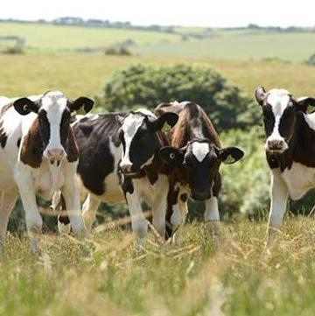
Objectives
To understand the importance of maintaining the health and welfare of dairy cows.
To recognise there are differences between farming systems.
To be aware of the different initiatives being undertaken by dairy farmers to protect and enhance the environment.

Slide 3
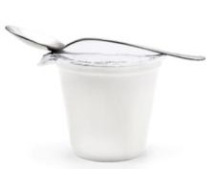
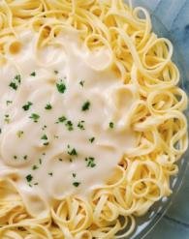
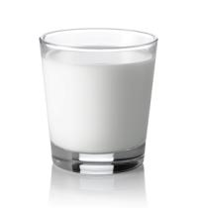
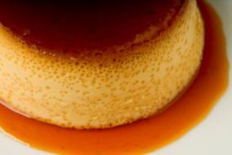
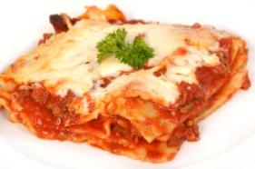
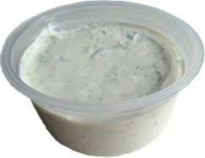
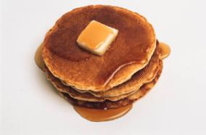
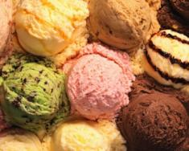
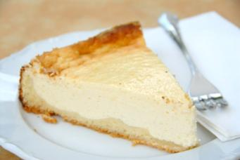
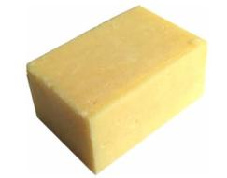
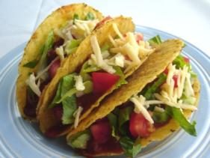
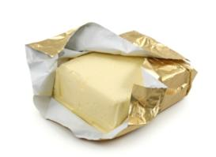
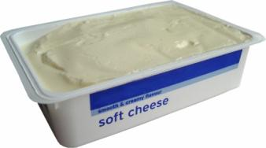
Dairy products
Name a variety of different dishes and meals which contain dairy products.

Slide 4
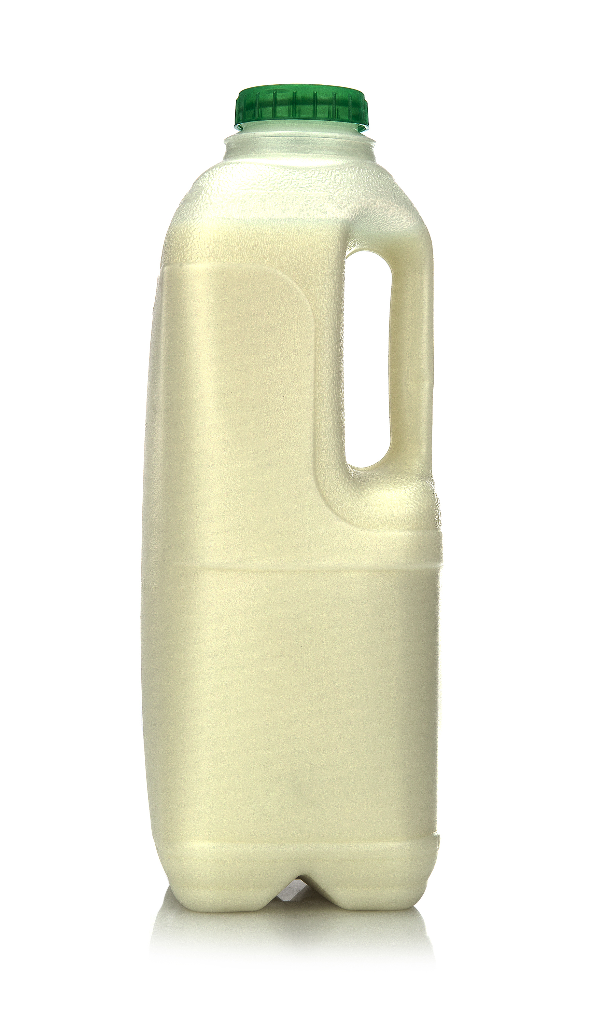
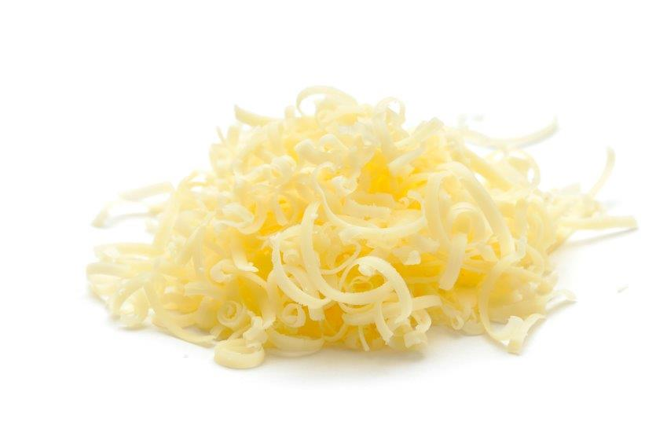
Milk
Milk and dairy foods can play an important part of a healthy diet and are very popular in the United Kingdom (UK).
British dairy farmers produce 14* billion litres of milk each year.
In the UK 6.9* million litres are sold for drinking and some go into dairy products such as cheese, butter and dried milk power, which is an important part of many other food products.

Slide 5
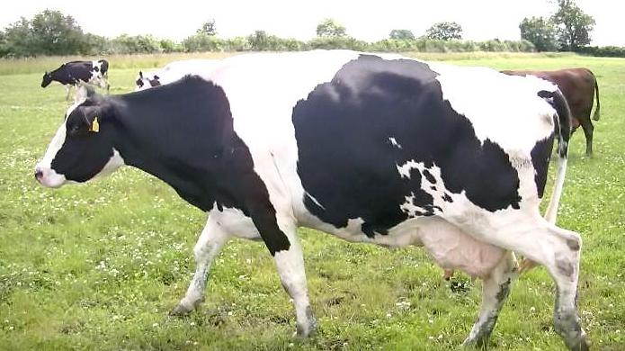
Where does milk comes from?
There are 13,227* dairy farms across the UK. The majority of farms are located in the western parts of the British Isles where the warm, wet climate gives ideal conditions for grass growth.
Dairy farms are all different shapes and sizes, with small herds to farms with more than 1000+ cows.

Slide 6
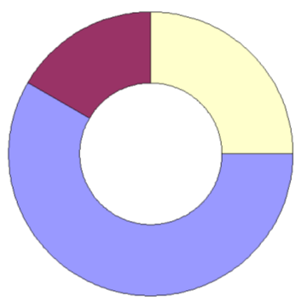
How does a cow produce milk?
A dairy cow needs to give birth to a calf in order to produce milk.
This chart represents a one year period.
The ‘dry’ period is similar to an adult going on maternity leave, where the cow will rest and prepare for the birth of her calf.
Calving
– birth of the calf
‘Dry’ period
Lactation
– production of milk
Insemination
– where a cow becomes
pregnant
Pregnancy

Slide 7
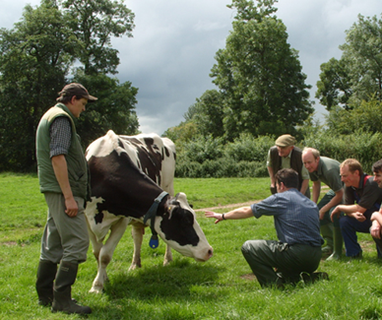
Dairy farmers’ top priority
A dairy farmer’s main concern is the health and welfare of their cows. The Freedoms below ensure that farmers keep their cows healthy on the dairy farms.
The Farm Animal Welfare Council's Five Freedoms are:
Freedom from hunger and thirst;
Freedom from discomfort;
Freedom from pain, injury or disease;
Freedom to express normal behaviour;
Freedom from fear and distress.

Slide 8
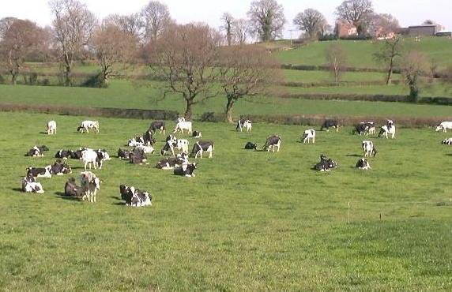
Where do cows live?
Most dairy cows are housed during the winter and bad weather. The cows can move freely, socialise and eat and drink when they want in sheds that have natural light.
Dairy cows mostly graze outdoors during the summer, moving from indoor housing. Outside they can easily graze at their own leisure, exercise, get fresh air and natural light.

Slide 9
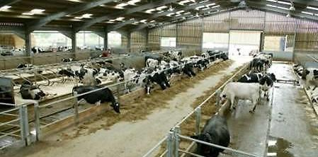
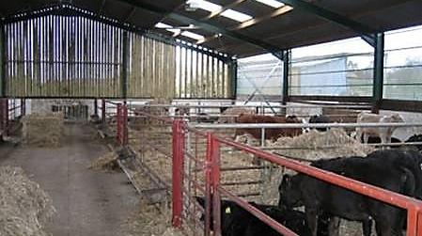
What if the weather turns bad?
In the winter and during bad weather, most dairy cows are housed.
Sheds are designed to be extremely spacious and airy, allowing the cows to rest, stand and move around freely to exercise and socialise.
Sheds are carefully designed to ensure that the 'Five Freedoms' are met, and to maintain the health and welfare of the cows.

Slide 10
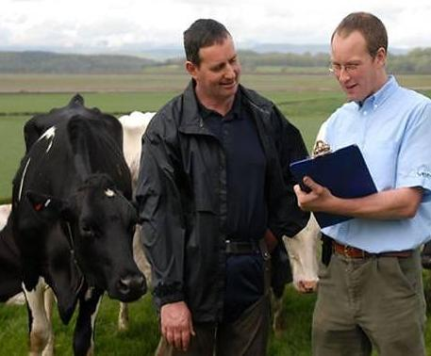
Who helps the famer look after the health and welfare of cows?
Herd health checks are carried out regularly. The farmer works closely with a veterinarian and animal nutritionist to ensure the highest quality of health and welfare for the dairy cows.
Each dairy cow has an animal passport showing where the cow was born and any other places it has been moved to.

Slide 11
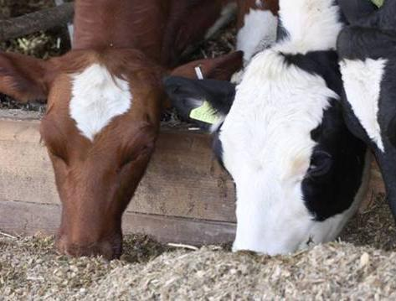
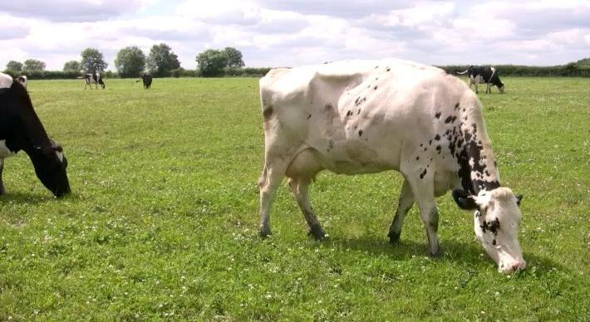
What do dairy cows eat?
Most British dairy cows eat grass during the summer and silage (dried grass or maize) in the winter.
This is usually supplemented with dry feeds such as cereals and protein feeds with added vitamins and minerals to ensure the cows have a nutritionally balanced diet.

Slide 12
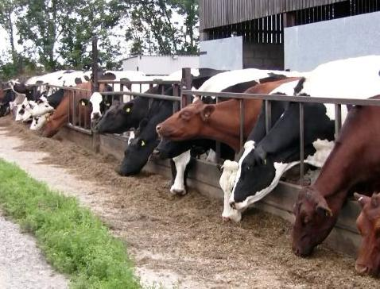
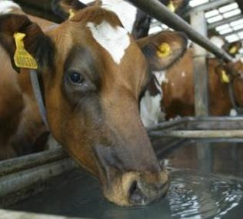
The diet of a dairy cow
Each dairy cow eats between 25 and 50 kilograms of feed each day.
A dairy cow drinks around 60 litres of water per day.
Some cows may need up to drink 100 litres, or more, depending on how much milk they produce.

Slide 13
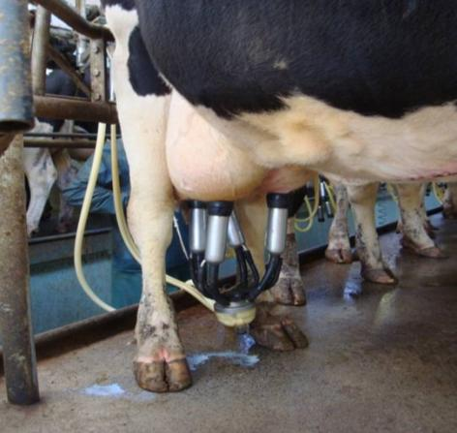
Milking
Milking is not a painful process for the cows and is not uncomfortable.
Milking is very similar to a calf suckling. Dairy cows would feed their calves naturally, at four to six hourly intervals.
Cows are milked at different times depending on the farm and the type of parlour used.

Slide 14
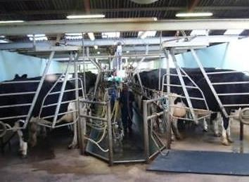
Milking
Here are three examples of different ways in which cows are milked:
In a herringbone parlour, the cows line up beside each other at an angle. The farmer accesses the udders from a sunken pit.

Slide 15
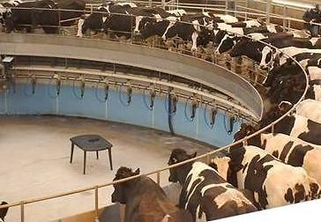
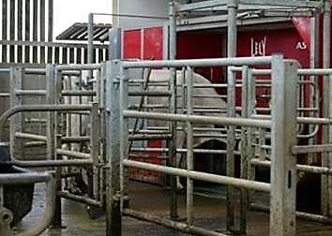
Milking
In a rotary parlour the cow stands on a circular raised platform which rotates slowly. The farmer attaches the milking machine from below.
In a robotic milking parlour, the cows choose when to be milked. The milking machine automatically connects to the cow’s udders and turns off when the milking is complete.

Slide 16
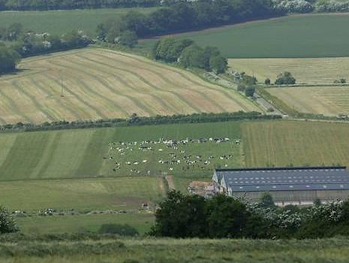
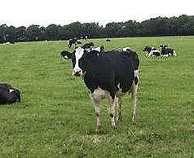
Different farming systems
Throughout the UK, there are a number of differences between dairy farms. No matter which farming system is used, the health of the dairy cows, remain a priority. Cows could be housed in loose housing or the free stall system, where they have individual beds.
Some dairy cows will graze on fields with an extensive system. They may also be fed a diet of organic feed. Some famers follow an organic farming system.

Slide 17
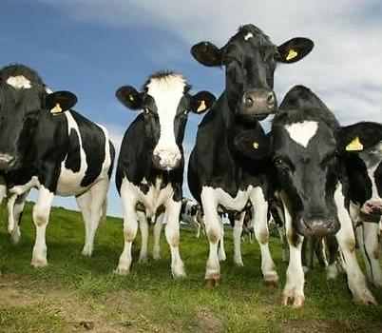
Methane and greenhouse gases
When cows chew and digest food they burp and emit methane(CH₄). This gas also exists naturally in the atmosphere and helps regulate the Earth's temperature.
Dairy cow farming can have an impact on the environment due to methane production contributing to global warming.
There are a range of measures being used by dairy farmers to reduce the impact on the environment, as well as to enhance the environment.

Slide 18
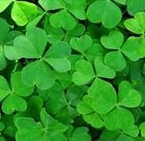
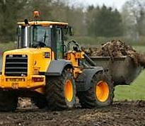
Farmers help to look after the environment
There are many ways in which dairy farmers are working to improve and sustain the environment.
Some farmers will plant clover in fields. This promotes nitrogen in the soil to reduce the use of artificial fertilisers.
Managing manure is an important aspect of dairy farming. It is important to reduce the odour and the risk of water pollution. Manure can be used as a natural fertiliser on the farm. Some dairy farmers, particularly those with larger farms, use anaerobic digesters to turn cows' manure into electrical energy.

Slide 19
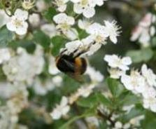
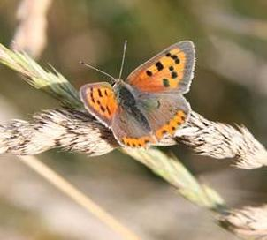
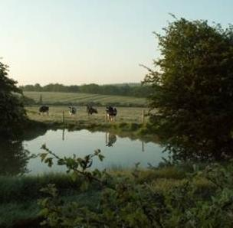
The farm enviornment
There is more to the farm than cows. Britain's hedgerows are regularly maintained by farmers to provide a breeding ground for birds and other wildlife.
Many dairy farmers leave a strip of grass around the edge of the pastures for planting trees and establishing ponds to attract wildlife.
Some farmers will leave maize stubble in fields over the winter for ground nesting birds - this is so they can nest amongst the stubble.

Slide 20
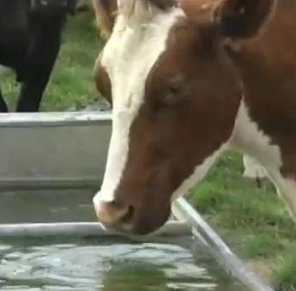
Water conservation
Water is essential for dairy farming. Cows must drink and the farmer needs to clean the milking parlour and other equipment.
British dairy farmers are constantly looking at ways to conserve water and reduce costs without compromising either animal welfare or dairy hygiene.
Water is often recycled on farms.

Slide 21

Red tractor scheme
The Red Tractor symbol on packaging helps consumers know that the milk and dairy foods have been produced according to the high standards of the Assured Dairy Farms scheme.
This has been developed by dairy farmers, processors, the National Farmers Union and the British Cattle Veterinary Association.

Slide 22
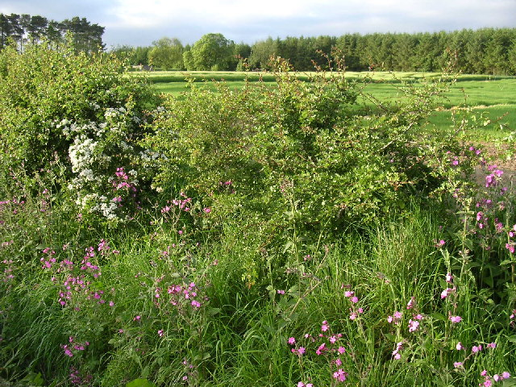

LEAF Marque
The LEAF Marque is a food assurance scheme showing that food has been produced with environmental care.
Food displaying the LEAF Marque logo has been produced by farmers who carry out a wide range of activities to look after the environment and its wildlife.
These include managing hedgerows for wildlife, using pesticides and fertilisers only when absolutely necessary, leaving a strip of land between hedgerows and crops to act as a habitat for wildlife, recycling on-farm waste, conserving energy and improving water efficiency and quality.

Slide 23
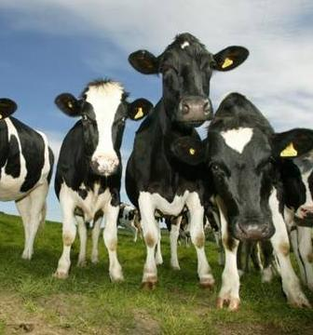
Summary
Farming techniques and the size of dairy farms differ around the UK.
Although different feed, housing and milking parlours may be used, the health and welfare of the dairy cows remains the highest priority for farmers.
Farmers work hard to improve and sustain the natural environment.
Schemes like the Red Tractor symbol help consumers know that high standards of farming have been used during the production of dairy products.

Slide 24
For further information, go to:
www.foodafactoflife.org.uk

