Slide 1
Milk production

Slide 2
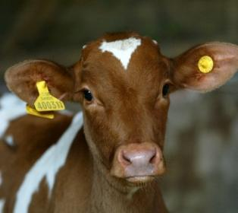
Objectives
To recognise that the farmer considers the health and welfare of the dairy cows during different aspects of farming.

Slide 3
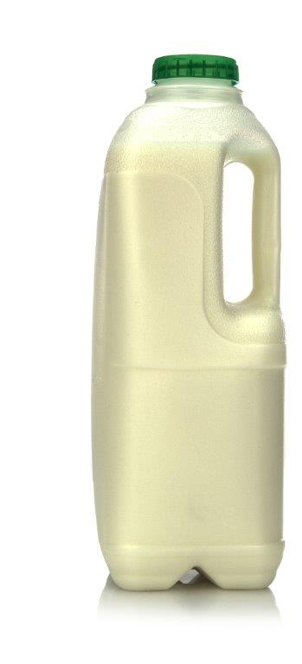
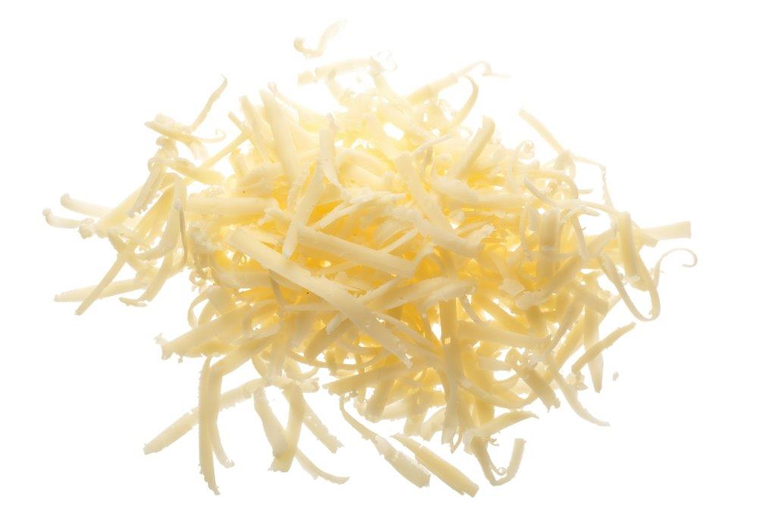
Dairy farming in the UK
The population of the UK drinks around 6.9* billion litres of milk each year.
Some is sold for drinking and some goes into dairy products such as cheese, butter and dried milk powder, which is a vital component of many other food products.

Slide 4
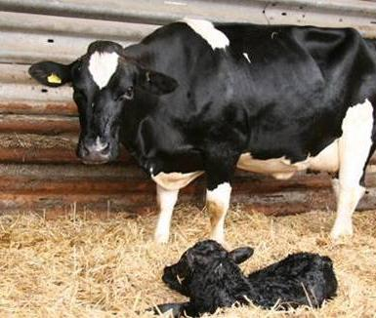
Life cycle on a dairy farm
The production of milk requires dairy cows to be in lactation, producing milk, to do this she must have given birth to a calf.
The cycle of calving, lactation, insemination and pregnancy, then a ‘dry’ period, tends to work in 12 month cycles.
The ‘dry’ period is similar to an adult going on maternity leave, where the cow will rest and prepare for the birth of her calf.
Dairy farms are reliant on the production of calves for the production of milk.

Slide 5
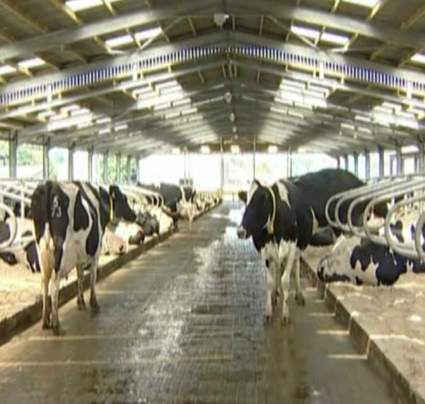
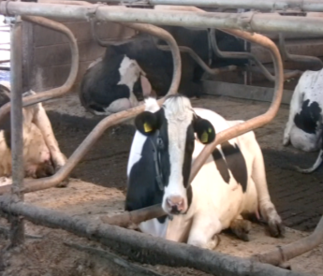
Cow housing
Like most dairy farms across the UK, the cows on this farm graze outdoors during the summer and are housed during the winter.
This farm uses a cow shed with a free stalls system, with individual beds for each cow. Elastic stall segregation is used to prevent cows from harming themselves.
The cows are able to rest, stand and move around freely.

Slide 6
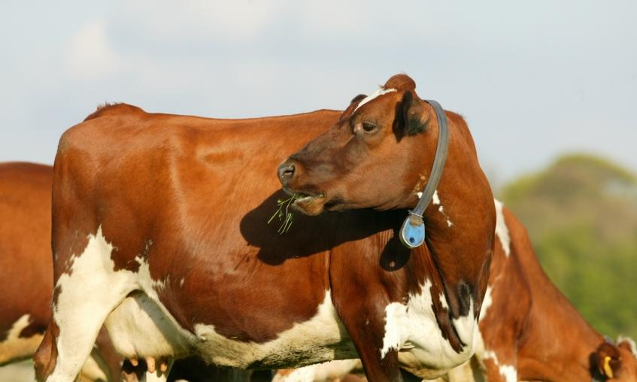
Dairy farming in the UK
Herd health checks are carried out regularly and the farmer works closely with a veterinarian and animal nutritionist to ensure the highest quality of health and welfare for the dairy cows.
Each dairy cow also has an animal passport identifying the origin of the cow and any other locations it has been transported to.

Slide 7
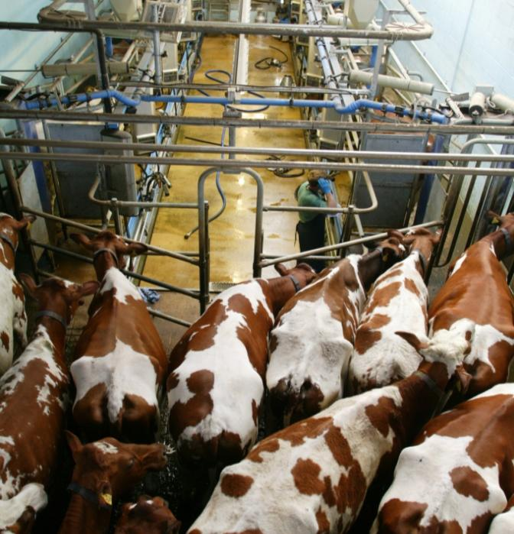
Cow milking
The cows come in from the fields or the barn into the collecting yard twice a day.
From the yard a number of cows are taken into the ‘herringbone style’ milking parlour.

Slide 8
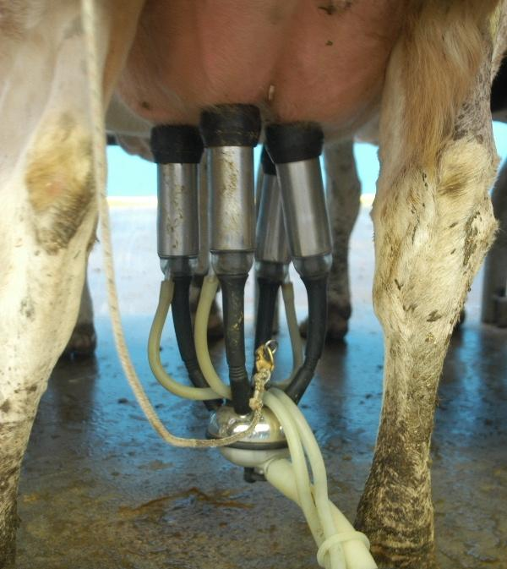
Milking
The herdsman or farmer firstly uses a clean paper towel is to wipe each udder.
Foremilk is stripped. This is where a little bit of milk is squeezed from each teat to ensure the milk looks clean and healthy.
One cup (flexible rubber) is applied to each teat from the cluster. The vacuum draws the milk from the udder, in a similar fashion as a baby calf's mouth massaging the teat.

Slide 9
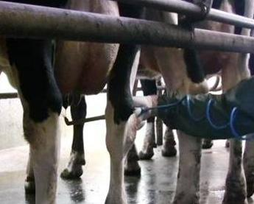
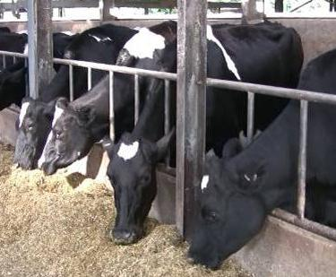
Milking
To prevent over milking the cluster automatically detaches itself. The udders are checked by hand to ensure the cow has been milked out properly.
Antibacterial spray is applied to each teat to prevent infection, such as mastitis, and keep the skin healthy.
Once the cows in that row have been milked, they are let out of the parlour. The cows are free to move around, sit down, eat and drink.

Slide 10
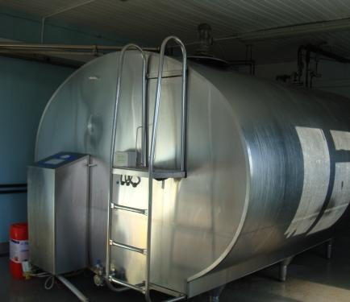
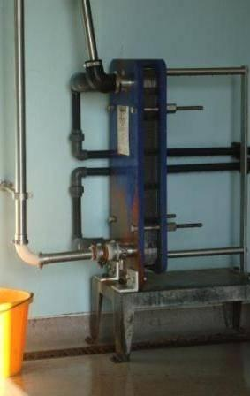
Milk storage
The lift pump draws the milk through large diameter stainless steel piping into the dairy.
The milk passes through a plate heat exchanger to reduce the temperature of the milk to between 1-4 ºC before being stored in a refrigerated bulk tank.

Slide 11
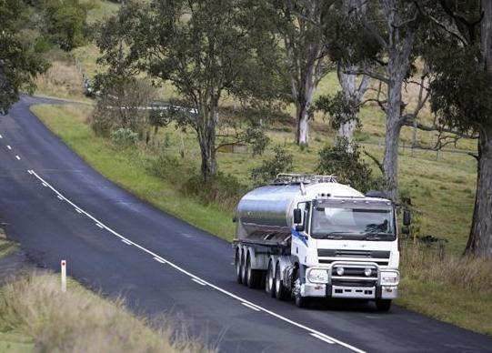
Transport
A milk tanker calls at the farm daily or every other day to collect the milk. The driver checks the temperature of the milk before transporting it to the processing dairy.
This farm will process the milk to produce cheese in a factory on the farm.
Other farms will transport the milk to a processing dairy further away.

Slide 12
For further information, go to:
www.foodafactoflife.org.uk

