Slide 1
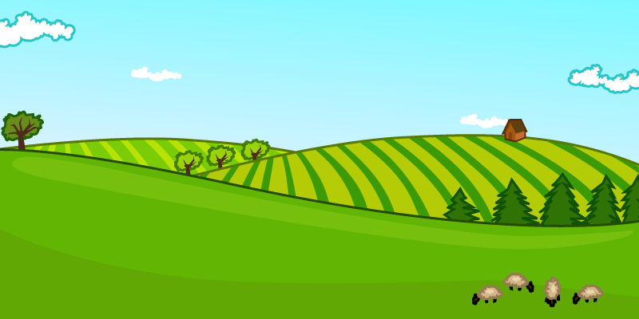
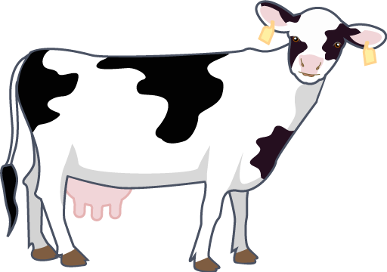
The farm visit

Slide 2

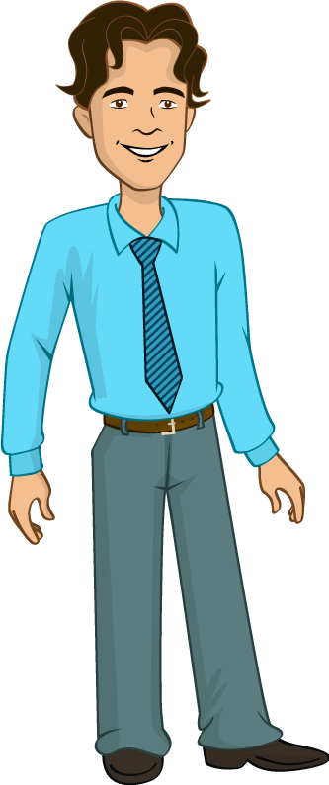
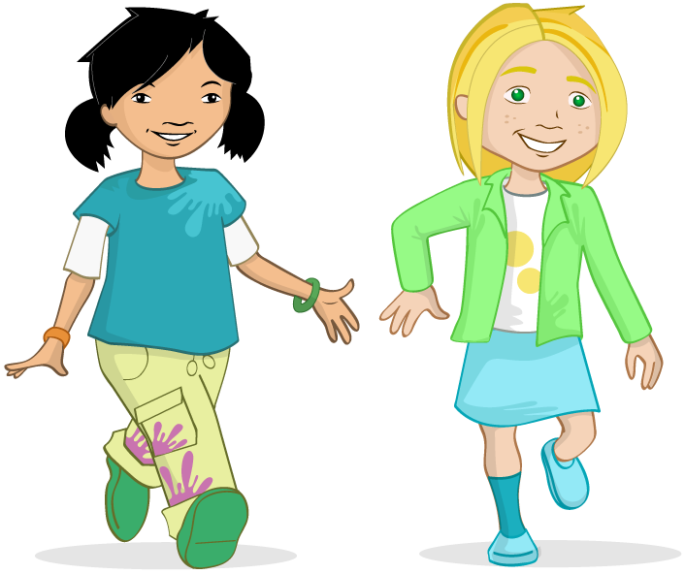
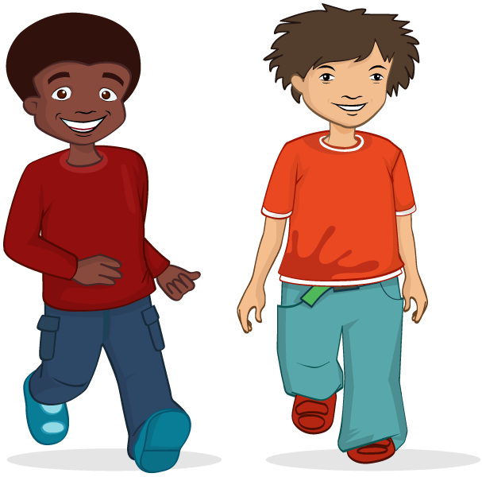
“Come along, chop, chop,” said Mr Valdez.
It was the day of the school trip. Jordan, Alisha, Nicola, Ronnie and all of Class V were excited! They were going to visit a farm.
“Coats, lunchboxes, walk in pairs,” Mr Valdez called out to the class as he led them outside.

Slide 3
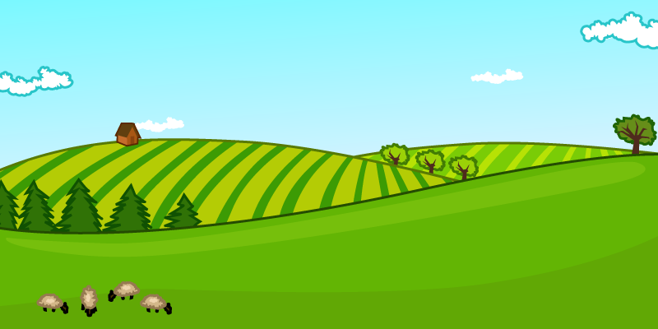

The children climbed onto the coach and fastened their seat belts.
The coach crawled slowly out of the busy town.
Soon, it was whizzing past different fields in the countryside.
Some had barley growing, some were apple orchards and others had sheep grazing. The children chatted excitedly.

Slide 4
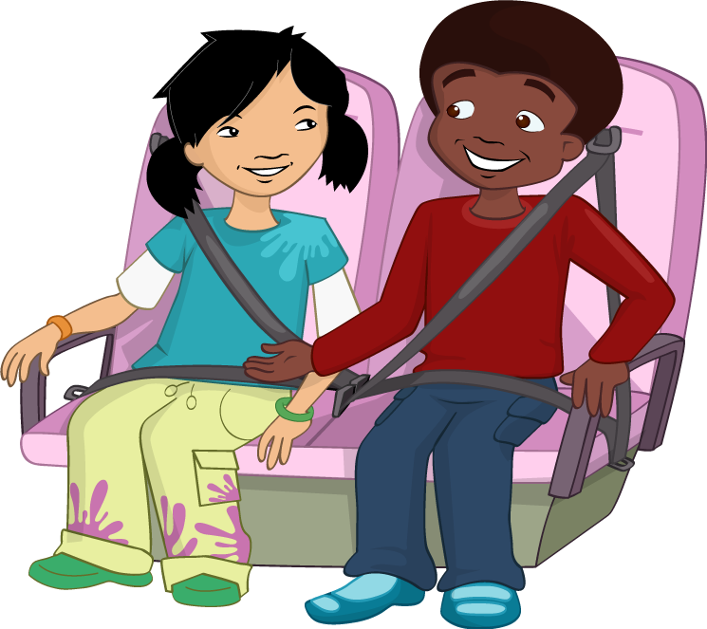



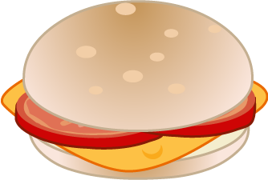
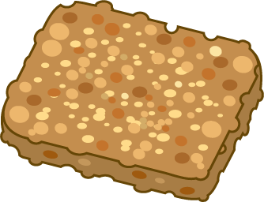
Jordan was hungry. He hadn’t eaten his breakfast and was now looking through his lunchbox. Mum had packed some delicious treats today! There was a tasty looking cheese and tomato roll, some neatly cut carrot sticks and homemade flapjack. His mouth began to water!

Slide 5
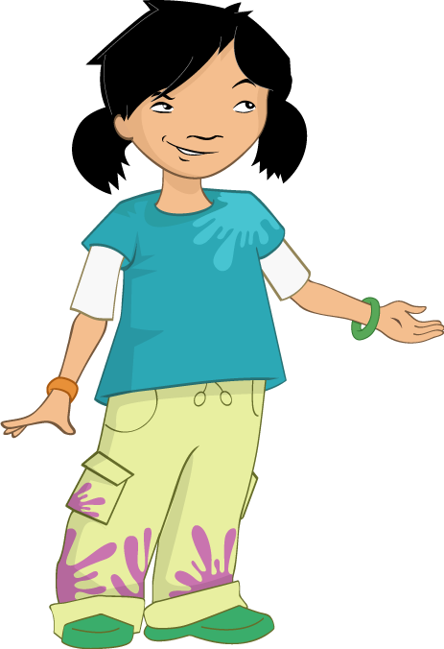
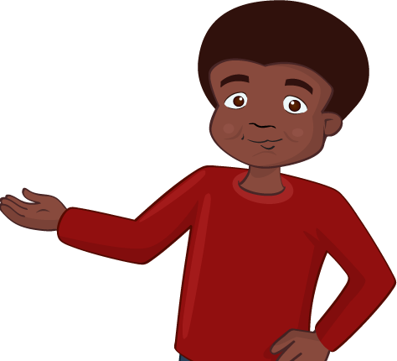
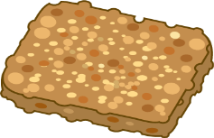
“You can’t eat that!”, said Alisha, “That’s for your lunch”.
Jordan didn’t listen and continued to look at his food.
Then, in one quick move, he stuffed the cheese and tomato roll into his mouth!
“Jordan! Stop being greedy,” scolded Nicola.

Slide 6

“Delicious,” mumbled Jordan with his mouth still full. “Cheese is my favourite food.”
“I bet you don’t even know where it comes from,” said Alisha.
“That’s easy,” Jordan replied. “A shop!”. Alisha rolled her eyes and shook her head. She was about to explain to Jordan where cheese came from when the coach stopped.

Slide 7
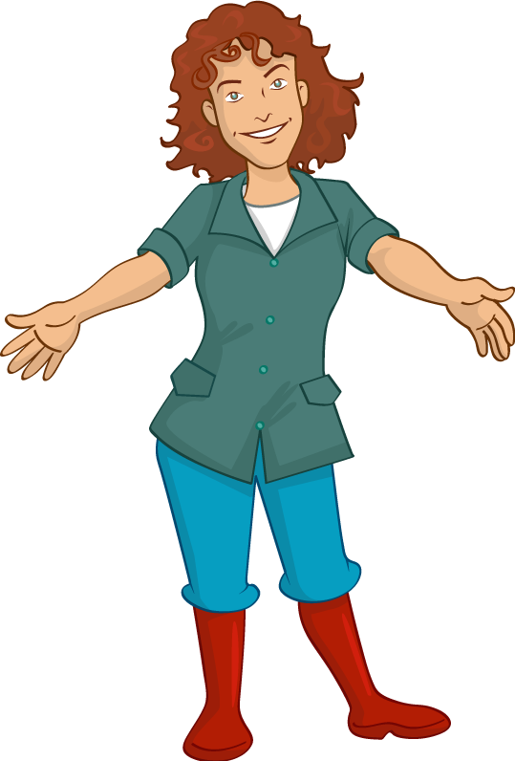
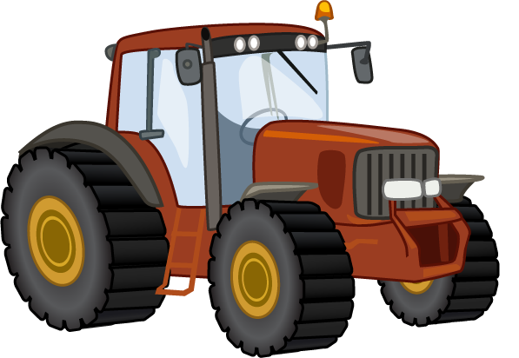
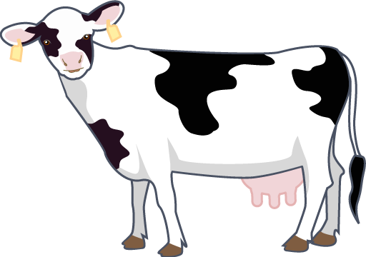

They had arrived at the farm. The farmer, Mrs Jenkins, smiled at the children as they climbed off the coach.
“Good morning Class V!” she greeted them, cheerfully. “Welcome to my farm!”
There was a lot to see on the farm, but all the children were excited about watching the cows being milked.
Alisha nudged Jordan, “Now you’ll learn where cheese comes from,” she said.

Slide 8

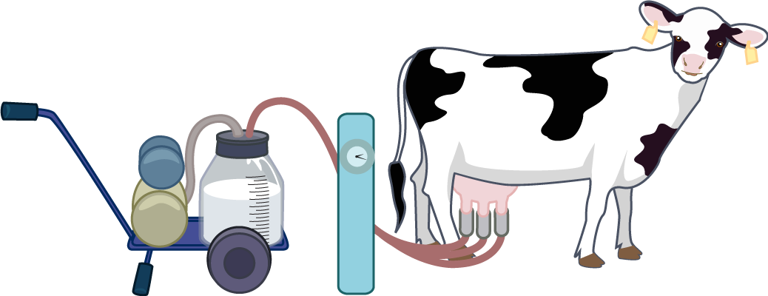
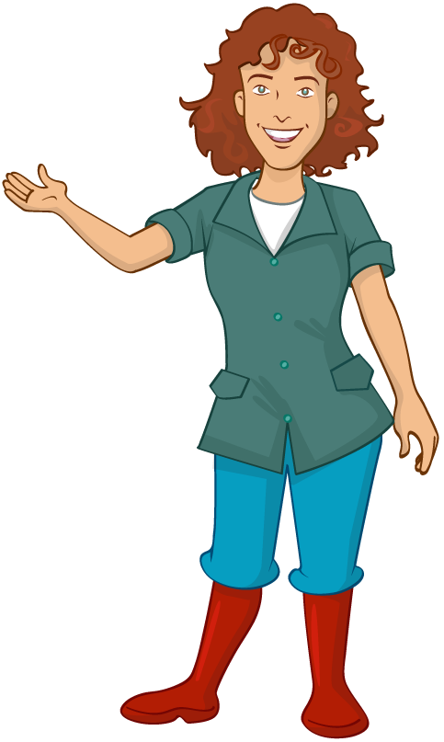
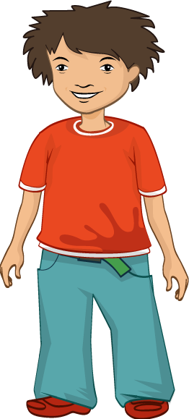
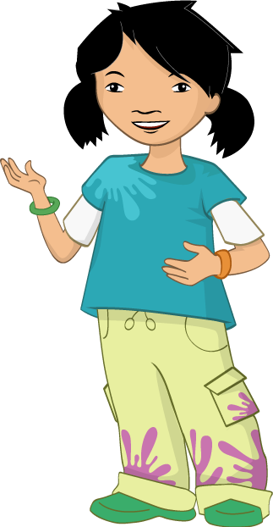
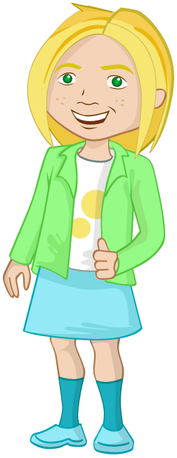
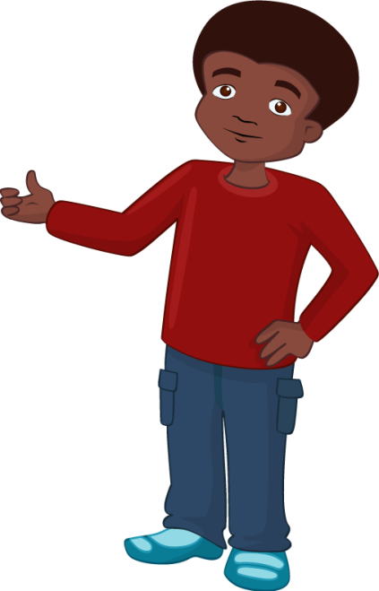
Mrs Jenkins led the children into the milking parlour. The cows were taking their places in the stalls.
“How do you get the milk from the cow?” asked Alisha.
“That’s a good question, I’ll show you,” replied Mrs Jenkins.
The children watched as she wiped the cows’ udders clean. She turned on the milking machine and then fitted four rubber cups to the udders. The machine gently sucked the milk from the cow.

Slide 9
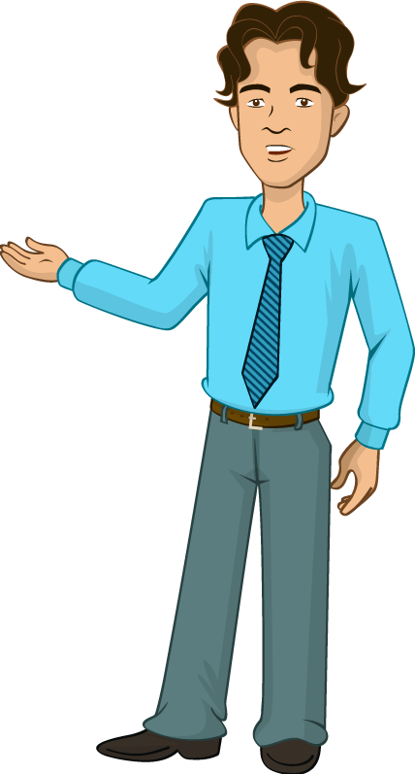
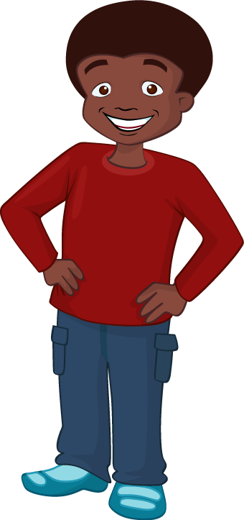
“Look!” said Jordan excitedly, “I can see milk going up that pipe!”. Jordan couldn’t believe his eyes. He had only ever seen milk in a plastic bottle, never from a cow!
The children watched the meter as it measured the amount of milk taken from the cow.
“How much milk do you think each cow makes in a day?” Mr Valdez asked the children.

Slide 10
12
6
The children tried to guess.
“6 litres,” said Jordan.
“12 litres,” guessed Alisha.
“Actually, we generally get about 10 to 25 litres from each of these a cows everyday,” explained Mrs Jenkins.
“Wow!” said Ronnie.
“Can we try some?” asked Jordan.

Slide 11
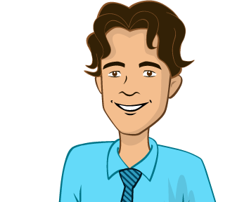
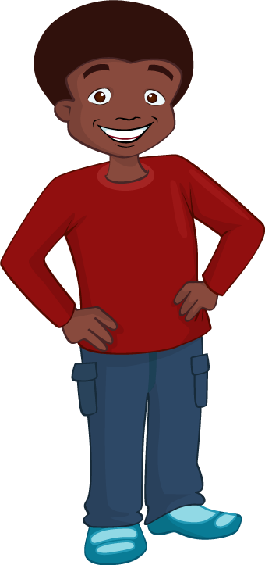
“I’m afraid not, “ said Mrs Jenkins. “You see the raw milk has to be treated first ready for us to drink.” “You give the milk treats?” enquired Nicola.
Jordan and Ronnie started to laugh.
“Perhaps I could give it the flapjack from my lunchbox,” giggled Jordan.
“No, no,” chuckled Mr Valdez. “It is heat-treated to remove naturally occurring bacteria, then it is ready for us to drink.”

Slide 12

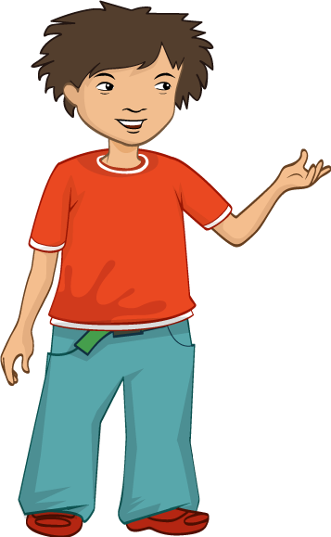
“What happens after it is treated?” asked Jordan, curiously.
“The milk is put into cartons or bottles and sent to shops and supermarkets,” answered Mrs Jenkins.
“Did you know that you can also make other foods from milk?” asked Mrs Jenkins.
“Like milkshake?” suggested Ronnie. “Yes,” said Mrs Jenkins. “You can make milkshake, but there are other foods too, follow me and I’ll show you.”

Slide 13

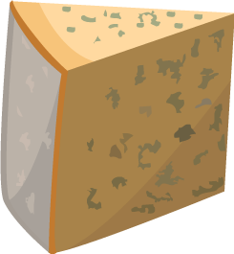



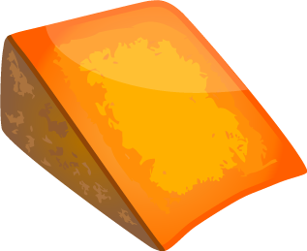

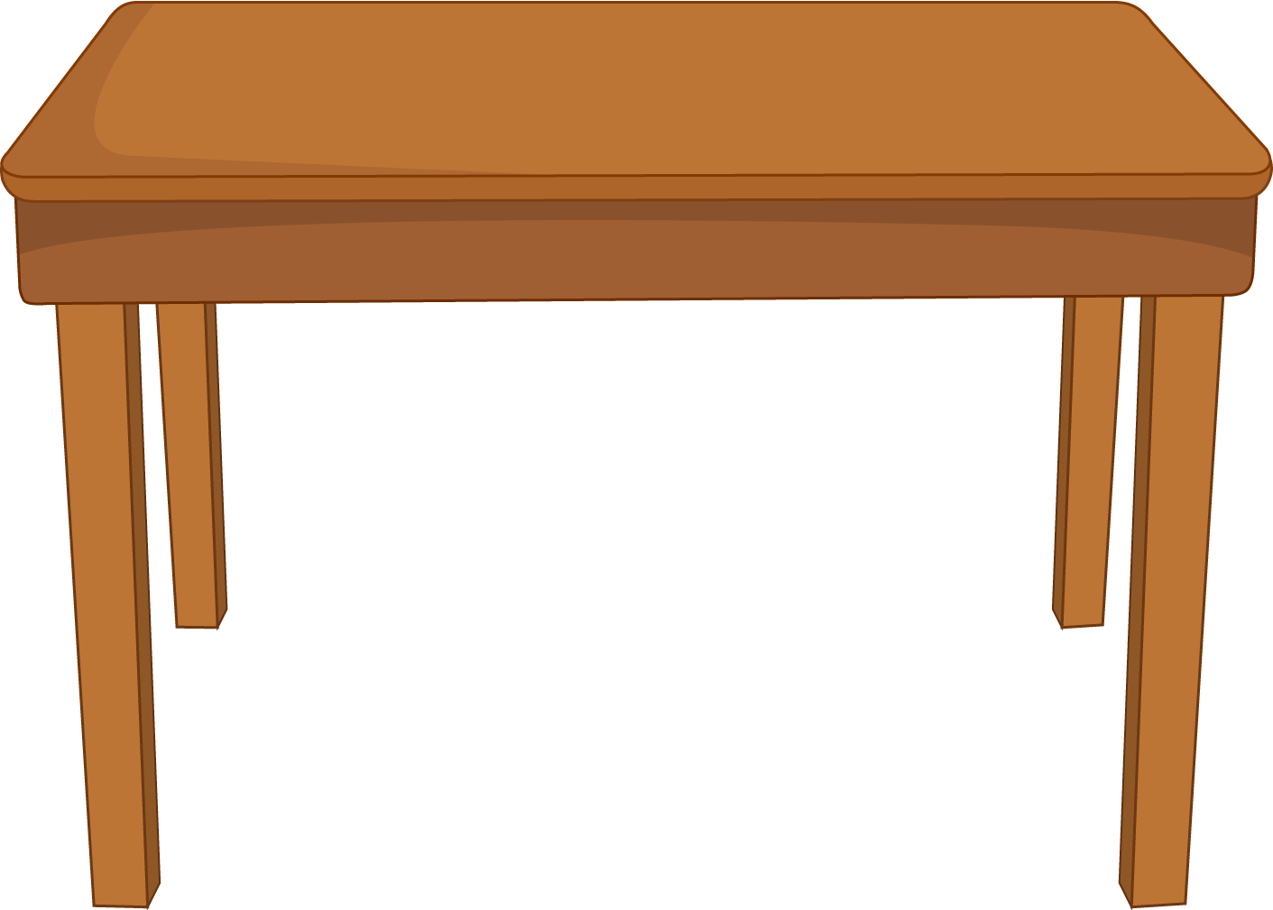

Mrs Jenkins took the children into the farm’s kitchen. She had an amazing selection of different food and drinks on display. The children peered over the foods, licking their lips.
“Can you tell me what all these foods have in common?” asked Mrs Jenkins.
On the table was milk, different flavoured yogurts and a colourful selection of cheese. The children looked puzzled.

Slide 14
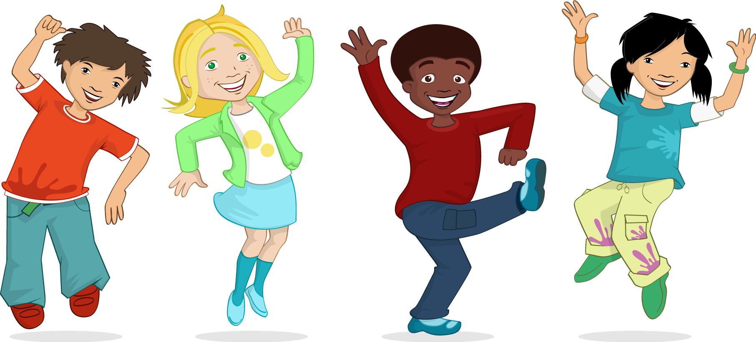



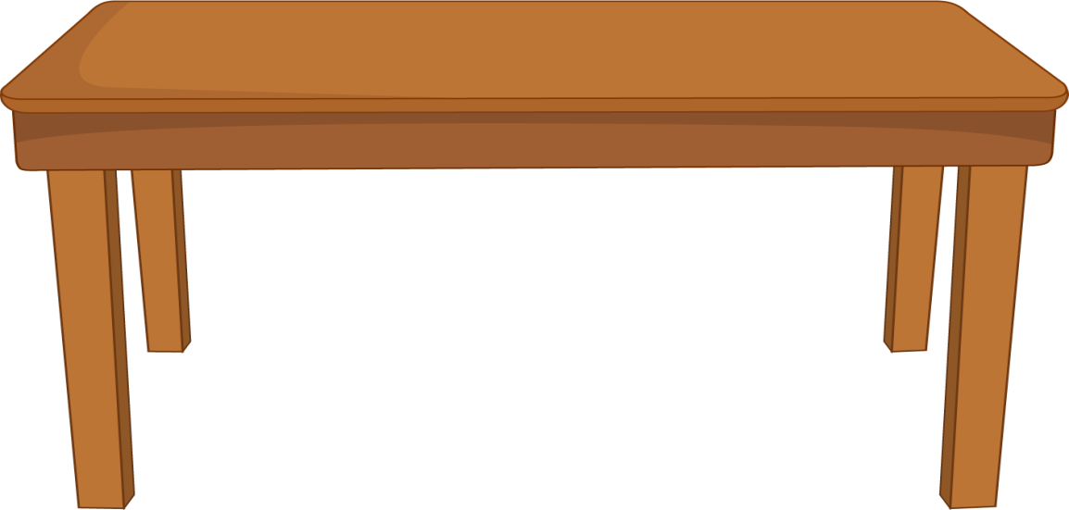
=
“Are they all made from milk?” asked Alisha. “Well done, that’s right,” said Mrs Jenkins, smiling.
Jordan couldn’t believe that his favourite food was made from milk. He was amazed! “So cheese comes from milk, and milk comes from cows,” Jordan announced confidently. “Correct!” said Mrs Jenkins.

Slide 15

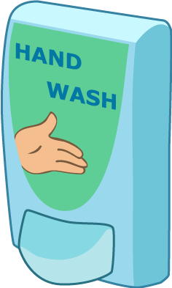

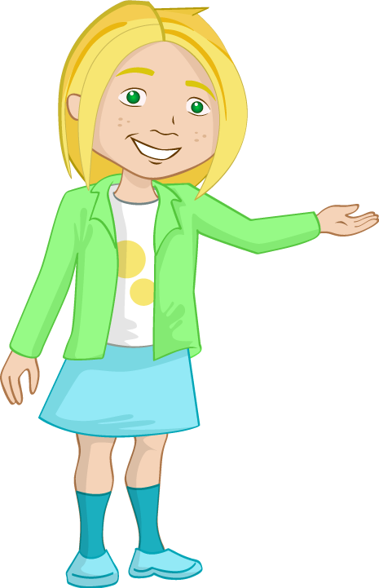
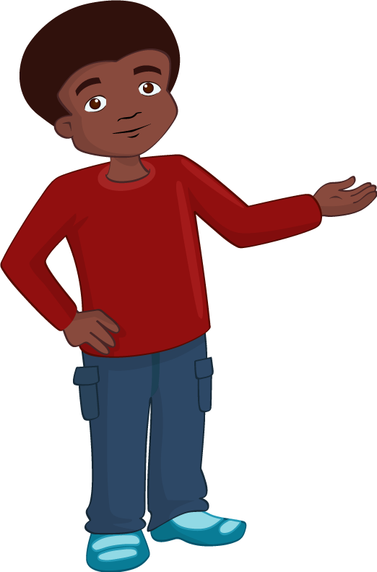
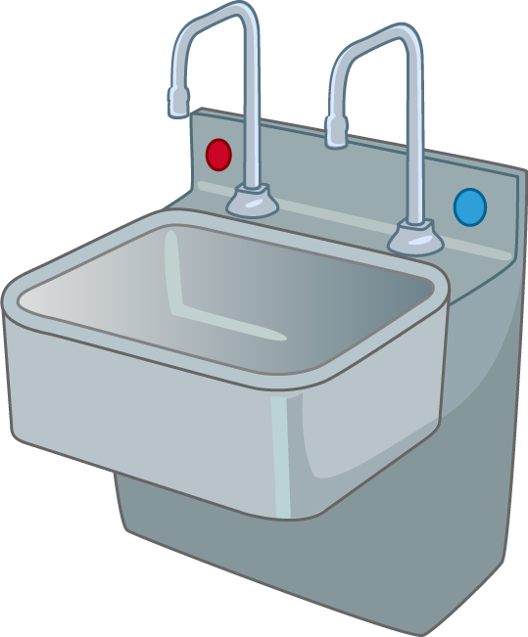
After a busy morning looking around the farm, it was time for lunch.
Mrs Jenkins led the children to a place where they could wash their hands.
She explain that it was very important to wash their hands properly as they had been touching animals and farm equipment.

Slide 16
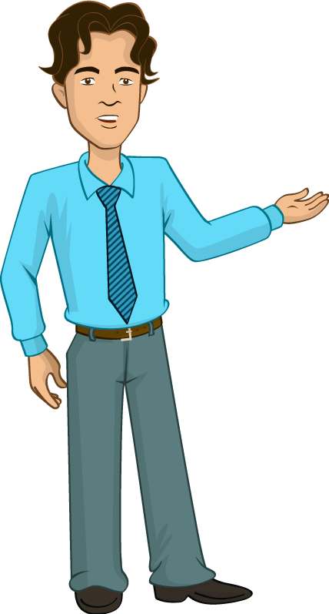
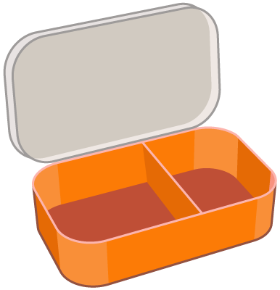

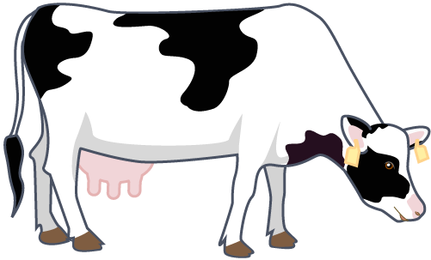

When they had all washed and dried their hands, Mrs Jenkins took them to the picnic area.
“Has anyone got any food made from milk in their lunchbox?” asked Mr Valdez.
Some children had milk to drink, some had cheese and some had yogurts.

Slide 17

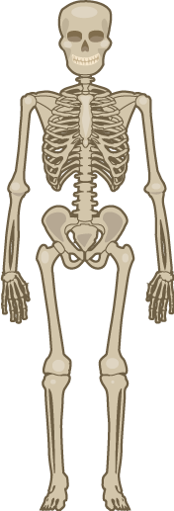
“Great! said Mr Valdez. “We need to eat some of these types of foods everyday to help us have strong bones and teeth”. “How do they help our bones and teeth?” asked Alisha.
Mr Valdez explained that it was the calcium found in milk and foods made from milk and that helped bones and teeth stay healthy.

Slide 18

Jordan looked at his nearly empty lunchbox.
“I had a cheese roll,” he said.
“Where is it?” asked Mr Valdez.
“I ate it on the coach for breakfast,” said Jordan, quietly.
“It’s really important to have a proper breakfast, Jordan,” said Mr Valdez. “You need to save your lunch for lunchtime.”

Slide 19
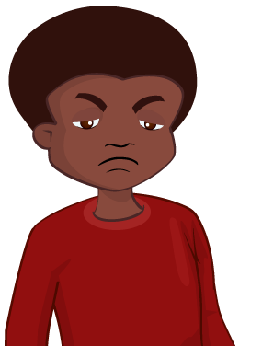
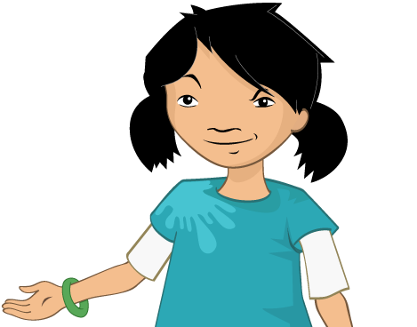
?
“That’s very true,” said Mrs Jenkins. “I always have a proper breakfast so I can get all my work done in the mornings without feeling tired or hungry.”
“I’ll make sure I do in the future,” said Jordan.
Alisha knew that Jordan was feeling hungry, but she did not want to hurt his feelings.
She wondered what she could do to help her friend.

Slide 20
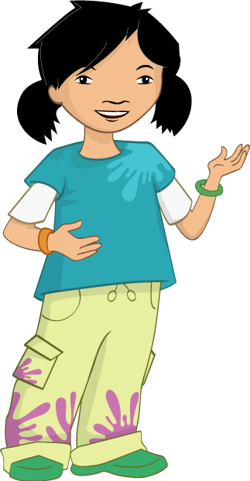

“Here,” said Alisha. “You can have one of my wraps for your lunch, I’ve got too many.”
“Thank you,” said Jordan, “are you sure you have enough for yourself?”

Slide 21
“It’s been really good learning about where milk comes from,” said Ronnie.
“I’d like to find out more interesting things about food and where it comes from,” suggested Nicola. “Me too!” said Jordan.
“Let’s start a club to investigate food!” proposed Alisha. “But what could we call ourselves…”
“The Food investigators!” they all said together.

Slide 22
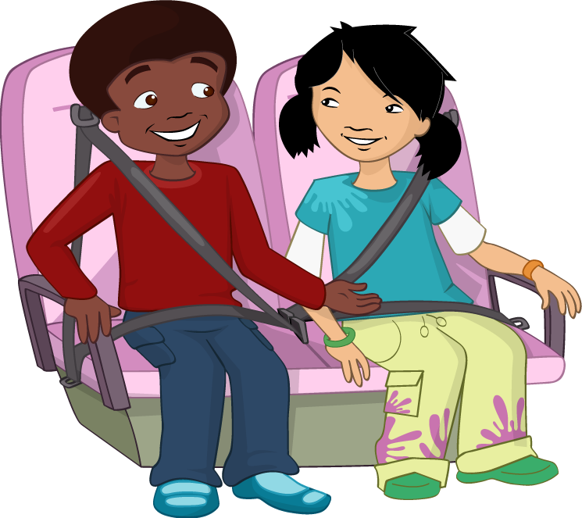
The class thanked Mrs Jenkins and walked back to the coach.
“So the cheese in my sandwich came from milk and the tomato came from a plant but where did the bread come from?” asked Jordan. Alisha rolled her eyes.
“I think that’s a question for another day,” sighed Mr Valdez.
Alisha looked at her 3 friends, “I think it’s a job for the Food investigators!” she said. They all grinned.

Slide 23
For further information, go to:
www.foodafactoflife.org.uk

