Slide 1

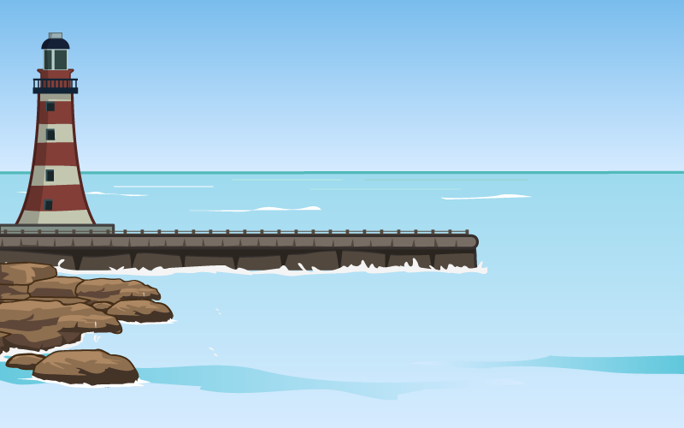
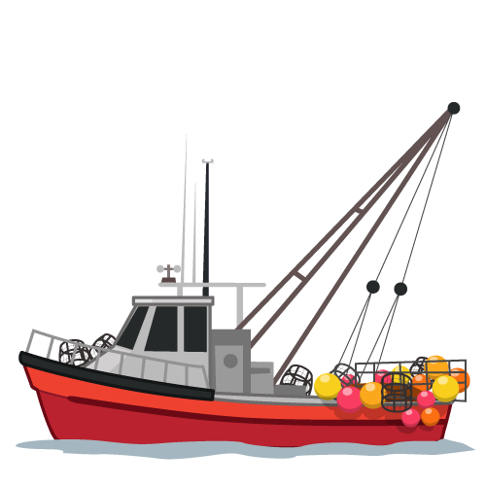
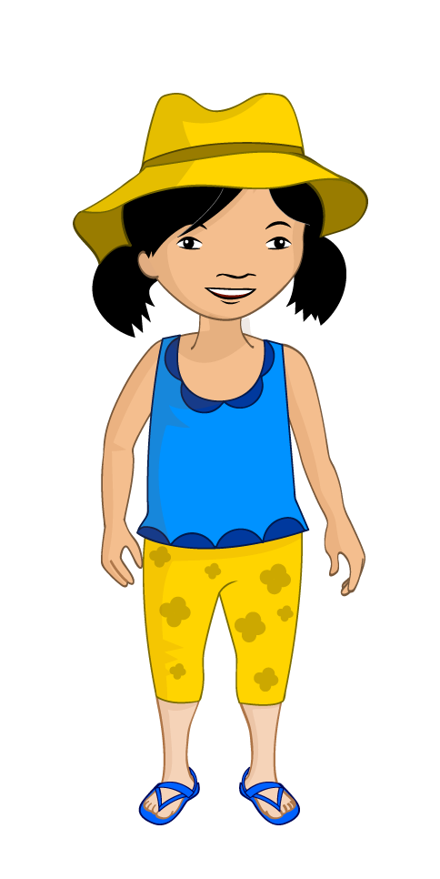
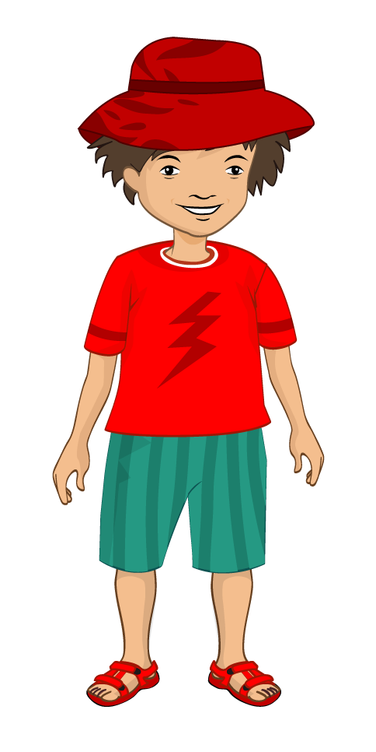
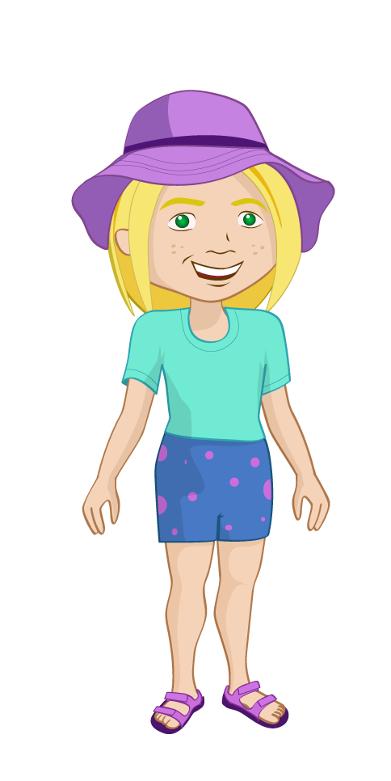
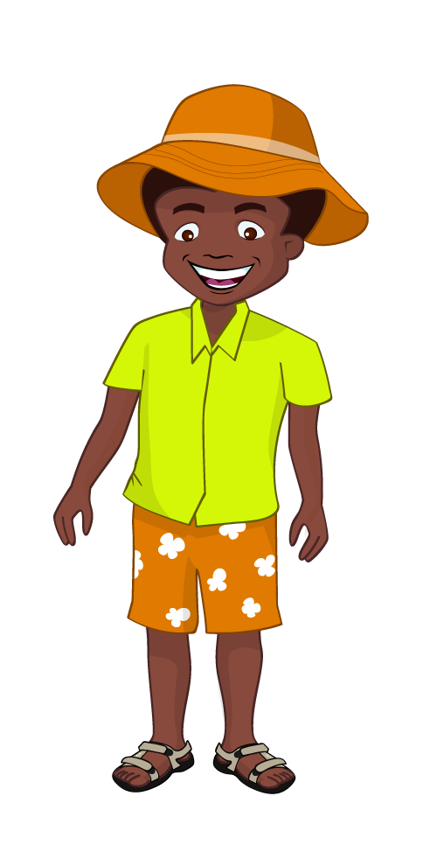


The bread stories
The seaside adventure

Slide 2

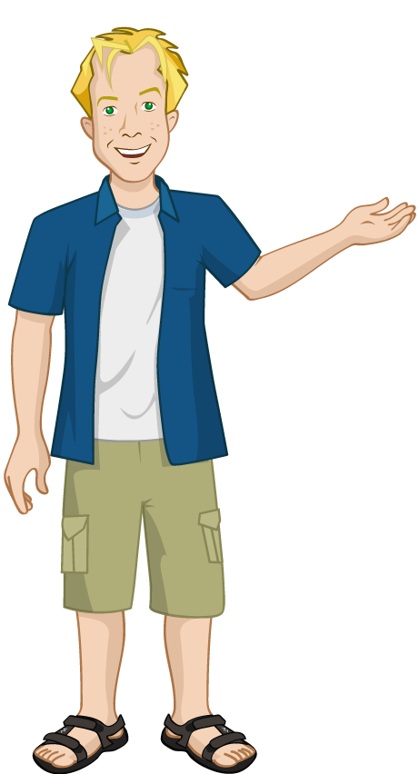
The seaside express
It was nearly the end of the summer holidays. Nicola’s dad took the Food Investigators for a trip to the seaside. The children were really excited as it had been a long time since they were at the beach because of the bad weather.

Slide 3
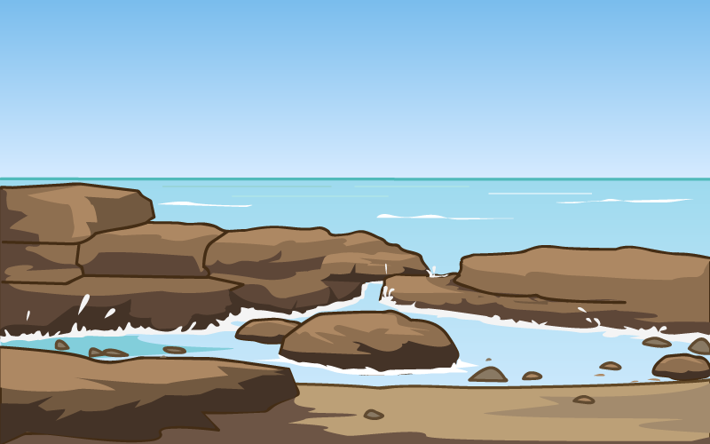


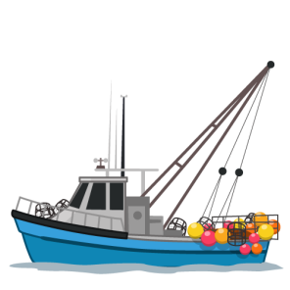
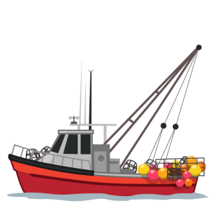
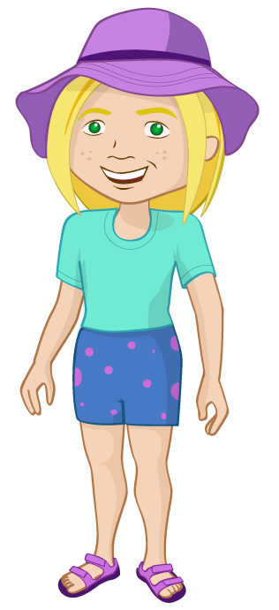
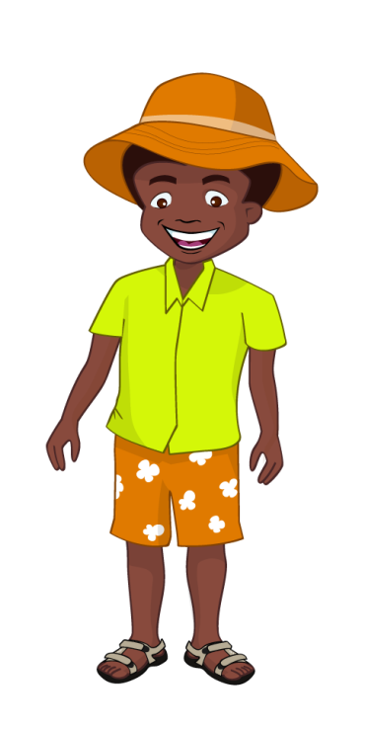









After arriving at the seaside, Nicola, Ronnie, Alisha and Jordan could not wait to go down to the beach. “Look,” Ronnie shouted, “There are tiny crabs crawling in and out of the rock pools!” The children went over and were amazed. Suddenly, the children noticed boats appearing on the horizon. “Those must be the fishermen arriving back from sea!” Nicola’s dad remarked. “Let’s go and have a look!” Alisha suggested enthusiastically.

Slide 4
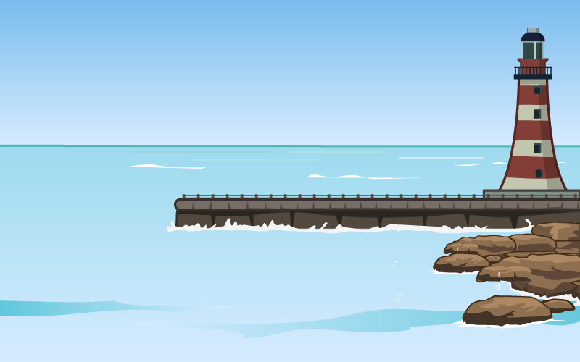
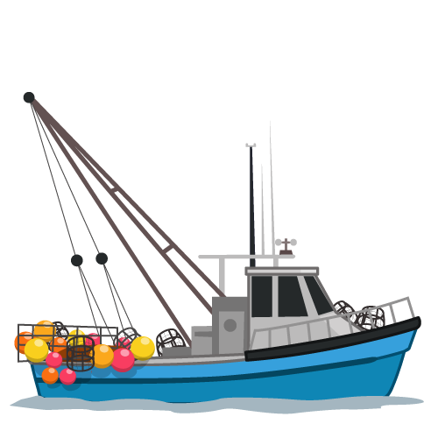
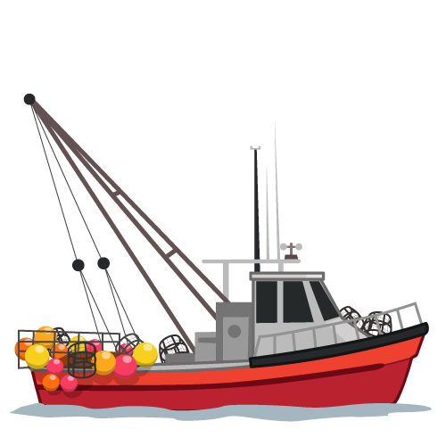



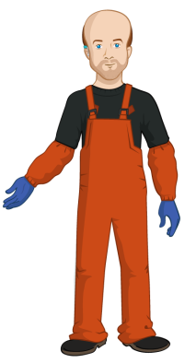
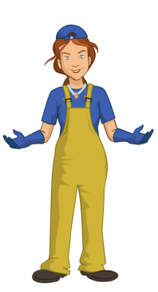
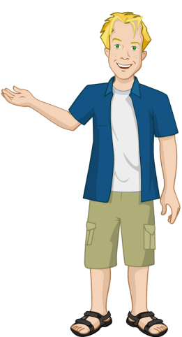
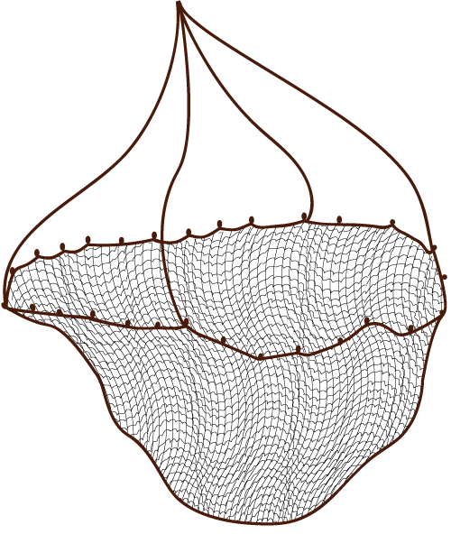


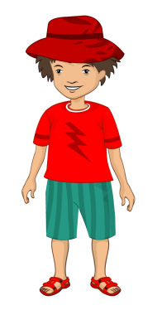
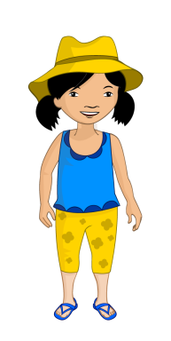



Skate’s
Skate’s
Nicola’s dad and the children went up to the harbour and saw lots of boats coming back from their morning catch. Nicola saw a familiar face. “Dad, isn’t that Mr Skate?” She said. Nicola’s dad looked at where Nicola was pointing and saw his old school friend Ray Skate, who fished locally.

Slide 5






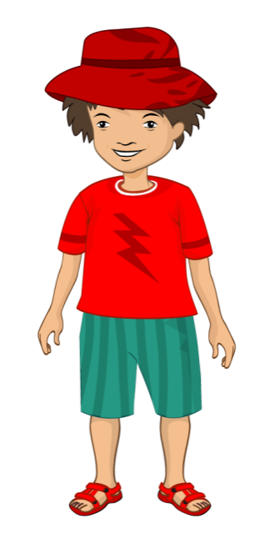

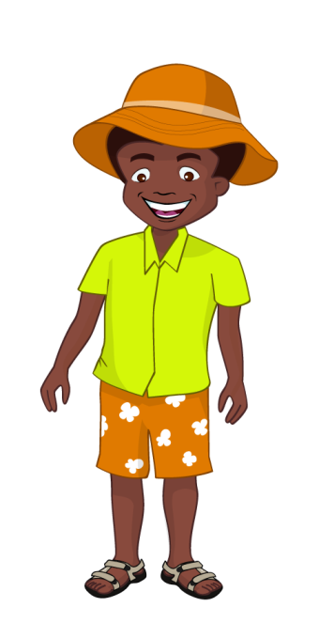



Skate’s
Skate’s
Nicola gave Mr Skate a hug. “Hello Nicola,” Mr Skate said cheerfully,“ It’s been a while since I last saw you! Glad you still remember me! Have you changed your mind about fish?” Nicola stuck her tongue out and made a funny face. Nicola’s dad said, “Of course not! I am still trying to convince her to eat fish. Perhaps you could help me!” Nicola didn’t like the smell of fish.

Slide 6
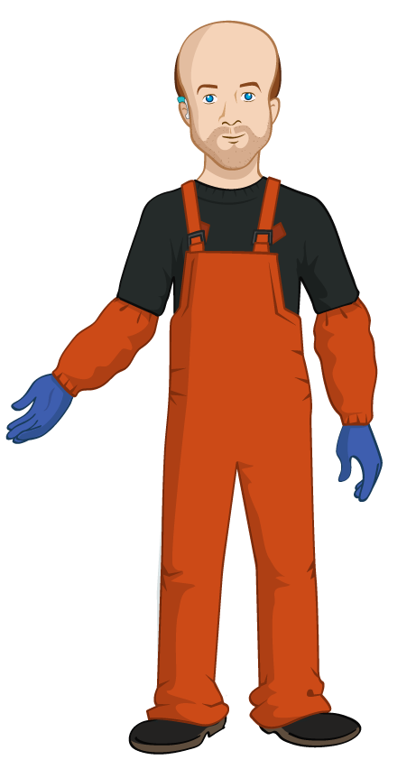

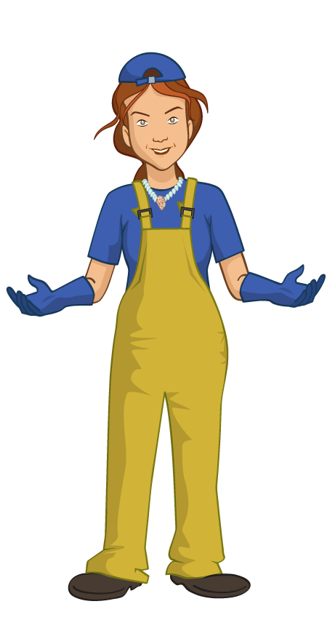


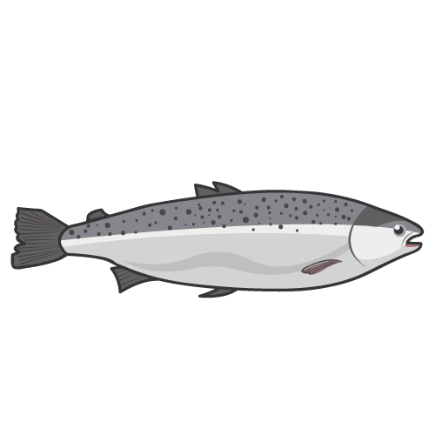
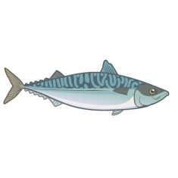
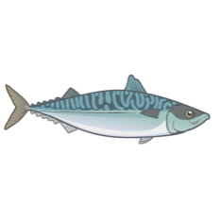
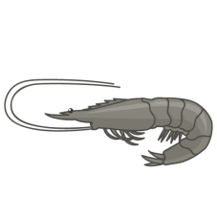
Skate’s
Skate’s
Mr Skate said hello to all the children and they introduced themselves as the Food Investigators. Alisha loved seafood and was interested to know more about what Mr Skate did. “What happens to all the fish you catch?” Alisha asked. “Ahh, well it goes to the market to be sold. Would you like to see the market?” said Mr Skate. “Oh yes please,” said Alisha.
“That would be great if it’s no trouble, Ray?” said Nicola’s dad.
“Of course not, follow me,” said Mr Skate. The children followed Mr Skate to the market and questioned him on the way!

Slide 7
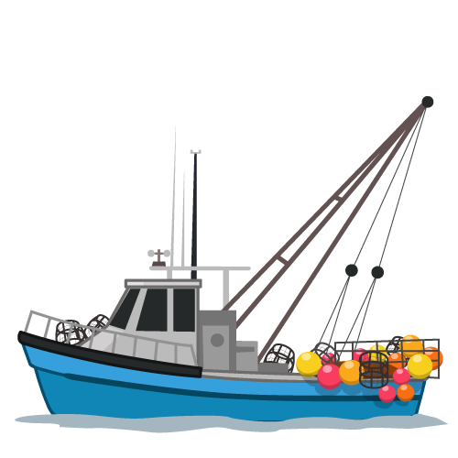



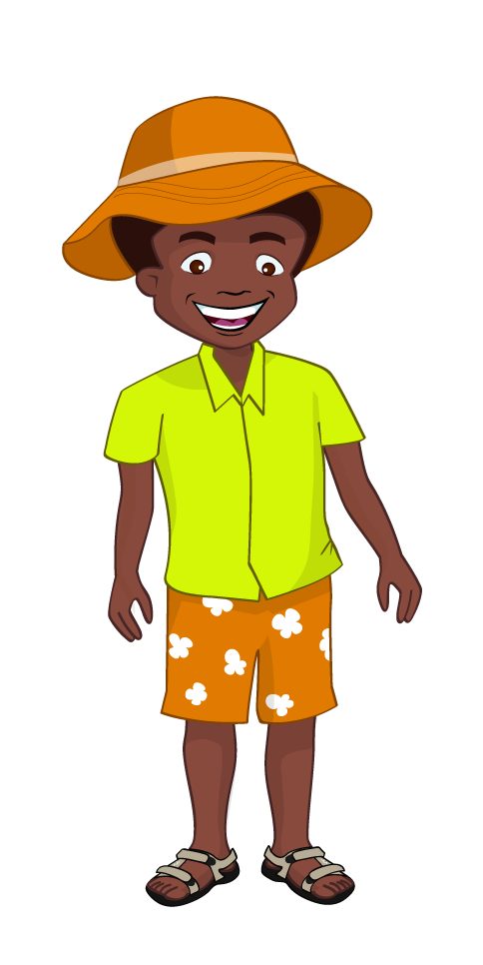

Skate’s
Skate’s
“How often do you go out to the sea?” Ronnie asked. Mr Skate replied, “As often as we can during the week, but sometimes the sea may be too rough for us. Safety is very important.” “Sounds so exciting! Maybe I can come along too!” said Jordan. Mr Skate smiled, “Our day starts very early, often before most of you wake up, so that we can catch fresh fish for the markets and shops.”

Slide 8





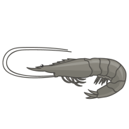
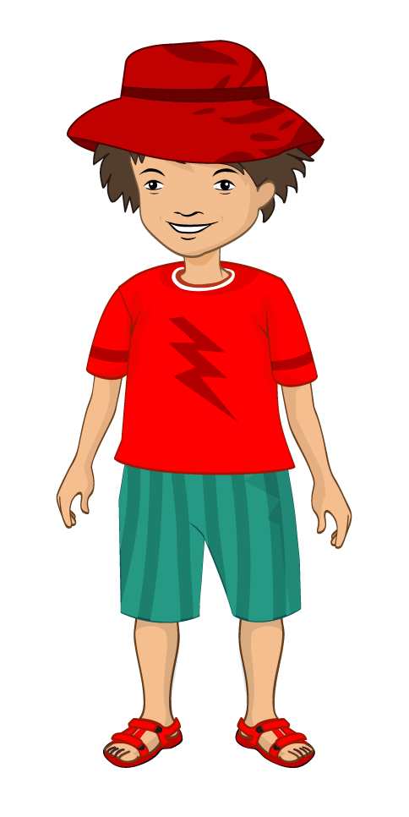


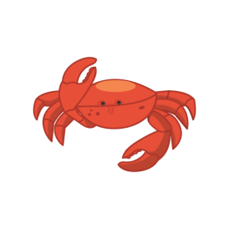

Skate’s
Skate’s
Skate’s
Skate’s
Skate’s
Skate’s
Skate’s
After a short walk, they arrived at the market. It looked like a big shed. The fishermen and helpers were taking boxes of fish they had caught into the market and stacking them up ready to be sold. “I have never seen so many different types of fish before!” said Jordan. Mr Skate chuckled and said, “There are plenty indeed, all from the sea.”

Slide 9



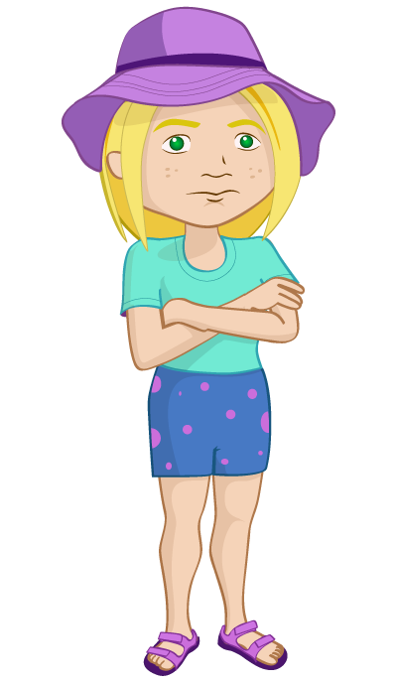
Skate’s
Skate’s
Skate’s
Skate’s
Skate’s
“What happens at the market?” Alisha asked. Mr Skate answered, “We sell the fish here at this market and then it goes to local shops and fish mongers. I actually own a fish mongers just down the road. Would you like to come along and have a look?”
The Food investigators looked at Nicola’s dad, “Sounds good, let’s go!” he said, smiling. Alisha, Ronnie and Jordan were excited. Nicola frowned.

Slide 10
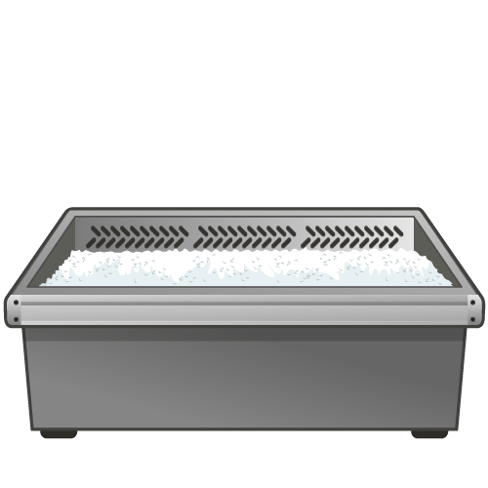
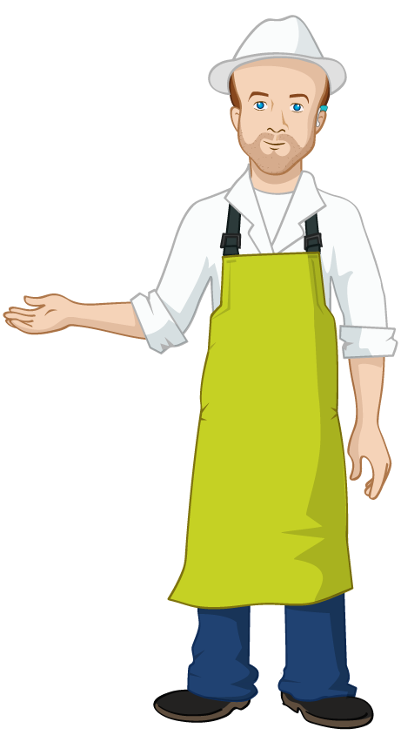
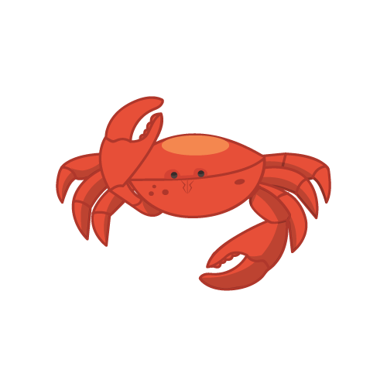
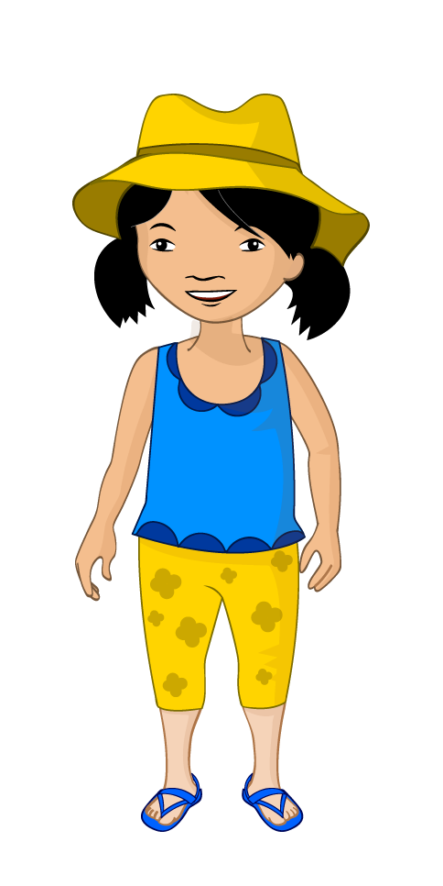



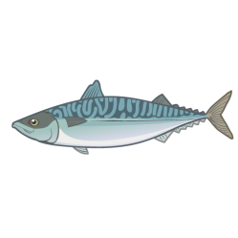


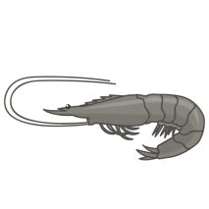

Salmon
Cod
Mussels
Crab
Mackerel
Haddock
Prawns
Squid
Skate’s
Mr Skate showed the children around the shop and the different types of fish he sold. They saw oily fish like salmon and mackerel , white fish like haddock and cod, as well as mussels , prawns and crabs! Ronnie pointed at the crabs and said, “We saw some of these at the beach this morning!” Mr Skate laughed. “These are different. We don’t normally eat the ones on the beach.”

Slide 11


Salmon
Cod
Mussels
Crab
Mackerel
Haddock
Prawns
Squid
Skate’s
Nicola asked, “Why are these fish lying on ice?” Mr Skate replied, “This is to keep them cool and fresh.”
Jordan said, “I have only seen fish in a can!”
Mr Skate remarked, “Yes, you can get fish which is canned or frozen but this is fresh fish. Tell me, what are your favourite fish dishes?”

Slide 12
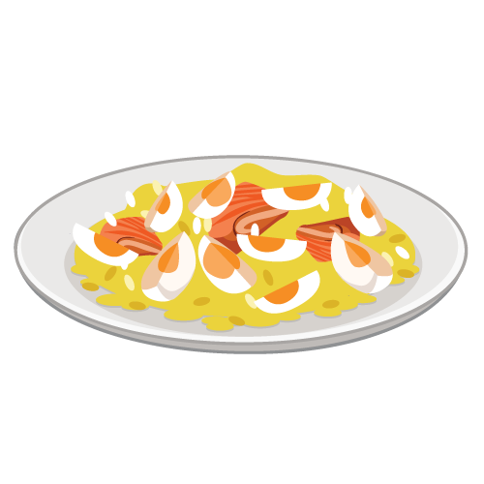
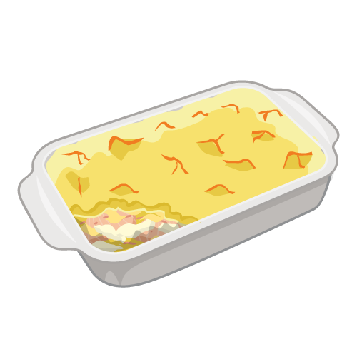
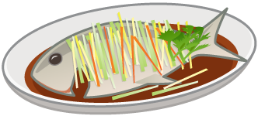
? ? ?
The children took turns to talk about their favourite recipes. Jordan said, “I love helping my gran to cook fish pie!” Ronnie followed, “Kedgeree tastes delicious! It’s a family favourite.” Alisha said, “My mum cooks the best steamed fish! It’s very healthy and delicious with rice. A very popular dish at our friend’s Chinese restaurant too!”
Of course, Nicola did not have a favourite fish dish and she felt very embarrassed!

Slide 13
Salmon
Cod
Mussels
Crab
Mackerel
Haddock
Prawns
Squid
Skate’s
Mr Skate said, “Very well children, are you hungry?” The children had been out the whole morning and it had been a while since they had breakfast. “Would you like to try some of our signature mini fishcakes?” Mr Skate asked. Alisha, Ronnie and Jordan all said “Yes!”
Nicola shook her head gently.

Slide 14
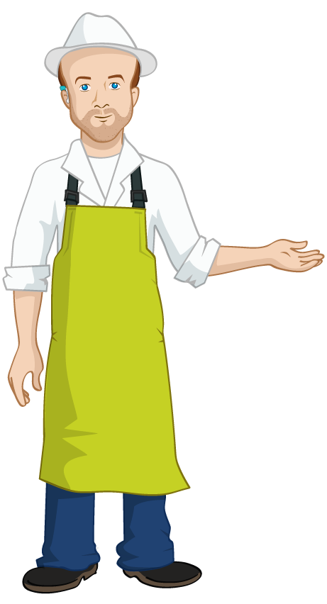
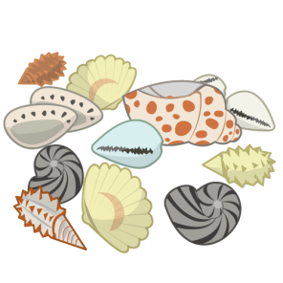

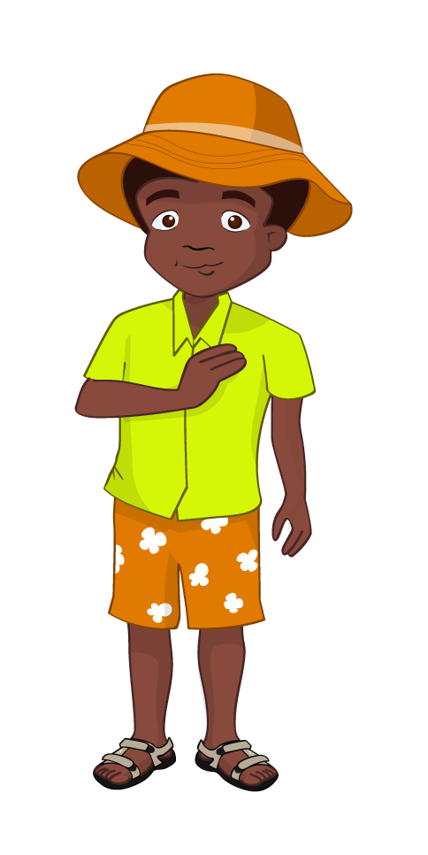
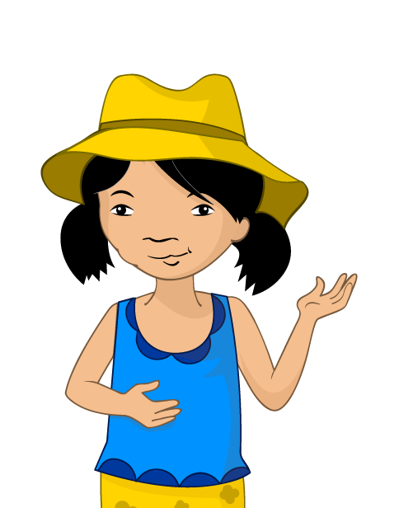
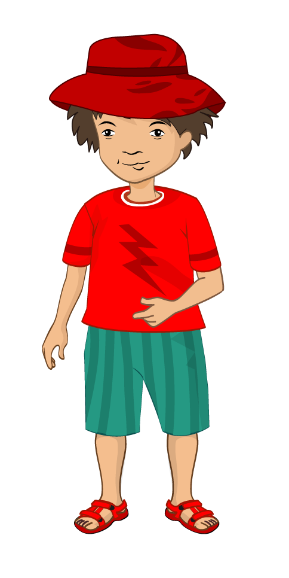

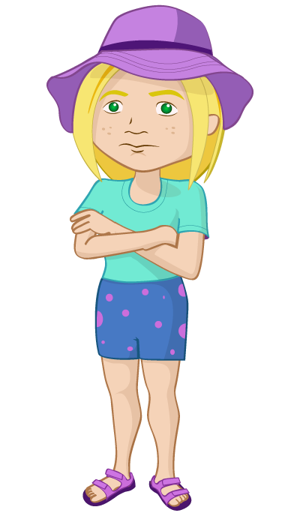




Skate’s
Mr Skate went inside the kitchen and cooked some fishcakes. “Wow!” said Alisha and laughed. “They are shaped like fish too!” Alisha, Ronnie, Jordan and Nicola’s dad each tried a mouthful.
“They are delicious!” they all said together. “Nicola, would you like to try some too?” Mr Skate asked.

Slide 15



Skate’s
After seeing how everyone else enjoyed the fishcakes, Nicola thought she may give it a go. “Yes please!” she said, and sampled her first bite. To her surprise, it tasted delicious! Nicola said, “Yum! Thank you, Mr Skate. I never knew fish cakes tasted so good.” “That’s why it’s always worth giving new foods a try!” Mr Skate said and winked.

Slide 16









Skate’s
It was time to go. “I’m afraid it’s time to head home!” said Nicola’s dad. The children and Nicola’s dad thanked Mr Skate for his time. It had been a great morning learning more about fish.

Slide 17

The seaside express
On their way back, Nicola’s dad asked the children to think about the different types of fish that could be used in cooking. They loved the challenge, well they were the Food Investigators!

Slide 18




“Let’s try to come up with a fish dish each! How about… sushi?” suggested Alisha. “Fish fingers!” yelled Jordan. “Tuna sandwiches!” shouted Ronnie. “How about seafood salad?” asked Nicola. Alisha, Ronnie and Jordan smiled and were surprised how Nicola had become interested in fish. “I never knew fish could be so tasty and I can’t wait to help Dad cook some more!” Nicola grinned.

Slide 19
The end.
For further information, go to:
www.foodafactoflife.org.uk

