Slide 1
Flour foods

Slide 2
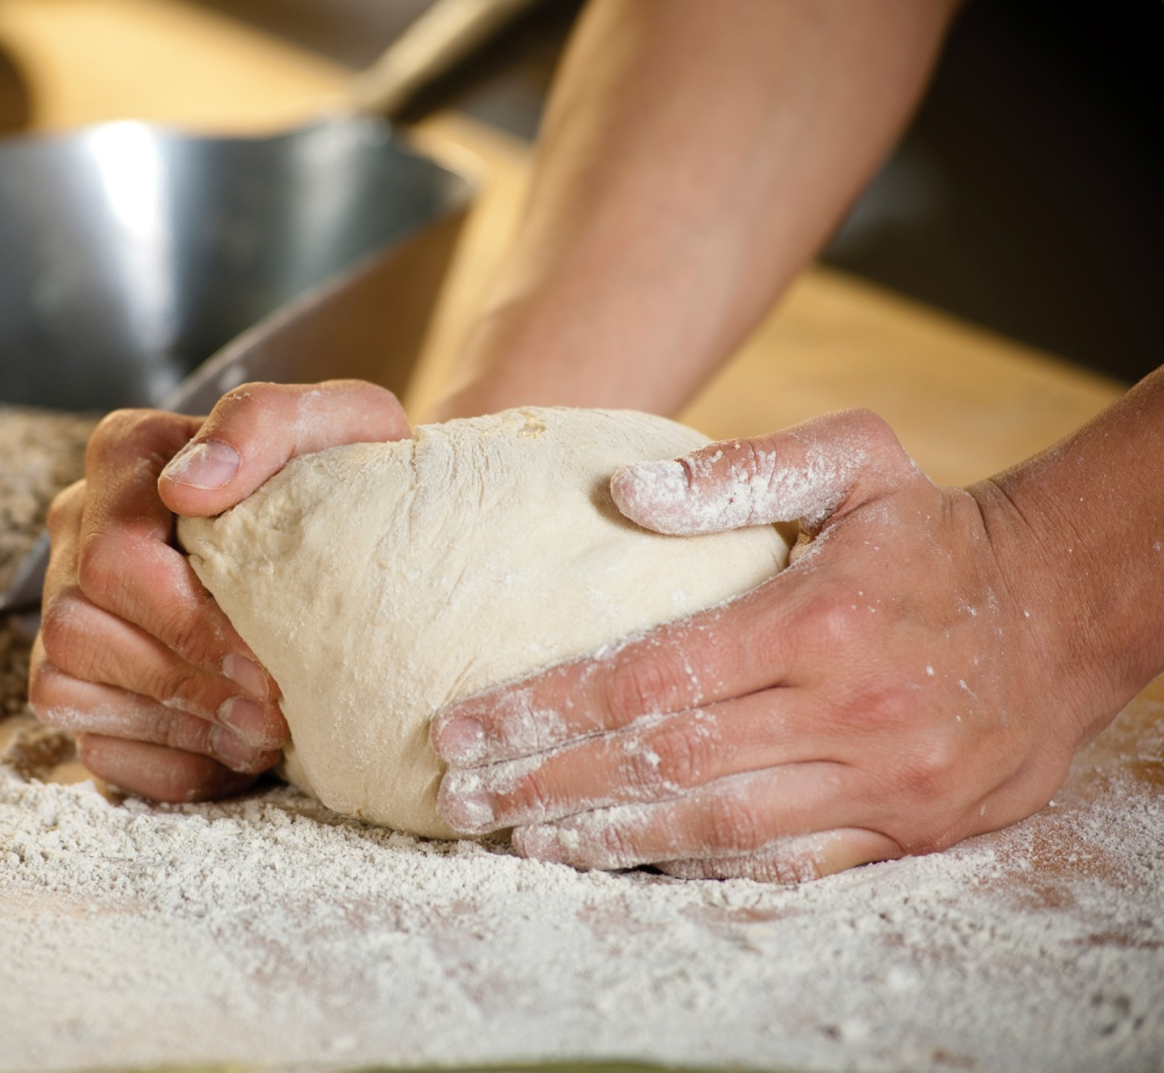
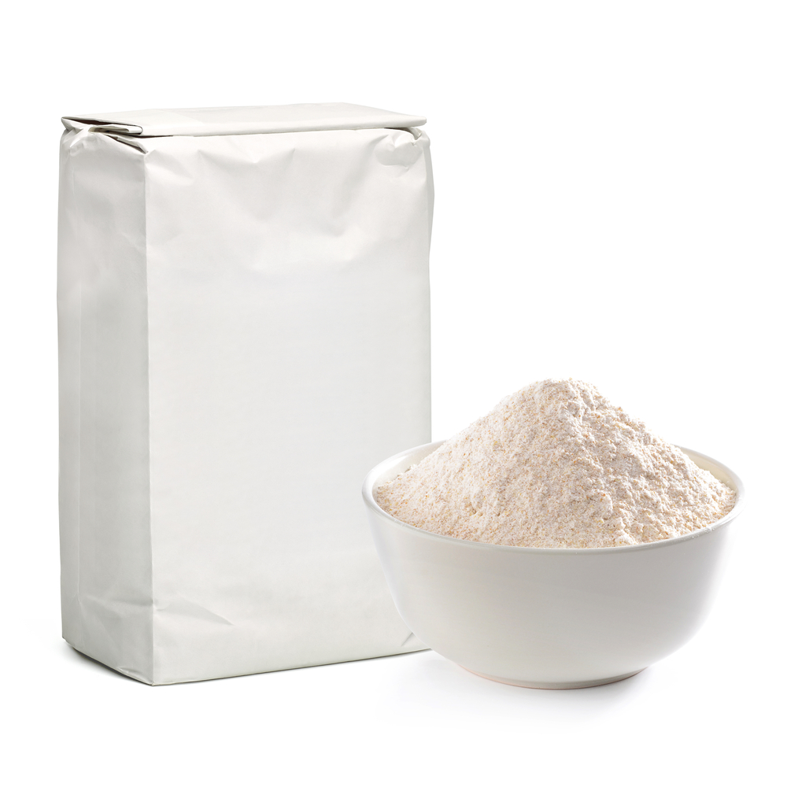
Flour can make lots of food
What food made from flour can you name?

Slide 3
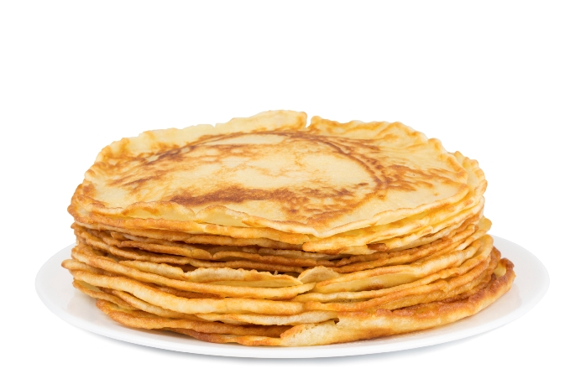
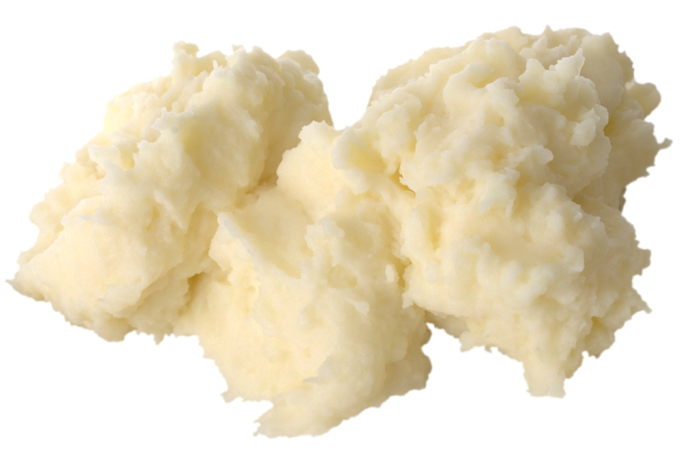
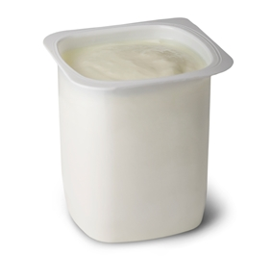
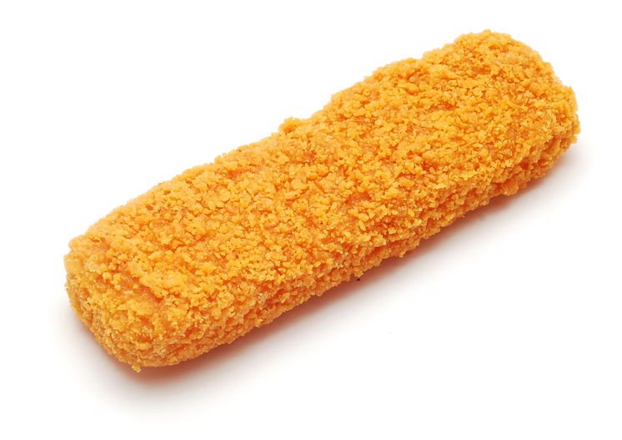
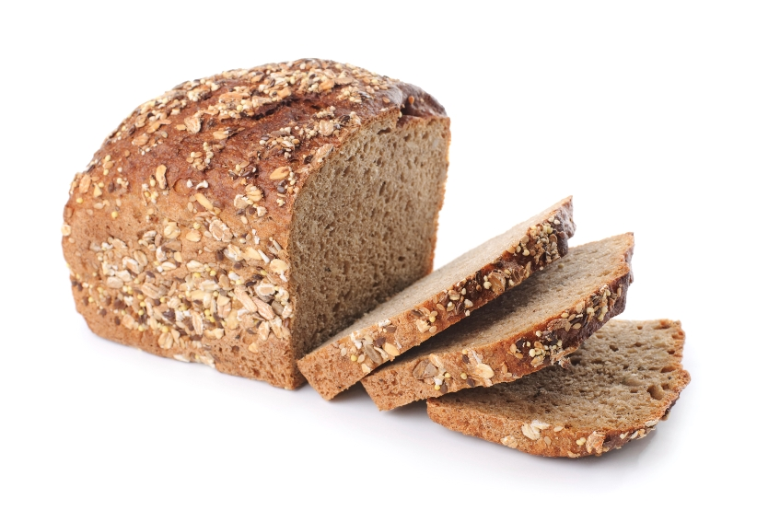
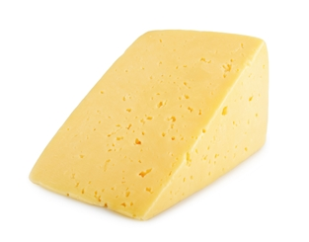
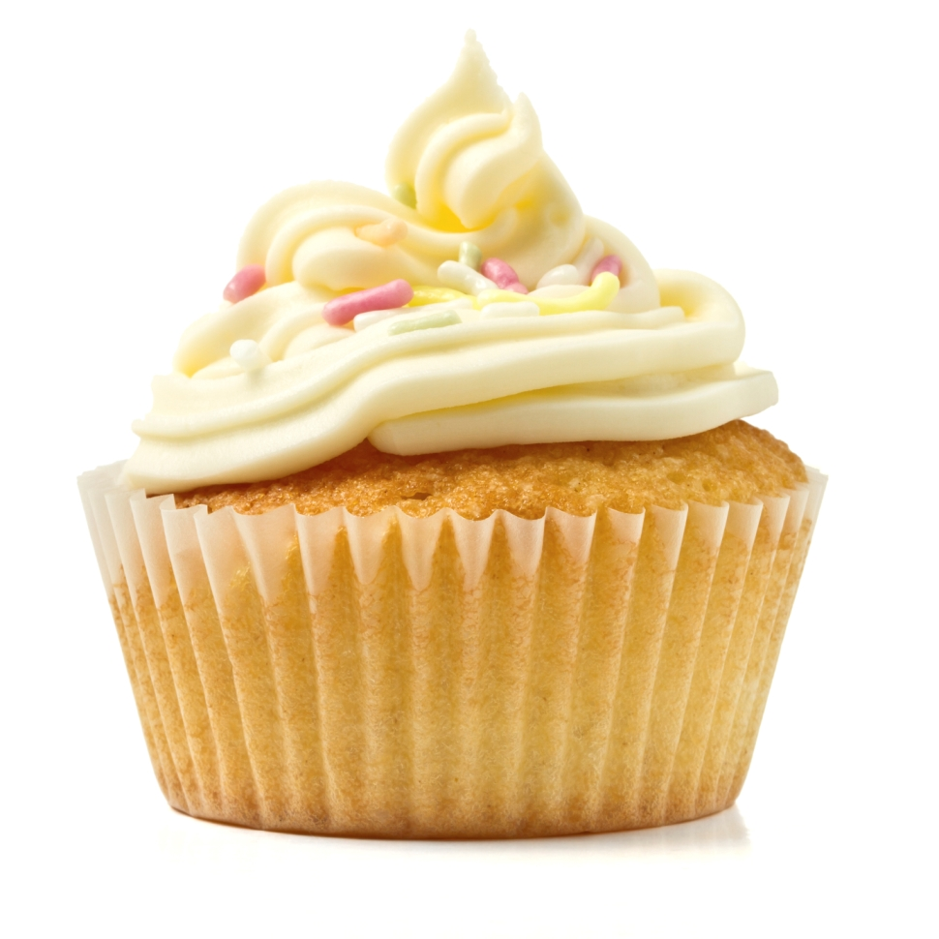
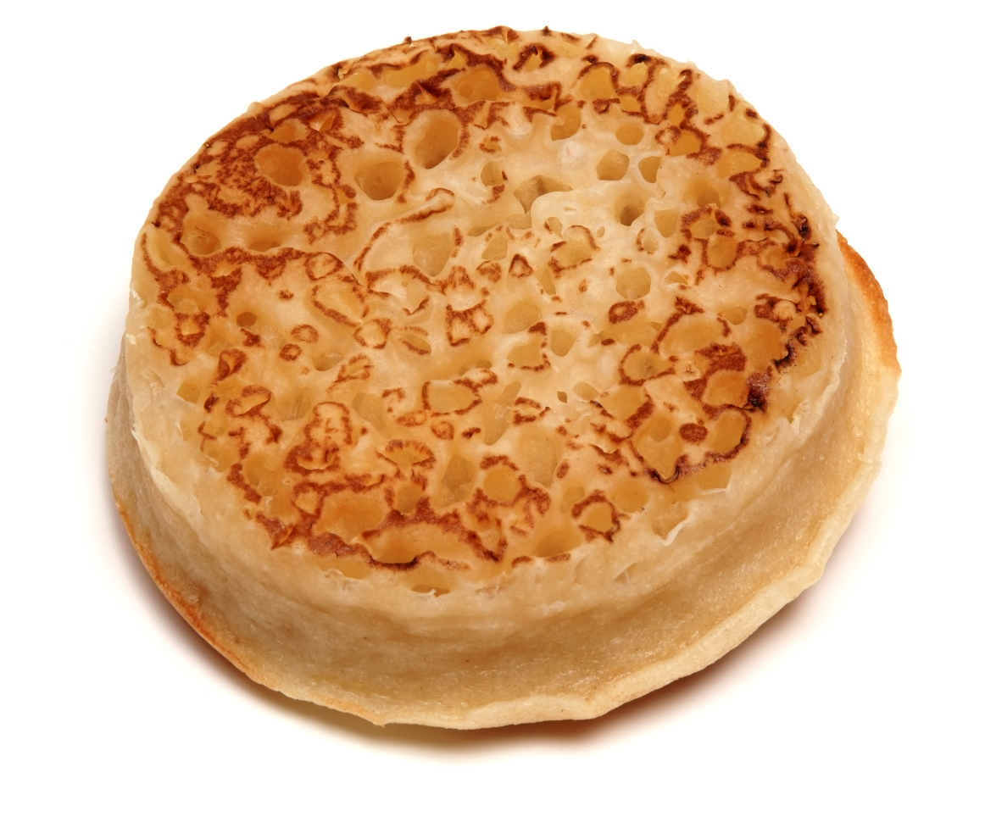
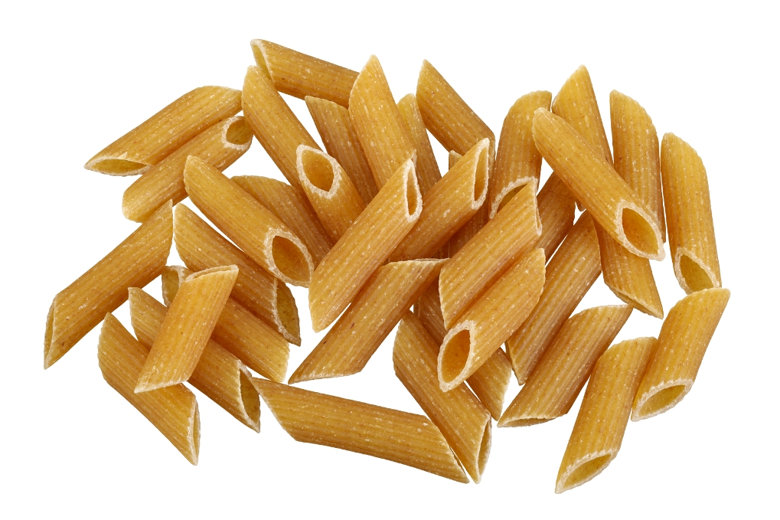
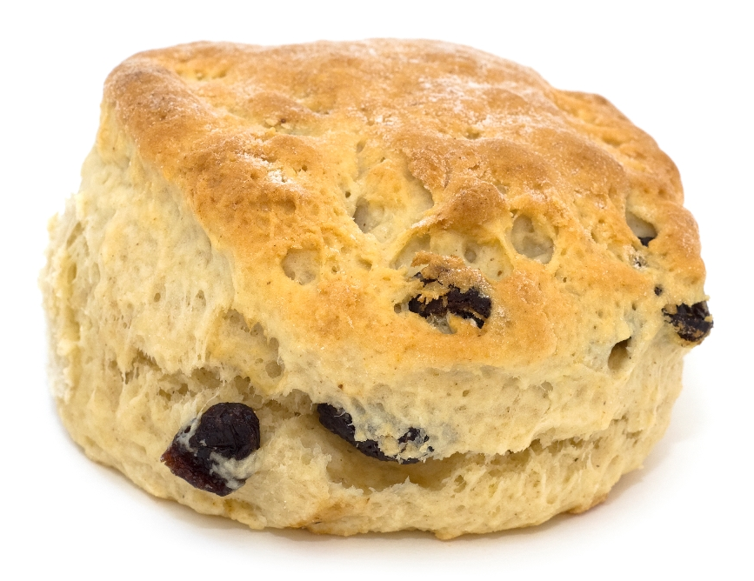
Made from flour?
Each time you see an image, say ‘yes’ if it is made with flour and ‘no’ if it is not!

Slide 4
What is this?
Bread
YES!
Is it made with flour?

Slide 5
What is this?
Pancakes
YES!
Are they made with flour?

Slide 6
What is this?
Yogurt
NO!
Is it made with flour?

Slide 7
What is this?
A cake
YES!
Is it made with flour?

Slide 8
What is this?
Pasta
YES!
Is it made with flour?

Slide 9
What is this?
Mashed potato
No!
Is it made with flour?

Slide 10
What is this?
A scone
YES!
Is it made with flour?

Slide 11
What is this?
A fish finger
Yes! Did you know that to make a fish finger, you dip fish in flour, beaten egg and then bread crumbs?
YES!
Is it made with flour?

Slide 12
What is this?
Cheese
NO!
Is it made with flour?

Slide 13
What is this?
A crumpet
YES!
Is it made with flour?

Slide 14
For further information, go to:
www.foodafactoflife.org.uk

