Slide 1
Grains

Slide 2
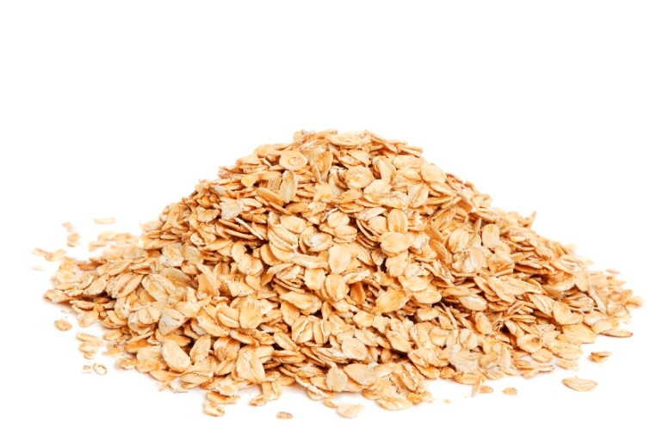
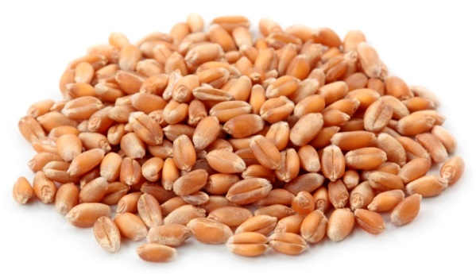
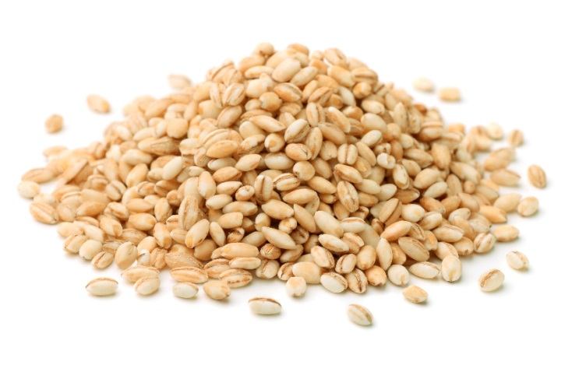
Grains
Do you know what each of these grains is called?

Slide 3
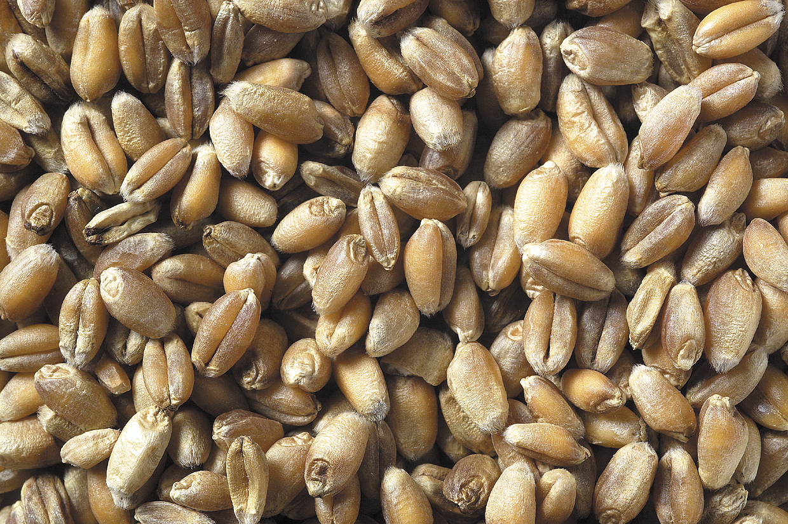
Wheat grains
What do they look like?

Slide 4
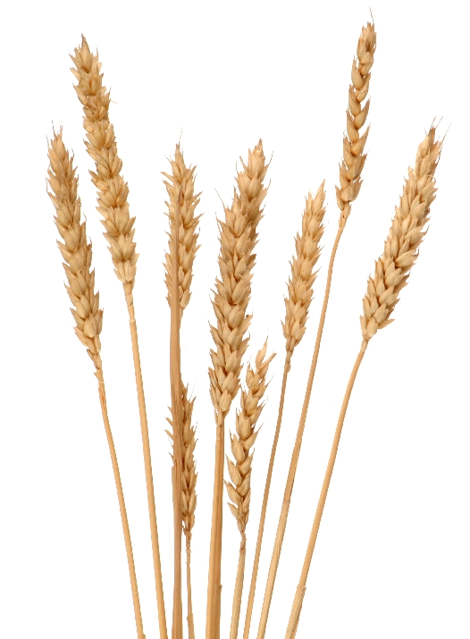
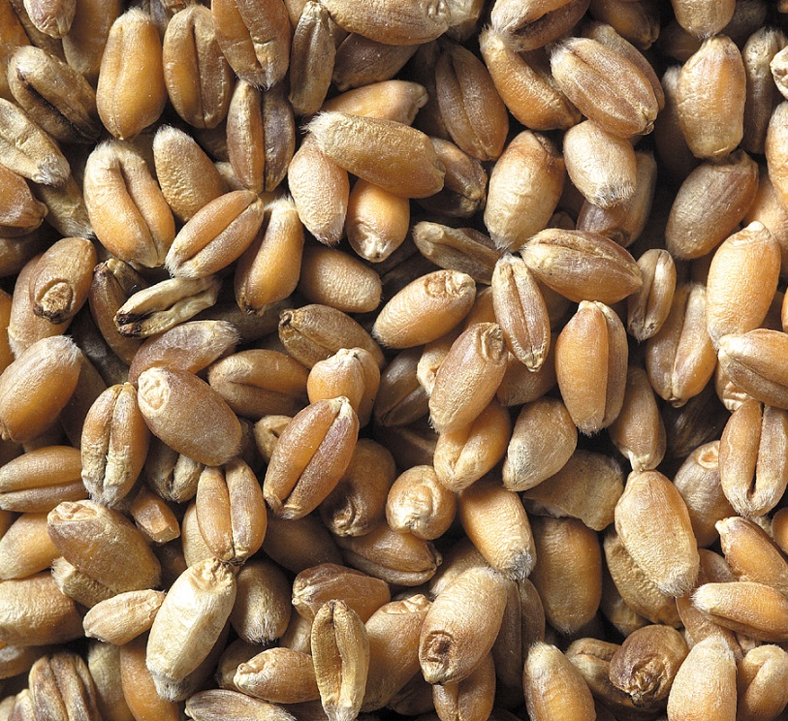
Where do wheat grains come from?
The grains are in the ears of the wheat plant.

Slide 5
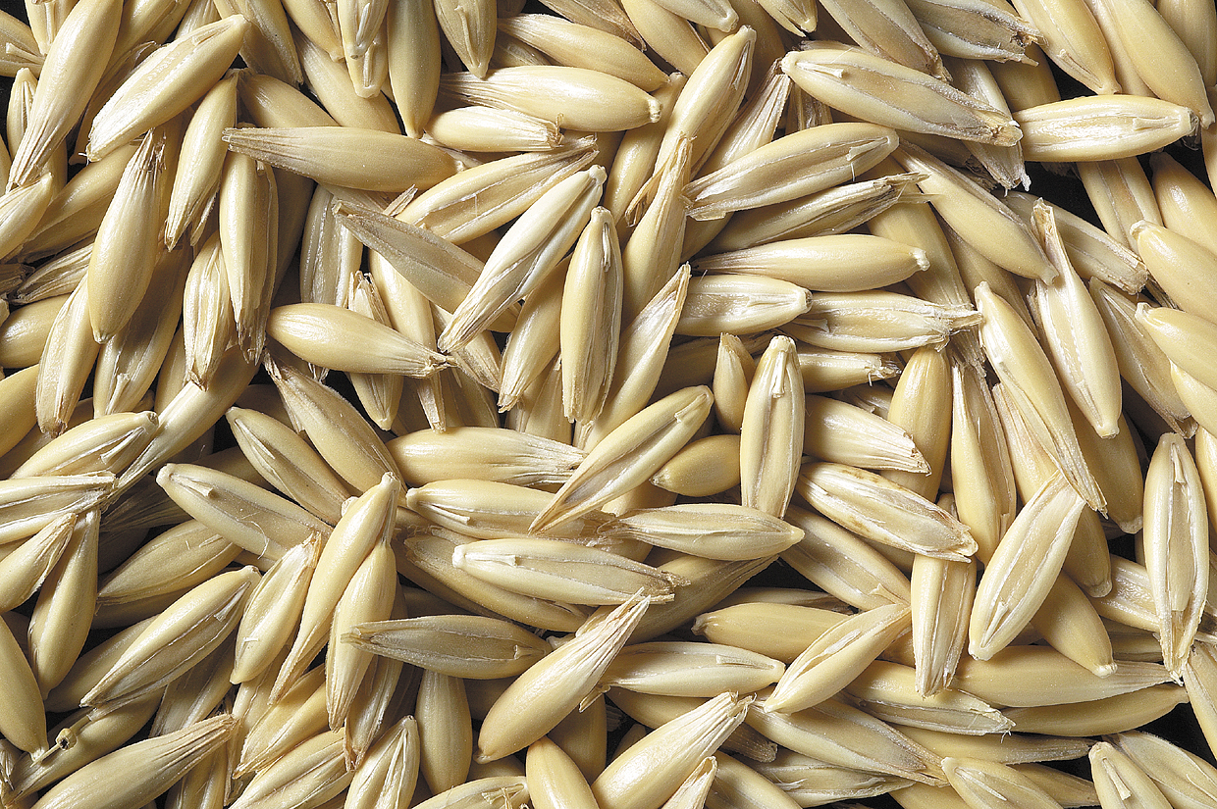
Oats
What do they look like?

Slide 6
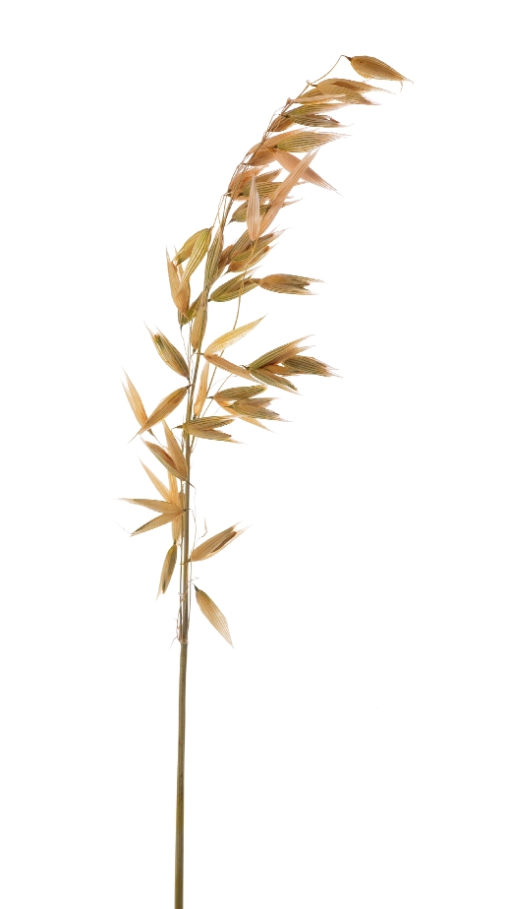
Where do oat grains come from?
The grains are in the ears of the oat plant.

Slide 7
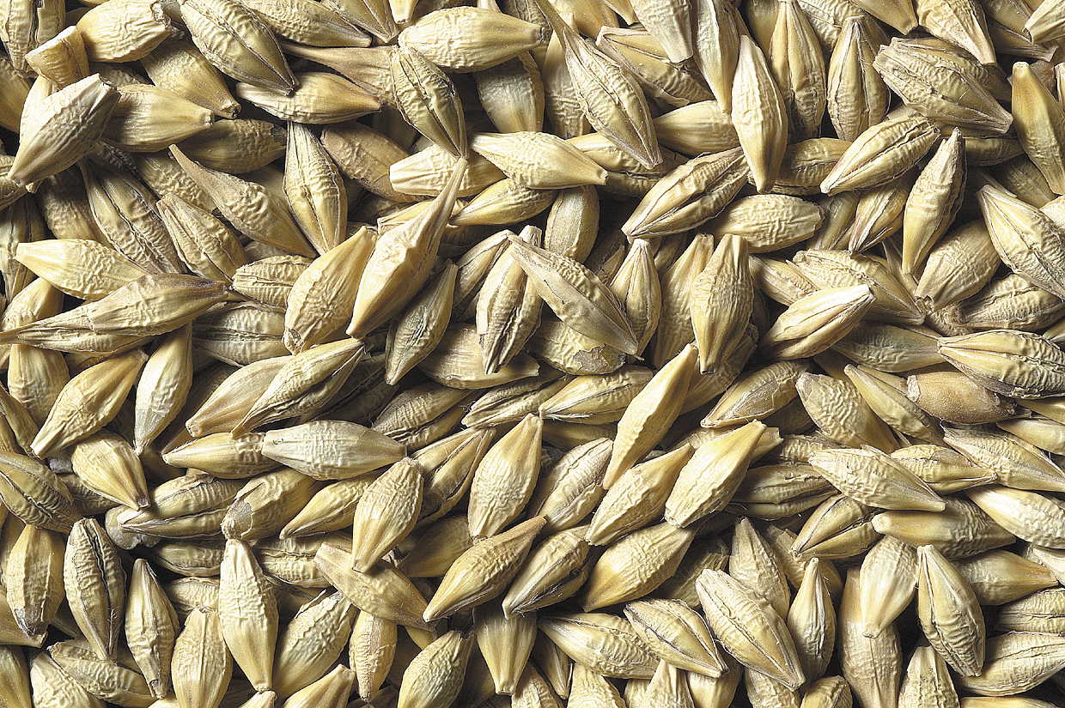
Barley
What do they look like?

Slide 8
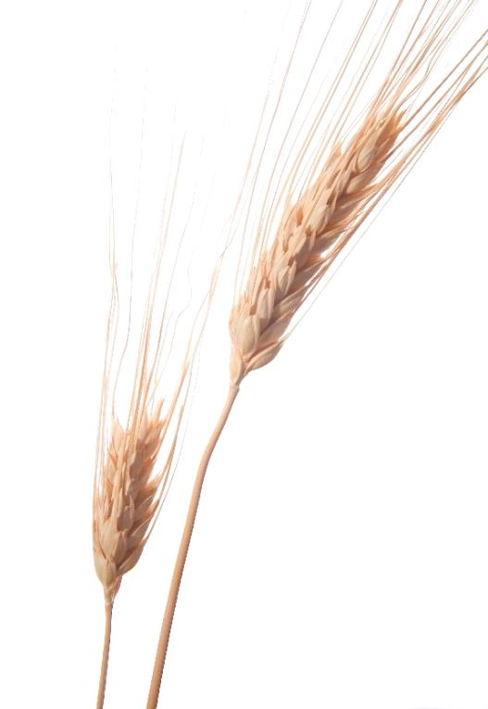
Where do barley grains come from?
The grains are in the ears of the barley plant.

Slide 9
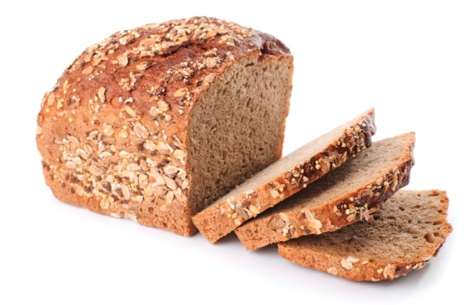
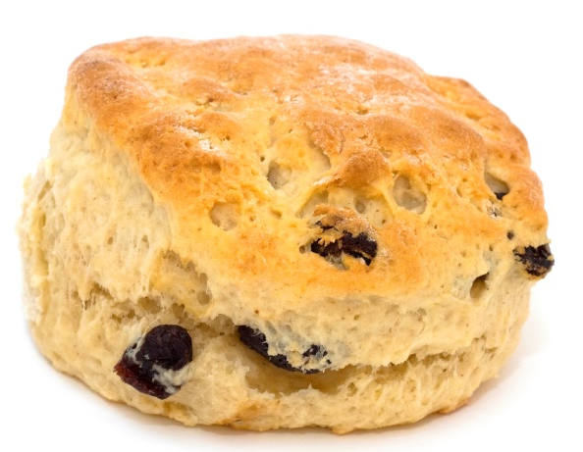
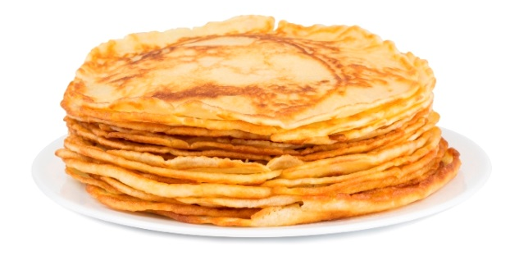
What foods are made from wheat?
Bread
Scones
Pancakes

Slide 10
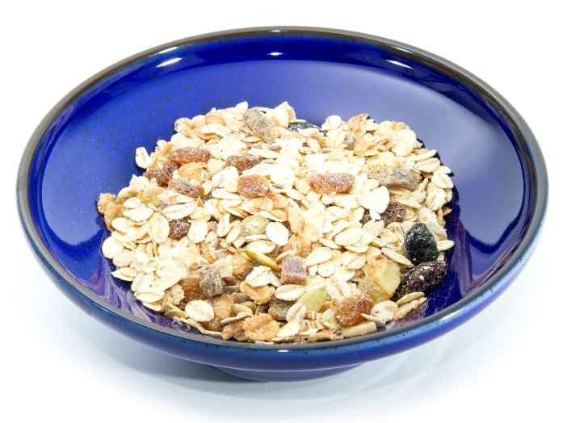
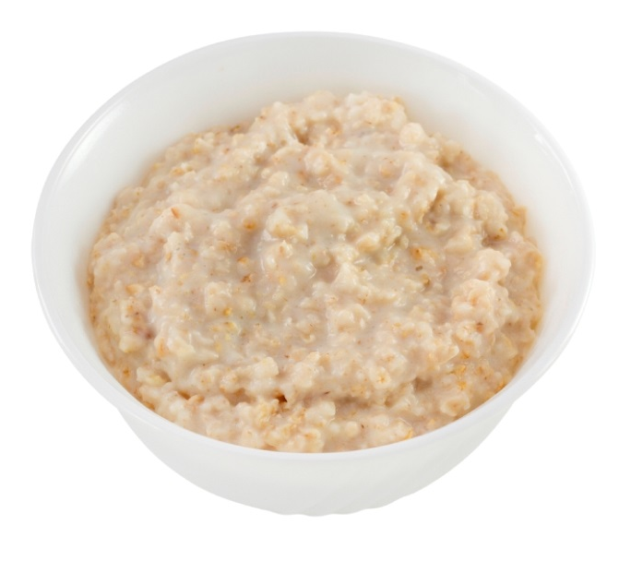
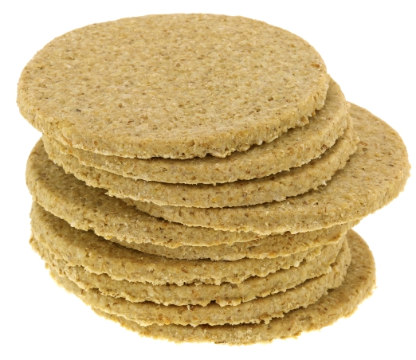
What foods are made from oats?
Porridge
Oat cakes
Muesli

Slide 11
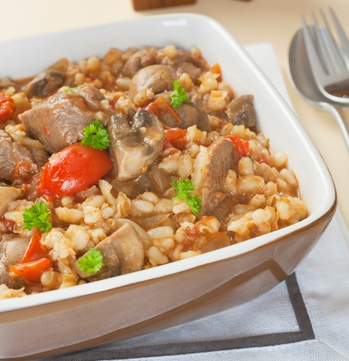
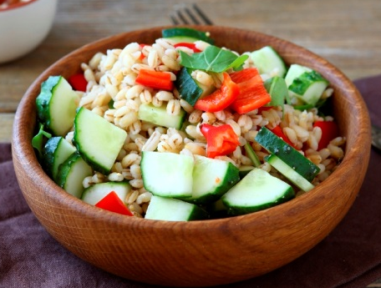
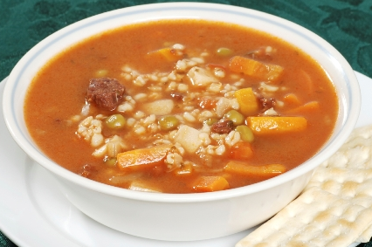
What foods are made from barley?
Stew
Salad
Soup

Slide 12
For further information, go to:
www.foodafactoflife.org.uk

