Slide 1
Out of home calorie labelling

Slide 2

Programmes in place to reduce obesity and poor health
Childhood Obesity Plan – includes introducing a soft drinks industry levy and taking out 20% of sugar in products (reformulation).
Sugar Tax - a tax on sugar-containing soft drinks came in from April 2018 across the UK with the levy invested in programmes to reduce obesity.
The draft report of the SACN (Scientific Advisory Committee on Nutrition) report on saturated fat and health is now out.
Results from the past year of the sugar reduction programme have been released.

Slide 3
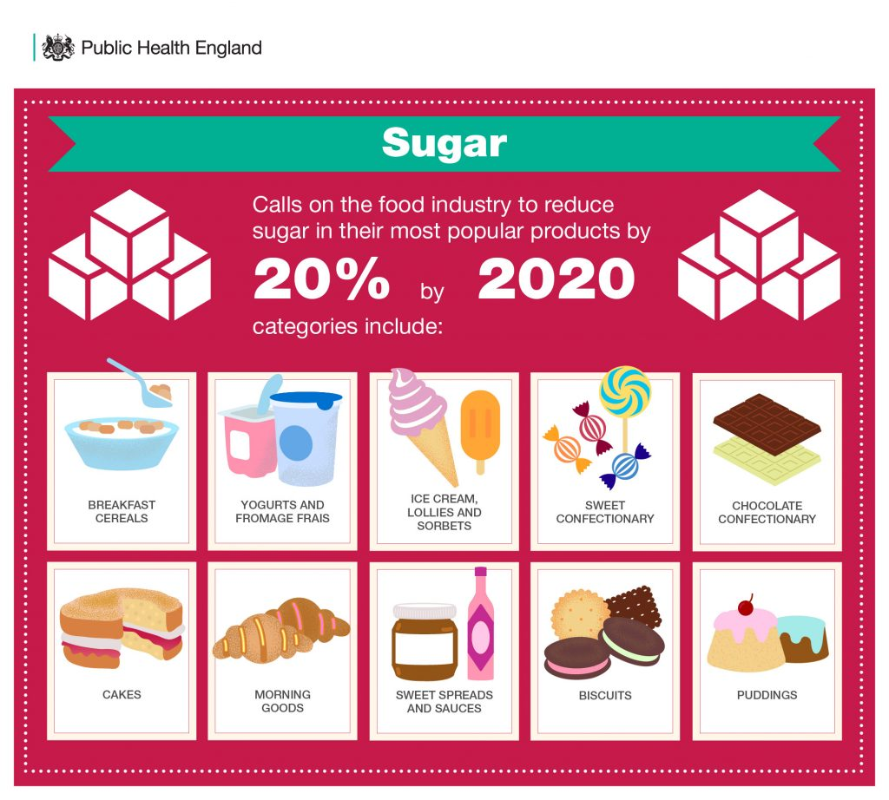
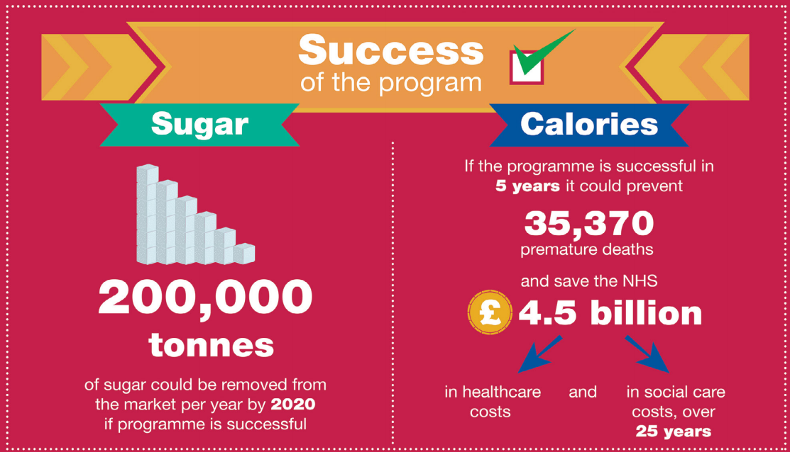
Sugar reduction programme
In the first year of this work (August 2016 – August 2017), there have been;
Reductions in sugar levels in 5 of the 8 categories targeted.
3 of the categories meeting or exceeding the initial 5% ambition set for the first year

Slide 4
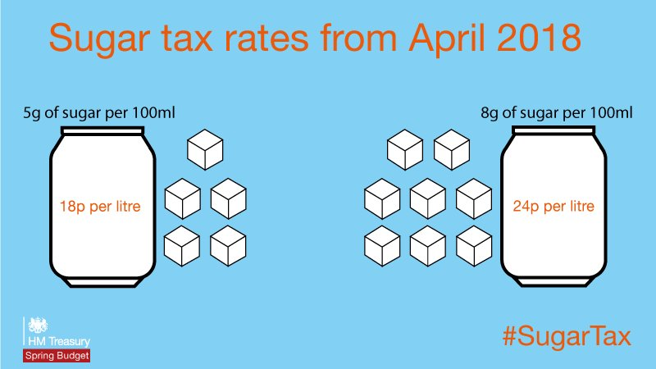
Sugar tax (Soft Drinks Industry Levy)
The Soft Drinks Industry Levy has seen:
sugar in the levied drinks reduced by 11%;
average calories per portion reduced by 6%;
a shift in volume sales towards lower sugar drinks (below 5g per 100ml) which are not subjected to the levy.

Slide 5



Calorie reduction programme
Estimates of the excess calories consumed by overweight and obese children and adults of different ages.
Plans for a programme of work with the food industry to reduce calories by 20% by 2024, in 15 savoury food categories using reformulation and/or reductions in portion sizes.
The launch of the One You campaign, Know your numbers, giving ‘a rule of thumb’ for adults on the calories to consume at main meals.

Slide 6
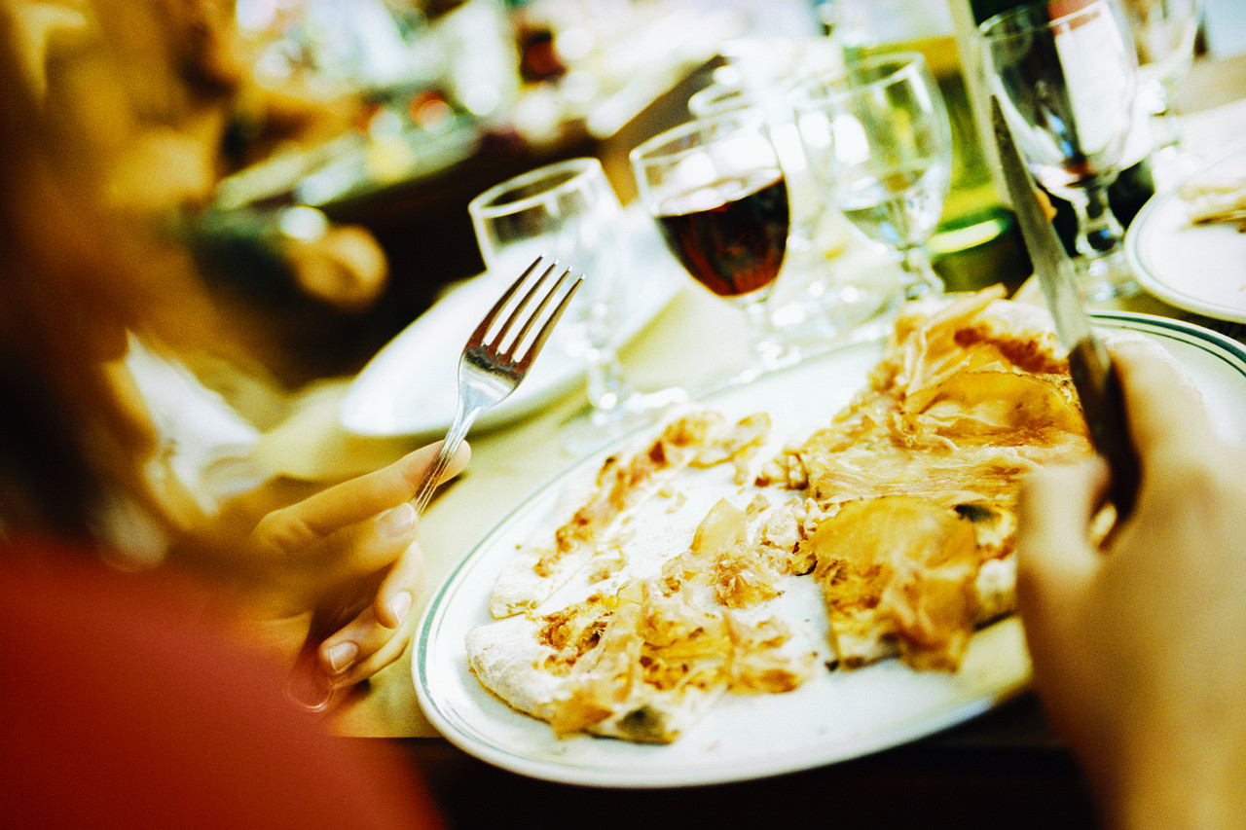
What type of businesses are included in out of home?
A range of sectors, including:
Quick Service Restaurants/takeaways
Pub dining
Casual dining
Coffee/sandwich shops
Retailers
Contract caterers
Theme Parks
Business and industry

Slide 7
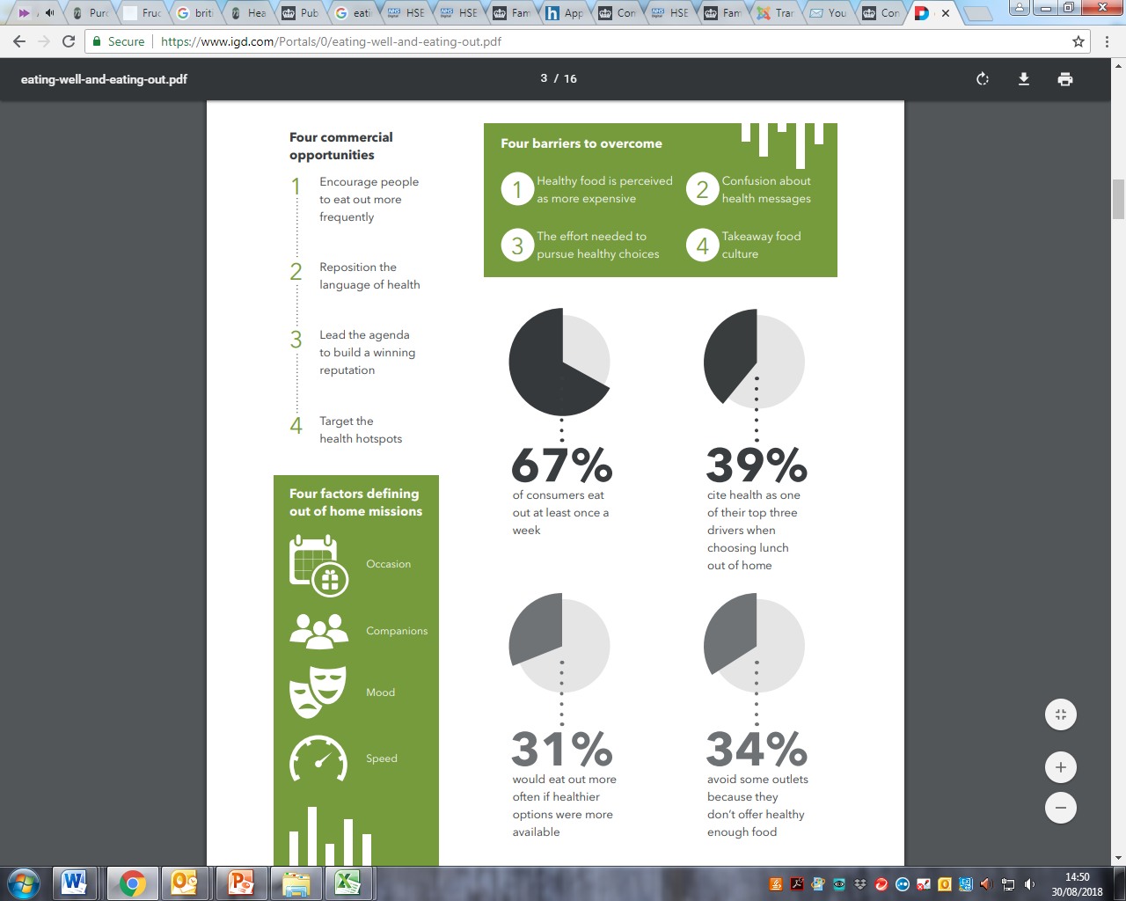
IGD – out of home shopper research
Two-thirds of people eat out at least once a week.
More people could be encouraged to eat out more frequently if their needs on health are met.
https://www.igd.com/Portals/0/eating-well-and-eating-out.pdf

Slide 8

The health context for targeting out of home
The latest Health Survey for England (HSE) data shows us that over 1 in 4 adults (age 16 and over) are obese.
Out of Home Calorie (OOH) Labelling is intended to inform and empower people to make healthier choices.
It also encourages OOH food businesses to make healthier options more available.
Some foods and drinks provide more energy than people think.

Slide 9

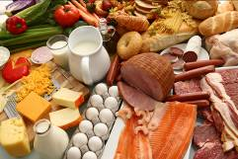

Area of action in the out of home sector
There are four key areas for action:
Information to consumers
(people)
Content of food (product)
Improving the availability of healthy food (place)
Promotion of healthier food choices (promotions)

Slide 10

Underpinning principles
Calorie information is displayed clearly and prominently at point of choice.
Calorie information is provided for standardised food and drink items sold (standardised means ‘food offered for at least 30 days a year’).
Calorie information is provided per portion/item/meal; and for multi portion or sharing items the number of portions will also be provided.
Reference information on calorie requirement is displayed clearly, prominently and in a way that is appropriate for the consumer, e.g. “Women need around 2,000 and men 2,500 kcal a day, children need less".

Slide 11




Out of home targets from the Childhood obesity plan – company’s work to date
In 2015, Costa pledged to reduce added sugar by 25% in all handcrafted drinks and by 30% in ice drinks by 2020 – achieved 14% reduction in handcrafted drinks by January 2018.
In January 2016 Starbucks announced a target to reduce added sugar in indulgent beverages by 25% by the end of 2020 and reduce sugar across their bakery range by 20% by end 2020. Variety of success to date including 63% of all beverages sold in the UK in 2016 contained zero added sugar.
McDonald’s average children’s meal sold in 2016 contained 21.2% less salt, 10.7% less saturated fat, 16.9% less sugar, compared with the average Happy Meal sold in 2006.
Whitbred Restaurants have reduced the overall sugar average for the desserts category in Brewers Fayre by 16% over the last year.

Slide 12
Example 1: Quick service restaurant

Slide 13
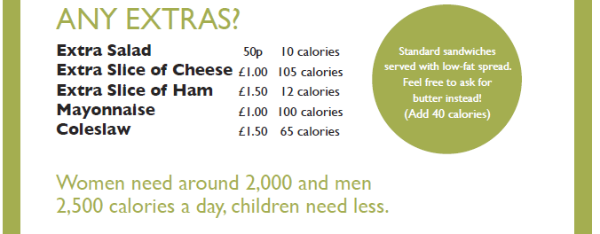
Example 2: Deli bar

Slide 14
Example 3: Coffee board

Slide 15
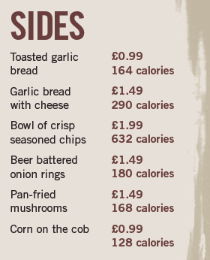
Example 4: Restaurant menu

Slide 16
Out of home calorie labelling
For further information, go to:
www.foodafactoflife.org.uk

