Slide 1
pH practical

Slide 2
Starter
What is meant by the following terms?
Acid
Alkaline
Neutral
A solution with a pH of less than pH 7
A solution with a pH of exactly pH 7
A solution with a pH of exactly pH 7

Slide 3
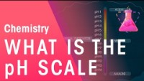
Fill in the gaps
We can tell if something is ________, alkaline or neutral by using an ________. Indicators are substances that show ________ colours when they are in acidic, alkaline or neutral conditions.
________ paper is one example of an indicator. It turns ________ in acids and ________ in alkaline. How acidic or alkaline something is can be measured on the ________. We can use ________ indicator, a mixture of other ________, to test and compare substances to the pH scale. The pH scale runs from ________ to ________.
If you wanted a more accurate measure of pH, you could use a ________.
Video used with kind permission of FuseSchool

Slide 4
Fill in the gaps
We can tell if something is acidic, alkaline or neutral by using an indicator. Indicators are substances that show different colours when they are in acidic, alkaline or neutral conditions.
Litmus paper is one example of an indicator. it turns red in acids and blue in alkaline. How acidic or alkaline something is can be measured on the pH scale. We can use universal indicator, a mixture of other indicators, to test and compare substances to the pH scale. The pH scale runs from zero to fourteen.
If you wanted a more accurate measure of pH, you could use a pH meter.
Video used with kind permission of FuseSchool

Slide 5
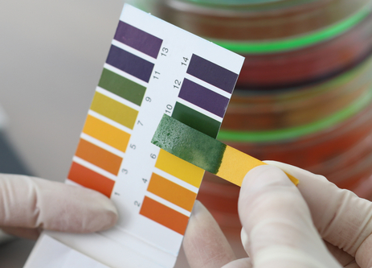
The pH scale
The pH scale shows how acidic or alkaline a substance is.
It can be measured using a pH meter which gives a numerical value (0 to 14)
pH can be also be measured using an indicator and comparing the colour with a comparison chart.
One example is Universal indicator (UI), which is a mixture of indicators.

Slide 6
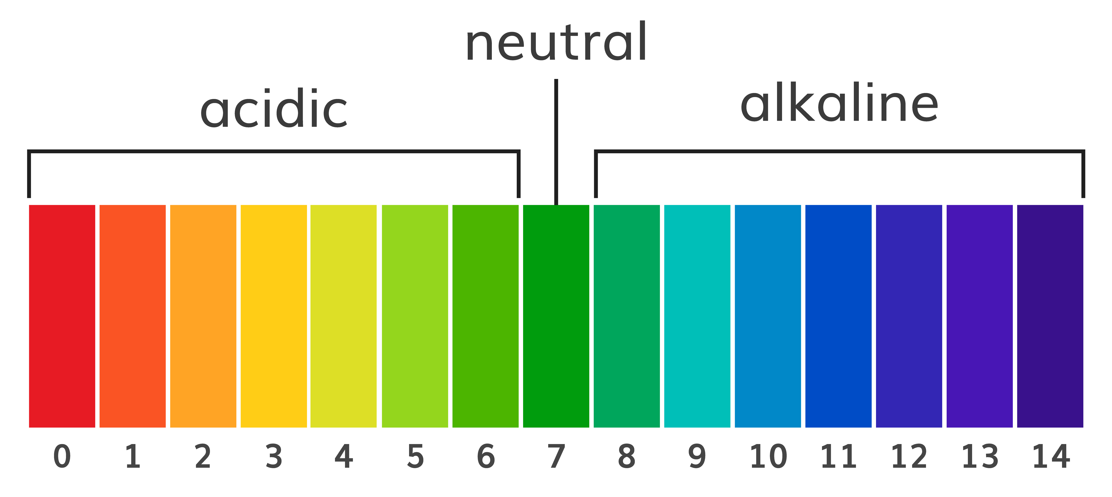
pH scale
The pH scale goes from 1-14 and different numbers indicate different strength of acid and alkaline.
This is the colour scale for using universal indicator.

Slide 7
Colour test – match the number to the colour
7
1
Discussion: Is pure water acidic, alkaline or neutral?
How about river water?
14
5

Slide 8
Colour test – match the number to the colour
1
Pure water is neutral but river water can contain other dissolved substances, which might mean it is slightly acidic or slightly alkaline.
5
7
14

Slide 9
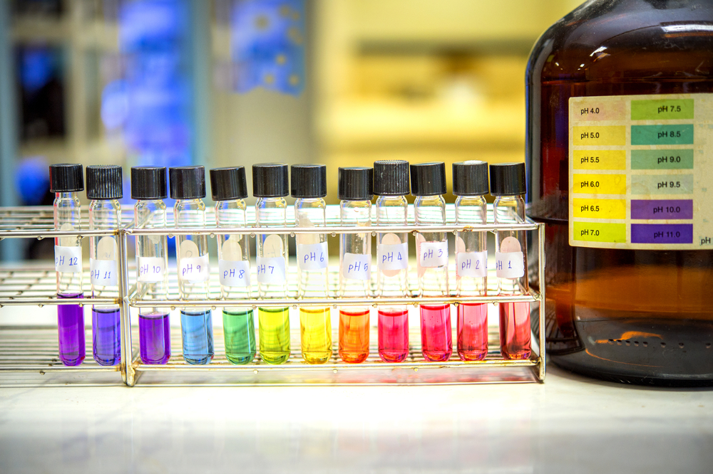
Practical
Special chemicals called indicators are used to determine if a substance is acidic, alkaline or neutral.
These turn different colours in acids, alkalis and neutral solutions.
Today we are going to be measuring the pH of different substances using universal indicator.

Slide 10
Hypothesis
A hypothesis is a prediction of what you think might happen in an experiment.
Today’s activity is testing the pH of different substances (whether they are acidic, alkaline or neutral).
The table on the next slide gives the list of substances we’ll be testing. Make a prediction of the colours each indicator will turn once tested.

Slide 11
Results table
Substance tested | Predicted colour change | Actual colour change | Acid/Alkali/Neutral?
Hydrochloric acid
Sodium Hydroxide
Distilled Water
Orange juice
Vinegar
Toothpaste
Coca cola
Saltwater

Slide 12
Practical instructions
Collect the dimple trays, pipette (for UI) and Universal indicator (UI) for your pair.
Take your dimple tray around the room and add each of the substances you are going to test into the dimple tray using a pipette (2 drops of each). Each pipette should stay with the substance it is next to.
Using a pipette, add 2 drops of Universal indicator into each dimple on the dimple tray.
Add the colour change to your results table.

Slide 13

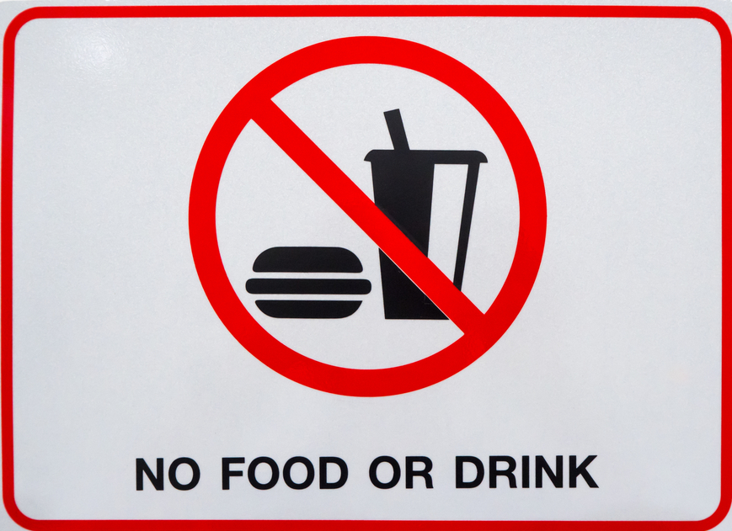
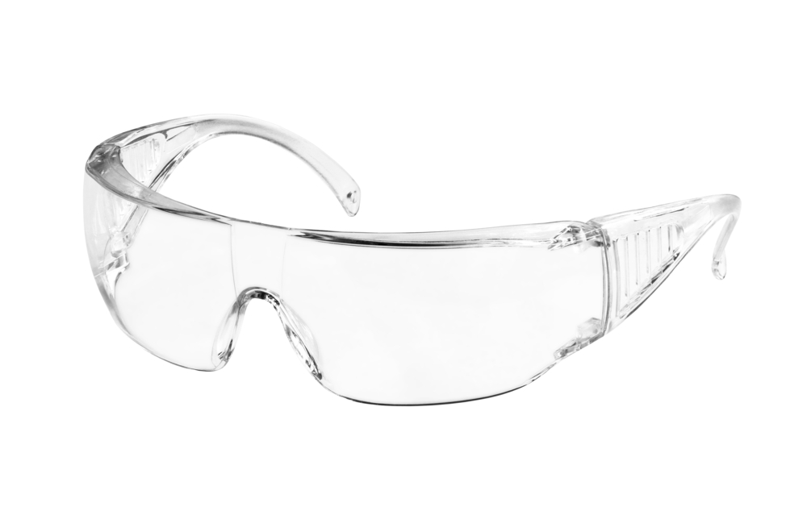

Turn and talk – how are we going to stay safe during this practical?
Wear safety goggles
Use test tube holders
No eating or drinking
Keep desks/benches tidy and make sure bags are not trip hazards

Slide 14
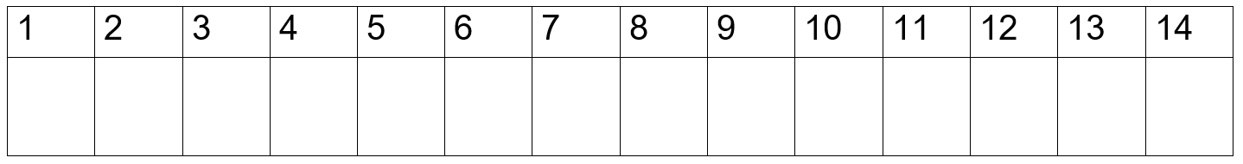
Create your own pH scale
Substance tested
Hydrochloric acid
Sodium Hydroxide
Distilled Water
Orange juice
Vinegar
Toothpaste
Coca cola
Saltwater
Make a pH chart which runs from pH 1 to pH 14.
Colour the chart to show the colour change substances make when tested with Universal Indicator.
Add pictures or labels to show the pH values of the substances you have tested during the lesson.

Slide 15
Homework
Research how you could conduct an experiment using red cabbage as an indicator.
Make sure to include:
How you prepare the red cabbage so it can be used as an indicator.
How you will use the indicator to test the pH of different substances.
What the results are for acid, alkaline and neutral (what colours would the indicators show?)

Slide 16
Key words
Key word​ | Meaning​
Acid | Any substance that increases the concentration of hydrogen (H+) ions when added to a water solution (pH 1-6).
Neutral solution | A solution with a pH of exactly 7.
Alkali | Any substance that decreases the concentration of hydrogen (H+) ions when added to a water solution (pH 7-14).
pH scale | A scale from 0 to 14 that tells us how acidic or alkaline an aqueous solution is.
Indicator | A substance added to a test sample which alters (e.g., in colour) to indicate whether a specific reaction has taken place.
Litmus | A dye that is red under acid conditions and blue under alkaline conditions.

Slide 17
Teachers’ guide

Slide 18
Lesson structure
Starter: Begin a discussion around the key terms (5 minutes).
Fill in the gaps: Give out worksheet and ask students to fill in based on video (5 minutes, 5 minutes to go over).
Explanation of pH scale and then colour test (conduct as class AfL) (5 minutes)
Practical (25 minutes) – include time to copy results table and discuss good practical behaviour/safety.
Create your own pH scale (start when finished with the practical)
Homework task – research task on cabbage as an indicator.

Slide 19
Running a pH testing practical classroom
Common pitfalls:
Overfilling dimple trays – when demonstrating the practical, ensure it is clear how much of the substance (and indicator) to put in each of the dimple trays. When students are carrying dimple trays around the room there is always a risk of dropping or spilling which adds to tidying time.
Spillages – spillages are always a risk in science practicals, but there are ways to minimise. One way is to get students to leave their dimple trays on their desk and to bring the substances to their desk to pipette. This could add time but will minimise the risk of carrying and spilling overfilled dimple trays.

Slide 20
Running a pH testing practical classroom
Common pitfalls:
Poor/slow tidying - for tidying, make sure it is clear where everything needs to go and explain how to clean dimple trays and pipettes. Many students at KS3 will not have cleaned a pipette before which can often lead them to spraying water into them and water going everywhere. Setting up a beaker of water by sinks (to clean pipettes) and having sieves available at the sink will save time.
Bottlenecking in the classroom – make sure to spread out equipment to avoid bottlenecking. You could set up by giving each pair a dimple tray, pipette and UI bottle (if there are enough, if not you could put one per desk) and then spread the substances to test evenly around the room.

Slide 21
Running a pH testing practical classroom
Common misconceptions:
All acids show up red with indicator, all alkalis show up blue/purple – carry out multiple different experiments using different indicators. Universal Indicator will show up like this but using red cabbage as an indicator will show up differently.
Acid strength and concentration are the same thing – this is important to get across to students in KS3 as it will be tested in further detail in KS4. The following slides give some information on how you might be able to teach these or, for KS3, just focussing on using the correct terminology and correcting mistakes will be important.

Slide 22
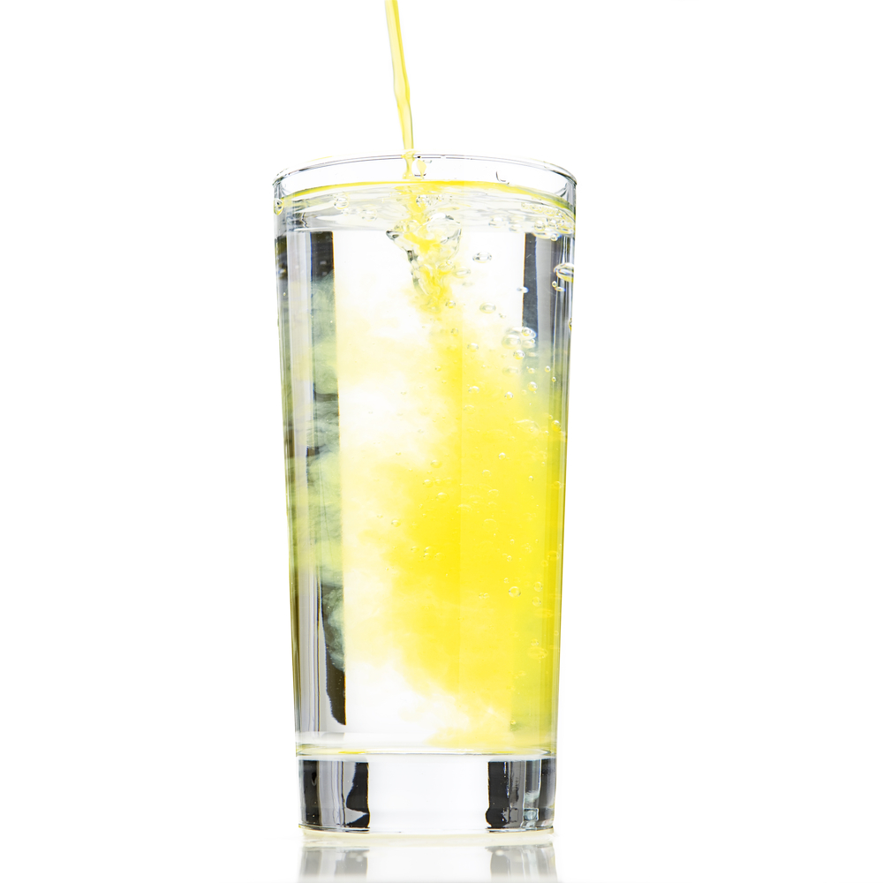
Strength and concentration
Strength and concentration are not the same thing.
You can think of concentration in terms of concentrations of a squash drink.
How could I get two different concentrations of orange squash that have the same overall volume?

Slide 23
Strength and concentration
In terms of the particle model, these are:
High concentration
Low concentration

Slide 24
Concentration
From the particle model, we can see that the more particles there are in the same volume, the greater the concentration.
Therefore we can define concentration as:
‘…the amount of particles of solute in a certain volume of solvent’.

Slide 25
Strength
However strength is different. You can have strong acids that are concentrated or dilute or you can have weak acids that are concentrated or dilute.
Acids in solution are a source of H+ (hydrogen) ions. The H+ ions are produced when the acid dissociates or breaks down to form ions.
We can define strength as:
‘…a measure of the fraction of acid particles that are ‘split up’ or dissociated.’

Slide 26
Strong and weak acids
Strong acids completely dissociate into ions in solution.
Weak acids only partially dissociate in solution.
The pH of a solution is a measure of its concentration of hydrogen ions:
the higher the concentration of H⁺ ions, the lower the pH.
the lower the concentration of H⁺ ions, the higher the pH.

Slide 27
For a given concentration…
All of this means that when we talk about the pH scale we need to use the phrase, for a given concentration in aqueous solution, the stronger an acid, the lower the pH.
This is because the more concentrated the solution of an acid, the lower its pH will be.
A strong acid has a lower pH than a weak acid for a given concentration.

Slide 28
Teaching about pH:
Evaluate whether a substance is acid, alkali or neutral.
Describe the factors affecting pH.
Identify strong and weak acids.
Analyse data and use observations to determine the pH of a solution.

Slide 29
Progressing the learning
The topic of pH is also covered at GCSE (14-16 years).
It is covered as part of the human digestive system, particularly looking at different enzymes involved in digestion and the stomach.
At GCSE level pupils can also investigate the effect of temperature on the rate of decay of fresh milk by measuring pH change.

Slide 30
Talking about the science of pH testing
During a demonstration, explain the importance of practical safety during science practicals.
Discuss the difference between strength and concentration of acids.
Discuss how substances that are acidic or alkaline will likely have different roles in industry.
Discuss how the pH of the stomach changes.

Slide 31
pH practical
For further information, go to:
www.foodafactoflife.org.uk
This science pack is one of a series of resources produced for the pHood Futures project, supported by the Royal Society of Chemistry.
This resource meets the Guidelines for producers and users of school education resources about food.

