Slide 1
The grain chain

Slide 2
Overview
This presentation gives an overview and explanation of:
the grain chain;
wheat farming in the UK;
grain structure;
the milling process.

Slide 3
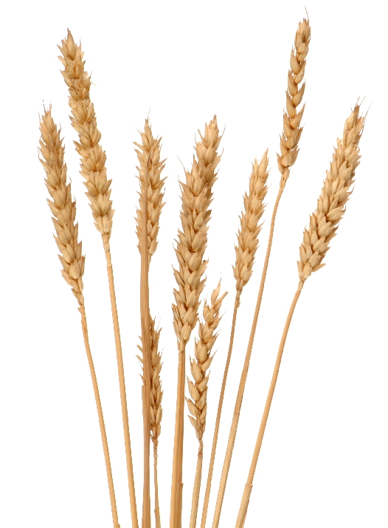
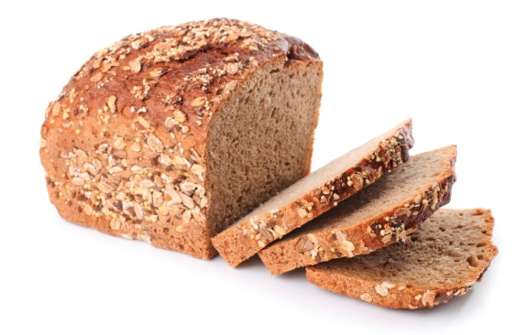
The grain chain
Farmers grow wheat plants and the grain from those plants is milled to make flour.
Flour is used to make lots of different food products, such as bread, pasta, biscuits and cakes. These products are delivered to shops and supermarkets so that we can buy them.
All these steps link together to make the grain chain.

Slide 4
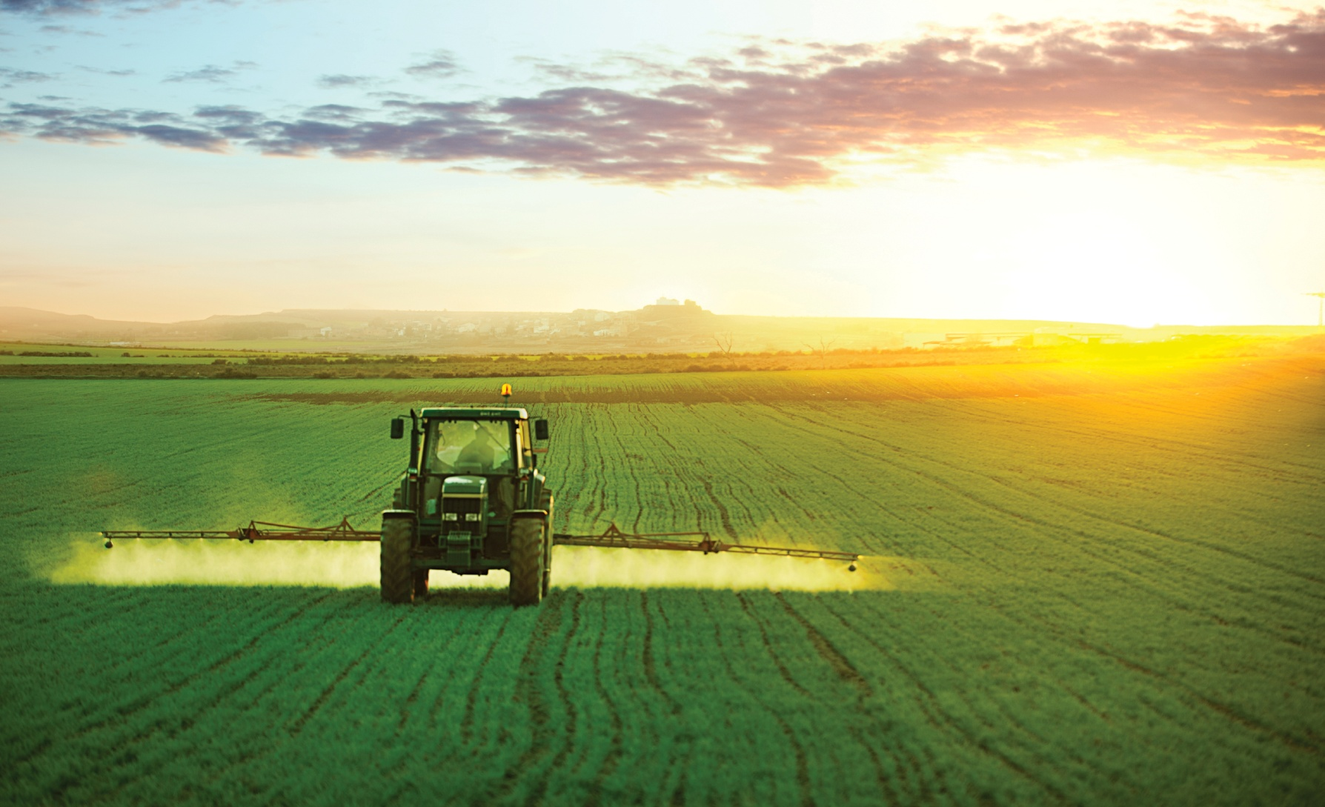
Farming
Wheat is grown worldwide. The main wheat producers in order of volume are Europe, China, India, USA, Russia, Ukraine, Canada and Australia.
Different varieties of wheat are grown depending on the growing climate and geography of each country. Different varieties are used to cope with the dry sun-baked lands of Northern India and parts of Africa.

Slide 5
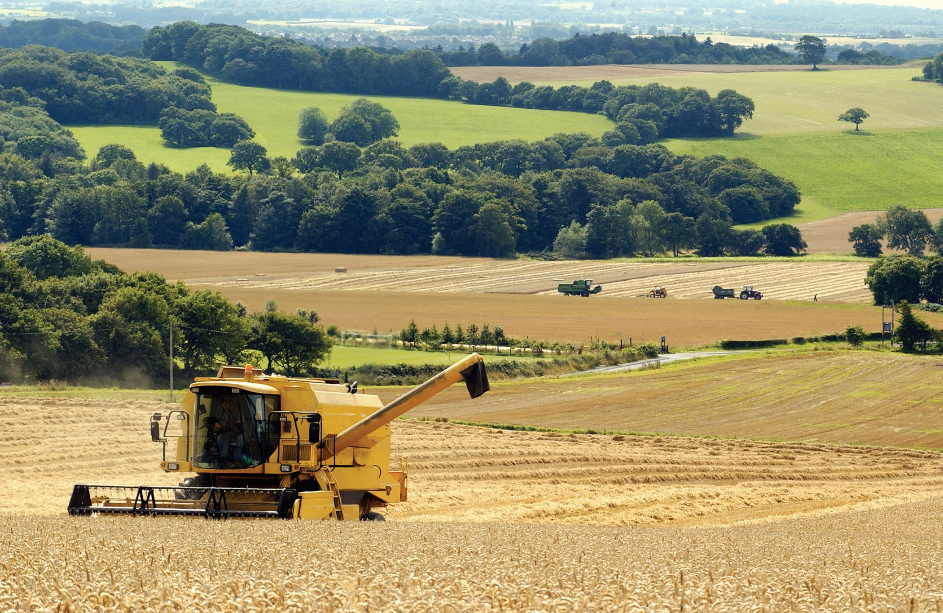
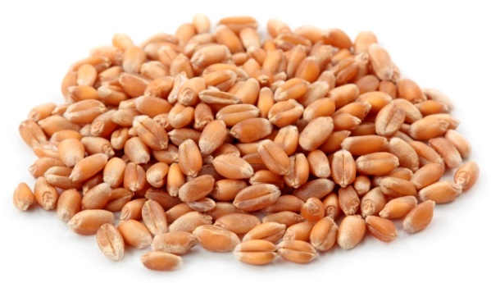
Farming in the UK
Wheat is sown on two fifths of Britain’s arable land, resulting in a total harvest of 15-17 million tonnes per year.
About half of the crop is made into food for humans, and some is used for animal feed (e.g. to feed chickens, cows and pigs). About 3% of the crop is used as seed to plant for the following year.
Some of the remainder is exported for human and animal consumption.

Slide 6
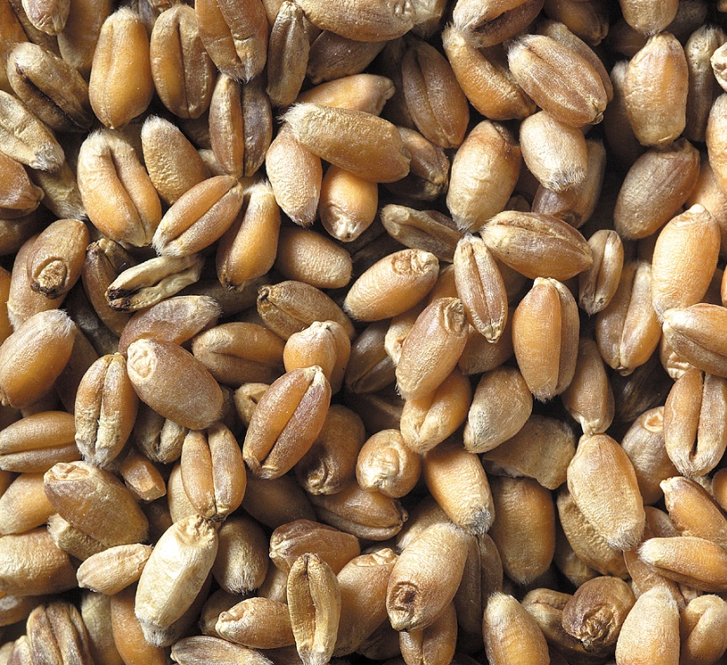
Wheat
Wheat grains grow at the top of the plant. They are closely packed together in clusters called ears.
Each ear of wheat is made up of 45-50 grains, however, this can vary depending on the type of wheat. It is these starchy grains that we eat.

Slide 7

Planting and harvesting
In the UK, wheat is planted in September and harvested the following August. The harvesting process removes the grains from the plant.
Flour may display The Red Tractor mark. This shows that it has been produced to a high set of quality standards.

Slide 8
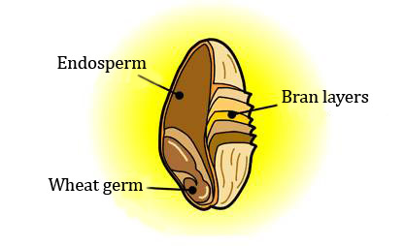
A grain of wheat
Each grain of wheat has three distinct parts.
Bran layers - the coarse outer.
Wheat germ – a new plant would grow from this part.
Endosperm (the starchy store of food which the germ feeds on while it grows).

Slide 9
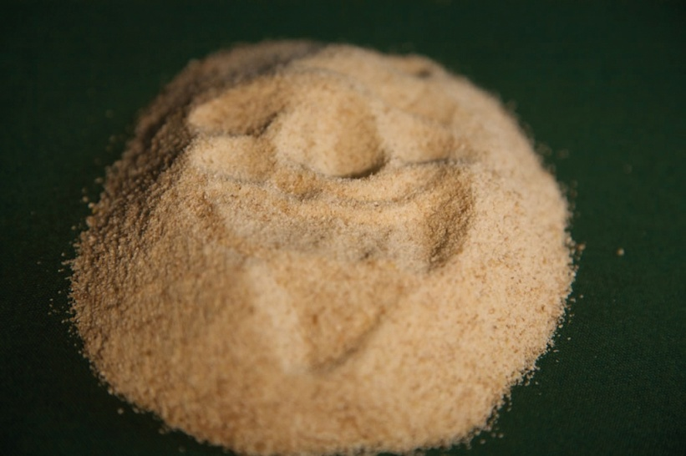
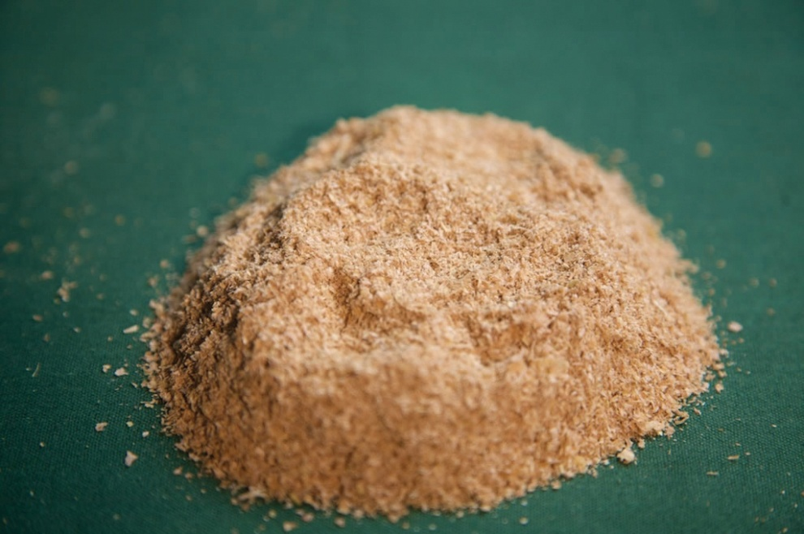
A grain of wheat
The endosperm is the white flour we use to make many products.
After milling, the wheat germ and bran can be added back to white flour in different amounts to create either brown or wholemeal flour.

Slide 10
Milling
The next step is milling - the process turns wheat into flour.
Different parts of the wheat grain are used to make different types of flour.
The miller must use their skill to buy, blend and mill the wheat to produce the right kinds of flour.

Slide 11
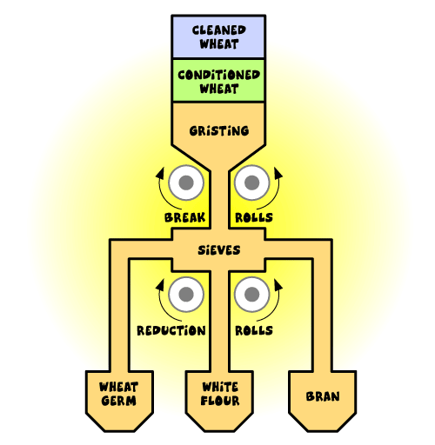
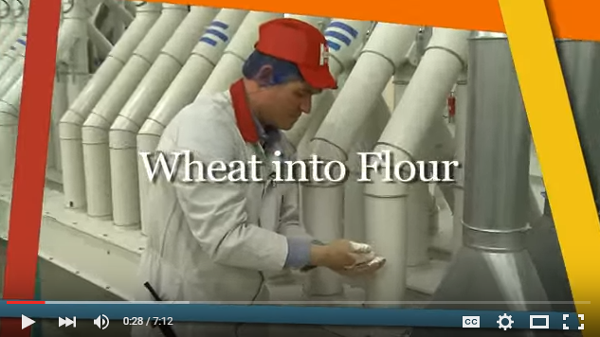
The milling process
Flour is made by the following process (start from the top down).
To view the process, click the video:

Slide 12
Delivery and storage
The grains are delivered to the mill.
Wheat must meet specifications for:
Variety: different varieties produce different flour qualities.
Moisture content: this determines the length of time that a grain can be stored.
Specific weight: a high weight is considered to be better.
Enzyme activity: high enzyme levels can result in sticky bread, making slicing difficult.
Protein quality and quantity: important for baking purposes.

Slide 13
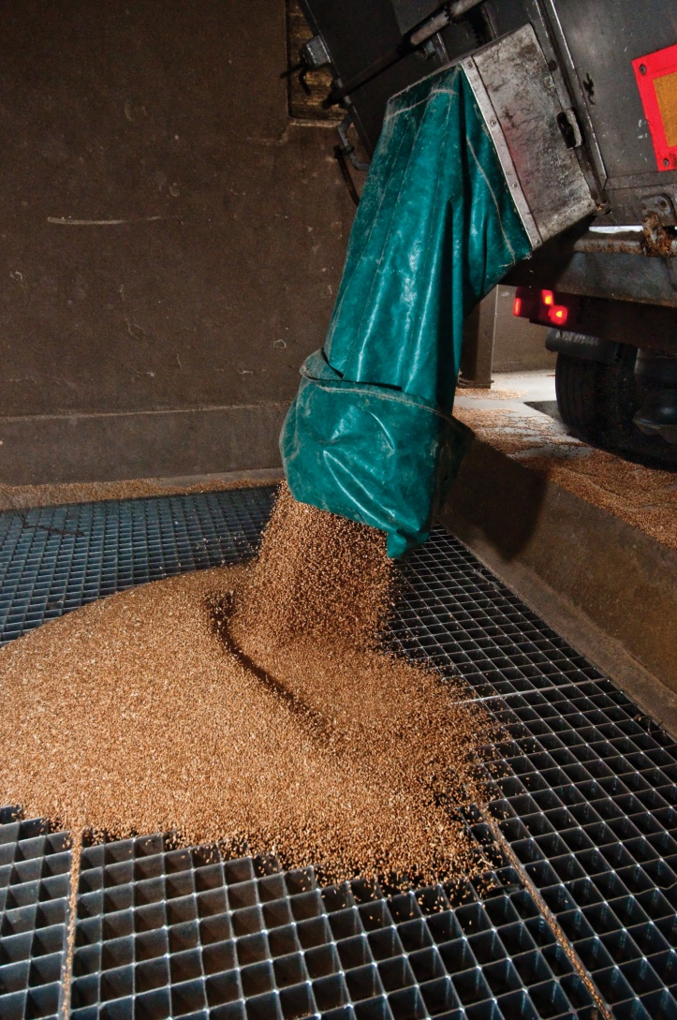
Cleaning and conditioning
Powerful magnets, metal detectors and other machines extract metal objects, stones and other grains such as barley, oats and small seeds from the wheat grain. Throughout the cleaning process, air currents lift off dust and chaff.
Conditioning with water softens the outer pericarp (bran) layer of the wheat and makes it easier to remove the floury endosperm during milling.

Slide 14
Gristing
The cleaned and conditioned wheat is blended with other types of wheat in a process called gristing to make different kinds of flour.
Occasionally, wheat gluten is added to increase the protein content of milled flours.

Slide 15
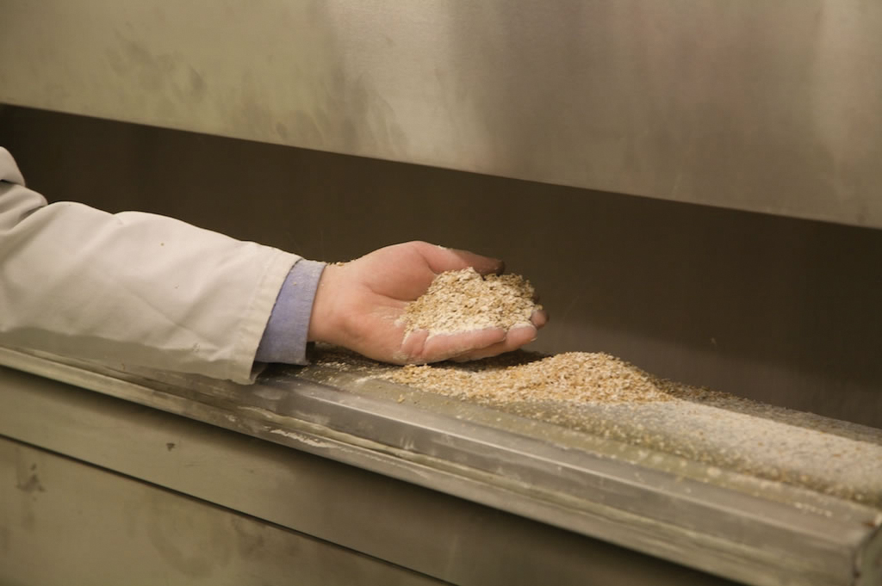
Milling: Stage 1
The grist is passed through a series of fluted 'break' rolls rotating at different speeds.
These rolls are set so that they do not crush the wheat but shear it open, separating the white, inner portion from the outer skins.

Slide 16
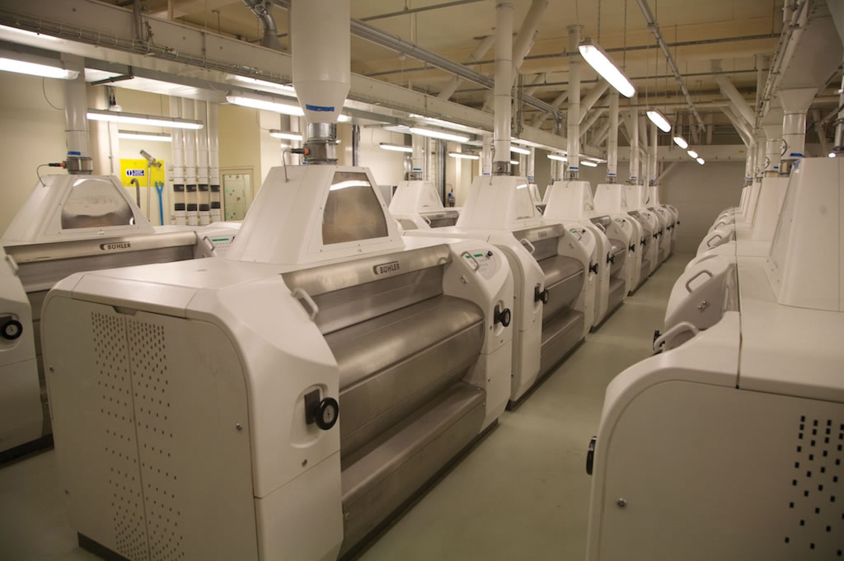
Milling: Stage 2
The fragments of wheat grain are separated by a complex arrangement of sieves.
White endosperm particles are channelled to a series of smooth 'reduction' rolls for final milling into white flour.

Slide 17
Mixing
The bran, wheatgerm and endosperm have all been separated out. They can now be blended to make different types of flour.
Wholemeal flour uses all parts of the grain.
Brown flour contains about 85% of the original grain, but with some bran and germ removed.
White flour is made from the endosperm only.

Slide 18
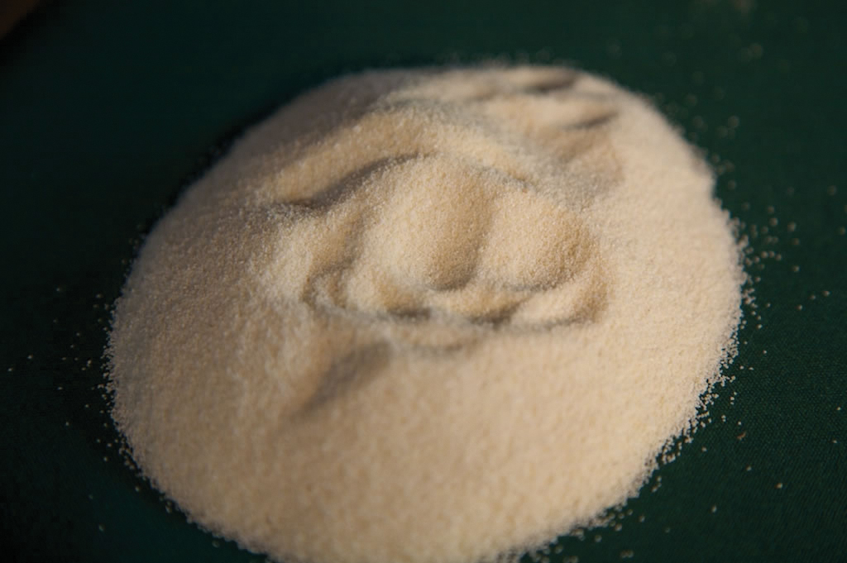
Different flours
White
Brown
Wholemeal

Slide 19
Packing
The different flours are packaged and sent to the bakeries. The flour is used for bread as well as biscuits, pies, cakes and confectionery.
Wheatgerm and bran may be used for certain breads and cereals or sold as health foods. The remainder is blended into wheat feed for animal food. As all components of the wheat grain are used, waste is kept to an absolute minimum.

Slide 20
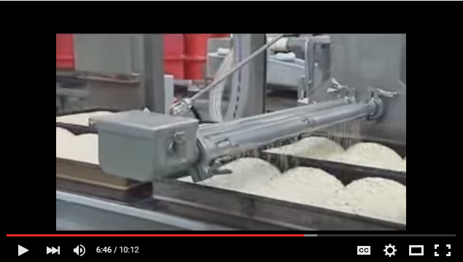
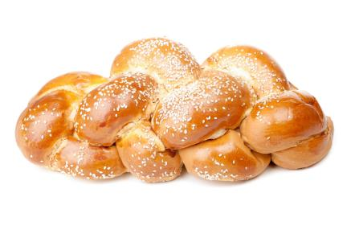
Bread
The last stage of the chain is making bread, or another dish that uses flour.
To find out more, watch this video:

Slide 21
The grain chain
For further information, go to:
www.foodafactoflife.org.uk
This resource meets the Guidelines for producers and users of school education resources about food.

