Slide 1
Food production, weather and climate

Slide 2
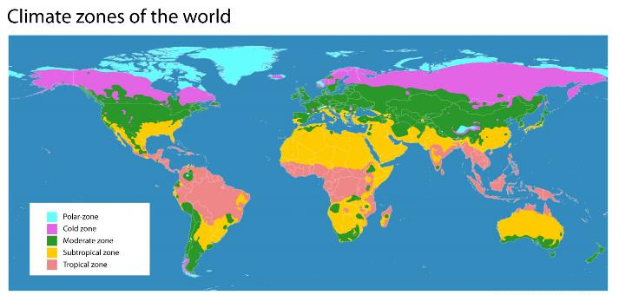
Where food is grown
There are many factors which affect where food is grown, reared and caught. Climate and terrain are two key factors that determine food production.

Slide 3
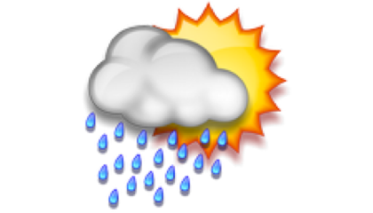
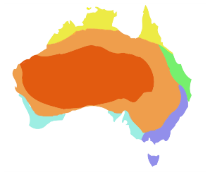
Weather and climate
What is the difference between weather and climate?
WEATHER is day to day localised conditions which can vary.
CLIMATE is the long-term patterns for an area.

Slide 4
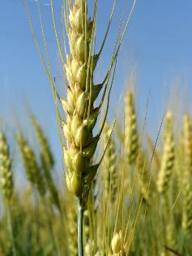
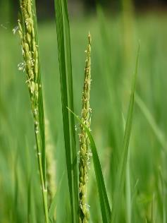
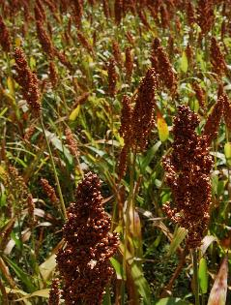
Where food is grown - climate
Where do you think these crops are grown?
Temperate climate
UK/Europe
Central Asia
Canada
Lowland tropical climate
South and South East Asia
Sub tropical climate
Africa
Asia
Wheat
Paddy rice
Sorghum

Slide 5
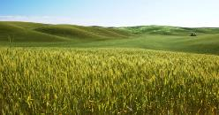
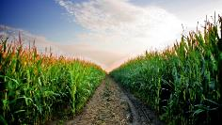
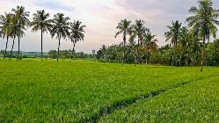
Where food is grown - climate
Wheat and barley are found in temperate climates like the UK, Europe, parts of Asia and North America.
Maize grows best in hotter conditions and is an important cereal crop in many tropical areas.
Rice is a crop of the wet tropics while sorghum can survive in very hot, dry conditions.
All of these plants have adaptations which enable them to survive and grow well in particular environmental conditions.

Slide 6
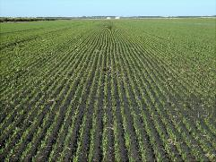
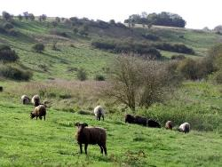
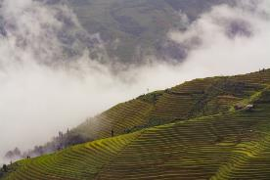
Where food is grown - terrain
Terrain means the type of land and its physical features, e.g. mountainous or low-lying.
The terrain or landscape determines which crops are grown or animals are reared.
Cereal crops are grown in flat plains whereas sheep can live in hilly rugged terrain.
Terrace farming has made cultivation of crops in hilly or mountainous regions possible. It is commonly used in Asia by rice-growing countries such as Vietnam, Philippines, and Indonesia.

Slide 7
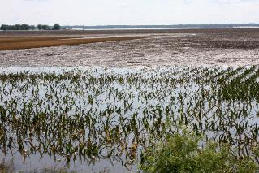
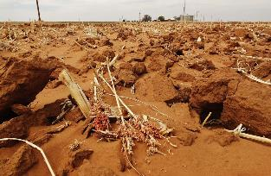
Climate change
There is world wide concern about climate change.
This is lasting change in long term weather patterns over a significant period of time.
One of the effects of climate change is an increase in the incidences of extreme, unusual weather conditions.
These can have a negative effect on food production.

Slide 8
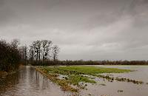
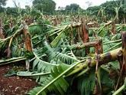
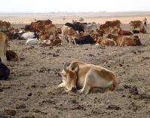
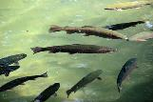
Climate change and extreme weather
Increased air temperatures and rainfall levels can affect soil. Crops can fail through drought and flooding.
Cyclones and hurricanes can cause damage to animals and crops.
Change in temperatures (higher or lower) can affect plant growing seasons and livestock may not survive.
Change in temperatures can also affect fish and other species. Some marine diseases have been linked with changing climate.

Slide 9
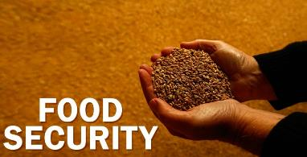
Food security
It is thought that climate change is very likely to affect food security at the global, regional, and local level.
What does food security mean?
Food security occurs when all people are able to access enough affordable, safe and nutritious food to meet their requirements for a healthy life, in ways the planet can sustain into the future.

Slide 10
Food production, weather and climate
For further information, go to:
www.foodafactoflife.org.uk
This resource meets the Guidelines for producers and users of school education resources about food.

