Slide 1
Functional food

Slide 2
What are functional ingredients?
Functional ingredients are ingredients that are specifically included in food for additional health benefits. Functional ingredients include:
probiotics – ‘good’ bacteria that may have a positive impact on human health;
prebiotics – food ingredients that promote the growth of beneficial microorganisms in the gut;
sterols/stanols – compounds that can lower cholesterol;
healthy fats (e.g. omega-3);
added vitamins and minerals (more than in the original food).
British Nutrition Foundation, 2016

Slide 3
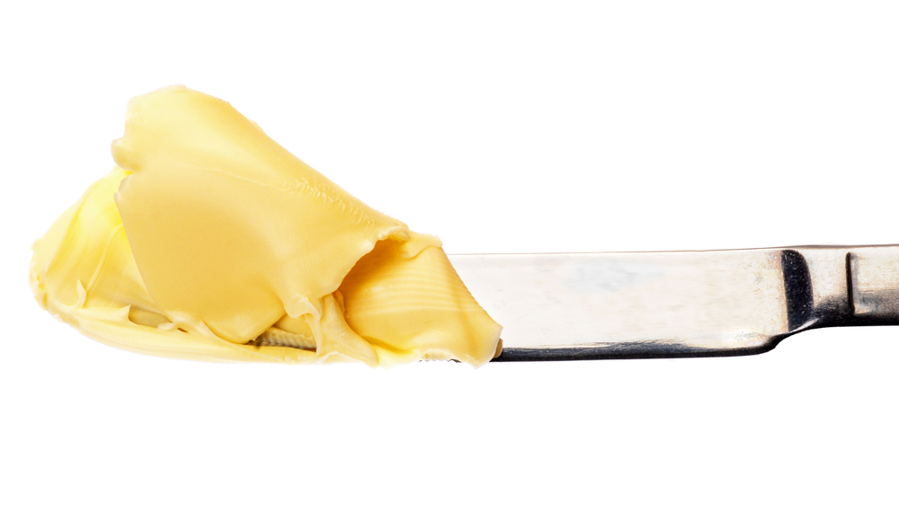
Functional food
When a functional ingredient is included in a food product, that product is known as a functional food. These foods are designed to provide one or more additional health benefits. Examples include:
eggs containing omega-3 fatty acids;
specially formulated spreads which can help to lower cholesterol levels in the body;
probiotic drinks, designed to improve gut health.

Slide 4
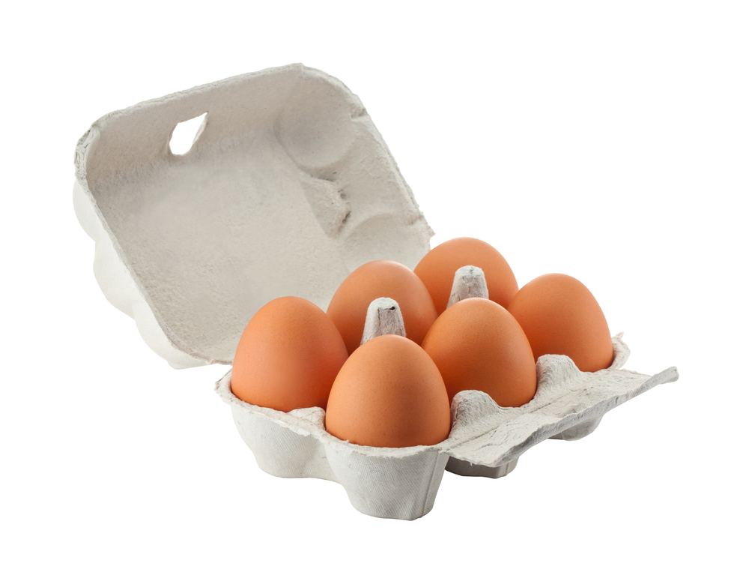
Vitamin and mineral fortification
A product that is fortified with additional vitamins and minerals may be considered a functional food.
For example, vitamin D is sometimes added to breakfast cereals or drinks where it would not normally be present.
However, it is important to look at the other nutrients in breakfast cereals and to avoid those with high levels of saturated fat, sugars or salt.
Other examples of fortified foods include omega-3 fortified eggs and calcium-fortified juices.

Slide 5
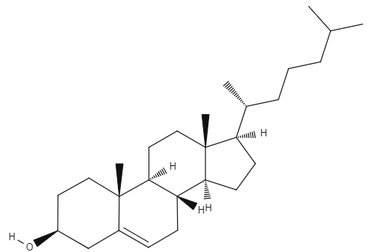
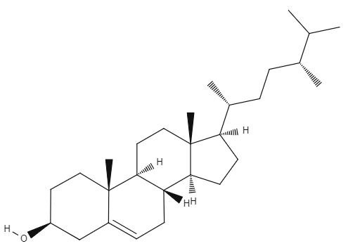
Sterols and stanols
Stanols and sterols are often added to ‘cholesterol-lowering’ dairy products, such as spreads and yogurts.
They are compounds found naturally in some plants.
When eaten, they can ‘mimic’ cholesterol, due to their similar structure (see image, right). This means that the body does not absorb as much cholesterol.
Stanols and sterols may lower total cholesterol and also reduce the amount of ‘bad’ cholesterol in the blood. This is useful because high levels of cholesterol are associated with heart disease.
Cholesterol
A plant sterol (campesterol). The two look very similar, but function very differently.

Slide 6
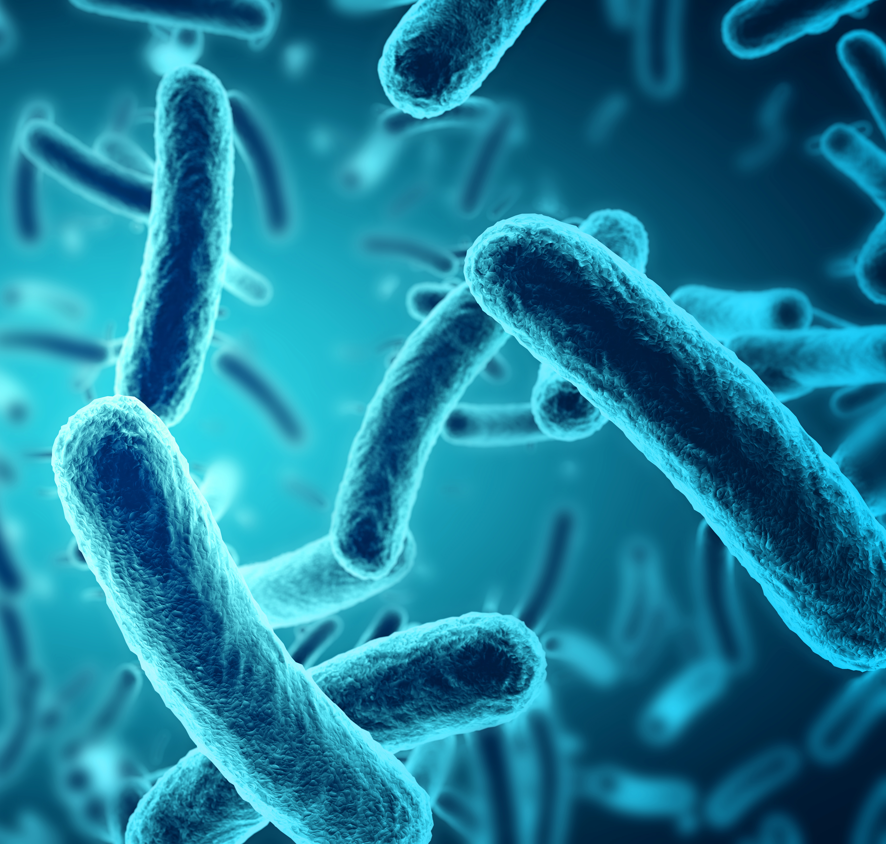
Probiotics
Probiotics are living microorganisms (usually bacteria), that are consumed in food, drink or supplements in order to provide health benefits.
They are sometimes referred to as ‘good’ bacteria.
There are a number of food products that contain probiotics. These are mostly dairy products, as probiotics tend to survive well in these foods.

Slide 7
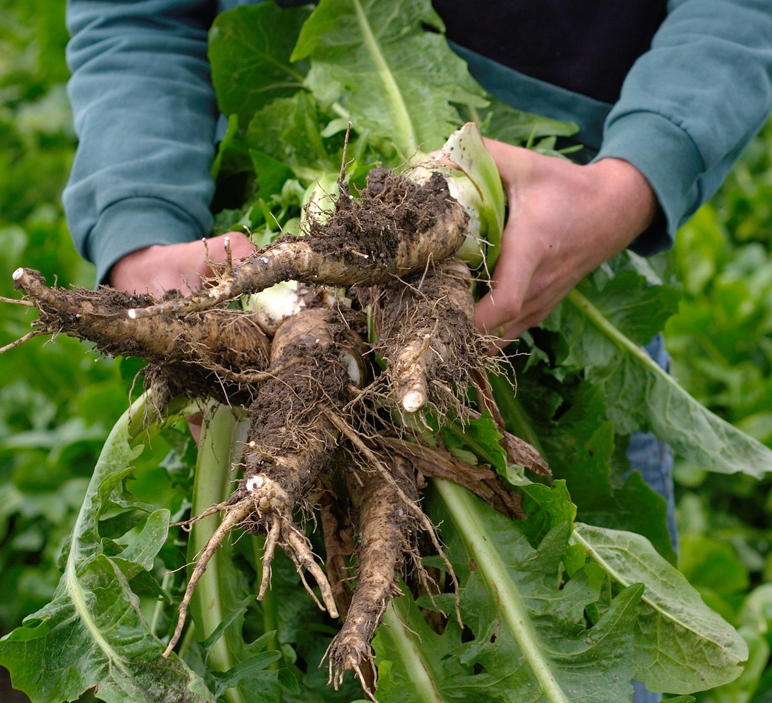
Prebiotics
Prebiotics are components of food that can be digested by microorganisms in the large intestine (colon). They are:
non-digestible by humans;
fermentable by microorganisms in the large intestine;
promote the growth of ‘good’ microorganisms and/or increase their activity.
Prebiotics are usually special types of dietary fibre.
The aim of a prebiotic is to encourage ‘good’ microorganisms to grow and multiply to greater numbers. Research suggests that these microorganisms may be able to contribute to health through their activity in the gut.
A prebiotic commonly added to foods, inulin, is sourced from the roots of the chicory plant.

Slide 8

Health claims
From 2006 to 2020, UK nutrition and health claims were assessed by the European Food Safety Authority (EFSA) under EU Nutrition and Health Claims Regulations (2006).
Since Brexit, UK applications are considered by the UK Nutrition and Health Claims Committee (UKNHCC).
You can find more information on the Great Britain nutrition and health claims (NHC) register, here.
A content analysis of the European food safety Authority’s scientific opinion on authorised and rejected appetite-related health claim applications - ScienceDirect

Slide 9
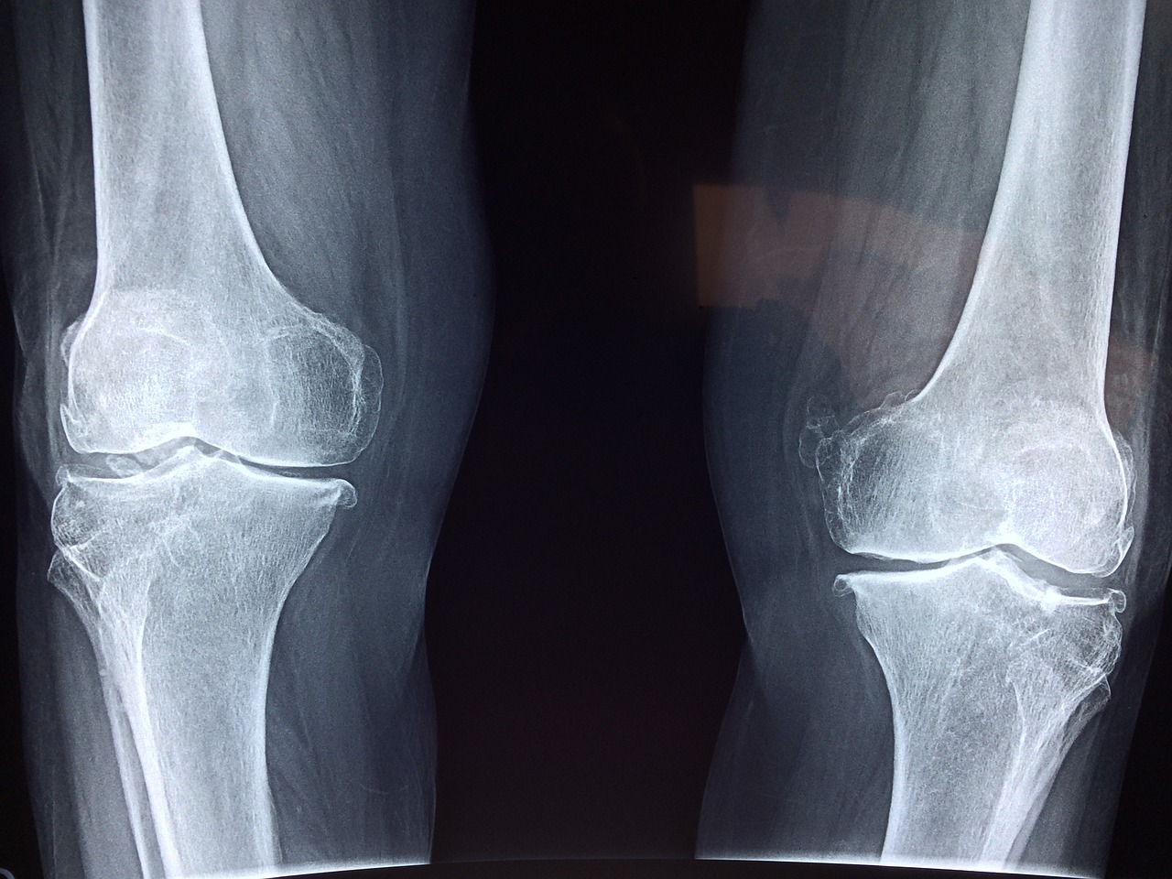
Examples of health claims
Examples of health claims approved by the UK Nutrition and Health Claims Committee (UKNHCC) include:
Vitamin D contributes to the maintenance of normal bones.
Vitamin C increases iron absorption.
Iron contributes to normal oxygen transport in the body.
These fall under the category ‘Authorised for use in Great Britain’.
Great Britain nutrition and health claims (NHC) register

Slide 10
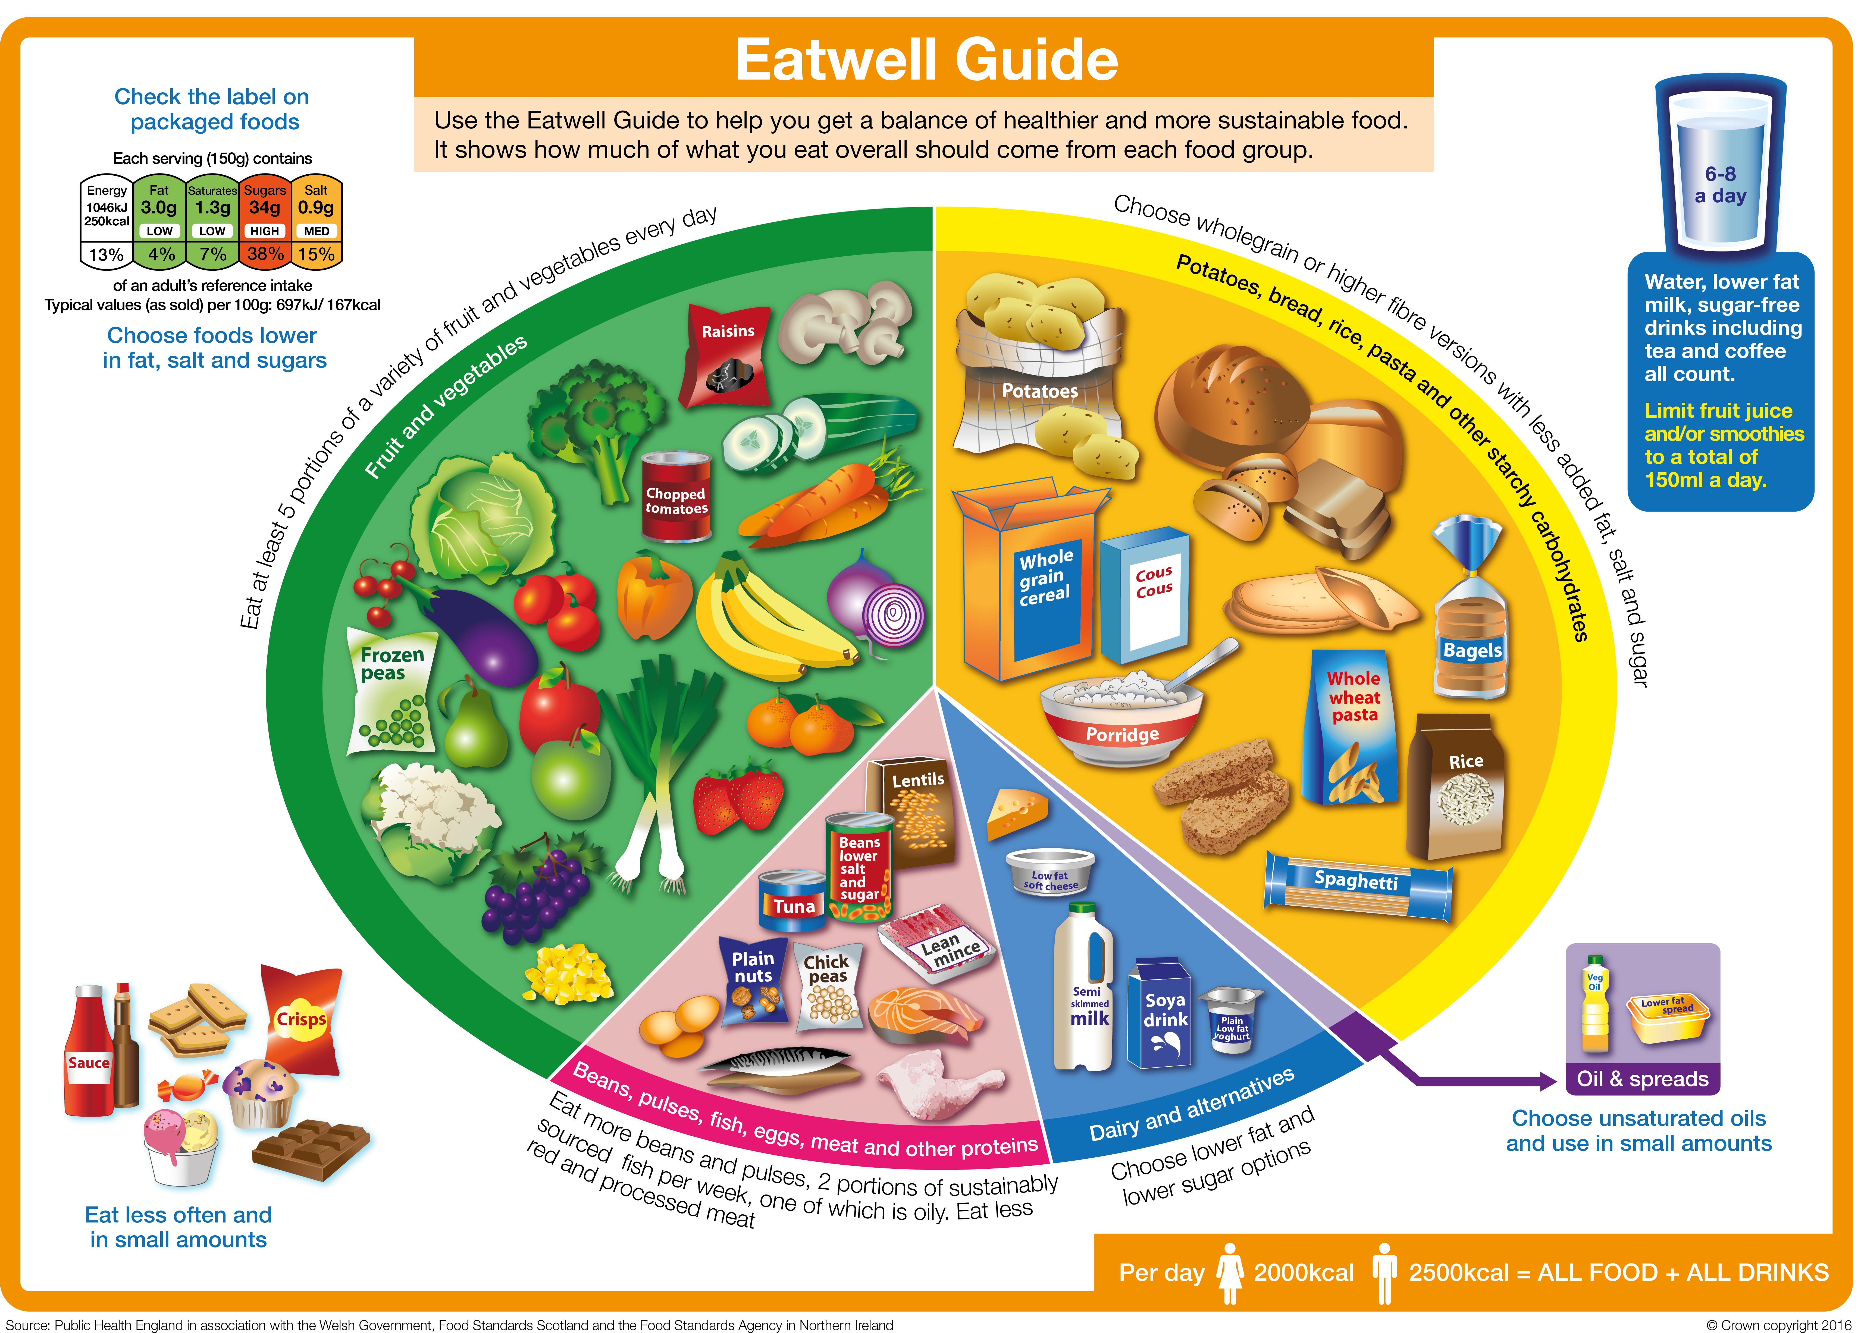
The role of functional food in the diet
Whilst a functional food may be able to provide additional health benefits, they are not designed to replace a balanced diet.
Consuming a variety of food, by following the advice laid out in the Eatwell Guide, is the best way to get the recommended amounts of nutrients.
Functional foods are not always nutrient-rich and some may contain high levels of saturated fat, free sugars, salt or energy (calories).

Slide 11
Functional food
For further information, go to:
www.foodafactoflife.org.uk
This resource meets the Guidelines for producers and users of school education resources about food.

