Slide 1
Personal hygiene

Slide 2
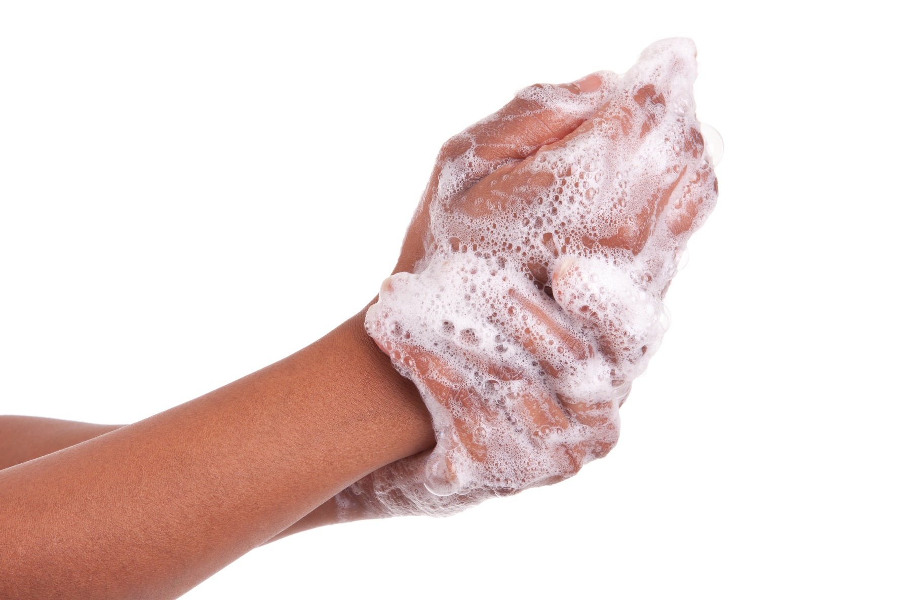
Personal hygiene
Good personal hygiene is important to prevent risk of food poisoning.

Slide 3
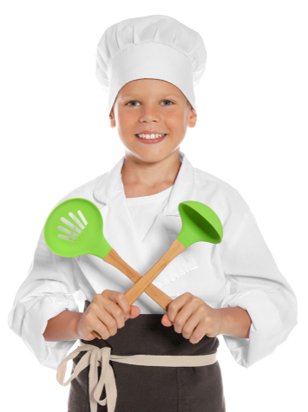
Tie back long hair
Stops hair dangling in food.
Prevents hair from landing in food.
Prevent hair from being caught in equipment.
If you’ve got a hat, wear it.

Slide 4
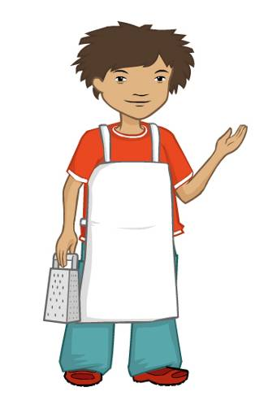
Roll up long sleeves
Stops sleeves and cuffs becoming dirty.
Prevents dirt from sleeves touching food.

Slide 5
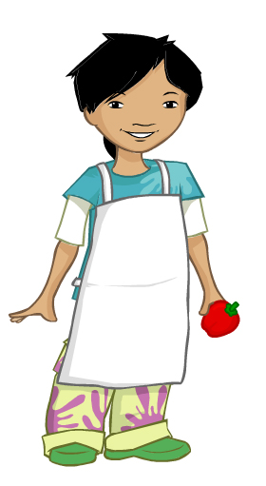
Wear an apron
Stops your clothes from getting dirty.
Prevents dirt from your clothes touching food.

Slide 6
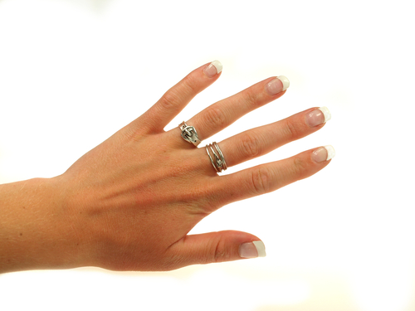
Remove jewellery
Stops your jewellery from getting dirty.
Prevents dirt from your jewellery touching food.
Stops jewellery being mixed into food.

Slide 7
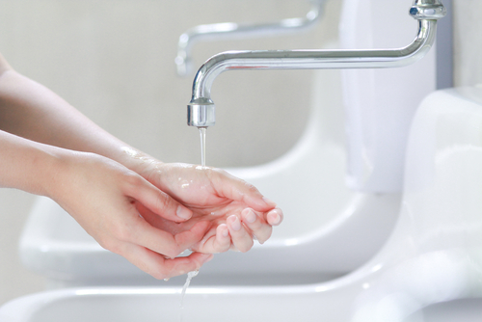
Wash hands
Wash hands thoroughly, with hot soapy water;
Helps to remove dirt and microbes;
Need to wash hands before, during and after cooking;
Wash hands after going to the toilet, blowing your nose or handling waste.

Slide 8
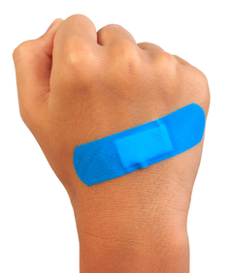
Cuts and boils
Cover with a waterproof plaster, preferably blue (so you can see them).

Slide 9
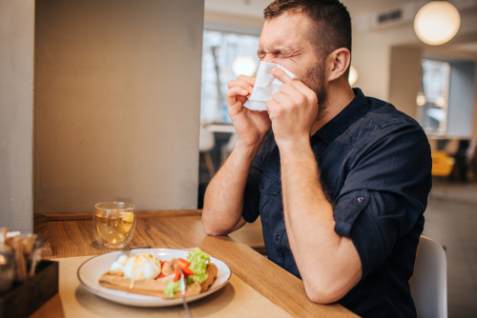
Coughs and sneezes
Don’t cough or sneeze over food.

Slide 10
For further information, go to:
www.foodafactoflife.org.uk

