Slide 1
Spaghetti Bolognese
Complexity: medium-high

Slide 2
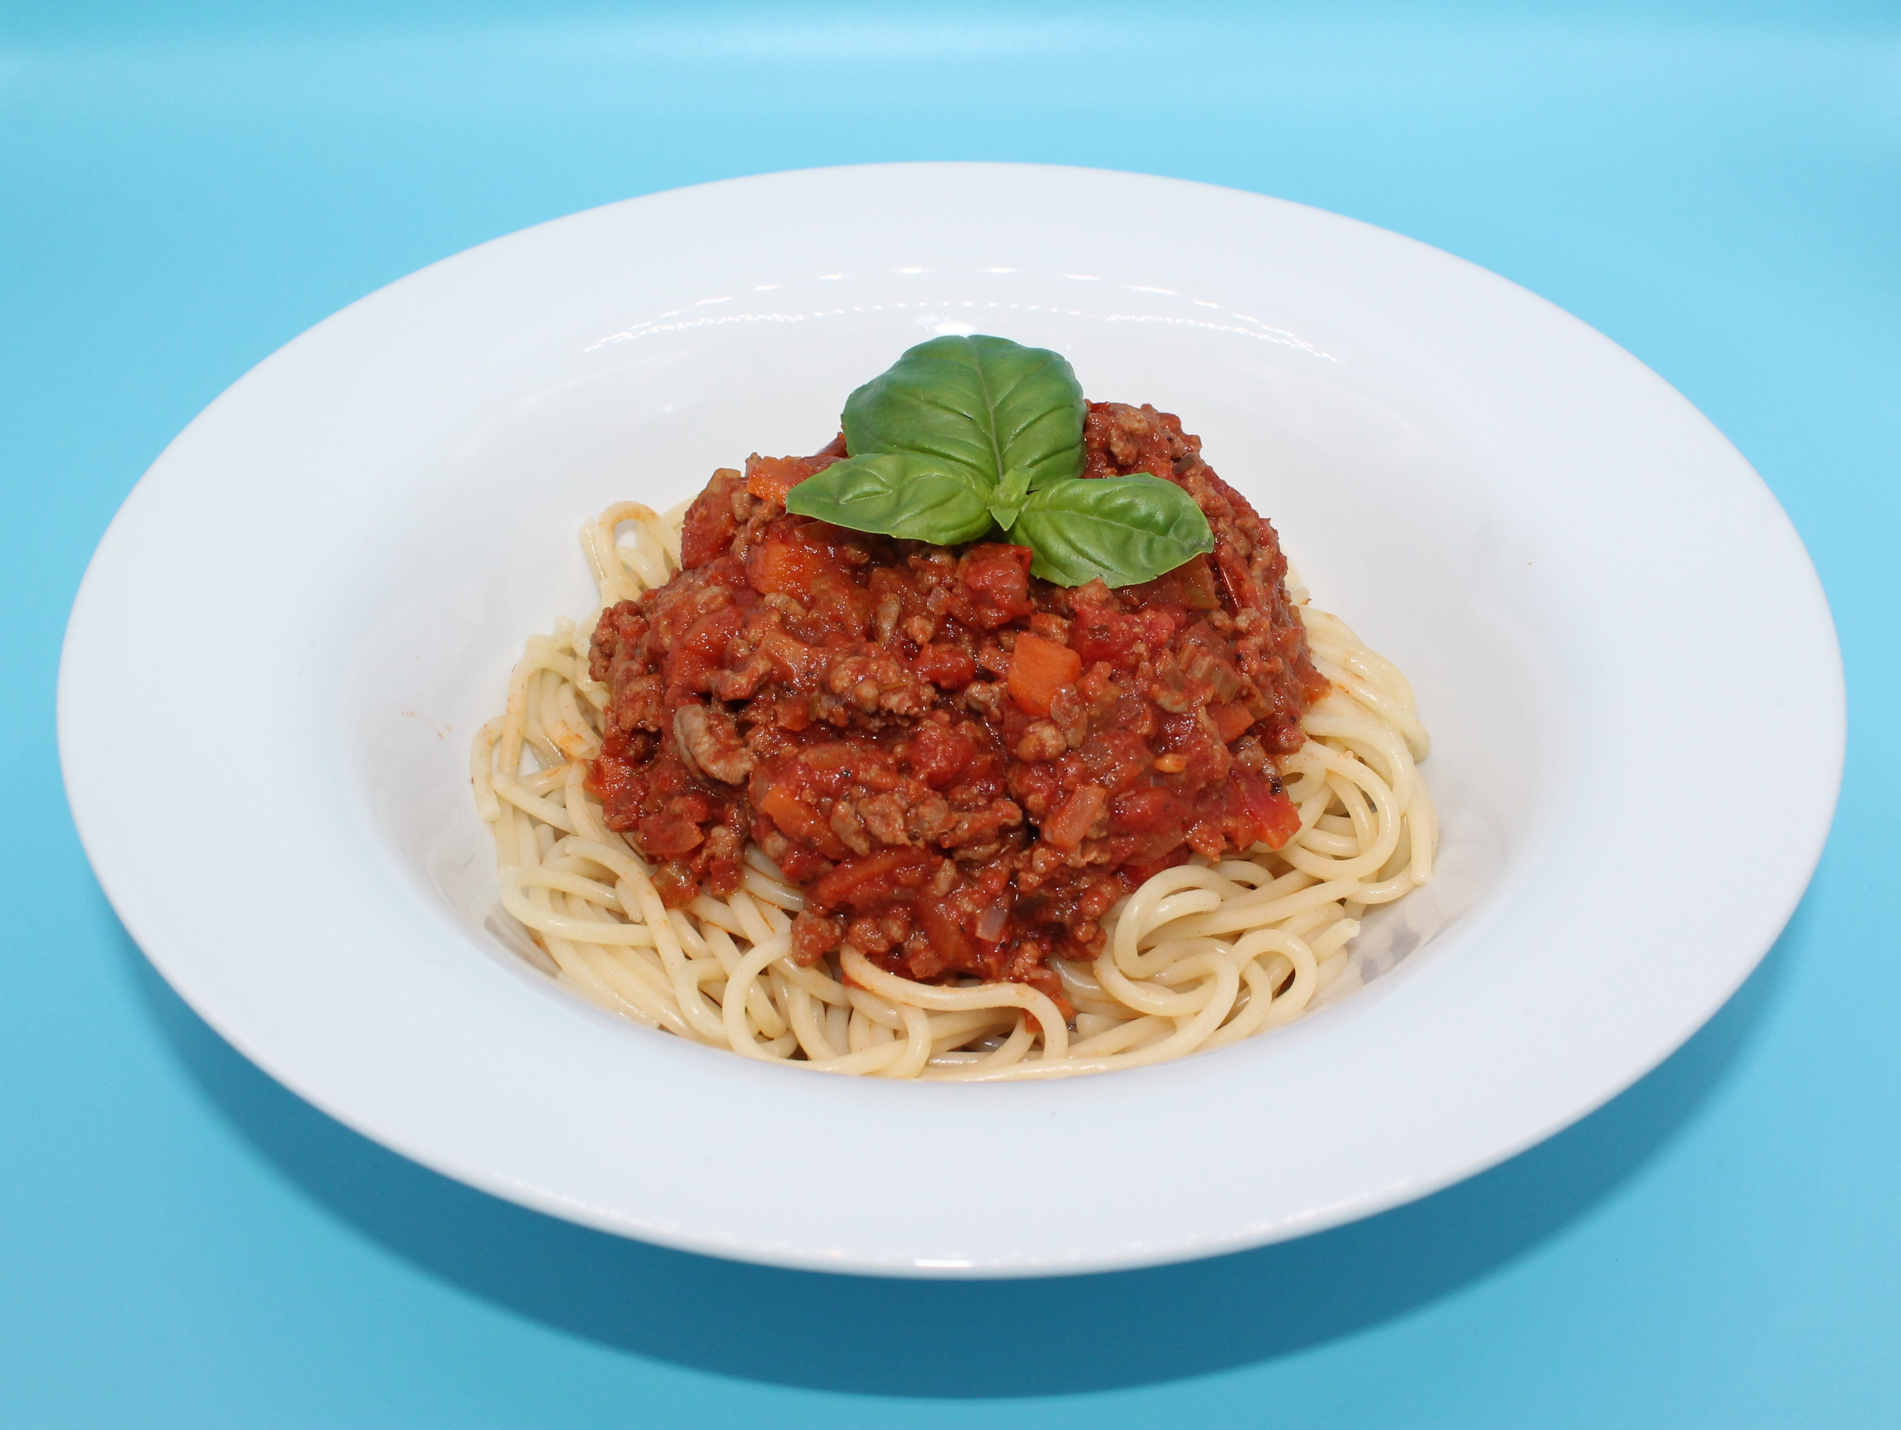

Slide 3
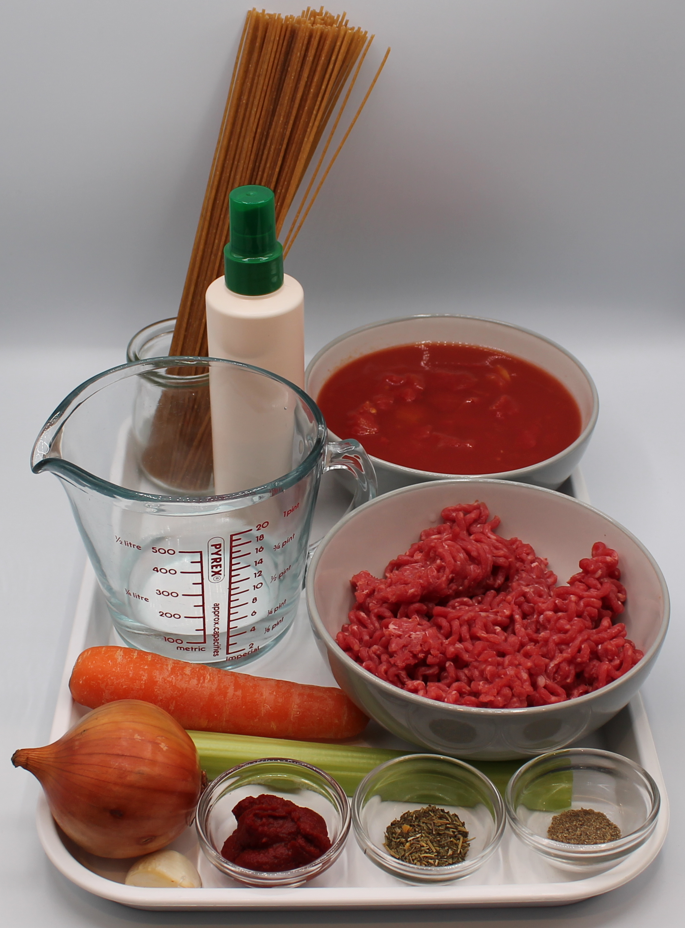
Ingredients
1 onion
1 clove garlic
1 carrot
1 celery stick
1 x 15ml oil r spray oil
250g lean minced beef
1 can chopped tomatoes (400g)
1 x 15ml spoon tomato purée
100ml water
1 x 5ml spoon
mixed herbs
Black pepper
240g wholemeal
spaghetti

Slide 4
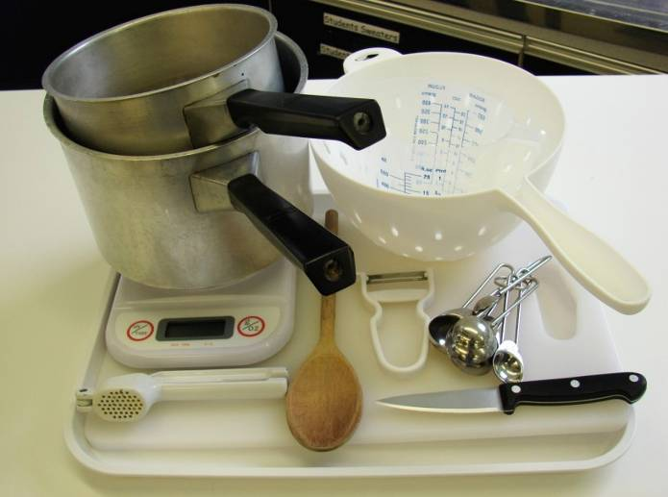
Equipment
Chopping board
Sharp knife
Garlic press
Peeler
Measuring spoons
2 saucepans
Weighing scales
Measuring jug
Heat resistant spoon
Colander

Slide 5
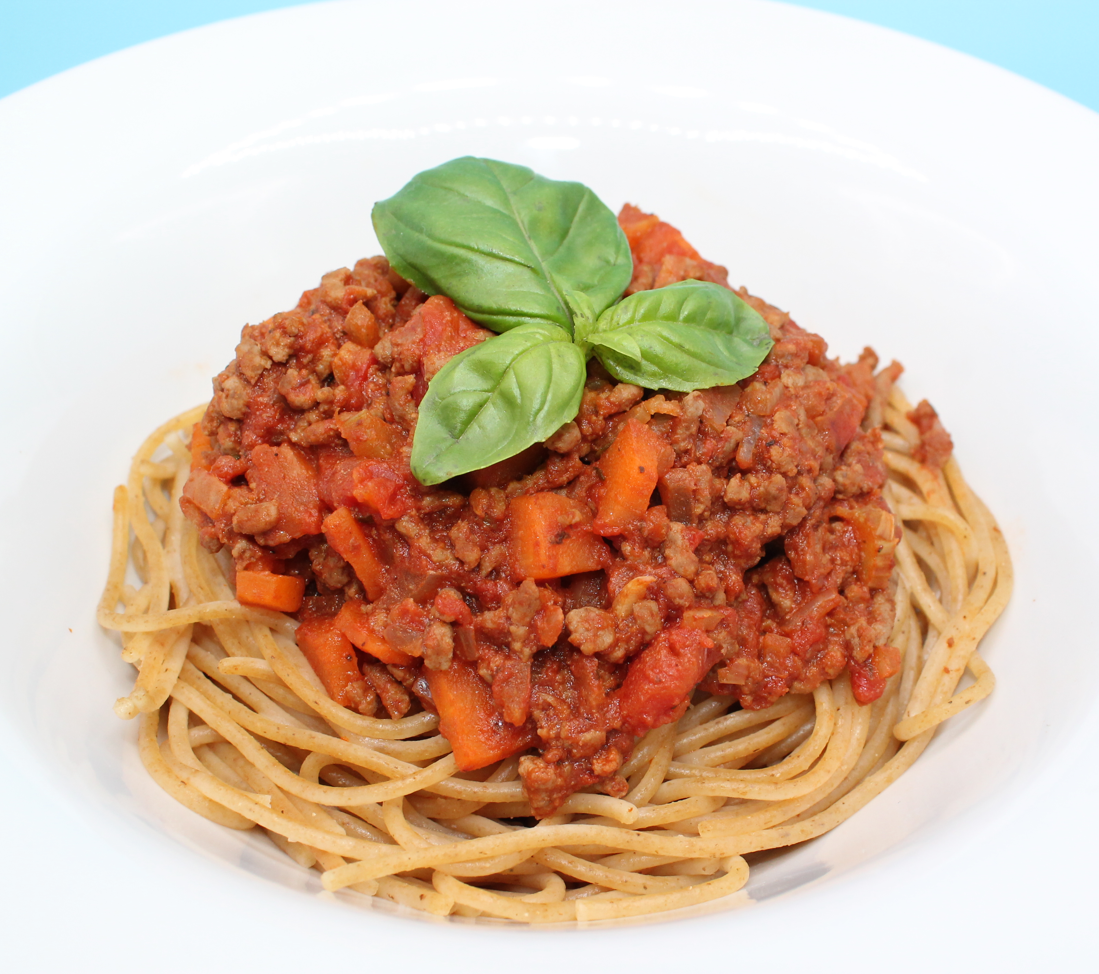
Food skills
Weigh
Measure
Peel
Crush
Chop, slice, dice and trim
Fry and sauté
Mix, stir and combine
Melt, boil and simmer
Drain

Slide 6
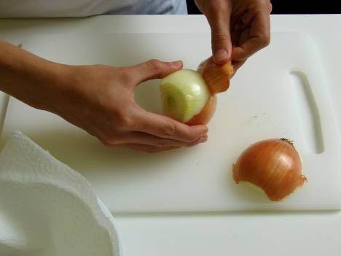
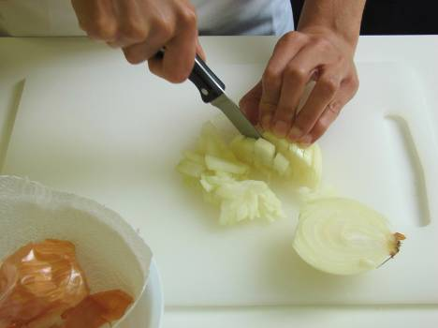
Method
Prepare the vegetables:
peel and chop the onion;

Slide 7
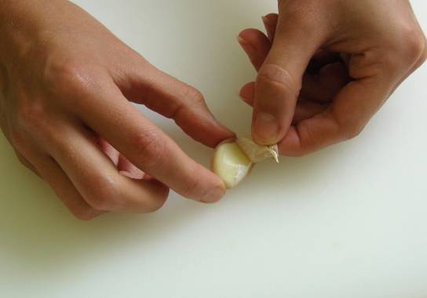
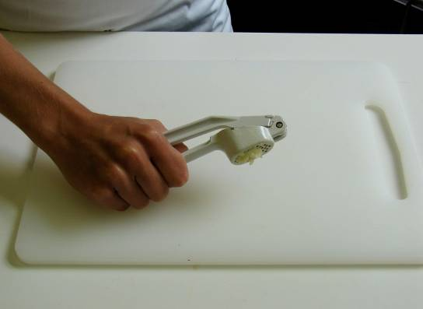
peel and crush the garlic;

Slide 8
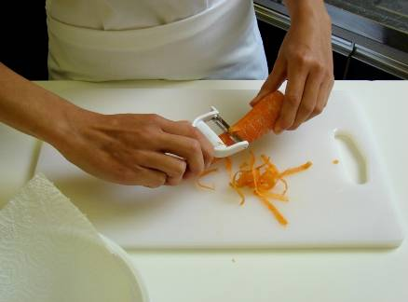
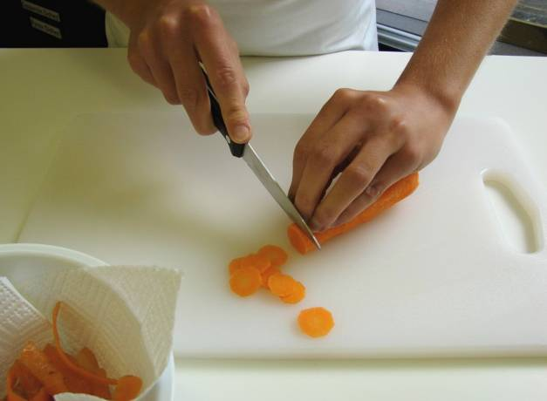
peel and slice the carrot;

Slide 9
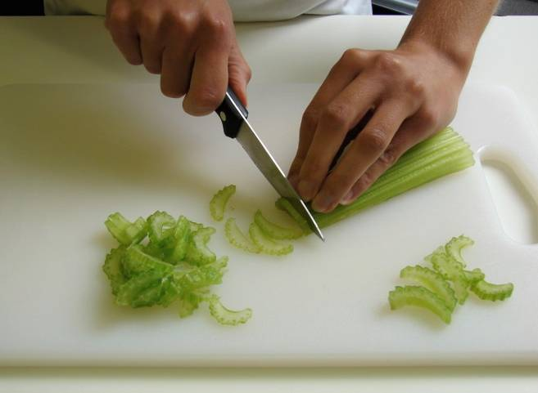
finely slice the celery.

Slide 10
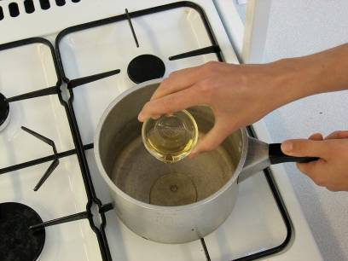
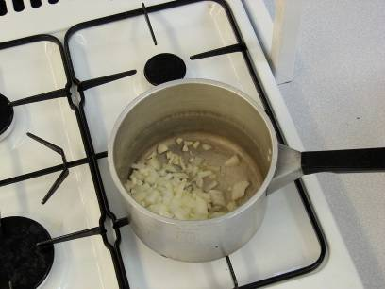
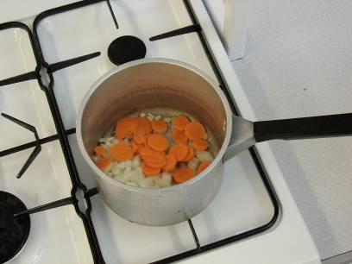
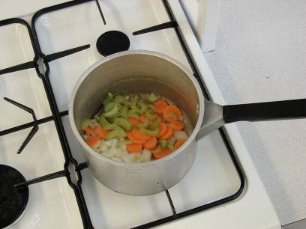
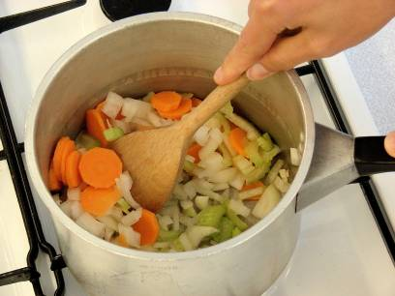
Fry the onion, garlic and carrot and celery in the oil.

Slide 11
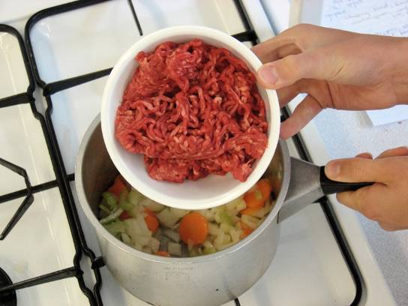
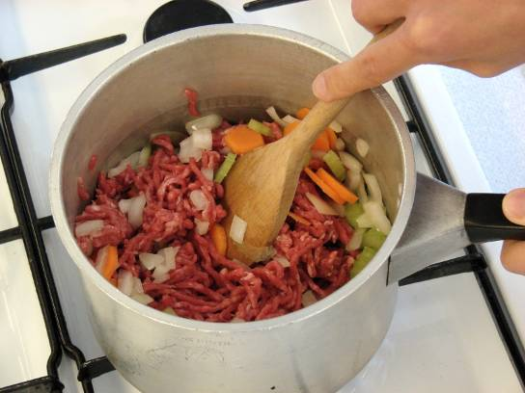
Add the meat and cook until the mince is lightly browned.

Slide 12
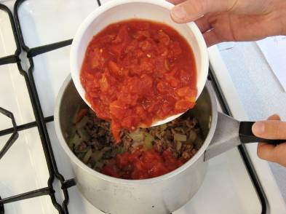
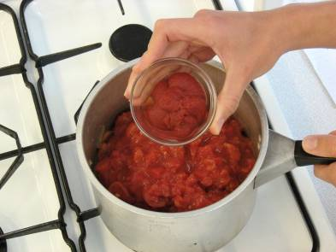
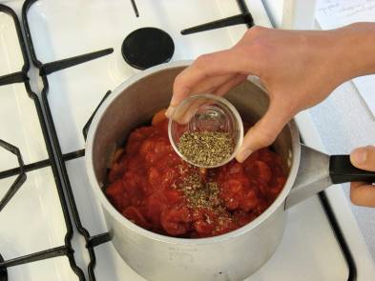
Add the tomatoes, tomato purée and mixed herbs.

Slide 13
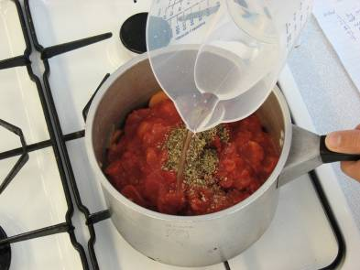
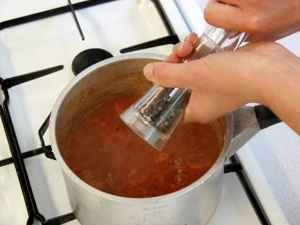
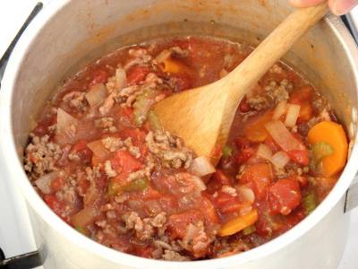
Add the water and a twist of black pepper, then stir all the ingredients together.

Slide 14
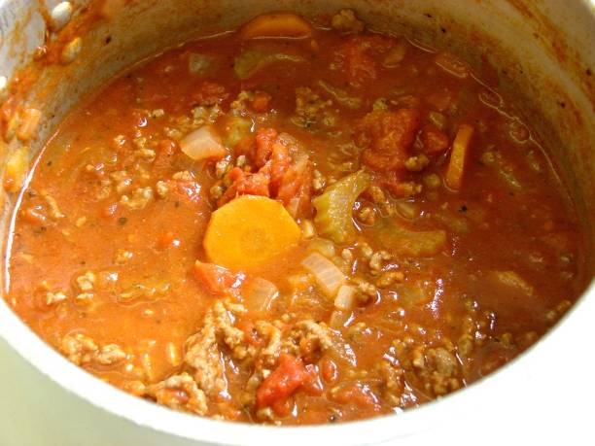
Bring to the boil, then simmer for 20 minutes.

Slide 15
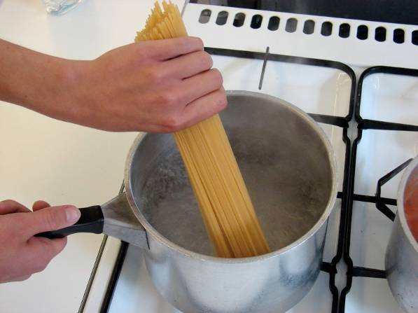
Meanwhile place the spaghetti in a separate saucepan of boiling water. Cook for 10 – 12 minutes or until the spaghetti is al dente (tender).

Slide 16
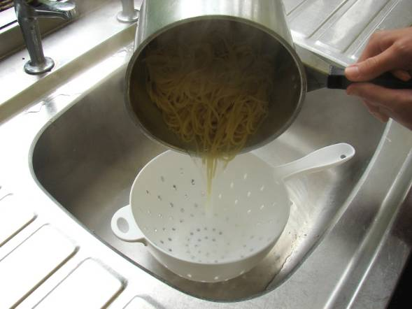
Drain the boiling water away from the spaghetti into a colander in the sink.

Slide 17
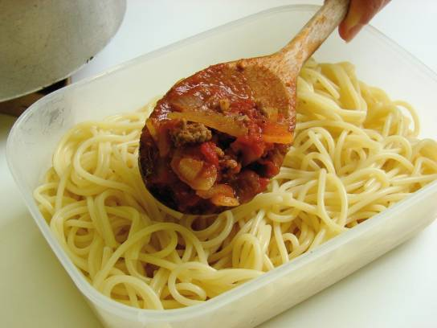
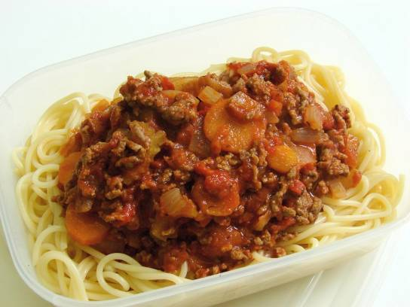
To serve, pour some of the Bolognese sauce over the spaghetti

Slide 18
Top tips
Food skills
Serving suggestion- serve your spaghetti bolognaise with parmesan cheese and fresh basil.
Transform your leftovers- use your leftover Bolognese to create a new dish like nachos, burritos or chilli con carne.
For a vegetarian option swap the minced beef for lentils or beans.
Weigh
Measure
Peel
Crush
Chop, slice, dice and trim
Fry and sauté
Mix, stir and combine
Melt, boil and simmer
Drain

Slide 19
Spaghetti Bolognese
For further information, go to:
www.foodafactoflife.org.uk

