Slide 1
Planning what to eat social story

Slide 2
What does this cover?
Time of day
Personal preference
Special occasions
Where are you eating?
Who are you eating with?
Money
Health
Cooking skills
Getting ideas
Once you have decided what to make

Slide 3
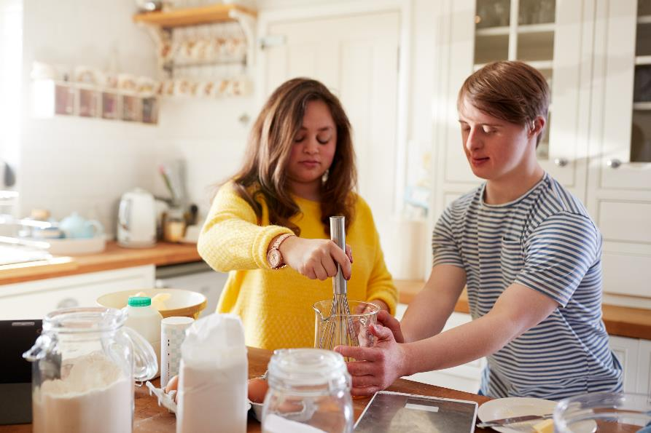
What are you planning to make?

Slide 4
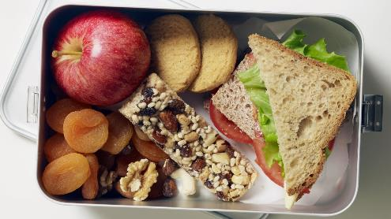
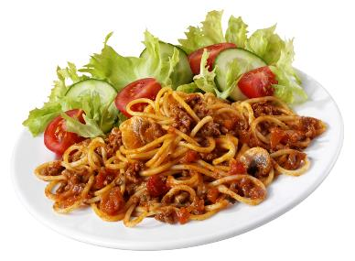
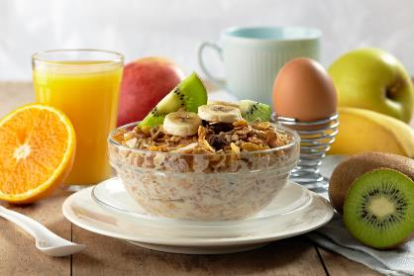
1. Time of day
Breakfast
Lunch
Evening Meal

Slide 5

2. Personal preferences
I like it …

Slide 6
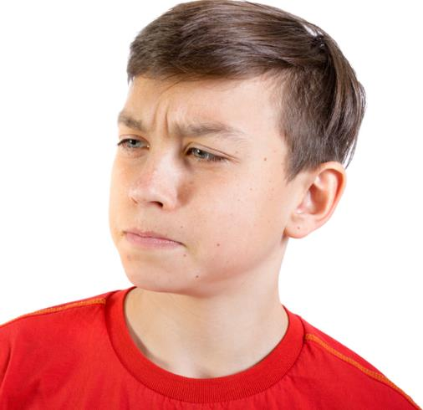
2. Personal preferences
I’m not sure I like it

Slide 7
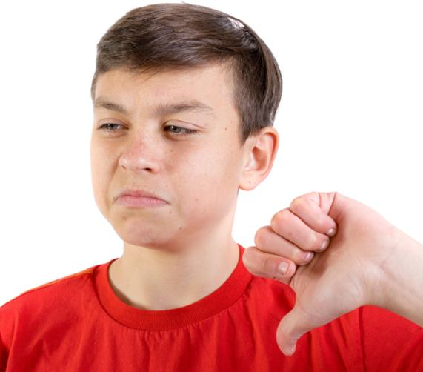
2. Personal preferences
I don’t like it …

Slide 8
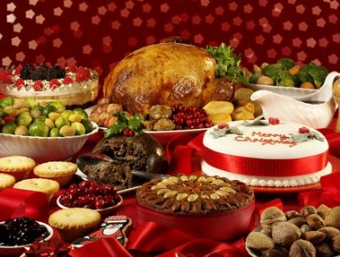
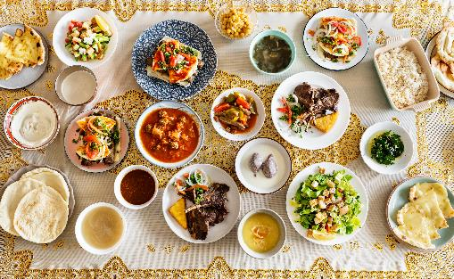
3. Special occasions
Christmas
Ramadan

Slide 9
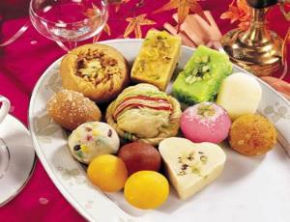
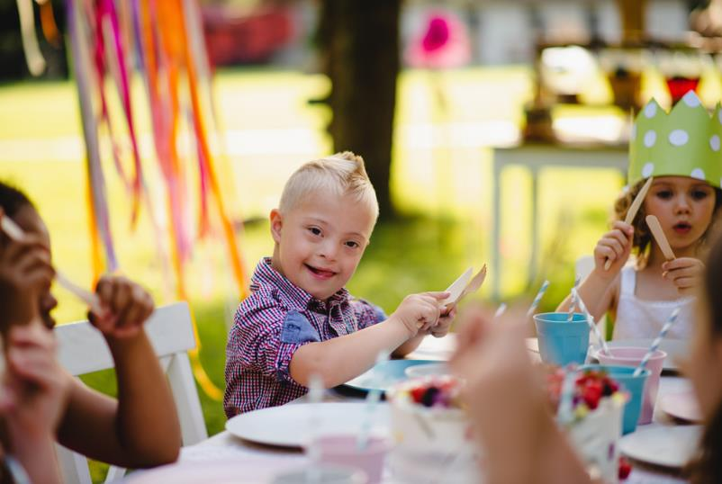
3. Special occasions
Diwali
Birthdays

Slide 10
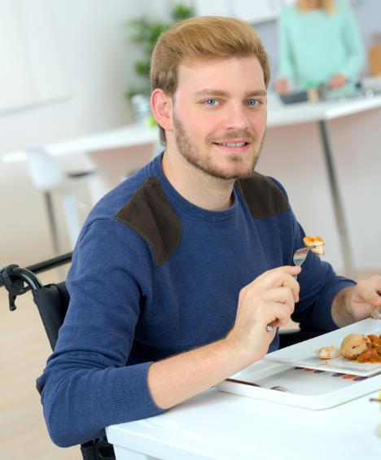
4. Where are you eating?
At home
In a park

Slide 11

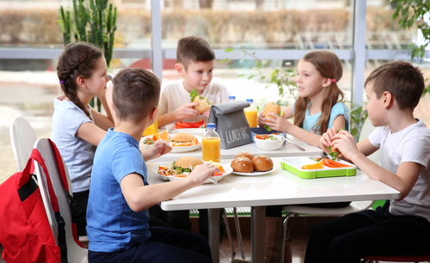
4. Where are you eating?
At school
In a cafe

Slide 12
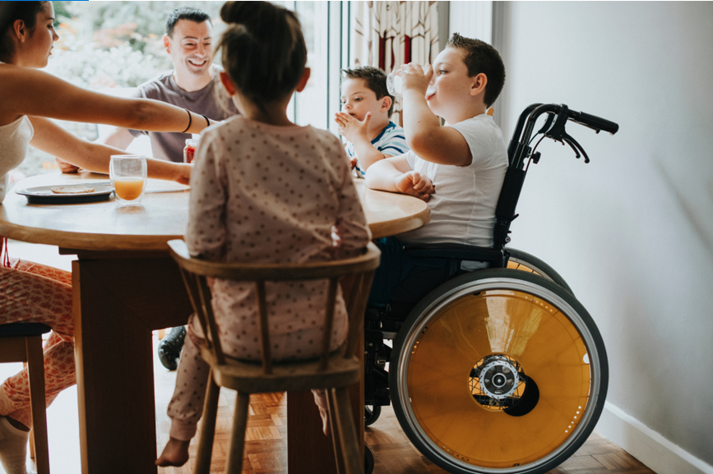
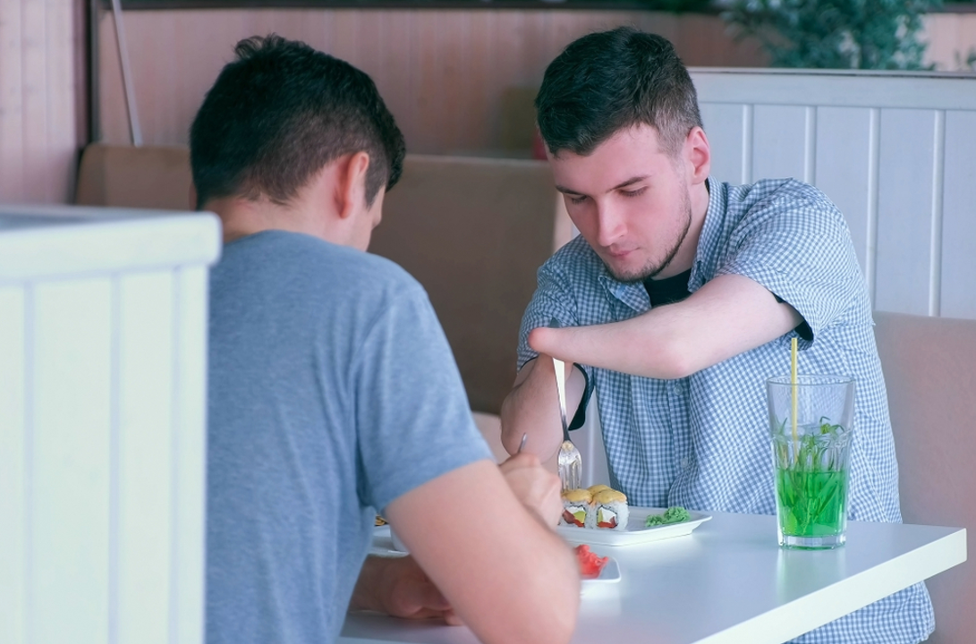
5. Who are you eating with?
Family
Friends

Slide 13
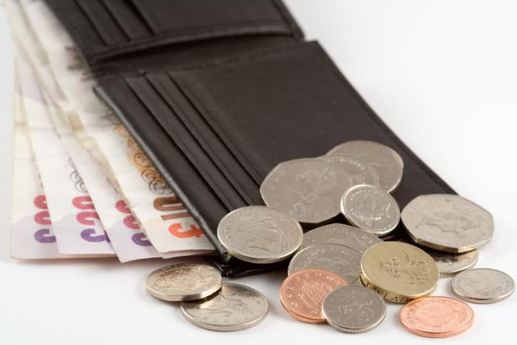
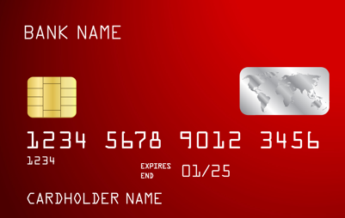
6. Money

Slide 14
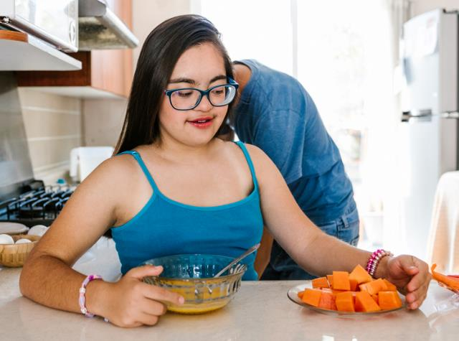
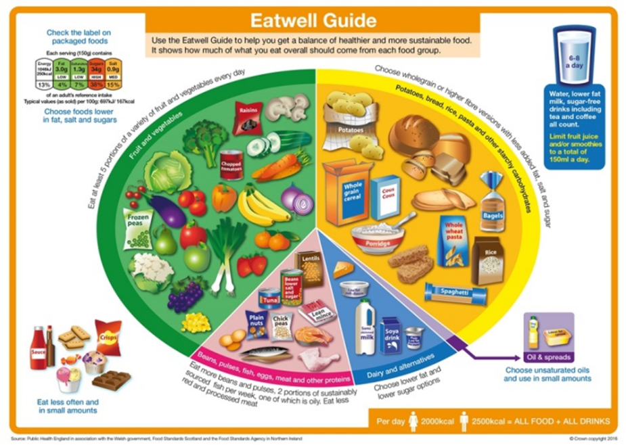
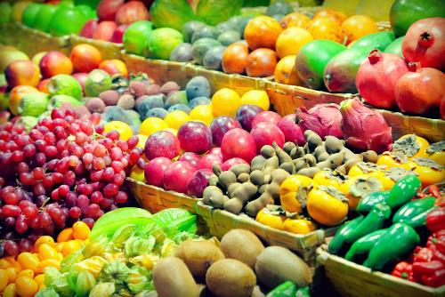
7. Health

Slide 15
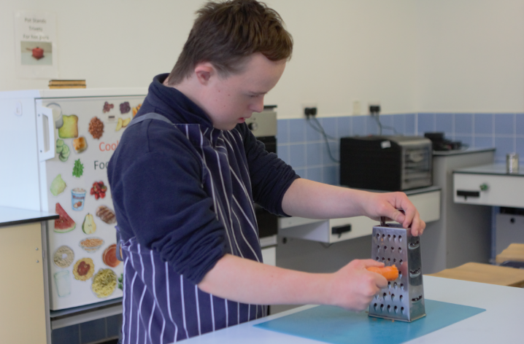
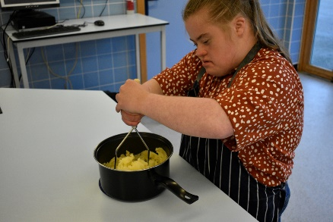
8. Cooking skills

Slide 16
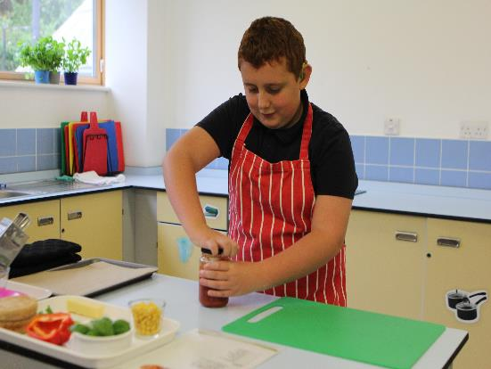
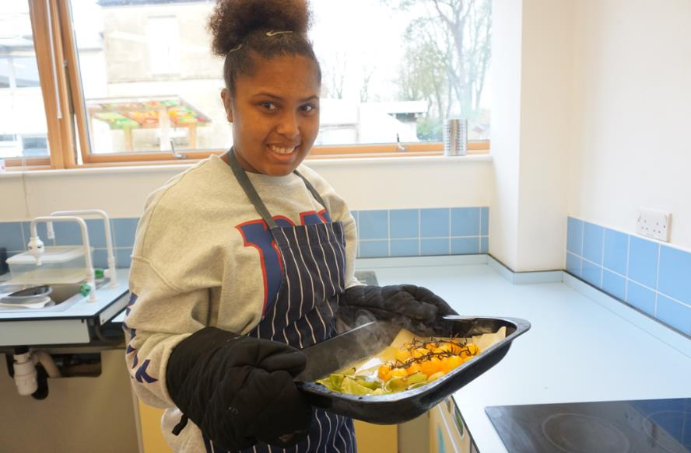
8. Cooking skills

Slide 17
9. Getting ideas
Where do you get ideas?
Recipes – books, internet, television
Friends and family – family favourites
Fake-aways – homemade versions of take-aways
Classics and traditional dishes
Food from around the world

Slide 18
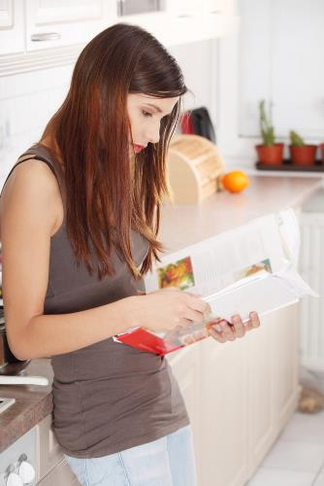
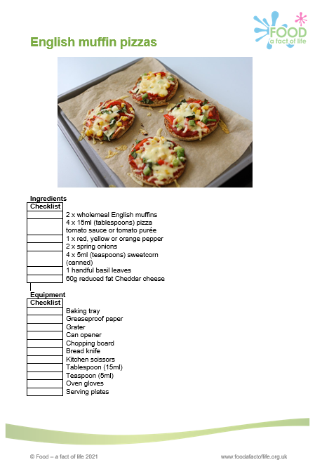
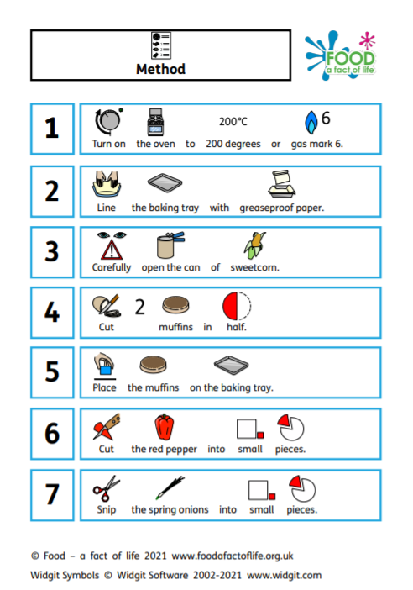
Recipes

Slide 19
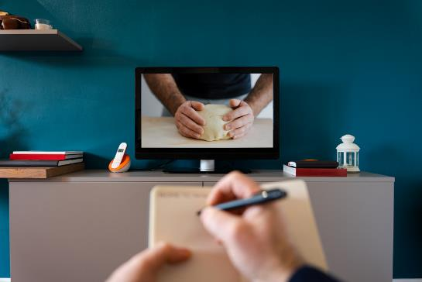
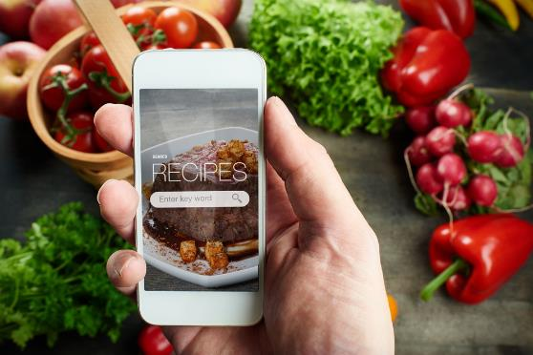
Recipes

Slide 20
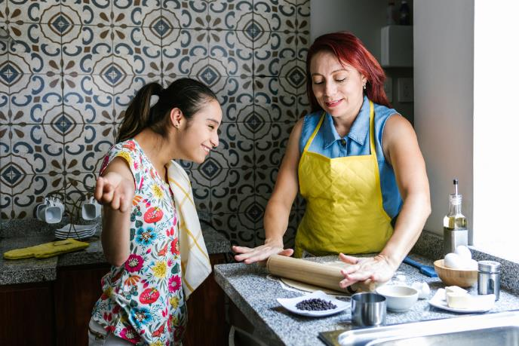
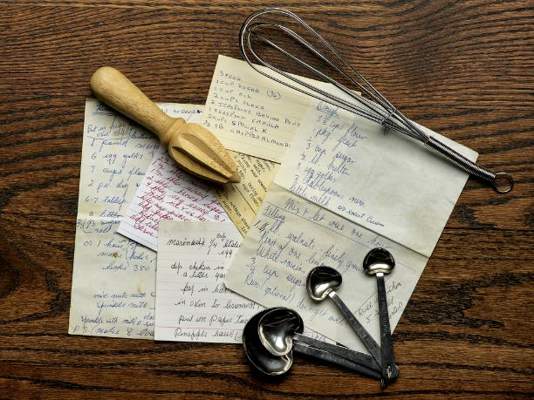
Friends and family

Slide 21
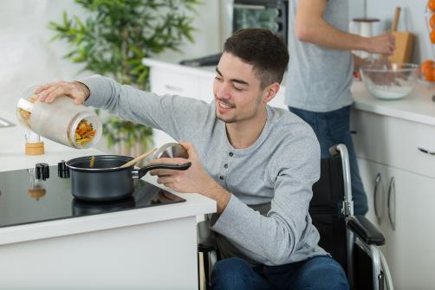
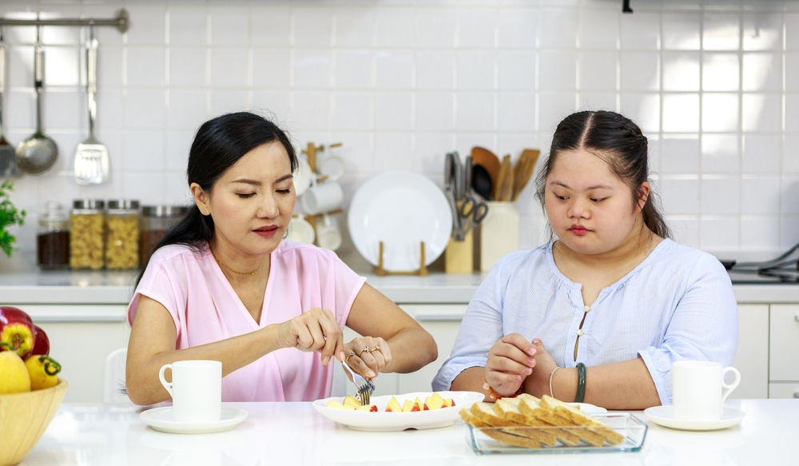
Friends and family

Slide 22
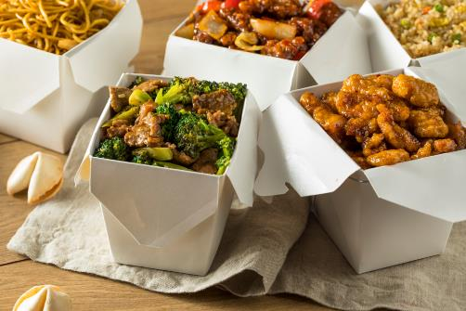
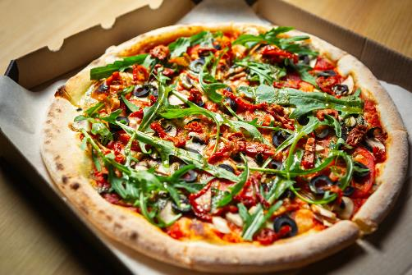
Fakeaways

Slide 23
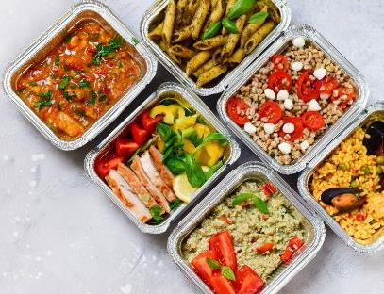
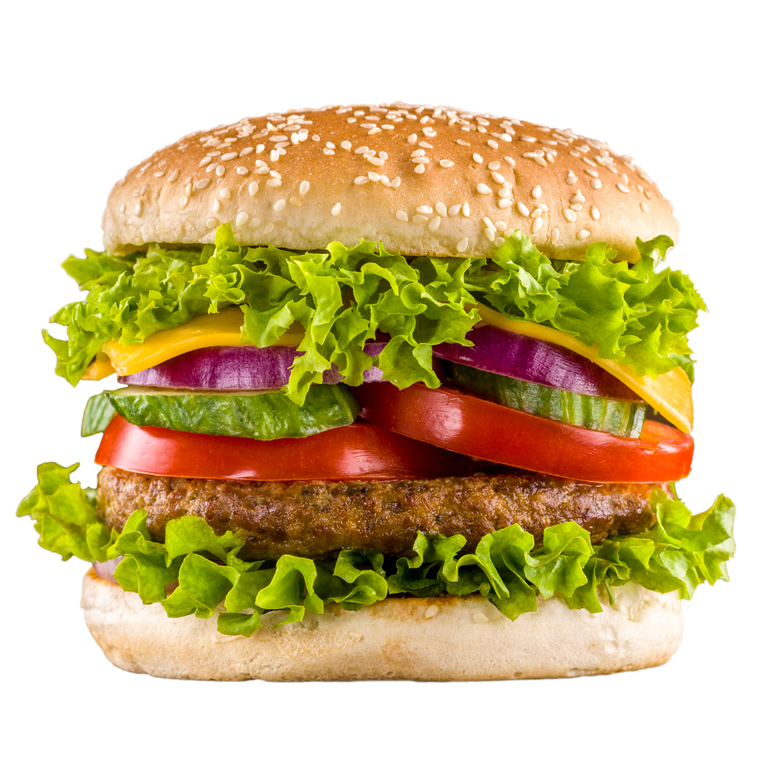
Fakeaways

Slide 24
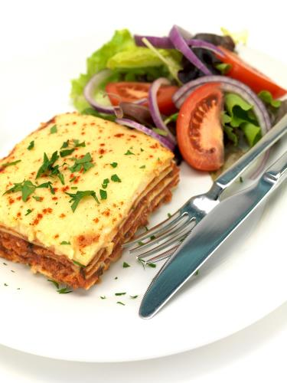
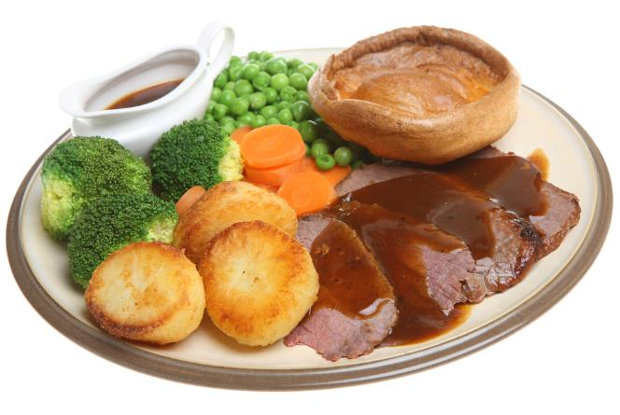
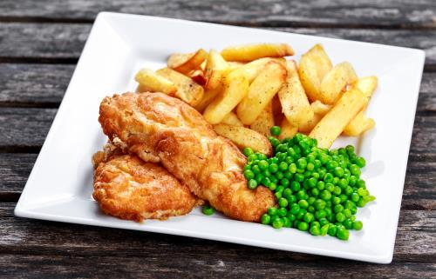
Traditional or classic dishes

Slide 25
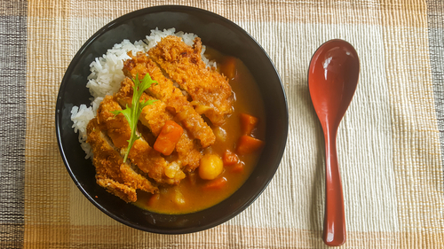
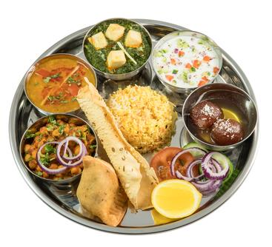
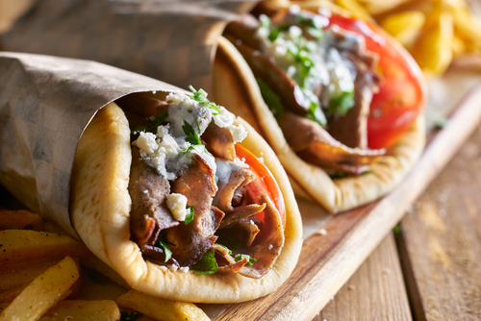
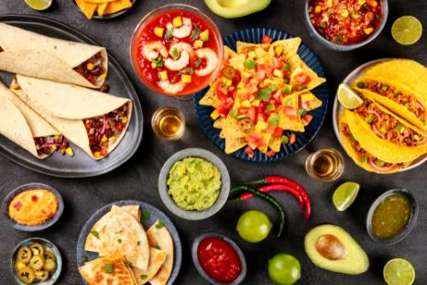
Food from around the world

Slide 26
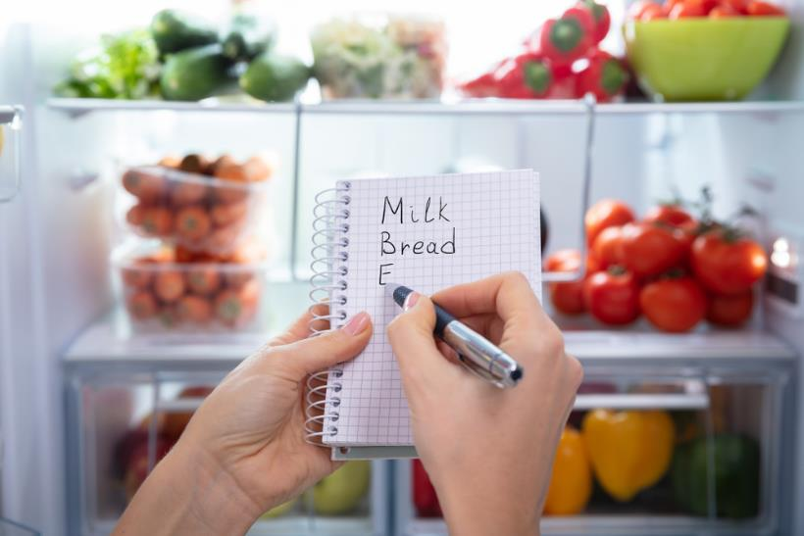
10. Once you have decided what to make
Do you have the ingredients?
Do you have the equipment?
Write a shopping list
Go shopping!

Slide 27
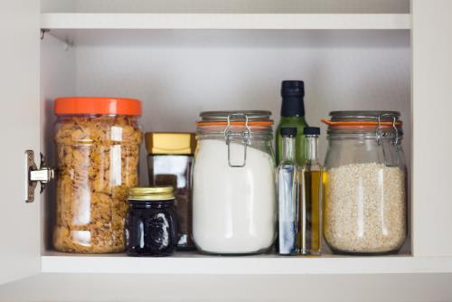
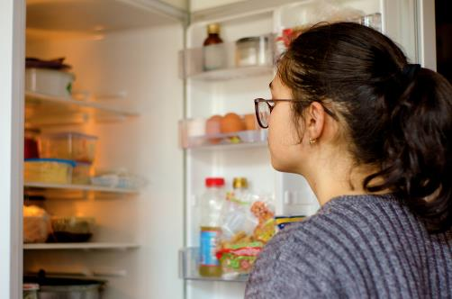
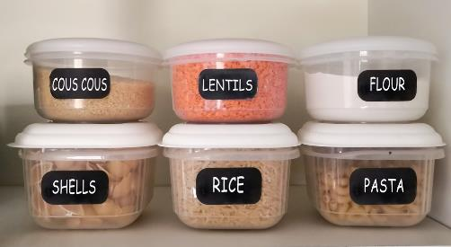
Do you have the ingredients?

Slide 28
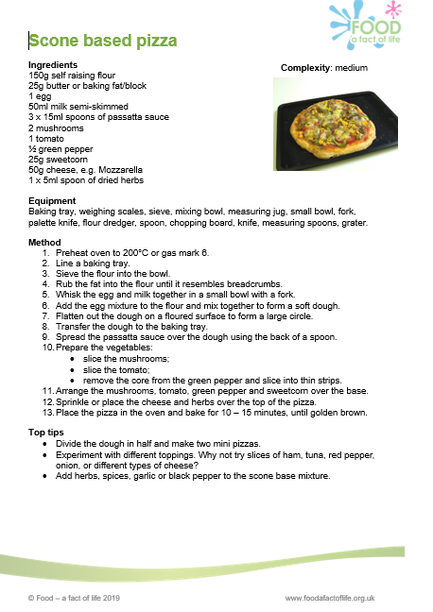
Check what you need
Ingredients

Slide 29
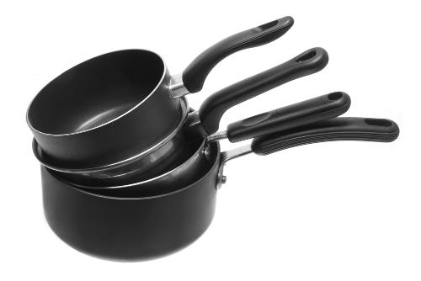
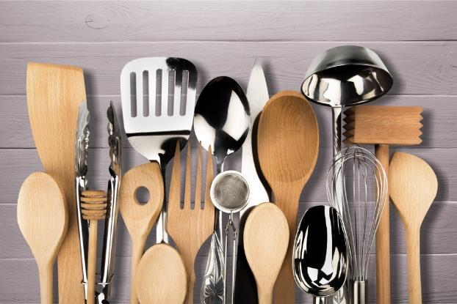

Do you have the equipment?

Slide 30
Check what you need
Equipment

Slide 31



Write a shopping list

Slide 32
What did this social story cover?
Time of day
Personal preference
Special occasions
Where are you eating?
Who are you eating with?
Money
Health
Cooking skills
Getting ideas
Once you have decided what to make

Slide 33


The story continues … let’s go shopping!

Slide 34
Planning photo storybook
For further information, go to:
www.foodafactoflife.org.uk
This resource meets the Guidelines for producers and users of school education resources about food.

