Slide 1
Food tests – instructions for pupils

Slide 2
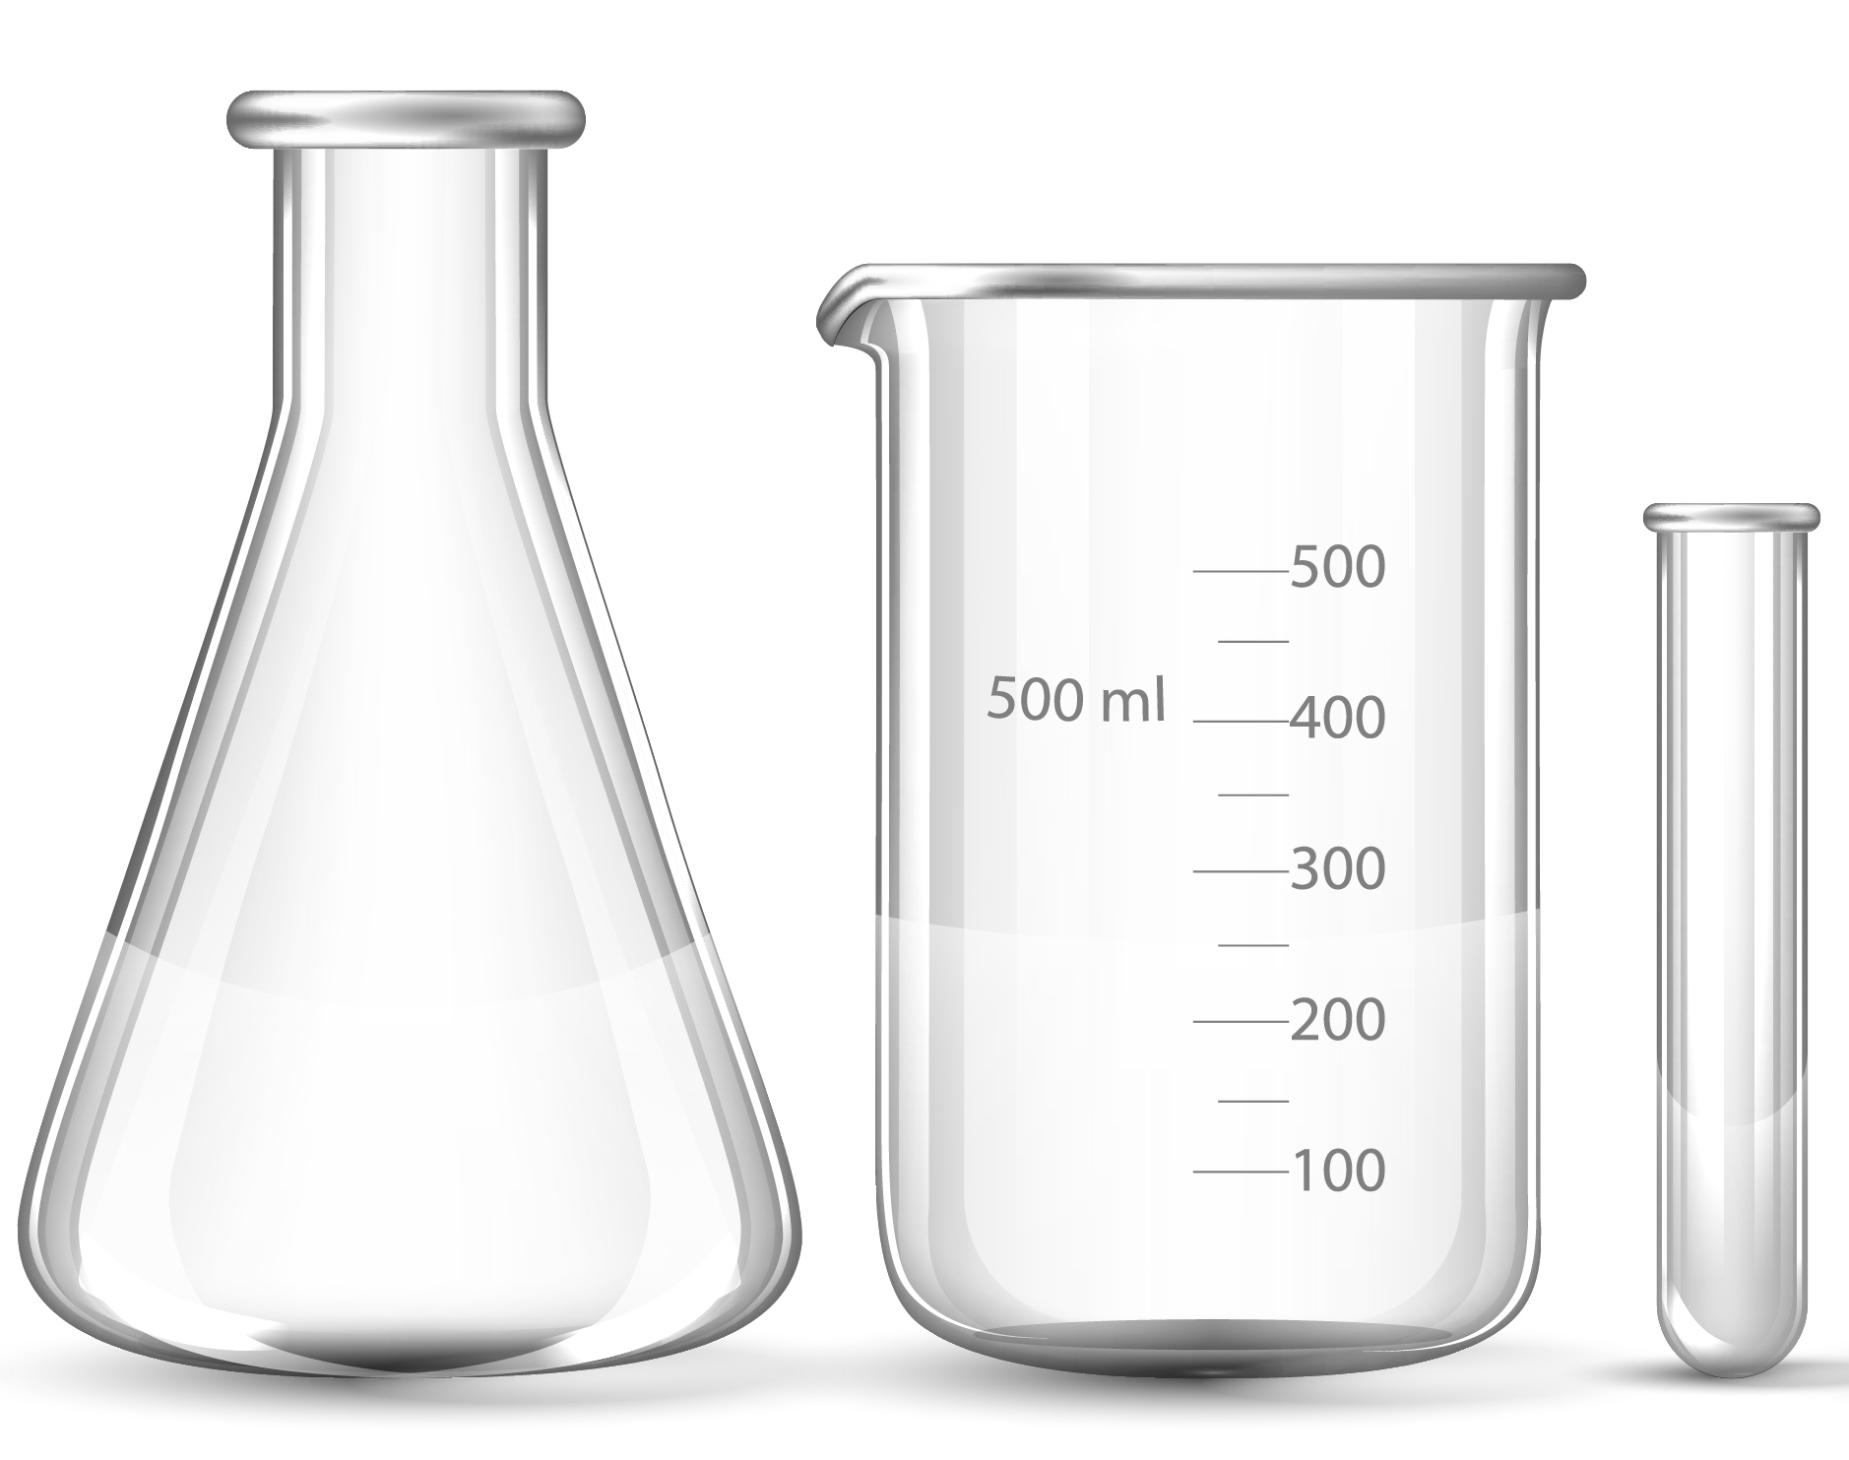
Prepare your food sample
Use a pestle & mortar to grind the food sample
Add a spatula of the food to a boiling tube & label
Add 8cm³ of distilled water
Stopper the tube & shake well
Place the solution into a water bath for 2 minutes
Cool & allow to settle in a test tube rack
Once a food sample is prepared, follow the instructions on the sheet.
Use ONE food and do all four tests. Don’t throw away the food sample after preparing.
Then, start again by preparing a second food sample.

Slide 3
Testing for starch
1 Place a small amount of food on the spotting tile.
2 Add a few drops of iodine solution to the food on the spotting tile.
3 Orange iodine solution turns blue–black if starch is present.
4 Repeat steps 1–3 for other types of food.
5 Record all your results in a results table.

Slide 4
Testing for lipid (fats)
1 Place a small amount of food into a test tube.
2 Add a few drops of ethanol to the test tube.
3 Shake the test tube and leave for one minute.
4 Pour the solution into a test tube of water.
5 Ethanol added to a solution gives a cloudy white layer if a lipid is present.
6 Repeat steps 1–5 for other types of food.
7 Record all your results in a results table.

Slide 5
Testing for protein
1 Place a small amount of food in a test tube.
2 Add 1 cm³ of Biuret reagent.
3 Blue Biuret reagent turns purple if protein is present.
4 Repeat steps 1–3 for other types of food.
5 Record all your results in a results table.

Slide 6
Testing for sugar
1 Place a small amount of food in a test tube.
2 Add enough Benedict’s solution to cover the food.
3 Place the test tube in a warm water bath for 10 minutes.
4 Blue Benedict’s solution turns brick red on heating if a sugar such as glucose is present.
5 Repeat steps 1–4 for other types of food.
6 Record all your results in a results table.

Slide 7
Copy out the following table
Food | Starch present? | Sugar present? | Protein present? | Lipid present?
White bread
Chicken
Canned pineapple
Cheese
Rice
Marshmallow
List the foods that showed a positive result for protein. Describe how you knew this was the case.
List the foods that showed a positive result for lipids. Describe how you knew this was the case.
Do the foods that contain sugar also contain starch? Use your results to justify your answer.

Slide 8
Extension
A student uses Benedict’s solution to test different foods for sugar. Each food is tested under the same conditions and the results are presented in the following table.
Suggest an explanation for these results.
Food tested | Final colour of Benedict’s solution
A | brick red
B | blue
C | yellow
D | green

