Slide 1
Diverticular disease and diverticulitis

Slide 2
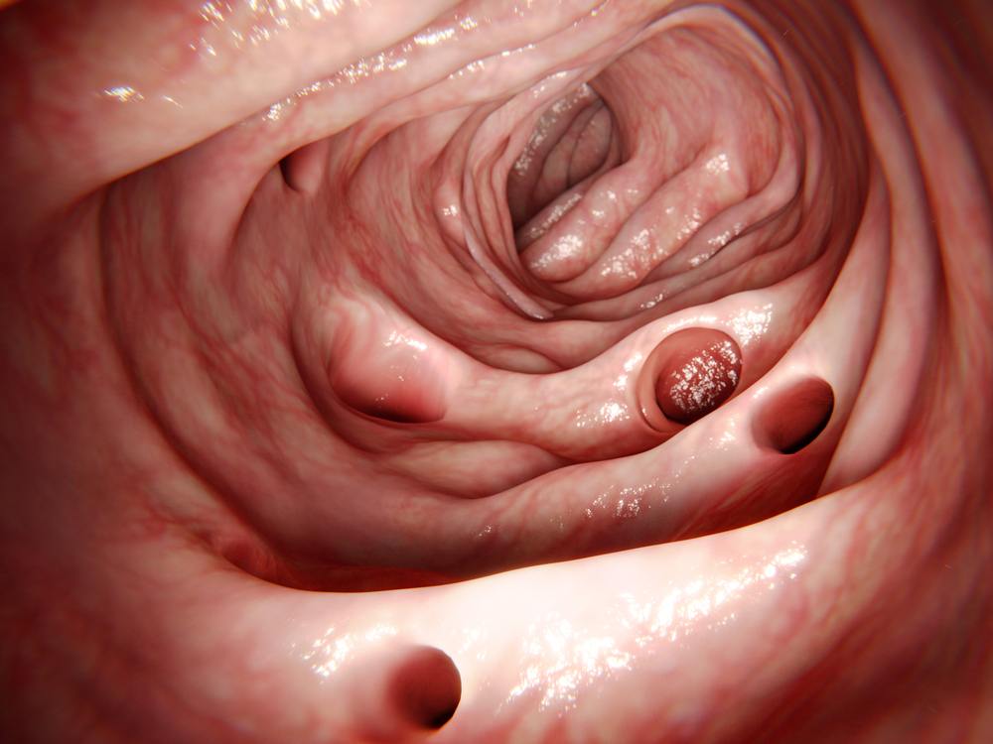
Diverticular disease and diverticulitis
Diverticular disease and diverticulitis are related digestive conditions that affect the diverticula of the large intestine (bowel).
Diverticula are small bulges or pockets that can develop in the lining of the intestine as you get older causing pain (diverticular disease) or swelling (diverticulitis).
NHS

Slide 3

Symptoms of diverticular disease and diverticulitis
Most people with diverticula do not display any symptoms.
When symptoms do occur, such as pain in the lower tummy, it is known as diverticular disease.
If the diverticula become inflamed or infected, causing more severe symptoms, it's called diverticulitis.
NHS

Slide 4
Symptoms of diverticular disease and diverticulitis
Symptoms of diverticular disease include:
tummy pain, usually in your lower left side, that tends to come and go and gets worse during or shortly after eating (emptying your bowels or passing wind eases it)
feeling bloated
constipation, diarrhoea, or both
occasionally, mucus in your faeces
If your diverticula become infected and inflamed (diverticulitis), you may suddenly:
get constant, more severe tummy pain
have a high temperature of 38C or above
feel sick or vomit
feel generally tired and unwell
get blood in your faeces or rectal bleeding
NHS

Slide 5

Diagnosis
Diverticular disease and diverticulitis are diagnosed through either a colonoscopy or a CT scan.

Slide 6
Treatment
A low fibre diet increases the chance of getting diverticular disease. Eating a high fibre diet may help ease the symptoms of diverticular disease and stop you developing diverticulitis.
Most people do not eat enough dietary fibre. The recommended average intake for dietary fibre is 30g per day for adults. Children need proportionately less.
Age (years) | Recommended intake of fibre (g/day)
2-5 years | 15 grams
5-11 years | 20 grams
11-16 years | 25 grams
17+ years | 30 grams

Slide 7
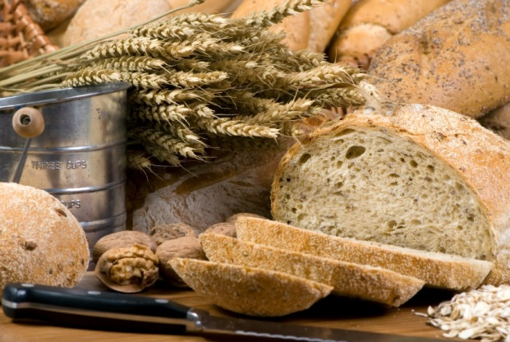
Sources of dietary fibre
Components of dietary fibre are found in different proportions in food, therefore it is important to eat a variety of fibre-containing foods.
Dietary fibre is found in:
wholegrain cereals and cereal products;
beans;
lentils;
fruit and vegetables;
nuts and seeds.

Slide 8
Suggest some ways of increasing fibre within your diet
Choose a high fibre breakfast cereal e.g. bran flakes, or porridge.
Go for wholemeal or granary breads instead of white bread.
Choose wholegrains like wholewheat pasta, bulgur wheat or brown rice.
Go for potatoes with skins e.g. baked potato or boiled new potatoes.
For snacks try fruit, vegetable sticks, rye crackers, oatcakes, unsalted nuts or seeds.
Include plenty of vegetables with meals – either as a side dish or added to sauces, stews or curries.
Add pulses like beans, lentils or chickpeas to stews, curries and salads.
Have some fresh or dried fruit, or fruit canned in natural juice for dessert.

Slide 9
Diverticular disease and diverticulitis
For further information, go to:
www.foodafactoflife.org.uk
This resource meets the Guidelines for producers and users of school education resources about food.

