Slide 1
Dairy farming

Slide 2
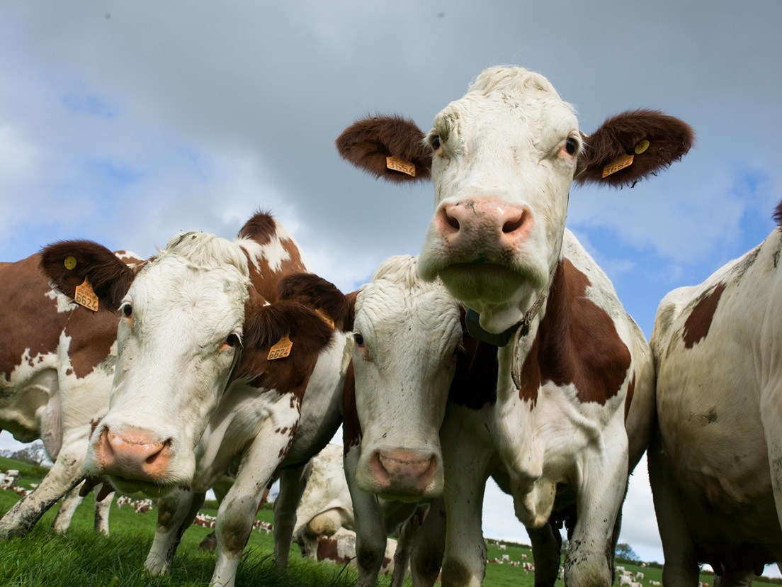
Where does milk come from?
Milk is from a dairy cow.
Dairy cows are reared by farmers around the UK.
Have you seen a dairy cow before?

Slide 3
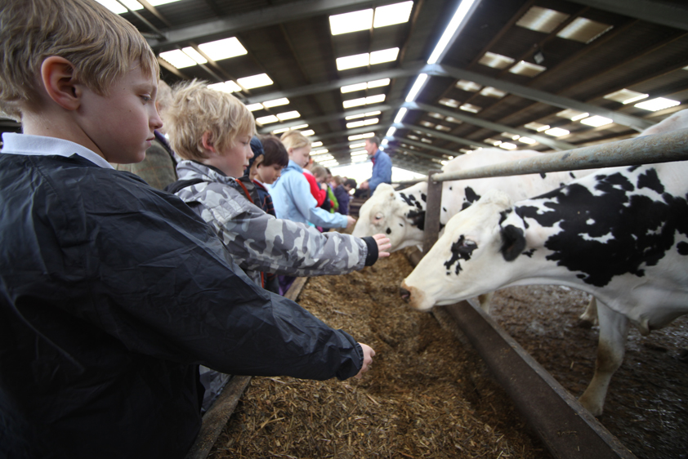
The dairy farm
There are thousands of dairy farms in the UK.
Dairy farms are all different shapes and sizes, with small herds of 50 cows to farms with more then 1,000 cows.

Slide 4
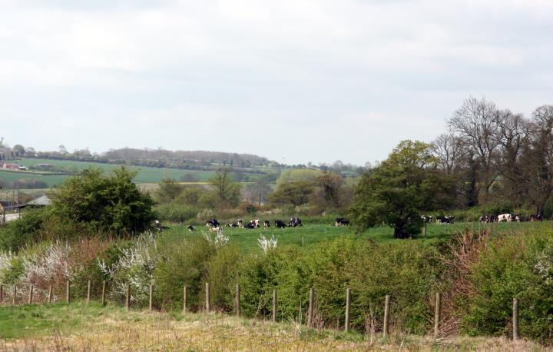
The dairy farm
The farmer’s most important job is to look after the health and welfare of the cows.
Farmers also look after the countryside.

Slide 5
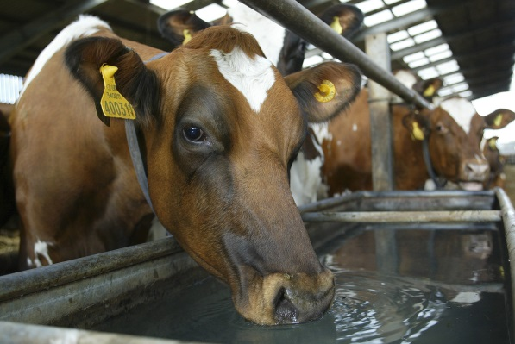
The dairy cow
Most British dairy cows eat grass in the field during the summer and silage in the winter – around 25-50kg a day.
They drink 60-80 litres of water, although some drink more if they produce more milk.

Slide 6
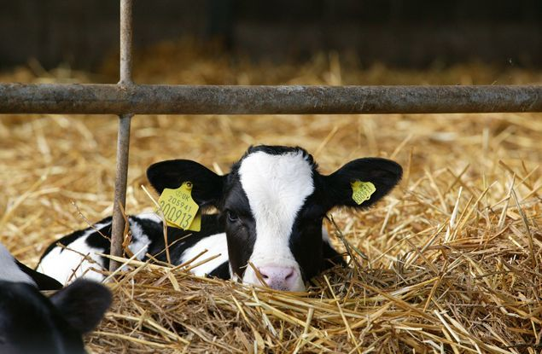
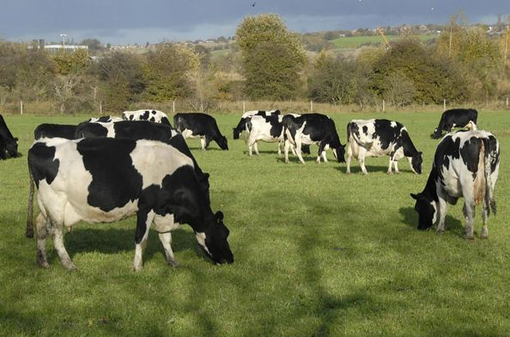
The dairy cow
Each cow wears ear tags with a unique number – this is also on their cattle passport.
Most dairy cows graze outdoors during the summer and stay indoors during the winter.

Slide 7
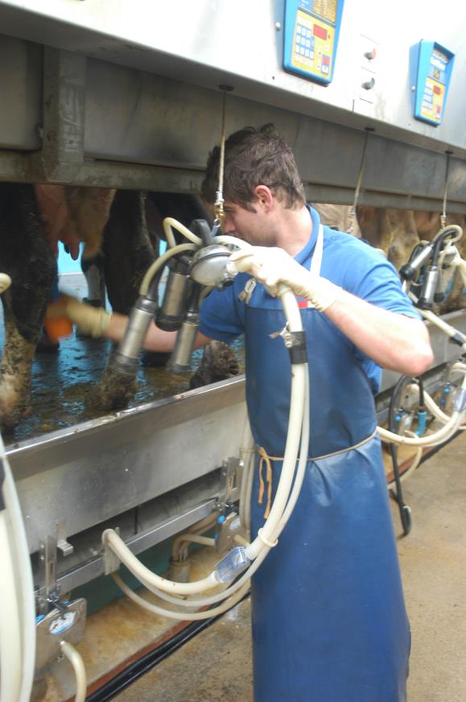
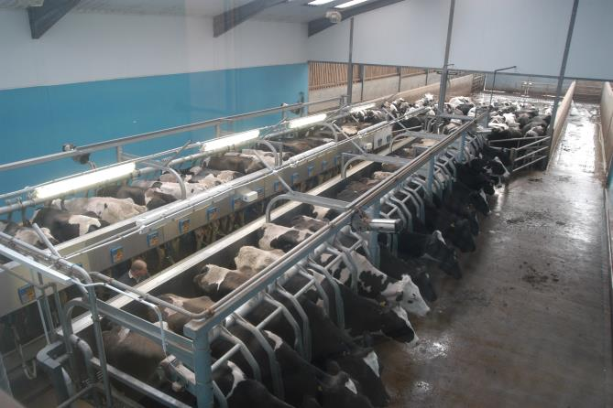
Milking
Cows are milked on average 2-3 times a day.

Slide 8
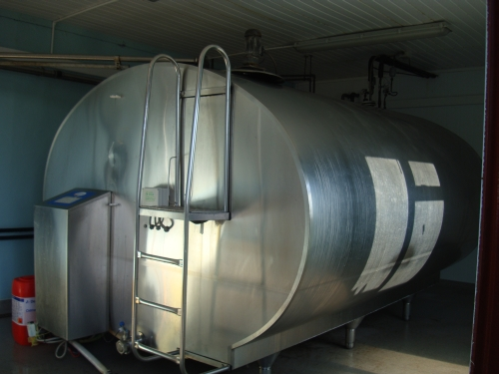
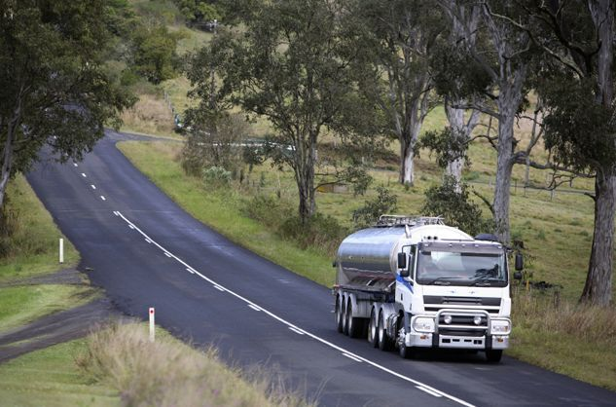
Milking
Once the cows have been milked the milk is chilled and stored.
A milk tanker calls at the farm to collect the milk.

Slide 9
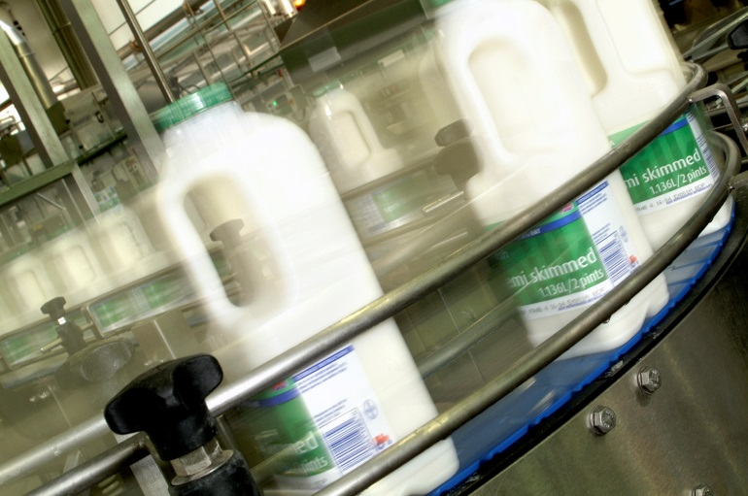
Processing
The milk from the farm is treated to stop any naturally occurring bacteria turning it sour.
The milk is put into bottles or cartons and is sent to different places for sale.

Slide 10
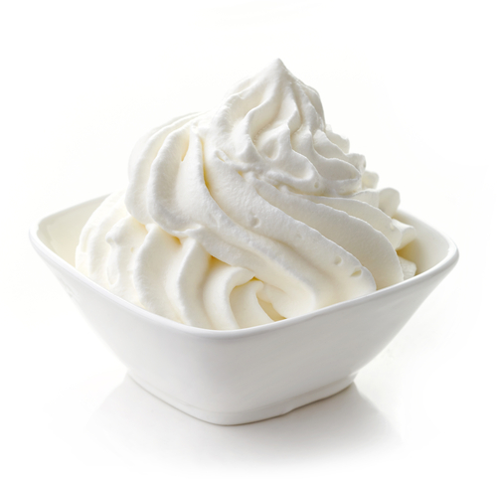
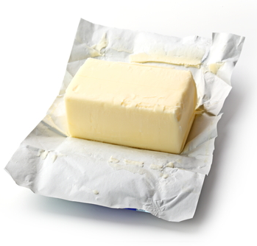
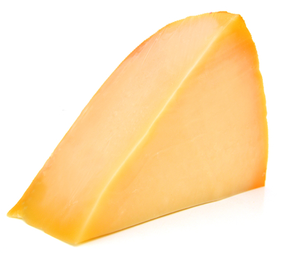
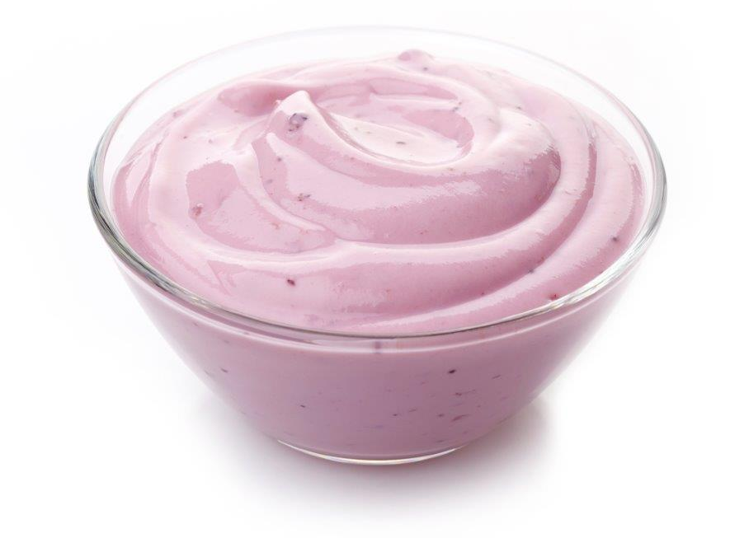
Processing
Milk is also used to make cheese, yogurt, cream and butter.

Slide 11
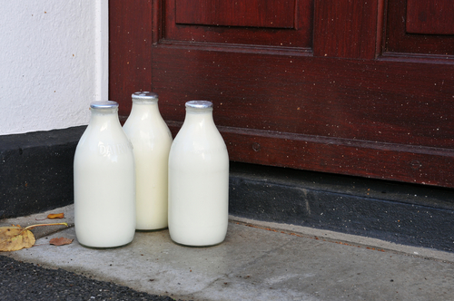
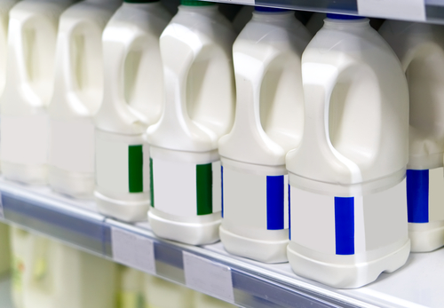
In the shops
The fresh milk is available for sale. It is kept cold to keep at its best.
Some people have milk delivered to their home, others buy it from local shops or supermarkets.

Slide 12
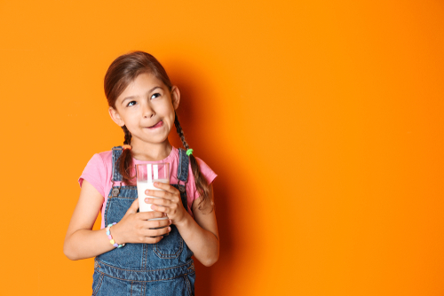
Drinking milk
Many school children have milk at school as a drink.

Slide 13
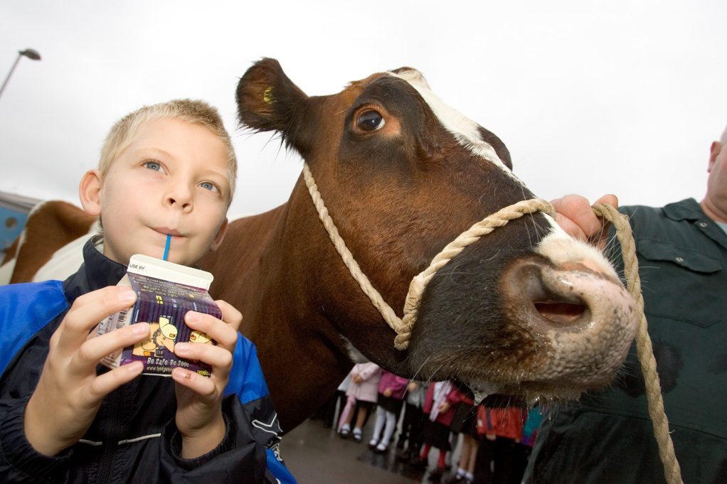
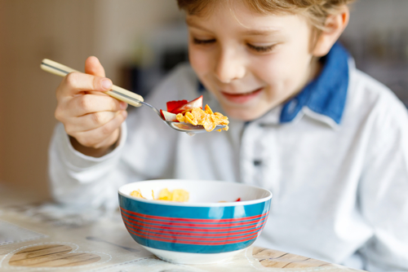
Drink and enjoy
Milk can be enjoyed as a drink and poured over breakfast cereal.

Slide 14
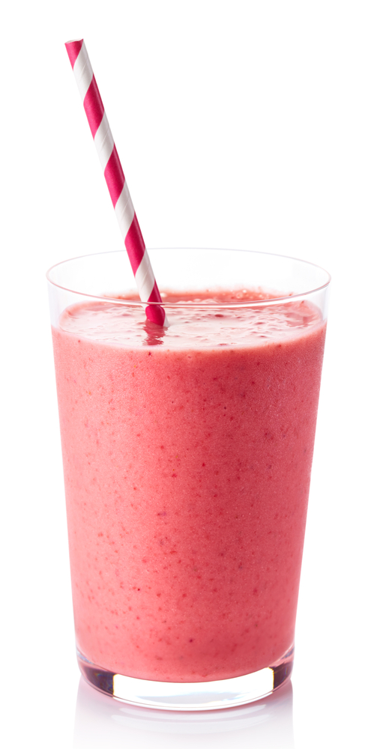
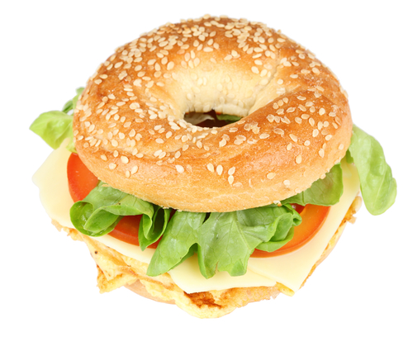
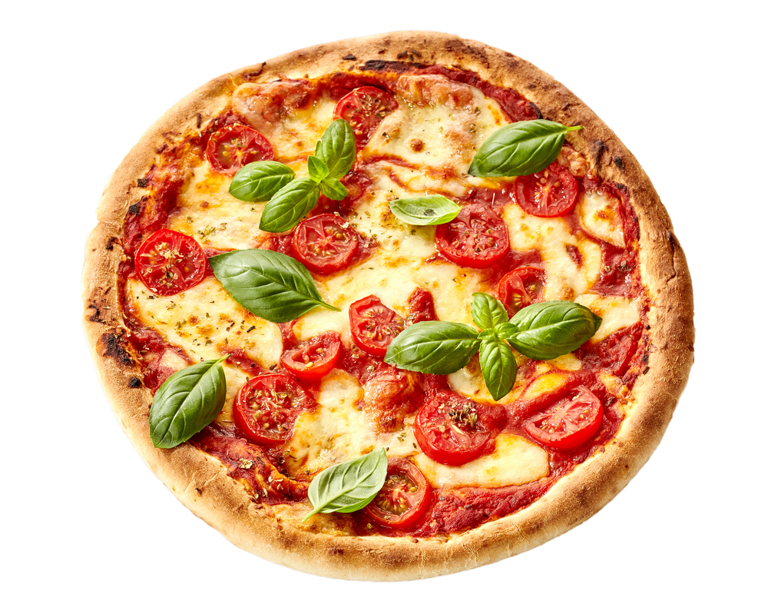
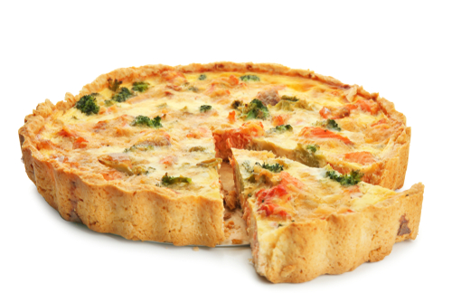
Dishes
Milk, yogurt and cheese are also used in many dishes.

Slide 15
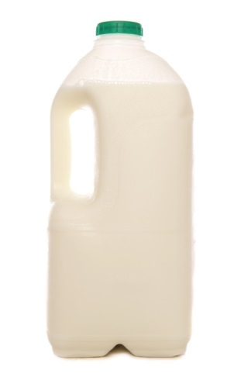
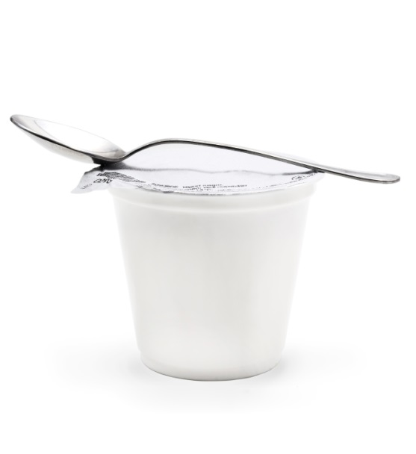
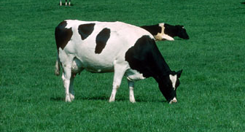
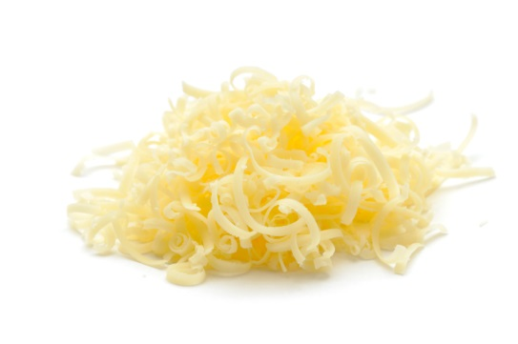
Summary
Milk is from a dairy cow.
Milk – from the dairy cow.
Yogurt and cheese is made from milk.

Slide 16
For further information, go to:
www.foodafactoflife.org.uk

