Slide 1
Where does meat come from?

Slide 2
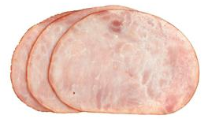
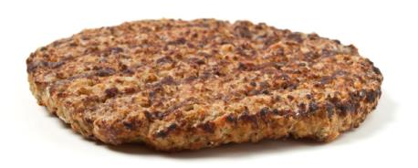
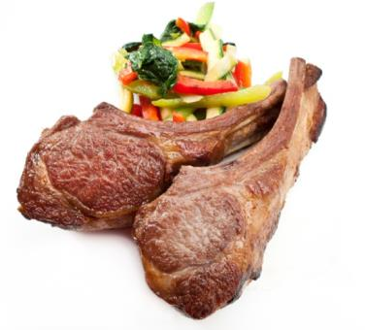
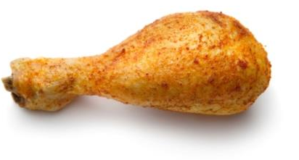
What are these?
They are all types of meat.
Where do they come from?
They are from different types of animals.

Slide 3
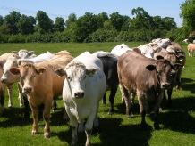
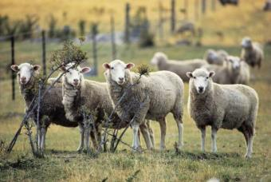
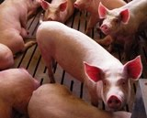
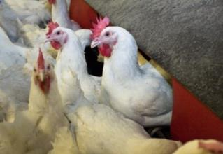



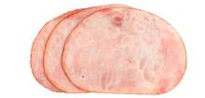
Meat is from different animals
Cattle
Sheep
Pigs
Chicken
Beef burger
Lamb chop
Ham
Chicken drumstick

Slide 4
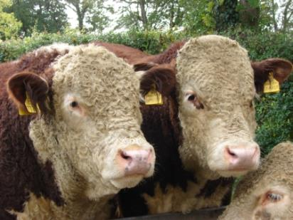
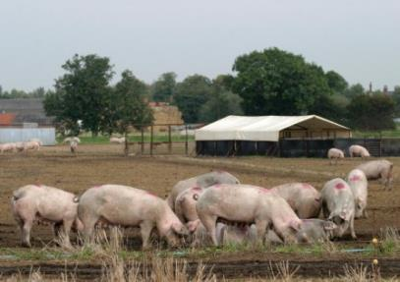
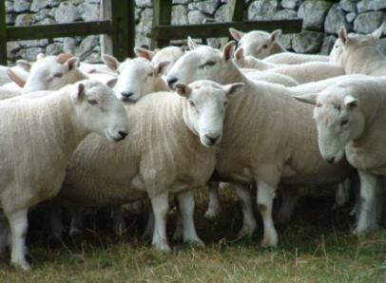
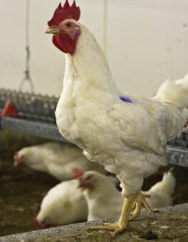
Meat
Animals are reared by farmers across the UK for our food.
Popular animals include cattle, sheep, pigs and chicken.

Slide 5

What are these?
Cattle

Slide 6
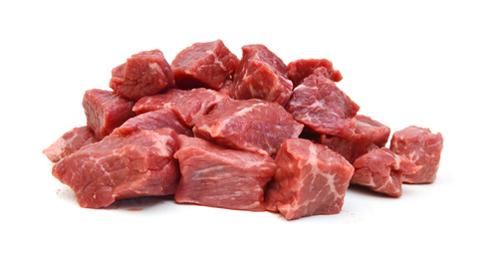
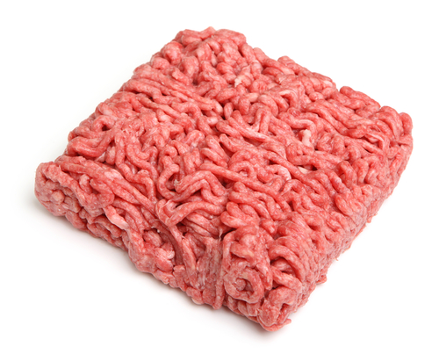
What meat is from cattle?
Beef

Slide 7
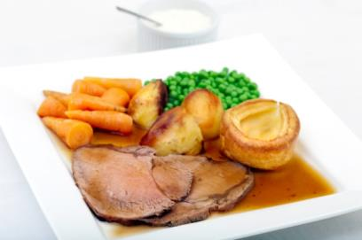
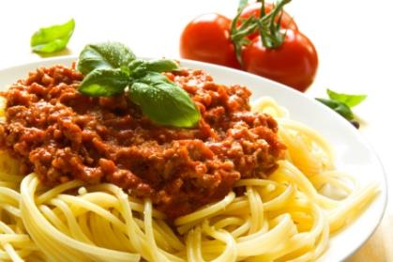
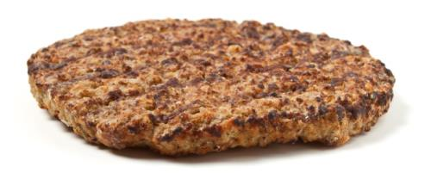
What food is made from beef?
Roast beef
Beef burger
Spaghetti bolognese

Slide 8

What are these?
Pigs

Slide 9
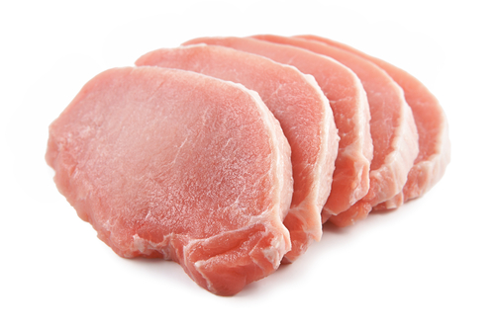
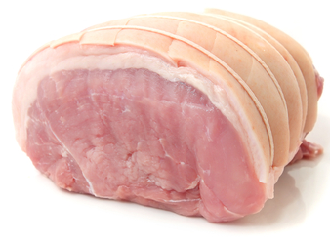
What meat is from pigs?
Pork

Slide 10
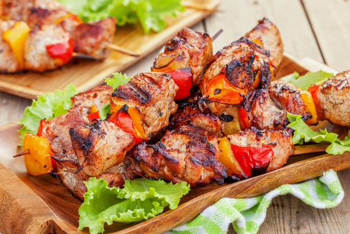
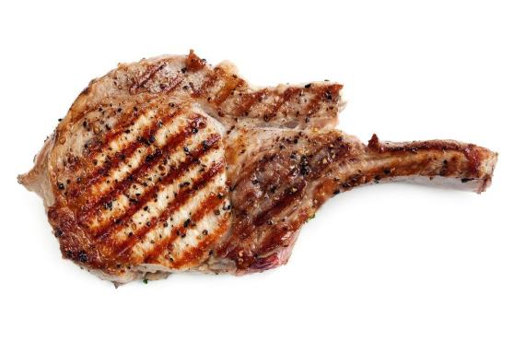
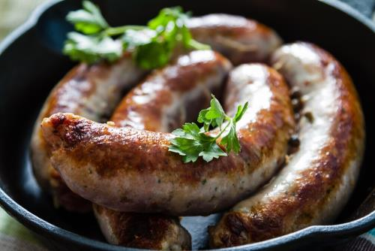
What food is made from pork?
Pork kebab
Pork chop
Sausages

Slide 11
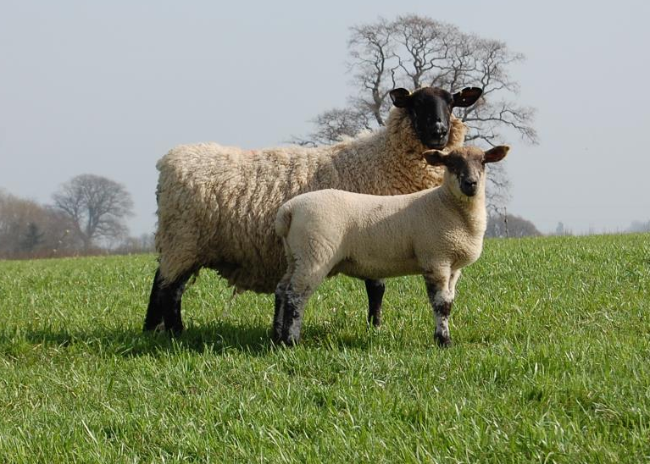
What can you see here?
Lamb

Slide 12
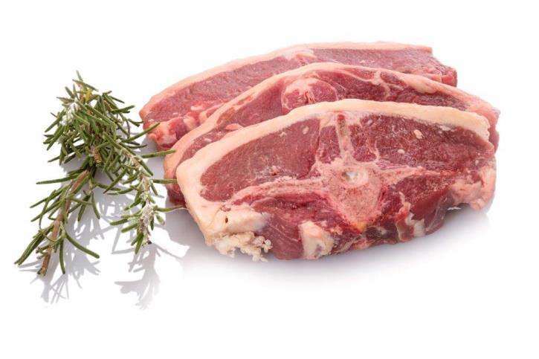
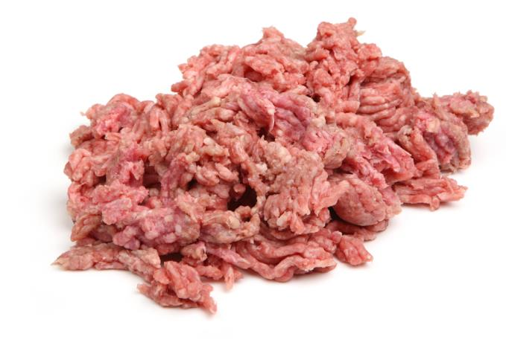
What meat is from lamb?
Lamb

Slide 13
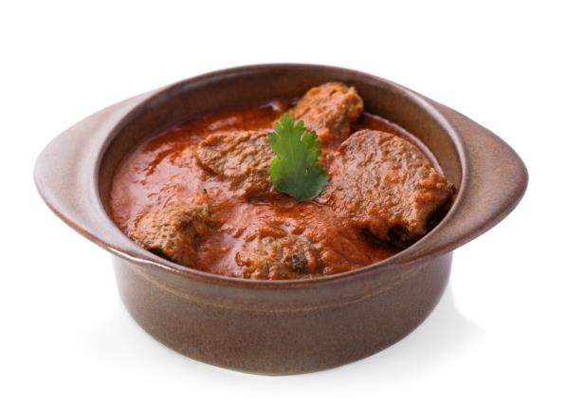

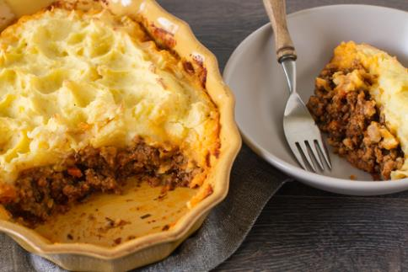
What food is made from lamb?
Shepherds pie
Lamb chops
Lamb rogan

Slide 14
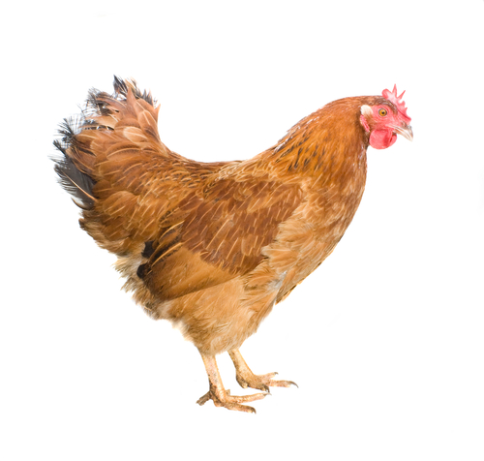
What can you see here?
A chicken

Slide 15
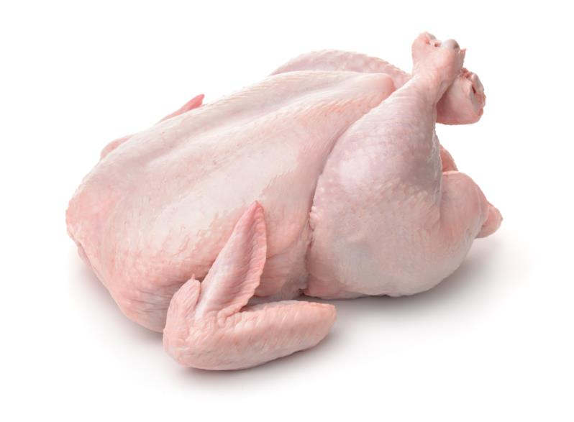
What meat is from chickens?
Chicken
Chickens which provide meat are called broilers.

Slide 16
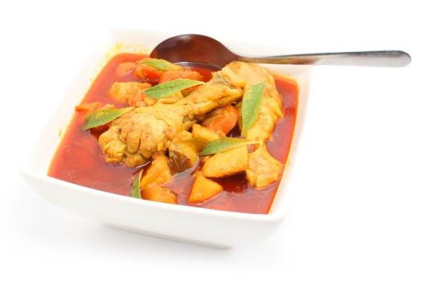
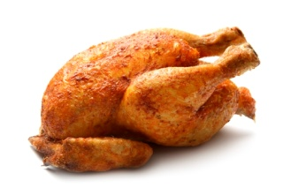
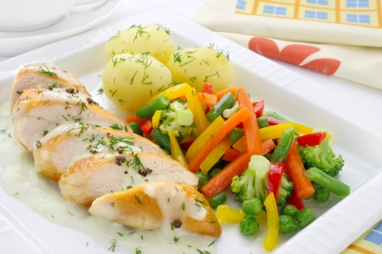
What food is made from chicken?
Roast chicken
Chicken breast
Chicken curry

Slide 17
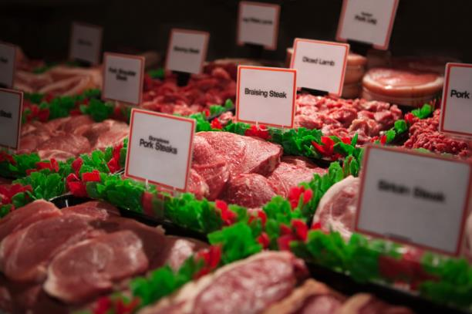
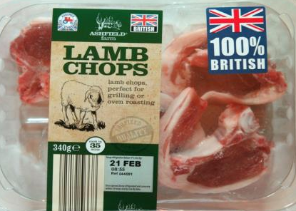
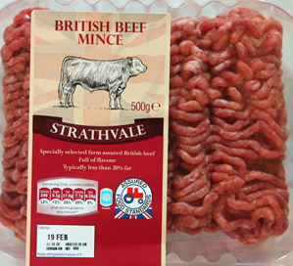
Where do we buy meat?
Meat is from a local shop or supermarket.
Meat is also available from a butcher.

Slide 18

Summary
Animals are reared for our food.
Meat – from the animal.
Lots of different meals are made with meat.

Slide 19
For further information, go to:
www.foodafactoflife.org.uk

